Slide 1
Barbara Streisand My Coloring Book
https://www.youtube.com/watch?v=39kpKh3E6aM

Slide 2
Favorite Color

Slide 4
Blue
You are:
conservative, reliable and trustworthy
Deepest need:
To find inner peace and truth.

Slide 5
Green
You are:
kind, generous, and compassionate
Deepest need:
to belong, to love, and to feel safe

Slide 6
Black
You are:
Strong-willed and determined.
Deepest need:
To have power and control.

Slide 7
Indigo
You are:
honest, compassionate, and understanding.
Deepest need:
harmony and oneness with the universe.

Slide 8
Brown
You are:
honest, down-to-earth and wholesome
Deepest need:
a safe, secure, simple and comfortable existence

Slide 9
Red
You are:
extroverted, optimistic, courageous and confident
Deepest need:
physical achievement, fulfillment, satisfaction

Slide 10
Orange
You are:
warm, friendly, tolerant and accepting of others
Deepest need:
to be with people, to socialize, and to be accepted as part of a group.

Slide 11
Yellow
You are:
cheerful and fun to be with
Deepest need:
logical order in your daily life

Slide 12
Turquoise
You are:
friendly and approachable, and easy to communicate with.
Deepest need:
to be able to express your hopes and dreams even if they are idealistic

Slide 13
Magenta
You are:
imaginative, creative, and surrounded by beauty
Deepest need:
to have a perfect balance in your physical, emotional, mental and spiritual attributes.

Slide 14
White
You are:
neat and immaculate in your appearance. you think ahead with a positive and optimistic nature.
Deepest need:
to create simplicity in your life

Slide 15
Pink
You are:
loving, kind, and sensitive to the needs of others
Deepest need:
to be accepted and loved unconditionally

Slide 16
Grey
You are:
cool, calm, and neutral about life
Deepest need:
to be respected for who you are

Slide 17
Violet
You are:
a gentle and free spirit with deep feelings
Deepest need:
emotional security and to create order and perfection in all areas of your life.

Slide 18
Silver
You are:
intuitive, insightful and have a strong connection with spiritual guidance.
Deepest need:
to find deep meaning and spiritual fulfilment

Slide 19
Gold
You are:
radiant, charismatic, independent and have a big personality.
Deepest need:
To acquire the deepest knowledge and understanding of yourself and your spirit

Slide 20
Barbara Streisand My Coloring Book

Slide 21
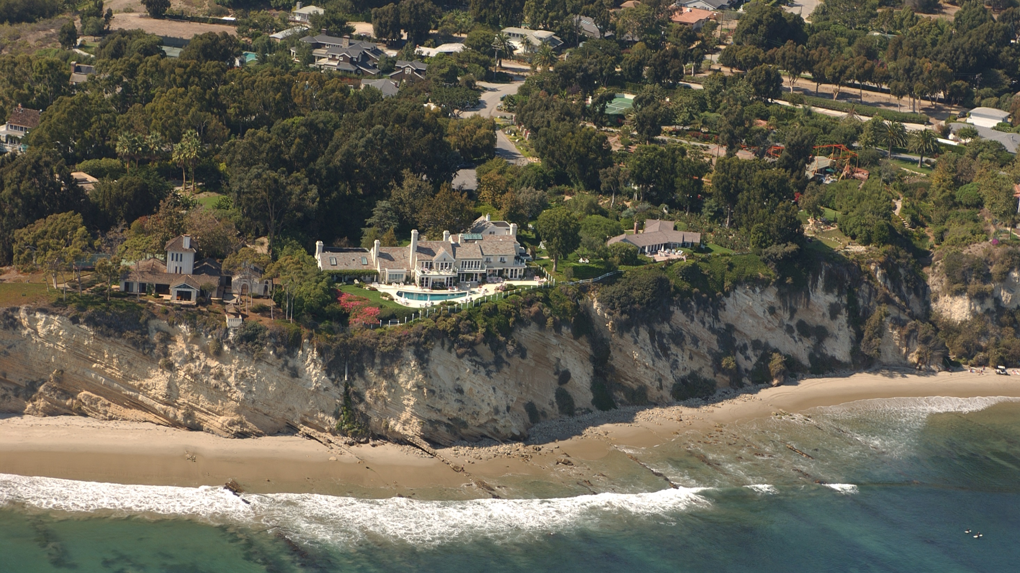
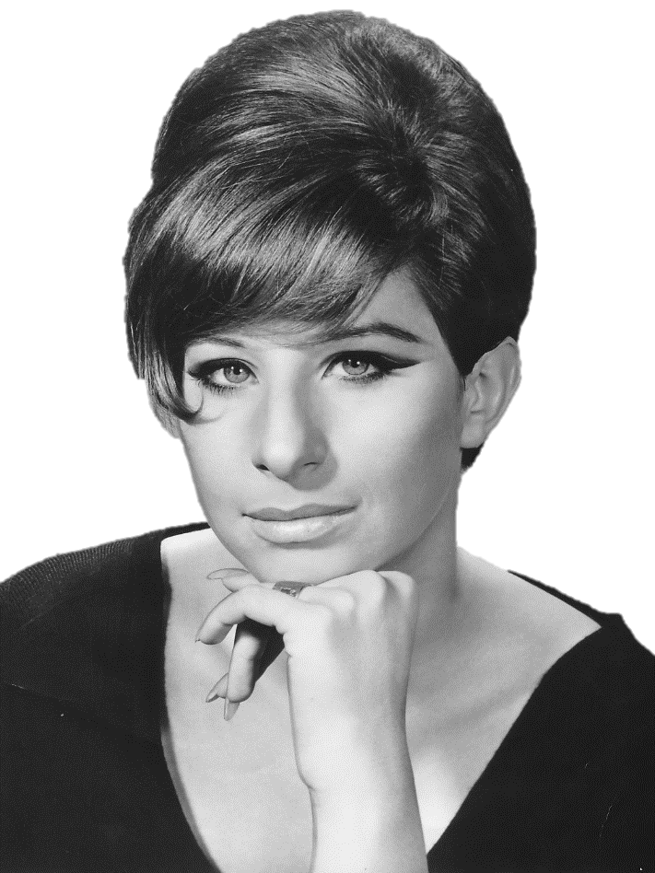
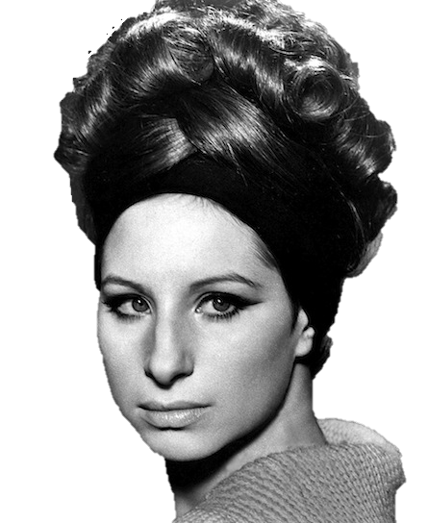
Barbara Streisand
The Streisand Effect
The Streisand effect is a phenomenon whereby an attempt to hide, remove, or censor a piece of information has the unintended consequence of publicizing the information more widely, usually facilitated by the Internet.

Slide 22
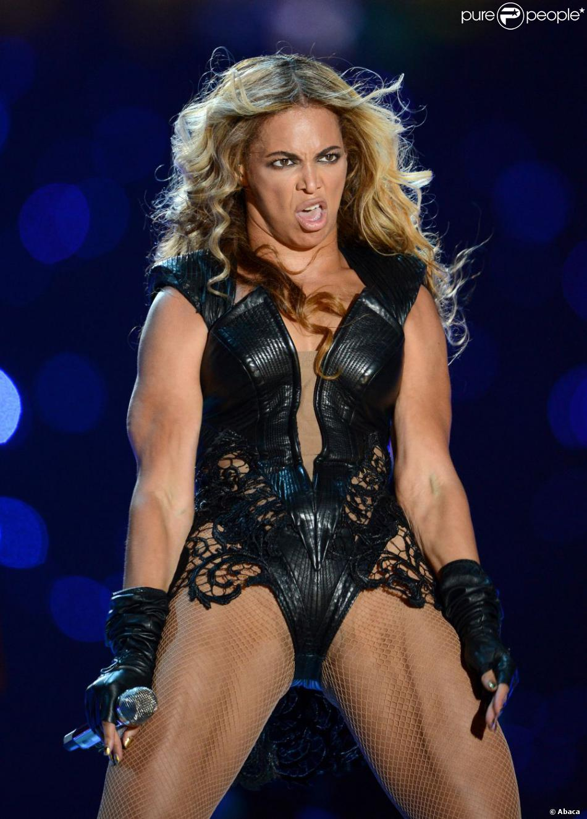
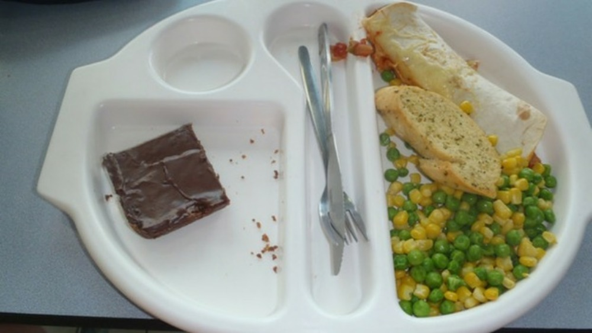
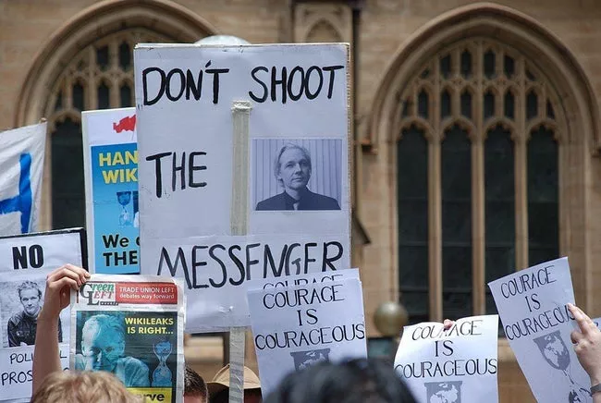
https://www.youtube.com/watch?v=eLdmvZbXzo4

Slide 23
Listen and Color

Slide 25
My Coloring Book
For those who fancy coloring books as certain people do
Here's a new one for you a most unusual coloring book

Slide 26
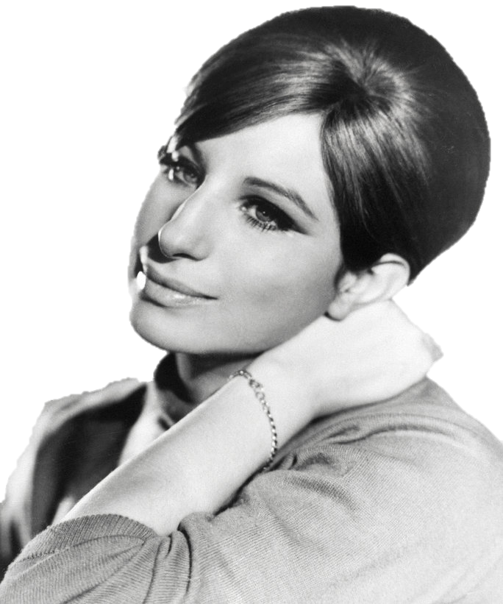
My Coloring Book
The kind you never see Crayons ready? Very well Begin to color me

Slide 27
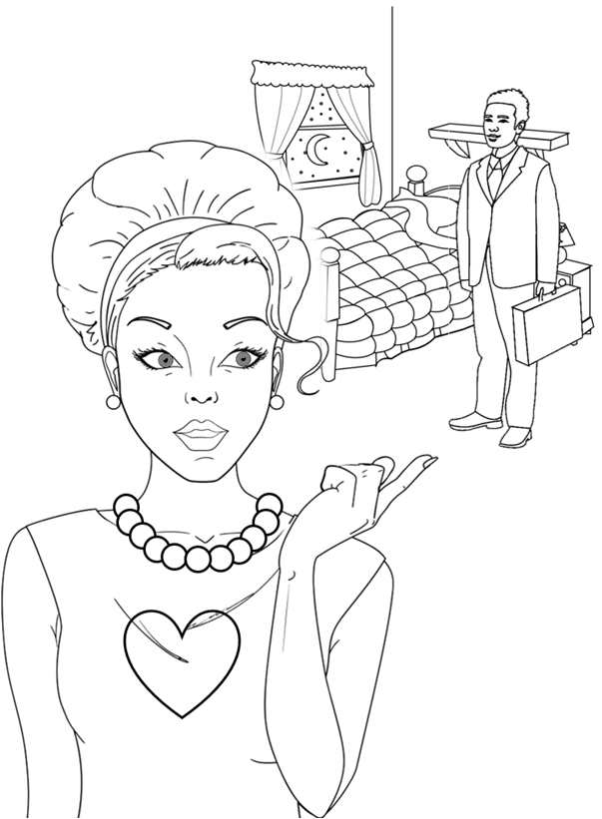
My Coloring Book
These are the eyes that watched him As he walked away Color them gray

Slide 28
Grey
Not white or black.
No emotion.
Loss or depression.

Slide 29
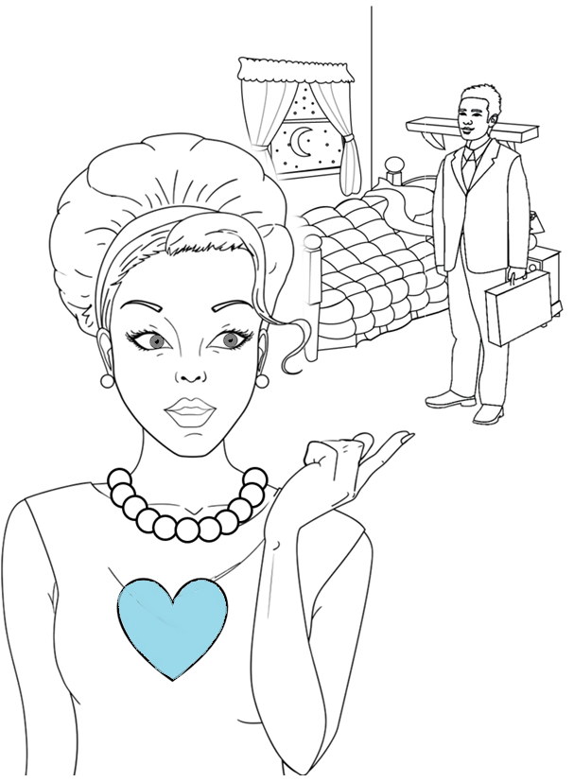
My Coloring Book
This is the heart that thought He would always be true Color it blue

Slide 30
Blue
Crying.
Sadness.

Slide 31
My Coloring Book
These are the arms that held him and touched him Then lost him, somehow Color them empty, now

Slide 33
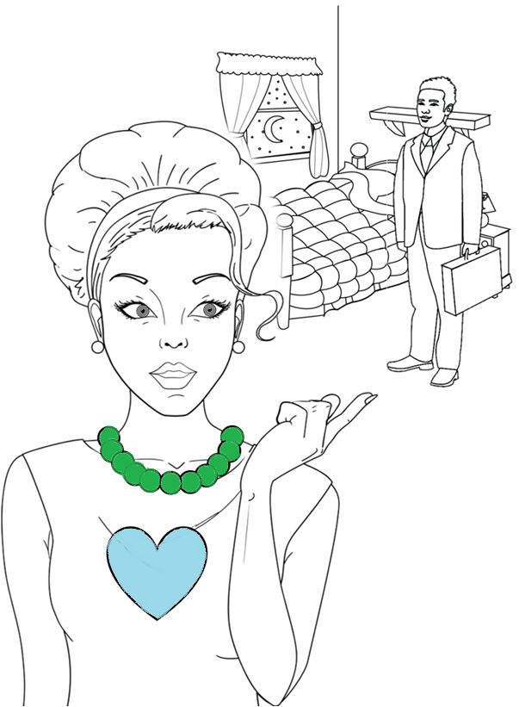
My Coloring Book
These are the beads I wore Until she came between Color them green

Slide 34
Green
Green with envy.
Jealousy.

Slide 35
My Coloring Book
This is the room I sleep in Walk in and weep in, hiding That nobody sees Color it lonely, please

Slide 36
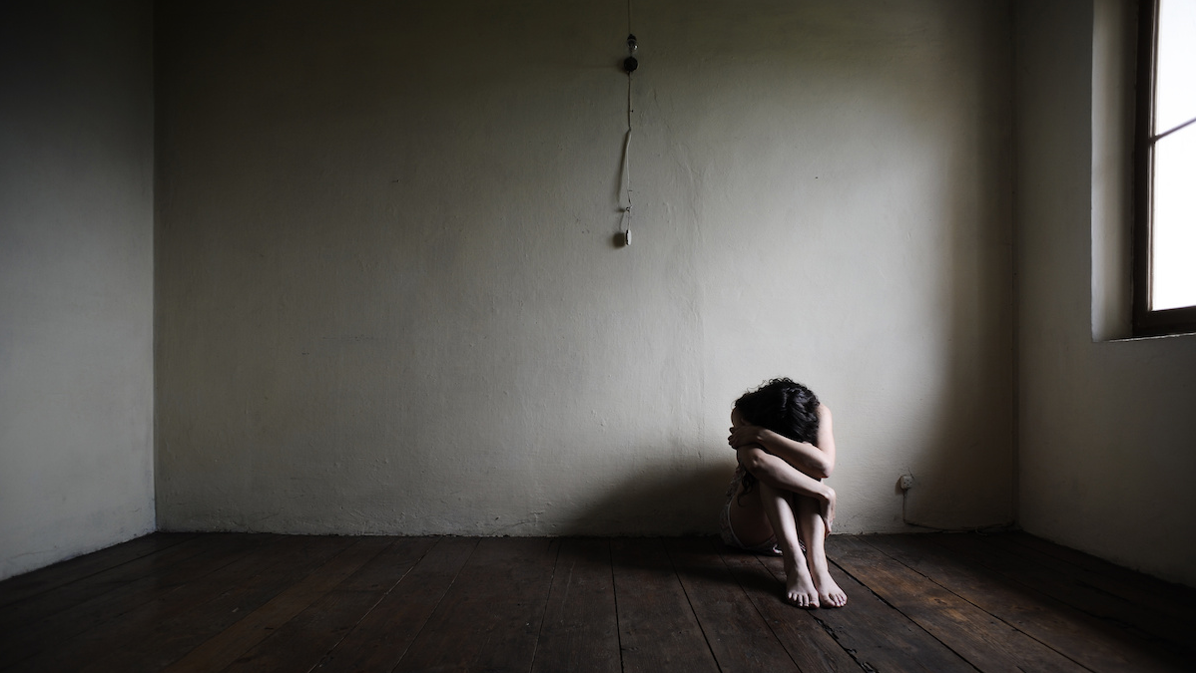

Slide 37
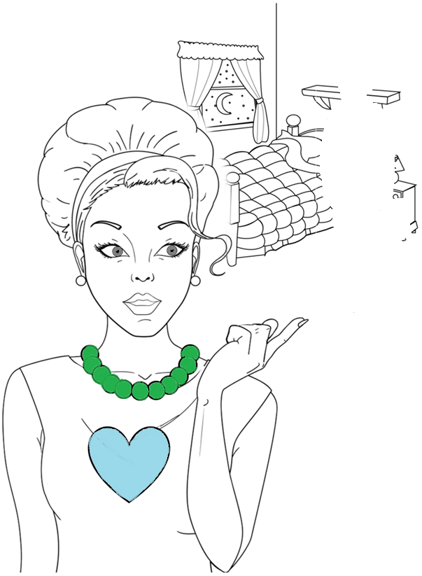
My Coloring Book
This is the man The one I depended upon Color him gone

Slide 39
Color Idioms

