Slide 1
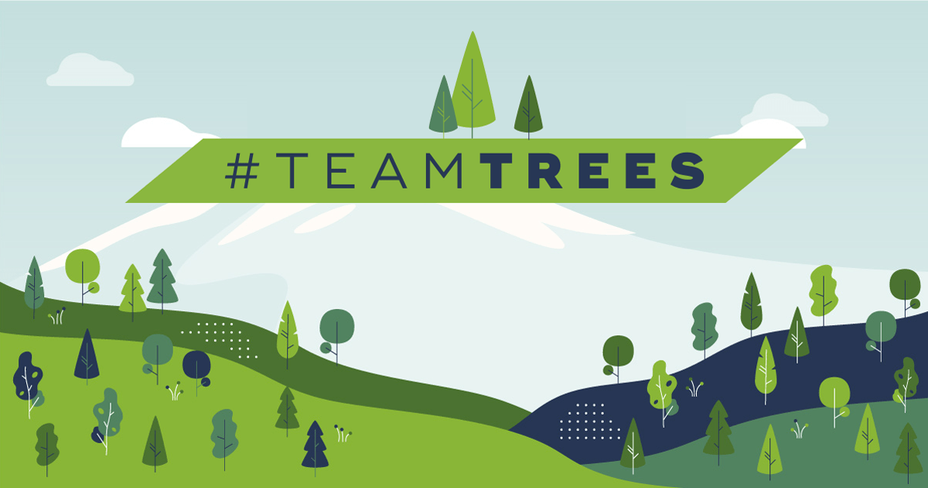
20,000,000 Trees

Slide 2
PLANTING 20,000,000 TREES
https://www.youtube.com/watch?v=HPJKxAhLw5I

Slide 3
Planting 20,000,000 Trees
How can you test if a tree is planted well?
The Pull Test

Slide 4
Planting 20,000,000 Trees
Does talking to trees make them grow faster?
Maybe

Slide 5
Planting 20,000,000 Trees
Why does Chris think it’s weird to use mulch?
Dead relatives

Slide 6
Planting 20,000,000 Trees
How many trees did they plant?
300

Slide 7
Planting 20,000,000 Trees
Now how many trees did they plant?
1,700

Slide 8
How would you plant
20,000,000 trees?

Slide 9
USING DRONES TO PLANT TREES
https://www.youtube.com/watch?v=U7nJBFjKqAY

Slide 10
Planting 20,000,000 Trees
Why is Mr. Beast planting 20,000,000 trees?
20,000,000 subscribers

Slide 11
Planting 20,000,000 Trees
What was Mark Rober’s plan?
Drones

Slide 12
Planting 20,000,000 Trees
Where does the mass of a tree come from?
Air

Slide 13
Planting 20,000,000 Trees
Tell me about the seed pucks.
Seeds+Fertilizer

Slide 14
Planting 20,000,000 Trees
Why do they include the ghost pepper in the puck?
Mammals won’t eat it

Slide 15
Planting 20,000,000 Trees
Olfactory and Gustatory
Deterrents

Slide 16
HOW TO BUILD A FOREST
https://www.youtube.com/watch?v=PkVZBSKdwQM

Slide 17
Planting 20,000,000 Trees
What are some factors involved with planting this many seeds?

Slide 18
Planting 20,000,000 Trees
Why is diversity an issue?

Slide 20
Planting 20,000,000 Trees
What do you expect with low biodiversity?

Slide 22
Planting 20,000,000 Trees
What was the purpose of the Great Green Wall?

Slide 23
Planting 20,000,000 Trees
Why did the Great Green Wall fail?

Slide 24
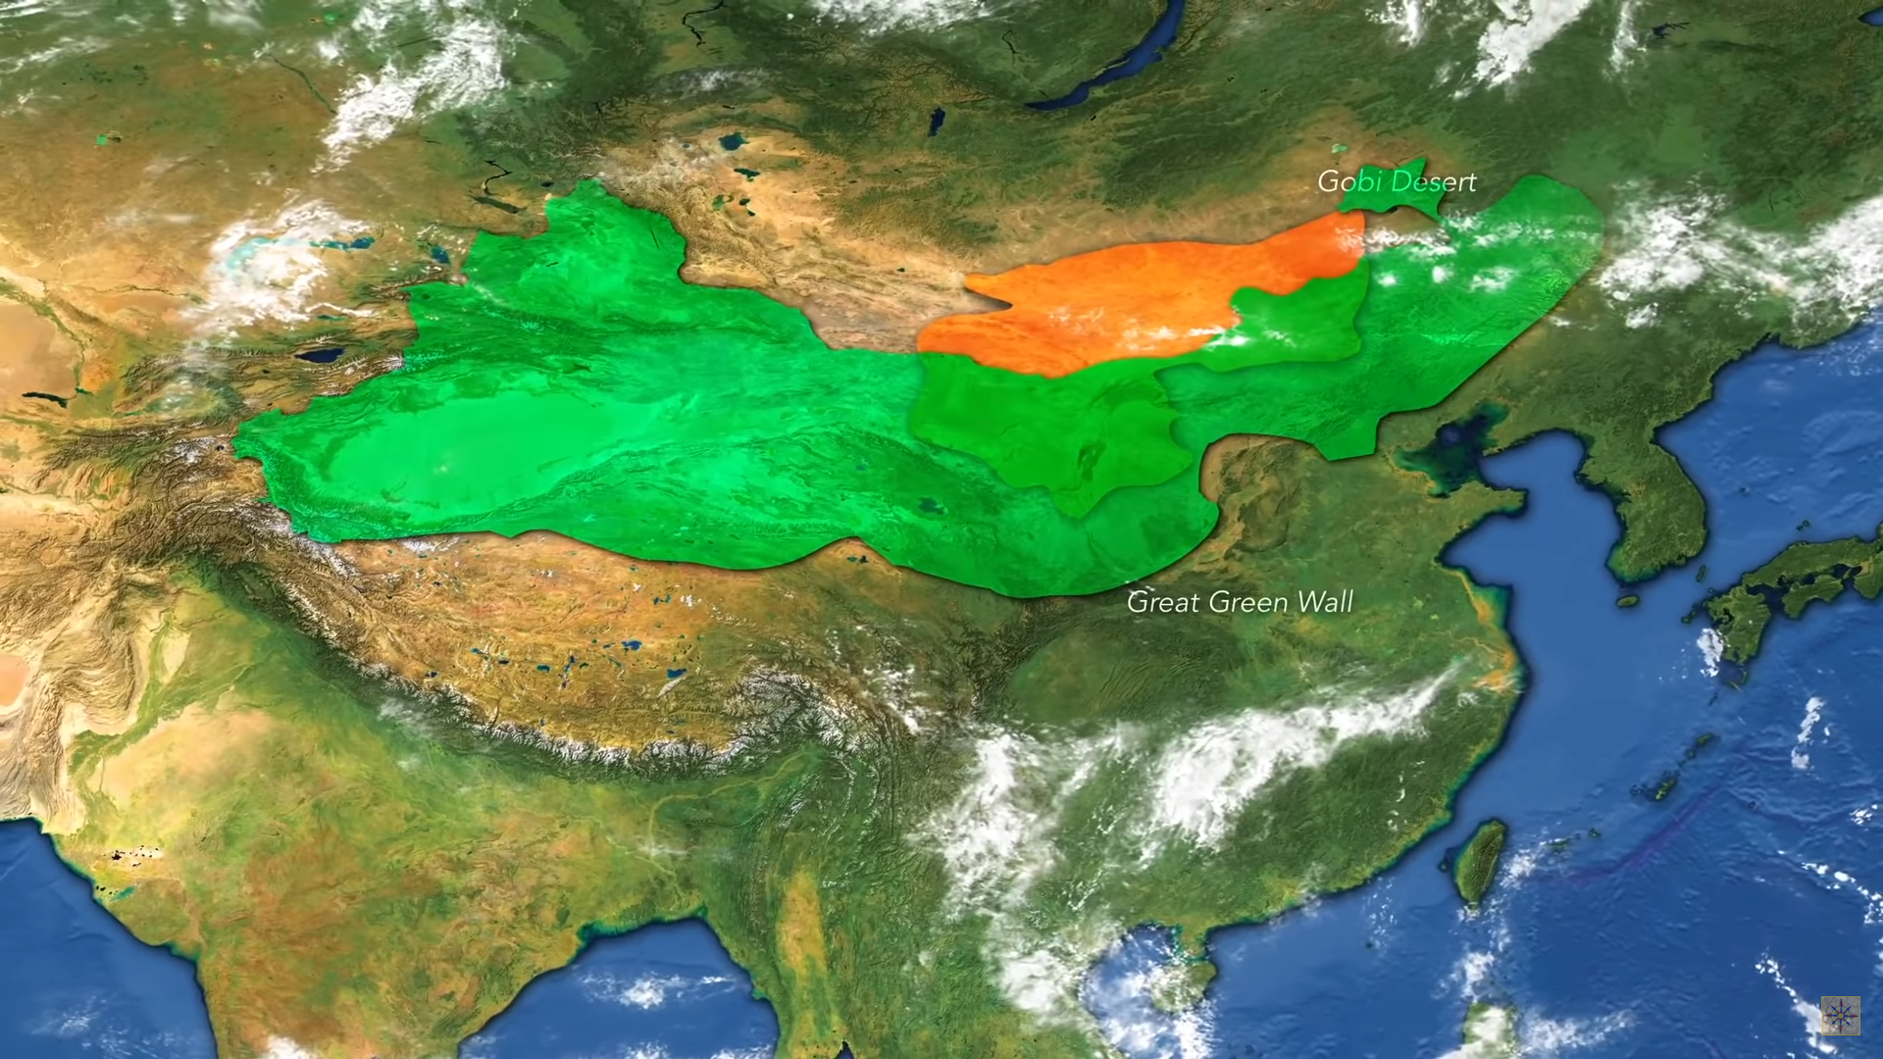

Slide 25
Planting 20,000,000 Trees
How can you choose the types of trees to plant?

Slide 26
Planting 20,000,000 Trees
Where should you plant the trees?

Slide 28
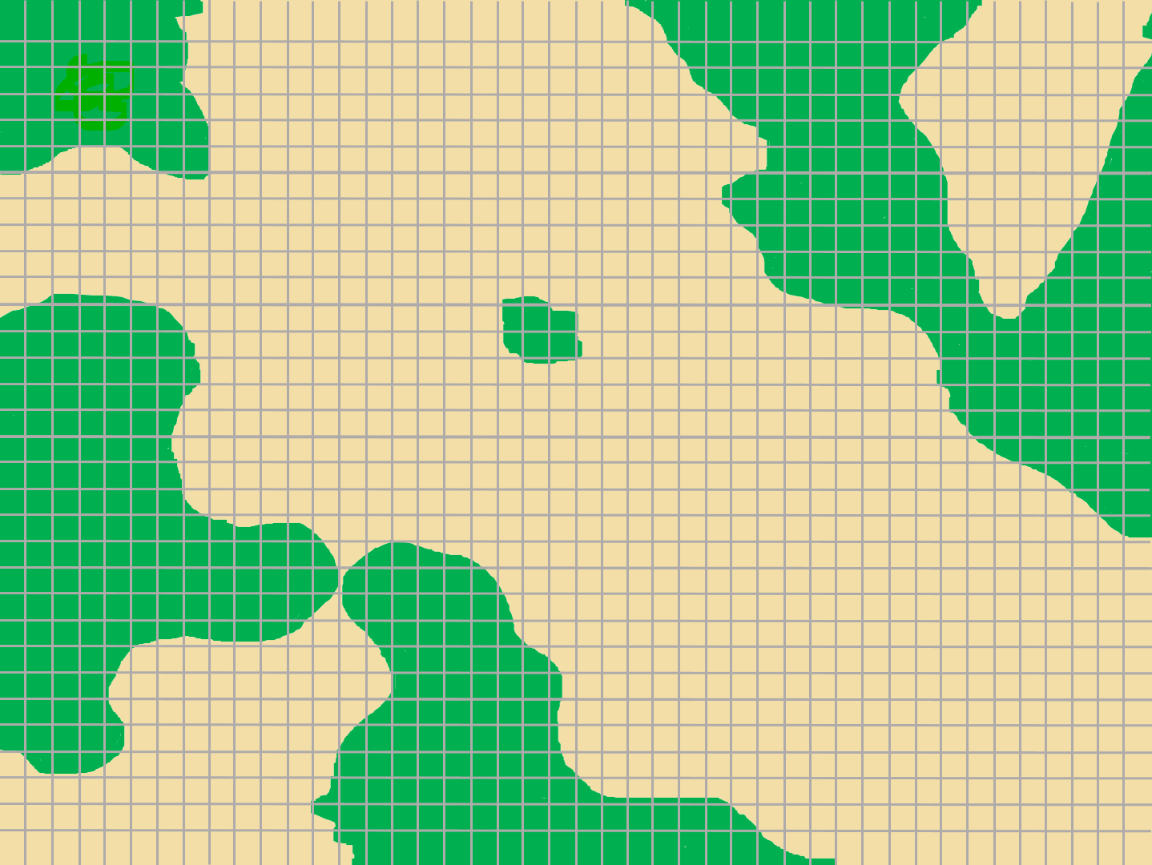
Green is forest

Slide 29
Planting 20,000,000 Trees
How does building a road through a forest affect it?

Slide 32
Planting 20,000,000 Trees
Where in the world should we plant these trees?

Slide 33
Planting 20,000,000 Trees
If we want to reduce co2, what is better than a forest?

Slide 36
Saving vs Planting Trees
https://www.youtube.com/watch?v=LfcHgUxzgqk

Slide 37
https://teamtrees.org/

