Slide 1
Reinforcement

Slide 2
Review
Pleasant
Unpleasant
Add
Positive Reinforcement
Positive Punishment
Negative Punishment
Negative Reinforcement
Subtract

Slide 3
Reinforcement Theory
Behavior is a function of consequence

Slide 4
Negative
REINFORCEMENT
Positive

Slide 5
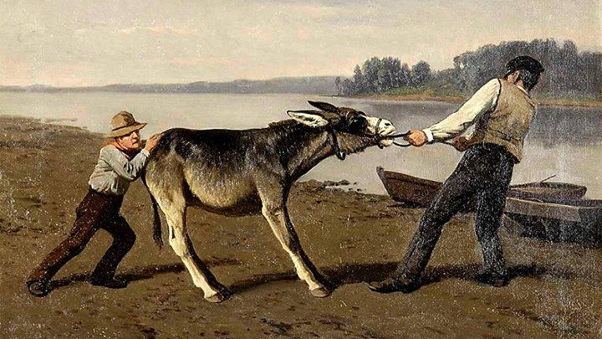
DONKEY
MULE
BURRO
ASS

Slide 6
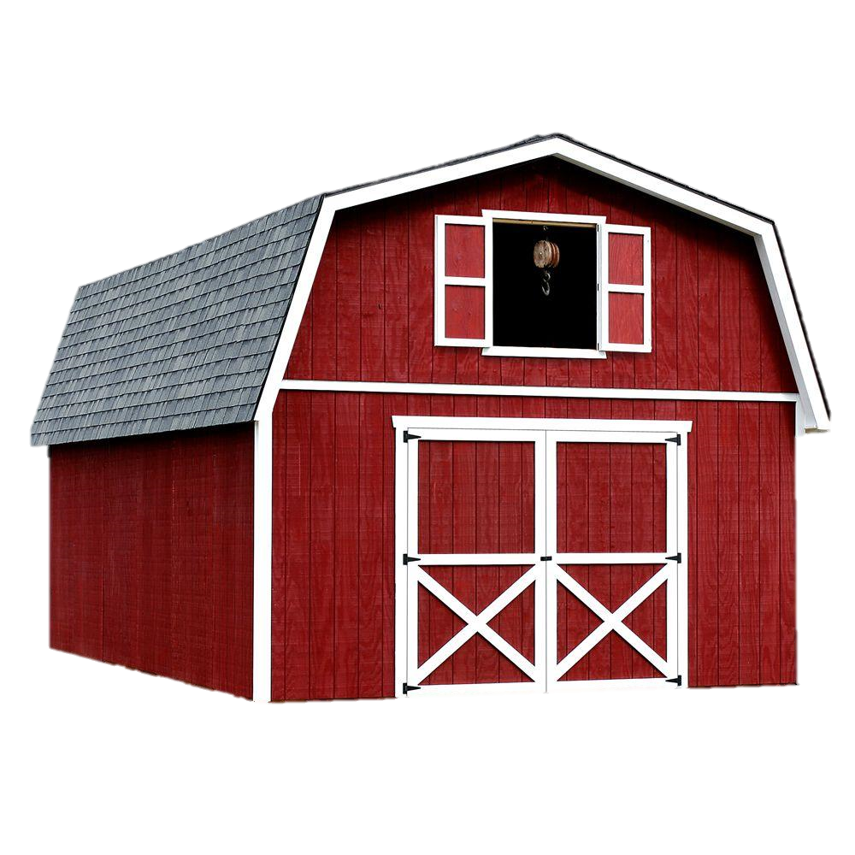
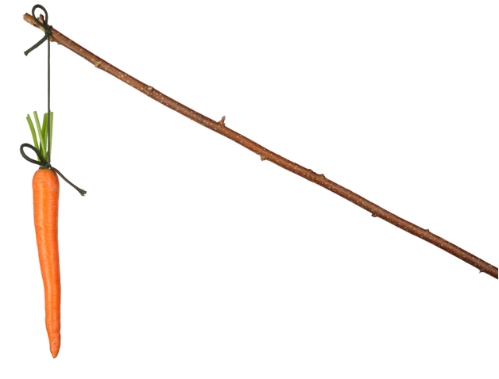
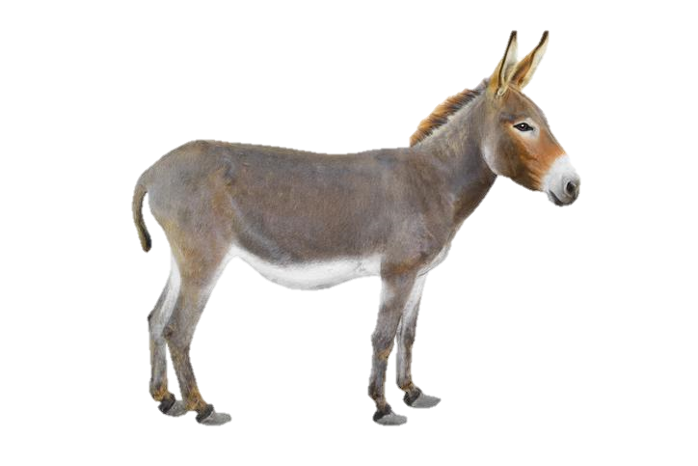

Slide 7
Positive
REINFORCEMENT

Slide 8
Positive Reinforcement
Desired behavior
Pleasant consequence
Desirability of the reward

Slide 9
Positive Reinforcement
Doing well on a test.
Receive praise from parents.

Slide 10
Positive Reinforcement
Completing an assignment in time
Get an early recess

Slide 11
Positive Reinforcement
Receive a sticker
(collect enough and get a prize)
Cleaning up the classroom

Slide 12
Positive Reinforcement
Answer a difficult question in class
Verbal praise

Slide 13
Positive Reinforcement
Making a presentation in front of the class
Clapping

Slide 14
Positive Reinforcement
Winning a game
Candy

Slide 15
Negative
REINFORCEMENT

Slide 16
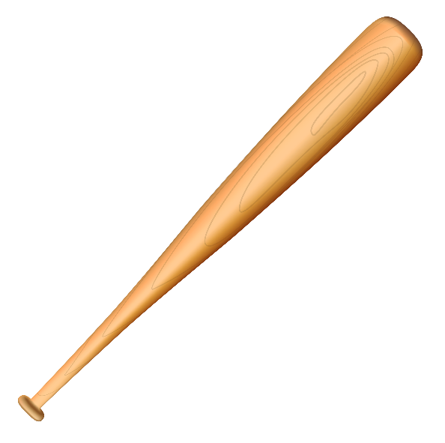

Slide 17
Negative Reinforcement
Remove an undesirable consequence
Desired behavior
Increase desired behavior

Slide 18
Negative Reinforcement
Finish your work during class
Don’t have to do homework

Slide 19
Negative Reinforcement
Clean your desk
Teacher stops nagging me

Slide 20
REINFORCEMENT
Types of

Slide 21
Different Types of Reinforcerment
Direct Reinforcement
Karma
Social Reinforcement
Verbal praise, written approval, smiling, nodding your head, thumbs up, high fives or clapping
Activity Reinforcement
Play a game or spend some time on the computers.
It works especially well if they can choose a classmate to participate in the activity with them.
Tangible Reinforcement
Candies, stickers, stamps, coupons, certificate, school supplies, toys
Displaying work
Token Reinforcement
Stamps, stickers

Slide 22
Discussion
Which is the most valuable?

Slide 25
Punishment

Slide 26
Punishment
Unwanted Behavior
Add an unpleasant consequence
Decrease unwanted behavior

Slide 27
Punishment
Student is bullying
Time Out

Slide 28
Punishment
Never prepared for class
Call the parents

Slide 29
Punishment
Student gets into a fight
Send to the principal’s office

Slide 30
Discussion
When is punishment required?

Slide 31
Logical Consequences
Punishment

Slide 32
Extinction

Slide 33
Extinction
Unwanted Behavior
Do nothing
Do not reward unwanted behavior

Slide 34
Punishment
Student doesn’t raise their hand
Ignore their answer

Slide 35
Punishment
Student make inappropriate remarks
Ignore their remarks

Slide 36
Reward Systems

Slide 37
SYSTEMS
Reward

Slide 38
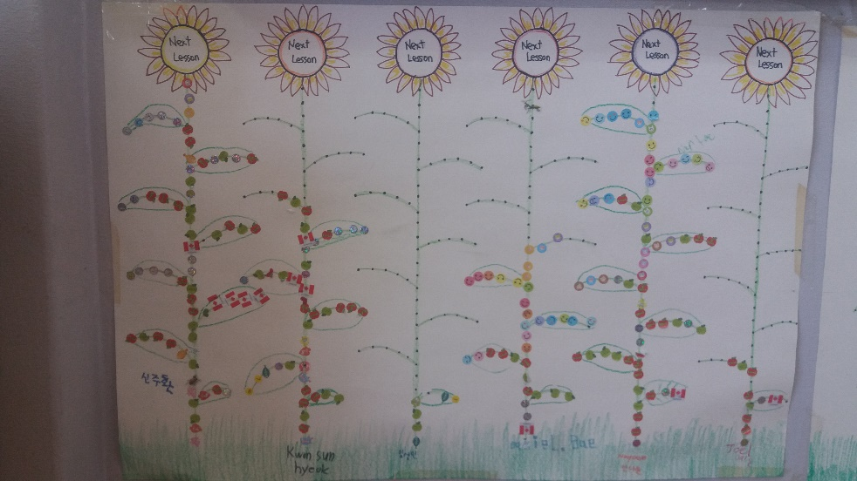

Slide 39
Group Work
Design your own reward system

Slide 40
teacher
Role of the

Slide 41
Role of the Teacher
New challenges
Teaching Methods
Technology
Political Environment

