Slide 1
Snake Oil

Slide 2
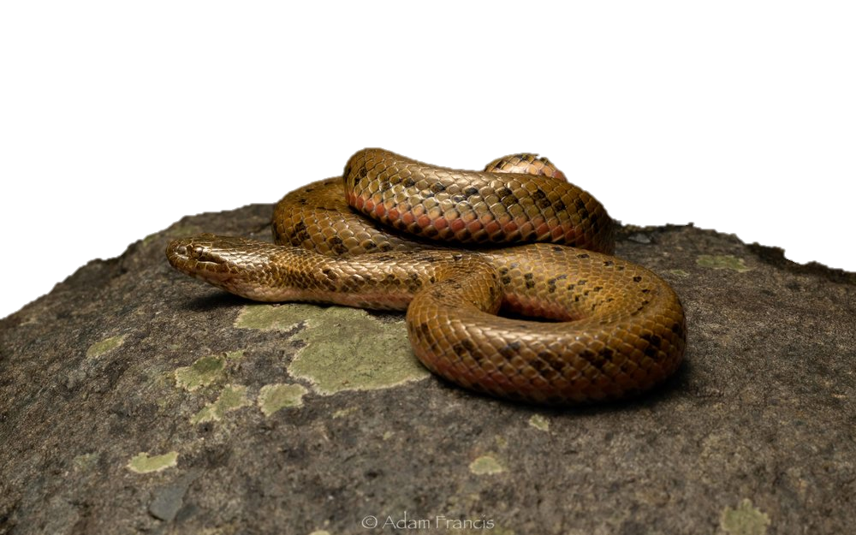
Chinese Water Snake
Chinese railroad workers (1849 – 1882)
Brought the idea to America

Slide 3
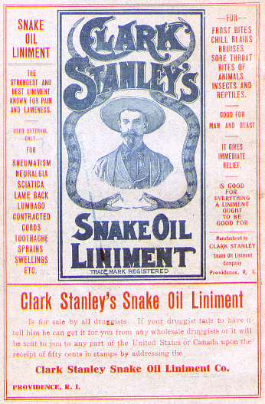
Clark Stanley
The Rattlesnake King
The oil didn’t work
It didn’t even contain snake oil

Slide 4
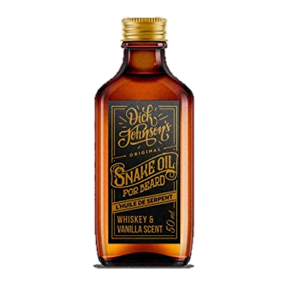
Snake Oil
Didn’t work as well as medicine

Slide 5
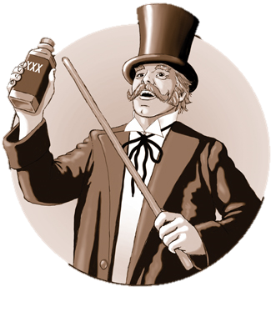
Snake Oil
Didn’t work as well as medicine
Sell + Leave

Slide 6
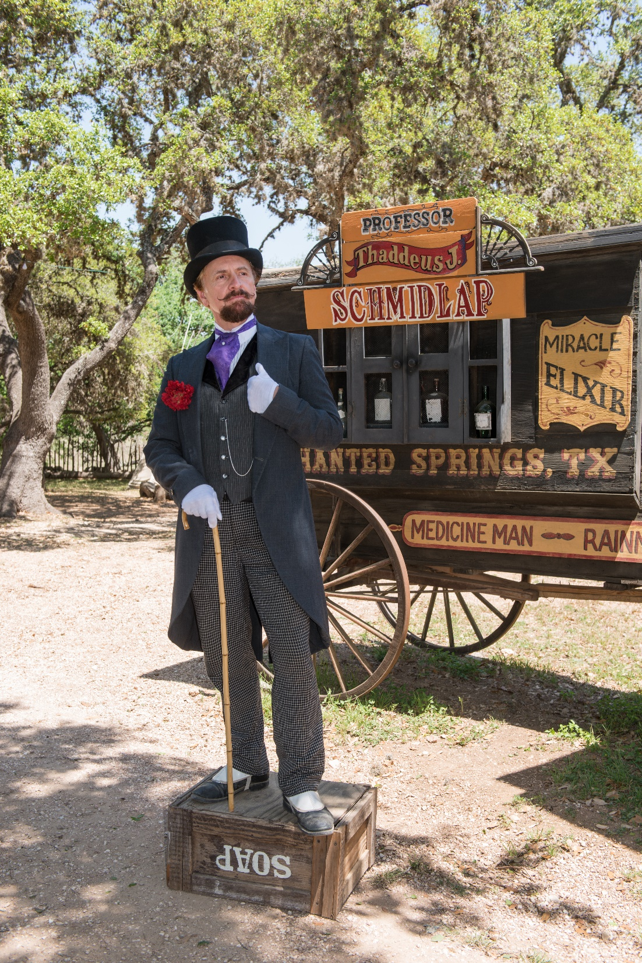
Snake Oil
Didn’t work as well as medicine
Sell + Leave
Synonymous with fraud

Slide 7
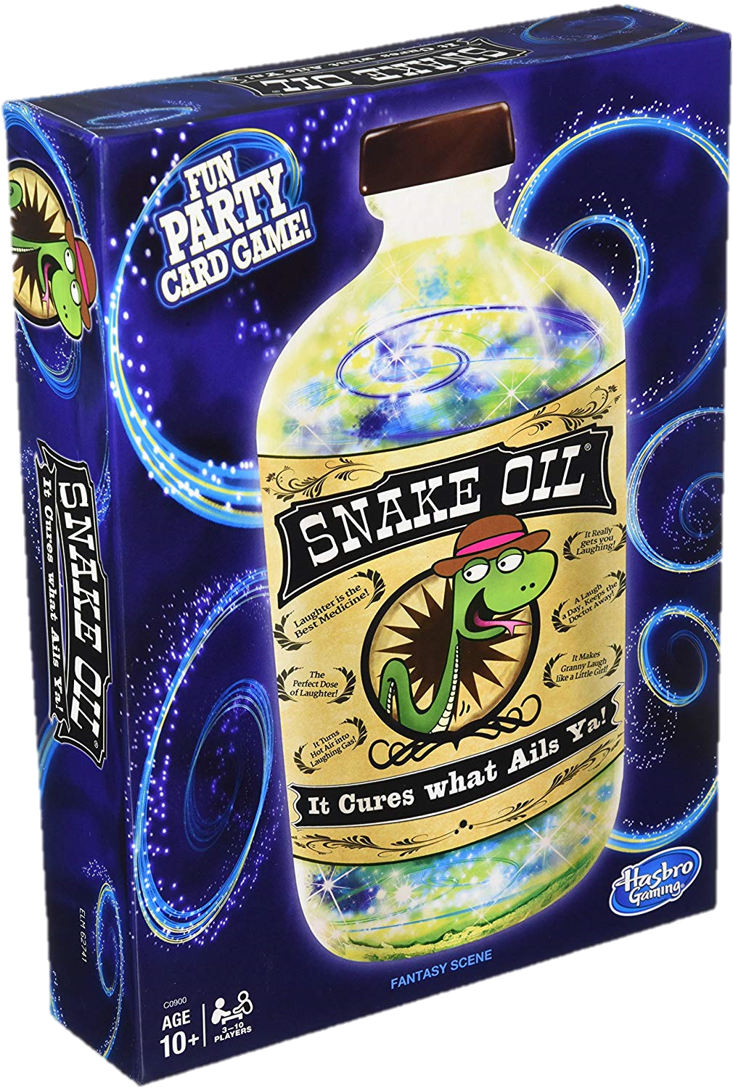
Snake Oil

Slide 8
Snake Oil
You are the snake oil salesman
One person will be the customer

Slide 9
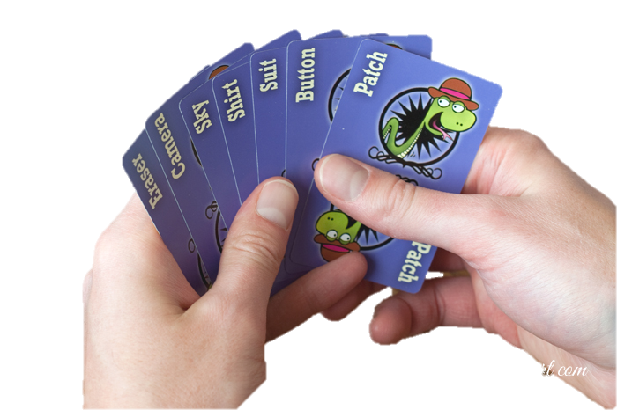
Snake Oil
To make a product, combine two cards

Slide 10
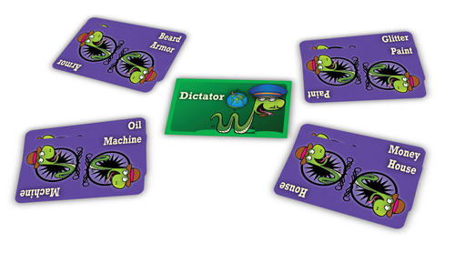
Snake Oil
Try to sell your product to the customer.
The customer will choose 1 product

Slide 11
Snake Oil
You can make any claim you want

