Slide 1
Intrinsic Motivation

Slide 2
Intrinsic Motivation vs Extrinsic Motivation

Slide 3
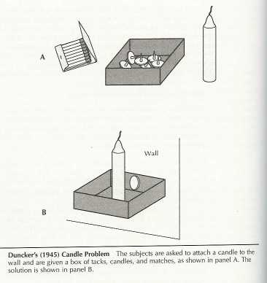
The Candle Problem
Attach the candle to the wall
Light the candle
No wax can drop on the floor
Click to reveal answer

Slide 4
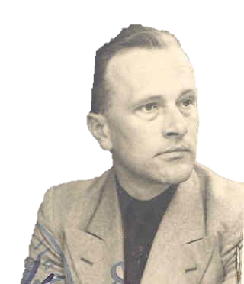
The Candle Problem
Karl Duncker (1945)
Test creative solutions
When tacks were left outside of the box, the solution was easily found.

Slide 5
The Candle Problem
Glucksburg (1962)
First look at motivation
Some subjects were offered NO PRIZE
Some subjects were offered $5.00 to $10.00 (depends on how fast they finish)
$41.00 to $166.00 (2018)

Slide 6
Offering money is an example of _____________?
Positive Reinforcement
Who performed better Money or No Money?
No Money

Slide 7
Why did this happen?
Overjustification Effect – lowers intrinsic motivation (crowding out)
Competition – causes stress
Stress – shuts down problem solving (prefrontal cortex)

Slide 8
Overjustification Effect
This process is known as "crowding out" since whatever motivation for the task that previously existed — as estimated by the control condition that was not offered compensation for the task — has been crowded out by motivation merely based on the payment.

Slide 9
Why did this happen?
Operant Conditioning says extrinsic rewards should increase motivation

Slide 10
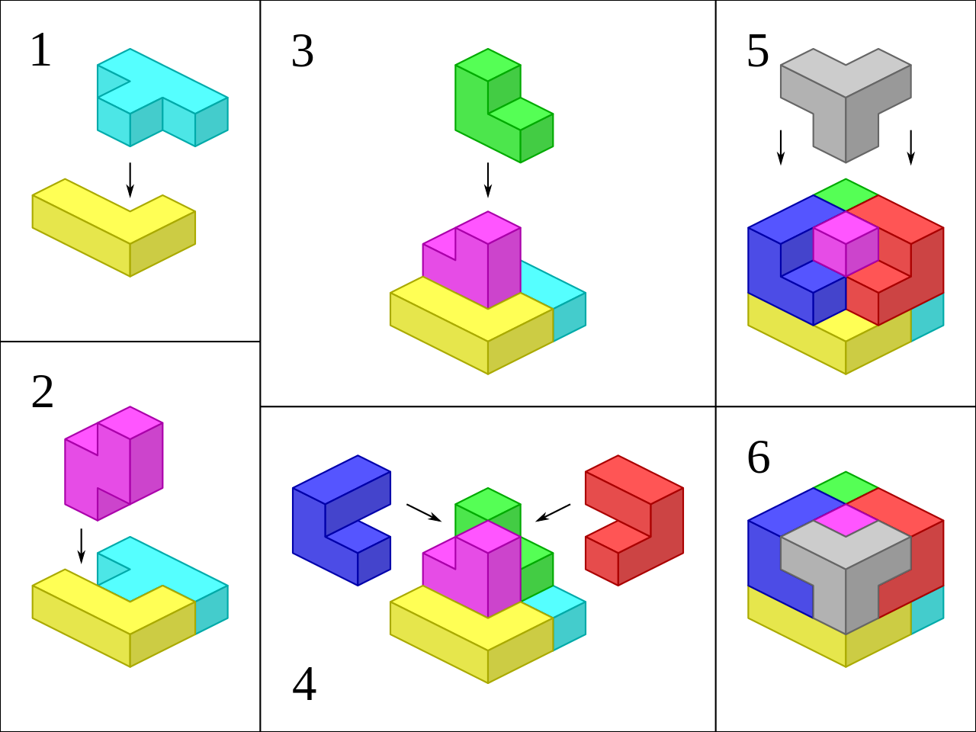
Edward Deci
Multiple puzzles or IQ Test questions
½ were paid a flat fee
½ were paid based on performance
After the test, he let them stay in the room
Measured how many continued answering the questions
SOMA cube

Slide 11
Who answered additional questions?
Flat fee

Slide 12
Lepper et al. found that children who were told that they would receive a reward in exchange for drawing — something they had previously shown to be intrinsically interested in — subsequently became less interested in drawing after the reward was given, compared to those who received a reward unexpectedly or who received no reward at all.

Slide 13
Kruglanski et al. found that if high school students were promised an extrinsic incentive before engaging in a variety of tasks, the students showed less creativity and subsequently reported enjoying the task less compared to those who were not promised payment at the outset.

Slide 14
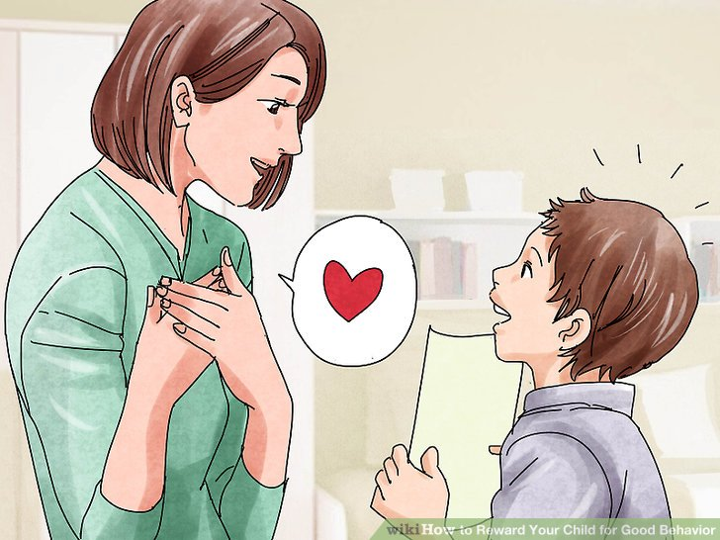
In a follow-up study that replicated the basic pattern of results from 1971, Deci later found that offering verbal praise as a reward for task completion did not have a similar backfiring effect as offering a monetary reward had.

Slide 15
Crowding out occurs when:
Previously intrinsically motivated
Rewards are known in advance (expected)
Rewards are tangible

Slide 16
ANAGRAMS

Slide 17
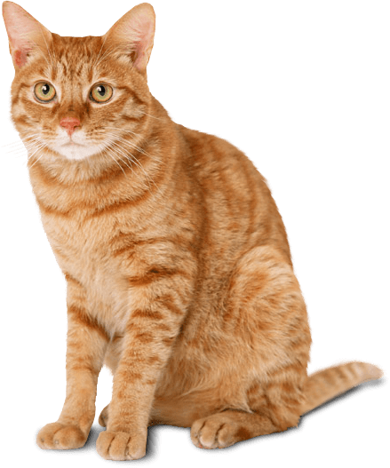
CAT
ACT

Slide 18
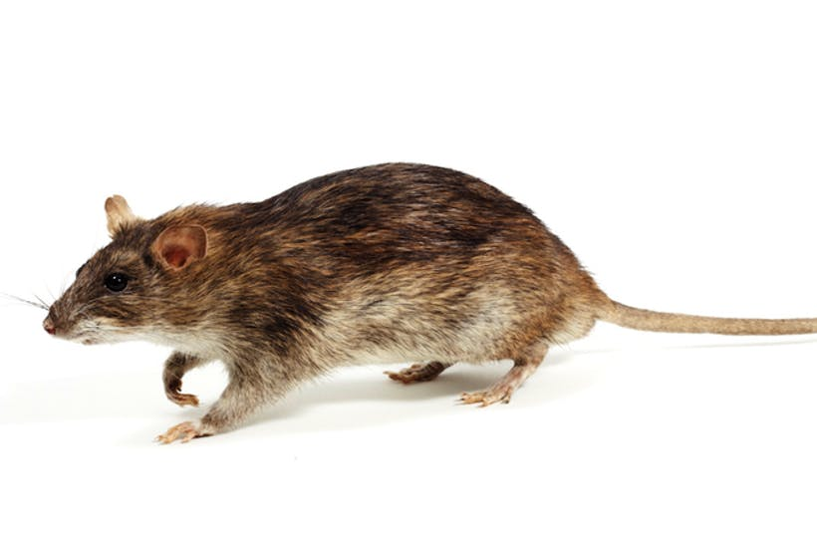
TAR
RAT

Slide 19
THERE
THREE

Slide 20
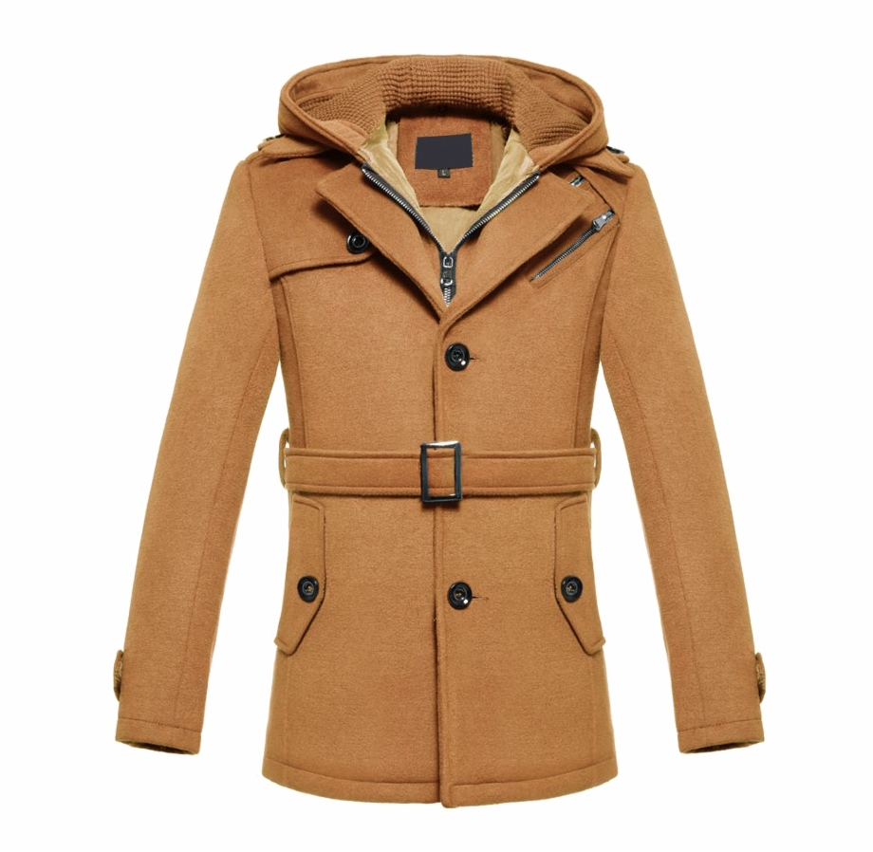
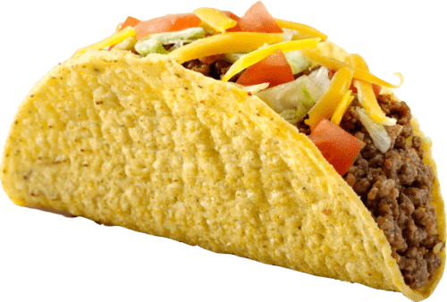
TACO
COAT

Slide 21
LISTEN
SILENT

Slide 22
THE EYES
THEY SEE

Slide 23
VIOLET
I LOVE IT

Slide 24
EARTH
HEART

Slide 25
BINGE
BEGIN

Slide 26
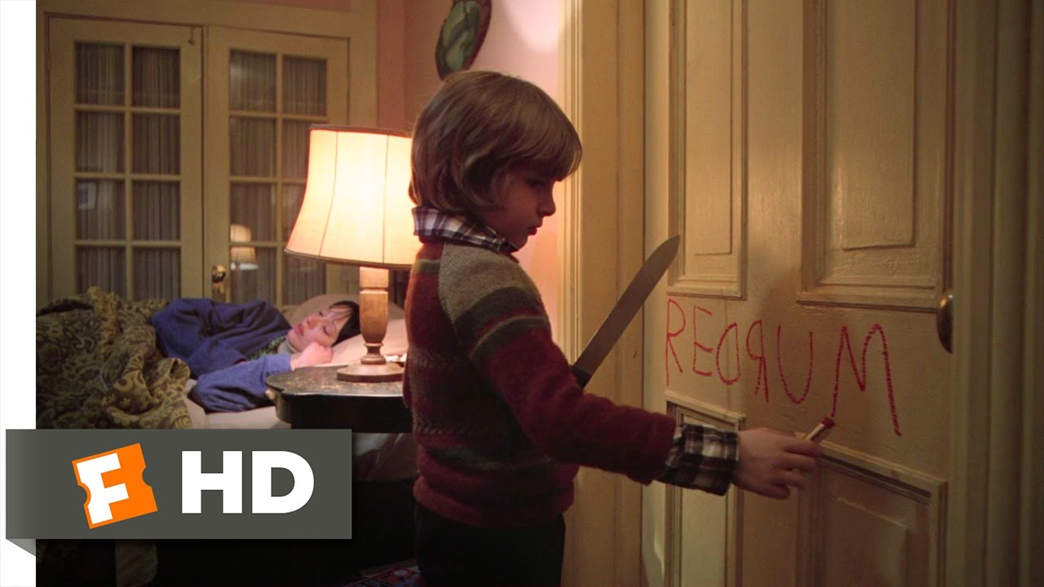
REDRUM
MURDER

Slide 27
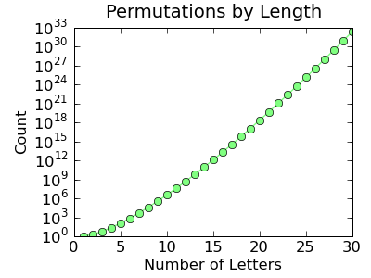

Slide 28
Anagrams
Harter (1978)
Anagram task
Some children were told that it was simply a word game that they might enjoy
Some children were told they would be graded on performance

Slide 29
Results
Performance Test
Avoided challenge (easier anagrams)
Less pleasure (smiling)
Perceived comparable anagrams to be more difficult
Said they preferred easier anagrams to avoid bad grades.
Threat of bad grades made them nervous or anxious

Slide 30
List 1
MUG
NIGHT
VASES
VECTOR
GUM
THING
SAVES
COVERT

Slide 31
Feedback:
Good for you
Good for you, you must have worked really hard.
Good you, you must be smart

Slide 32
List 2 (experience failure)
MARCHING
NAMELESS
LICENSED
TEACHING
THICKENS
CHARMING
SALESMAN
SILENCED
CHEATING
KITCHENS

Slide 33
List 3 (after experiencing failure)
HOST
INCH
FIBER
GLARE
SISTERS
SHOT
CHIN
BRIEF
LARGE
RESISTS

Slide 34
Results:
Good for you
Good for you, you must have worked really hard.
Good you, you must be smart
Problems solved
List #1
List #2

Slide 35
Anagrams
Todd Zakrajsek
32:47
https://www.youtube.com/watch?v=jX9xttiUcMQ

Slide 36
Motivation
Controlled vs Autonomous

Slide 37
Motivation
Historical view – only amount of motivation matters
A bigger carrot or stick
Quality of behavior NOT Quantity of behavior
Memorization vs Understanding (concepts)

Slide 38
Controlled Motivation
Seduced
Coerced
Pressured
Take short cuts

Slide 39
Autonomous Motivation
Volition and choice
Endorsement
Interesting / enjoyably
Deeply Valued

Slide 40
Autonomous Motivation
Creativity
Problem Solving
Performance
Positive Emotions
Psychological & Physical Wellness

Slide 41
Autonomy Supportive
Environment

Slide 42
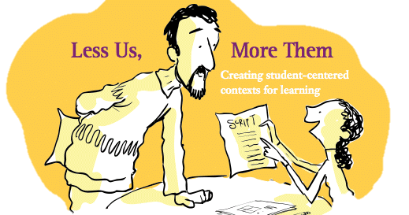
Autonomy Support
Their perspective
Choice
Explore
Self initiation
Rationale

Slide 43
Results in
Happier
Deeper / conceptual learning
Confident and competent

Slide 44
Deci’s Conclusion:
Don’t ask how you can motivate others!
Ask how you can create the conditions within which others will motivate themselves

Slide 45
Feeling empowered
Can you do it? (self-efficacy)
Will it work? (response-efficacy)
Is it worth it? (motivation – consequence)

