Slide 1


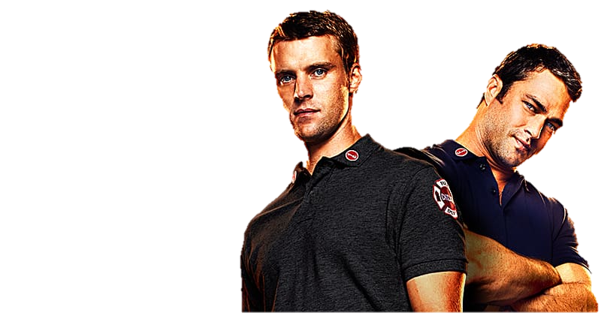
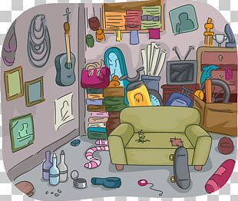





ACTORS
ADMIRER
ANGERED
DORMITORY
CLEANLINESS
THE ANSWER
A BARTENDER
COMMITTEES
CONSERVATIVE

Slide 2
ANAGRAMS ANAGRAMS ANAGRAMS ANAGRAMS ANAGRAMS ANAGRAMS ANAGRAMS ANAGRAMS
ANAGRAMS ANAGRAMS ANAGRAMS ANAGRAMS ANAGRAMS ANAGRAMS ANAGRAMS ANAGRAMS
ANAGRAMS ANAGRAMS ANAGRAMS ANAGRAMS ANAGRAMS ANAGRAMS ANAGRAMS ANAGRAMS
ANAGRAMS ANAGRAMS ANAGRAMS ANAGRAMS ANAGRAMS ANAGRAMS ANAGRAMS ANAGRAMS
ANAGRAMS ANAGRAMS ANAGRAMS ANAGRAMS ANAGRAMS ANAGRAMS ANAGRAMS ANAGRAMS
ANAGRAMS ANAGRAMS ANAGRAMS ANAGRAMS ANAGRAMS ANAGRAMS ANAGRAMS ANAGRAMS
ANAGRAMS ANAGRAMS ANAGRAMS ANAGRAMS ANAGRAMS ANAGRAMS ANAGRAMS ANAGRAMS
ANAGRAMS ANAGRAMS ANAGRAMS ANAGRAMS ANAGRAMS ANAGRAMS ANAGRAMS ANAGRAMS
ANAGRAMS ANAGRAMS ANAGRAMS ANAGRAMS ANAGRAMS ANAGRAMS ANAGRAMS ANAGRAMS
ANAGRAMS ANAGRAMS ANAGRAMS ANAGRAMS ANAGRAMS ANAGRAMS ANAGRAMS ANAGRAMS
ANAGRAMS ANAGRAMS ANAGRAMS ANAGRAMS ANAGRAMS ANAGRAMS ANAGRAMS ANAGRAMS
ANAGRAMS ANAGRAMS ANAGRAMS ANAGRAMS ANAGRAMS ANAGRAMS ANAGRAMS ANAGRAMS
ANAGRAMS ANAGRAMS ANAGRAMS ANAGRAMS ANAGRAMS ANAGRAMS ANAGRAMS ANAGRAMS
ANAGRAMS ANAGRAMS ANAGRAMS ANAGRAMS ANAGRAMS ANAGRAMS ANAGRAMS ANAGRAMS
ANAGRAMS ANAGRAMS ANAGRAMS ANAGRAMS ANAGRAMS ANAGRAMS ANAGRAMS ANAGRAMS
ANAGRAMS ANAGRAMS ANAGRAMS ANAGRAMS ANAGRAMS ANAGRAMS ANAGRAMS ANAGRAMS
ANAGRAMS ANAGRAMS ANAGRAMS ANAGRAMS ANAGRAMS ANAGRAMS ANAGRAMS ANAGRAMS
ANAGRAMS ANAGRAMS ANAGRAMS ANAGRAMS ANAGRAMS ANAGRAMS ANAGRAMS ANAGRAMS
ANAGRAMS ANAGRAMS ANAGRAMS ANAGRAMS ANAGRAMS ANAGRAMS ANAGRAMS ANAGRAMS
ANAGRAMS ANAGRAMS ANAGRAMS ANAGRAMS ANAGRAMS ANAGRAMS ANAGRAMS ANAGRAMS
ANAGRAMS ANAGRAMS ANAGRAMS ANAGRAMS ANAGRAMS ANAGRAMS ANAGRAMS ANAGRAMS
ANAGRAMS ANAGRAMS ANAGRAMS ANAGRAMS ANAGRAMS ANAGRAMS ANAGRAMS ANAGRAMS
ANAGRAMS ANAGRAMS ANAGRAMS ANAGRAMS ANAGRAMS ANAGRAMS ANAGRAMS ANAGRAMS
ANAGRAMS ANAGRAMS ANAGRAMS ANAGRAMS ANAGRAMS ANAGRAMS ANAGRAMS ANAGRAMS
ANAGRAMS ANAGRAMS ANAGRAMS ANAGRAMS ANAGRAMS ANAGRAMS ANAGRAMS ANAGRAMS
ANAGRAMS ANAGRAMS ANAGRAMS ANAGRAMS ANAGRAMS ANAGRAMS ANAGRAMS ANAGRAMS
ANAGRAMS ANAGRAMS ANAGRAMS ANAGRAMS ANAGRAMS ANAGRAMS ANAGRAMS ANAGRAMS
ANAGRAMS ANAGRAMS ANAGRAMS ANAGRAMS ANAGRAMS ANAGRAMS ANAGRAMS ANAGRAMS
ANAGRAMS ANAGRAMS ANAGRAMS ANAGRAMS ANAGRAMS ANAGRAMS ANAGRAMS ANAGRAMS
ANAGRAMS ANAGRAMS ANAGRAMS ANAGRAMS ANAGRAMS ANAGRAMS ANAGRAMS ANAGRAMS
ANAGRAMS ANAGRAMS ANAGRAMS ANAGRAMS ANAGRAMS ANAGRAMS ANAGRAMS ANAGRAMS
ANAGRAMS ANAGRAMS ANAGRAMS ANAGRAMS ANAGRAMS ANAGRAMS ANAGRAMS ANAGRAMS
ANAGRAMS ANAGRAMS ANAGRAMS ANAGRAMS ANAGRAMS ANAGRAMS ANAGRAMS ANAGRAMS
ANAGRAMS ANAGRAMS ANAGRAMS ANAGRAMS ANAGRAMS ANAGRAMS ANAGRAMS ANAGRAMS
ANAGRAMS ANAGRAMS ANAGRAMS ANAGRAMS ANAGRAMS ANAGRAMS ANAGRAMS ANAGRAMS
ANAGRAMS ANAGRAMS ANAGRAMS ANAGRAMS ANAGRAMS ANAGRAMS ANAGRAMS ANAGRAMS
ANAGRAMS ANAGRAMS ANAGRAMS ANAGRAMS ANAGRAMS ANAGRAMS ANAGRAMS ANAGRAMS
ANAGRAMS ANAGRAMS ANAGRAMS ANAGRAMS ANAGRAMS ANAGRAMS ANAGRAMS ANAGRAMS
ANAGRAMS ANAGRAMS ANAGRAMS ANAGRAMS ANAGRAMS ANAGRAMS ANAGRAMS ANAGRAMS
ANAGRAMS ANAGRAMS ANAGRAMS ANAGRAMS ANAGRAMS ANAGRAMS ANAGRAMS ANAGRAMS

Slide 3


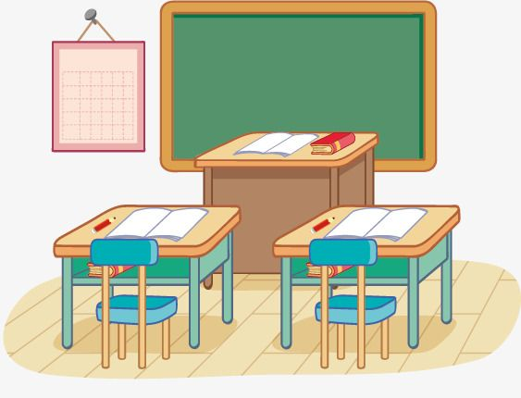

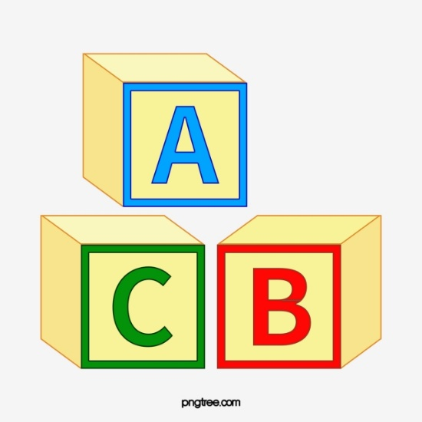




THE BAYONETS
SCHOOL MASTER
BREAK
ASTRONOMERS
CHARITABLENESS
ALPHABETICALLY
STATUE OF LIBERTY
THE CHECKMATING
THE CENTENARIANS

Slide 4
ANAGRAMS ANAGRAMS ANAGRAMS ANAGRAMS ANAGRAMS ANAGRAMS ANAGRAMS ANAGRAMS
ANAGRAMS ANAGRAMS ANAGRAMS ANAGRAMS ANAGRAMS ANAGRAMS ANAGRAMS ANAGRAMS
ANAGRAMS ANAGRAMS ANAGRAMS ANAGRAMS ANAGRAMS ANAGRAMS ANAGRAMS ANAGRAMS
ANAGRAMS ANAGRAMS ANAGRAMS ANAGRAMS ANAGRAMS ANAGRAMS ANAGRAMS ANAGRAMS
ANAGRAMS ANAGRAMS ANAGRAMS ANAGRAMS ANAGRAMS ANAGRAMS ANAGRAMS ANAGRAMS
ANAGRAMS ANAGRAMS ANAGRAMS ANAGRAMS ANAGRAMS ANAGRAMS ANAGRAMS ANAGRAMS
ANAGRAMS ANAGRAMS ANAGRAMS ANAGRAMS ANAGRAMS ANAGRAMS ANAGRAMS ANAGRAMS
ANAGRAMS ANAGRAMS ANAGRAMS ANAGRAMS ANAGRAMS ANAGRAMS ANAGRAMS ANAGRAMS
ANAGRAMS ANAGRAMS ANAGRAMS ANAGRAMS ANAGRAMS ANAGRAMS ANAGRAMS ANAGRAMS
ANAGRAMS ANAGRAMS ANAGRAMS ANAGRAMS ANAGRAMS ANAGRAMS ANAGRAMS ANAGRAMS
ANAGRAMS ANAGRAMS ANAGRAMS ANAGRAMS ANAGRAMS ANAGRAMS ANAGRAMS ANAGRAMS
ANAGRAMS ANAGRAMS ANAGRAMS ANAGRAMS ANAGRAMS ANAGRAMS ANAGRAMS ANAGRAMS
ANAGRAMS ANAGRAMS ANAGRAMS ANAGRAMS ANAGRAMS ANAGRAMS ANAGRAMS ANAGRAMS
ANAGRAMS ANAGRAMS ANAGRAMS ANAGRAMS ANAGRAMS ANAGRAMS ANAGRAMS ANAGRAMS
ANAGRAMS ANAGRAMS ANAGRAMS ANAGRAMS ANAGRAMS ANAGRAMS ANAGRAMS ANAGRAMS
ANAGRAMS ANAGRAMS ANAGRAMS ANAGRAMS ANAGRAMS ANAGRAMS ANAGRAMS ANAGRAMS
ANAGRAMS ANAGRAMS ANAGRAMS ANAGRAMS ANAGRAMS ANAGRAMS ANAGRAMS ANAGRAMS
ANAGRAMS ANAGRAMS ANAGRAMS ANAGRAMS ANAGRAMS ANAGRAMS ANAGRAMS ANAGRAMS
ANAGRAMS ANAGRAMS ANAGRAMS ANAGRAMS ANAGRAMS ANAGRAMS ANAGRAMS ANAGRAMS
ANAGRAMS ANAGRAMS ANAGRAMS ANAGRAMS ANAGRAMS ANAGRAMS ANAGRAMS ANAGRAMS
ANAGRAMS ANAGRAMS ANAGRAMS ANAGRAMS ANAGRAMS ANAGRAMS ANAGRAMS ANAGRAMS
ANAGRAMS ANAGRAMS ANAGRAMS ANAGRAMS ANAGRAMS ANAGRAMS ANAGRAMS ANAGRAMS
ANAGRAMS ANAGRAMS ANAGRAMS ANAGRAMS ANAGRAMS ANAGRAMS ANAGRAMS ANAGRAMS
ANAGRAMS ANAGRAMS ANAGRAMS ANAGRAMS ANAGRAMS ANAGRAMS ANAGRAMS ANAGRAMS
ANAGRAMS ANAGRAMS ANAGRAMS ANAGRAMS ANAGRAMS ANAGRAMS ANAGRAMS ANAGRAMS
ANAGRAMS ANAGRAMS ANAGRAMS ANAGRAMS ANAGRAMS ANAGRAMS ANAGRAMS ANAGRAMS
ANAGRAMS ANAGRAMS ANAGRAMS ANAGRAMS ANAGRAMS ANAGRAMS ANAGRAMS ANAGRAMS
ANAGRAMS ANAGRAMS ANAGRAMS ANAGRAMS ANAGRAMS ANAGRAMS ANAGRAMS ANAGRAMS
ANAGRAMS ANAGRAMS ANAGRAMS ANAGRAMS ANAGRAMS ANAGRAMS ANAGRAMS ANAGRAMS
ANAGRAMS ANAGRAMS ANAGRAMS ANAGRAMS ANAGRAMS ANAGRAMS ANAGRAMS ANAGRAMS
ANAGRAMS ANAGRAMS ANAGRAMS ANAGRAMS ANAGRAMS ANAGRAMS ANAGRAMS ANAGRAMS
ANAGRAMS ANAGRAMS ANAGRAMS ANAGRAMS ANAGRAMS ANAGRAMS ANAGRAMS ANAGRAMS
ANAGRAMS ANAGRAMS ANAGRAMS ANAGRAMS ANAGRAMS ANAGRAMS ANAGRAMS ANAGRAMS
ANAGRAMS ANAGRAMS ANAGRAMS ANAGRAMS ANAGRAMS ANAGRAMS ANAGRAMS ANAGRAMS
ANAGRAMS ANAGRAMS ANAGRAMS ANAGRAMS ANAGRAMS ANAGRAMS ANAGRAMS ANAGRAMS
ANAGRAMS ANAGRAMS ANAGRAMS ANAGRAMS ANAGRAMS ANAGRAMS ANAGRAMS ANAGRAMS
ANAGRAMS ANAGRAMS ANAGRAMS ANAGRAMS ANAGRAMS ANAGRAMS ANAGRAMS ANAGRAMS
ANAGRAMS ANAGRAMS ANAGRAMS ANAGRAMS ANAGRAMS ANAGRAMS ANAGRAMS ANAGRAMS
ANAGRAMS ANAGRAMS ANAGRAMS ANAGRAMS ANAGRAMS ANAGRAMS ANAGRAMS ANAGRAMS
ANAGRAMS ANAGRAMS ANAGRAMS ANAGRAMS ANAGRAMS ANAGRAMS ANAGRAMS ANAGRAMS

Slide 5
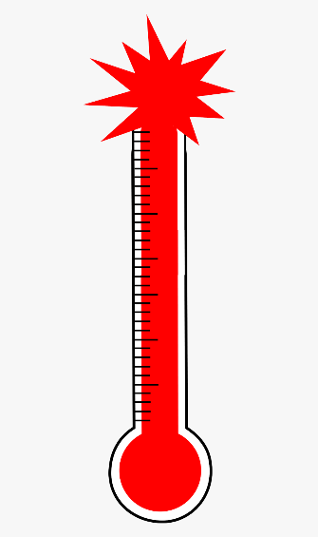
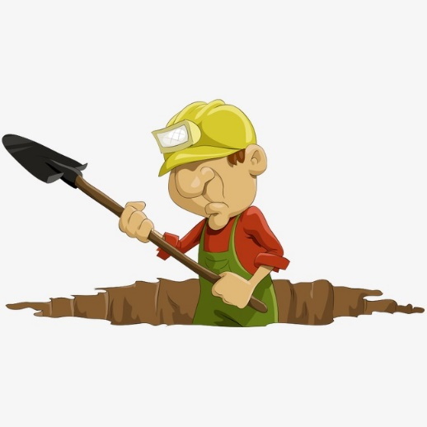




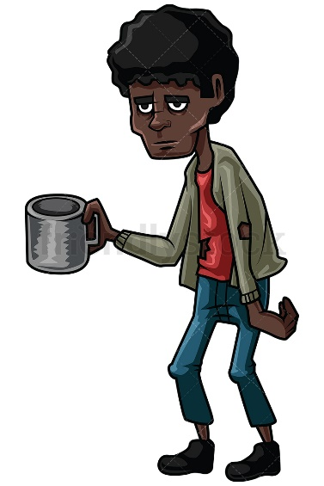

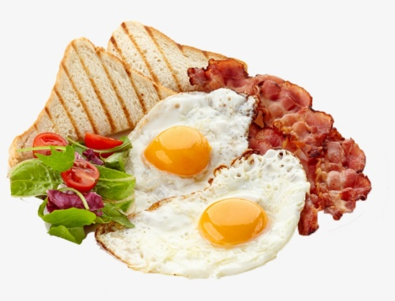
THE ARABIAN DESERT
THE ACTIVE VOLCANOES
THE CALIFORNIA GOLD RUSH
THE COMPULSORY EDUCATION LAW
DETOUR
HEIGHTS
GARBAGE
FAST BAKER
ELEVATORS

Slide 6
ANAGRAMS ANAGRAMS ANAGRAMS ANAGRAMS ANAGRAMS ANAGRAMS ANAGRAMS ANAGRAMS
ANAGRAMS ANAGRAMS ANAGRAMS ANAGRAMS ANAGRAMS ANAGRAMS ANAGRAMS ANAGRAMS
ANAGRAMS ANAGRAMS ANAGRAMS ANAGRAMS ANAGRAMS ANAGRAMS ANAGRAMS ANAGRAMS
ANAGRAMS ANAGRAMS ANAGRAMS ANAGRAMS ANAGRAMS ANAGRAMS ANAGRAMS ANAGRAMS
ANAGRAMS ANAGRAMS ANAGRAMS ANAGRAMS ANAGRAMS ANAGRAMS ANAGRAMS ANAGRAMS
ANAGRAMS ANAGRAMS ANAGRAMS ANAGRAMS ANAGRAMS ANAGRAMS ANAGRAMS ANAGRAMS
ANAGRAMS ANAGRAMS ANAGRAMS ANAGRAMS ANAGRAMS ANAGRAMS ANAGRAMS ANAGRAMS
ANAGRAMS ANAGRAMS ANAGRAMS ANAGRAMS ANAGRAMS ANAGRAMS ANAGRAMS ANAGRAMS
ANAGRAMS ANAGRAMS ANAGRAMS ANAGRAMS ANAGRAMS ANAGRAMS ANAGRAMS ANAGRAMS
ANAGRAMS ANAGRAMS ANAGRAMS ANAGRAMS ANAGRAMS ANAGRAMS ANAGRAMS ANAGRAMS
ANAGRAMS ANAGRAMS ANAGRAMS ANAGRAMS ANAGRAMS ANAGRAMS ANAGRAMS ANAGRAMS
ANAGRAMS ANAGRAMS ANAGRAMS ANAGRAMS ANAGRAMS ANAGRAMS ANAGRAMS ANAGRAMS
ANAGRAMS ANAGRAMS ANAGRAMS ANAGRAMS ANAGRAMS ANAGRAMS ANAGRAMS ANAGRAMS
ANAGRAMS ANAGRAMS ANAGRAMS ANAGRAMS ANAGRAMS ANAGRAMS ANAGRAMS ANAGRAMS
ANAGRAMS ANAGRAMS ANAGRAMS ANAGRAMS ANAGRAMS ANAGRAMS ANAGRAMS ANAGRAMS
ANAGRAMS ANAGRAMS ANAGRAMS ANAGRAMS ANAGRAMS ANAGRAMS ANAGRAMS ANAGRAMS
ANAGRAMS ANAGRAMS ANAGRAMS ANAGRAMS ANAGRAMS ANAGRAMS ANAGRAMS ANAGRAMS
ANAGRAMS ANAGRAMS ANAGRAMS ANAGRAMS ANAGRAMS ANAGRAMS ANAGRAMS ANAGRAMS
ANAGRAMS ANAGRAMS ANAGRAMS ANAGRAMS ANAGRAMS ANAGRAMS ANAGRAMS ANAGRAMS
ANAGRAMS ANAGRAMS ANAGRAMS ANAGRAMS ANAGRAMS ANAGRAMS ANAGRAMS ANAGRAMS
ANAGRAMS ANAGRAMS ANAGRAMS ANAGRAMS ANAGRAMS ANAGRAMS ANAGRAMS ANAGRAMS
ANAGRAMS ANAGRAMS ANAGRAMS ANAGRAMS ANAGRAMS ANAGRAMS ANAGRAMS ANAGRAMS
ANAGRAMS ANAGRAMS ANAGRAMS ANAGRAMS ANAGRAMS ANAGRAMS ANAGRAMS ANAGRAMS
ANAGRAMS ANAGRAMS ANAGRAMS ANAGRAMS ANAGRAMS ANAGRAMS ANAGRAMS ANAGRAMS
ANAGRAMS ANAGRAMS ANAGRAMS ANAGRAMS ANAGRAMS ANAGRAMS ANAGRAMS ANAGRAMS
ANAGRAMS ANAGRAMS ANAGRAMS ANAGRAMS ANAGRAMS ANAGRAMS ANAGRAMS ANAGRAMS
ANAGRAMS ANAGRAMS ANAGRAMS ANAGRAMS ANAGRAMS ANAGRAMS ANAGRAMS ANAGRAMS
ANAGRAMS ANAGRAMS ANAGRAMS ANAGRAMS ANAGRAMS ANAGRAMS ANAGRAMS ANAGRAMS
ANAGRAMS ANAGRAMS ANAGRAMS ANAGRAMS ANAGRAMS ANAGRAMS ANAGRAMS ANAGRAMS
ANAGRAMS ANAGRAMS ANAGRAMS ANAGRAMS ANAGRAMS ANAGRAMS ANAGRAMS ANAGRAMS
ANAGRAMS ANAGRAMS ANAGRAMS ANAGRAMS ANAGRAMS ANAGRAMS ANAGRAMS ANAGRAMS
ANAGRAMS ANAGRAMS ANAGRAMS ANAGRAMS ANAGRAMS ANAGRAMS ANAGRAMS ANAGRAMS
ANAGRAMS ANAGRAMS ANAGRAMS ANAGRAMS ANAGRAMS ANAGRAMS ANAGRAMS ANAGRAMS
ANAGRAMS ANAGRAMS ANAGRAMS ANAGRAMS ANAGRAMS ANAGRAMS ANAGRAMS ANAGRAMS
ANAGRAMS ANAGRAMS ANAGRAMS ANAGRAMS ANAGRAMS ANAGRAMS ANAGRAMS ANAGRAMS
ANAGRAMS ANAGRAMS ANAGRAMS ANAGRAMS ANAGRAMS ANAGRAMS ANAGRAMS ANAGRAMS
ANAGRAMS ANAGRAMS ANAGRAMS ANAGRAMS ANAGRAMS ANAGRAMS ANAGRAMS ANAGRAMS
ANAGRAMS ANAGRAMS ANAGRAMS ANAGRAMS ANAGRAMS ANAGRAMS ANAGRAMS ANAGRAMS
ANAGRAMS ANAGRAMS ANAGRAMS ANAGRAMS ANAGRAMS ANAGRAMS ANAGRAMS ANAGRAMS
ANAGRAMS ANAGRAMS ANAGRAMS ANAGRAMS ANAGRAMS ANAGRAMS ANAGRAMS ANAGRAMS

Slide 7
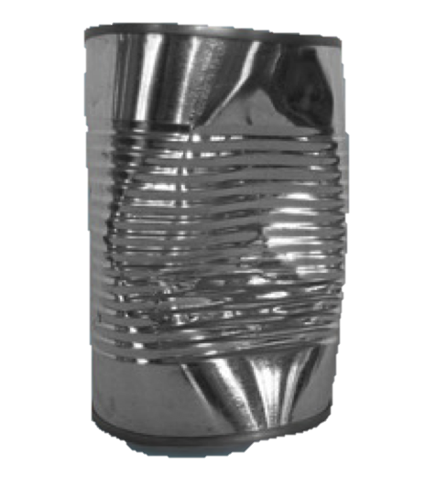



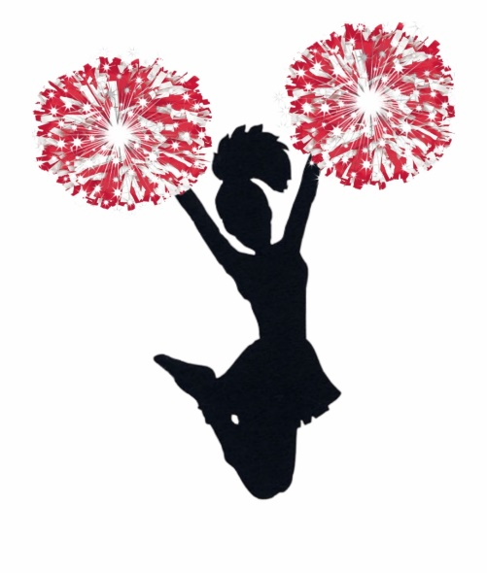



CONSTRAINT
IDENTIFIED
DYNAMITE
THE DENTIST
HELICOPTERS
HOTEL TO USE
CONSIDERATE
AN EVIL MIND

Slide 8
ANAGRAMS ANAGRAMS ANAGRAMS ANAGRAMS ANAGRAMS ANAGRAMS ANAGRAMS ANAGRAMS
ANAGRAMS ANAGRAMS ANAGRAMS ANAGRAMS ANAGRAMS ANAGRAMS ANAGRAMS ANAGRAMS
ANAGRAMS ANAGRAMS ANAGRAMS ANAGRAMS ANAGRAMS ANAGRAMS ANAGRAMS ANAGRAMS
ANAGRAMS ANAGRAMS ANAGRAMS ANAGRAMS ANAGRAMS ANAGRAMS ANAGRAMS ANAGRAMS
ANAGRAMS ANAGRAMS ANAGRAMS ANAGRAMS ANAGRAMS ANAGRAMS ANAGRAMS ANAGRAMS
ANAGRAMS ANAGRAMS ANAGRAMS ANAGRAMS ANAGRAMS ANAGRAMS ANAGRAMS ANAGRAMS
ANAGRAMS ANAGRAMS ANAGRAMS ANAGRAMS ANAGRAMS ANAGRAMS ANAGRAMS ANAGRAMS
ANAGRAMS ANAGRAMS ANAGRAMS ANAGRAMS ANAGRAMS ANAGRAMS ANAGRAMS ANAGRAMS
ANAGRAMS ANAGRAMS ANAGRAMS ANAGRAMS ANAGRAMS ANAGRAMS ANAGRAMS ANAGRAMS
ANAGRAMS ANAGRAMS ANAGRAMS ANAGRAMS ANAGRAMS ANAGRAMS ANAGRAMS ANAGRAMS
ANAGRAMS ANAGRAMS ANAGRAMS ANAGRAMS ANAGRAMS ANAGRAMS ANAGRAMS ANAGRAMS
ANAGRAMS ANAGRAMS ANAGRAMS ANAGRAMS ANAGRAMS ANAGRAMS ANAGRAMS ANAGRAMS
ANAGRAMS ANAGRAMS ANAGRAMS ANAGRAMS ANAGRAMS ANAGRAMS ANAGRAMS ANAGRAMS
ANAGRAMS ANAGRAMS ANAGRAMS ANAGRAMS ANAGRAMS ANAGRAMS ANAGRAMS ANAGRAMS
ANAGRAMS ANAGRAMS ANAGRAMS ANAGRAMS ANAGRAMS ANAGRAMS ANAGRAMS ANAGRAMS
ANAGRAMS ANAGRAMS ANAGRAMS ANAGRAMS ANAGRAMS ANAGRAMS ANAGRAMS ANAGRAMS
ANAGRAMS ANAGRAMS ANAGRAMS ANAGRAMS ANAGRAMS ANAGRAMS ANAGRAMS ANAGRAMS
ANAGRAMS ANAGRAMS ANAGRAMS ANAGRAMS ANAGRAMS ANAGRAMS ANAGRAMS ANAGRAMS
ANAGRAMS ANAGRAMS ANAGRAMS ANAGRAMS ANAGRAMS ANAGRAMS ANAGRAMS ANAGRAMS
ANAGRAMS ANAGRAMS ANAGRAMS ANAGRAMS ANAGRAMS ANAGRAMS ANAGRAMS ANAGRAMS
ANAGRAMS ANAGRAMS ANAGRAMS ANAGRAMS ANAGRAMS ANAGRAMS ANAGRAMS ANAGRAMS
ANAGRAMS ANAGRAMS ANAGRAMS ANAGRAMS ANAGRAMS ANAGRAMS ANAGRAMS ANAGRAMS
ANAGRAMS ANAGRAMS ANAGRAMS ANAGRAMS ANAGRAMS ANAGRAMS ANAGRAMS ANAGRAMS
ANAGRAMS ANAGRAMS ANAGRAMS ANAGRAMS ANAGRAMS ANAGRAMS ANAGRAMS ANAGRAMS
ANAGRAMS ANAGRAMS ANAGRAMS ANAGRAMS ANAGRAMS ANAGRAMS ANAGRAMS ANAGRAMS
ANAGRAMS ANAGRAMS ANAGRAMS ANAGRAMS ANAGRAMS ANAGRAMS ANAGRAMS ANAGRAMS
ANAGRAMS ANAGRAMS ANAGRAMS ANAGRAMS ANAGRAMS ANAGRAMS ANAGRAMS ANAGRAMS
ANAGRAMS ANAGRAMS ANAGRAMS ANAGRAMS ANAGRAMS ANAGRAMS ANAGRAMS ANAGRAMS
ANAGRAMS ANAGRAMS ANAGRAMS ANAGRAMS ANAGRAMS ANAGRAMS ANAGRAMS ANAGRAMS
ANAGRAMS ANAGRAMS ANAGRAMS ANAGRAMS ANAGRAMS ANAGRAMS ANAGRAMS ANAGRAMS
ANAGRAMS ANAGRAMS ANAGRAMS ANAGRAMS ANAGRAMS ANAGRAMS ANAGRAMS ANAGRAMS
ANAGRAMS ANAGRAMS ANAGRAMS ANAGRAMS ANAGRAMS ANAGRAMS ANAGRAMS ANAGRAMS
ANAGRAMS ANAGRAMS ANAGRAMS ANAGRAMS ANAGRAMS ANAGRAMS ANAGRAMS ANAGRAMS
ANAGRAMS ANAGRAMS ANAGRAMS ANAGRAMS ANAGRAMS ANAGRAMS ANAGRAMS ANAGRAMS
ANAGRAMS ANAGRAMS ANAGRAMS ANAGRAMS ANAGRAMS ANAGRAMS ANAGRAMS ANAGRAMS
ANAGRAMS ANAGRAMS ANAGRAMS ANAGRAMS ANAGRAMS ANAGRAMS ANAGRAMS ANAGRAMS
ANAGRAMS ANAGRAMS ANAGRAMS ANAGRAMS ANAGRAMS ANAGRAMS ANAGRAMS ANAGRAMS
ANAGRAMS ANAGRAMS ANAGRAMS ANAGRAMS ANAGRAMS ANAGRAMS ANAGRAMS ANAGRAMS
ANAGRAMS ANAGRAMS ANAGRAMS ANAGRAMS ANAGRAMS ANAGRAMS ANAGRAMS ANAGRAMS
ANAGRAMS ANAGRAMS ANAGRAMS ANAGRAMS ANAGRAMS ANAGRAMS ANAGRAMS ANAGRAMS

Slide 9



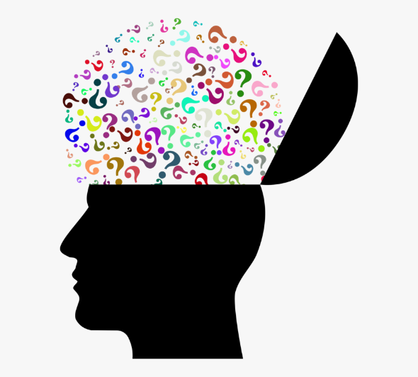
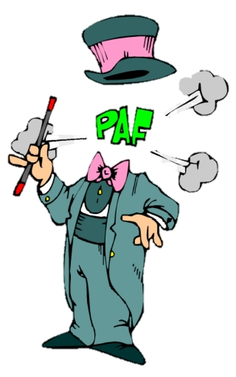




A GENTLEMAN
DESPERATION
ELEVEN + TWO
THE DETECTIVES
CONTEMPLATION
DISINTEGRATION
THE EARTHQUAKES
THE COUNTRYSIDE
A DECIMAL POINT

Slide 10
ANAGRAMS ANAGRAMS ANAGRAMS ANAGRAMS ANAGRAMS ANAGRAMS ANAGRAMS ANAGRAMS
ANAGRAMS ANAGRAMS ANAGRAMS ANAGRAMS ANAGRAMS ANAGRAMS ANAGRAMS ANAGRAMS
ANAGRAMS ANAGRAMS ANAGRAMS ANAGRAMS ANAGRAMS ANAGRAMS ANAGRAMS ANAGRAMS
ANAGRAMS ANAGRAMS ANAGRAMS ANAGRAMS ANAGRAMS ANAGRAMS ANAGRAMS ANAGRAMS
ANAGRAMS ANAGRAMS ANAGRAMS ANAGRAMS ANAGRAMS ANAGRAMS ANAGRAMS ANAGRAMS
ANAGRAMS ANAGRAMS ANAGRAMS ANAGRAMS ANAGRAMS ANAGRAMS ANAGRAMS ANAGRAMS
ANAGRAMS ANAGRAMS ANAGRAMS ANAGRAMS ANAGRAMS ANAGRAMS ANAGRAMS ANAGRAMS
ANAGRAMS ANAGRAMS ANAGRAMS ANAGRAMS ANAGRAMS ANAGRAMS ANAGRAMS ANAGRAMS
ANAGRAMS ANAGRAMS ANAGRAMS ANAGRAMS ANAGRAMS ANAGRAMS ANAGRAMS ANAGRAMS
ANAGRAMS ANAGRAMS ANAGRAMS ANAGRAMS ANAGRAMS ANAGRAMS ANAGRAMS ANAGRAMS
ANAGRAMS ANAGRAMS ANAGRAMS ANAGRAMS ANAGRAMS ANAGRAMS ANAGRAMS ANAGRAMS
ANAGRAMS ANAGRAMS ANAGRAMS ANAGRAMS ANAGRAMS ANAGRAMS ANAGRAMS ANAGRAMS
ANAGRAMS ANAGRAMS ANAGRAMS ANAGRAMS ANAGRAMS ANAGRAMS ANAGRAMS ANAGRAMS
ANAGRAMS ANAGRAMS ANAGRAMS ANAGRAMS ANAGRAMS ANAGRAMS ANAGRAMS ANAGRAMS
ANAGRAMS ANAGRAMS ANAGRAMS ANAGRAMS ANAGRAMS ANAGRAMS ANAGRAMS ANAGRAMS
ANAGRAMS ANAGRAMS ANAGRAMS ANAGRAMS ANAGRAMS ANAGRAMS ANAGRAMS ANAGRAMS
ANAGRAMS ANAGRAMS ANAGRAMS ANAGRAMS ANAGRAMS ANAGRAMS ANAGRAMS ANAGRAMS
ANAGRAMS ANAGRAMS ANAGRAMS ANAGRAMS ANAGRAMS ANAGRAMS ANAGRAMS ANAGRAMS
ANAGRAMS ANAGRAMS ANAGRAMS ANAGRAMS ANAGRAMS ANAGRAMS ANAGRAMS ANAGRAMS
ANAGRAMS ANAGRAMS ANAGRAMS ANAGRAMS ANAGRAMS ANAGRAMS ANAGRAMS ANAGRAMS
ANAGRAMS ANAGRAMS ANAGRAMS ANAGRAMS ANAGRAMS ANAGRAMS ANAGRAMS ANAGRAMS
ANAGRAMS ANAGRAMS ANAGRAMS ANAGRAMS ANAGRAMS ANAGRAMS ANAGRAMS ANAGRAMS
ANAGRAMS ANAGRAMS ANAGRAMS ANAGRAMS ANAGRAMS ANAGRAMS ANAGRAMS ANAGRAMS
ANAGRAMS ANAGRAMS ANAGRAMS ANAGRAMS ANAGRAMS ANAGRAMS ANAGRAMS ANAGRAMS
ANAGRAMS ANAGRAMS ANAGRAMS ANAGRAMS ANAGRAMS ANAGRAMS ANAGRAMS ANAGRAMS
ANAGRAMS ANAGRAMS ANAGRAMS ANAGRAMS ANAGRAMS ANAGRAMS ANAGRAMS ANAGRAMS
ANAGRAMS ANAGRAMS ANAGRAMS ANAGRAMS ANAGRAMS ANAGRAMS ANAGRAMS ANAGRAMS
ANAGRAMS ANAGRAMS ANAGRAMS ANAGRAMS ANAGRAMS ANAGRAMS ANAGRAMS ANAGRAMS
ANAGRAMS ANAGRAMS ANAGRAMS ANAGRAMS ANAGRAMS ANAGRAMS ANAGRAMS ANAGRAMS
ANAGRAMS ANAGRAMS ANAGRAMS ANAGRAMS ANAGRAMS ANAGRAMS ANAGRAMS ANAGRAMS
ANAGRAMS ANAGRAMS ANAGRAMS ANAGRAMS ANAGRAMS ANAGRAMS ANAGRAMS ANAGRAMS
ANAGRAMS ANAGRAMS ANAGRAMS ANAGRAMS ANAGRAMS ANAGRAMS ANAGRAMS ANAGRAMS
ANAGRAMS ANAGRAMS ANAGRAMS ANAGRAMS ANAGRAMS ANAGRAMS ANAGRAMS ANAGRAMS
ANAGRAMS ANAGRAMS ANAGRAMS ANAGRAMS ANAGRAMS ANAGRAMS ANAGRAMS ANAGRAMS
ANAGRAMS ANAGRAMS ANAGRAMS ANAGRAMS ANAGRAMS ANAGRAMS ANAGRAMS ANAGRAMS
ANAGRAMS ANAGRAMS ANAGRAMS ANAGRAMS ANAGRAMS ANAGRAMS ANAGRAMS ANAGRAMS
ANAGRAMS ANAGRAMS ANAGRAMS ANAGRAMS ANAGRAMS ANAGRAMS ANAGRAMS ANAGRAMS
ANAGRAMS ANAGRAMS ANAGRAMS ANAGRAMS ANAGRAMS ANAGRAMS ANAGRAMS ANAGRAMS
ANAGRAMS ANAGRAMS ANAGRAMS ANAGRAMS ANAGRAMS ANAGRAMS ANAGRAMS ANAGRAMS
ANAGRAMS ANAGRAMS ANAGRAMS ANAGRAMS ANAGRAMS ANAGRAMS ANAGRAMS ANAGRAMS

Slide 11
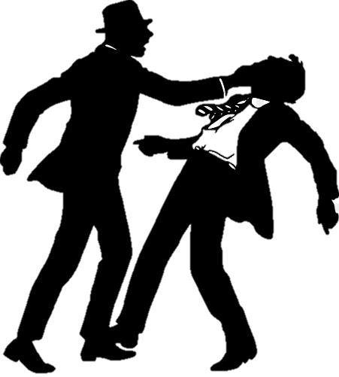
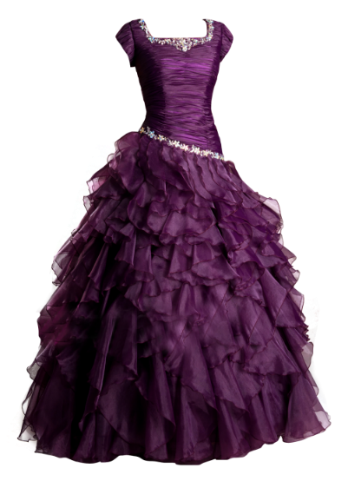
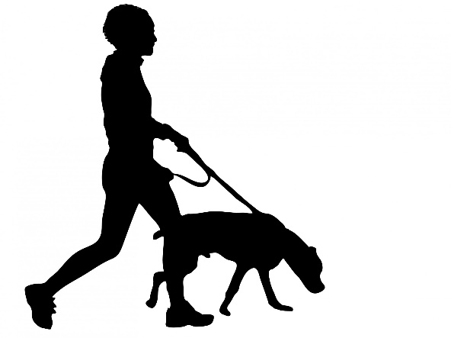

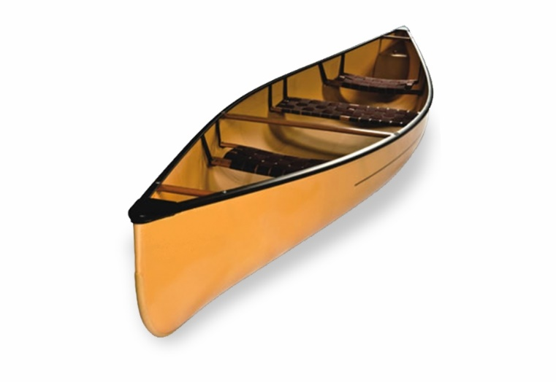


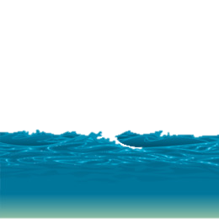

FRENCH REVOLUTION
FASHION’S DECREE
A DOMESTICATED ANIMAL
RAISE
OCEAN
MIRAGE
RECIPES
PIRATES
PANTIES

Slide 12
ANAGRAMS ANAGRAMS ANAGRAMS ANAGRAMS ANAGRAMS ANAGRAMS ANAGRAMS ANAGRAMS
ANAGRAMS ANAGRAMS ANAGRAMS ANAGRAMS ANAGRAMS ANAGRAMS ANAGRAMS ANAGRAMS
ANAGRAMS ANAGRAMS ANAGRAMS ANAGRAMS ANAGRAMS ANAGRAMS ANAGRAMS ANAGRAMS
ANAGRAMS ANAGRAMS ANAGRAMS ANAGRAMS ANAGRAMS ANAGRAMS ANAGRAMS ANAGRAMS
ANAGRAMS ANAGRAMS ANAGRAMS ANAGRAMS ANAGRAMS ANAGRAMS ANAGRAMS ANAGRAMS
ANAGRAMS ANAGRAMS ANAGRAMS ANAGRAMS ANAGRAMS ANAGRAMS ANAGRAMS ANAGRAMS
ANAGRAMS ANAGRAMS ANAGRAMS ANAGRAMS ANAGRAMS ANAGRAMS ANAGRAMS ANAGRAMS
ANAGRAMS ANAGRAMS ANAGRAMS ANAGRAMS ANAGRAMS ANAGRAMS ANAGRAMS ANAGRAMS
ANAGRAMS ANAGRAMS ANAGRAMS ANAGRAMS ANAGRAMS ANAGRAMS ANAGRAMS ANAGRAMS
ANAGRAMS ANAGRAMS ANAGRAMS ANAGRAMS ANAGRAMS ANAGRAMS ANAGRAMS ANAGRAMS
ANAGRAMS ANAGRAMS ANAGRAMS ANAGRAMS ANAGRAMS ANAGRAMS ANAGRAMS ANAGRAMS
ANAGRAMS ANAGRAMS ANAGRAMS ANAGRAMS ANAGRAMS ANAGRAMS ANAGRAMS ANAGRAMS
ANAGRAMS ANAGRAMS ANAGRAMS ANAGRAMS ANAGRAMS ANAGRAMS ANAGRAMS ANAGRAMS
ANAGRAMS ANAGRAMS ANAGRAMS ANAGRAMS ANAGRAMS ANAGRAMS ANAGRAMS ANAGRAMS
ANAGRAMS ANAGRAMS ANAGRAMS ANAGRAMS ANAGRAMS ANAGRAMS ANAGRAMS ANAGRAMS
ANAGRAMS ANAGRAMS ANAGRAMS ANAGRAMS ANAGRAMS ANAGRAMS ANAGRAMS ANAGRAMS
ANAGRAMS ANAGRAMS ANAGRAMS ANAGRAMS ANAGRAMS ANAGRAMS ANAGRAMS ANAGRAMS
ANAGRAMS ANAGRAMS ANAGRAMS ANAGRAMS ANAGRAMS ANAGRAMS ANAGRAMS ANAGRAMS
ANAGRAMS ANAGRAMS ANAGRAMS ANAGRAMS ANAGRAMS ANAGRAMS ANAGRAMS ANAGRAMS
ANAGRAMS ANAGRAMS ANAGRAMS ANAGRAMS ANAGRAMS ANAGRAMS ANAGRAMS ANAGRAMS
ANAGRAMS ANAGRAMS ANAGRAMS ANAGRAMS ANAGRAMS ANAGRAMS ANAGRAMS ANAGRAMS
ANAGRAMS ANAGRAMS ANAGRAMS ANAGRAMS ANAGRAMS ANAGRAMS ANAGRAMS ANAGRAMS
ANAGRAMS ANAGRAMS ANAGRAMS ANAGRAMS ANAGRAMS ANAGRAMS ANAGRAMS ANAGRAMS
ANAGRAMS ANAGRAMS ANAGRAMS ANAGRAMS ANAGRAMS ANAGRAMS ANAGRAMS ANAGRAMS
ANAGRAMS ANAGRAMS ANAGRAMS ANAGRAMS ANAGRAMS ANAGRAMS ANAGRAMS ANAGRAMS
ANAGRAMS ANAGRAMS ANAGRAMS ANAGRAMS ANAGRAMS ANAGRAMS ANAGRAMS ANAGRAMS
ANAGRAMS ANAGRAMS ANAGRAMS ANAGRAMS ANAGRAMS ANAGRAMS ANAGRAMS ANAGRAMS
ANAGRAMS ANAGRAMS ANAGRAMS ANAGRAMS ANAGRAMS ANAGRAMS ANAGRAMS ANAGRAMS
ANAGRAMS ANAGRAMS ANAGRAMS ANAGRAMS ANAGRAMS ANAGRAMS ANAGRAMS ANAGRAMS
ANAGRAMS ANAGRAMS ANAGRAMS ANAGRAMS ANAGRAMS ANAGRAMS ANAGRAMS ANAGRAMS
ANAGRAMS ANAGRAMS ANAGRAMS ANAGRAMS ANAGRAMS ANAGRAMS ANAGRAMS ANAGRAMS
ANAGRAMS ANAGRAMS ANAGRAMS ANAGRAMS ANAGRAMS ANAGRAMS ANAGRAMS ANAGRAMS
ANAGRAMS ANAGRAMS ANAGRAMS ANAGRAMS ANAGRAMS ANAGRAMS ANAGRAMS ANAGRAMS
ANAGRAMS ANAGRAMS ANAGRAMS ANAGRAMS ANAGRAMS ANAGRAMS ANAGRAMS ANAGRAMS
ANAGRAMS ANAGRAMS ANAGRAMS ANAGRAMS ANAGRAMS ANAGRAMS ANAGRAMS ANAGRAMS
ANAGRAMS ANAGRAMS ANAGRAMS ANAGRAMS ANAGRAMS ANAGRAMS ANAGRAMS ANAGRAMS
ANAGRAMS ANAGRAMS ANAGRAMS ANAGRAMS ANAGRAMS ANAGRAMS ANAGRAMS ANAGRAMS
ANAGRAMS ANAGRAMS ANAGRAMS ANAGRAMS ANAGRAMS ANAGRAMS ANAGRAMS ANAGRAMS
ANAGRAMS ANAGRAMS ANAGRAMS ANAGRAMS ANAGRAMS ANAGRAMS ANAGRAMS ANAGRAMS
ANAGRAMS ANAGRAMS ANAGRAMS ANAGRAMS ANAGRAMS ANAGRAMS ANAGRAMS ANAGRAMS

Slide 13





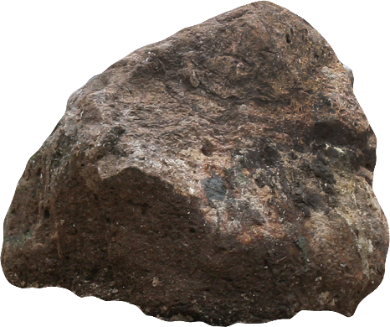


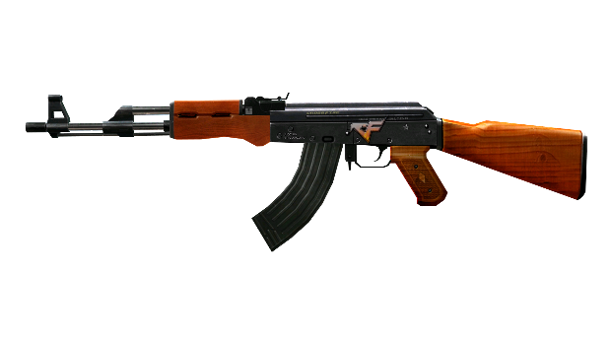
LIONESSES
ONE HUG
MINUTES
REALISTIC
IGNORANT
MARRIAGE
INTOXICATE
INTRUSION
INSURGENT

Slide 14
ANAGRAMS ANAGRAMS ANAGRAMS ANAGRAMS ANAGRAMS ANAGRAMS ANAGRAMS ANAGRAMS
ANAGRAMS ANAGRAMS ANAGRAMS ANAGRAMS ANAGRAMS ANAGRAMS ANAGRAMS ANAGRAMS
ANAGRAMS ANAGRAMS ANAGRAMS ANAGRAMS ANAGRAMS ANAGRAMS ANAGRAMS ANAGRAMS
ANAGRAMS ANAGRAMS ANAGRAMS ANAGRAMS ANAGRAMS ANAGRAMS ANAGRAMS ANAGRAMS
ANAGRAMS ANAGRAMS ANAGRAMS ANAGRAMS ANAGRAMS ANAGRAMS ANAGRAMS ANAGRAMS
ANAGRAMS ANAGRAMS ANAGRAMS ANAGRAMS ANAGRAMS ANAGRAMS ANAGRAMS ANAGRAMS
ANAGRAMS ANAGRAMS ANAGRAMS ANAGRAMS ANAGRAMS ANAGRAMS ANAGRAMS ANAGRAMS
ANAGRAMS ANAGRAMS ANAGRAMS ANAGRAMS ANAGRAMS ANAGRAMS ANAGRAMS ANAGRAMS
ANAGRAMS ANAGRAMS ANAGRAMS ANAGRAMS ANAGRAMS ANAGRAMS ANAGRAMS ANAGRAMS
ANAGRAMS ANAGRAMS ANAGRAMS ANAGRAMS ANAGRAMS ANAGRAMS ANAGRAMS ANAGRAMS
ANAGRAMS ANAGRAMS ANAGRAMS ANAGRAMS ANAGRAMS ANAGRAMS ANAGRAMS ANAGRAMS
ANAGRAMS ANAGRAMS ANAGRAMS ANAGRAMS ANAGRAMS ANAGRAMS ANAGRAMS ANAGRAMS
ANAGRAMS ANAGRAMS ANAGRAMS ANAGRAMS ANAGRAMS ANAGRAMS ANAGRAMS ANAGRAMS
ANAGRAMS ANAGRAMS ANAGRAMS ANAGRAMS ANAGRAMS ANAGRAMS ANAGRAMS ANAGRAMS
ANAGRAMS ANAGRAMS ANAGRAMS ANAGRAMS ANAGRAMS ANAGRAMS ANAGRAMS ANAGRAMS
ANAGRAMS ANAGRAMS ANAGRAMS ANAGRAMS ANAGRAMS ANAGRAMS ANAGRAMS ANAGRAMS
ANAGRAMS ANAGRAMS ANAGRAMS ANAGRAMS ANAGRAMS ANAGRAMS ANAGRAMS ANAGRAMS
ANAGRAMS ANAGRAMS ANAGRAMS ANAGRAMS ANAGRAMS ANAGRAMS ANAGRAMS ANAGRAMS
ANAGRAMS ANAGRAMS ANAGRAMS ANAGRAMS ANAGRAMS ANAGRAMS ANAGRAMS ANAGRAMS
ANAGRAMS ANAGRAMS ANAGRAMS ANAGRAMS ANAGRAMS ANAGRAMS ANAGRAMS ANAGRAMS
ANAGRAMS ANAGRAMS ANAGRAMS ANAGRAMS ANAGRAMS ANAGRAMS ANAGRAMS ANAGRAMS
ANAGRAMS ANAGRAMS ANAGRAMS ANAGRAMS ANAGRAMS ANAGRAMS ANAGRAMS ANAGRAMS
ANAGRAMS ANAGRAMS ANAGRAMS ANAGRAMS ANAGRAMS ANAGRAMS ANAGRAMS ANAGRAMS
ANAGRAMS ANAGRAMS ANAGRAMS ANAGRAMS ANAGRAMS ANAGRAMS ANAGRAMS ANAGRAMS
ANAGRAMS ANAGRAMS ANAGRAMS ANAGRAMS ANAGRAMS ANAGRAMS ANAGRAMS ANAGRAMS
ANAGRAMS ANAGRAMS ANAGRAMS ANAGRAMS ANAGRAMS ANAGRAMS ANAGRAMS ANAGRAMS
ANAGRAMS ANAGRAMS ANAGRAMS ANAGRAMS ANAGRAMS ANAGRAMS ANAGRAMS ANAGRAMS
ANAGRAMS ANAGRAMS ANAGRAMS ANAGRAMS ANAGRAMS ANAGRAMS ANAGRAMS ANAGRAMS
ANAGRAMS ANAGRAMS ANAGRAMS ANAGRAMS ANAGRAMS ANAGRAMS ANAGRAMS ANAGRAMS
ANAGRAMS ANAGRAMS ANAGRAMS ANAGRAMS ANAGRAMS ANAGRAMS ANAGRAMS ANAGRAMS
ANAGRAMS ANAGRAMS ANAGRAMS ANAGRAMS ANAGRAMS ANAGRAMS ANAGRAMS ANAGRAMS
ANAGRAMS ANAGRAMS ANAGRAMS ANAGRAMS ANAGRAMS ANAGRAMS ANAGRAMS ANAGRAMS
ANAGRAMS ANAGRAMS ANAGRAMS ANAGRAMS ANAGRAMS ANAGRAMS ANAGRAMS ANAGRAMS
ANAGRAMS ANAGRAMS ANAGRAMS ANAGRAMS ANAGRAMS ANAGRAMS ANAGRAMS ANAGRAMS
ANAGRAMS ANAGRAMS ANAGRAMS ANAGRAMS ANAGRAMS ANAGRAMS ANAGRAMS ANAGRAMS
ANAGRAMS ANAGRAMS ANAGRAMS ANAGRAMS ANAGRAMS ANAGRAMS ANAGRAMS ANAGRAMS
ANAGRAMS ANAGRAMS ANAGRAMS ANAGRAMS ANAGRAMS ANAGRAMS ANAGRAMS ANAGRAMS
ANAGRAMS ANAGRAMS ANAGRAMS ANAGRAMS ANAGRAMS ANAGRAMS ANAGRAMS ANAGRAMS
ANAGRAMS ANAGRAMS ANAGRAMS ANAGRAMS ANAGRAMS ANAGRAMS ANAGRAMS ANAGRAMS
ANAGRAMS ANAGRAMS ANAGRAMS ANAGRAMS ANAGRAMS ANAGRAMS ANAGRAMS ANAGRAMS

Slide 15








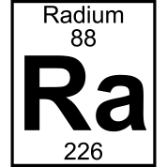
IMPATIENT
NEAT TAILORS
OUR DESTINY
PRECAUTION
PURCHASING
POSTPONED
PUNISHMENT
MADAM CURIE
THE MONA LISA

Slide 16
ANAGRAMS ANAGRAMS ANAGRAMS ANAGRAMS ANAGRAMS ANAGRAMS ANAGRAMS ANAGRAMS
ANAGRAMS ANAGRAMS ANAGRAMS ANAGRAMS ANAGRAMS ANAGRAMS ANAGRAMS ANAGRAMS
ANAGRAMS ANAGRAMS ANAGRAMS ANAGRAMS ANAGRAMS ANAGRAMS ANAGRAMS ANAGRAMS
ANAGRAMS ANAGRAMS ANAGRAMS ANAGRAMS ANAGRAMS ANAGRAMS ANAGRAMS ANAGRAMS
ANAGRAMS ANAGRAMS ANAGRAMS ANAGRAMS ANAGRAMS ANAGRAMS ANAGRAMS ANAGRAMS
ANAGRAMS ANAGRAMS ANAGRAMS ANAGRAMS ANAGRAMS ANAGRAMS ANAGRAMS ANAGRAMS
ANAGRAMS ANAGRAMS ANAGRAMS ANAGRAMS ANAGRAMS ANAGRAMS ANAGRAMS ANAGRAMS
ANAGRAMS ANAGRAMS ANAGRAMS ANAGRAMS ANAGRAMS ANAGRAMS ANAGRAMS ANAGRAMS
ANAGRAMS ANAGRAMS ANAGRAMS ANAGRAMS ANAGRAMS ANAGRAMS ANAGRAMS ANAGRAMS
ANAGRAMS ANAGRAMS ANAGRAMS ANAGRAMS ANAGRAMS ANAGRAMS ANAGRAMS ANAGRAMS
ANAGRAMS ANAGRAMS ANAGRAMS ANAGRAMS ANAGRAMS ANAGRAMS ANAGRAMS ANAGRAMS
ANAGRAMS ANAGRAMS ANAGRAMS ANAGRAMS ANAGRAMS ANAGRAMS ANAGRAMS ANAGRAMS
ANAGRAMS ANAGRAMS ANAGRAMS ANAGRAMS ANAGRAMS ANAGRAMS ANAGRAMS ANAGRAMS
ANAGRAMS ANAGRAMS ANAGRAMS ANAGRAMS ANAGRAMS ANAGRAMS ANAGRAMS ANAGRAMS
ANAGRAMS ANAGRAMS ANAGRAMS ANAGRAMS ANAGRAMS ANAGRAMS ANAGRAMS ANAGRAMS
ANAGRAMS ANAGRAMS ANAGRAMS ANAGRAMS ANAGRAMS ANAGRAMS ANAGRAMS ANAGRAMS
ANAGRAMS ANAGRAMS ANAGRAMS ANAGRAMS ANAGRAMS ANAGRAMS ANAGRAMS ANAGRAMS
ANAGRAMS ANAGRAMS ANAGRAMS ANAGRAMS ANAGRAMS ANAGRAMS ANAGRAMS ANAGRAMS
ANAGRAMS ANAGRAMS ANAGRAMS ANAGRAMS ANAGRAMS ANAGRAMS ANAGRAMS ANAGRAMS
ANAGRAMS ANAGRAMS ANAGRAMS ANAGRAMS ANAGRAMS ANAGRAMS ANAGRAMS ANAGRAMS
ANAGRAMS ANAGRAMS ANAGRAMS ANAGRAMS ANAGRAMS ANAGRAMS ANAGRAMS ANAGRAMS
ANAGRAMS ANAGRAMS ANAGRAMS ANAGRAMS ANAGRAMS ANAGRAMS ANAGRAMS ANAGRAMS
ANAGRAMS ANAGRAMS ANAGRAMS ANAGRAMS ANAGRAMS ANAGRAMS ANAGRAMS ANAGRAMS
ANAGRAMS ANAGRAMS ANAGRAMS ANAGRAMS ANAGRAMS ANAGRAMS ANAGRAMS ANAGRAMS
ANAGRAMS ANAGRAMS ANAGRAMS ANAGRAMS ANAGRAMS ANAGRAMS ANAGRAMS ANAGRAMS
ANAGRAMS ANAGRAMS ANAGRAMS ANAGRAMS ANAGRAMS ANAGRAMS ANAGRAMS ANAGRAMS
ANAGRAMS ANAGRAMS ANAGRAMS ANAGRAMS ANAGRAMS ANAGRAMS ANAGRAMS ANAGRAMS
ANAGRAMS ANAGRAMS ANAGRAMS ANAGRAMS ANAGRAMS ANAGRAMS ANAGRAMS ANAGRAMS
ANAGRAMS ANAGRAMS ANAGRAMS ANAGRAMS ANAGRAMS ANAGRAMS ANAGRAMS ANAGRAMS
ANAGRAMS ANAGRAMS ANAGRAMS ANAGRAMS ANAGRAMS ANAGRAMS ANAGRAMS ANAGRAMS
ANAGRAMS ANAGRAMS ANAGRAMS ANAGRAMS ANAGRAMS ANAGRAMS ANAGRAMS ANAGRAMS
ANAGRAMS ANAGRAMS ANAGRAMS ANAGRAMS ANAGRAMS ANAGRAMS ANAGRAMS ANAGRAMS
ANAGRAMS ANAGRAMS ANAGRAMS ANAGRAMS ANAGRAMS ANAGRAMS ANAGRAMS ANAGRAMS
ANAGRAMS ANAGRAMS ANAGRAMS ANAGRAMS ANAGRAMS ANAGRAMS ANAGRAMS ANAGRAMS
ANAGRAMS ANAGRAMS ANAGRAMS ANAGRAMS ANAGRAMS ANAGRAMS ANAGRAMS ANAGRAMS
ANAGRAMS ANAGRAMS ANAGRAMS ANAGRAMS ANAGRAMS ANAGRAMS ANAGRAMS ANAGRAMS
ANAGRAMS ANAGRAMS ANAGRAMS ANAGRAMS ANAGRAMS ANAGRAMS ANAGRAMS ANAGRAMS
ANAGRAMS ANAGRAMS ANAGRAMS ANAGRAMS ANAGRAMS ANAGRAMS ANAGRAMS ANAGRAMS
ANAGRAMS ANAGRAMS ANAGRAMS ANAGRAMS ANAGRAMS ANAGRAMS ANAGRAMS ANAGRAMS
ANAGRAMS ANAGRAMS ANAGRAMS ANAGRAMS ANAGRAMS ANAGRAMS ANAGRAMS ANAGRAMS

Slide 17



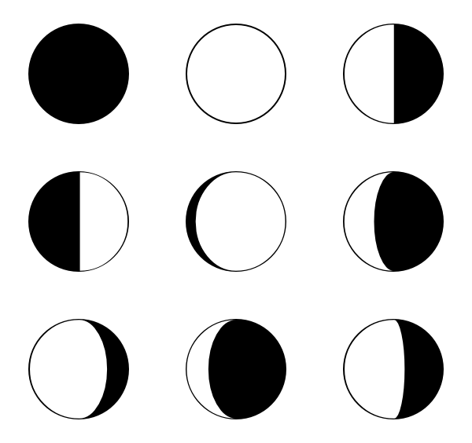

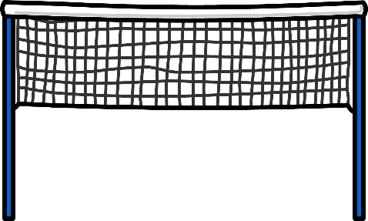



THE MORSE CODE
RESCUE
TRAIN
SWEAT
SHAPE
TENNIS
SHADOW
THIS EAR
WOMEN

Slide 18
ANAGRAMS ANAGRAMS ANAGRAMS ANAGRAMS ANAGRAMS ANAGRAMS ANAGRAMS ANAGRAMS
ANAGRAMS ANAGRAMS ANAGRAMS ANAGRAMS ANAGRAMS ANAGRAMS ANAGRAMS ANAGRAMS
ANAGRAMS ANAGRAMS ANAGRAMS ANAGRAMS ANAGRAMS ANAGRAMS ANAGRAMS ANAGRAMS
ANAGRAMS ANAGRAMS ANAGRAMS ANAGRAMS ANAGRAMS ANAGRAMS ANAGRAMS ANAGRAMS
ANAGRAMS ANAGRAMS ANAGRAMS ANAGRAMS ANAGRAMS ANAGRAMS ANAGRAMS ANAGRAMS
ANAGRAMS ANAGRAMS ANAGRAMS ANAGRAMS ANAGRAMS ANAGRAMS ANAGRAMS ANAGRAMS
ANAGRAMS ANAGRAMS ANAGRAMS ANAGRAMS ANAGRAMS ANAGRAMS ANAGRAMS ANAGRAMS
ANAGRAMS ANAGRAMS ANAGRAMS ANAGRAMS ANAGRAMS ANAGRAMS ANAGRAMS ANAGRAMS
ANAGRAMS ANAGRAMS ANAGRAMS ANAGRAMS ANAGRAMS ANAGRAMS ANAGRAMS ANAGRAMS
ANAGRAMS ANAGRAMS ANAGRAMS ANAGRAMS ANAGRAMS ANAGRAMS ANAGRAMS ANAGRAMS
ANAGRAMS ANAGRAMS ANAGRAMS ANAGRAMS ANAGRAMS ANAGRAMS ANAGRAMS ANAGRAMS
ANAGRAMS ANAGRAMS ANAGRAMS ANAGRAMS ANAGRAMS ANAGRAMS ANAGRAMS ANAGRAMS
ANAGRAMS ANAGRAMS ANAGRAMS ANAGRAMS ANAGRAMS ANAGRAMS ANAGRAMS ANAGRAMS
ANAGRAMS ANAGRAMS ANAGRAMS ANAGRAMS ANAGRAMS ANAGRAMS ANAGRAMS ANAGRAMS
ANAGRAMS ANAGRAMS ANAGRAMS ANAGRAMS ANAGRAMS ANAGRAMS ANAGRAMS ANAGRAMS
ANAGRAMS ANAGRAMS ANAGRAMS ANAGRAMS ANAGRAMS ANAGRAMS ANAGRAMS ANAGRAMS
ANAGRAMS ANAGRAMS ANAGRAMS ANAGRAMS ANAGRAMS ANAGRAMS ANAGRAMS ANAGRAMS
ANAGRAMS ANAGRAMS ANAGRAMS ANAGRAMS ANAGRAMS ANAGRAMS ANAGRAMS ANAGRAMS
ANAGRAMS ANAGRAMS ANAGRAMS ANAGRAMS ANAGRAMS ANAGRAMS ANAGRAMS ANAGRAMS
ANAGRAMS ANAGRAMS ANAGRAMS ANAGRAMS ANAGRAMS ANAGRAMS ANAGRAMS ANAGRAMS
ANAGRAMS ANAGRAMS ANAGRAMS ANAGRAMS ANAGRAMS ANAGRAMS ANAGRAMS ANAGRAMS
ANAGRAMS ANAGRAMS ANAGRAMS ANAGRAMS ANAGRAMS ANAGRAMS ANAGRAMS ANAGRAMS
ANAGRAMS ANAGRAMS ANAGRAMS ANAGRAMS ANAGRAMS ANAGRAMS ANAGRAMS ANAGRAMS
ANAGRAMS ANAGRAMS ANAGRAMS ANAGRAMS ANAGRAMS ANAGRAMS ANAGRAMS ANAGRAMS
ANAGRAMS ANAGRAMS ANAGRAMS ANAGRAMS ANAGRAMS ANAGRAMS ANAGRAMS ANAGRAMS
ANAGRAMS ANAGRAMS ANAGRAMS ANAGRAMS ANAGRAMS ANAGRAMS ANAGRAMS ANAGRAMS
ANAGRAMS ANAGRAMS ANAGRAMS ANAGRAMS ANAGRAMS ANAGRAMS ANAGRAMS ANAGRAMS
ANAGRAMS ANAGRAMS ANAGRAMS ANAGRAMS ANAGRAMS ANAGRAMS ANAGRAMS ANAGRAMS
ANAGRAMS ANAGRAMS ANAGRAMS ANAGRAMS ANAGRAMS ANAGRAMS ANAGRAMS ANAGRAMS
ANAGRAMS ANAGRAMS ANAGRAMS ANAGRAMS ANAGRAMS ANAGRAMS ANAGRAMS ANAGRAMS
ANAGRAMS ANAGRAMS ANAGRAMS ANAGRAMS ANAGRAMS ANAGRAMS ANAGRAMS ANAGRAMS
ANAGRAMS ANAGRAMS ANAGRAMS ANAGRAMS ANAGRAMS ANAGRAMS ANAGRAMS ANAGRAMS
ANAGRAMS ANAGRAMS ANAGRAMS ANAGRAMS ANAGRAMS ANAGRAMS ANAGRAMS ANAGRAMS
ANAGRAMS ANAGRAMS ANAGRAMS ANAGRAMS ANAGRAMS ANAGRAMS ANAGRAMS ANAGRAMS
ANAGRAMS ANAGRAMS ANAGRAMS ANAGRAMS ANAGRAMS ANAGRAMS ANAGRAMS ANAGRAMS
ANAGRAMS ANAGRAMS ANAGRAMS ANAGRAMS ANAGRAMS ANAGRAMS ANAGRAMS ANAGRAMS
ANAGRAMS ANAGRAMS ANAGRAMS ANAGRAMS ANAGRAMS ANAGRAMS ANAGRAMS ANAGRAMS
ANAGRAMS ANAGRAMS ANAGRAMS ANAGRAMS ANAGRAMS ANAGRAMS ANAGRAMS ANAGRAMS
ANAGRAMS ANAGRAMS ANAGRAMS ANAGRAMS ANAGRAMS ANAGRAMS ANAGRAMS ANAGRAMS
ANAGRAMS ANAGRAMS ANAGRAMS ANAGRAMS ANAGRAMS ANAGRAMS ANAGRAMS ANAGRAMS

Slide 19

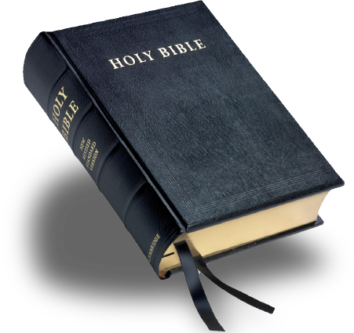




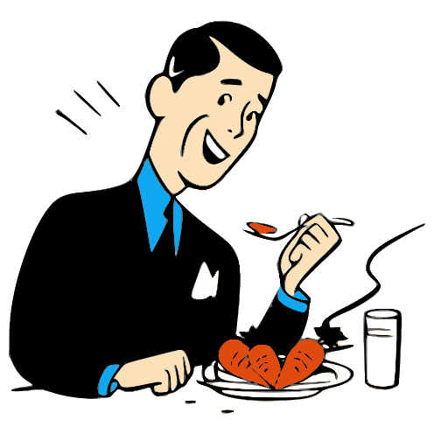


SURGEON
UNSIGHTLY
STATEMENT
SECLUSION
REVOLUTION
SEPARATION
THE WAITERS
A TELESCOPE
TERMINATION

Slide 20
ANAGRAMS ANAGRAMS ANAGRAMS ANAGRAMS ANAGRAMS ANAGRAMS ANAGRAMS ANAGRAMS
ANAGRAMS ANAGRAMS ANAGRAMS ANAGRAMS ANAGRAMS ANAGRAMS ANAGRAMS ANAGRAMS
ANAGRAMS ANAGRAMS ANAGRAMS ANAGRAMS ANAGRAMS ANAGRAMS ANAGRAMS ANAGRAMS
ANAGRAMS ANAGRAMS ANAGRAMS ANAGRAMS ANAGRAMS ANAGRAMS ANAGRAMS ANAGRAMS
ANAGRAMS ANAGRAMS ANAGRAMS ANAGRAMS ANAGRAMS ANAGRAMS ANAGRAMS ANAGRAMS
ANAGRAMS ANAGRAMS ANAGRAMS ANAGRAMS ANAGRAMS ANAGRAMS ANAGRAMS ANAGRAMS
ANAGRAMS ANAGRAMS ANAGRAMS ANAGRAMS ANAGRAMS ANAGRAMS ANAGRAMS ANAGRAMS
ANAGRAMS ANAGRAMS ANAGRAMS ANAGRAMS ANAGRAMS ANAGRAMS ANAGRAMS ANAGRAMS
ANAGRAMS ANAGRAMS ANAGRAMS ANAGRAMS ANAGRAMS ANAGRAMS ANAGRAMS ANAGRAMS
ANAGRAMS ANAGRAMS ANAGRAMS ANAGRAMS ANAGRAMS ANAGRAMS ANAGRAMS ANAGRAMS
ANAGRAMS ANAGRAMS ANAGRAMS ANAGRAMS ANAGRAMS ANAGRAMS ANAGRAMS ANAGRAMS
ANAGRAMS ANAGRAMS ANAGRAMS ANAGRAMS ANAGRAMS ANAGRAMS ANAGRAMS ANAGRAMS
ANAGRAMS ANAGRAMS ANAGRAMS ANAGRAMS ANAGRAMS ANAGRAMS ANAGRAMS ANAGRAMS
ANAGRAMS ANAGRAMS ANAGRAMS ANAGRAMS ANAGRAMS ANAGRAMS ANAGRAMS ANAGRAMS
ANAGRAMS ANAGRAMS ANAGRAMS ANAGRAMS ANAGRAMS ANAGRAMS ANAGRAMS ANAGRAMS
ANAGRAMS ANAGRAMS ANAGRAMS ANAGRAMS ANAGRAMS ANAGRAMS ANAGRAMS ANAGRAMS
ANAGRAMS ANAGRAMS ANAGRAMS ANAGRAMS ANAGRAMS ANAGRAMS ANAGRAMS ANAGRAMS
ANAGRAMS ANAGRAMS ANAGRAMS ANAGRAMS ANAGRAMS ANAGRAMS ANAGRAMS ANAGRAMS
ANAGRAMS ANAGRAMS ANAGRAMS ANAGRAMS ANAGRAMS ANAGRAMS ANAGRAMS ANAGRAMS
ANAGRAMS ANAGRAMS ANAGRAMS ANAGRAMS ANAGRAMS ANAGRAMS ANAGRAMS ANAGRAMS
ANAGRAMS ANAGRAMS ANAGRAMS ANAGRAMS ANAGRAMS ANAGRAMS ANAGRAMS ANAGRAMS
ANAGRAMS ANAGRAMS ANAGRAMS ANAGRAMS ANAGRAMS ANAGRAMS ANAGRAMS ANAGRAMS
ANAGRAMS ANAGRAMS ANAGRAMS ANAGRAMS ANAGRAMS ANAGRAMS ANAGRAMS ANAGRAMS
ANAGRAMS ANAGRAMS ANAGRAMS ANAGRAMS ANAGRAMS ANAGRAMS ANAGRAMS ANAGRAMS
ANAGRAMS ANAGRAMS ANAGRAMS ANAGRAMS ANAGRAMS ANAGRAMS ANAGRAMS ANAGRAMS
ANAGRAMS ANAGRAMS ANAGRAMS ANAGRAMS ANAGRAMS ANAGRAMS ANAGRAMS ANAGRAMS
ANAGRAMS ANAGRAMS ANAGRAMS ANAGRAMS ANAGRAMS ANAGRAMS ANAGRAMS ANAGRAMS
ANAGRAMS ANAGRAMS ANAGRAMS ANAGRAMS ANAGRAMS ANAGRAMS ANAGRAMS ANAGRAMS
ANAGRAMS ANAGRAMS ANAGRAMS ANAGRAMS ANAGRAMS ANAGRAMS ANAGRAMS ANAGRAMS
ANAGRAMS ANAGRAMS ANAGRAMS ANAGRAMS ANAGRAMS ANAGRAMS ANAGRAMS ANAGRAMS
ANAGRAMS ANAGRAMS ANAGRAMS ANAGRAMS ANAGRAMS ANAGRAMS ANAGRAMS ANAGRAMS
ANAGRAMS ANAGRAMS ANAGRAMS ANAGRAMS ANAGRAMS ANAGRAMS ANAGRAMS ANAGRAMS
ANAGRAMS ANAGRAMS ANAGRAMS ANAGRAMS ANAGRAMS ANAGRAMS ANAGRAMS ANAGRAMS
ANAGRAMS ANAGRAMS ANAGRAMS ANAGRAMS ANAGRAMS ANAGRAMS ANAGRAMS ANAGRAMS
ANAGRAMS ANAGRAMS ANAGRAMS ANAGRAMS ANAGRAMS ANAGRAMS ANAGRAMS ANAGRAMS
ANAGRAMS ANAGRAMS ANAGRAMS ANAGRAMS ANAGRAMS ANAGRAMS ANAGRAMS ANAGRAMS
ANAGRAMS ANAGRAMS ANAGRAMS ANAGRAMS ANAGRAMS ANAGRAMS ANAGRAMS ANAGRAMS
ANAGRAMS ANAGRAMS ANAGRAMS ANAGRAMS ANAGRAMS ANAGRAMS ANAGRAMS ANAGRAMS
ANAGRAMS ANAGRAMS ANAGRAMS ANAGRAMS ANAGRAMS ANAGRAMS ANAGRAMS ANAGRAMS
ANAGRAMS ANAGRAMS ANAGRAMS ANAGRAMS ANAGRAMS ANAGRAMS ANAGRAMS ANAGRAMS

Slide 21

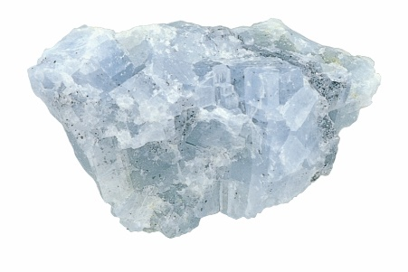
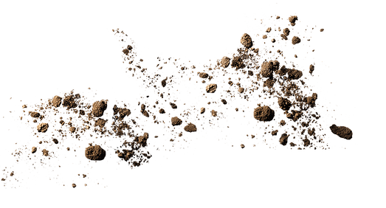






A SILVER MINE
SEDIMENTARY
SLOW READING
THE SLEIGH RIDE
SLOT MACHINES
SAY IT WITH FLOWERS
A TRIP AROUND THE WORLD
RACE
ELBOW

Slide 22
ANAGRAMS ANAGRAMS ANAGRAMS ANAGRAMS ANAGRAMS ANAGRAMS ANAGRAMS ANAGRAMS
ANAGRAMS ANAGRAMS ANAGRAMS ANAGRAMS ANAGRAMS ANAGRAMS ANAGRAMS ANAGRAMS
ANAGRAMS ANAGRAMS ANAGRAMS ANAGRAMS ANAGRAMS ANAGRAMS ANAGRAMS ANAGRAMS
ANAGRAMS ANAGRAMS ANAGRAMS ANAGRAMS ANAGRAMS ANAGRAMS ANAGRAMS ANAGRAMS
ANAGRAMS ANAGRAMS ANAGRAMS ANAGRAMS ANAGRAMS ANAGRAMS ANAGRAMS ANAGRAMS
ANAGRAMS ANAGRAMS ANAGRAMS ANAGRAMS ANAGRAMS ANAGRAMS ANAGRAMS ANAGRAMS
ANAGRAMS ANAGRAMS ANAGRAMS ANAGRAMS ANAGRAMS ANAGRAMS ANAGRAMS ANAGRAMS
ANAGRAMS ANAGRAMS ANAGRAMS ANAGRAMS ANAGRAMS ANAGRAMS ANAGRAMS ANAGRAMS
ANAGRAMS ANAGRAMS ANAGRAMS ANAGRAMS ANAGRAMS ANAGRAMS ANAGRAMS ANAGRAMS
ANAGRAMS ANAGRAMS ANAGRAMS ANAGRAMS ANAGRAMS ANAGRAMS ANAGRAMS ANAGRAMS
ANAGRAMS ANAGRAMS ANAGRAMS ANAGRAMS ANAGRAMS ANAGRAMS ANAGRAMS ANAGRAMS
ANAGRAMS ANAGRAMS ANAGRAMS ANAGRAMS ANAGRAMS ANAGRAMS ANAGRAMS ANAGRAMS
ANAGRAMS ANAGRAMS ANAGRAMS ANAGRAMS ANAGRAMS ANAGRAMS ANAGRAMS ANAGRAMS
ANAGRAMS ANAGRAMS ANAGRAMS ANAGRAMS ANAGRAMS ANAGRAMS ANAGRAMS ANAGRAMS
ANAGRAMS ANAGRAMS ANAGRAMS ANAGRAMS ANAGRAMS ANAGRAMS ANAGRAMS ANAGRAMS
ANAGRAMS ANAGRAMS ANAGRAMS ANAGRAMS ANAGRAMS ANAGRAMS ANAGRAMS ANAGRAMS
ANAGRAMS ANAGRAMS ANAGRAMS ANAGRAMS ANAGRAMS ANAGRAMS ANAGRAMS ANAGRAMS
ANAGRAMS ANAGRAMS ANAGRAMS ANAGRAMS ANAGRAMS ANAGRAMS ANAGRAMS ANAGRAMS
ANAGRAMS ANAGRAMS ANAGRAMS ANAGRAMS ANAGRAMS ANAGRAMS ANAGRAMS ANAGRAMS
ANAGRAMS ANAGRAMS ANAGRAMS ANAGRAMS ANAGRAMS ANAGRAMS ANAGRAMS ANAGRAMS
ANAGRAMS ANAGRAMS ANAGRAMS ANAGRAMS ANAGRAMS ANAGRAMS ANAGRAMS ANAGRAMS
ANAGRAMS ANAGRAMS ANAGRAMS ANAGRAMS ANAGRAMS ANAGRAMS ANAGRAMS ANAGRAMS
ANAGRAMS ANAGRAMS ANAGRAMS ANAGRAMS ANAGRAMS ANAGRAMS ANAGRAMS ANAGRAMS
ANAGRAMS ANAGRAMS ANAGRAMS ANAGRAMS ANAGRAMS ANAGRAMS ANAGRAMS ANAGRAMS
ANAGRAMS ANAGRAMS ANAGRAMS ANAGRAMS ANAGRAMS ANAGRAMS ANAGRAMS ANAGRAMS
ANAGRAMS ANAGRAMS ANAGRAMS ANAGRAMS ANAGRAMS ANAGRAMS ANAGRAMS ANAGRAMS
ANAGRAMS ANAGRAMS ANAGRAMS ANAGRAMS ANAGRAMS ANAGRAMS ANAGRAMS ANAGRAMS
ANAGRAMS ANAGRAMS ANAGRAMS ANAGRAMS ANAGRAMS ANAGRAMS ANAGRAMS ANAGRAMS
ANAGRAMS ANAGRAMS ANAGRAMS ANAGRAMS ANAGRAMS ANAGRAMS ANAGRAMS ANAGRAMS
ANAGRAMS ANAGRAMS ANAGRAMS ANAGRAMS ANAGRAMS ANAGRAMS ANAGRAMS ANAGRAMS
ANAGRAMS ANAGRAMS ANAGRAMS ANAGRAMS ANAGRAMS ANAGRAMS ANAGRAMS ANAGRAMS
ANAGRAMS ANAGRAMS ANAGRAMS ANAGRAMS ANAGRAMS ANAGRAMS ANAGRAMS ANAGRAMS
ANAGRAMS ANAGRAMS ANAGRAMS ANAGRAMS ANAGRAMS ANAGRAMS ANAGRAMS ANAGRAMS
ANAGRAMS ANAGRAMS ANAGRAMS ANAGRAMS ANAGRAMS ANAGRAMS ANAGRAMS ANAGRAMS
ANAGRAMS ANAGRAMS ANAGRAMS ANAGRAMS ANAGRAMS ANAGRAMS ANAGRAMS ANAGRAMS
ANAGRAMS ANAGRAMS ANAGRAMS ANAGRAMS ANAGRAMS ANAGRAMS ANAGRAMS ANAGRAMS
ANAGRAMS ANAGRAMS ANAGRAMS ANAGRAMS ANAGRAMS ANAGRAMS ANAGRAMS ANAGRAMS
ANAGRAMS ANAGRAMS ANAGRAMS ANAGRAMS ANAGRAMS ANAGRAMS ANAGRAMS ANAGRAMS
ANAGRAMS ANAGRAMS ANAGRAMS ANAGRAMS ANAGRAMS ANAGRAMS ANAGRAMS ANAGRAMS
ANAGRAMS ANAGRAMS ANAGRAMS ANAGRAMS ANAGRAMS ANAGRAMS ANAGRAMS ANAGRAMS

