Slide 1
Self-Efficacy
Your belief in yourself

Slide 3
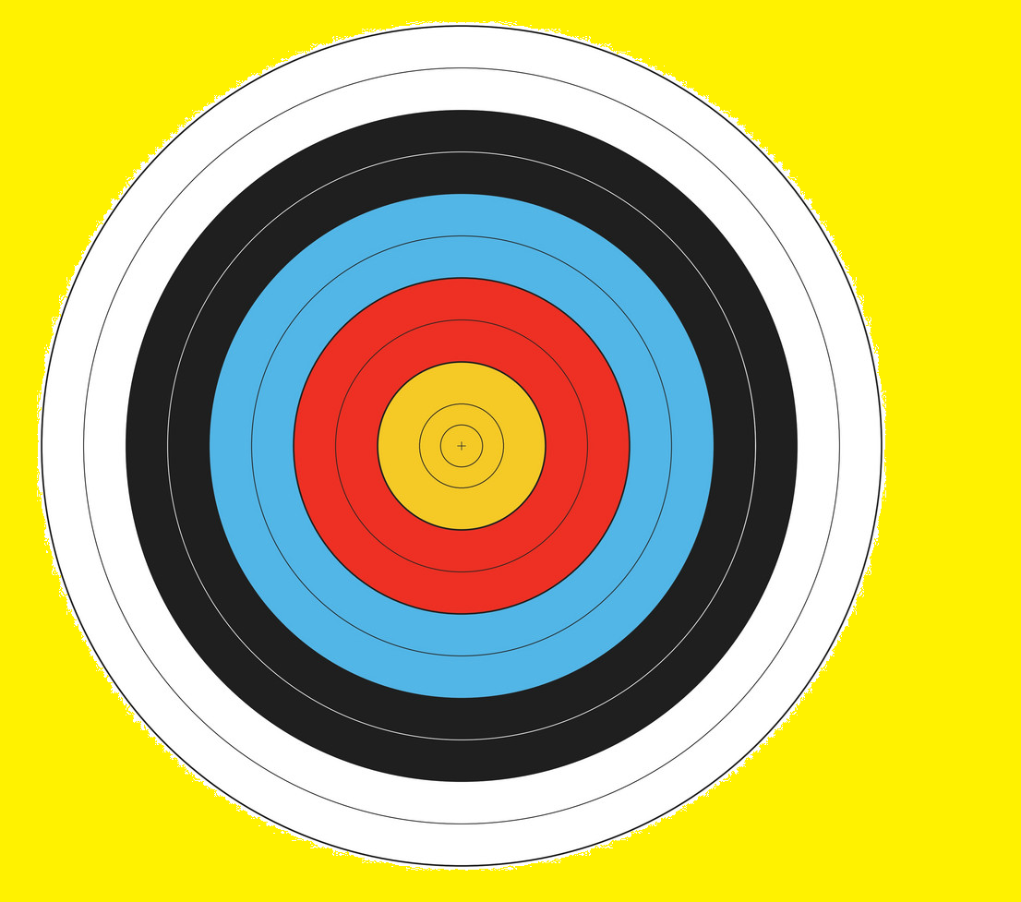
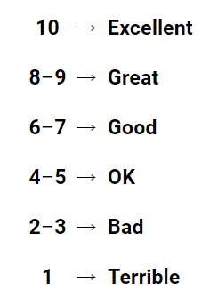
Hitting a Bulls-Eye
1m away
3m away
5m away

Slide 4
Self Efficacy
The belief that you can do a task

Slide 6
Self Efficacy vs Self Concept
Specific task
General ability
I can get a bullseye.
I am good at throwing things.

Slide 7
Self Efficacy vs Self Esteem
Belief in ability
Specific task
Overall feeling of
self-worth
I can get a bullseye.
I am awesome.

Slide 8
Self Esteem
Success
Perfectionist
Self Efficacy
Underachiever
Failure Acceptor

Slide 9
4 Factors
…that affect self efficacy

Slide 11
Personal Accomplishments
If you did it before, you can do it again

Slide 12
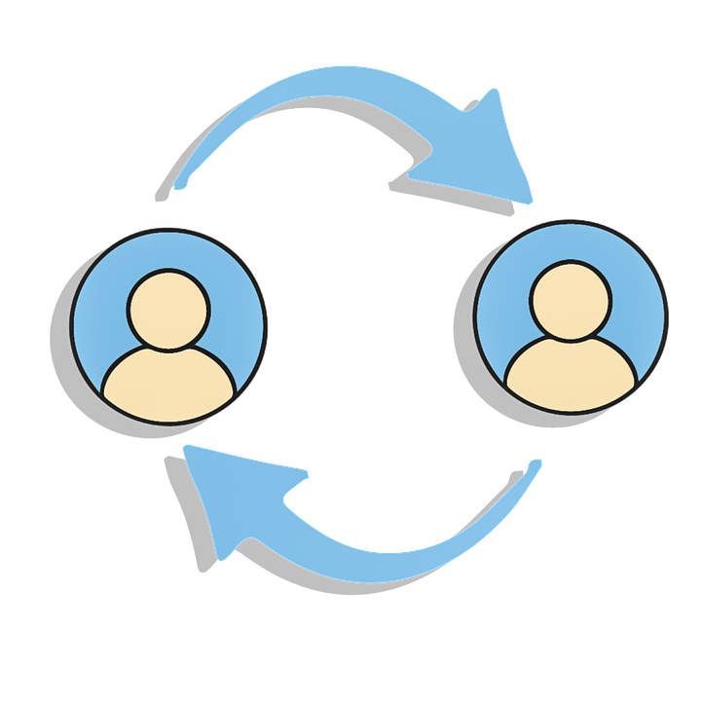
Personal Accomplishments
Self-fulfilling prophecy?

Slide 14
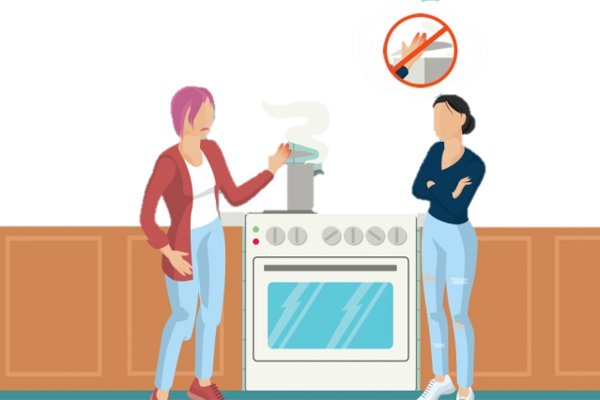
Vicarious Experiences
More similar to yourself.

Slide 16
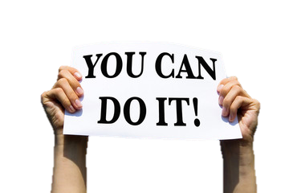
Verbal Persuasion
“I know you can do it!”

Slide 17
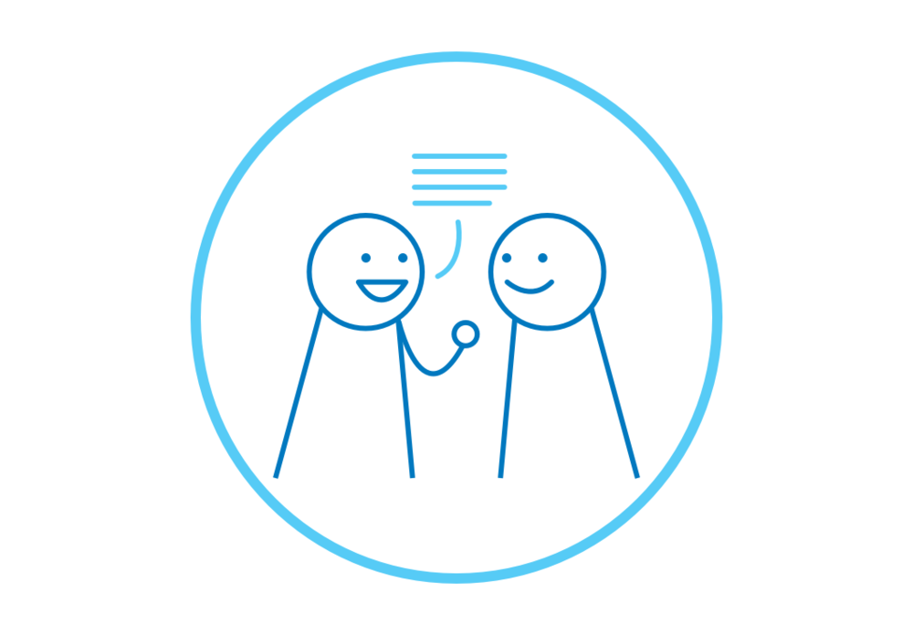
Verbal Persuasion
This usually occurs in the form of a “pep talk”

Slide 18
Verbal Persuasion
Credibility of persuader.

Slide 20
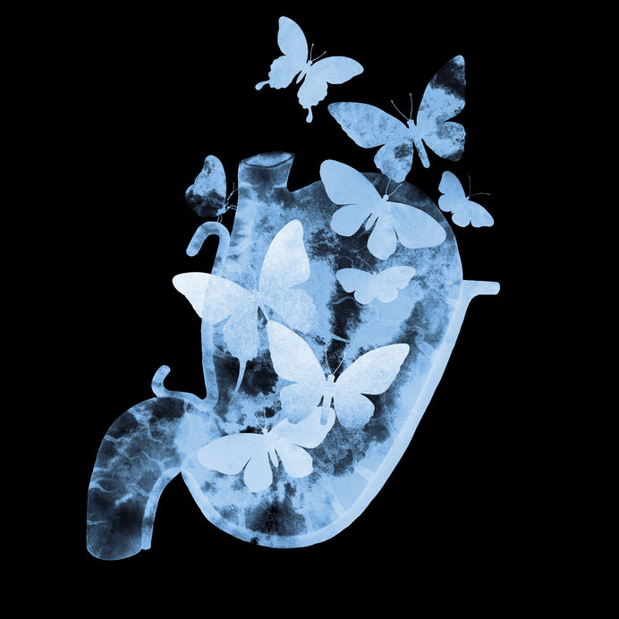
Physiological States
How someone feels.
How can you respond to arousal?

Slide 21
Physiological States
Butterflies in my stomach?

Slide 23
Self Efficacy influences…
Students aspirations, motivation and achievement.
Teacher self efficacy affects students.

Slide 24
Effects
… of high and low self efficacy

Slide 25
Self Efficacy predicts outcomes…
Motivation
Learning
Self-Regulation
Achievement

Slide 26
RISE and FALL
Strong
Self Efficacy
Weak
Self Efficacy
Recover quickly from disappointment
Interests are strong
Strong sense of commitment
Enjoy tasks
Failure inevitable
Avoid challenges
Lose confidence in abilities
Lack ability to complete tasks

Slide 27
High Self Efficacy
Pros
Cons
Leads to more positive outcomes
Highly motivated
Choose challenges
Disappointed if they can’t reach those expectations.
Over confident

Slide 28
Low Self Efficacy
Pros
Cons
Great sense of accomplishment
See improvement
Less willing to try new things
Avoid challenges
Rely on external factors

Slide 30
For Teachers
Applying self efficacy theory

Slide 31
1. Opportunity to feel success for work done.
Receiving praise for previous work, more likely to try hard on the next task.
Trust in the teacher providing material

Slide 32
2. Don’t praise them for things that are easy.
Praising effort vs praising ability
Likely to continue
What if it was easy for them?

Slide 33
3. Break challenges down into smaller steps.
Breaking tasks down into steps
Seeing accomplishments along the way

Slide 34
Try saying this instead:
I’m not good at this.
I’m awesome at this.
I give up
This is too hard
I can’t make this any better.
I just can’t do math.
I made a mistake
She’s so smart. I’ll never be that smart.
It’s good enough.
Plan A didn’t work.
What am I missing?
I’m on the right track.
I’ll use some of the strategies we’ve learned.
This may take some time and effort
I can always improve, so I’ll keep trying
I’m going to train my brain in math
Mistakes help me to learn better.
I’m going to figure out how she does it so I can try it!
Is it really my best work?
Good thing the alphabet has 25 more letters

Slide 35
Other Influencers
...on self efficacy

