Slide 1
Self Determination Theory
https://selfdeterminationtheory.org/

Slide 2
Self Determination Theory (SDT)
1890s – Classical Conditioning
1940s – Operant Conditioning
1970s – intrinsic vs extrinsic
1970s / 1980s – Self Efficacy
1980s – Self Determination Theory

Slide 3
Richard Ryan & Edward Deci

Slide 4
Three Psychological Needs
Competence
Relatedness
Autonomy

Slide 6
Competence
Seek to control the outcome and experience mastery
(Self efficacy)

Slide 7
Relatedness
Will to interact with, be connected to, and experience caring for others

Slide 8
Autonomy
Desire to be causal agents of one’s own life and act in harmony with one’s integrated self.

Slide 9
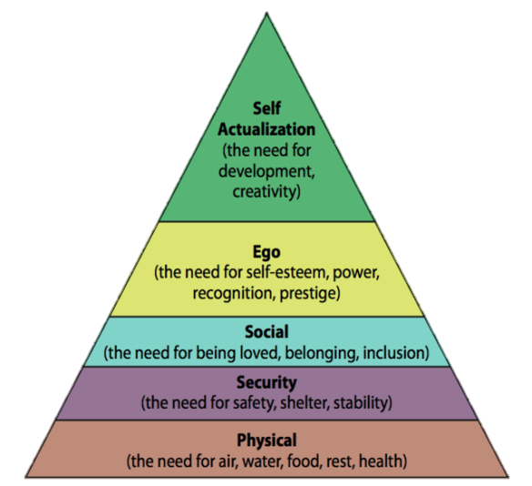
Three Psychological Needs
Competence
Relatedness
Autonomy

Slide 10
Applications
For SDT

Slide 11
Where do you think SDT has been applied?

Slide 12
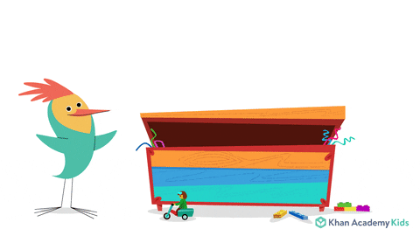
Education

Slide 13
Counseling & Psychotherapy

Slide 14
Goals

Slide 15
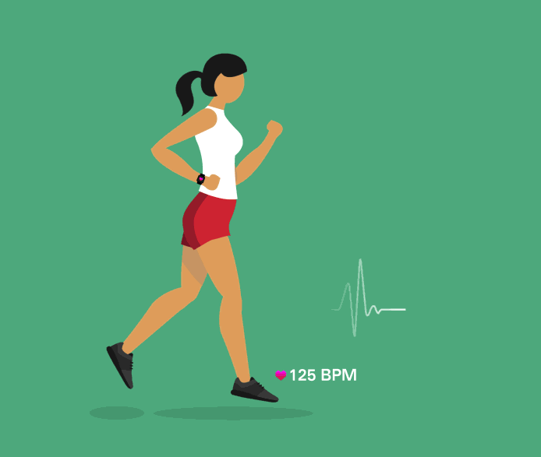
Health

Slide 16
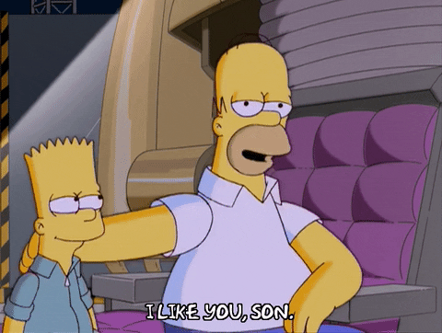
Parenting

Slide 17
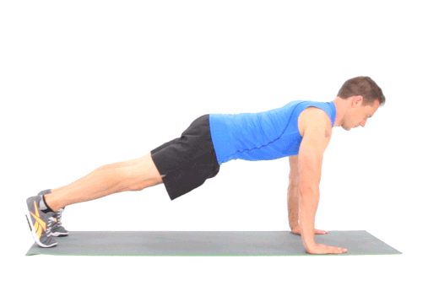
Physical Education

Slide 18
Psychopathology

Slide 19
Workplace

Slide 20
Relationships

Slide 21
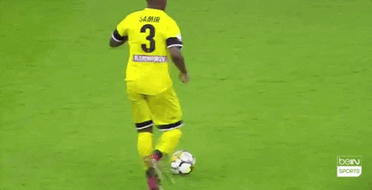
Sports and Exercise

Slide 22
Environment

Slide 23
Competence
Seek to control the outcome and experience mastery

Slide 24
Competence
When people feel that they have the necessary skills for success, they are more likely to take actions that will help them to achieve their goals

Slide 25
Competence
As someone gains mastery, they will seek similar and more challenging tasks.
https://www.youtube.com/watch?v=nMcdhCR9Ubw

Slide 26
Competence
How many hours to master something?
5,000 to 10,000 hours

Slide 27
Competence
In class, this can be up to 10 years of learning.

Slide 28
5 Levels of Proficiency
Elementary proficiency - The person is able to satisfy routine travel needs and minimum courtesy requirements.
Limited working proficiency - The person is able to satisfy routine social demands and limited work requirements.
Minimum professional proficiency - The person can speak the language with sufficient structural accuracy and vocabulary to participate effectively in most formal and informal conversations on practical, social, and professional topics.
Full professional proficiency - The person uses the language fluently and accurately on all levels normally pertinent to professional needs.
Native or bilingual proficiency -The person has speaking proficiency equivalent to that of an educated native speaker.

Slide 29
Competence
increases
Unexpected positive feedback ____________ motivation.
Feedback should include ________ they can get better.
Negative feedback _____________ intrinsic motivation.
It maybe difficult to notice changes in _____________ level.
Competition ______________ the feeling of competence.
how
decreases
competence
decreases

Slide 30
Competence
When an event (ie positive feedback) increases; perceived competence, interest and engagement ______________.
When an event (criticism) diminishes; perceived competence, interest and engagement ________________.
The need for ____________ fuels persistence, sustained effort and attention and the determination to improve.
increase
decrease
competence

Slide 31
Classroom
Choose appropriate materials (not too hard, not too easy)
Optimal challenges
Meta-cognitive activities (to track progress)
Reward high level students with additional responsibilities

Slide 32
Classroom Activities
Optimally challenging
Clear, understandable goals and objectives
Instructions provide useful tips to improve and succeed.
Guidance during the activity.
Feedback

Slide 33
Chess
Experiment

Slide 34
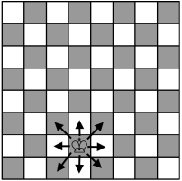
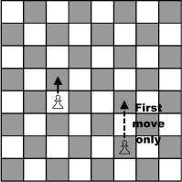
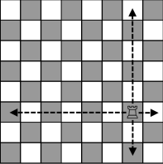
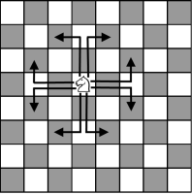
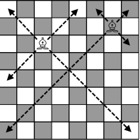
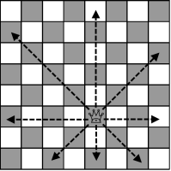
Chess
https://www.chesspuzzles.com/checkmate-worksheets

Slide 35
1 Move

Slide 36
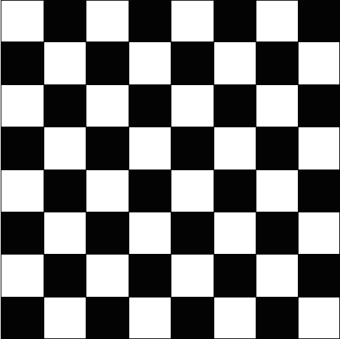
White

Slide 37
Black

Slide 38
White

Slide 39
White

Slide 40
2 Moves

Slide 41
White

Slide 42
Black

Slide 43
White

Slide 44
White

Slide 45
3 Moves

Slide 46
White

Slide 47
Black

Slide 48
White

Slide 49
White

Slide 50
Session I
Questionnaire – number of years playing chess, amount of enjoyment from playing
Experimenter left the room for 10 minutes – free time
In the room – chess-problems, magazines, coffee
Measured the time spent on chess problems
Experimenter returned offered one group a monetary reward
Only this session
Not in later sessions
The control group was not offered a monetary reward

Slide 51
Session II
Filler task
Experimenter left the room for 10 minutes
Reminded the group there is no monetary reward
Measured how long they worked on the chess problems

Slide 52
Results
After each session, they completed a questionnaire about how they feel about the task.
Both said it was interesting
Time spent on the task
Experimental drop had significant drop off
Control group not as large of a drop off

Slide 53
Memorizing Chess Boards
Pros vs Armatures
Quickly shown a board and asked to remember pieces
Take board away and have students replicate it

Slide 54
Memorizing Chess Boards
Professional did better (common arrangements)
Did just as poorly with random boards.

