Slide 1
Relatedness
Sense of Belonging

Slide 3
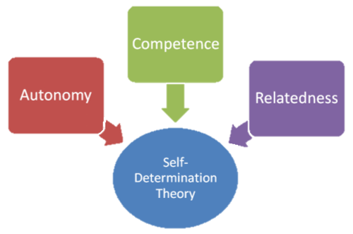
When all 3 needs are met,
autonomy is the strongest
BUT
If relatedness is missing, autonomy and
competence mean nothing

Slide 4
Increase Motivation
Decrease Motivation
Opinions are
Ignored
Acknowledge
Emotions
Teamwork
Warmth
“cold” interactions
Not involved
Empathy

Slide 5
Relatedness outcomes:
higher educational expectations
higher academic expectations
stronger motivation to learn
less absenteeism
greater social competence
fewer conduct problems
reduced drug use and delinquency
greater commitment to democratic values
more persistence on difficult tasks
more participation and engagement in class
higher levels of agency
more likely to act ethically and altruistically

Slide 6
How can we increase relatedness?
Teacher to Student

Slide 7
How can we increase relatedness?
Student to Student

Slide 8
How can we increase relatedness?
Student to Community

Slide 9
Collectivism

Slide 10
Communities change how we think.
“new normal”

Slide 11
The way we know we belong is through stories

Slide 12
Universal Story
The call to adventure
The refusal of the call
Meeting the mentor
Crossing the threshold
A road of trials (friends and tools)
Sacred battle
Atonement
Refusal of return
Return with the new knowledge

Slide 13
Collaboration

Slide 14
Project based activities

Slide 15
Lost at Sea

Slide 16
Group Timeline

Slide 17
Let’s plan a vacation!

Slide 18
Goal: To create an exciting itinerary
Work together
Use brochures
Make a presentation
Considerations:
Cost (hotel, activities)
Distance
Time
Enjoyment

