Slide 1
Finland

Slide 2
https://www.youtube.com/watch?v=oZkPgsGLnP4

Slide 3
PISA
Before 1970s – American style system
First PISA test (2000) – Overall top country
Second PISA test (2003) – Overall top country

Slide 4
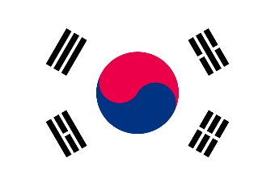
2018 PISA Results
2. Singapore
6. Canada
7. Finland
Reading
9. Korea
12. New Zealand
13. United States
14. United Kingdom
16. Australia

Slide 6
2018 PISA Results
2. Singapore
6. Korea
11. Canada
15. Finland
Mathematics
17. United Kingdom
26. New Zealand
28. Australia
36. United States

Slide 8
2018 PISA Results
2. Singapore
6. Finland
7. Korea
Science
8. Canada
12. New Zealand
14. United Kingdom
17. Australia
18. United States

Slide 10
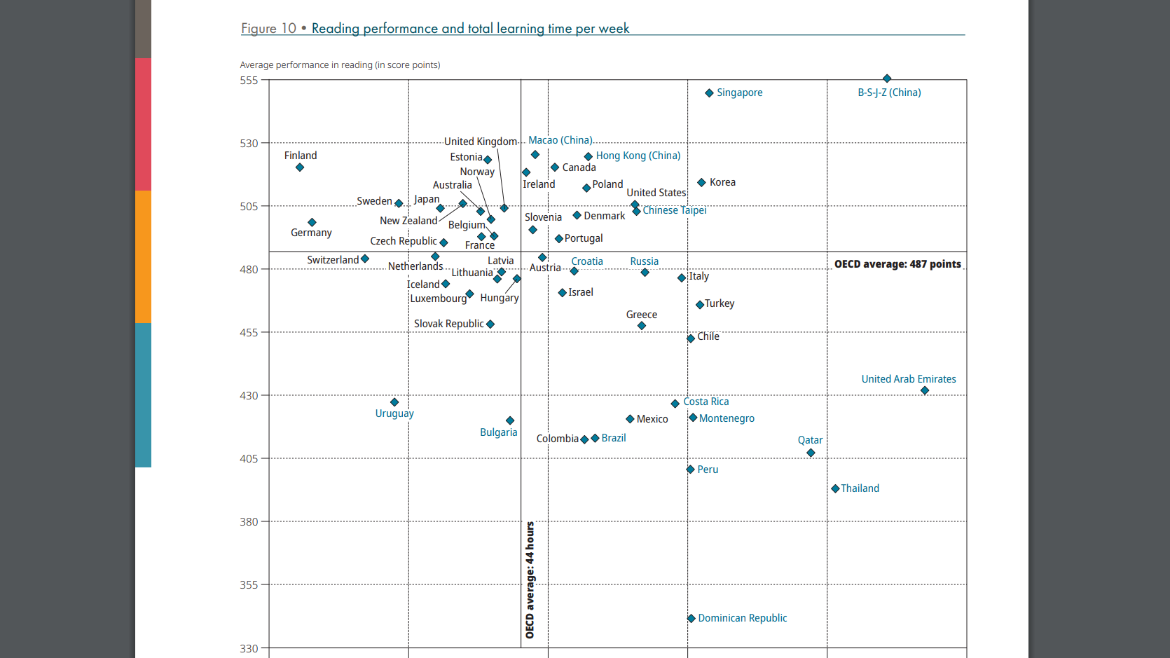

Slide 11
2019 Internations
4. Singapore
8. Finland
11. Canada
15. Australia
Quality of Life
16. New Zealand
37. Korea
44. United States
48. United Kingdom

Slide 12
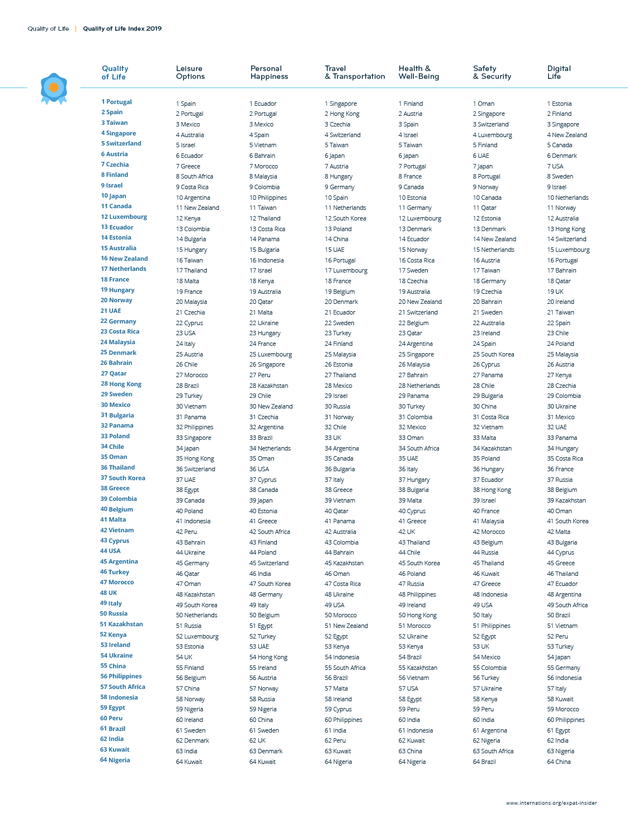

Slide 13
2013 Economist Intelligence Unit
2. Australia
6. Singapore
7. New Zealand
9. Canada
Quality of Life
11. Finland
16. United States
19. Korea
27. United Kingdom

Slide 14
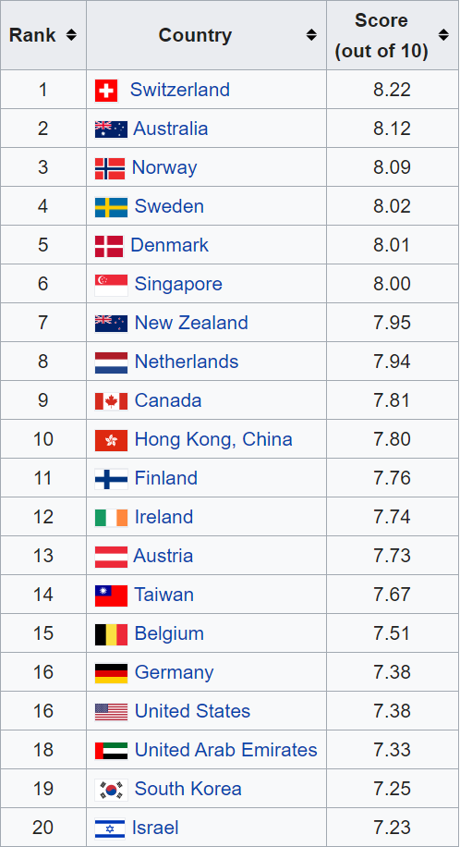
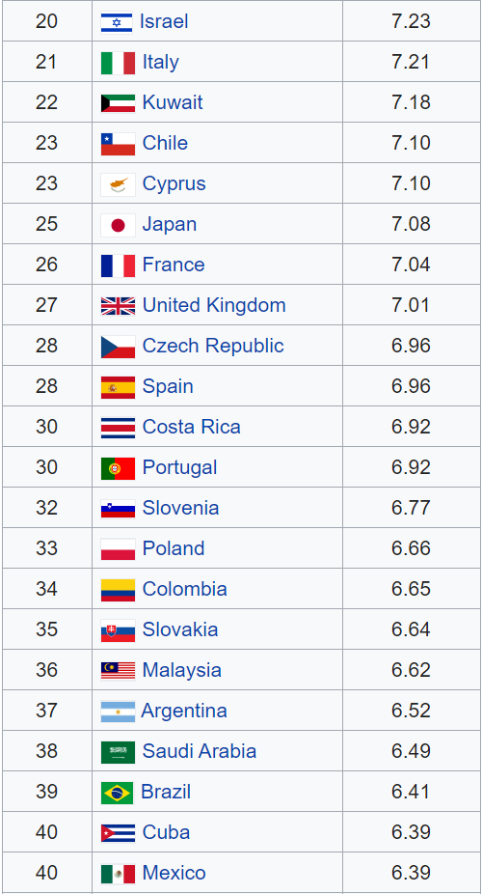

Slide 15
True / False
Finland’s Educational System

Slide 16
Finland’s Education System (True / False)
Students don’t start school until they are 7 years old.

Slide 17
Additionally, classes don’t start until 9:00 – 9:45 and classes finish 2:00 – 2:45.
Of these 5 hours, 75 minutes is break time.

Slide 18
Finland’s Education System (True / False)
Students are not required to do homework

Slide 19
Finnish student’s have far less homework than in Western countries, and often the homework is optional.

Slide 20
Finland’s Education System (True / False)
They are not evaluated until they are teenagers.

Slide 21
Results from tests are not released and participation is not mandatory.

Slide 22
Finland’s Education System (True / False)
Exams are voluntary.

Slide 23
There is only 1 standardized exam taken at the end of high school (National Matriculation Exam).
However, it is no longer required to enter university.

Slide 24
Finland’s Education System (True / False)
There is no competition between students or schools

Slide 25
Instead of focusing on competition, Finland focuses on cooperation.

Slide 26
Finland’s Education System (True / False)
Finland has one of the best educational systems.

Slide 27
World Top 20 (2019) ranks Finland 2nd only to Korea in best educational systems. But they note the difference in educational philosophy, by mentioning the high rates of depression and mental fatigue present in Korean students.

Slide 28
Finland’s Education System (True / False)
Finland tuition is one of the highest in the world for elementary school.

Slide 29
The educational system is publically funded.
There is no tuition.

Slide 30
Finland’s Education System (True / False)
The lack of standardization has lead to a large disparity between schools in educational outcomes.

Slide 31
Finland has one of the lowest disparities between schools according to 2018 PISA results.

Slide 32
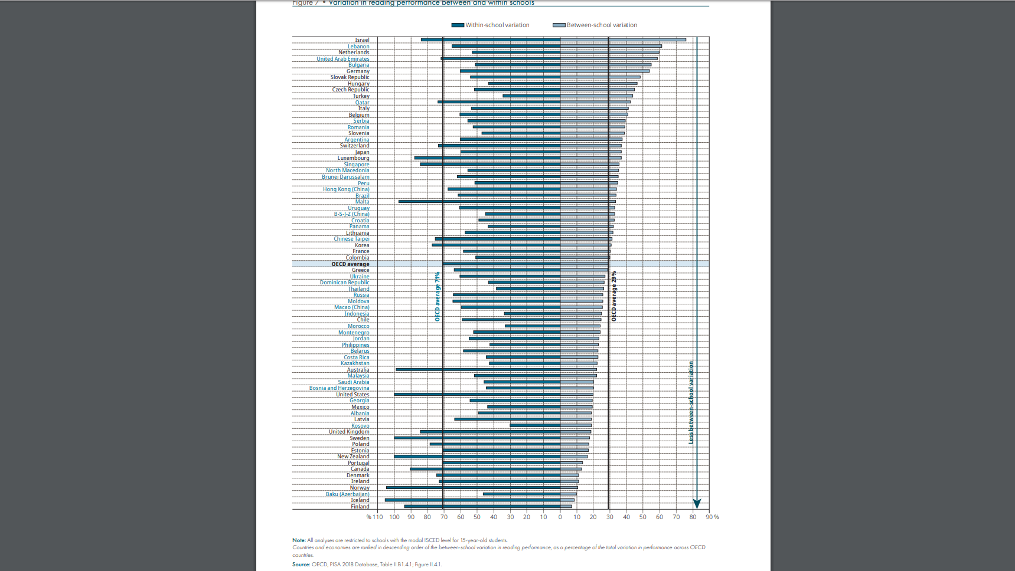

Slide 33
Finland’s Education System (True / False)
Finnish teachers are not held accountable

Slide 34
“There’s no word for accountability in Finnish… Accountability is something that is left when responsibility has been subtracted.”
- Pasi Sahlberg

Slide 35
Finland’s Education System (True / False)
Students can have the same teacher for up to 6 years.

Slide 36
Teachers take on the role of a mentor.
It builds trust and bonding.
See progress on individual level.
There is no passing along to the next teacher.

Slide 37
Since the 1980s, Finnish educators have focused on making these basics a priority:
Education should be an instrument to balance out social inequality.
All students receive free school meals.
Ease of access to health care
Psychological counseling
Individual guidance

Slide 39
Phenomenon-Based Education
Current events
Inter-disciplinary
4 Cs (collaboration, communication, creativity, and critical thinking)

Slide 40
https://www.youtube.com/watch?v=4ipk3dWsrXE

Slide 41
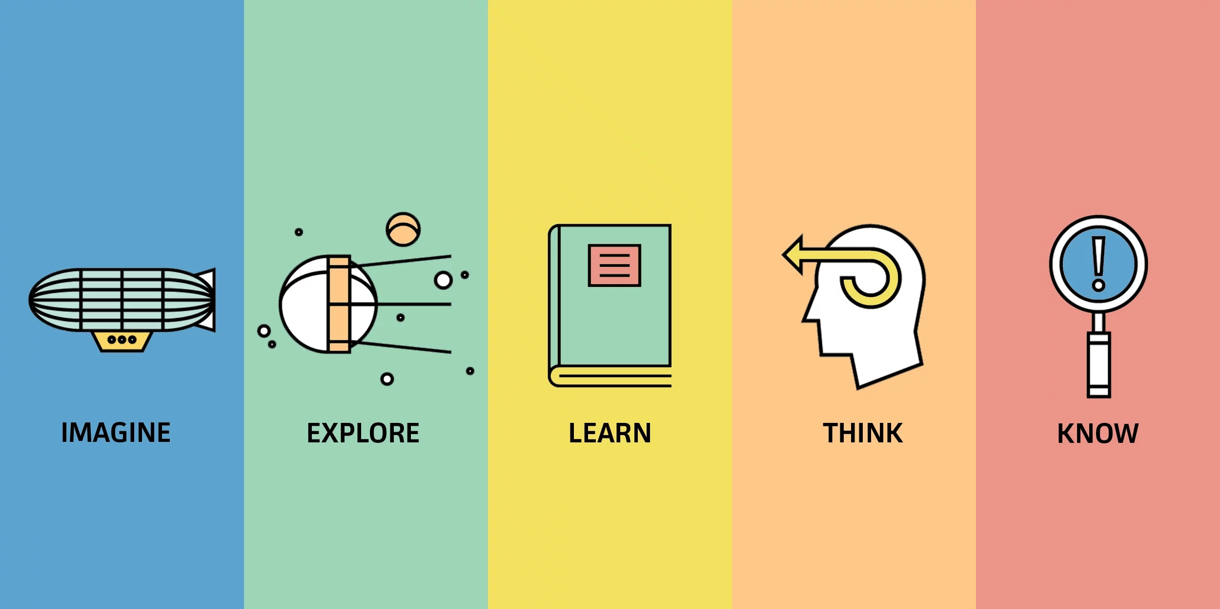

Slide 42
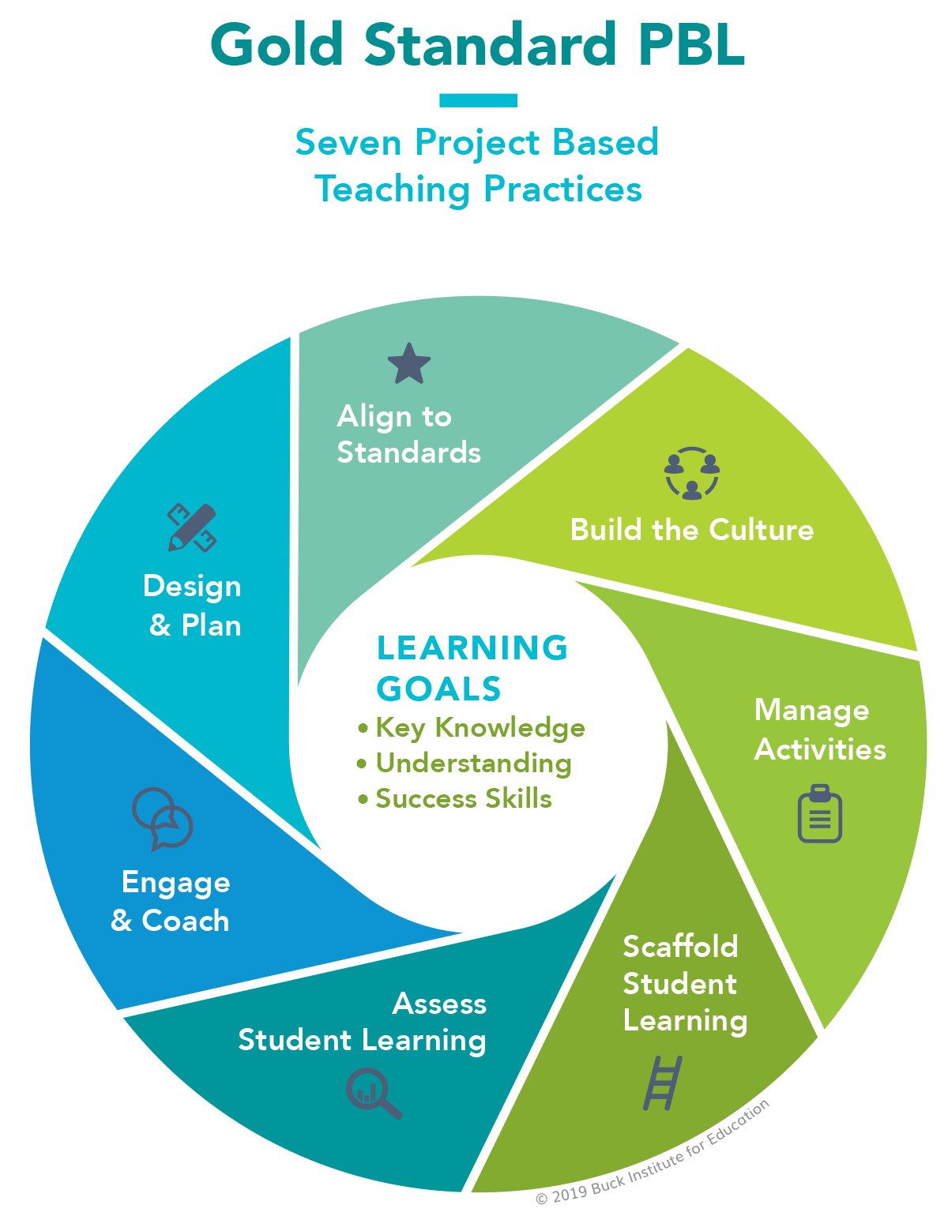
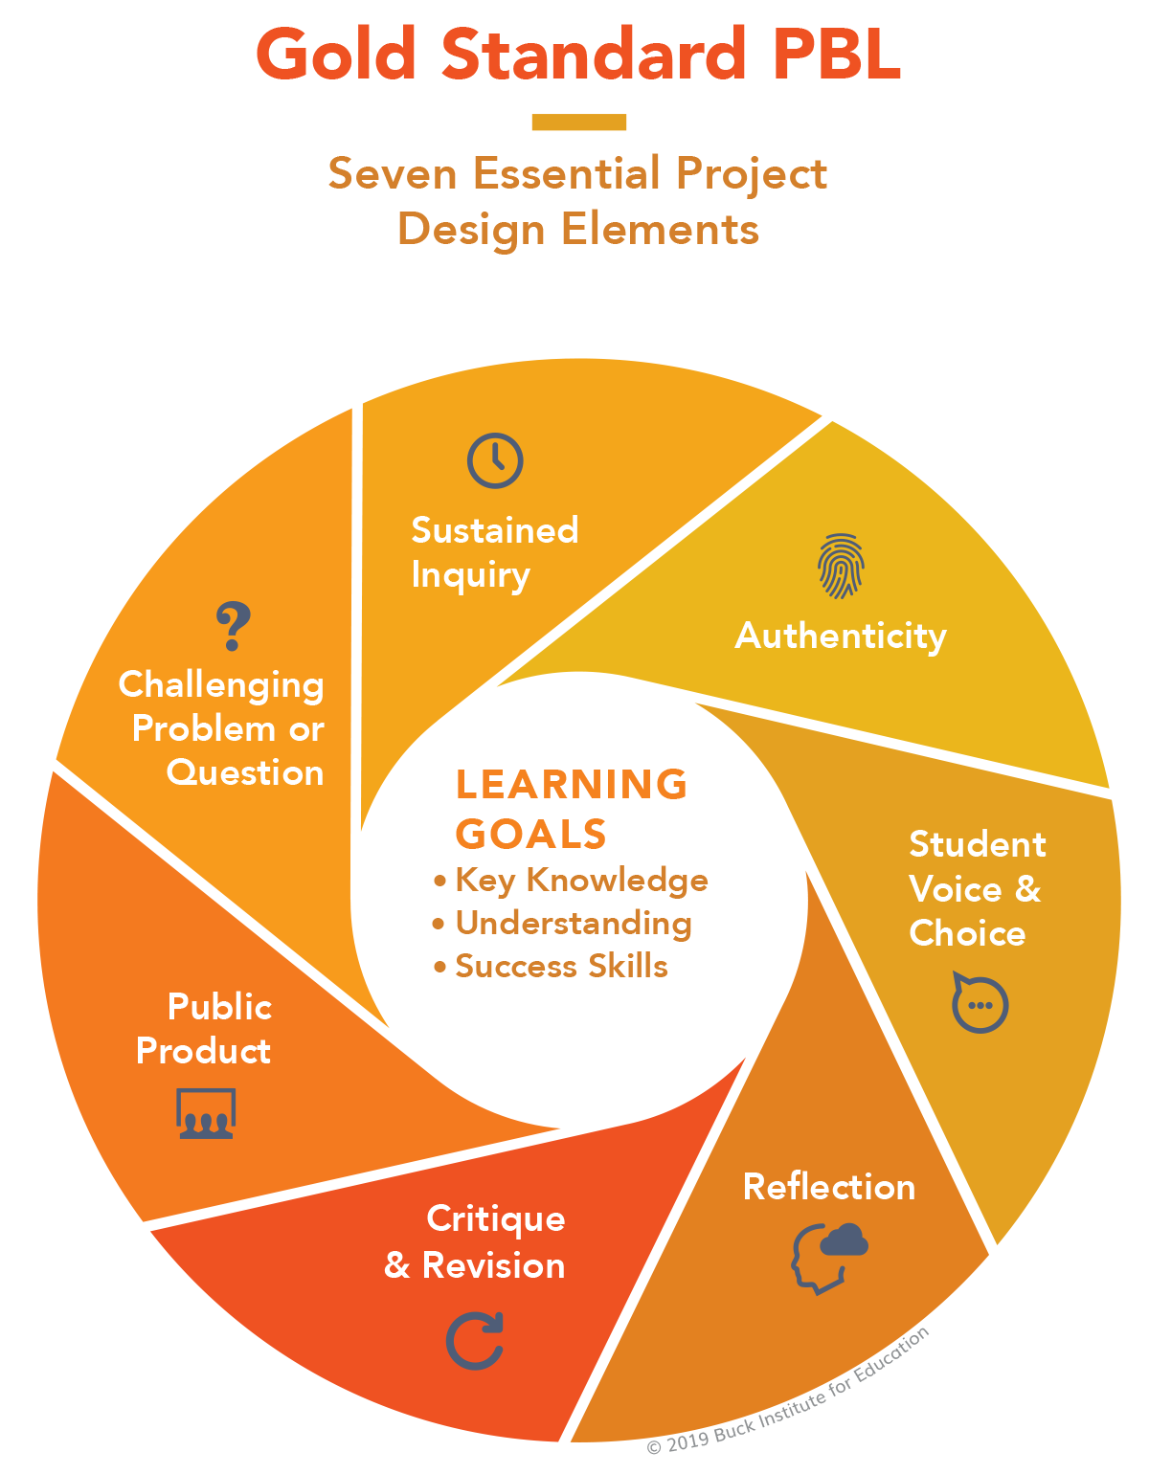

Slide 43
