Slide 1
Music Model
http://www.isetl.org/ijtlhe/pdf/IJTLHE774.pdf

Slide 2
M
U
S
I
C
e powerment
sefulness
uccess
nterest
aring

Slide 3
The music model was developed in 2009 by Dr. Brett D. Jones
It is meant for educators and focusses on educational motivation

Slide 4
eMpowerment
Students feel empowered by having the ability to make decisions about some aspects of their learning
Autonomy

Slide 5
Do students believe that they have control over some aspect of their learning?
Provide students with meaningful choices as to the topics they can study, materials they can use, strategies they can implement, or who they can work with.

Slide 6
Do students believe that the teacher empowers them and does not try to manipulate their behavior?
Provide rationales for rules and directions
Instead of saying “No!”, explain why.
Let students help to create the classroom policies

Slide 7
Usefulness
Students understand why what they are learning is useful for their short or long term goals.

Slide 8
Do students understand why what they are learning is useful to their interests, to their career goals, and/or in the “real world”?
Explicitly explain how it is related
Activities that demonstrate the usefulness of the content
Opportunities to see the material used in the real world

Slide 9
Success
Students believe that they can succeed if they put forth the effort required.
Competence

Slide 10
Do students understand the instructor’s expectations of them?
Makes expectations clear and explicit
Clear and understandable instructions.

Slide 11
Do students find the learning activities challenging in that they are not too hard or easy?
Learning activities that challenge students.
Divide longer or more complex learning activities into manageable sizes

Slide 12
Do students receive regular feedback about their level of competence?
Throughout the course, not just at the end.
Use of technology
Students to set their own specific, attainable short-term goals

Slide 13
Do students believe that they can succeed if they put forth the effort?
Allow students to re-do assignments
Provide help (study tips)
Accurate and honest feedback
Specific suggestions on how to improve
High, but reasonable expectations
Variety of assignments

Slide 14
Interest
Students are interested in the content and instructional activities
Interest Theory

Slide 15
Do students demonstrate a situational interest in the course activities/
Include one or more elements (novelty, food, social interaction, games, puzzles, fantasy, humor, narrative, physical activities, hands on activities)
Content related to student’s backgrounds
Emotional component
Presentation style
Information is surprising or inconsistent with previous knowledge.

Slide 16
Do students demonstrate an individual interest in the course content?
Teacher showing interest
Provide time for students to ask questions.

Slide 17
Caring
Students believe that the instructor and others in the learning environment care about their learning and about them as a person
Relatedness

Slide 18
Do students believe that the instructor cares about whether they achieve the course objectives?
Show concern for success and failures
Listen and value students’ opinions and ideas
Helping students

Slide 19
Do students believe that the instructor cares about their well-being?
Reasonable accommodations
Concern and interest in students’ lives

Slide 20
Do students have opportunities for positive interactions with one another?
Cooperative and collaborative learning
Content allows students to get to know each other on a personal level

Slide 21
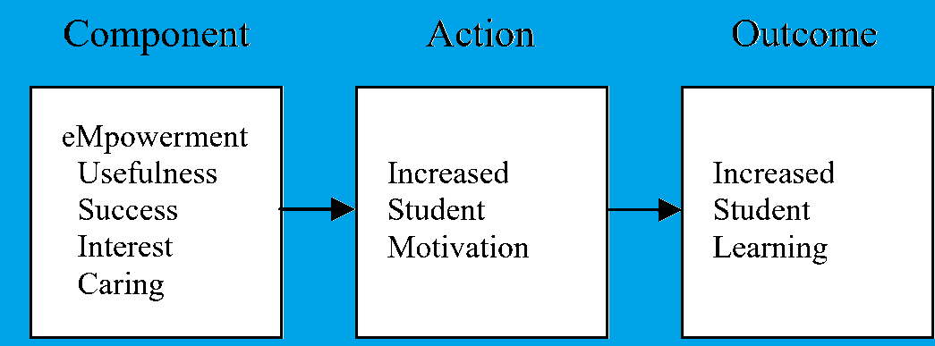

Slide 25
www.themusicmodel.com

