Slide 1
Mouth Shape

Slide 3
TEAM OATH
HE
Name
TIMOTHY

Slide 4
MAY PULL
SIR UP
Canadian Food
MAPLE SYRUP

Slide 5
DEW WINO HUE
Question
DO I KNOW YOU?

Slide 6
PEE NUT
BUTT HER
Bread’s friend.
PEANUT BUTTER

Slide 7
NOOSE PAY
PERRY PORT
Something
you read
NEWSPAPER REPORT

Slide 8
ED’S OAK OLD
Weather
IT’S SO COLD

Slide 9
OH RAN JEWS
Drink
ORANGE JUICE

Slide 10
MY CROW FUN
Audio
Equipment
MICROPHONE

Slide 11
AW ENTER JA CAT
Clothes
A WINTER JACKET

Slide 12
ALL WAITS BEEN EYES
A good rule.
ALWAYS BE NICE

Slide 13
LESS TART
Imperative
LET’S START

Slide 14
Mouth Shape

Slide 15
https://pronunciationstudio.com/korean-speakers-english-pronunciation-errors/

Slide 16
/iː/ and /ɪ/
Please sit on the seat next to the sheep on the ship.

Slide 17
Central Vowels
Burt’s words hurt worse than Shirley’s.

Slide 18
Extra Vowels
My sandwich. Look, a book!

Slide 19
/l/ and /r/ confusion
Rory rarely rushed round very thoroughly.

Slide 20
‘th’
Thankfully the three brothers theorise amongst themselves.

Slide 21
Pronunciation of /v/ and /f/
A very nice festival

Slide 22
Pronunciation of /w/
Would you buy me some wood and some wool?

Slide 23
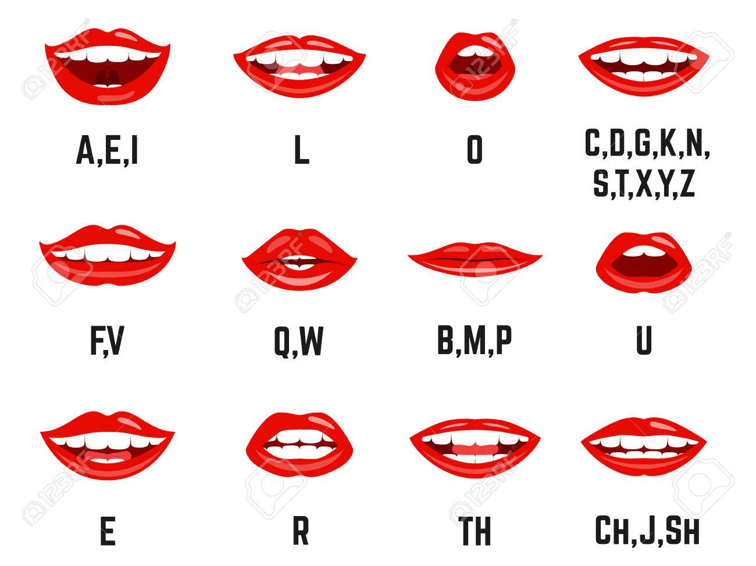
Mouth Shape

Slide 24
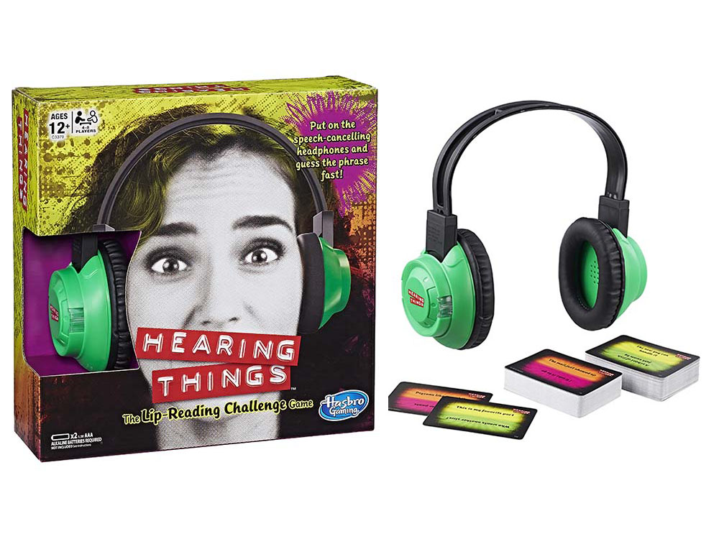

Slide 25
ar
b
d
e
ee
er
f
g
h
i
k

Slide 26
l
m
n
ng,nk
o
oo
oo
or
p
r
s,x
sh,ch

Slide 27
t
th
th
u
v
w,wh,qu
y
z
zh,j

