Slide 1
https://www.youtube.com/watch?v=ymwSbxUDtTw

Slide 5
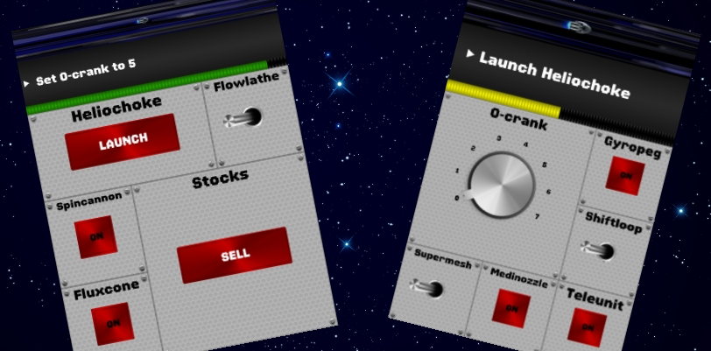

Slide 6
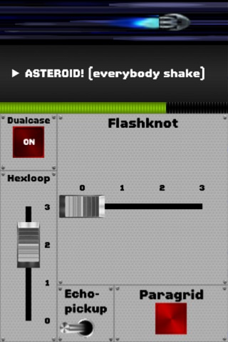

Slide 7
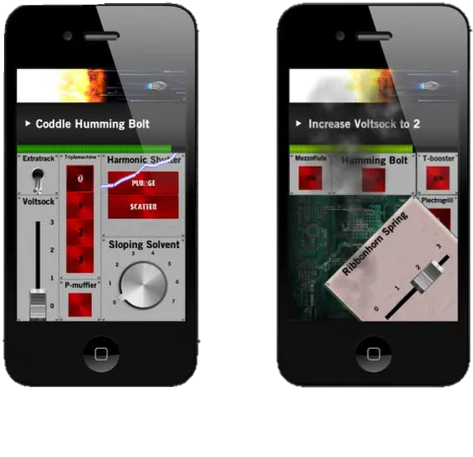

Slide 10
Notes:
ID: findbgj Pw: Shim1975

Slide 11
www.quizlet.live
Notes:
ID: findbgj Pw: Shim1975

Slide 12
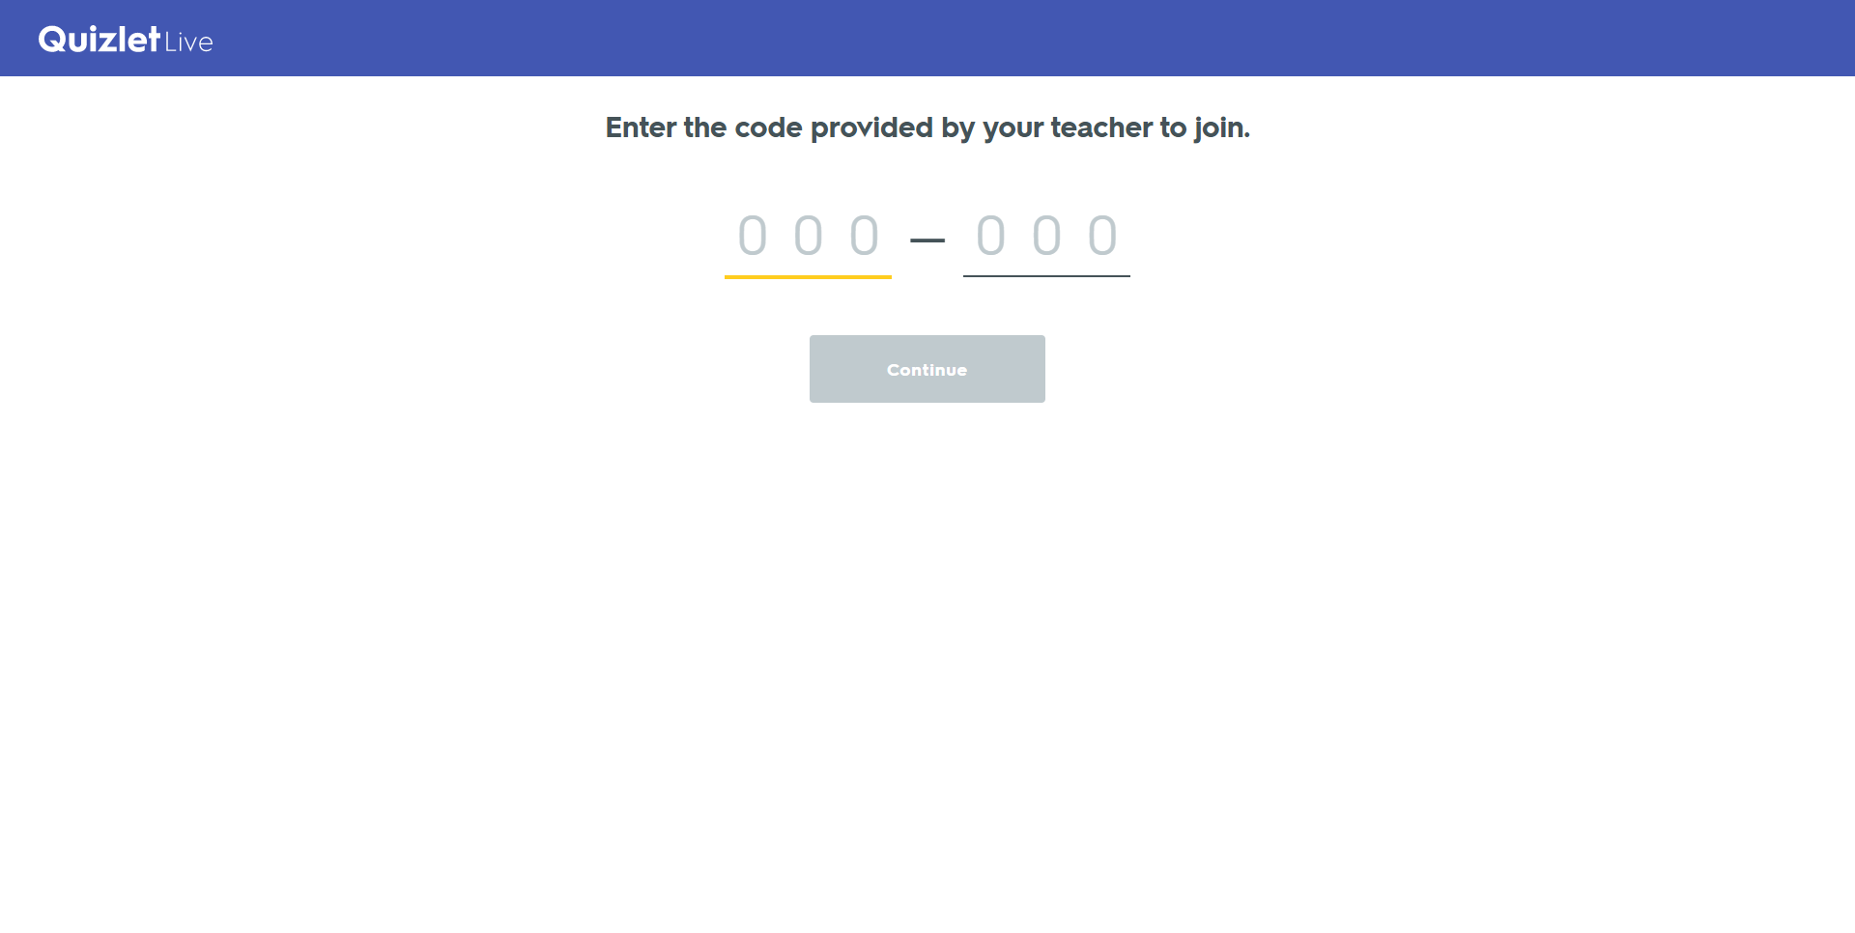
Notes:
ID: findbgj Pw: Shim1975

Slide 14
https://www.youtube.com/watch?v=cDIQhJH2ahY

Slide 15
How to Play
Choose a starting a ending word that are not related.
Using only the links in the Wikipedia article, can you get to the ending word?
Don’t use “references” or “see also”

