Slide 1
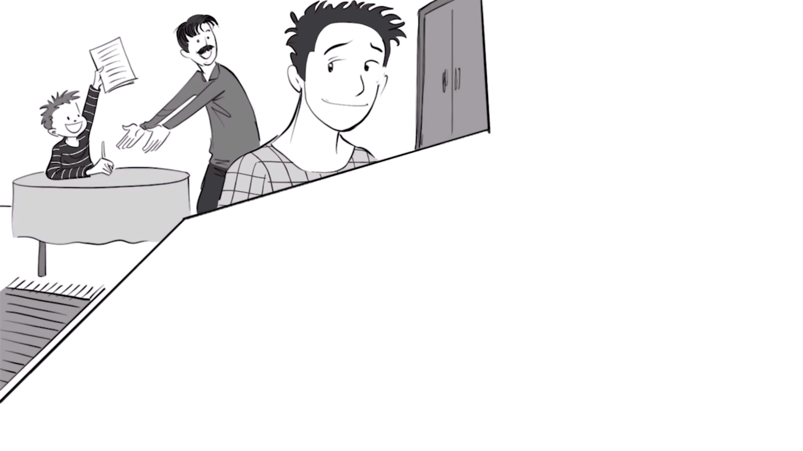
A Story About Intelligence

Slide 2
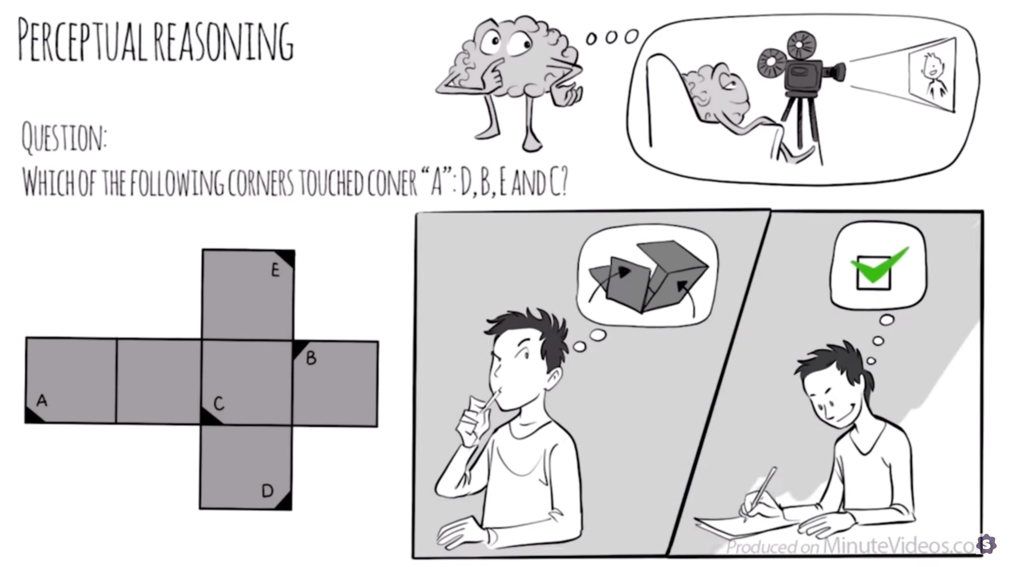

Slide 3
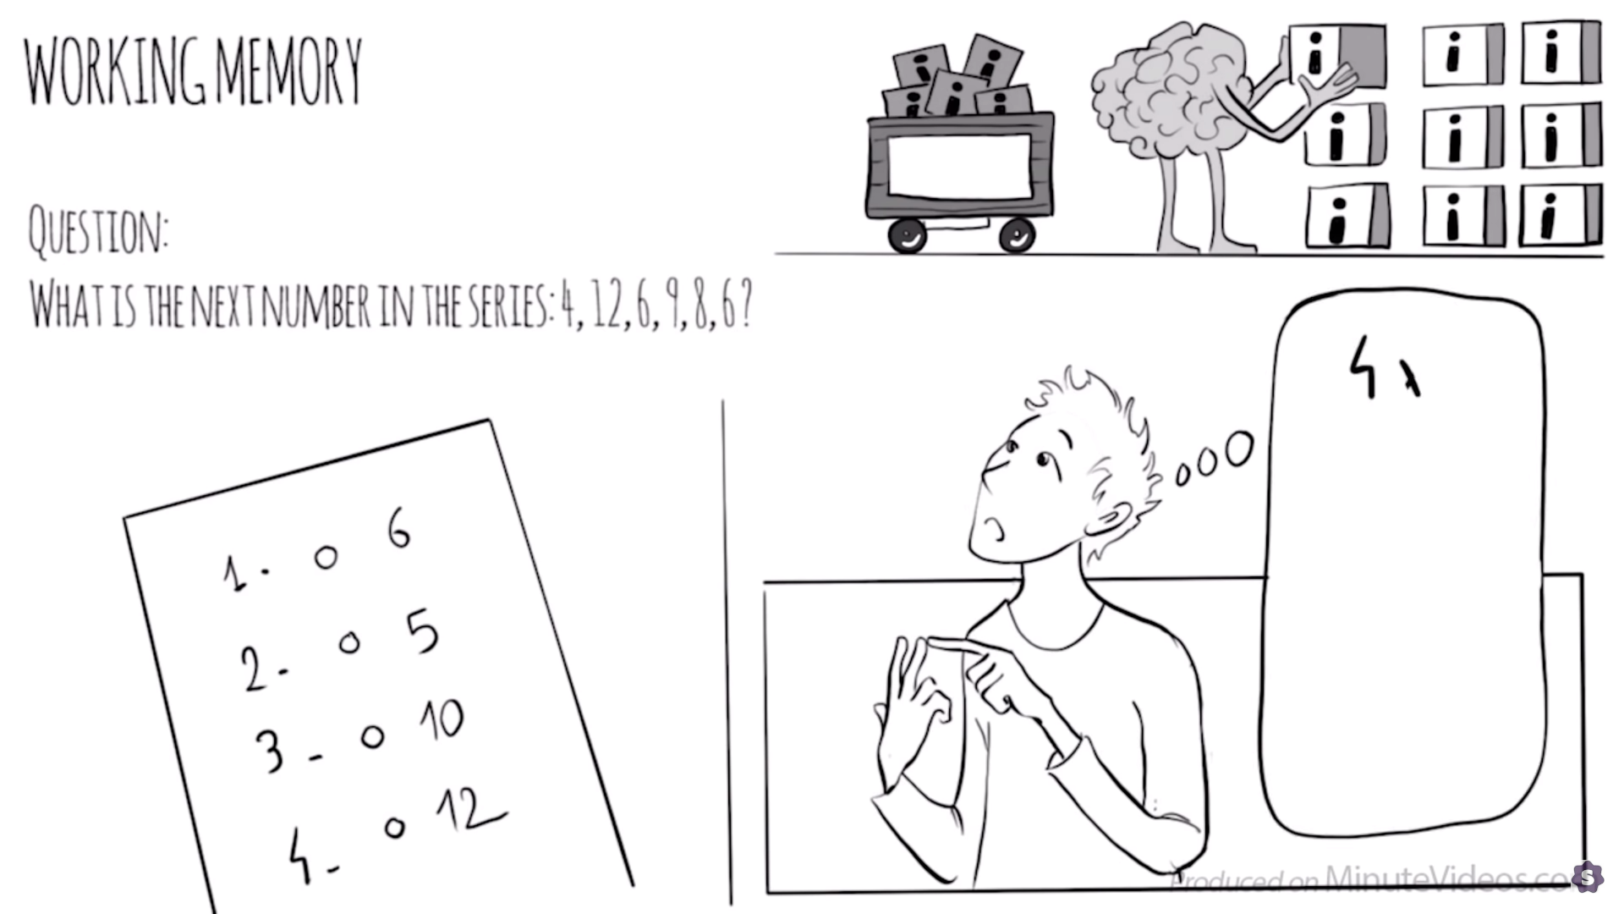

Slide 4
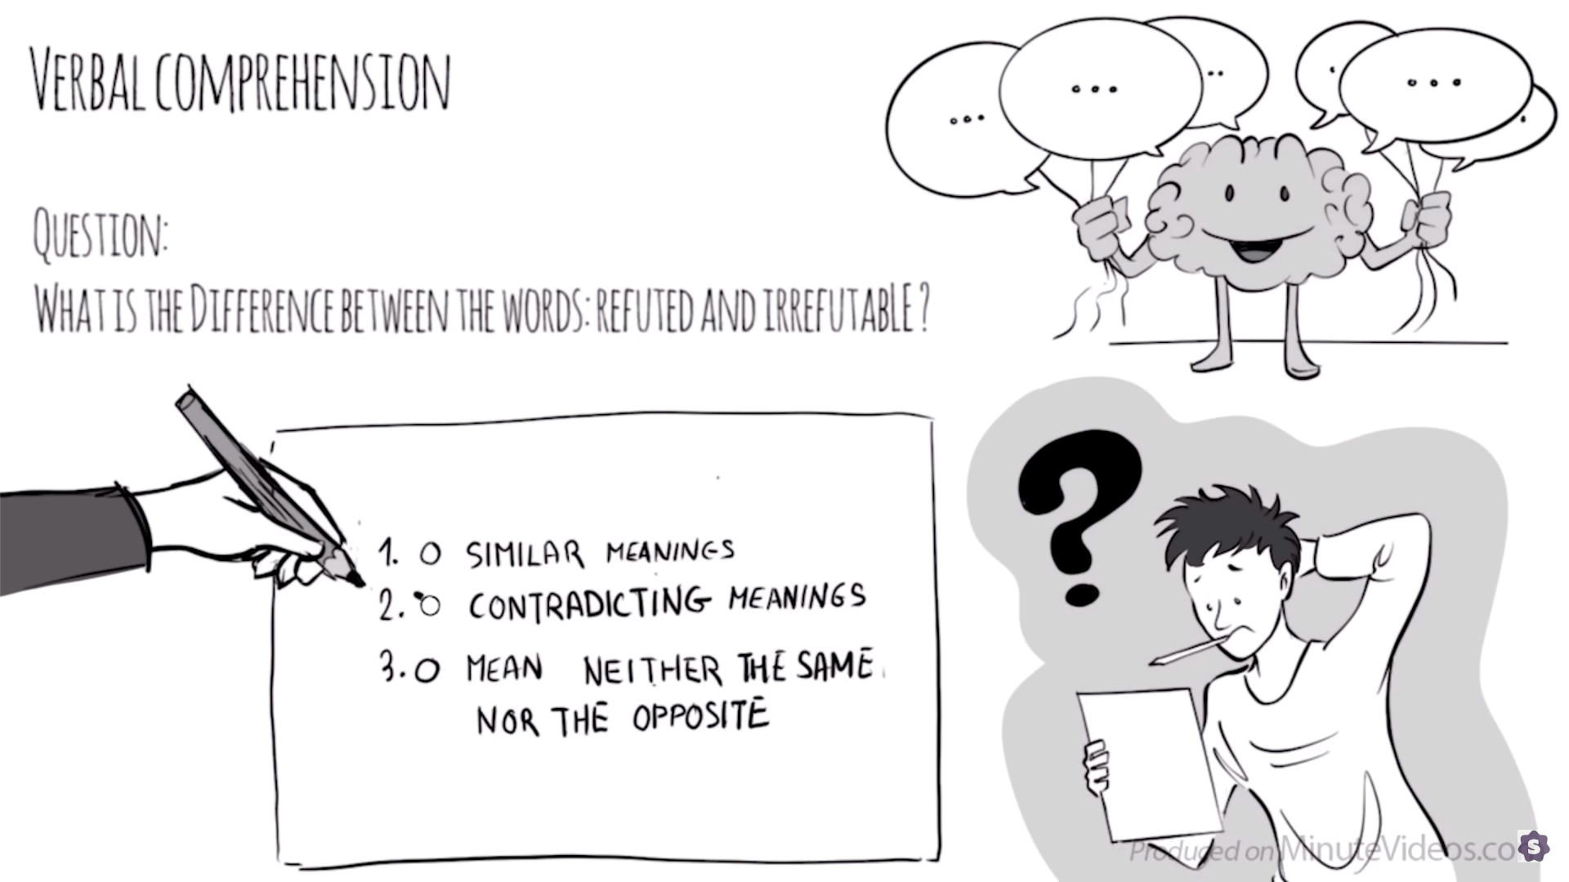

Slide 5
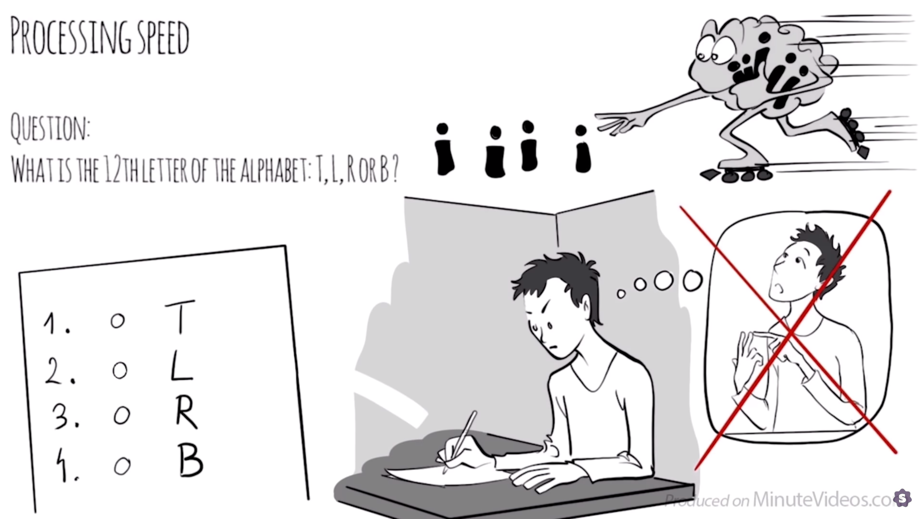

Slide 6
What is the story about?
Discuss the plot with your team.

Slide 7
A Story About Intelligence
https://www.youtube.com/watch?v=17T3fZIpT8I

Slide 8
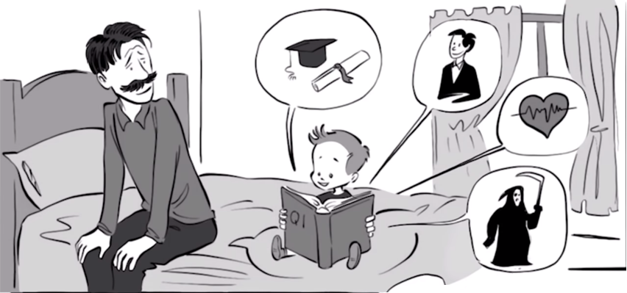
Who does the father like best?
Younger brother

Slide 9
What does IQ predict?
Good grades, a good career, health, mortality

Slide 10
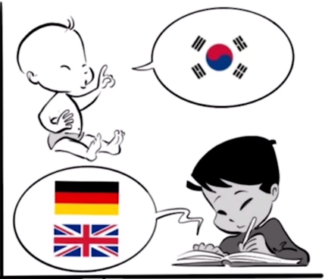
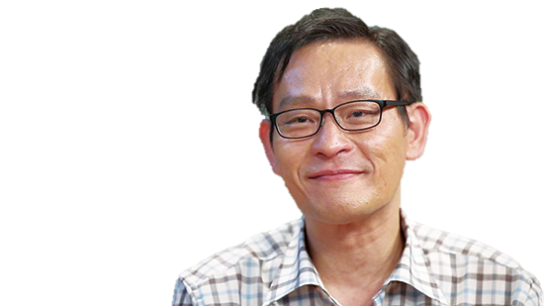
Who is Kim Ung-Yong (김웅용)?
210 IQ

Slide 11
In 2010, Kim criticized the idea that he is a "failed genius" and additionally said,
"Some think people with a high IQ can be omnipotent, but that's not true. Look at me, I don't have musical talent, nor am I excelling in sports. [...] Society should not judge anyone with unilateral standards – everyone has different learning levels, hopes, talents, and dreams and we should respect that."

Slide 12
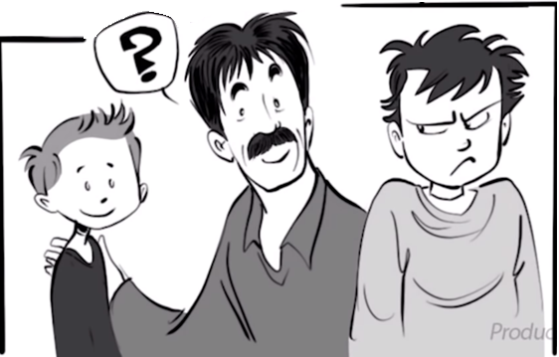
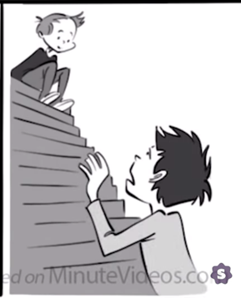
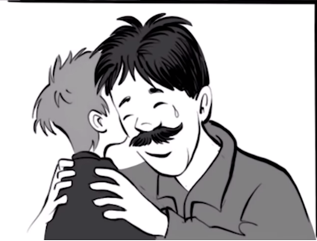
What was the central conflict of the story?
Jealousy

Slide 13
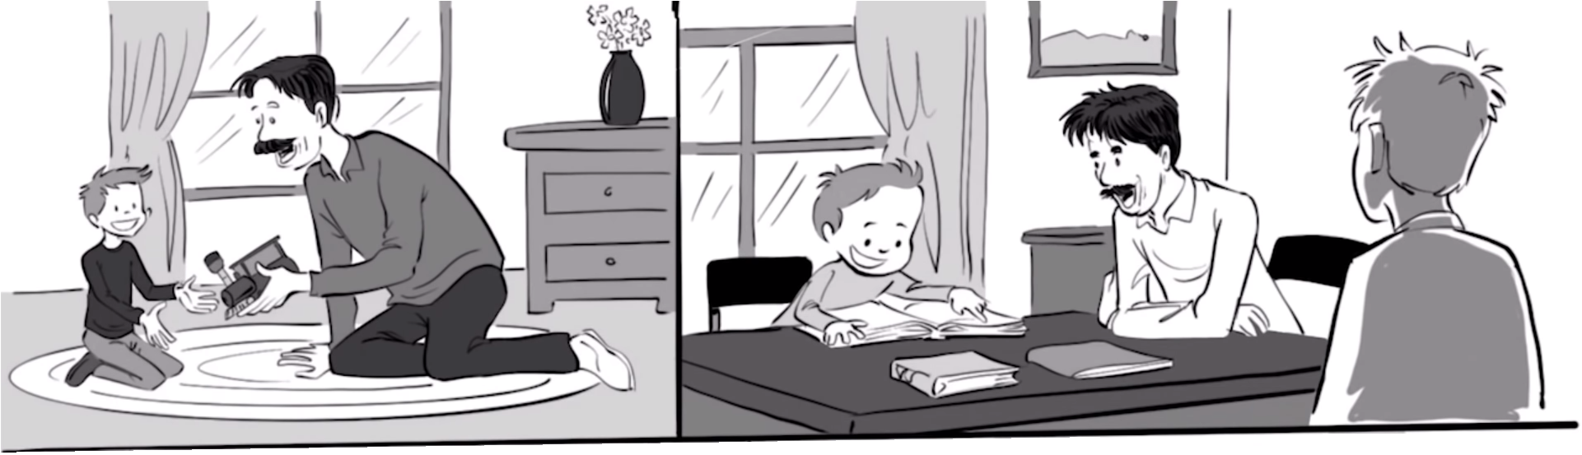
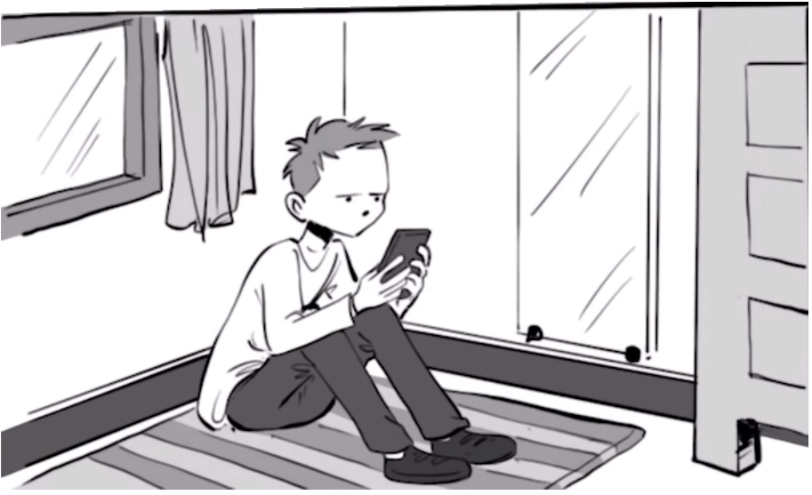
Describe his relationship to his father
Started great, now it’s not.

Slide 14
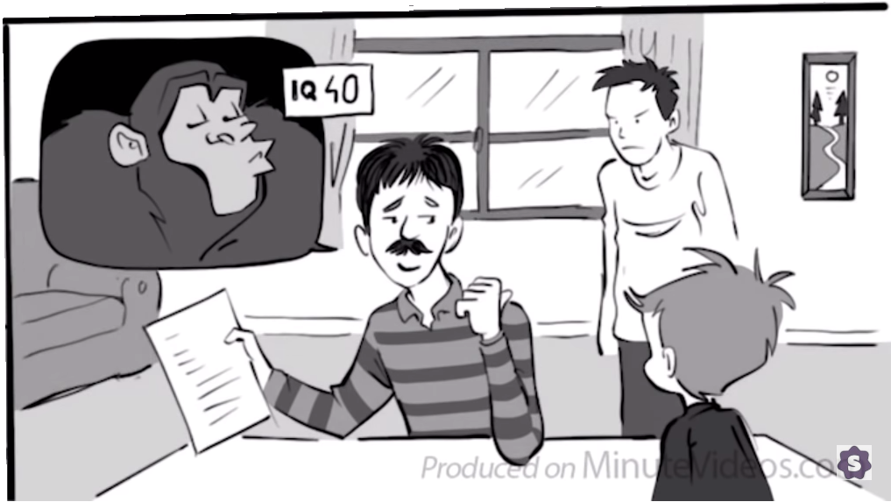
What happened when he brought home a bad grade?
Sarcasm

Slide 15
How did that affect his confidence?
Low self-confidence

Slide 16
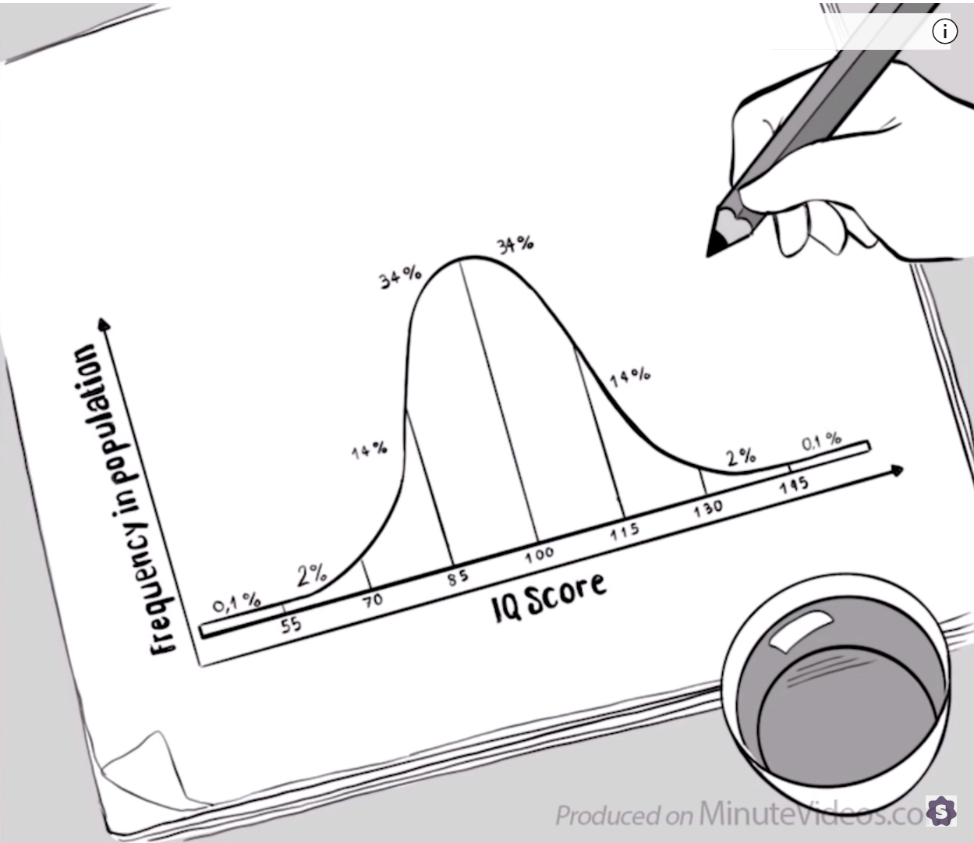
Explain this graph:

Slide 17

The Wechsler IQ score
Standard Deviation = 10

Slide 18
Other IQ scores
Standard Deviation = 15

Slide 19
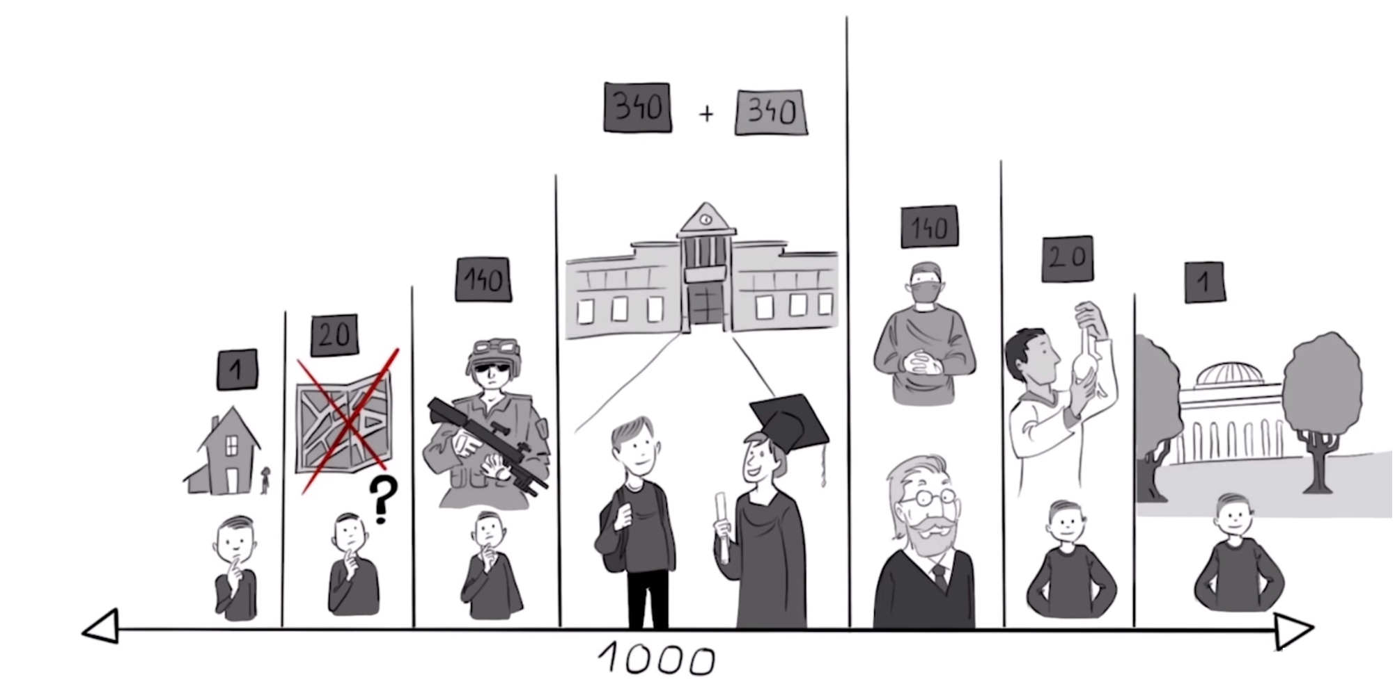
Out of a town of 1,000:
Can’t be a soldier
High School and College
Significant scientific work
PhD
Ivy League College
Difficulty reading a map
Mental Retardation*
- trouble living alone

Slide 20
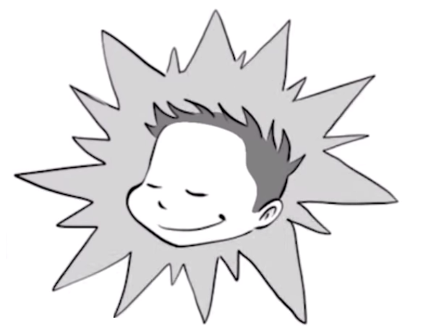
Where is his brother?

Slide 21
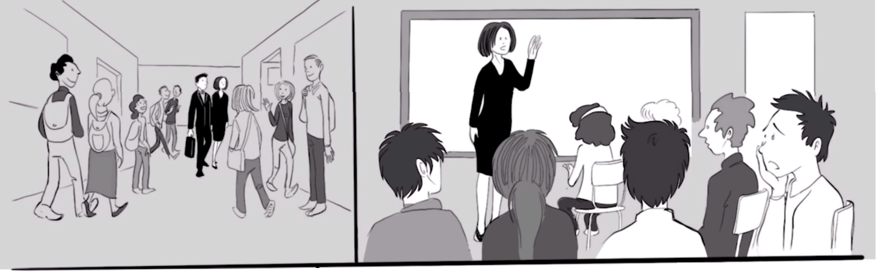
Who is she?
Cognitive assessment (Wechsler IQ Score)

Slide 22
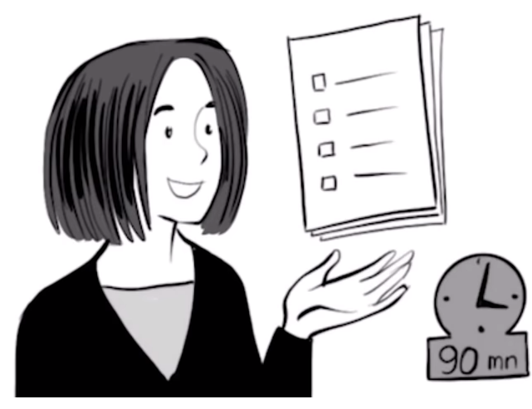
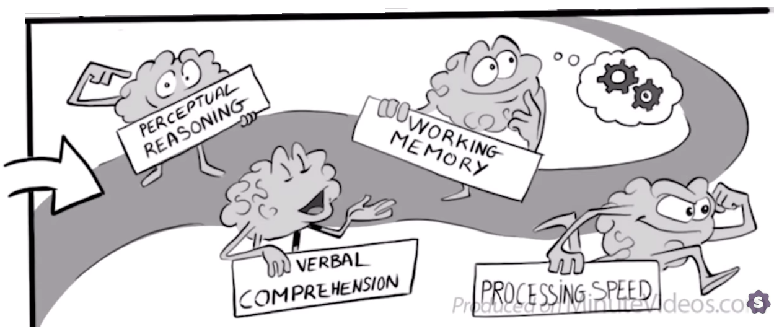
What does it test?

Slide 23
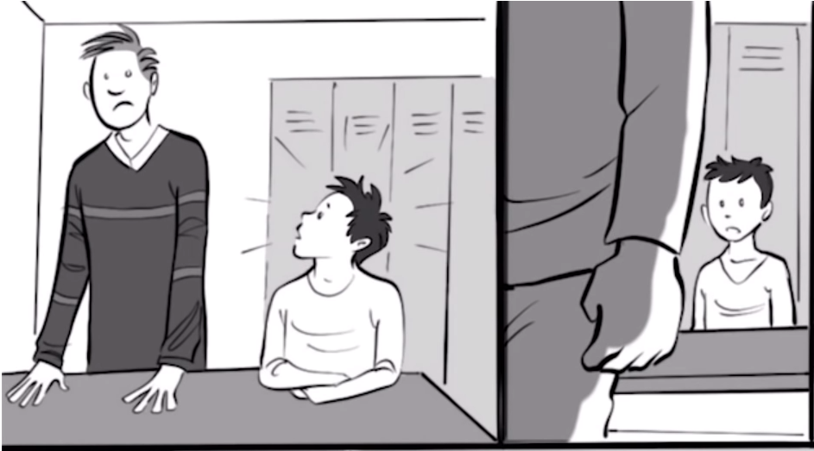
Mandatory or Voluntary?
Voluntary

Slide 24
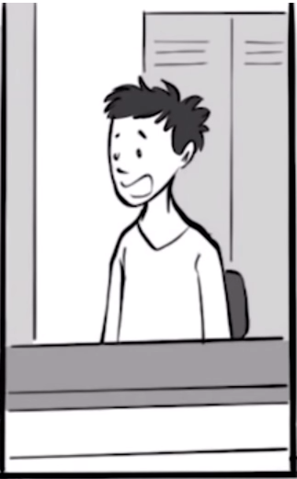
Did he stay?
Yes.

Slide 25
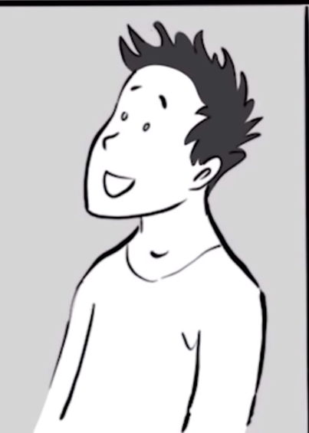
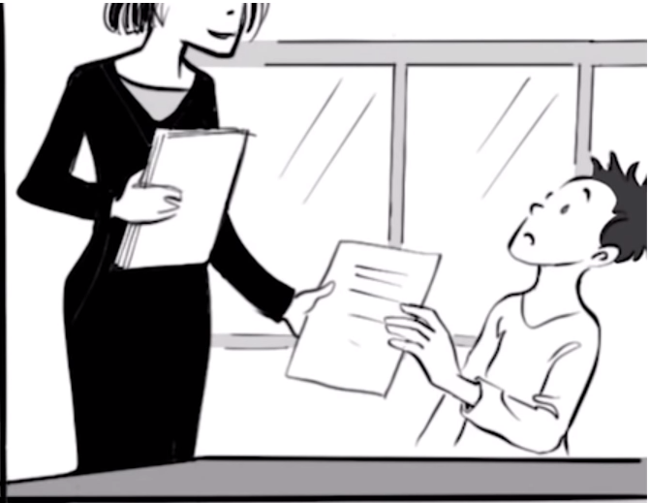
What gave him confidence?
“You’ll do fine here.” - Teacher

Slide 26
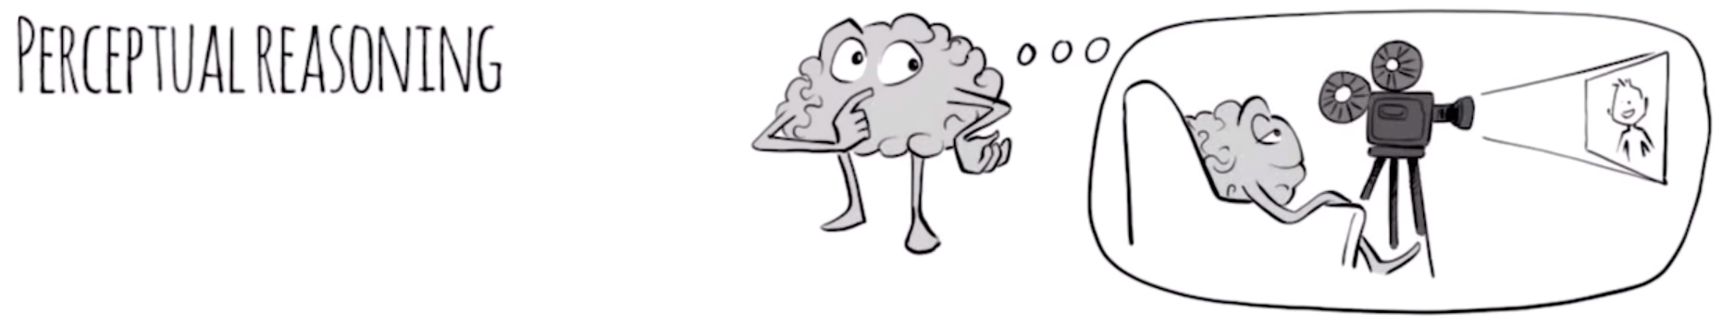
It is the ability to think and reason with visual information. It is the ability to see what is being asked and to organize information in our heads through images.

Slide 28
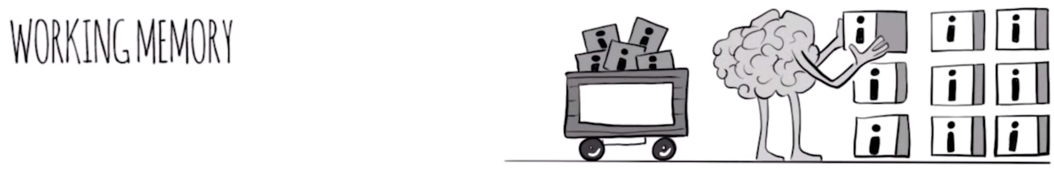
Our ability to keep several chunks of information in our mind simultaneously.

Slide 30
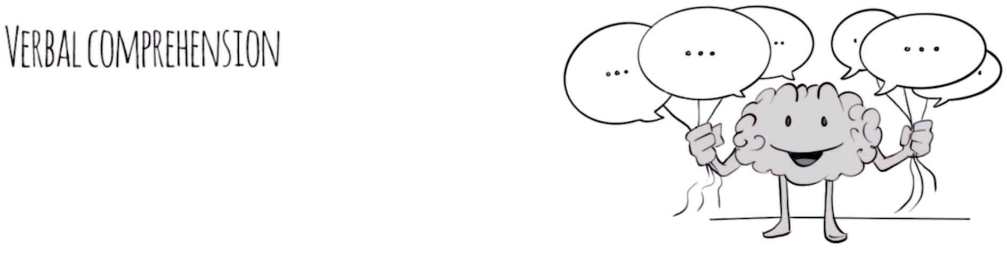
Measures our ability to access vocabulary, express ourselves in a meaningful manner, and apply reasoning skills to information presented verbally.

Slide 32
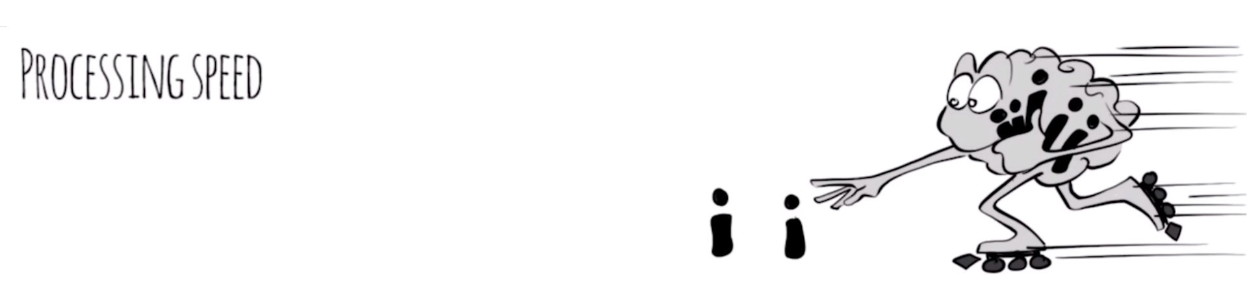
The pace at which we take in new information and make sense of it in order to make a response.

Slide 34
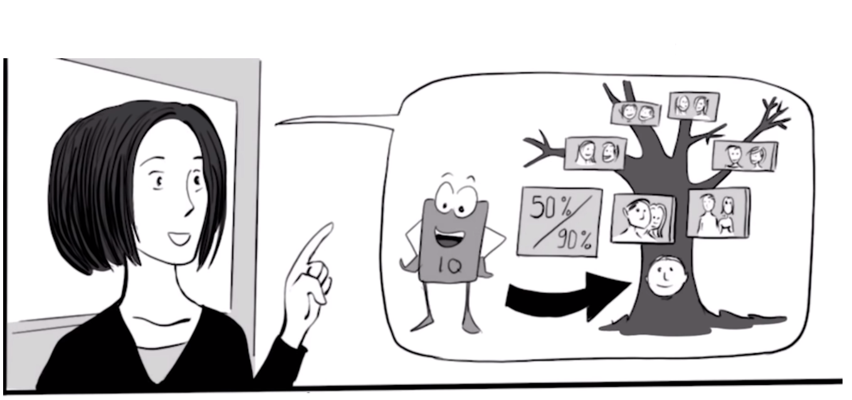
Influences on Intelligence
Genetic + Environmental

Slide 35
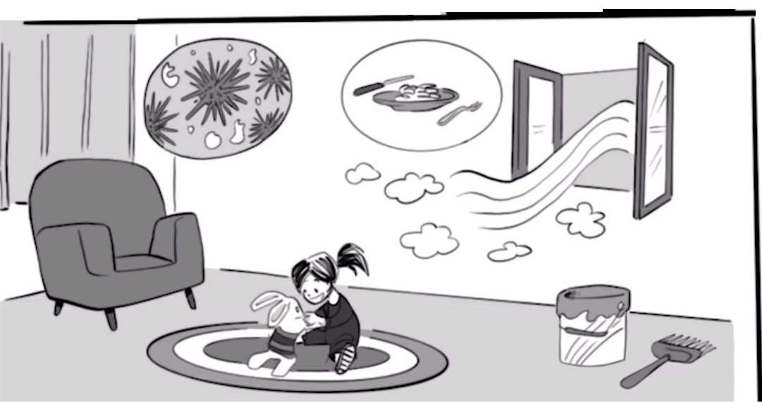
Environmental Factors?
Disease
Malnutrition
Air Pollution
Lead in Paint

Slide 36
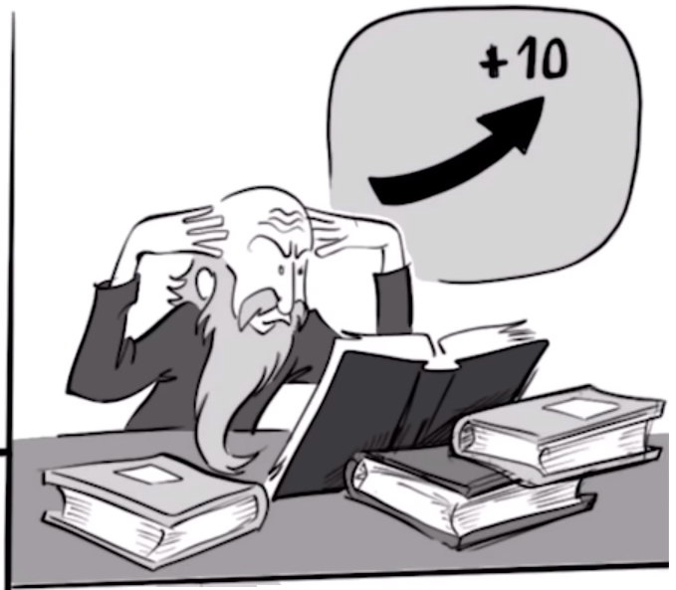
How much can you change your IQ?
Up to 10 points

Slide 37
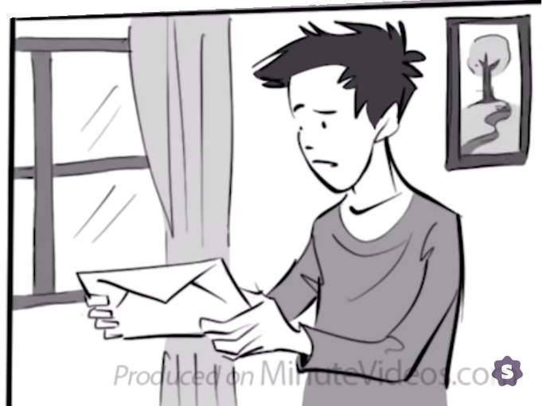
What choice did he have?

Slide 38
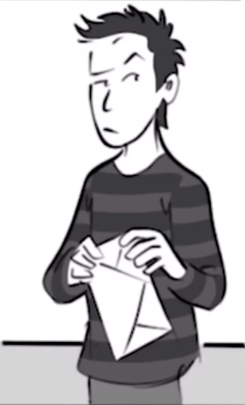
What was his IQ result?
He didn’t open the envelope

Slide 39
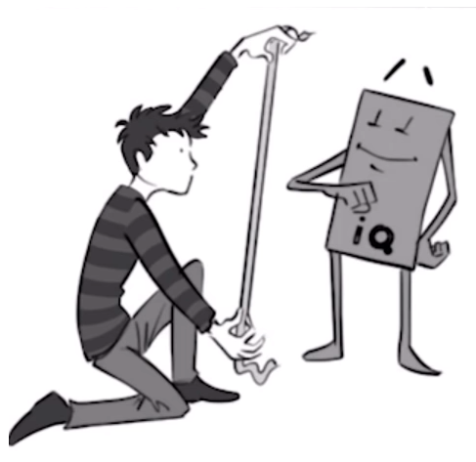
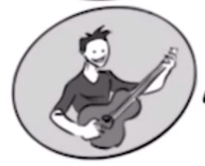
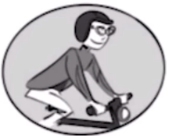
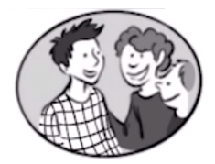
Why didn’t he open the envelope?
Life matters more
Don’t need to prove anything

Slide 40
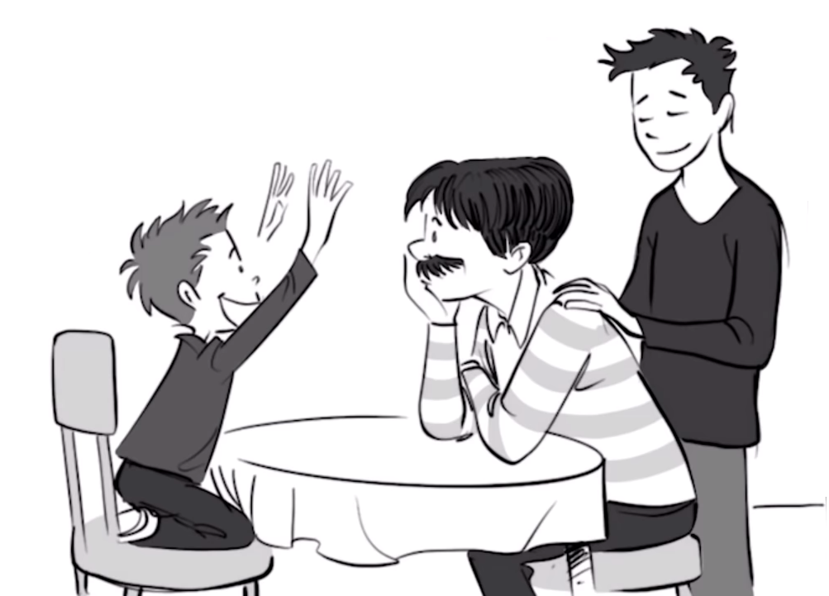
Why is his dad so proud of his brother?
Chance to be someone
(dad of a genius)

Slide 41
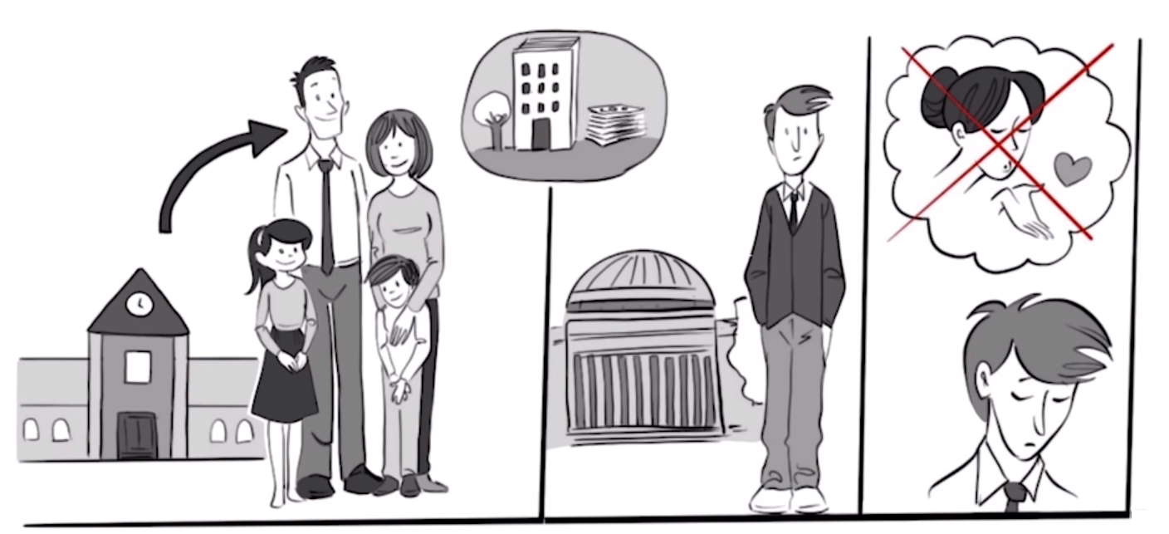
Compare his life to his brother’s life

Slide 42
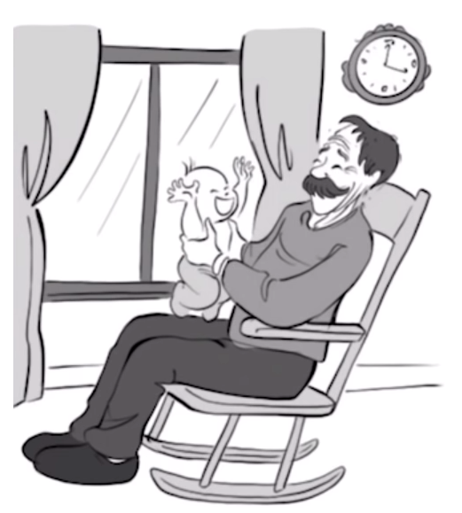
How does his father feel about IQ now?
He doesn’t care about it anymore.

Slide 43
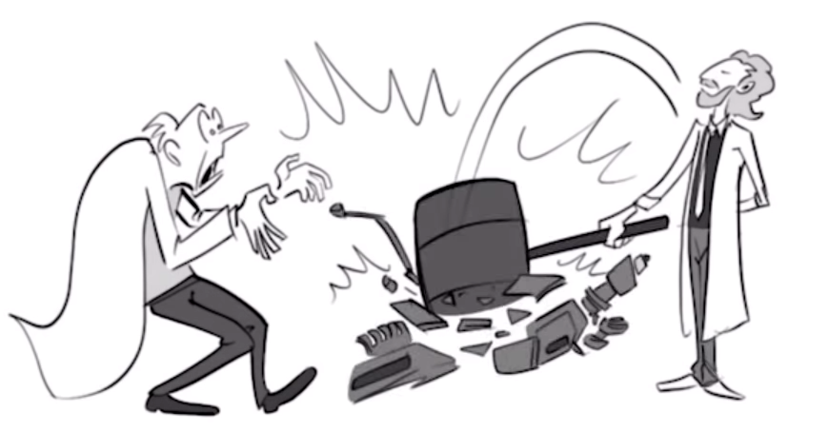
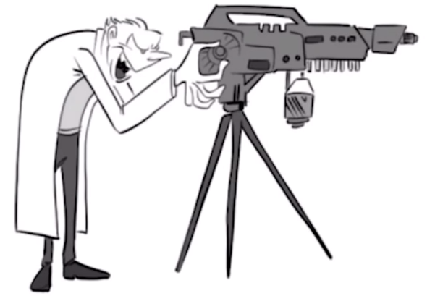
“They say it takes intelligence to know how to do things right. But it takes wisdom to do the right thing.”

