Slide 1
Six Degrees of Bacon

Slide 2
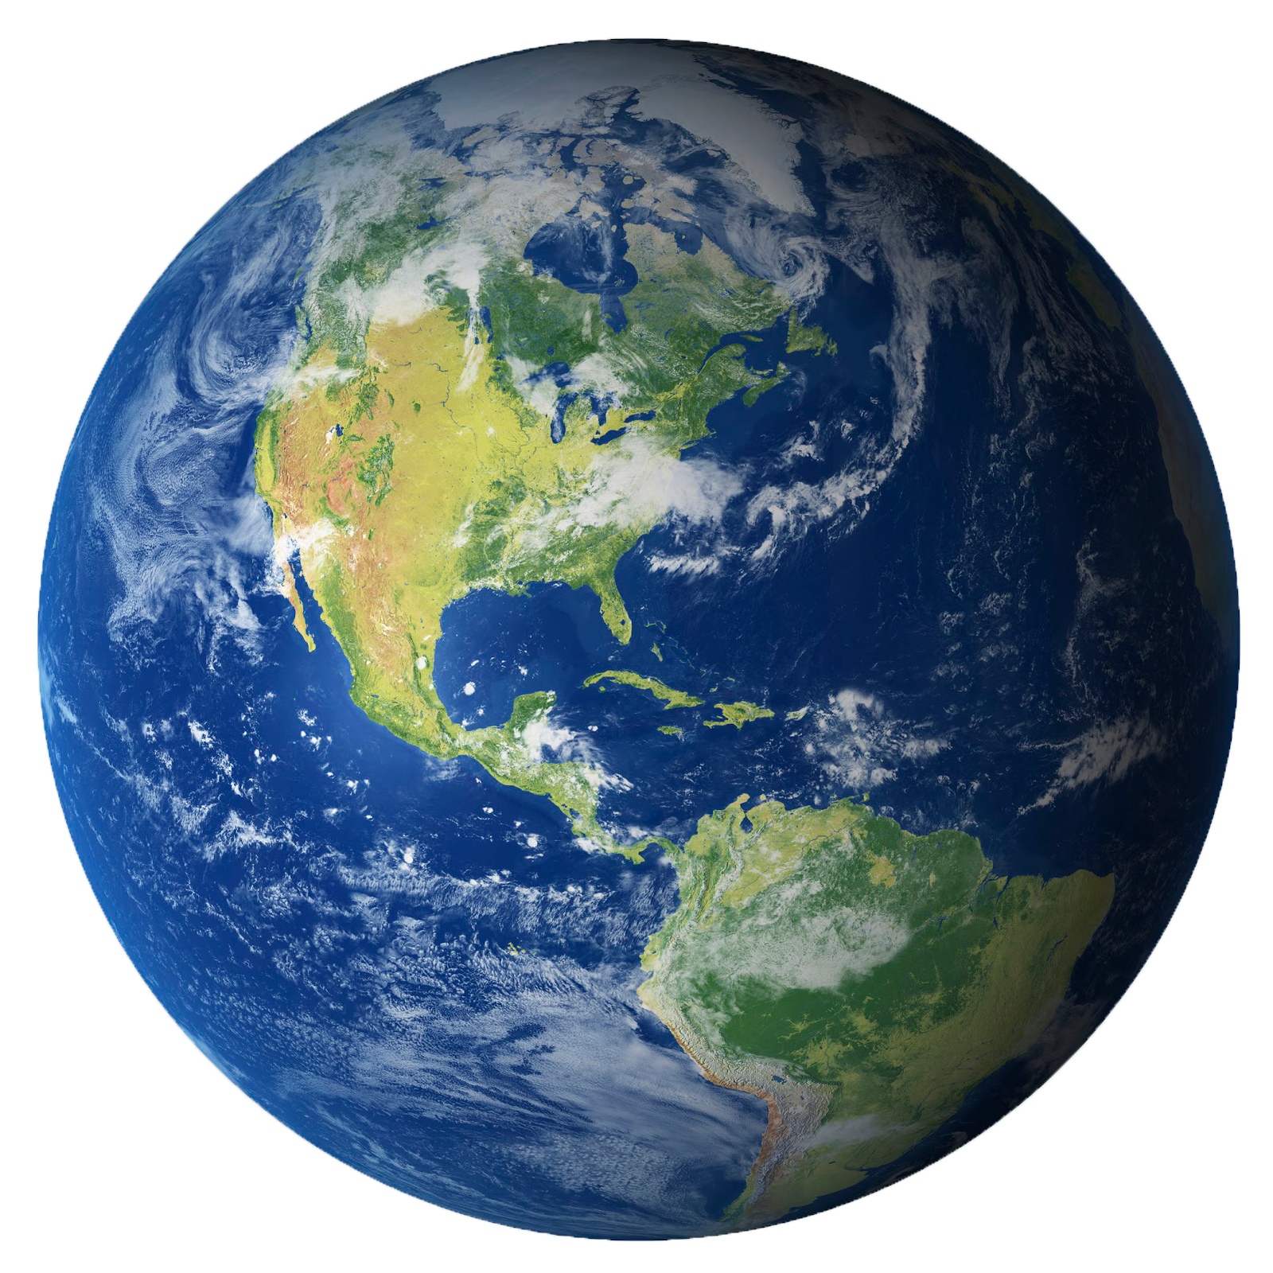
The Small World Phenomenon

Slide 3
The Small World Phenomenon
Have you ever met someone in another country from your hometown?
“It’s a small world.”

Slide 4
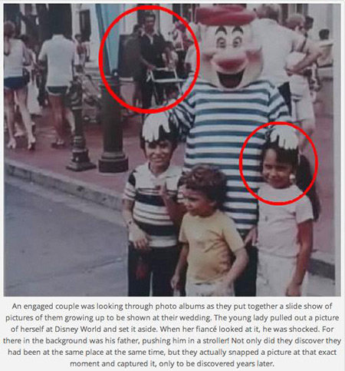
The Small World Phenomenon

Slide 5
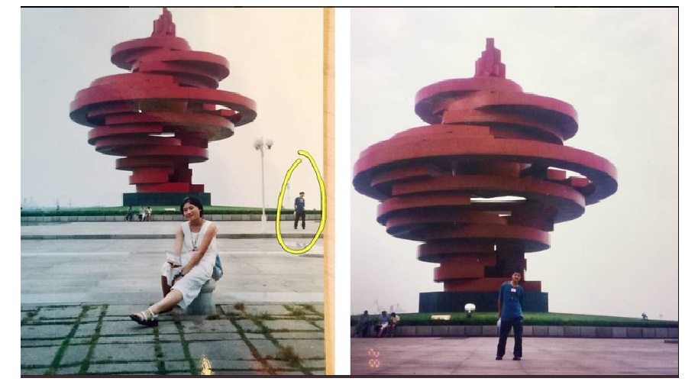
The Small World Phenomenon

Slide 6
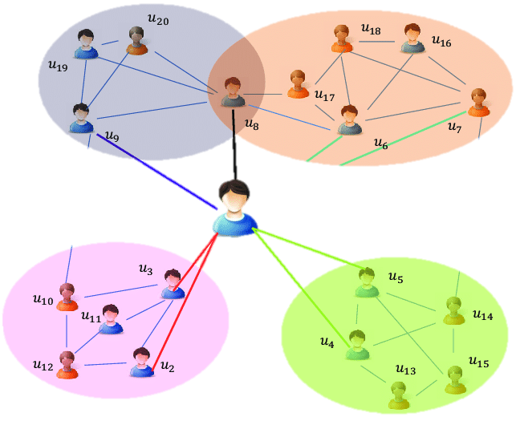
Six or Fewer Social Connections

Slide 7

“a friend of a friend”
How connected is the world?

Slide 8
Degrees of Separation (Twitter)
3.43

Slide 9
Degrees of Separation (Facebook)
4.75

Slide 10
Degrees of Separation (Websites)
19

Slide 11
Degrees of Separation (Wikipedia)
3.02

Slide 12

6 Degrees of Bacon:

Slide 13
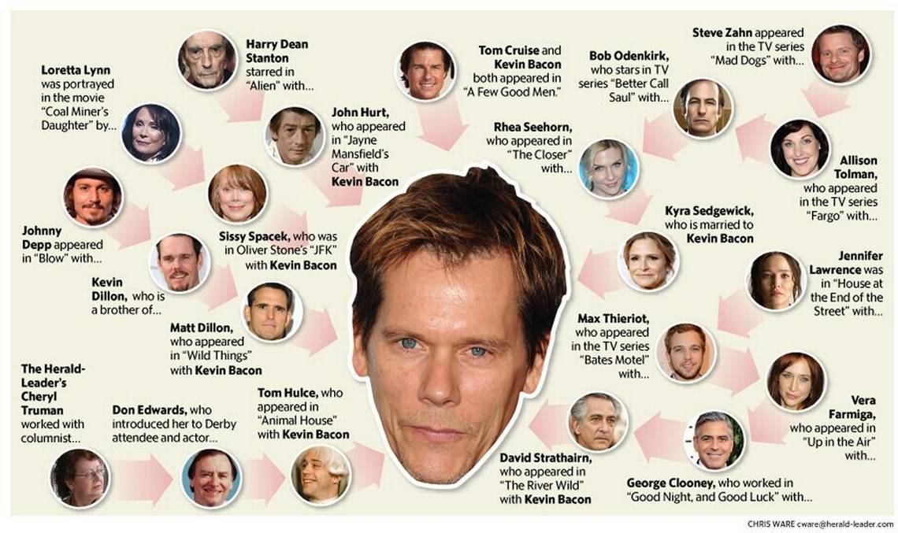

Slide 14
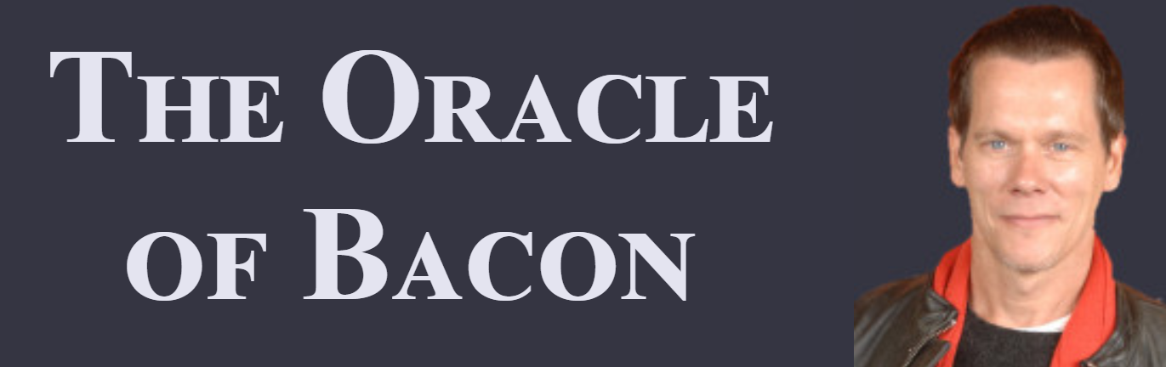
Bacon Number
How related a celebrity is to Kevin Bacon.
oracleofbacon.org

Slide 15
Listen and Analyze
Choose a Video
Listen with a group
Discuss the video
Explain to other groups

Slide 16
Videos
The Science of 6 Degrees of Separation
https://www.youtube.com/watch?v=TcxZSmzPw8k
How The Six Degrees Phenomenon Has Changed Science
https://www.youtube.com/watch?v=a99ry70CnRs
Six Degrees of Separation: It’s a Small World
https://www.youtube.com/watch?v=X0mHf3oSUdU
The Math in Six Degrees of Separation
https://vimeo.com/193114373

Slide 17

Wikipedia

Slide 18
Wikipedia
3.02 Degrees of Separation (average)
https://www.sixdegreesofwikipedia.com/

Slide 19
Wikipedia
Wiki Race
https://www.youtube.com/watch?v=cDIQhJH2ahY

Slide 20

https://www.youtube.com/watch?v=cDIQhJH2ahY

Slide 21
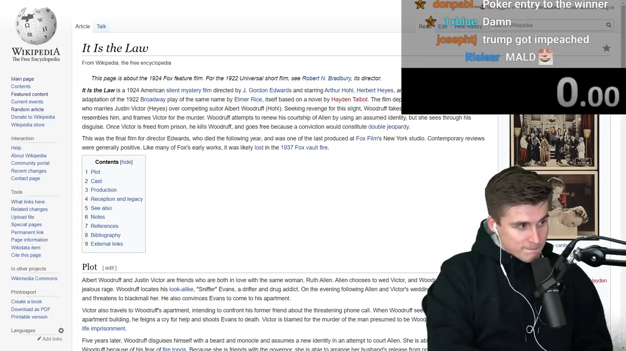
https://www.youtube.com/watch?v=cDIQhJH2ahY

Slide 22

https://www.youtube.com/watch?v=cDIQhJH2ahY

Slide 23
Uses of
Six Degrees of Separation?

Slide 24
How to Get a World-Famous Actor in Your Short Film
https://www.youtube.com/watch?v=sZpvVggtwyk
The Birthday Paradox
https://www.youtube.com/watch?v=ofTb57aZHZs
How to Spot a Pyramid Scheme – Stacie Bosley
https://www.youtube.com/watch?v=SBGfHk91Vrk

