Slide 1
Mouth Shape

Slide 2
What is she saying?

Slide 3
Phantom Word Illusion
https://www.youtube.com/watch?v=kbzL9PxtFf0

Slide 4
Do you hear…
Laurel
Yanny

Slide 6
TEAM OATH
HE
Name
TIMOTHY

Slide 7
MAY PULL
SIR UP
Canadian Food
MAPLE SYRUP

Slide 8
DEW WINO HUE
Question
DO I KNOW YOU?

Slide 9
BEYOND SAY
Singer
BEYONCE

Slide 10
PEE NUT
BUTT HER
Bread’s friend.
PEANUT BUTTER

Slide 11
NOOSE PAY
PERRY PORT
Something
you read
NEWSPAPER REPORT

Slide 12
ED’S OAK OLD
Weather
IT’S SO COLD

Slide 13
ACHE UP PUCK OFF HE
Morning happiness
A CUP OF COFFEE

Slide 14
OH RAN JEWS
Drink
ORANGE JUICE

Slide 15
ACRE HILL UH
Animal
A GORILLA

Slide 16
MY CROW FUN
Audio
Equipment
MICROPHONE

Slide 17
AW ENTER
JAY CAT
Clothes
A WINTER JACKET

Slide 18
ACORN REHAND REST
Chuseok
A KOREAN DRESS

Slide 19
ALL WAITS BEEN EYES
A good rule.
ALWAYS BE NICE

Slide 20
TREE COURT WREATH
Holiday phrase
TRICK OR TREAT

Slide 21
CLOTHES THUD OR
Imperative
CLOSE THE DOOR.

Slide 22
PILL EAST OPERA NING
Say to children
PLEASE STOP RUNNING

Slide 23
DEPOT STALL FIZZ
Place
THE POST OFFICE

Slide 24
AIM US KEY TUB HEIGHT
Camping problem
A MOSQUITO BITE

Slide 25
DUNE HOT FEED THAN HYMN HULLS
Zoo rule
DO NOT FEED THE ANIMALS

Slide 26
CREASED MY SIEVE
Aniticpation
CHRISTMAS EVE

Slide 27
ACE HECK HUNCH ANTS
Again?
A SECOND CHANCE

Slide 28
LESS TART
Imperative
LET’S START

Slide 29
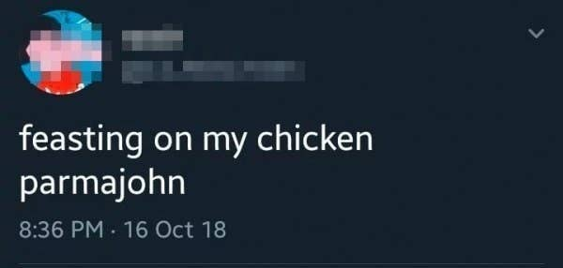

Slide 30
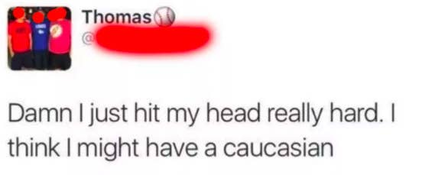

Slide 31
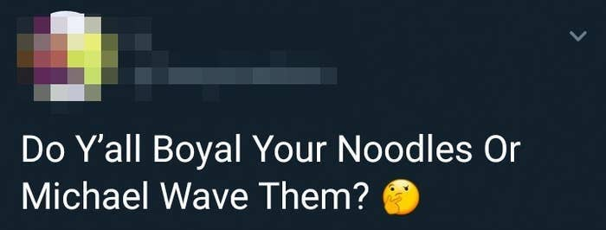

Slide 32
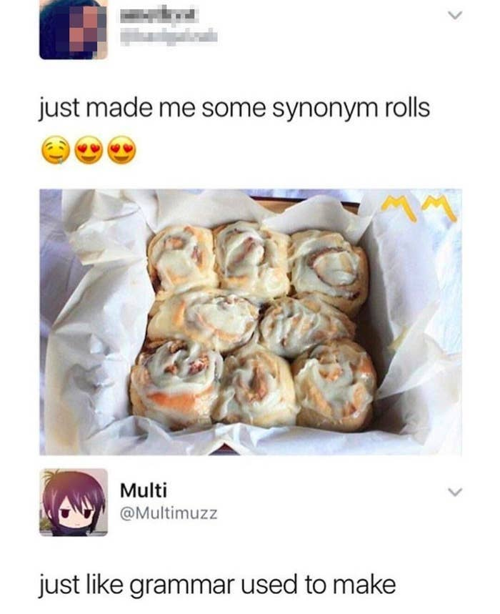

Slide 33
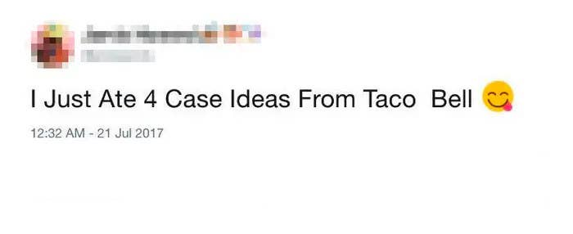

Slide 34
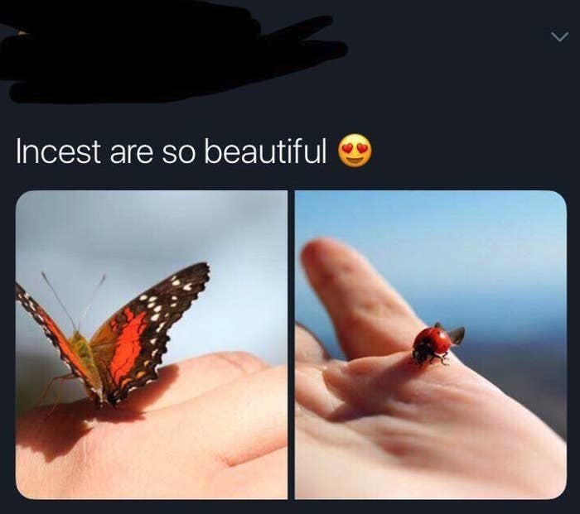

Slide 35
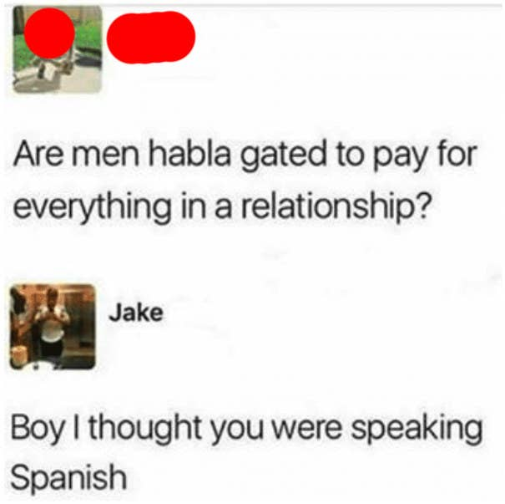

Slide 36
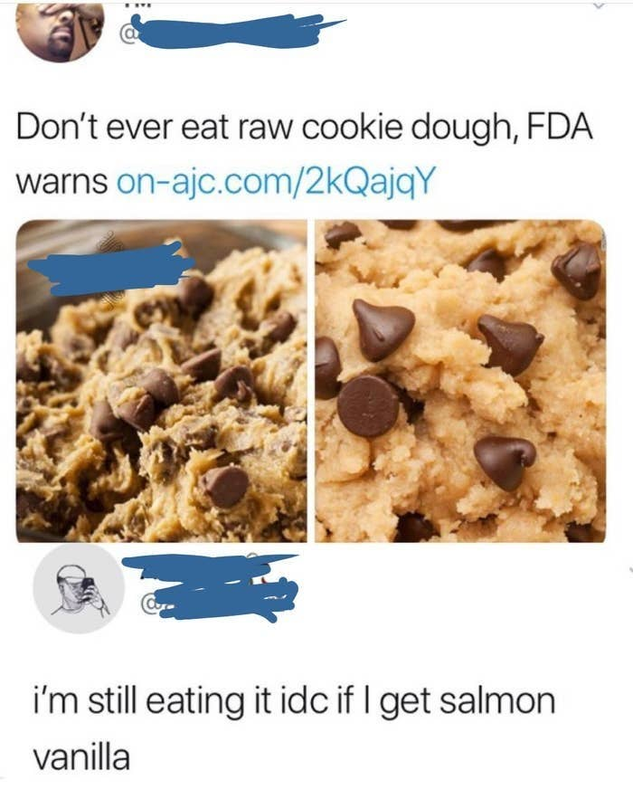

Slide 37
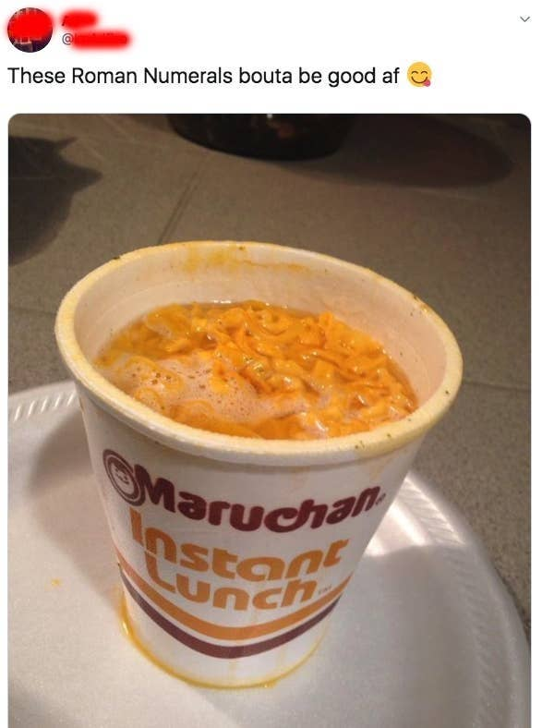

Slide 38
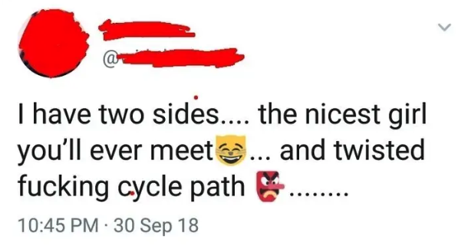

Slide 39
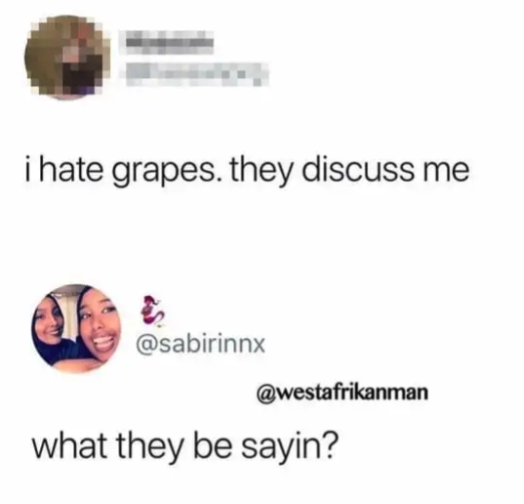

Slide 40
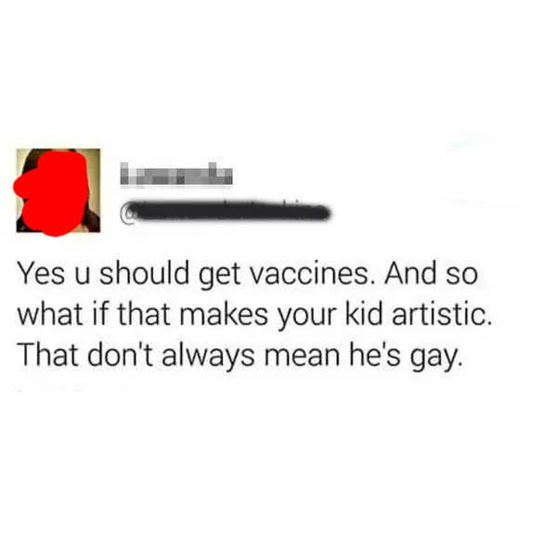

Slide 41
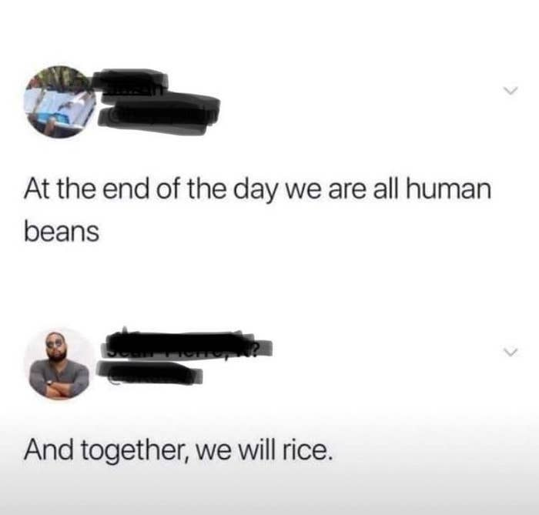

Slide 42
What is she saying?

Slide 43
Mouth Shape

Slide 44
https://pronunciationstudio.com/korean-speakers-english-pronunciation-errors/

Slide 45
/iː/ and /ɪ/
Please sit on the seat next to the sheep on the ship.

Slide 46
Central Vowels
Burt’s words hurt worse than Shirley’s.

Slide 47
Extra Vowels
My sandwich. Look, a book!

Slide 48
/l/ and /r/ confusion
Rory rarely rushed round very thoroughly.

Slide 49
‘th’
Thankfully the three brothers theorise amongst themselves.

Slide 50
Pronunciation of /v/ and /f/
A very nice festival

Slide 51
Pronunciation of /w/
Would you buy me some wood and some wool?

Slide 52
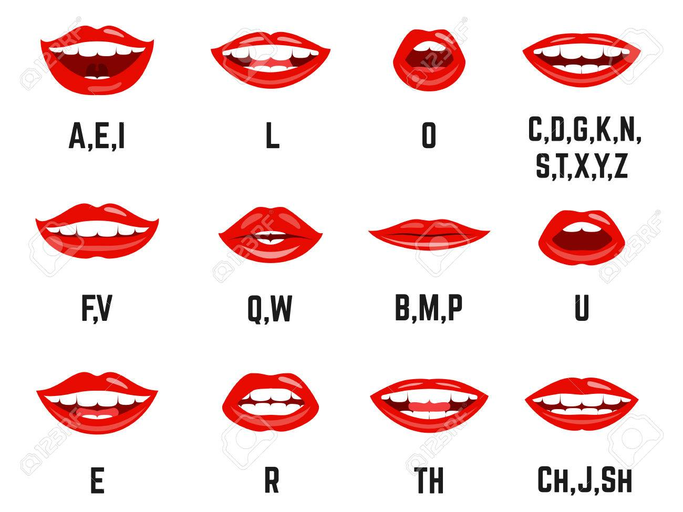
Mouth Shape

Slide 53
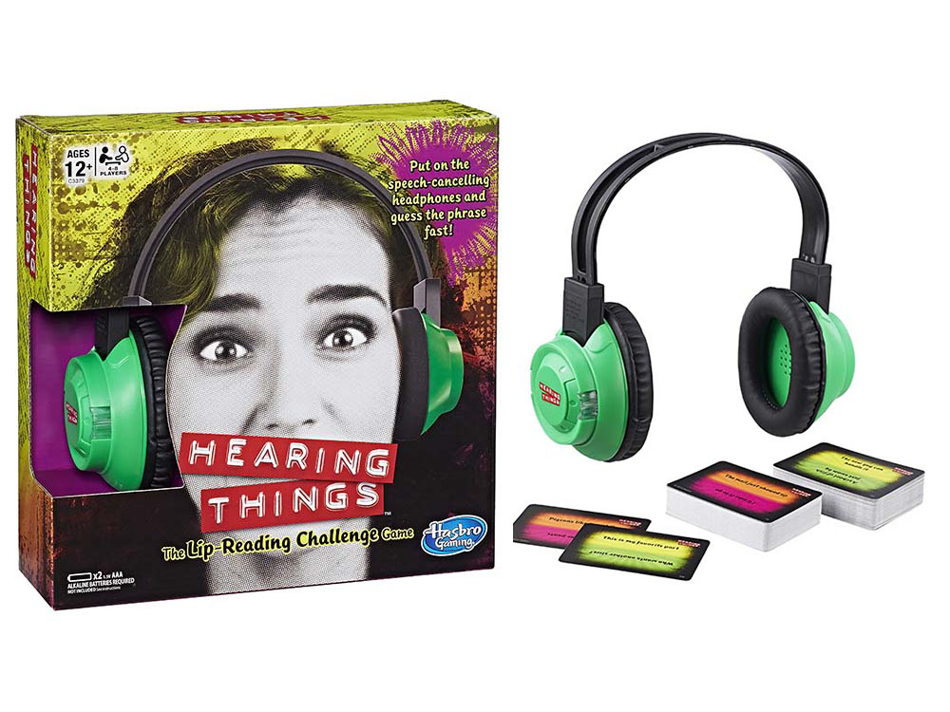

Slide 54
ar
b
d
e
ee
er
f
g
h
i
k

Slide 55
l
m
n
ng,nk
o
oo
oo
or
p
r
s,x
sh,ch

Slide 56
t
th
th
u
v
w,wh,qu
y
z
zh,j

