Slide 1
Portmanteau
Combining words to make a new word

Slide 2
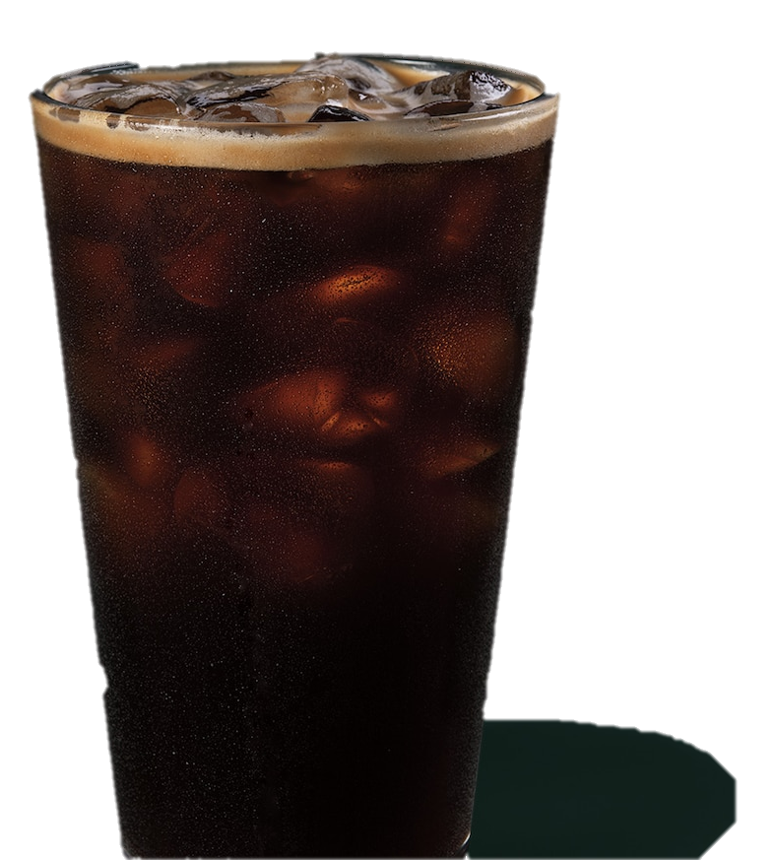
Explain it to me:
아아
Ice + Americano

Slide 3

Explain it to me:
혼술 / 혼밥
Alone + Eat

Slide 4

Explain it to me:
모솔
Alone since birth

Slide 5

Explain it to me:
생선
Birthday Present

Slide 6

Explain it to me:
생파
Birthday party

Slide 7

Explain it to me:
고터
Express bus terminal

Slide 8
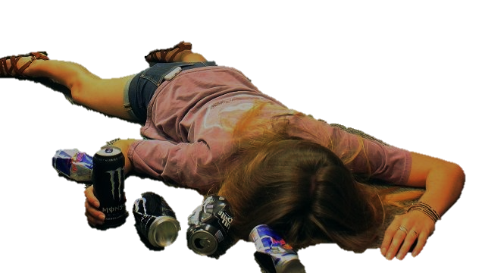
Explain it to me:
불금
Fire Friday = all-nighter

Slide 9

Explain it to me:
소확행
Small + Certain + Happiness

Slide 10

Explain it to me:
순삭
Very soon + Delete

Slide 11

Explain it to me:
갑분싸
Suddenly the atmosphere is frozen (uncomfortable)

Slide 12
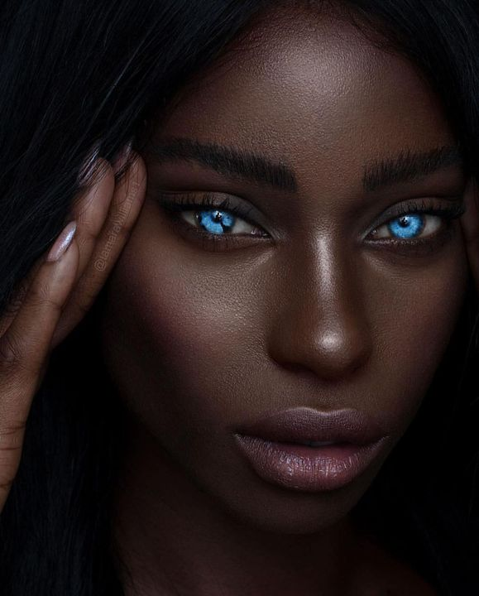
Explain it to me:
세젤예
In the world + Most beautiful

Slide 13

Explain it to me:
팩폭
Fact + Violence = the uncomfortable truth

Slide 14
Portmanteau
Blending two words to make a new word

Slide 15
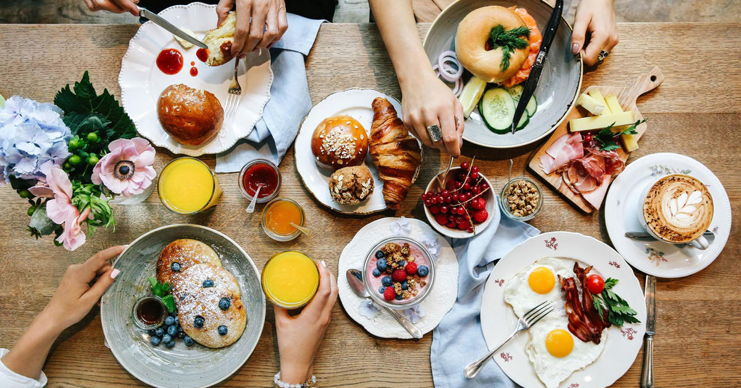
Breakfast
+
Lunch
Brunch

Slide 16

Electronic
+
Mail
email

Slide 17
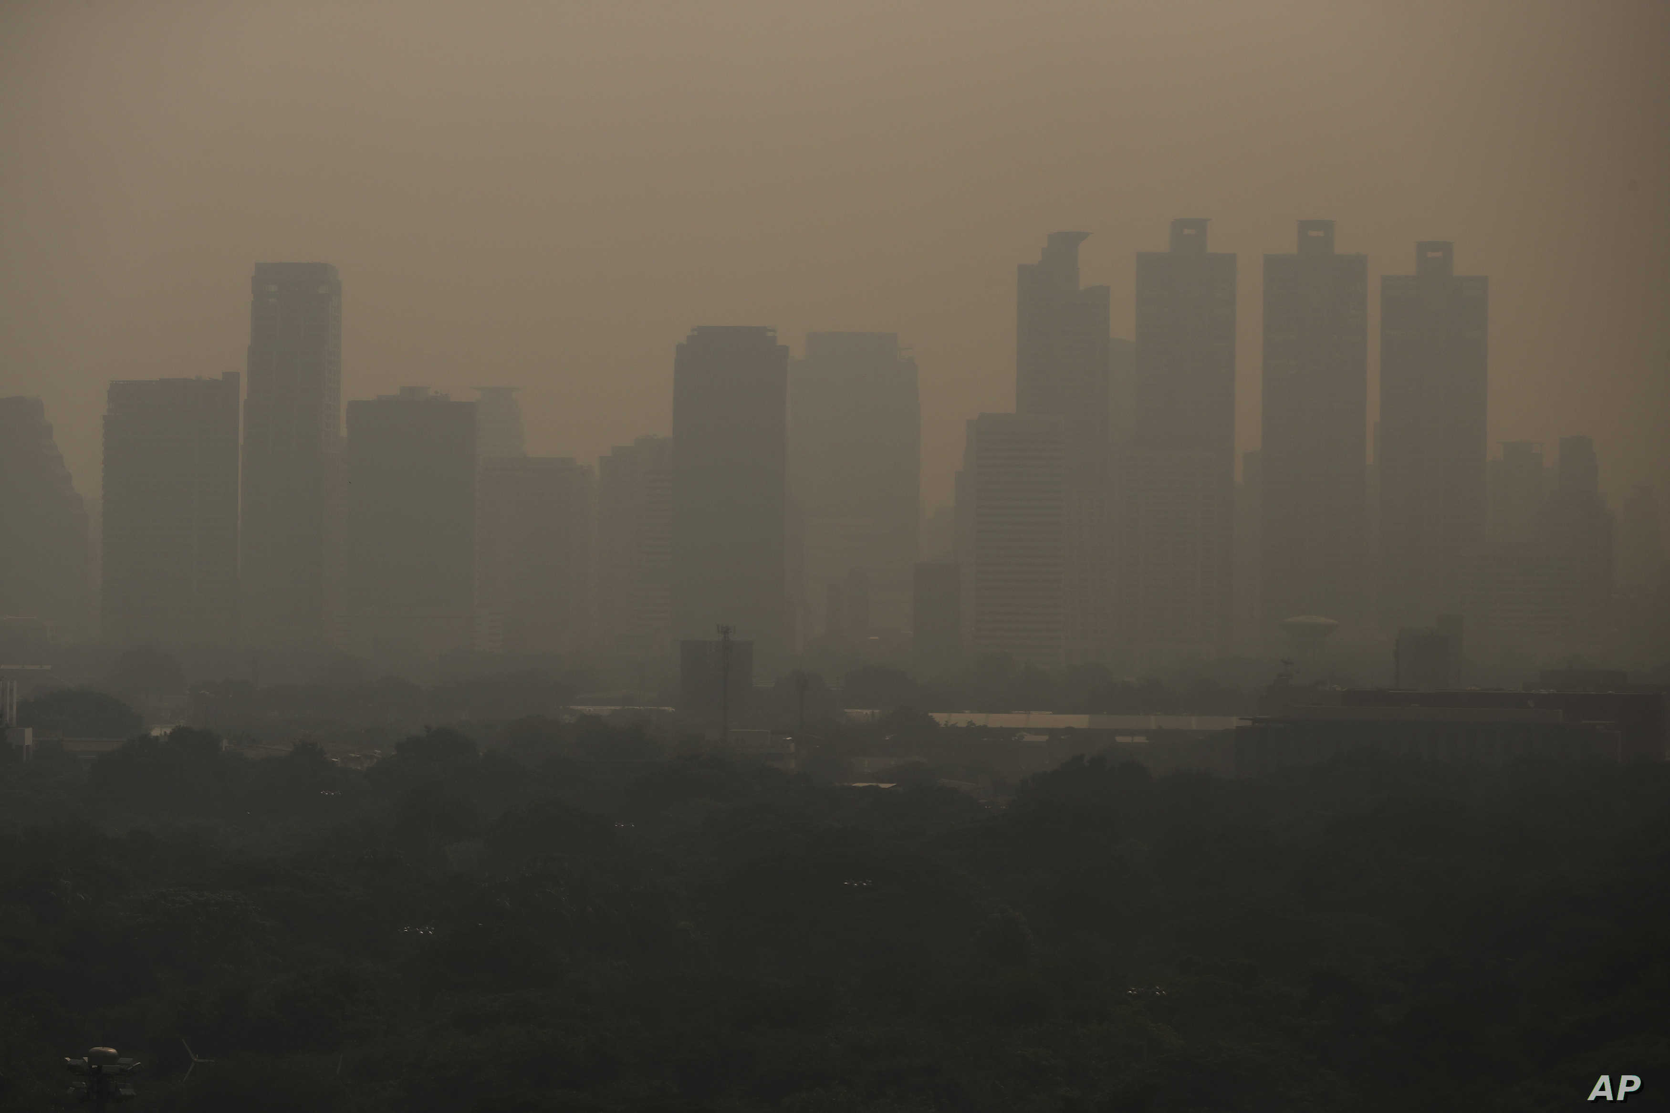
Smoke
+
Fog
Smog

Slide 18
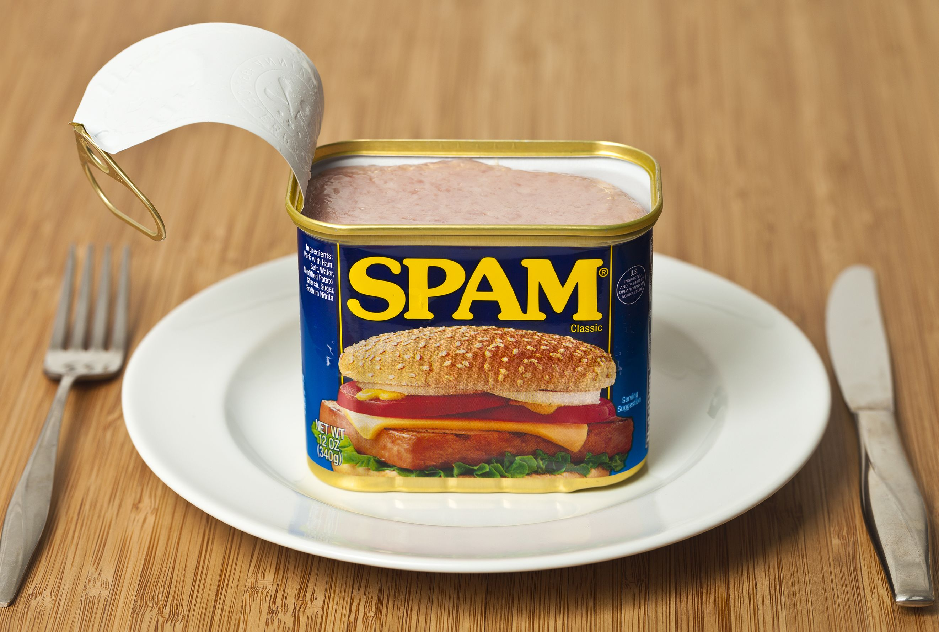
Spiced
+
Ham
Spam

Slide 19

Hungry
+
Angry
Hangry

Slide 20
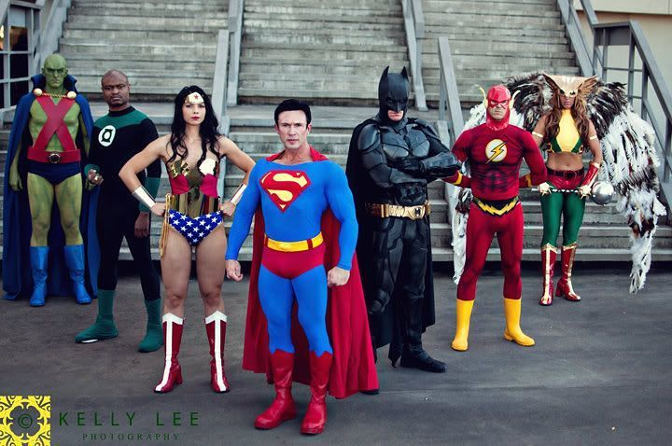
Costume
+
Play
Cosplay

Slide 21
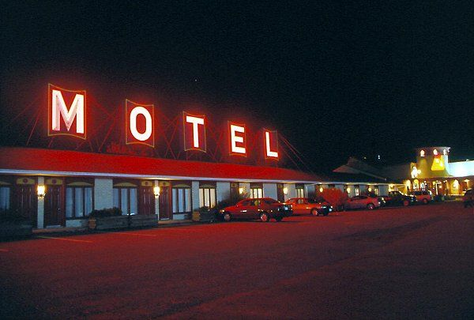
Motor
+
Hotel
Motel

Slide 22
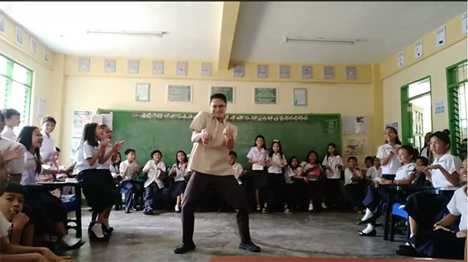
Education
+
Entertainment
Edutainment

Slide 23
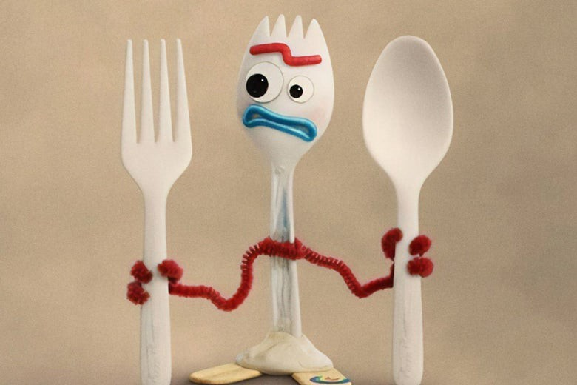
Spoon
+
Fork
Spork

Slide 24
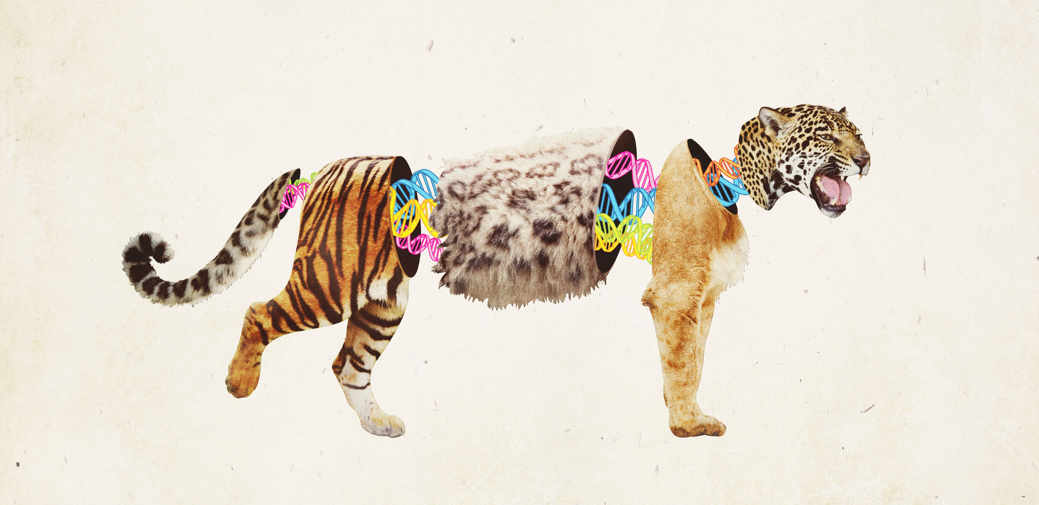
Animal Hybrids
Ilya Ivanovich Ivanov

Slide 25
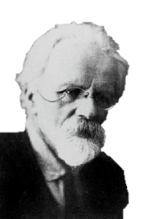
Ilya Ivanovich Ivanov
1870 - 1932
Russian
Scientist (Animal Reproduction)
Perfected “artificial insemination”
  Early 1900s
  Horses

Slide 26
Ilya Ivanovich Ivanov
By 1910s, he started experimenting with animal hybrids
  Zedonk (zebra-donkey)
  Zubron (European Bison – Domestic cow)

Slide 27
Portmanteau
Guess the animal hybrid

Slide 28
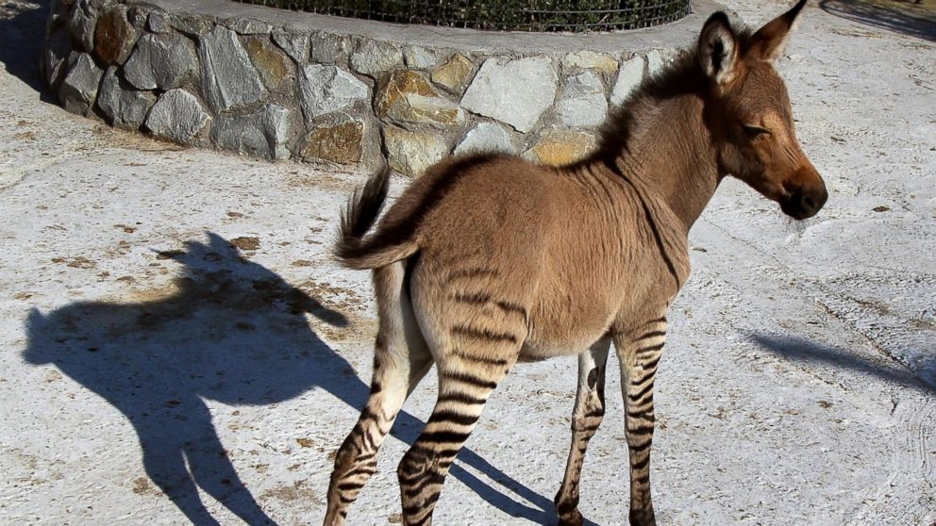
What is it called?
Zedonk (Zonkey)
Zebra + Donkey

Slide 29
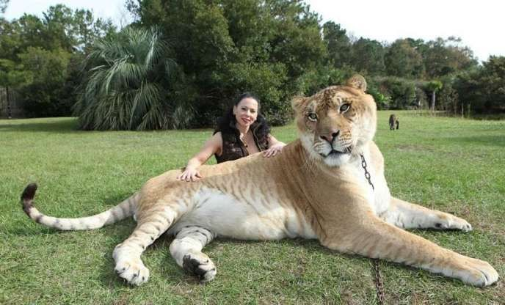
What is it called?
Liger
Lion + Tiger

Slide 30
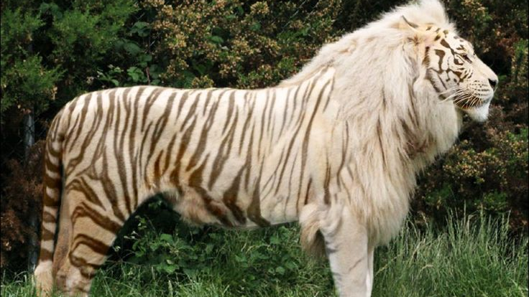
What is it called?
Tigon
Tiger + Lion

Slide 31
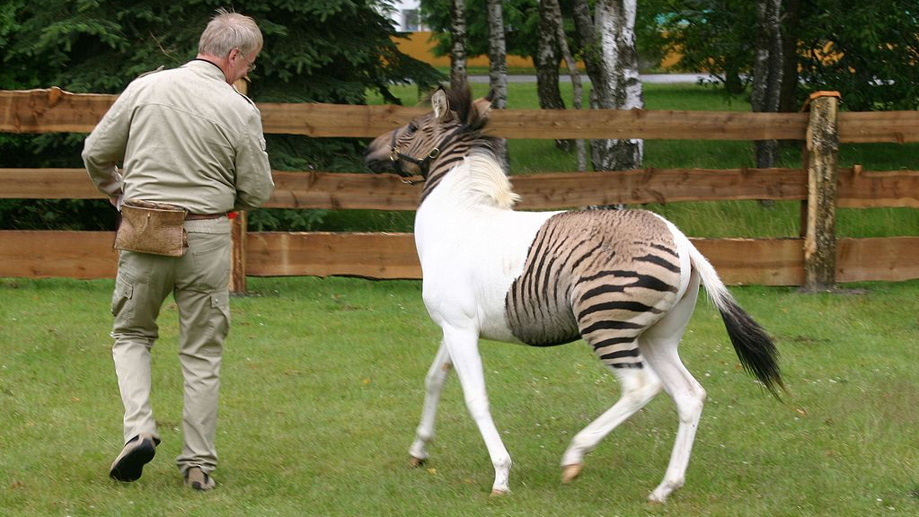
What is it called?
Zorse
Zebra + Horse

Slide 32
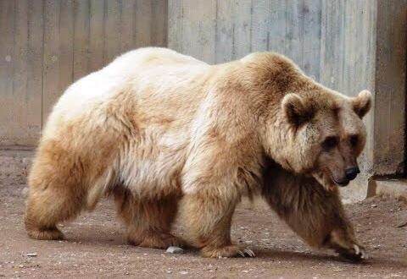
What is it called?
Grolar Bear / Pizzly
Grizzly Bear + Polar Bear

Slide 33
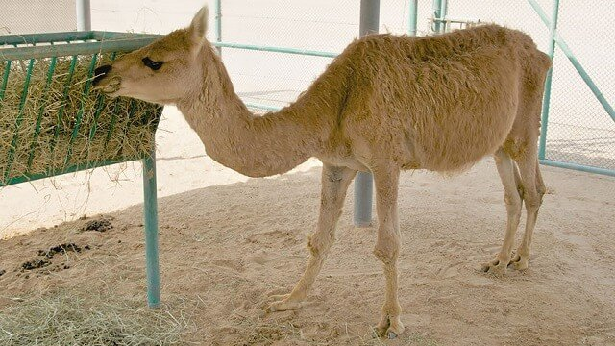
What is it called?
Cama
Camal + Lama

Slide 34
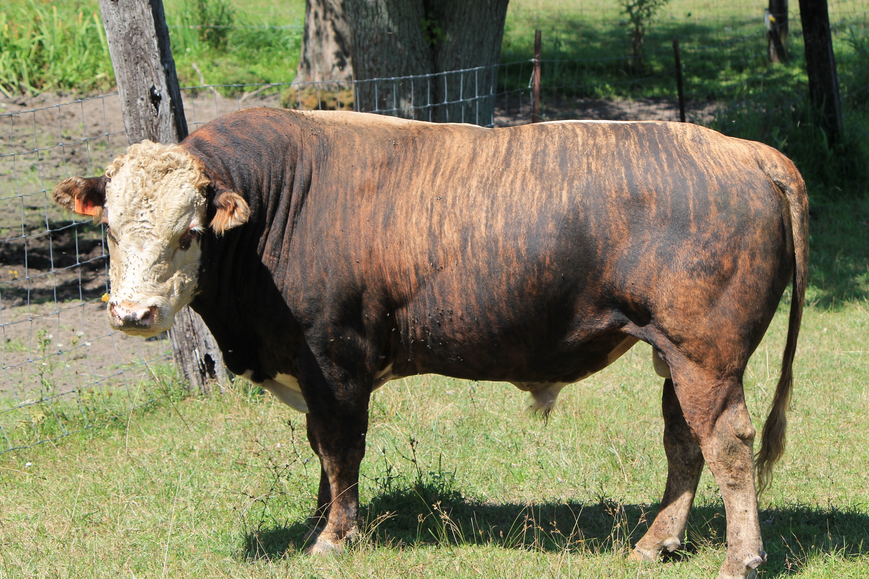
What is it called?
Beefalo / Cattalo
Beef + Buffalo

Slide 35
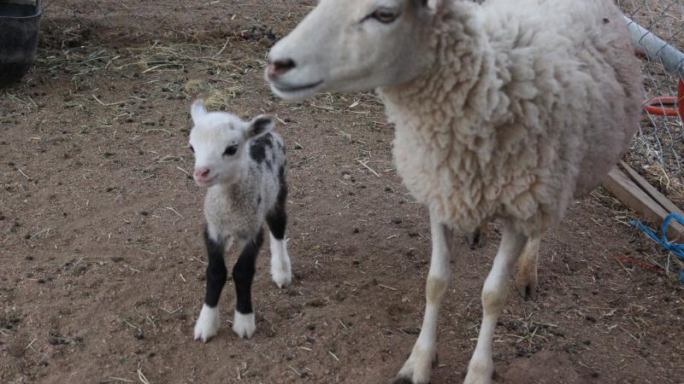
What is it called?
Geep
Goat + Sheep

Slide 36
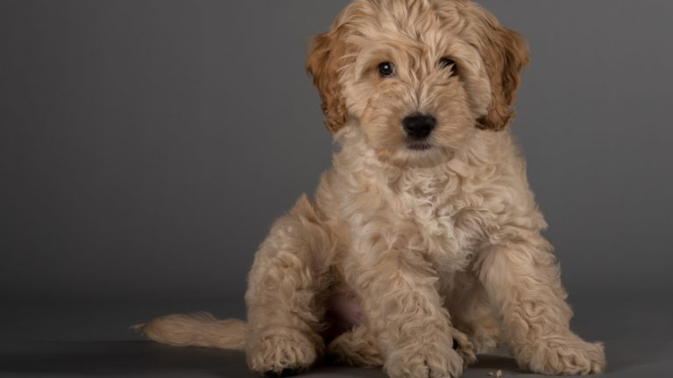
What is it called?
Cockapoo
Cocker Spaniel + Poodle

Slide 37
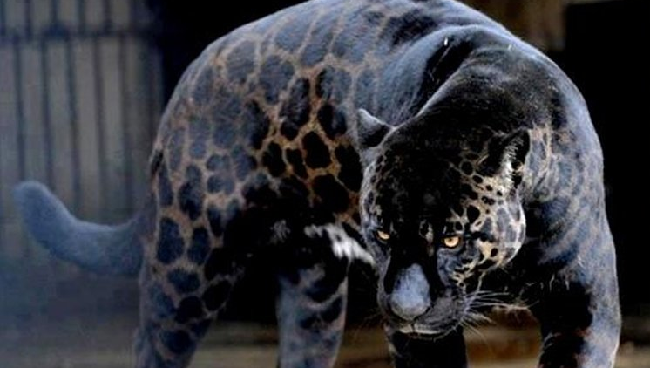
What is it called?
Jaglion
Jaguar + Lion

Slide 38
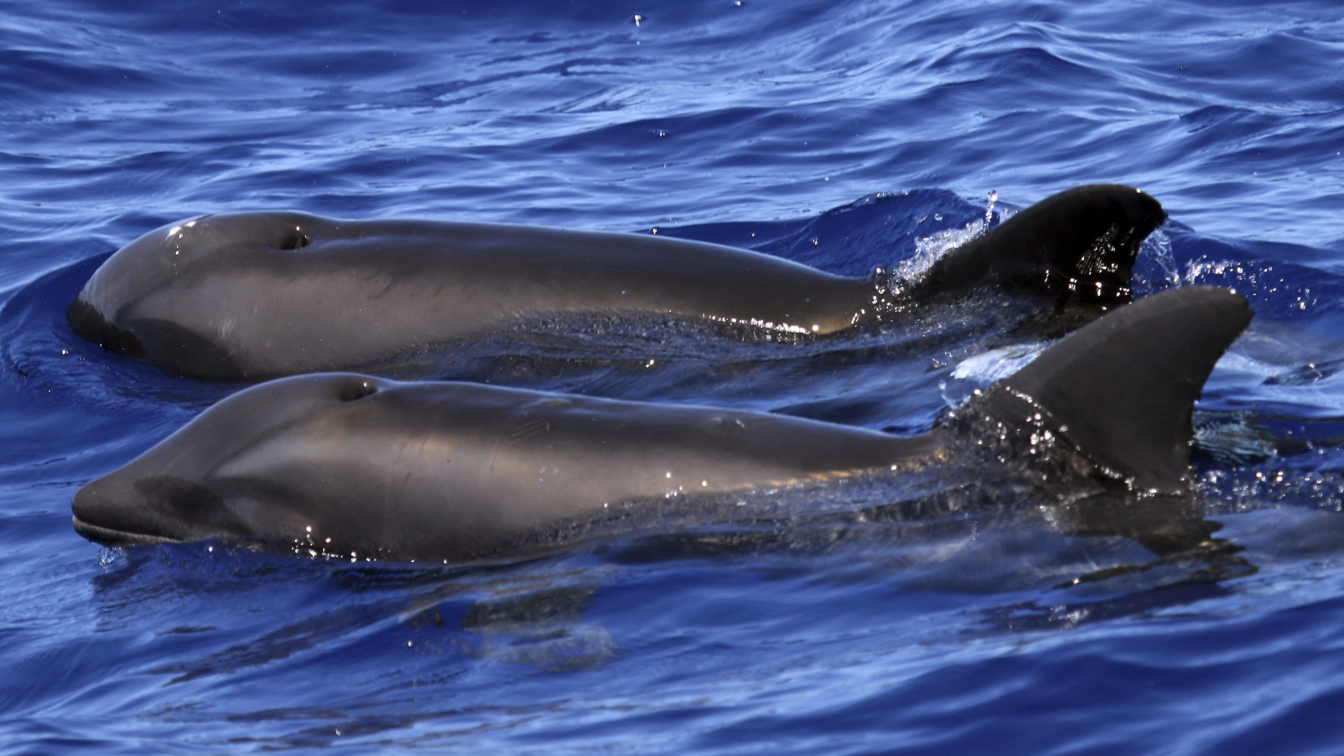
What is it called?
Wholphin
False Killer Whale (whale) + Dophin

Slide 39
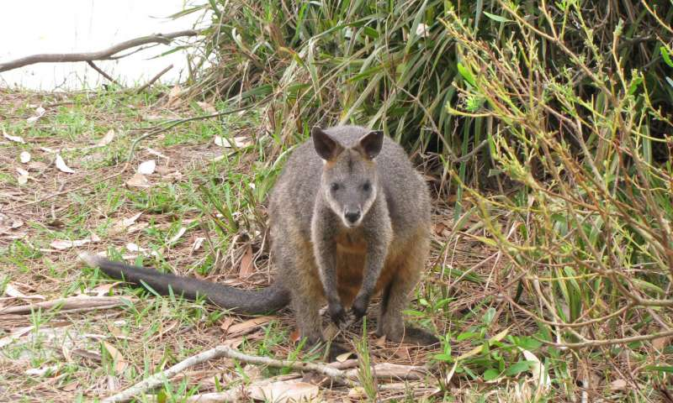
What is it called?
Wallaroo
Wallaby + Kangaroo

Slide 40
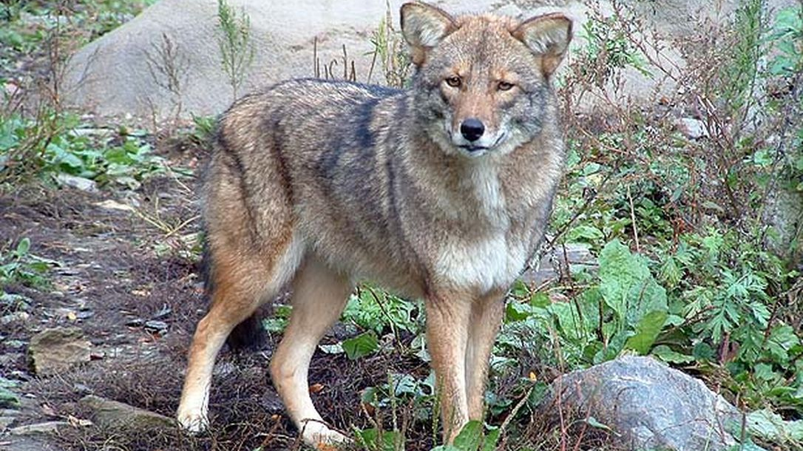
What is it called?
Coywolf
Coyote + Wolf

Slide 41
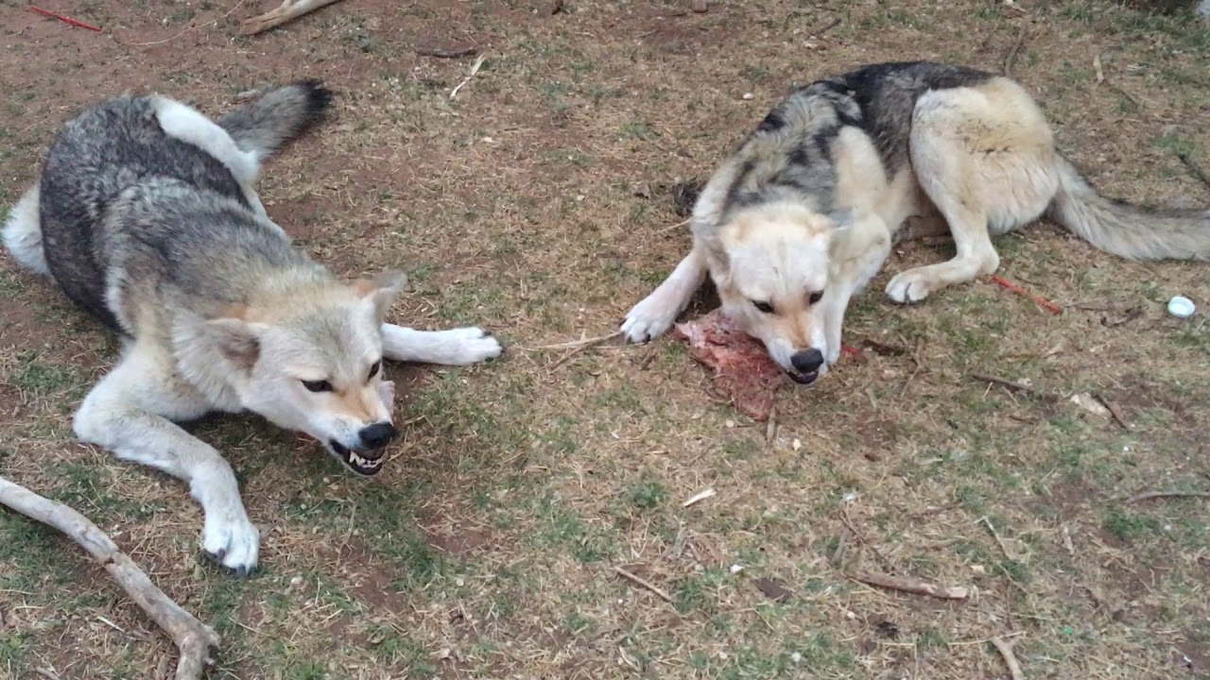
What is it called?
Coydog
Coyote + Dog

Slide 42
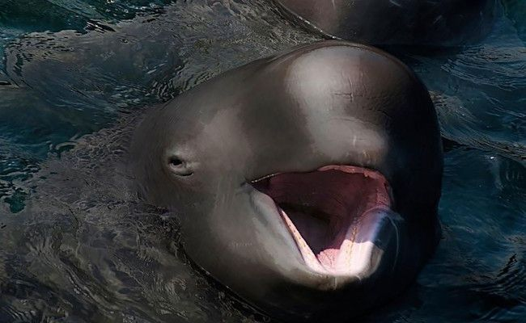
What is it called?
Narluga
Narwhal + Beluga

Slide 43
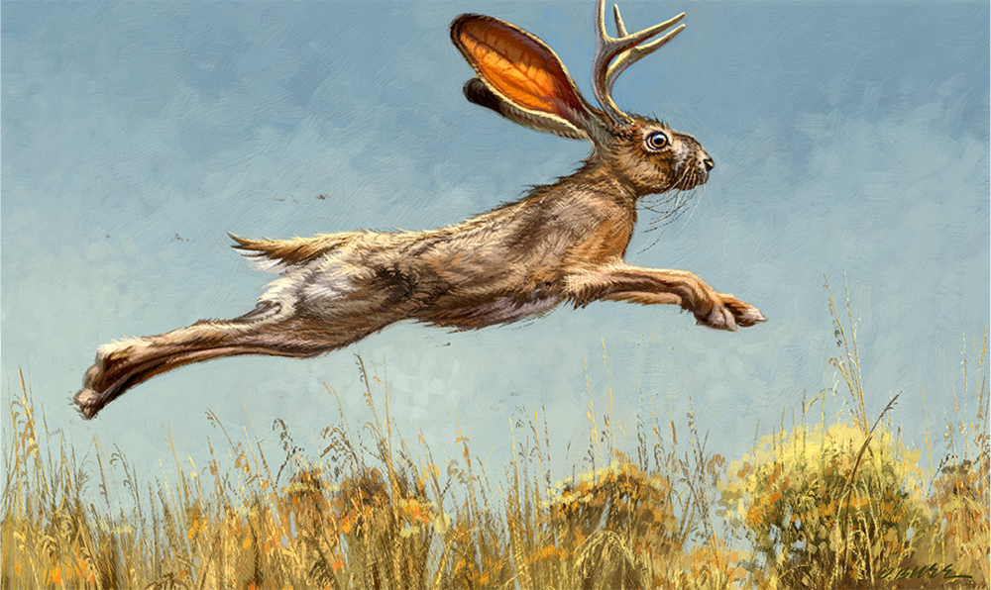
What is it called?
Jackalope
Jackrabbit + Antelope

Slide 44
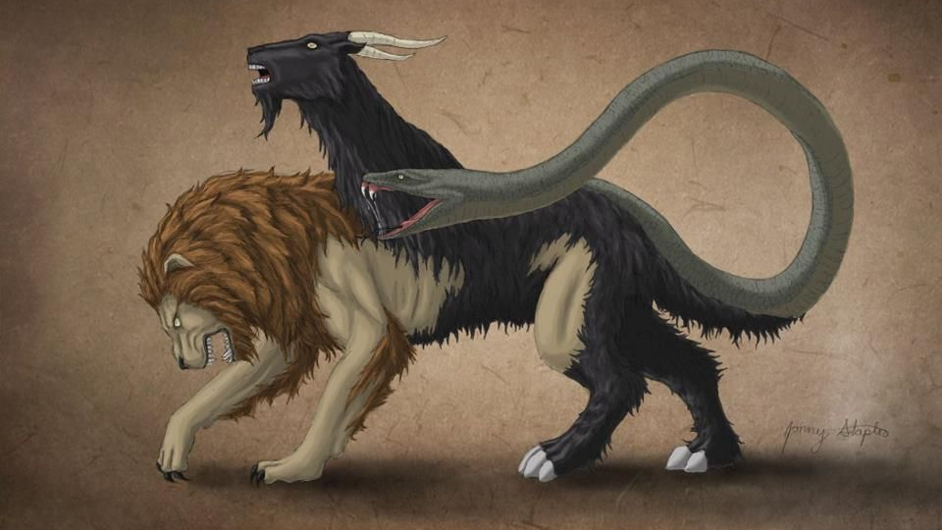
What is it called?
Chimera
In the world + Most beautiful

Slide 45
Ilya Ivanovich Ivanov
As early as 1910s he began talking about making a human – ape hybrid
What might this be called?
1924 – proposed his idea to the government.
Humanzee

Slide 46
Ilya Ivanovich Ivanov
Phase 1
1926 – Moved to Guinea
  The chimps were too young
Eventually got adult chimps
  Inseminated 3 chimps with human sperm
  None got pregnant though

Slide 47
Ilya Ivanovich Ivanov
Phase 2
He wanted to inseminate humans with chimp sperm
  No volunteers in Guinea
  Tried to trick medical patients
Sent back to Russia

Slide 48
Ilya Ivanovich Ivanov
Took 20 chimps back to Russia
  Only 4 survived.
  All died before he could use sperm.
5 women volunteered
Needed to get new apes.

Slide 49
Ilya Ivanovich Ivanov
Before he could complete his plan, the Soviet Union purged many scientists
He was exiled to Kazakhstan (1930)
Died in 1932

Slide 50
Ilya Ivanovich Ivanov
Red Frankenstein

Slide 51
Human Hybrids
Recently we have been making human hybrids to grow human cells / organs for us.
Rat-mice
Human-pig (1 in 100,000 cells)
Human-sheep

Slide 52
Portmanteau
Food

Slide 53
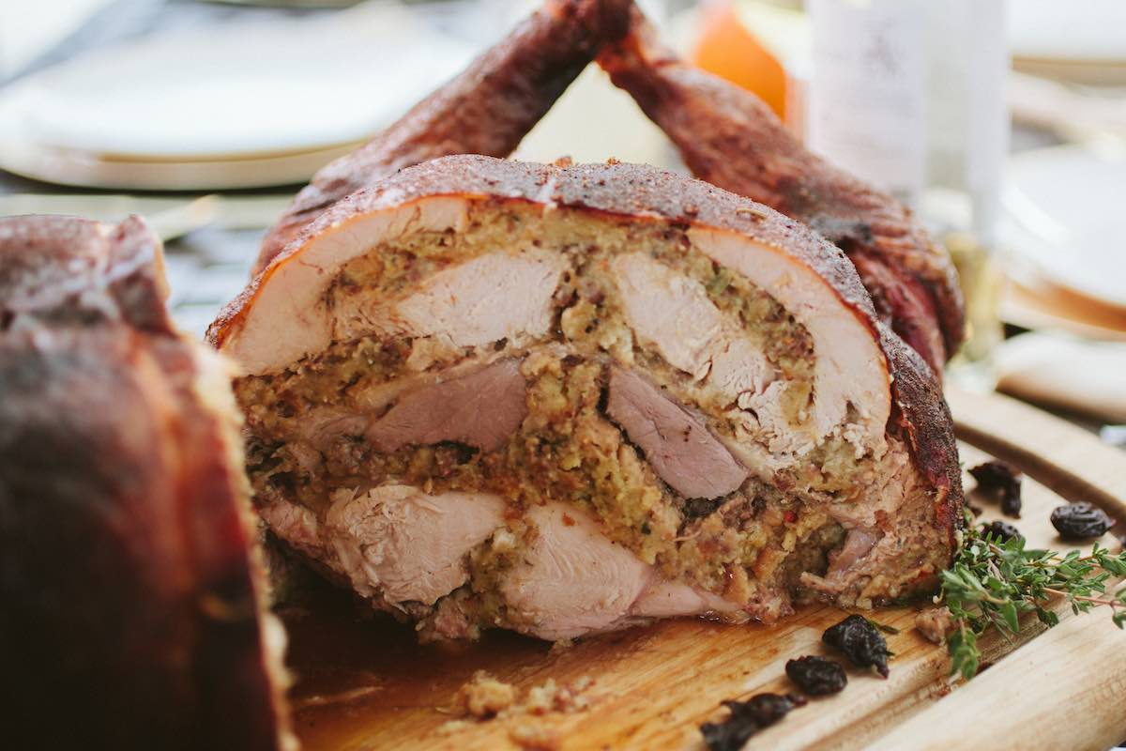
Cheeseburger
Craisin
Cronut
Frappuccino
Mocktail
Popcicle
Soysage
Turducken

Slide 54
Portmanteau
Create your own word
Guess what it means

Slide 55
Blasts from the past: The Soviet ape-man scandal
https://www.newscientist.com/article/mg19926701-000-blasts-from-the-past-the-soviet-ape-man-scandal/
Hybrid zoo: Introducing pi-human embryos and a rat-mouse
https://www.nature.com/news/hybrid-zoo-introducing-pig-human-embryos-and-a-rat-mouse-1.21378
Turducken Recipe
https://www.atbbq.com/thesauce/cooking-with-fire-episode-35-turducken/

