Slide 1
Explain the map

Slide 2
Every Map is Wrong

Slide 3
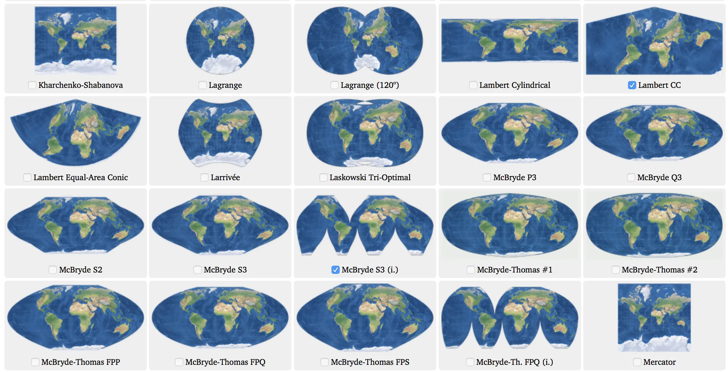

Slide 4
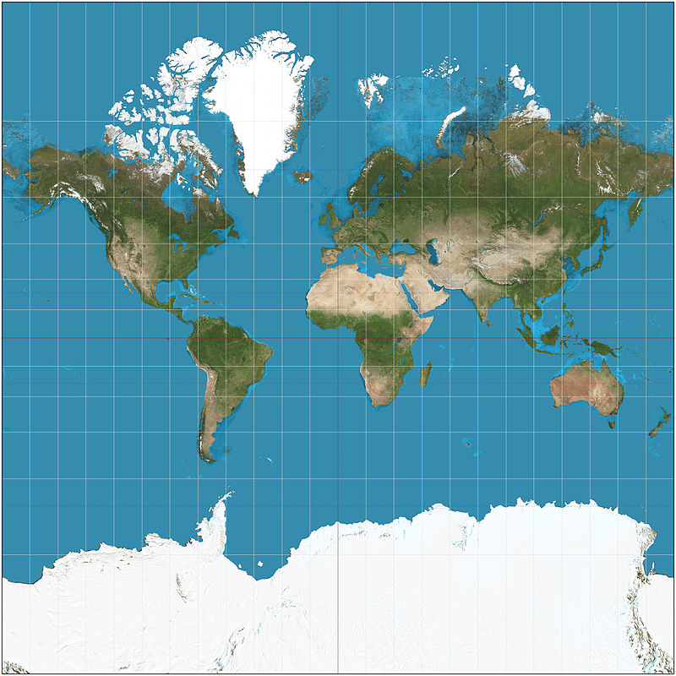
Mercator Projection
Notes:
By Strebe - Own work, CC BY-SA 3.0, https://commons.wikimedia.org/w/index.php?curid=17700069

Slide 5
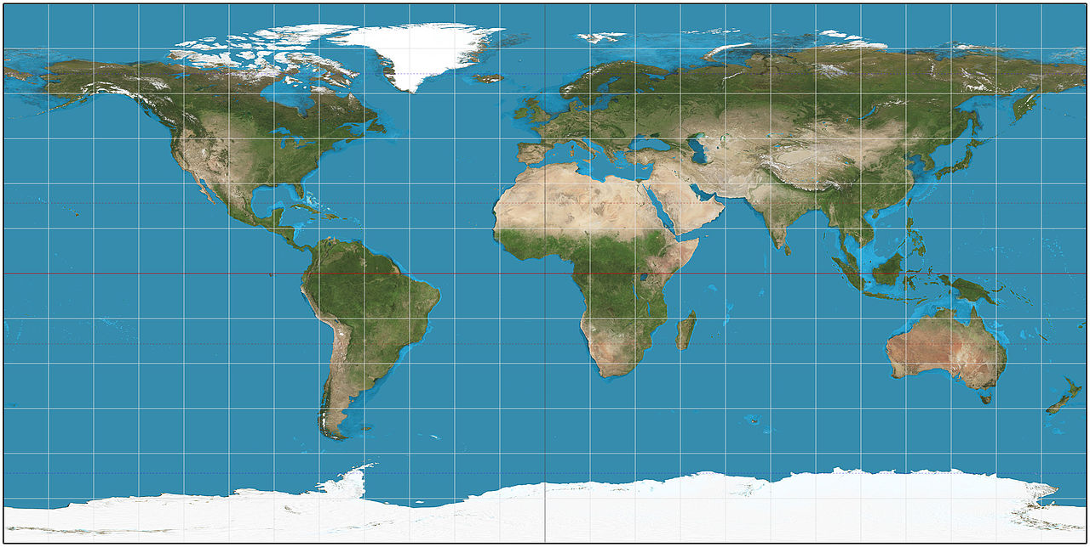
Plate Carrée Projection
Notes:
By Strebe - Own work, CC BY-SA 3.0, https://commons.wikimedia.org/w/index.php?curid=16115228

Slide 6
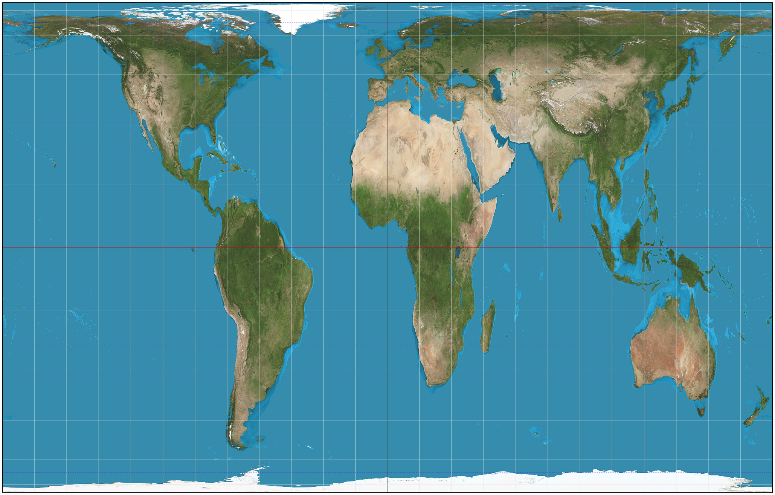
Gall-Peters Projection
Notes:
By Strebe - Own work, CC BY-SA 3.0, https://commons.wikimedia.org/w/index.php?curid=16115242

Slide 7
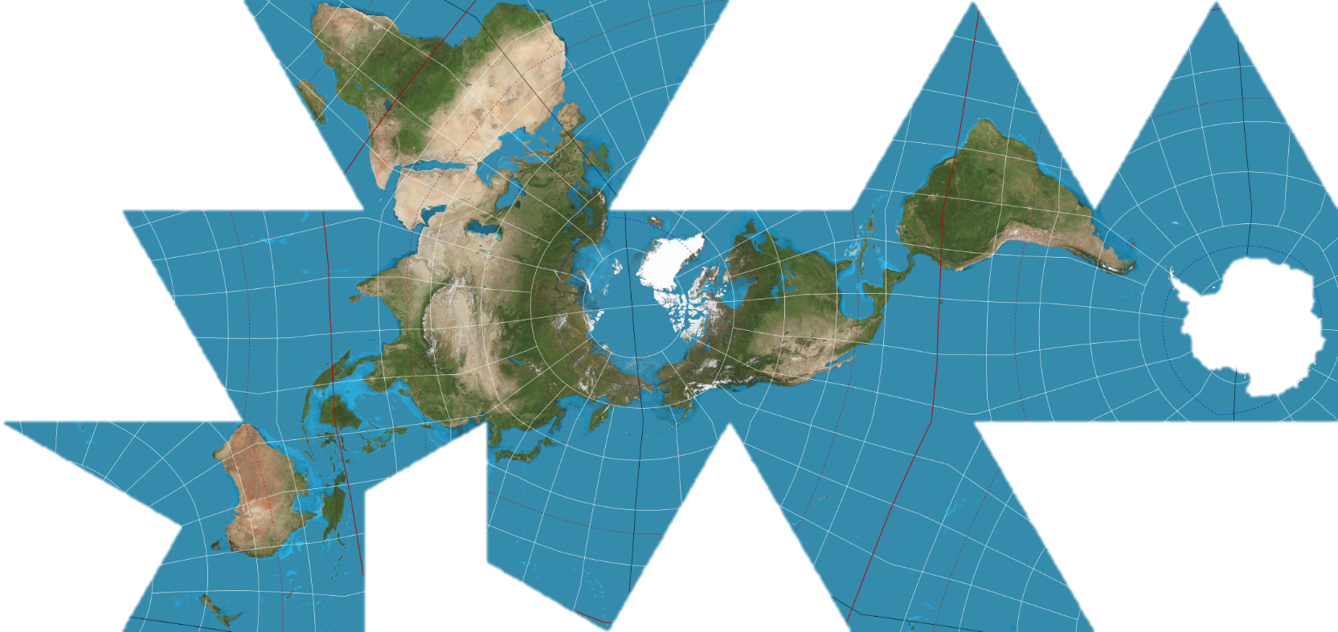
Dymaxion Map (Fuller Projection)
Notes:
By Justin Kunimune - Own work, CC BY-SA 4.0, https://commons.wikimedia.org/w/index.php?curid=65694588

Slide 8
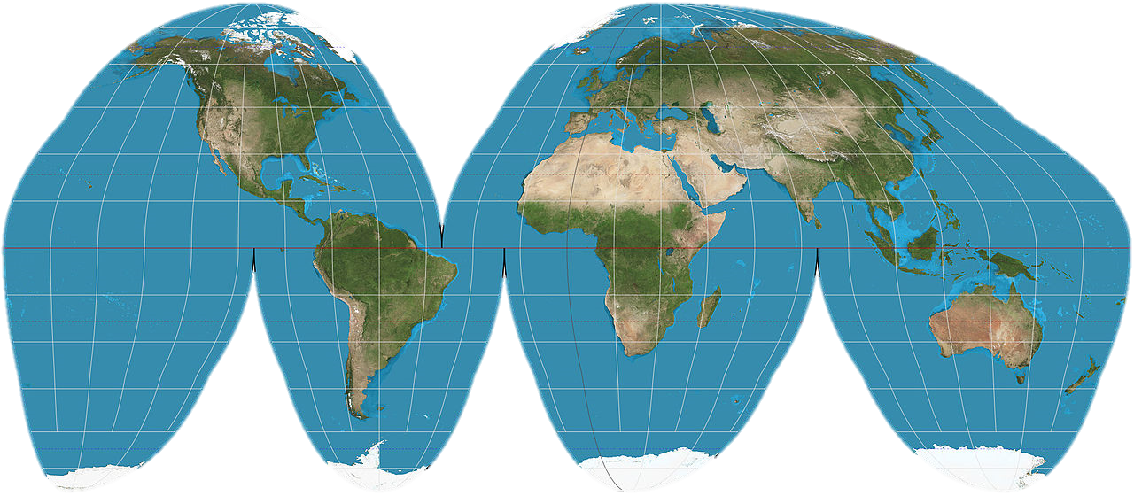
Goode Homolosine
Notes:
By Strebe - Own work, CC BY-SA 3.0, https://commons.wikimedia.org/w/index.php?curid=16115269

Slide 9
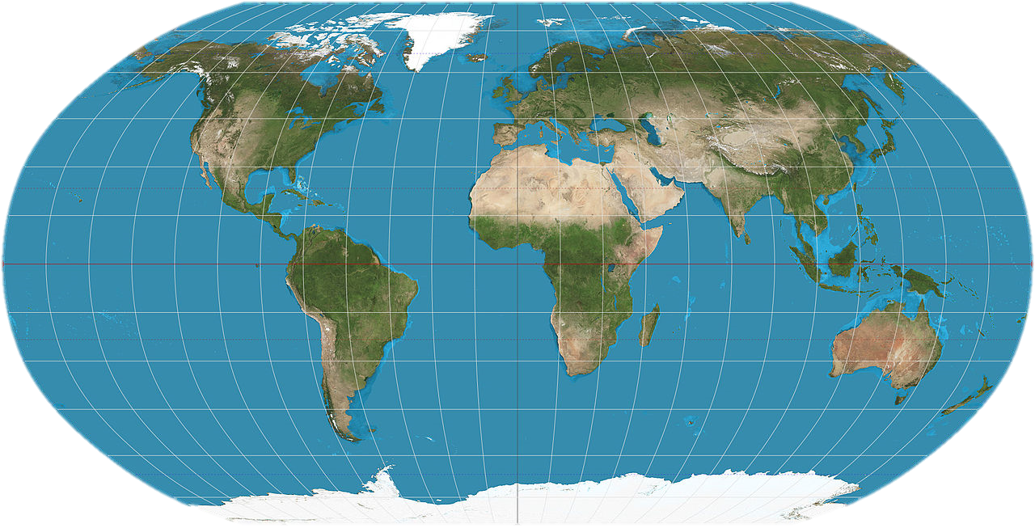
Robinson Projection
Notes:
By Strebe - Own work, CC BY-SA 3.0, https://commons.wikimedia.org/w/index.php?curid=16115337

Slide 10
The Problem with Projections

Slide 11
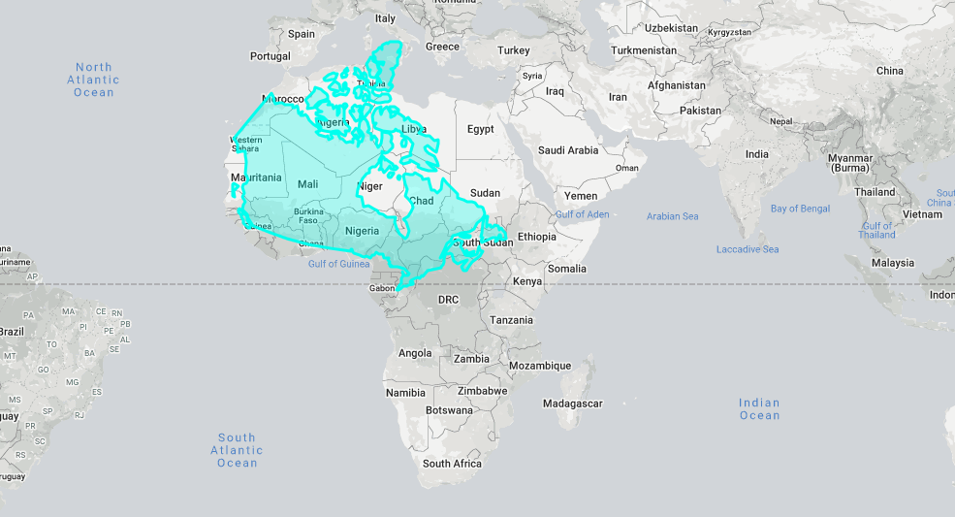

Slide 12
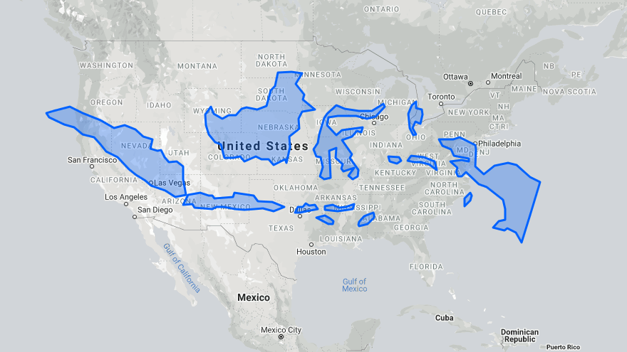

Slide 13
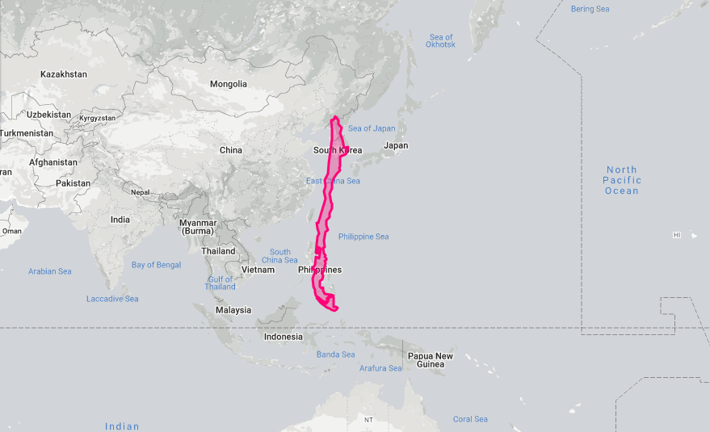

Slide 14
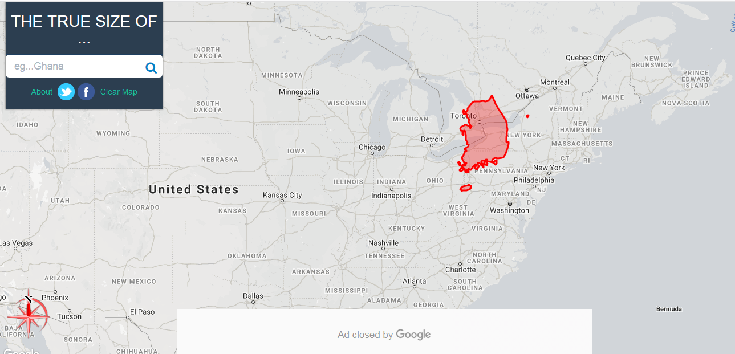
The true size of countries
https://thetruesize.com/#?borders=1~!MTU4MDg0MTA.NzMyMjMxNQ*NjcwMzUzNQ(MTg5OTA2NDU~!KR*MA.MTgwMDAwMDA)NQ

Slide 15
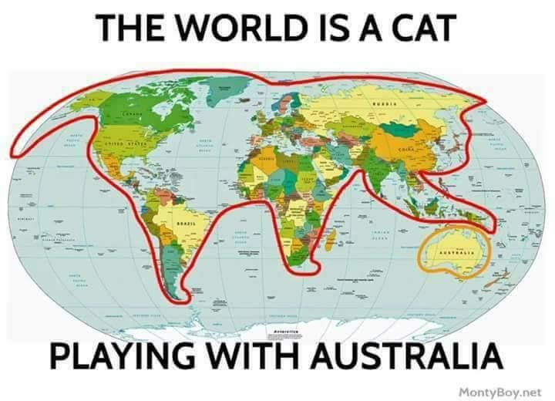
Korea
Italy
Pakistan (dog)

Slide 16
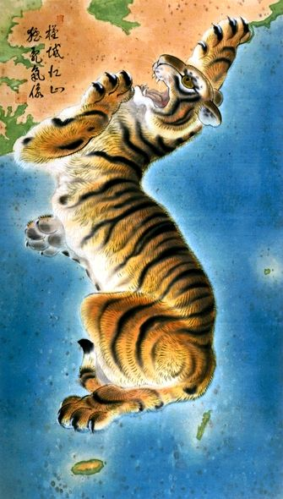
It looks like a tiger.

Slide 17
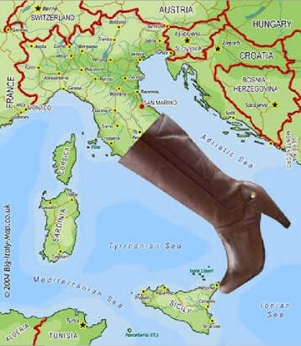
It looks like a boot.

Slide 18
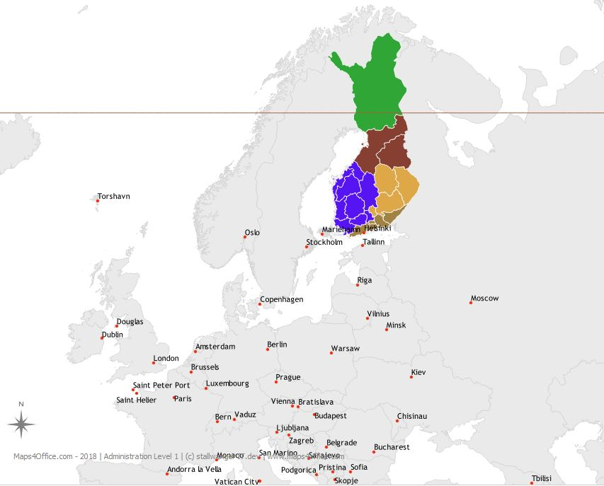
It looks like a rabbit.

Slide 19
It looks like a dog.

Slide 20
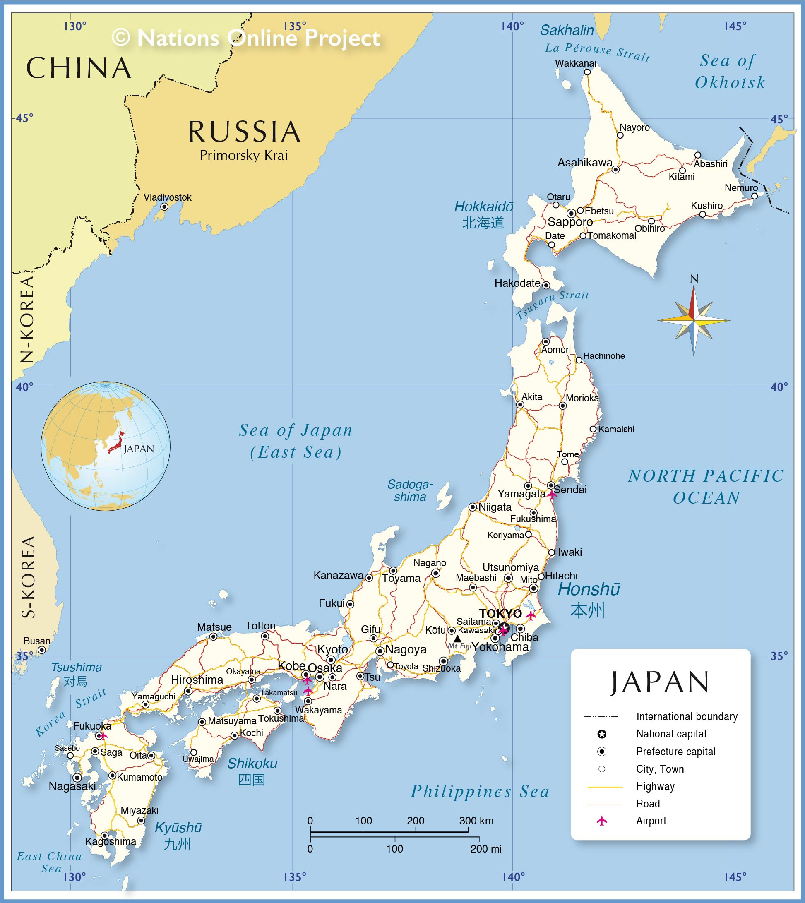
It looks like a seahorse.

Slide 21
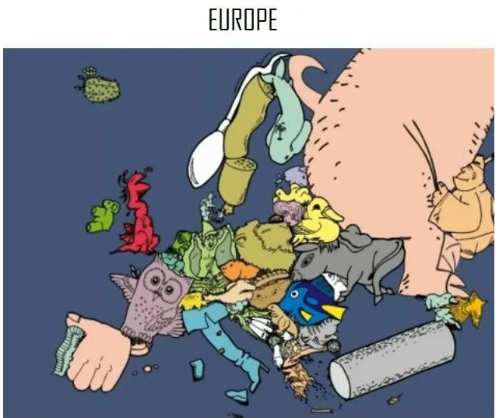

Slide 22
Explain the map

Slide 23
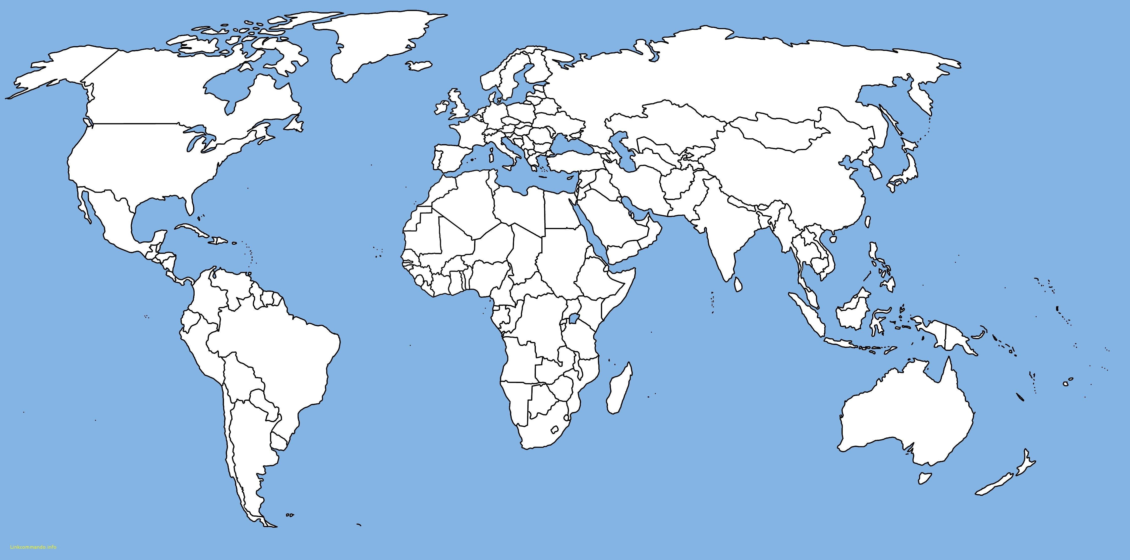
1
2
3
4
5
6
7
8
9
10
11
12
13
14
15
16
17
18
19
20
21
22
23
24
25
26
27
28
29
30
31
32
33
34
35
36
37
38
39
40
41
42
43
44
45
46
47
48
49
50
51
52
53
54
55
56
57
58
59
60

Slide 24
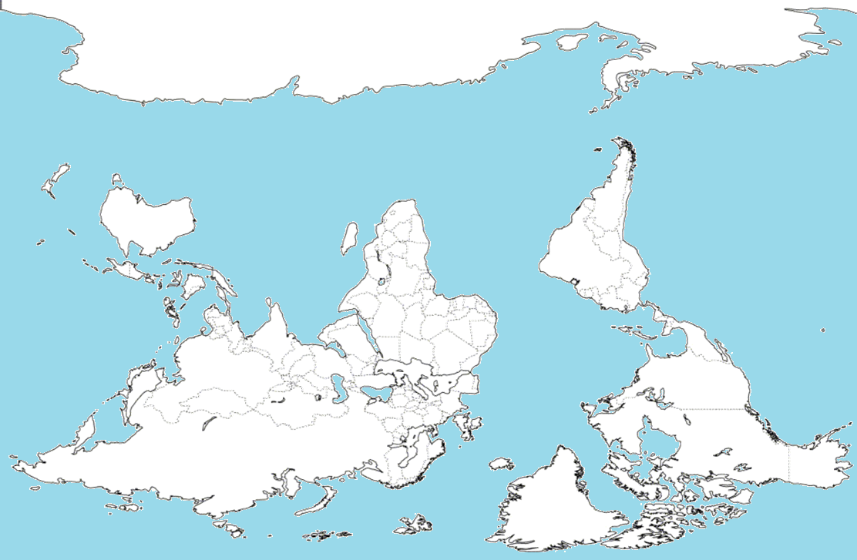
Root Menu
Upside-down map

Slide 25
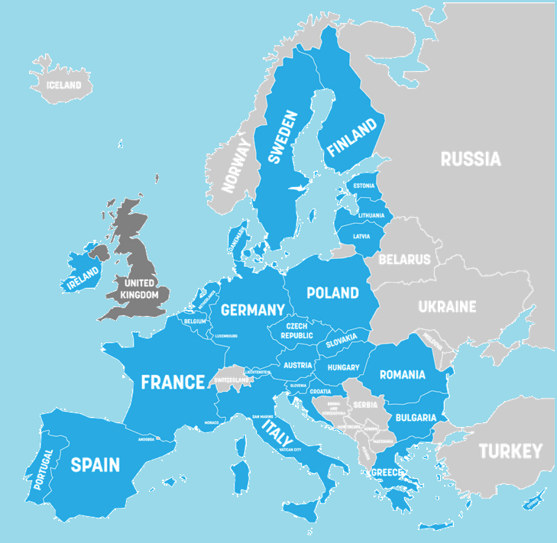
Root Menu
Members of the European Union

Slide 26
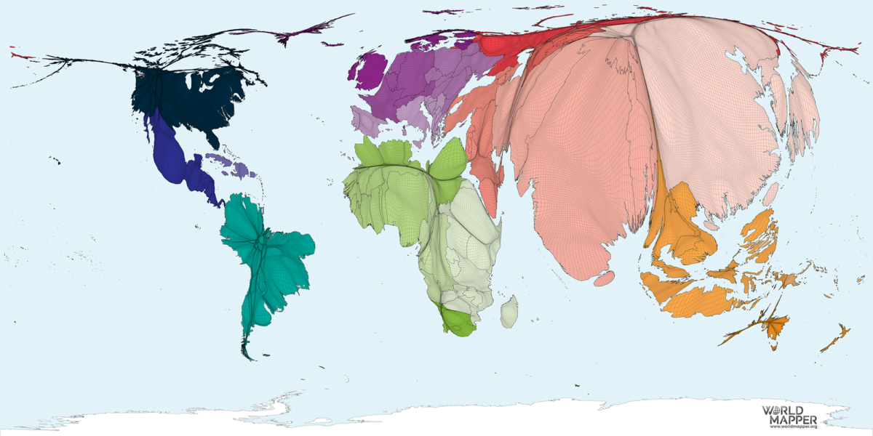
Root Menu
Area = Population

Slide 27
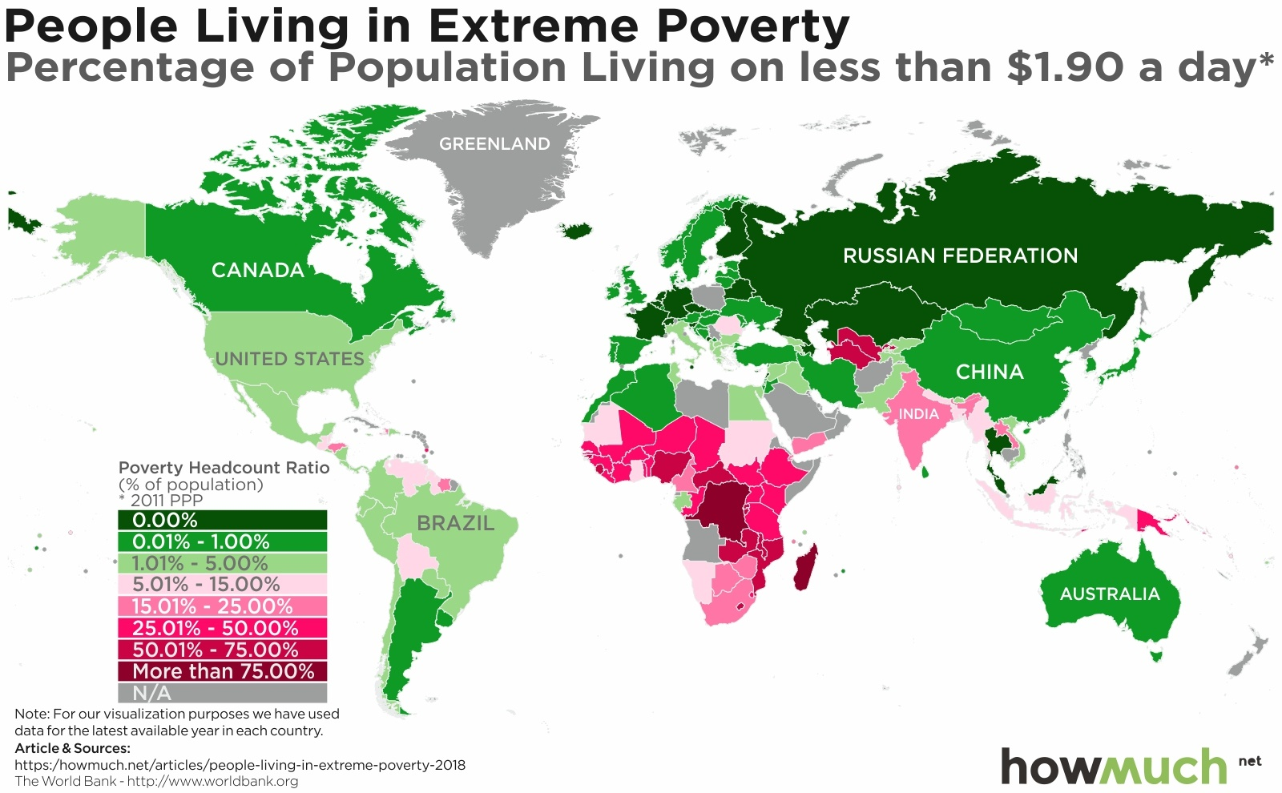
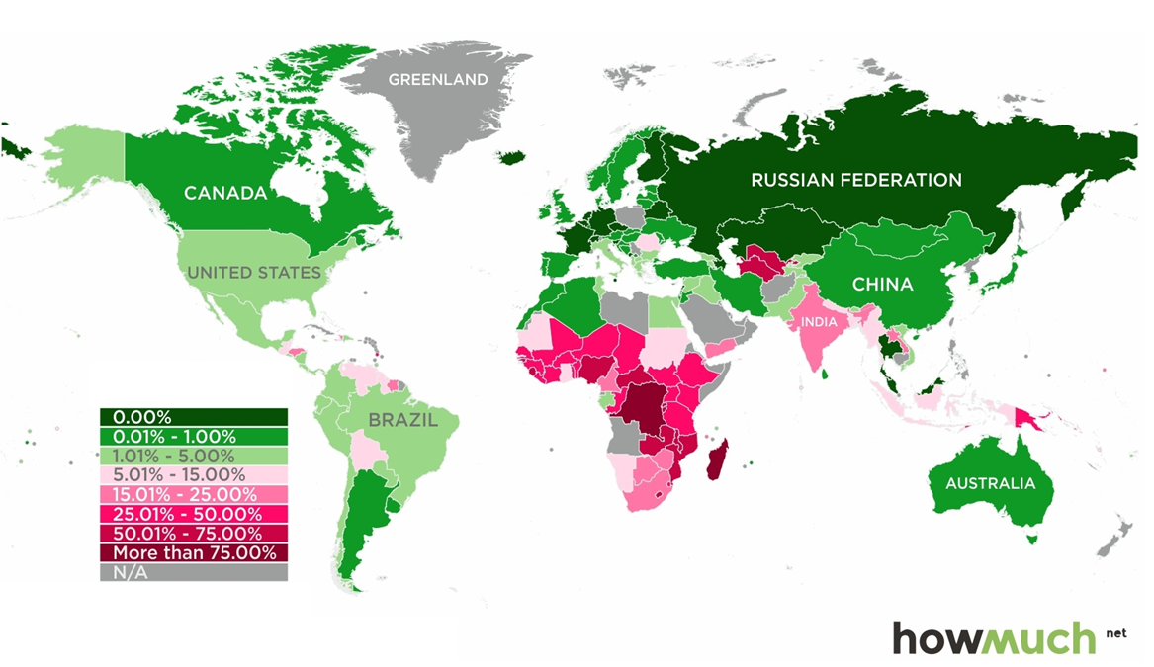
Root Menu
Percentage Living in Extreme Poverty

Slide 28
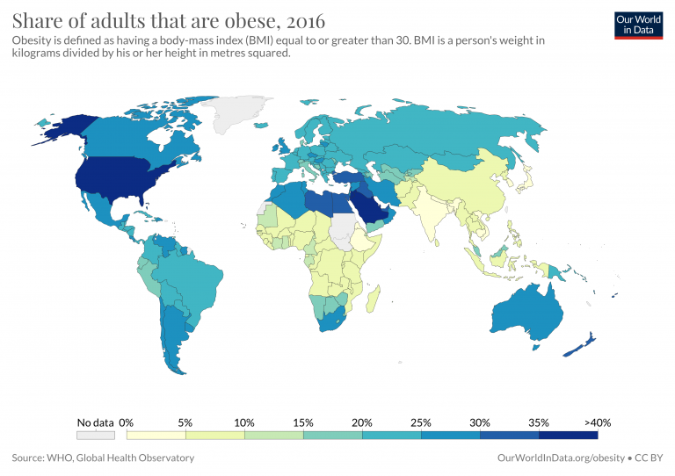
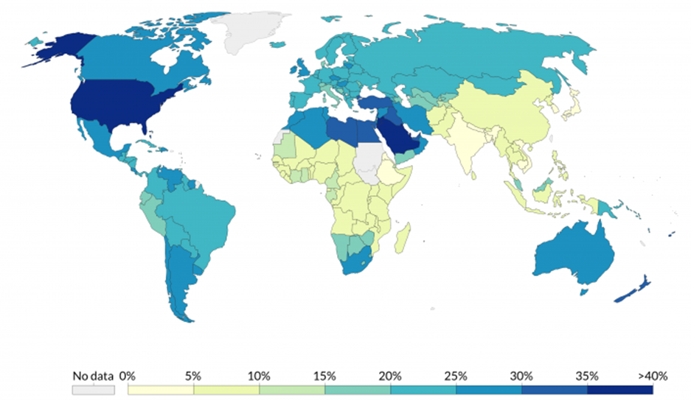
Root Menu
Adult Obesity %

Slide 29
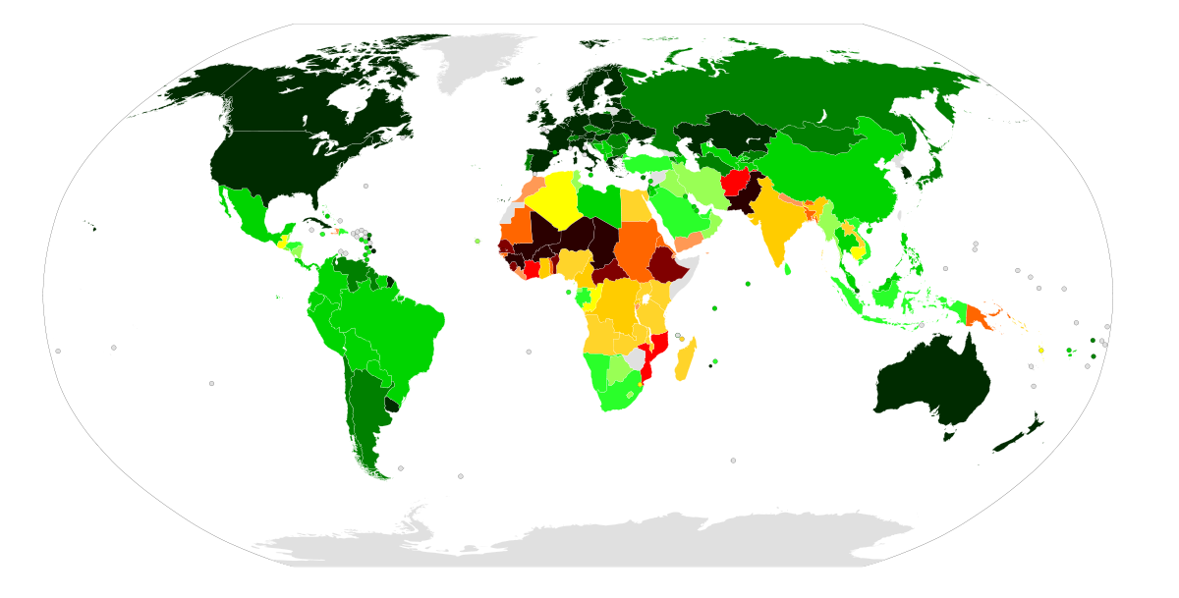
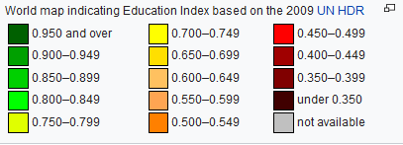
Root Menu
Education Index

Slide 30
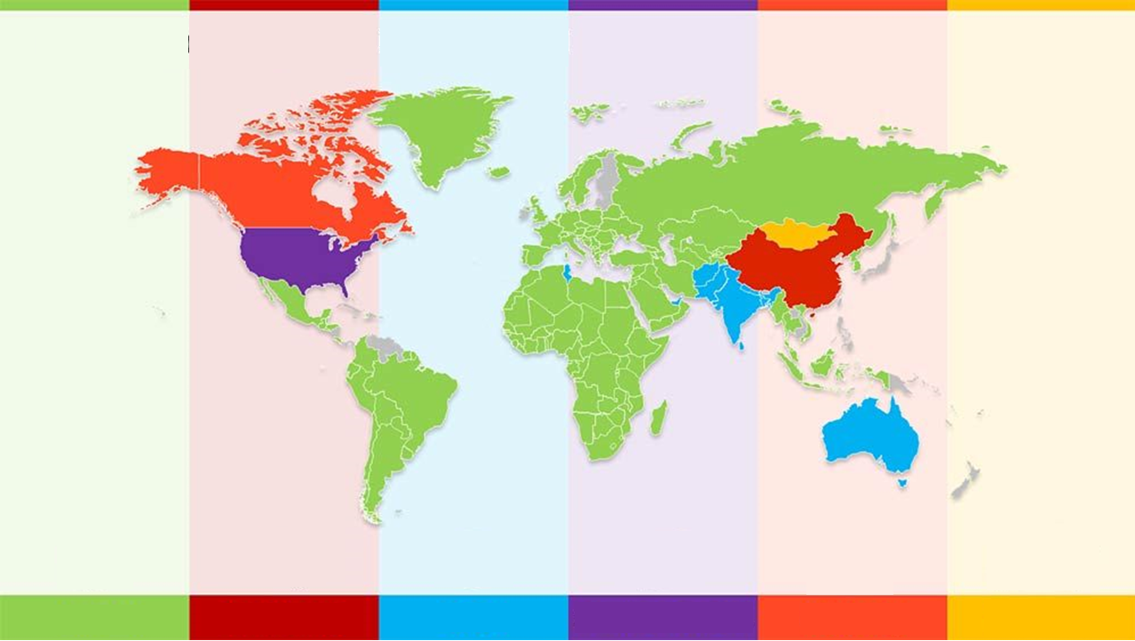
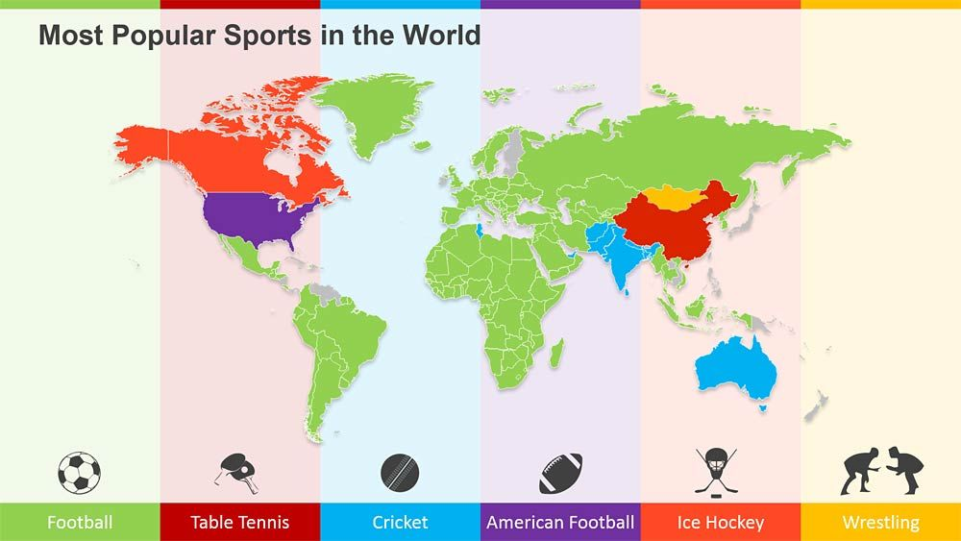
Root Menu

Slide 31
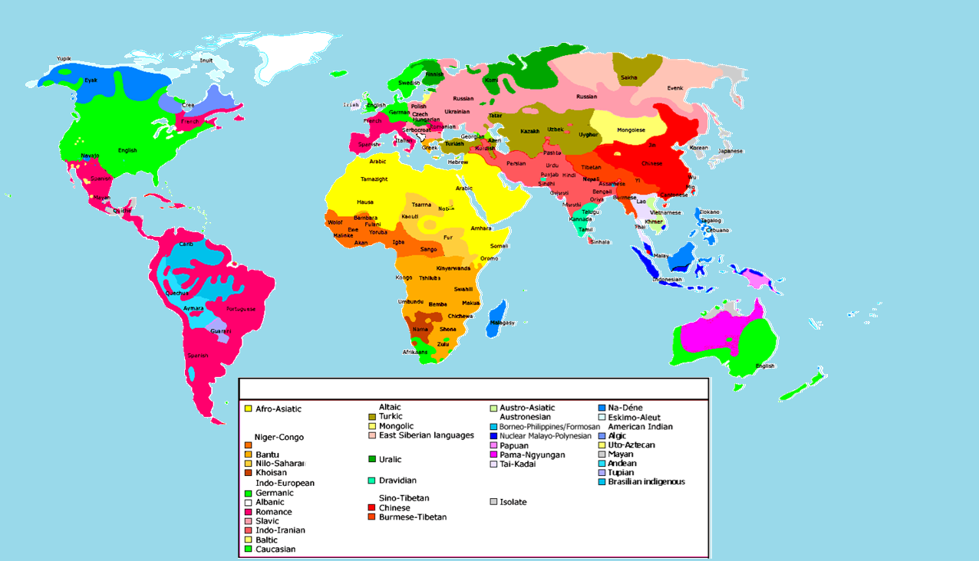
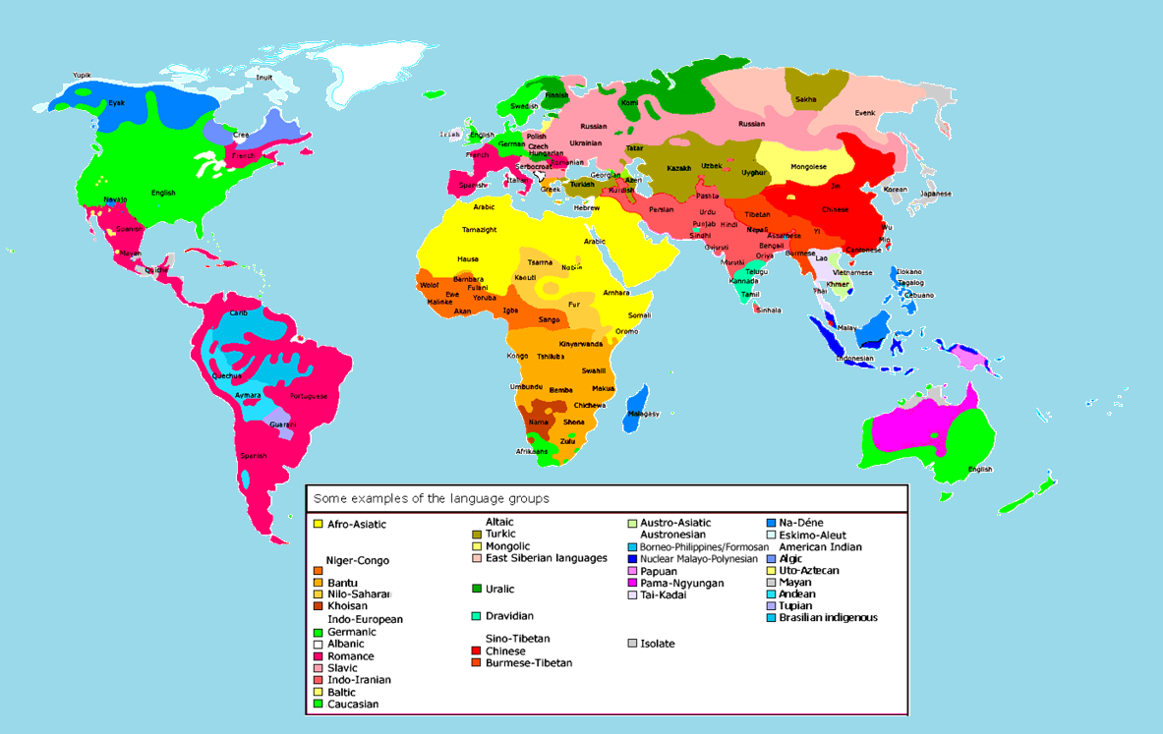
Root Menu
Language Groups

Slide 32
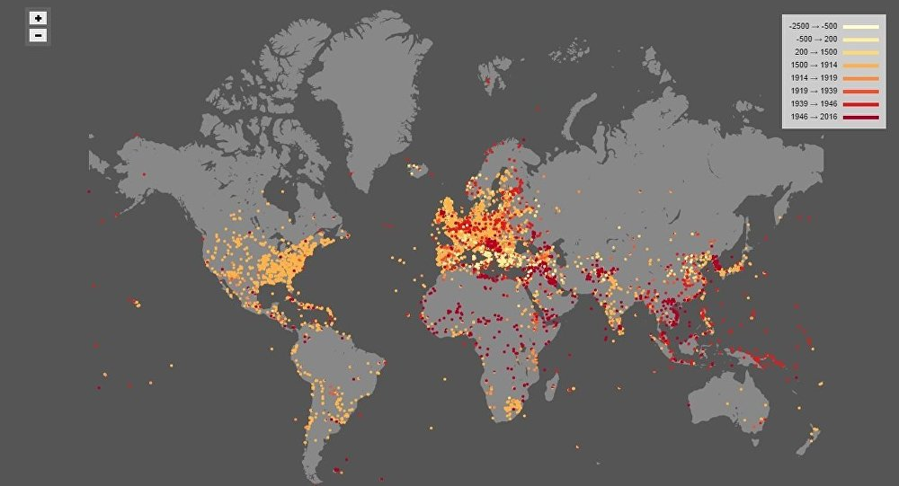
Root Menu
Wars Through History

Slide 33
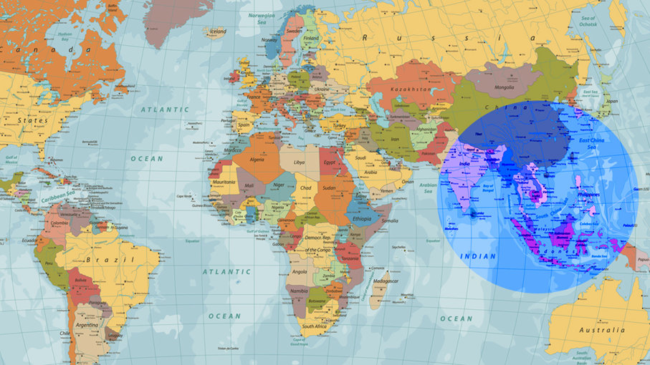
Root Menu
Half of the World’s Population Lives in the Circle

Slide 34
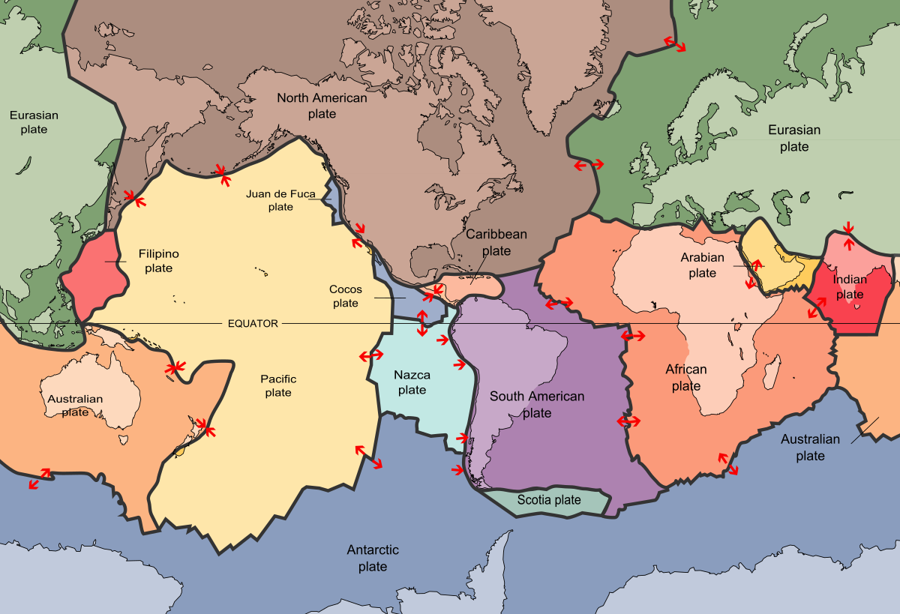
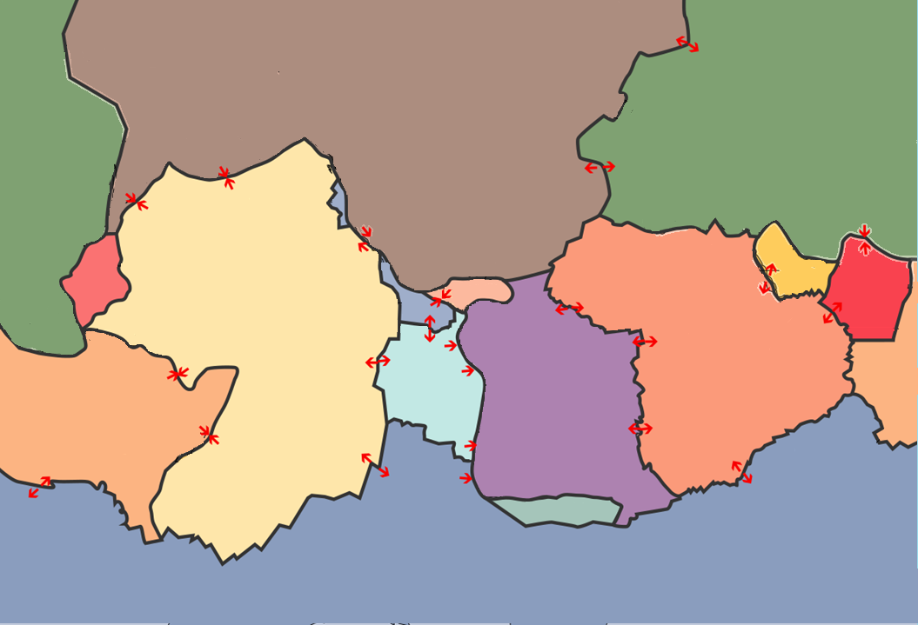
Root Menu
Tectonic Plates

Slide 35
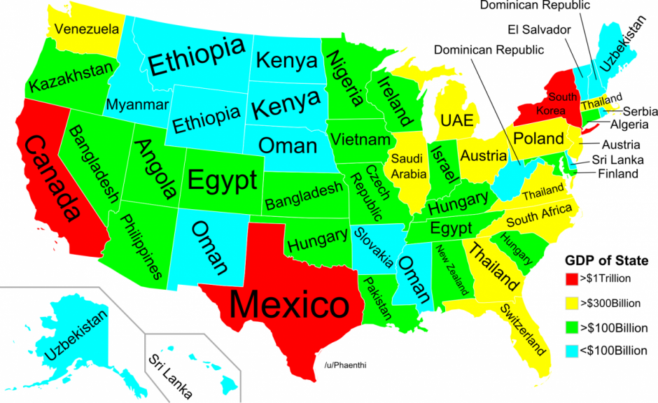
Root Menu
Similar GDP to each State

Slide 36
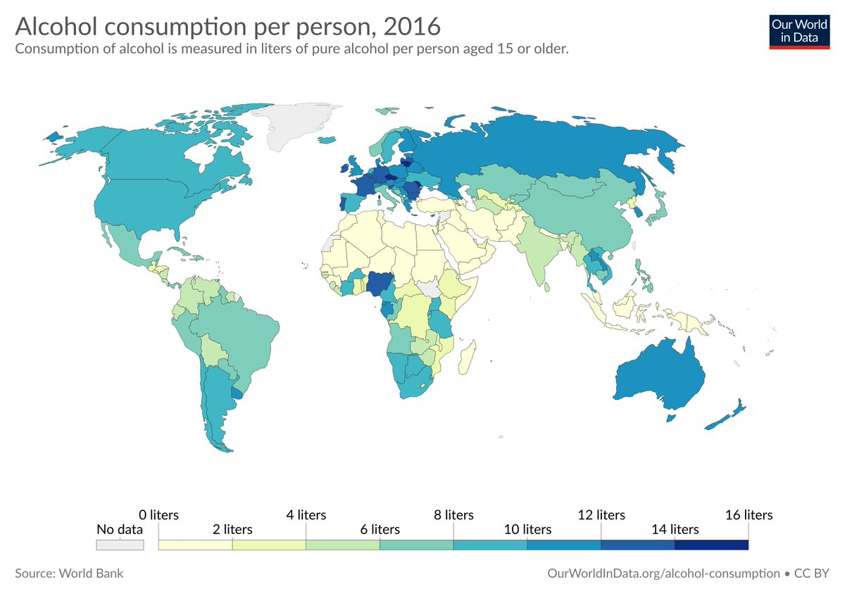
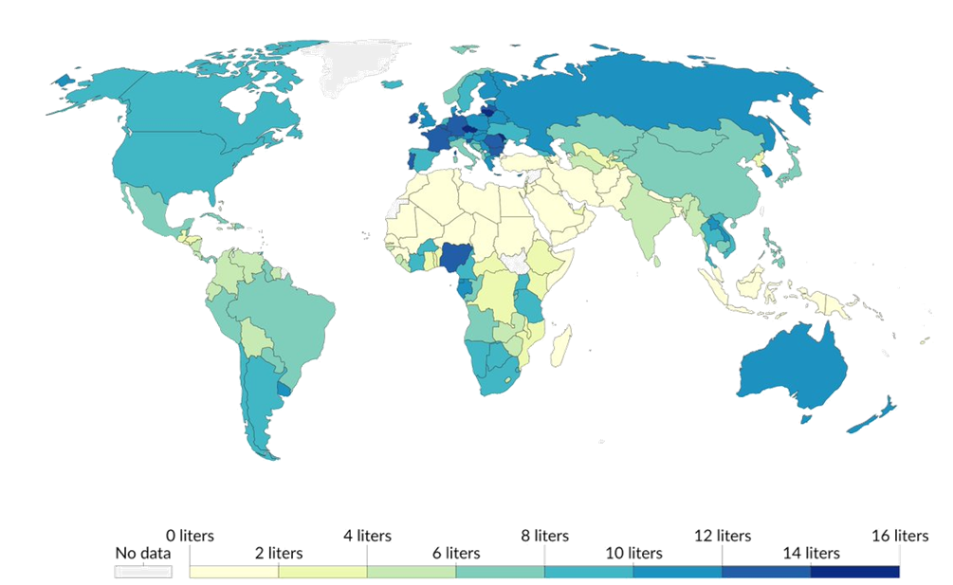
Root Menu
Alcohol Consumption

Slide 37
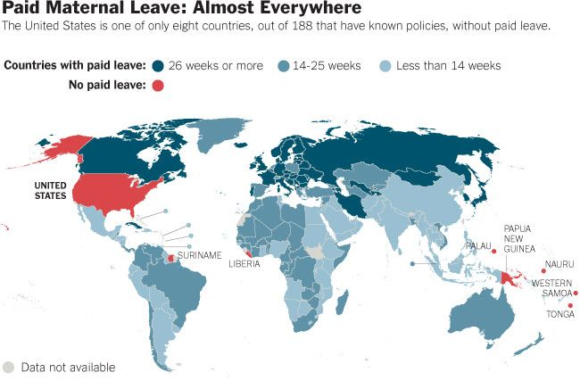
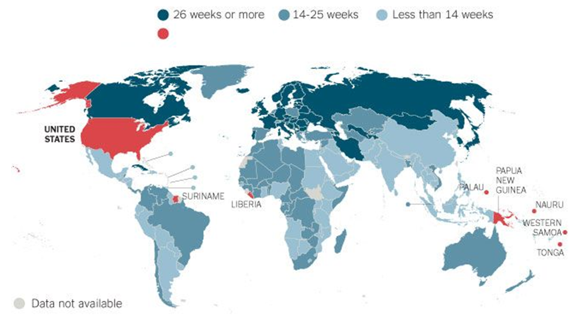
Root Menu

Slide 38
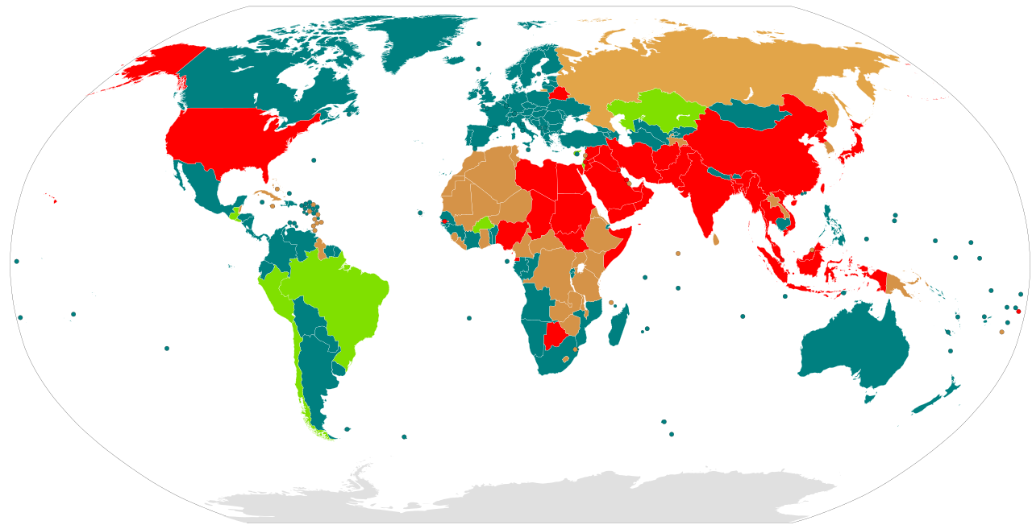
Root Menu
Capital Punishment

Slide 39
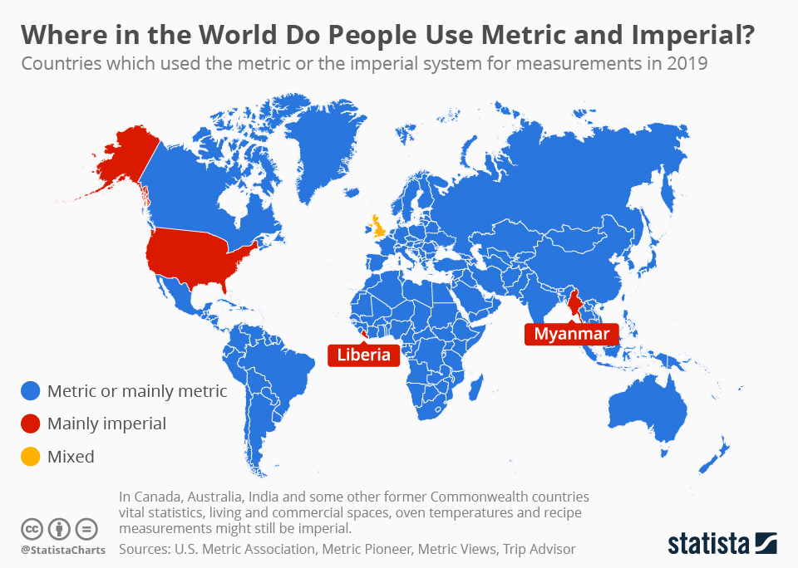
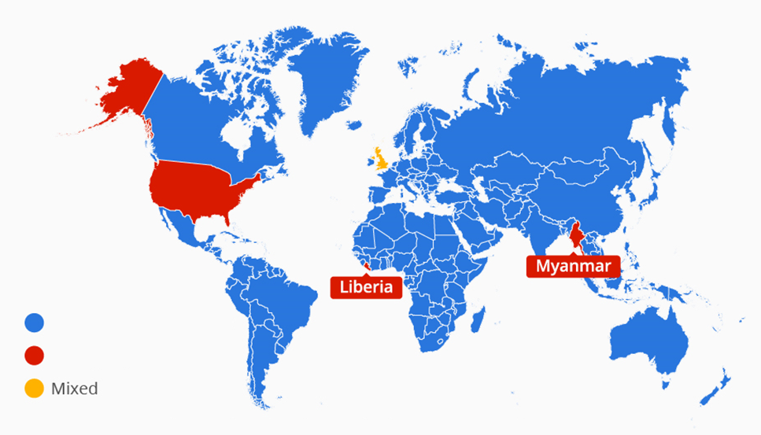
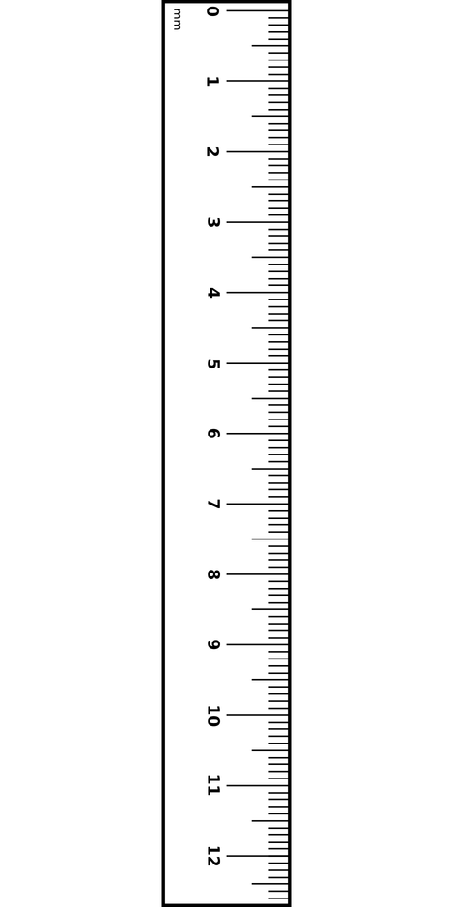
Root Menu

Slide 40
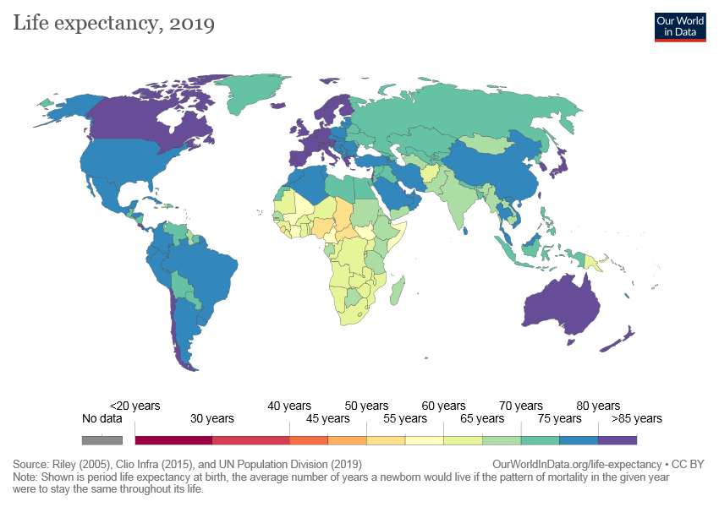
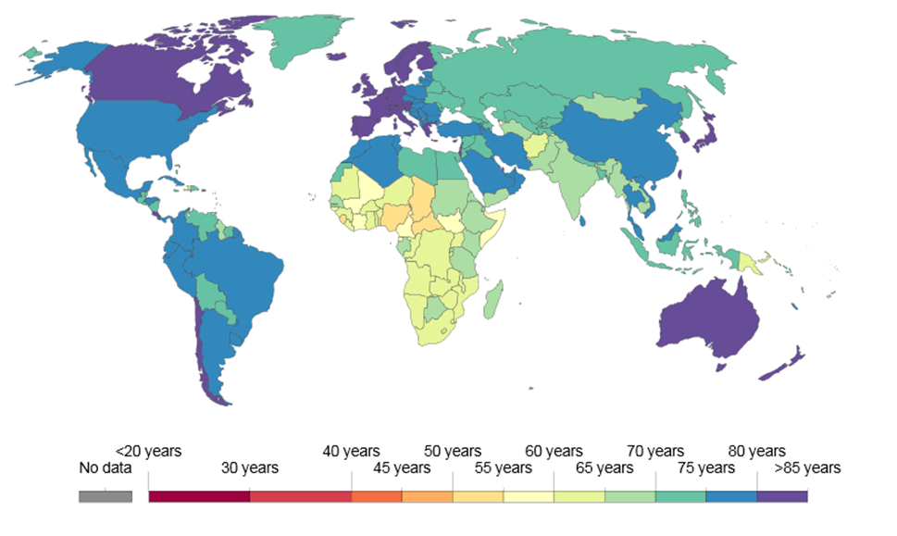
Root Menu

Slide 41
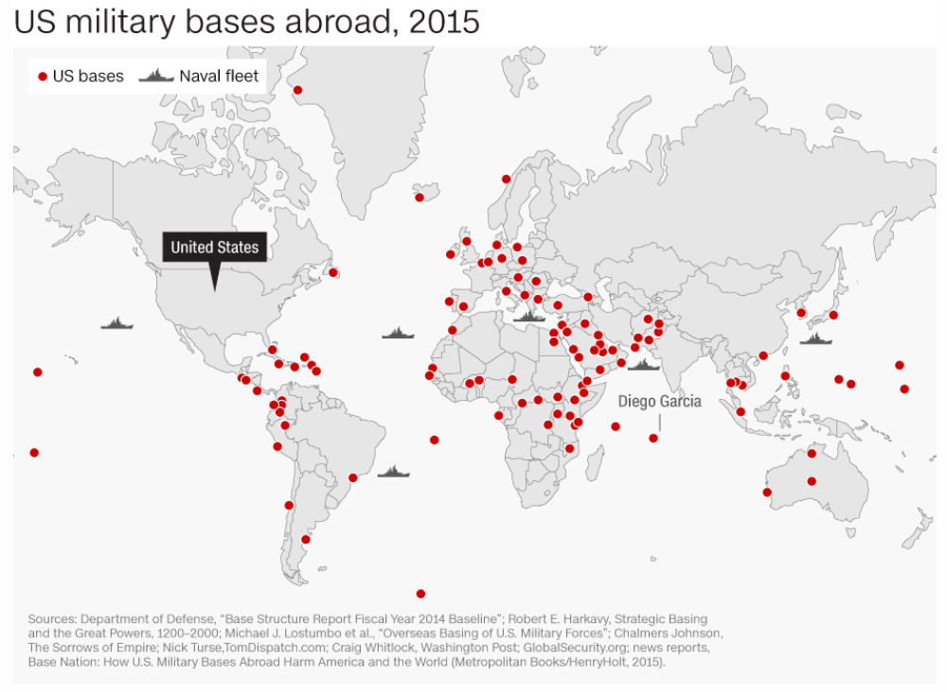
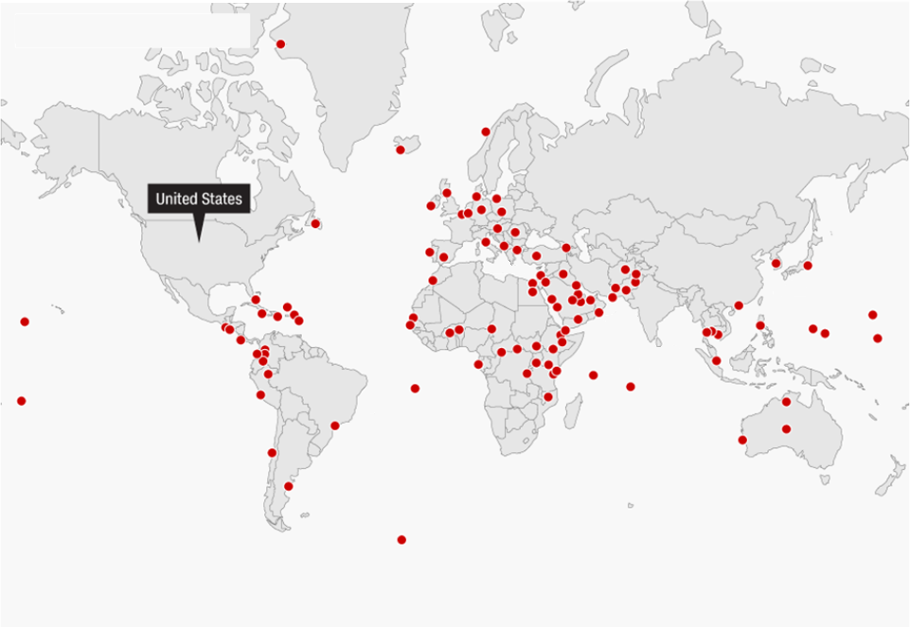
Root Menu

Slide 42
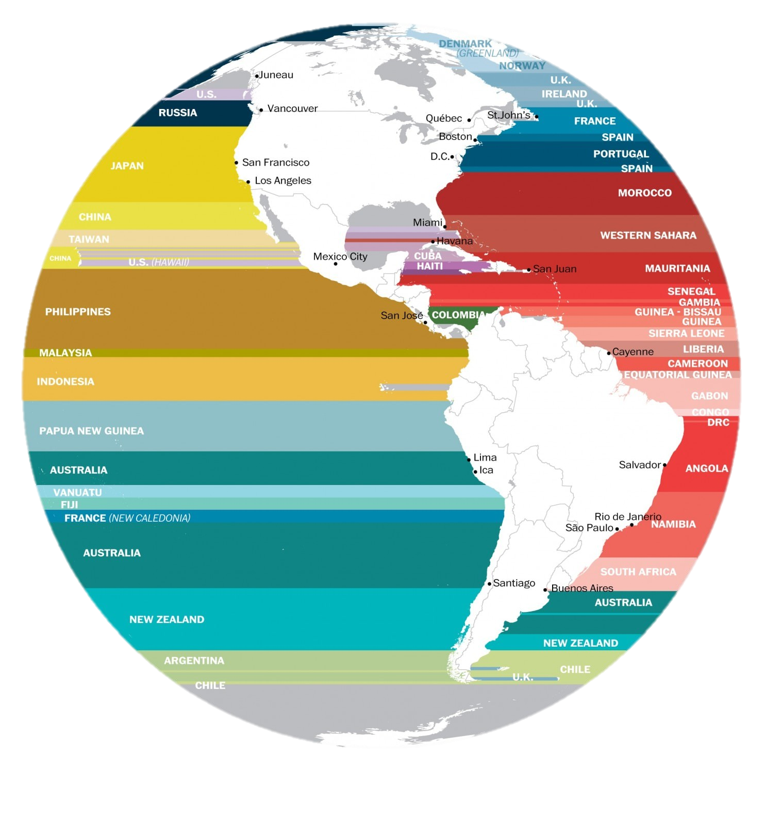
Across the Ocean

Slide 43
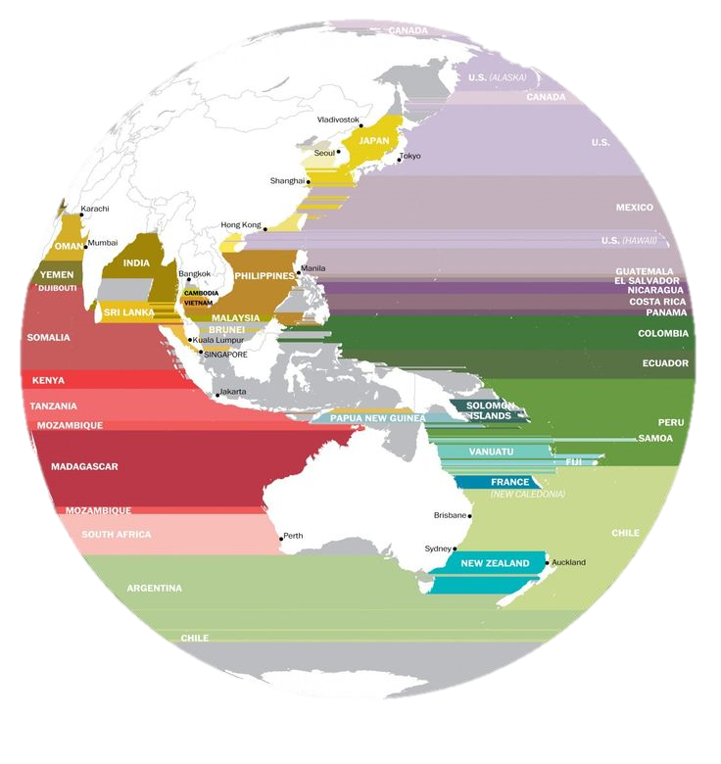
Root Menu

Slide 45
Root Menu

Slide 46
Root Menu
YouTube Access

Slide 47
Root Menu

Slide 48
Root Menu

Slide 50
Root Menu

Slide 51
Root Menu
Moons vs Flags

Slide 52
Root Menu
Mongol Empire

Slide 53
Root Menu
The Scramble for Africa
France
Britain
Netherlands
Italy
Portugal
Belgium
Spain

Slide 54
28Most visited countries
Root Menu

Slide 55
Root Menu
Driving Side

Slide 56
Root Menu
Cities with over 1 Million People

Slide 57
Root Menu
Railroads

Slide 58
Root Menu
Type of Electrical Outlet

Slide 59
33Coutnries that hosted the olympcs
Root Menu
Countries that Hosted the Olympics

Slide 60
34National IQ score
Root Menu
IQ Average

Slide 61
35Map of mars with water
Root Menu
Mars With Water

Slide 62
36Immigrants as a percentage of population
Root Menu

Slide 63
37English speakers
Root Menu
English Speaker (% of Population)

Slide 64
38Second languages
Root Menu
Language Being Studied

Slide 65
39Nuclear weapons
Root Menu
Countries with Nuclear Weapons

Slide 66
Root Menu
Elephant Range

Slide 67
41Gay marriage is legal
Root Menu
Legalized Same-Sex Marriage

Slide 68
42Profitable export
Root Menu
Top Exports

Slide 69
43Blonde hair distribution
Root Menu
Blonde Hair

Slide 70
44Number of internet users
Root Menu
Number of Internet Users

Slide 71
45 1570 - Old maps first of north America(ortelius)
Root Menu
Ortelius Map (1570)

Slide 72
46Viking conquest
Root Menu
Viking Settlements

Slide 73
47Most popular website
Root Menu
Tiger Range

Slide 74
48Emerging mega regions
Common Last Names

Slide 77
Root Menu

Slide 78
49Total precipitation
Root Menu
Total Annual Rainfall

Slide 79
50Eye color
Major Mountain of the Earth
Root Menu

Slide 80
51Countries colonized by Europe
Root Menu

Slide 81
52Pangea today
Root Menu
Pangaea with Modern Countries

Slide 82
53Friendliness towards visitor s
Friendliness to Foreigners
Root Menu

Slide 83
54Global peace index
Root Menu
Airplanes

Slide 84
55Korea from space?
Root Menu
Korea From Space (Night)

Slide 85
56French territories
Root Menu
French Territories

Slide 86
57Google street coverage
Root Menu
Google Street View

Slide 87
58what the world would look like if all of the ice melted
Root Menu
If the Poles Melted

Slide 88
59Time Zones
Root Menu

Slide 89
60Median Age
Root Menu
Average Age

Slide 90
Distorted Maps:
https://worldmapper.org/maps/
Terrible (funny) Maps:
https://www.boredpanda.com/funny-terrible-maps/?utm_source=google&utm_medium=organic&utm_campaign=organic
1 Hour of Maps
https://www.youtube.com/watch?v=8xM7afTG2Jk
Our World in Data (Informative maps)
https://ourworldindata.org/
Make Your Own Maps:
https://mapchart.net/

