Slide 1
Crew Selection

Slide 2
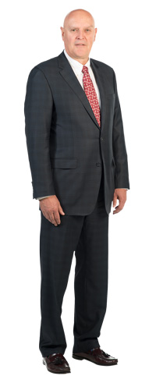
Name: George Stamford
Name: Bob Thornton
Gender:
Age:
Job:
Male
57
CEO
Gender:
Age:
Job:
Male
15
Buddhist
Monk
Bio:
Since he was young, Bob has always wanted to go to Mars. He started an electronics company and became rich. He destroyed his competition. He is aggressive. He does not like being told what to do. But, he will give you some extra money if you select him for the crew.
Bio:
George is young and religious. He believes that everyone should be kind to one another. It is his job to suffer for the rest of the crew. He doesn’t have many skills and he is not strong. But, he will do anything to help other people.

Slide 3
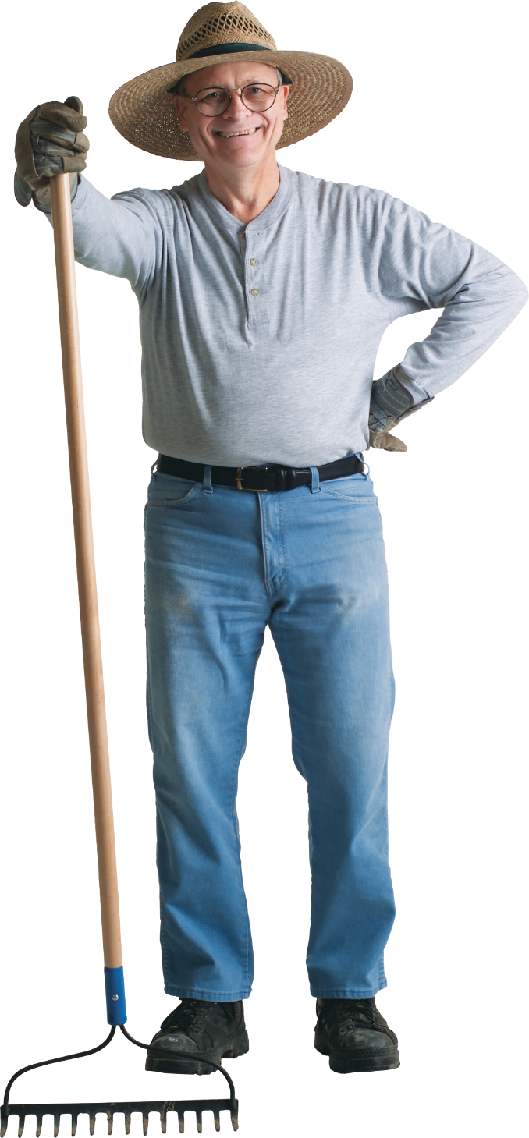
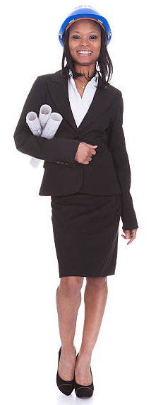
Name: Frank Rivers
Name: Lisa Angle
Gender:
Age:
Job:
Male
45
Farmer
Gender:
Age:
Job:
Female
39
Engineer
Bio:
Bio:
Frank is a quiet person. He is a hard worker and is strong despite his age. He has a good knowledge of how to grow crops in various soils. He likes working alone.
Lisa was always one of the top students in her class. She decided to become an engineer. She is really good at designing buildings and has some knowledge about machines as well. She does not like to do physical work, but she will if you select her for the crew.

Slide 4
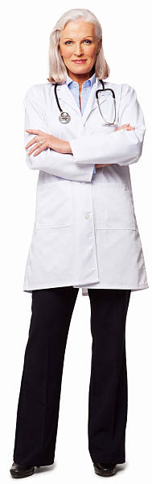
Name: Sarah Borland
Name: Samantha Fox
Gender:
Age:
Job:
Female
29
Teacher
Gender:
Age:
Job:
Female
62
Doctor
Bio:
Bio:
Sarah is an elementary school teacher. She is very interested in Mars and thinks it will be an exciting opportunity. She is really good at getting people to cooperate. She can take on the role of a leader or be a good team player. She is willing to help any way she can. Unfortunately, she does not have much special knowledge.
Samantha has many years of experience as a doctor. She can diagnose any disease and knows how to treat them. She even spent some time as a military doctor. She is surprisingly strong. But she does not want to be a leader. She would rather just do her job.

Slide 5
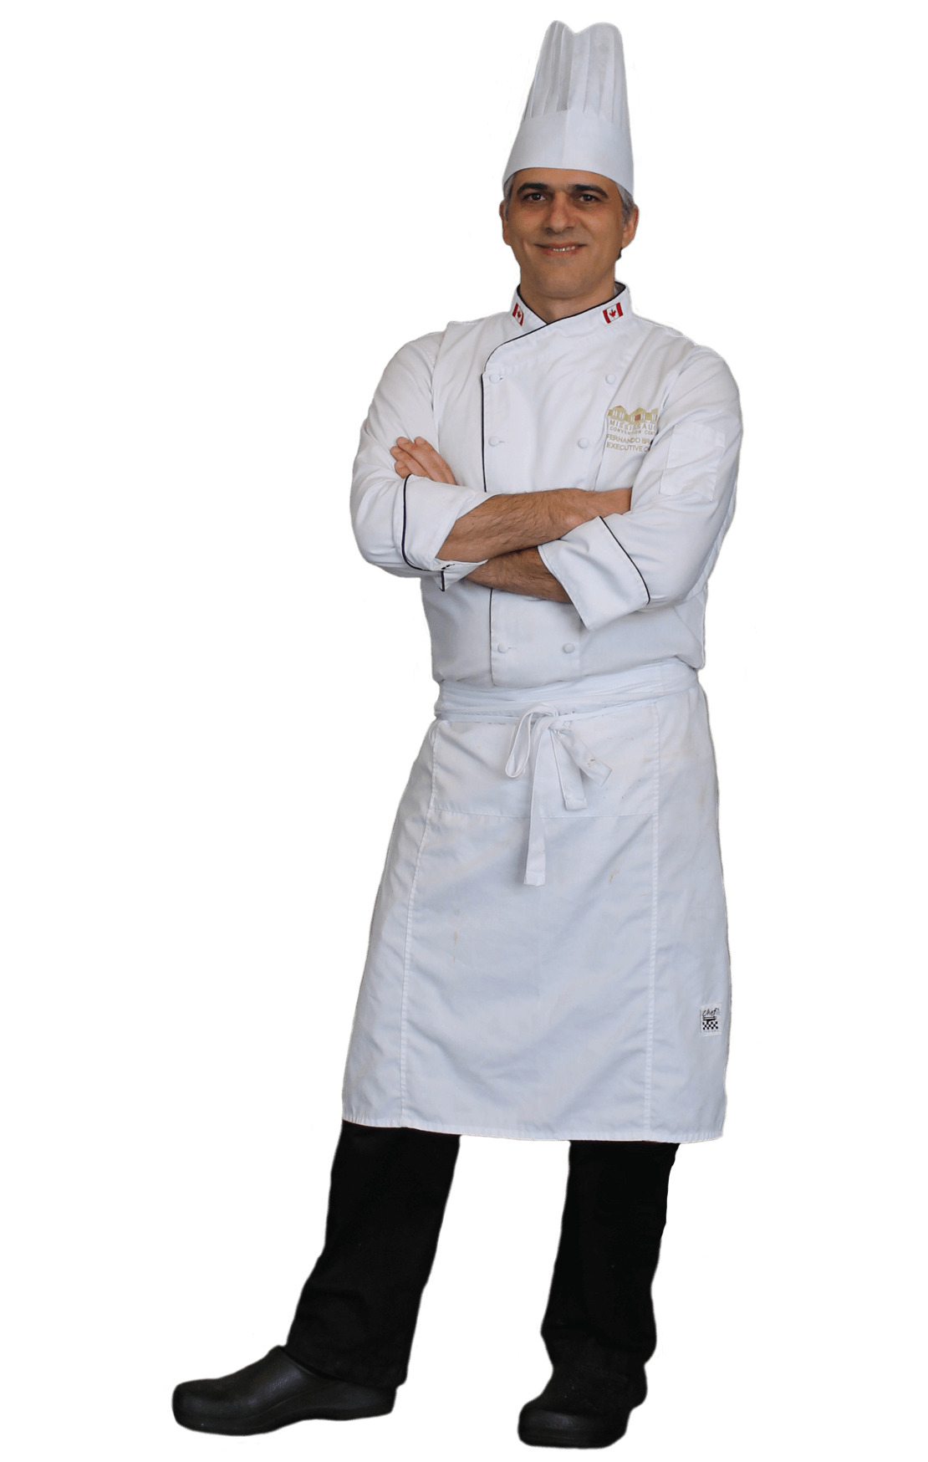
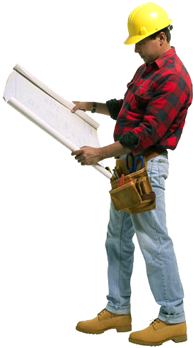
Name: Simon Skinner
Name: Hal Ragnow
Gender:
Age:
Job:
Male
26
Construction
Worker
Gender:
Age:
Job:
Male
37
Chef
Bio:
Hal has a lot of experience as a chef. In his restaurant he serves many customers every night. He also loves to experiment with new recipes. He is used to being a leader, but he can cooperate with others. Don’t count on him to do much physical work around the base though.
Bio:
Simon is a team player. He cooperates well and is very strong. He has experience building and can operate machine. He has some engineering knowledge, but mostly he is valuable as a worker. He gets along with everyone.

Slide 6
Name: Brian Holler
Name: Michelle Lee
Gender:
Age:
Job:
Male
48
Scientist
Gender:
Age:
Job:
Female
44
Lawyer
Bio:
Bio:
Brian has a broad understanding of the physical sciences (physics, biology, chemistry). But he focused mostly on plant biology. He is a genius and has knowledge about many things. He can also help with physical work, but his brain is his biggest advantage.
Michelle graduated from a top law school and is a defense attorney. One of her best skills is negotiation. She knows how to get people to work out their problems together. She is a natural leader, but probably won’t do much physical work.

Slide 7
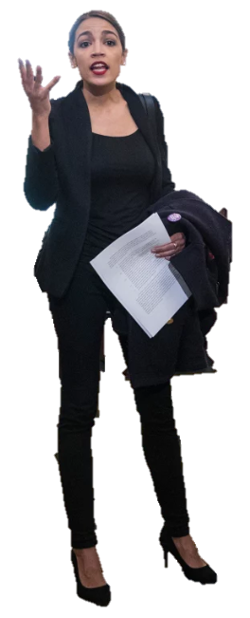
Name: Elizabeth Walker
Name: Maria Stansfield
Gender:
Age:
Job:
Female
24
Politician
Gender:
Age:
Job:
Female
31
Police
Officer
Bio:
Bio:
Elizabeth did not do too well in school. She became a police officer because she wanted to protect and help other people. She is strong and will help anyone.
Maria is opinionated. She loves to argue. She fights for less fortunate (or weaker) people. She is quite smart but thinks she is always right. She would rather use her words than her muscles.

Slide 8
Name: Derk Manley
Name: Amelia Stinger
Gender:
Age:
Job:
Male
52
Army Captain
Gender:
Age:
Job:
Female
34
Pilot
Bio:
Bio:
Derk is a natural leader. He has been leading men for a long time. He knows how to get the most out of people. He is strong and takes orders well. He obeys the rules and does what he is told. His main advantage is his leadership.
Amelia is a skilled pilot. She has flown fighter jets and passenger planes. She knows how to navigate and is fairly smart. She also has a lot of technical knowledge about machine, especially aircraft.

Slide 9
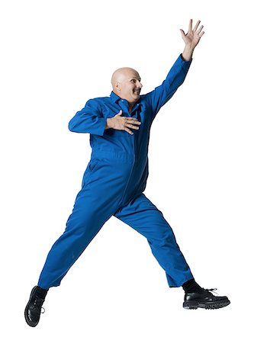
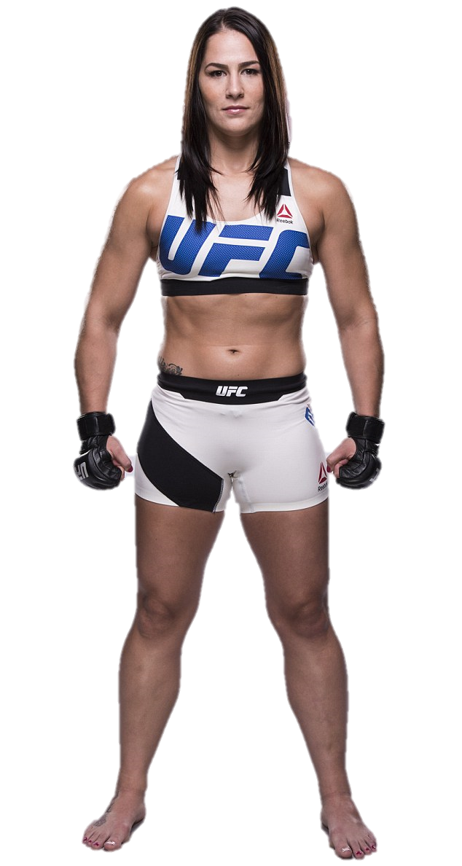
Name: Port Maitland
Name: Terrassa Kyle
Gender:
Age:
Job:
Male
42
Mechanic
Gender:
Age:
Job:
Female
30
Athlete
Bio:
Port has a lot of experience with machines. He instinctively knows what is wrong with cars and other machines. He is also strong and can help the crew with physical work. He has a great sense of humor and everyone loves him. He is overweight and requires more food than the rest of the crew.
Bio:
Terrassa is a UFC fighter. She is physically gifted. She can help the crew with anything physical. She doesn’t have much scientific or mechanical knowledge. Because she is physically talented she expects people to treat her better than everyone else.

