Slide 1
What is the Ugliest Color?
Pantone 448C

Slide 2
Ranking
Discussion Games

Slide 3
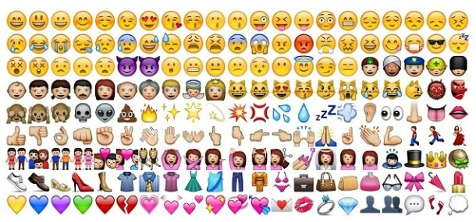
Emojis

Slide 4
Most Popular Emojis
Choose which one you think is most popular on Twitter…

Slide 5
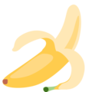
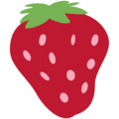
Most Popular Fruit Emoji

Slide 6
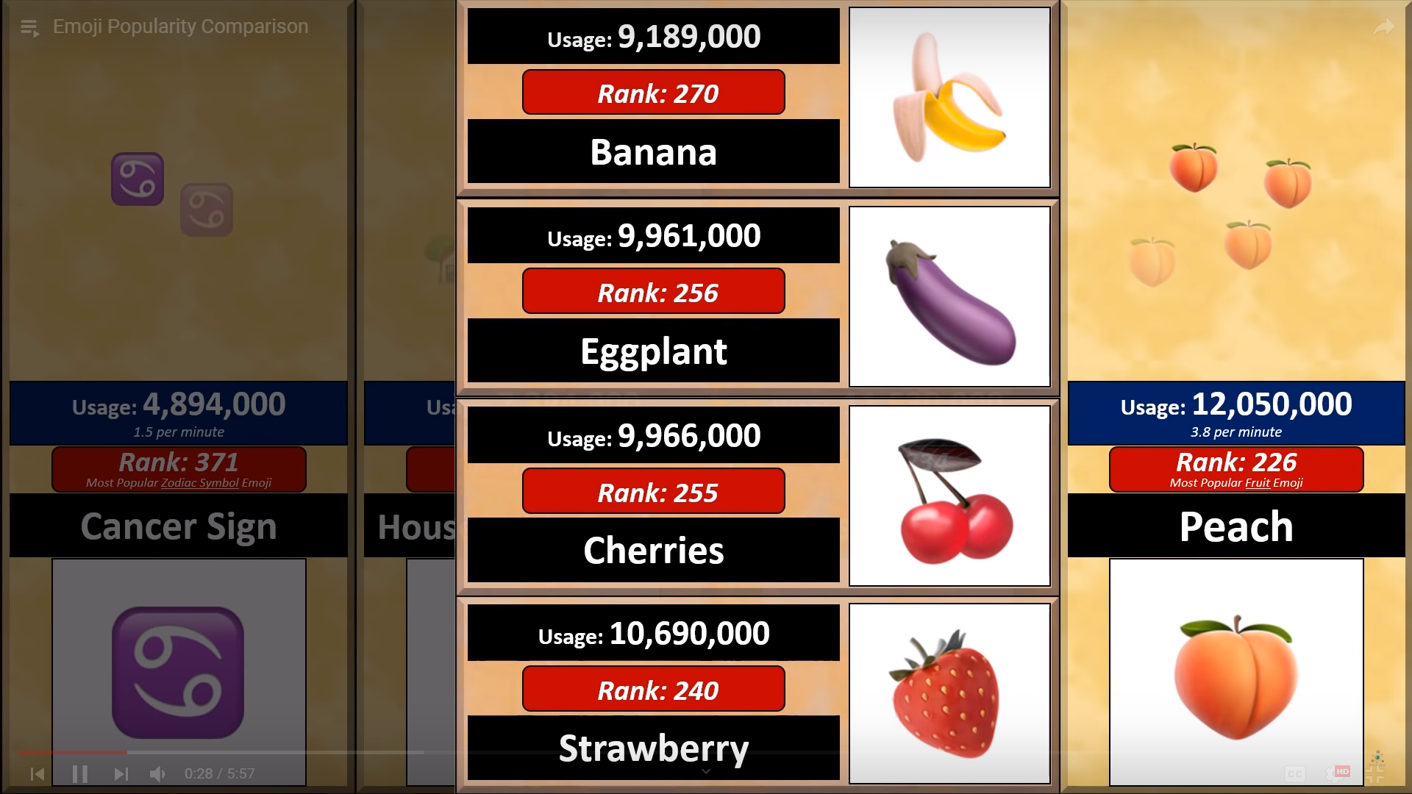

Slide 7
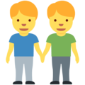
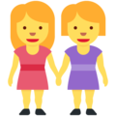
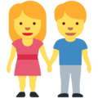
Most Popular Family Emoji

Slide 8
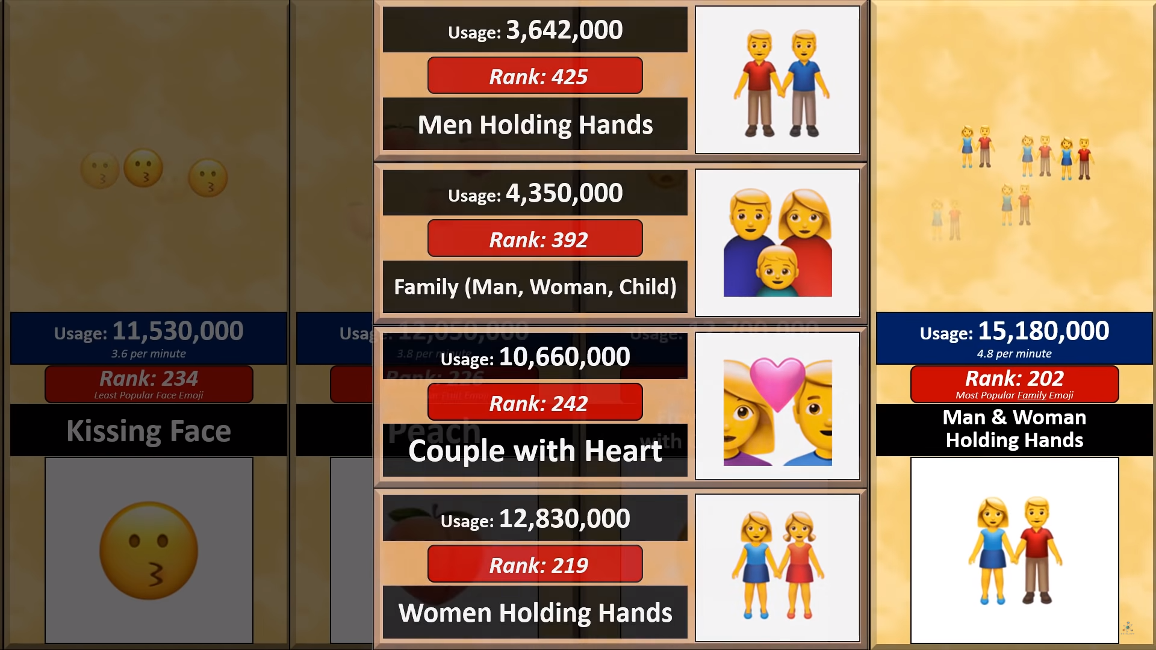

Slide 9
Most Popular Animal Face Emoji

Slide 10
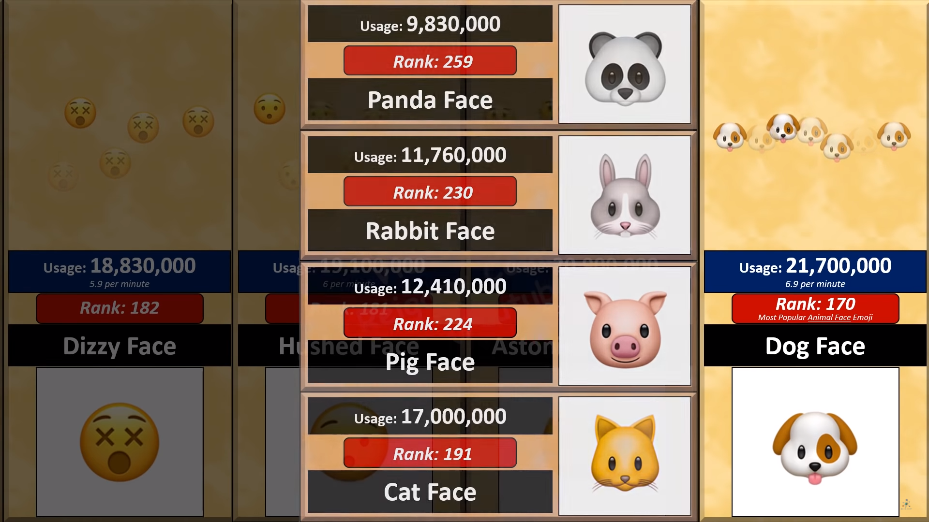

Slide 11
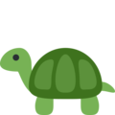
Most Popular Full Animal Emoji

Slide 12
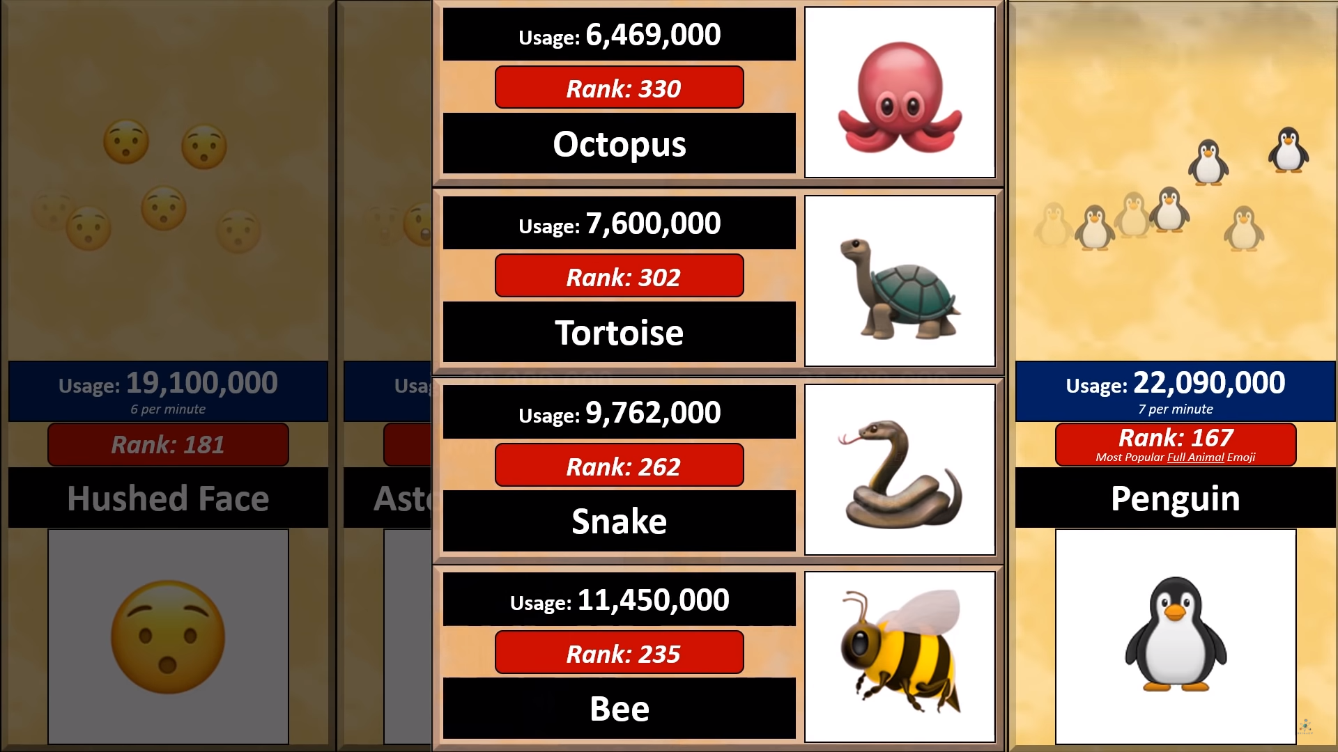

Slide 13
Most Popular Flag Emoji

Slide 14
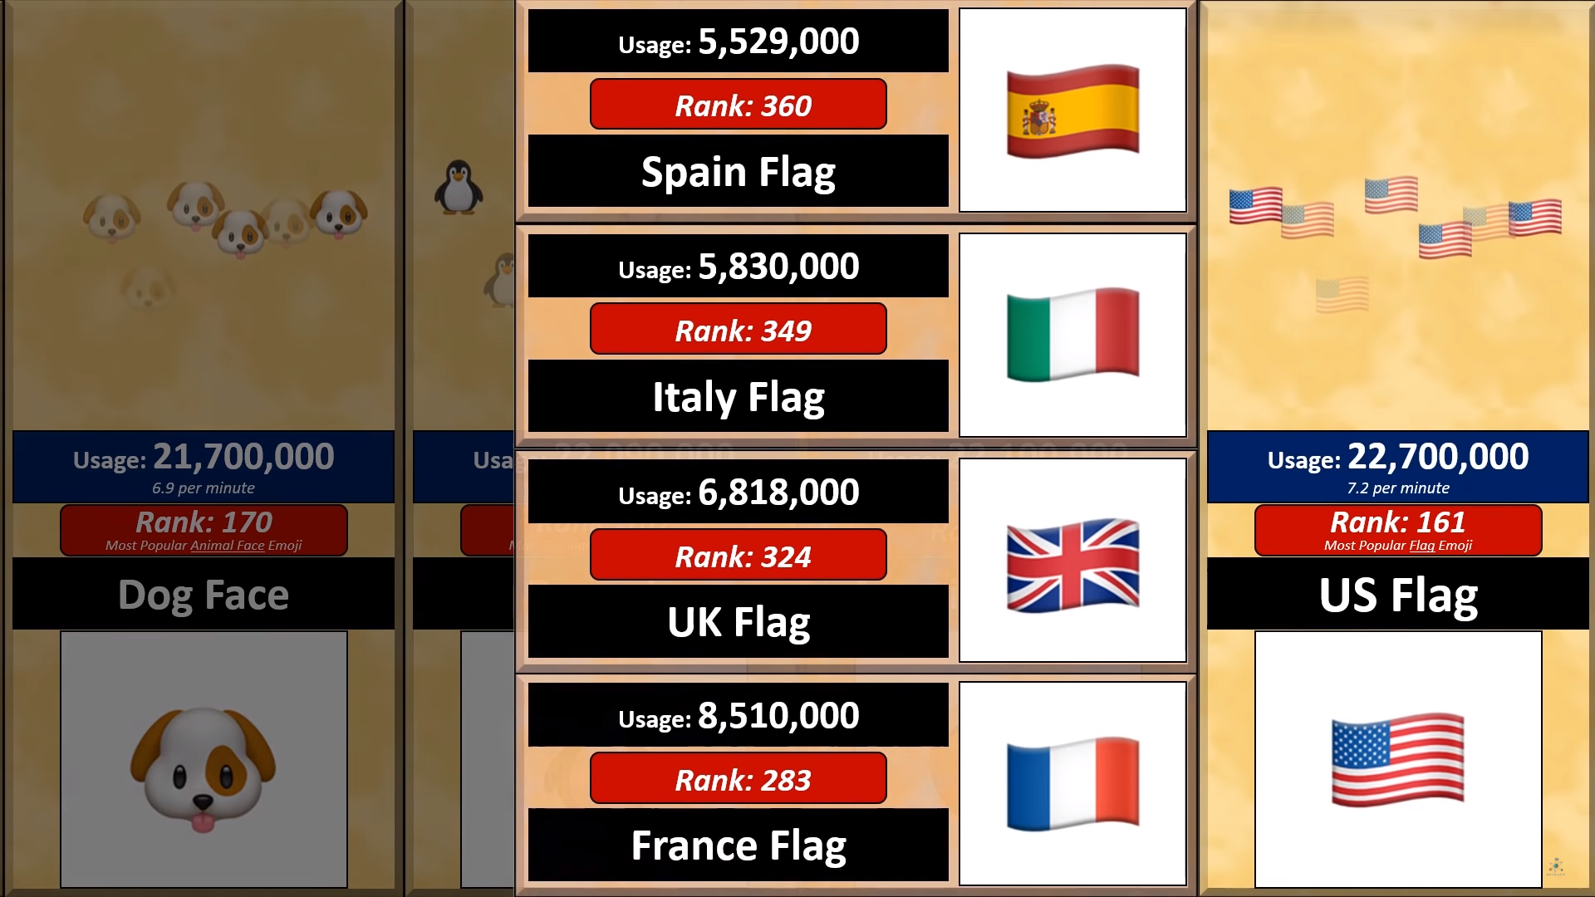

Slide 15
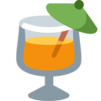
Most Popular Drink Emoji

Slide 16
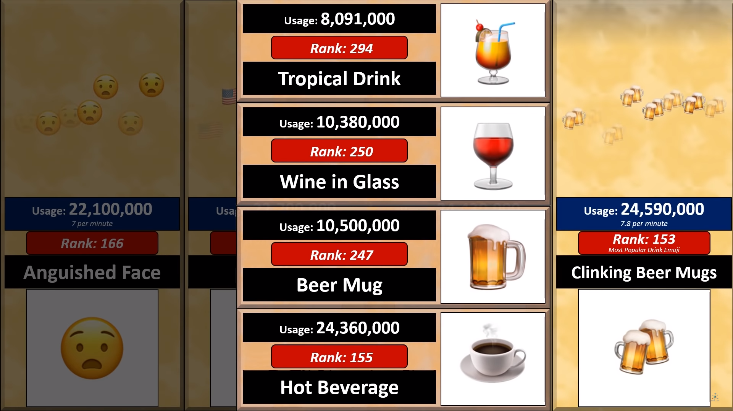

Slide 17
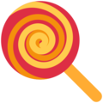
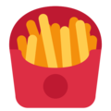
Most Popular Food Emoji

Slide 18
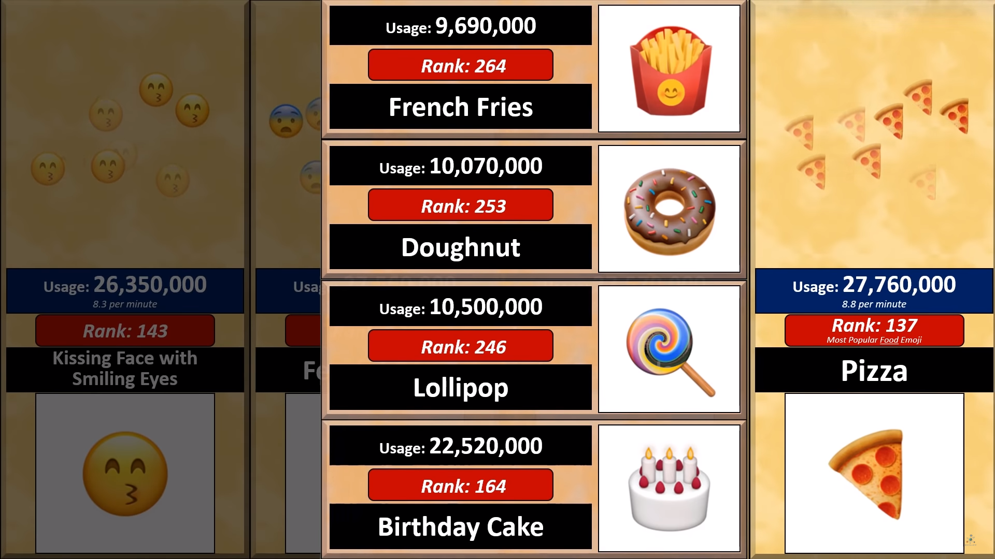

Slide 19
Most Popular Activity Emoji

Slide 20
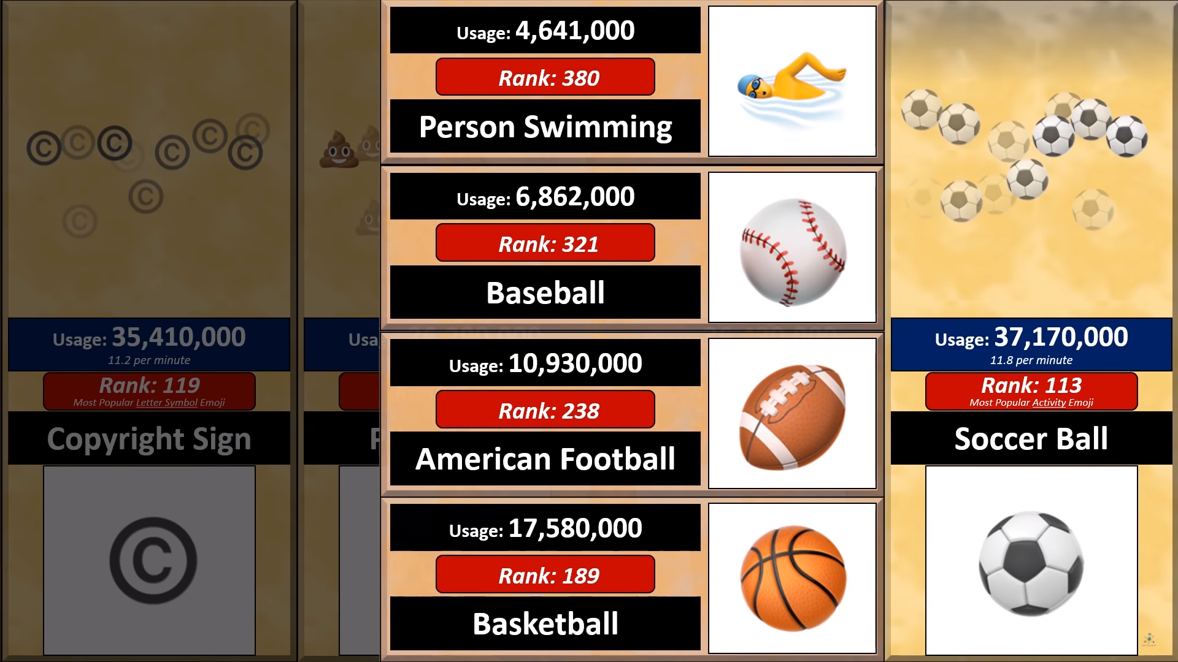

Slide 21
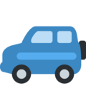
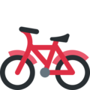
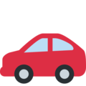
Most Popular Travel and Places Emoji

Slide 22
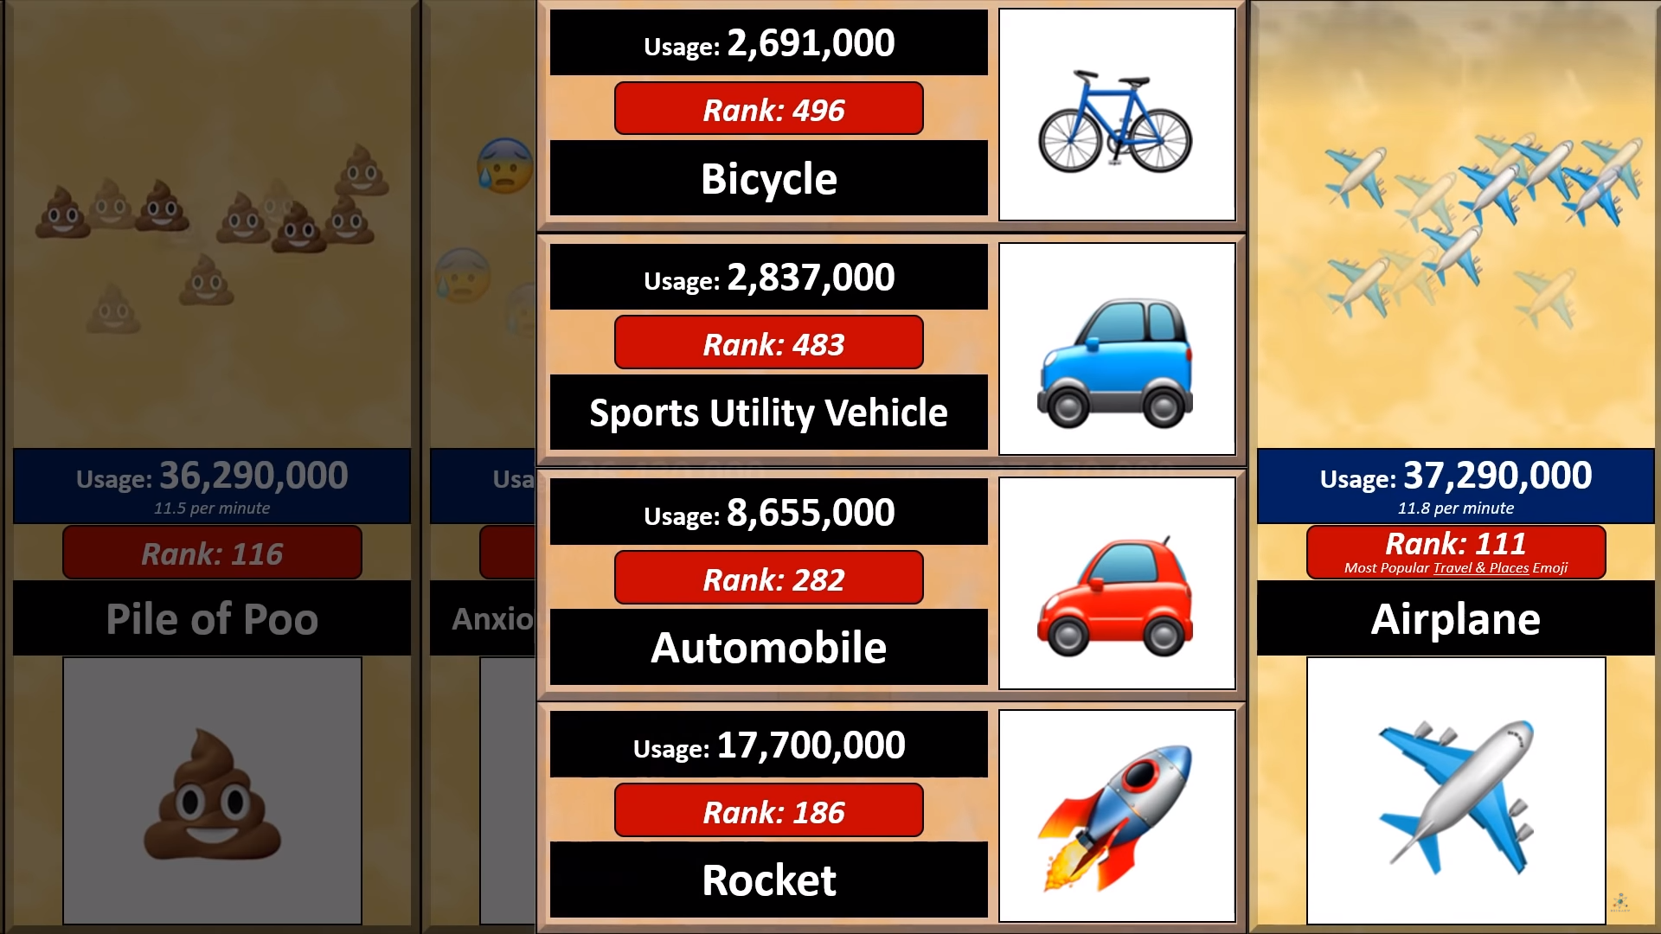

Slide 23
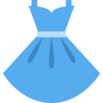
Most Popular Clothes Emoji

Slide 24
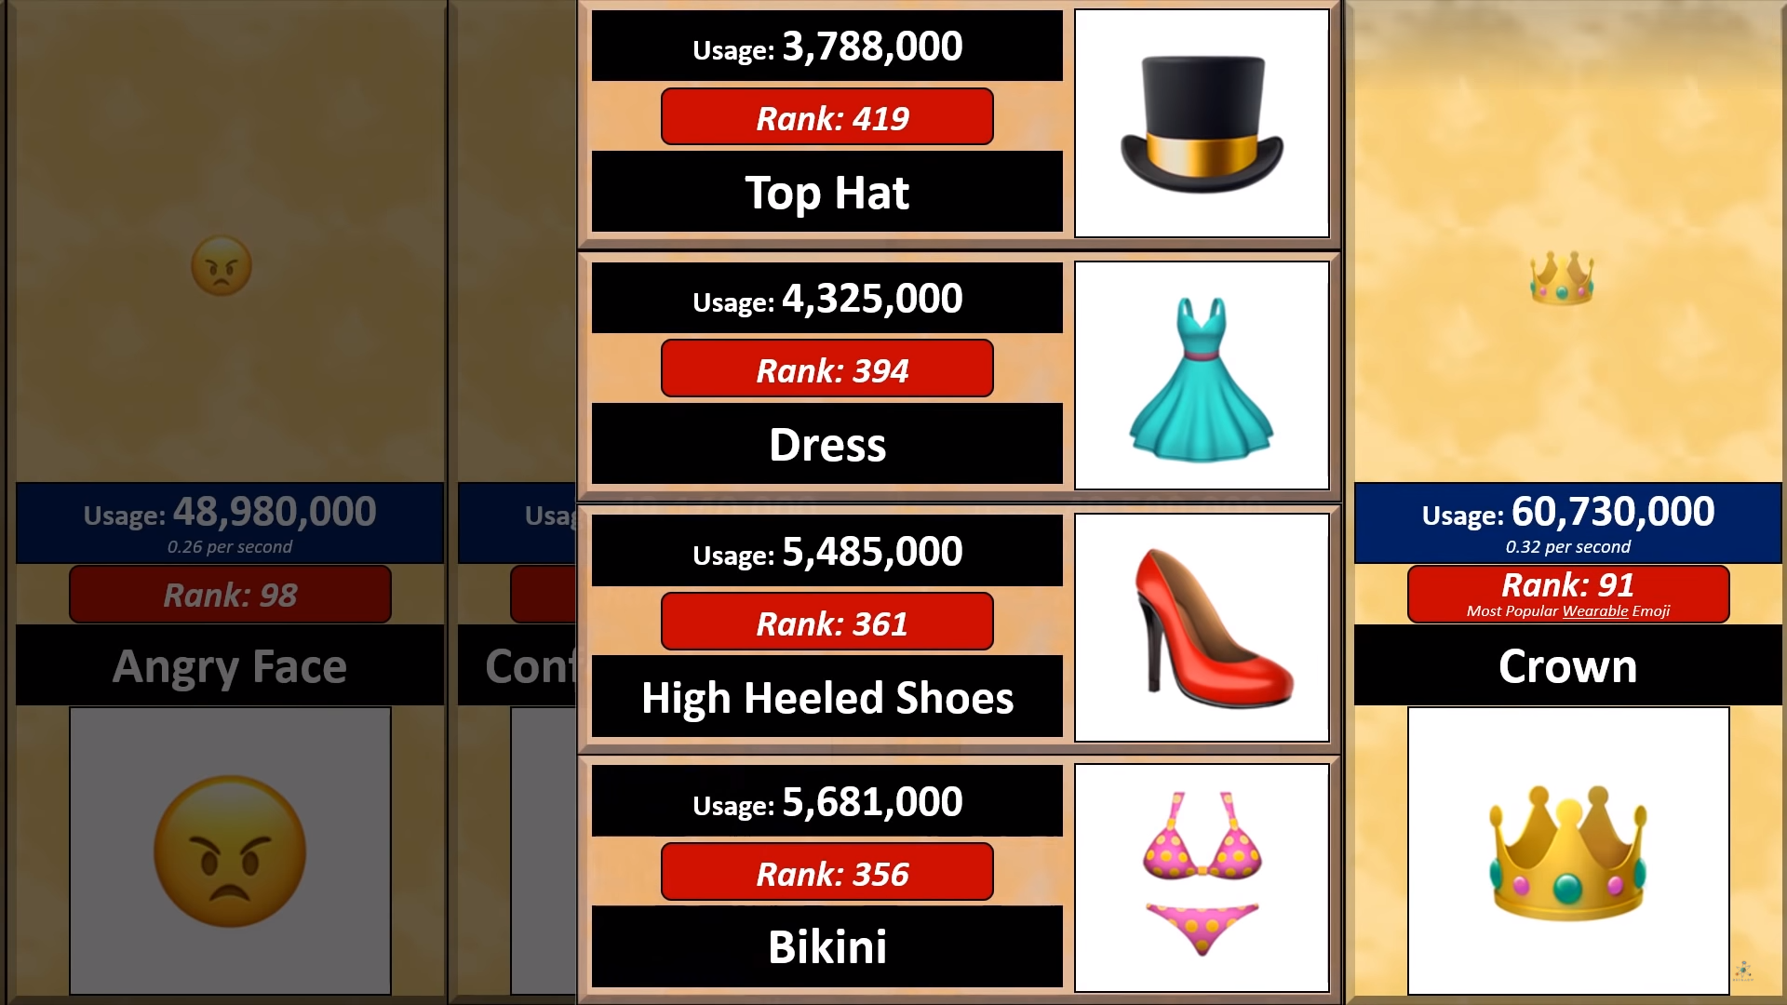

Slide 25
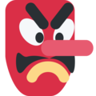
Most Popular Humanoid Face Emoji

Slide 26
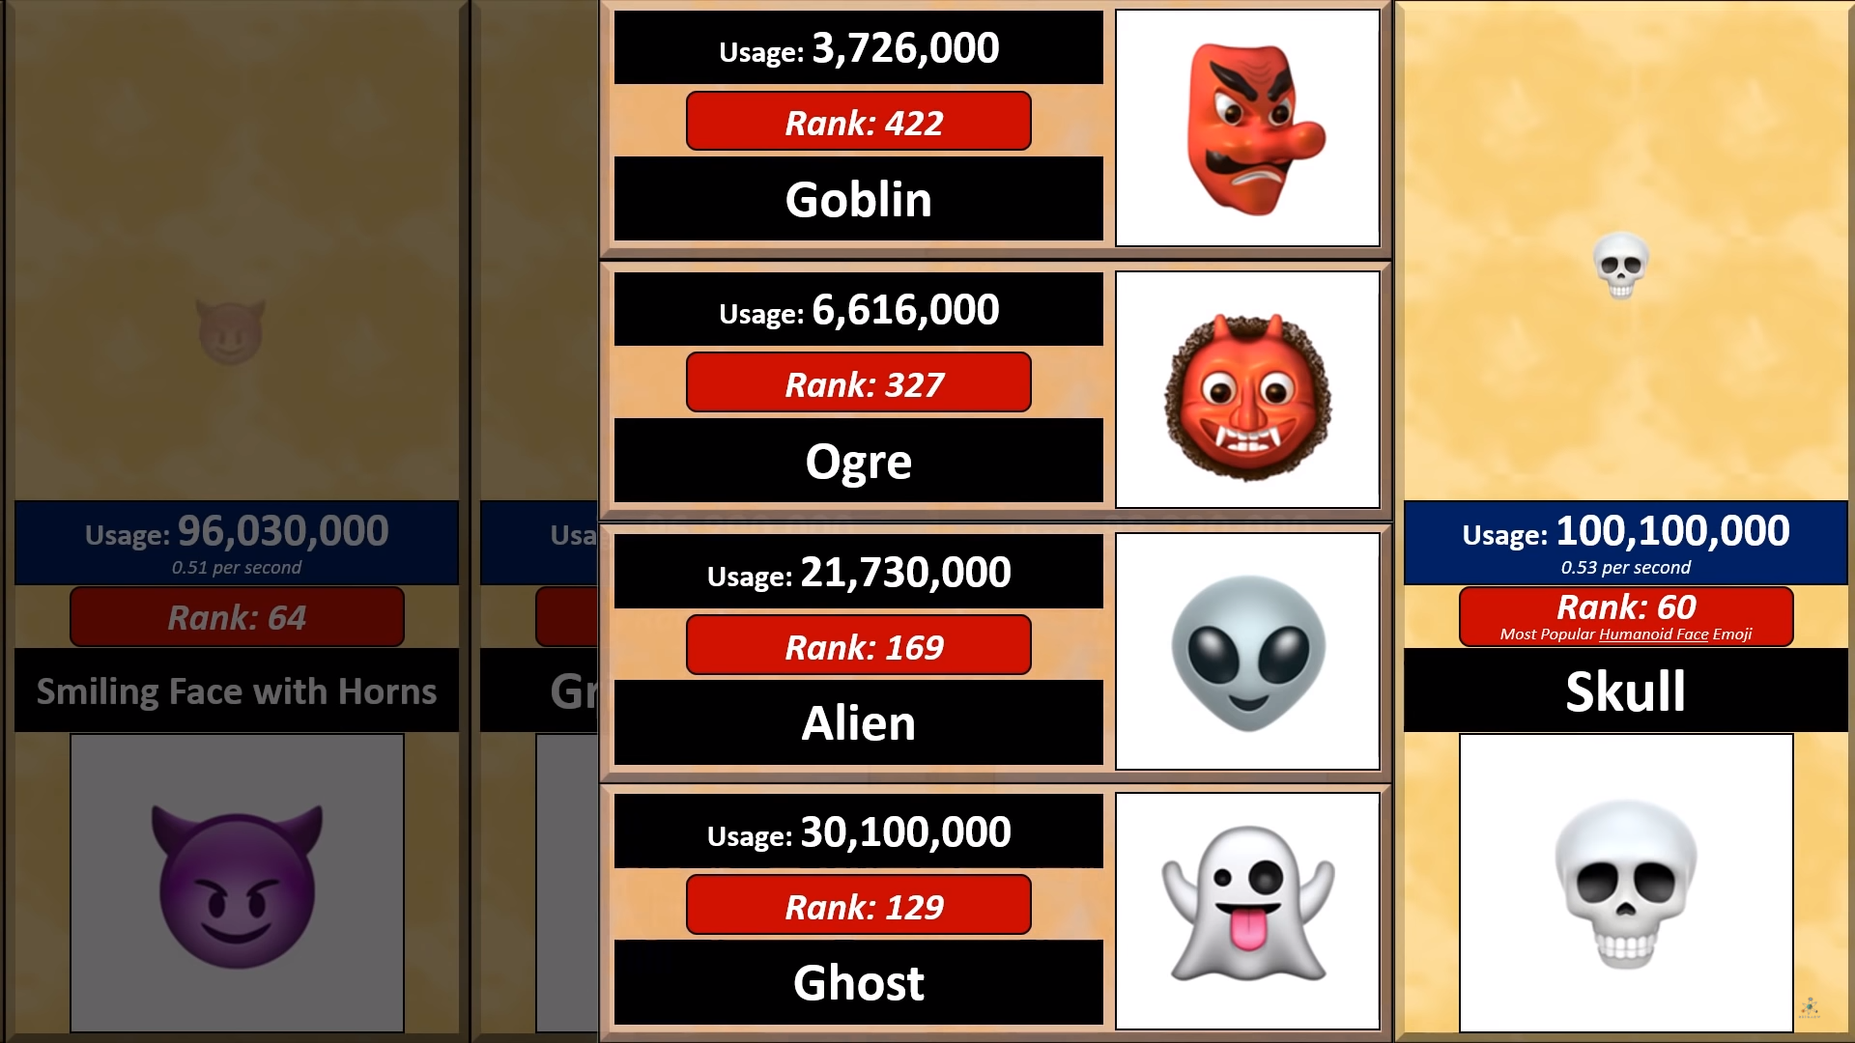

Slide 27
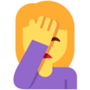
Most Popular Body Gesture Emoji

Slide 28
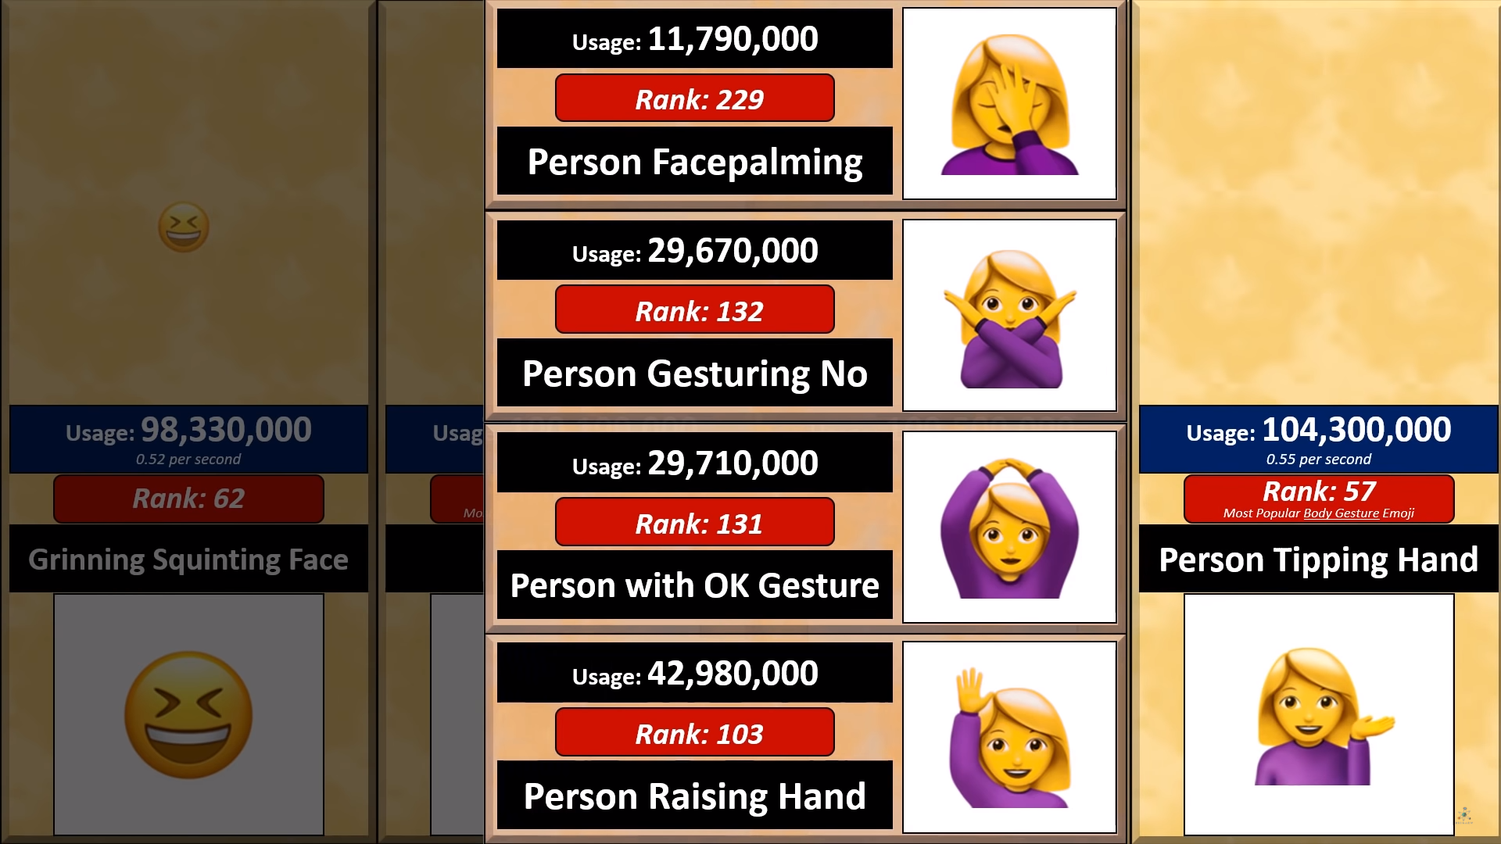

Slide 29
Most Popular Flower Emoji

Slide 30
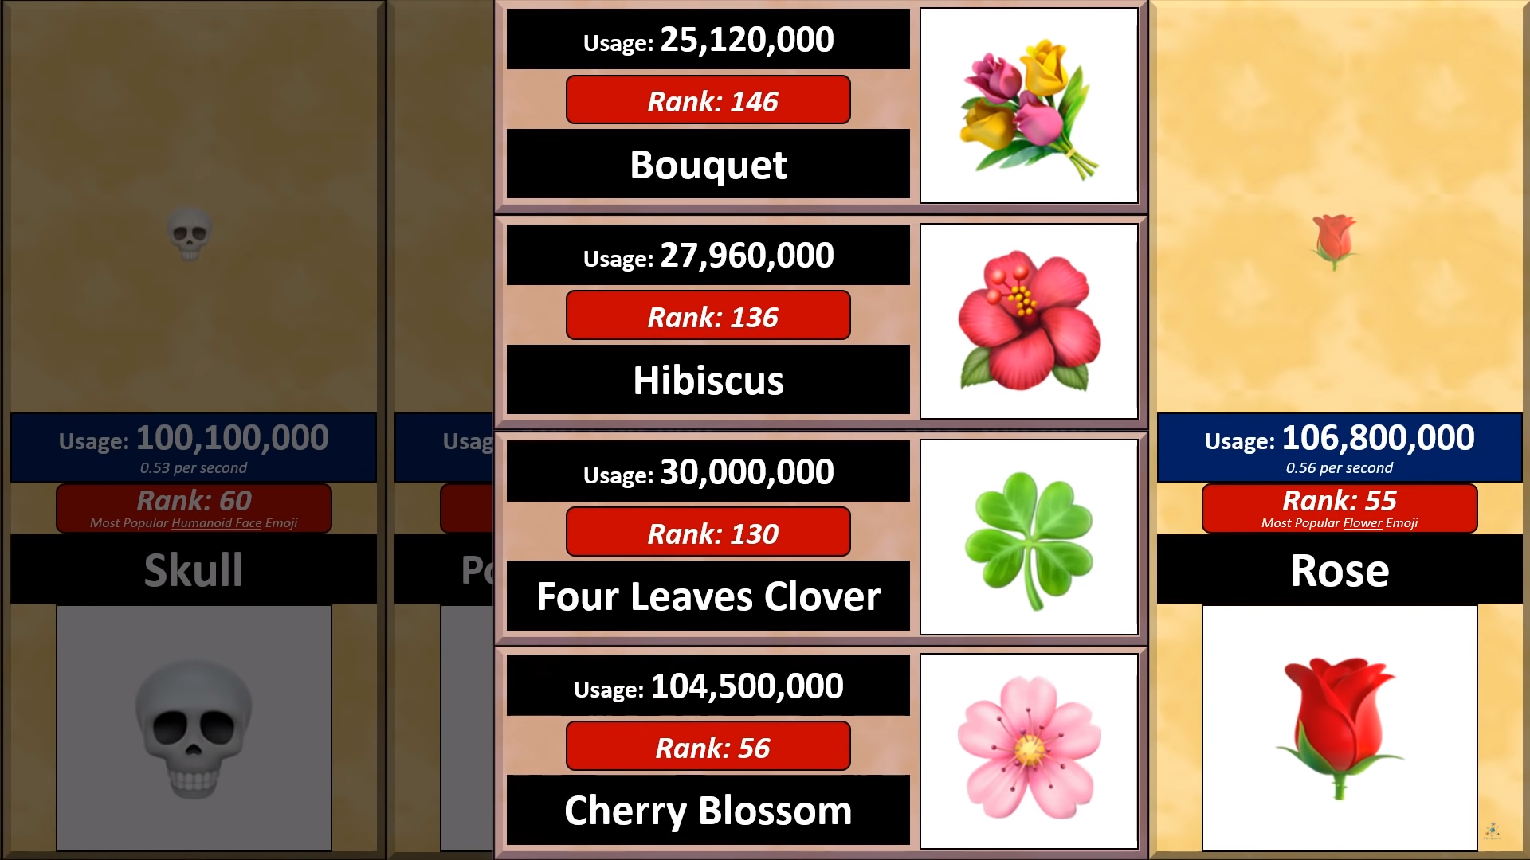

Slide 31
Most Popular Elemental Emoji

Slide 32
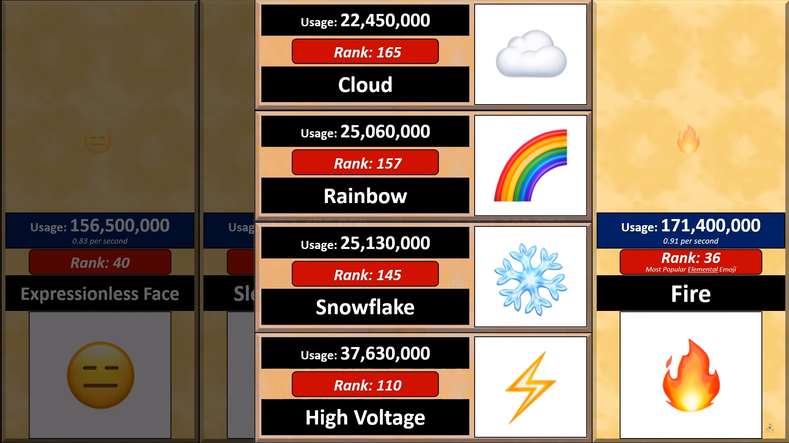

Slide 33
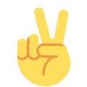
Most Popular Hand Gesture Emoji

Slide 34
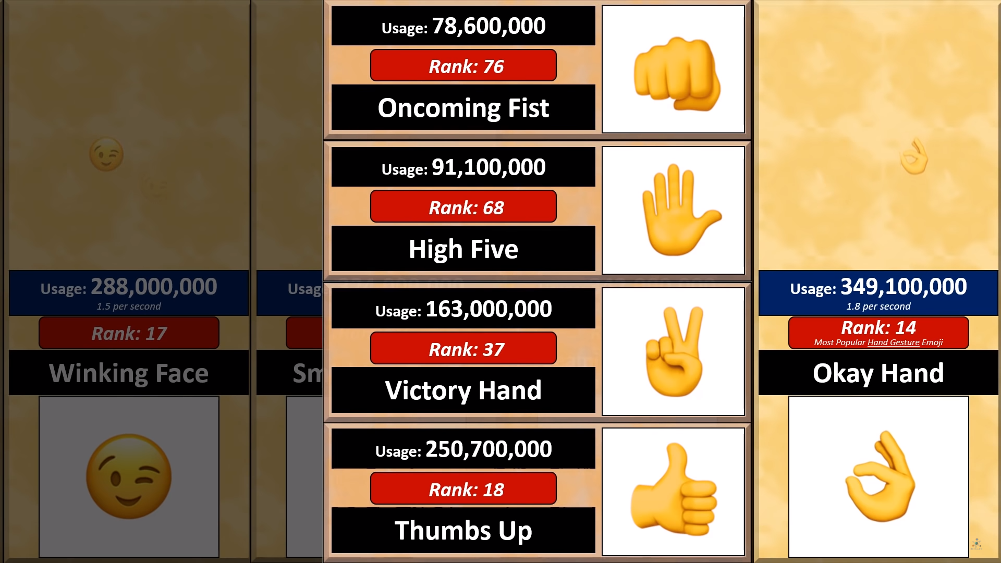

Slide 35
Most Popular Emoji

Slide 36
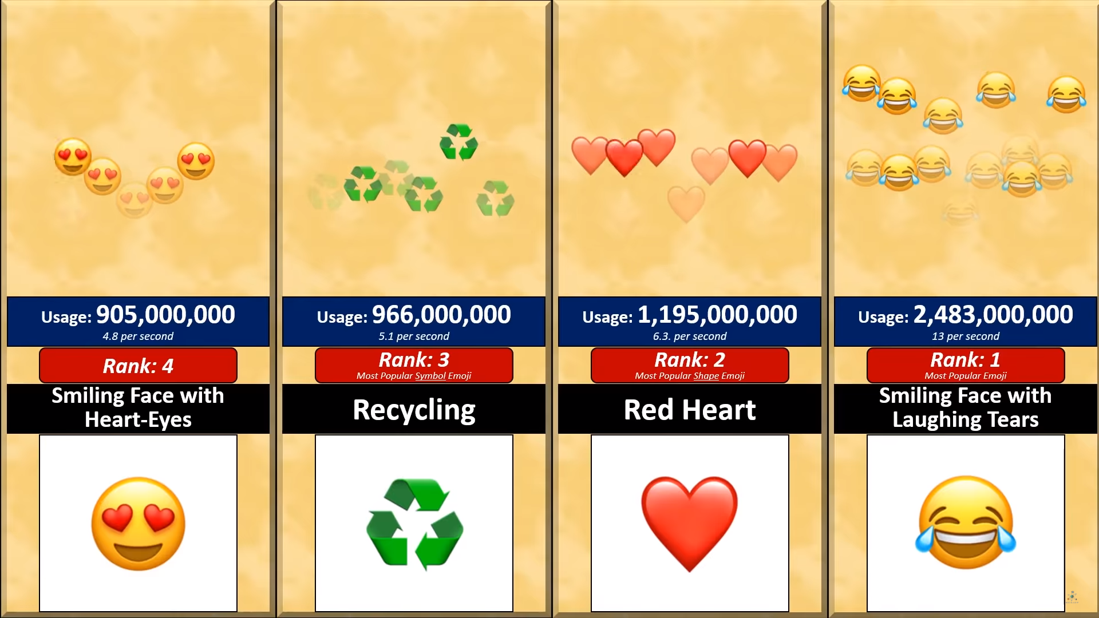

Slide 37
Settling Mars
Who will you take to start a new colony on Mars?

Slide 38
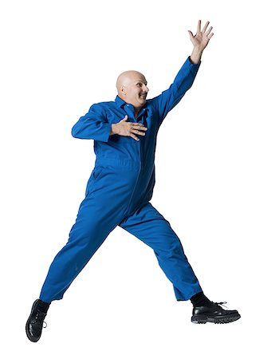
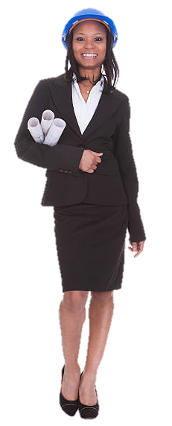
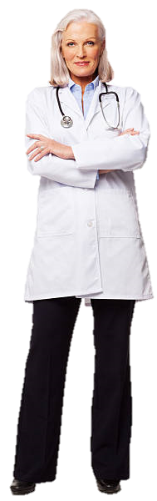
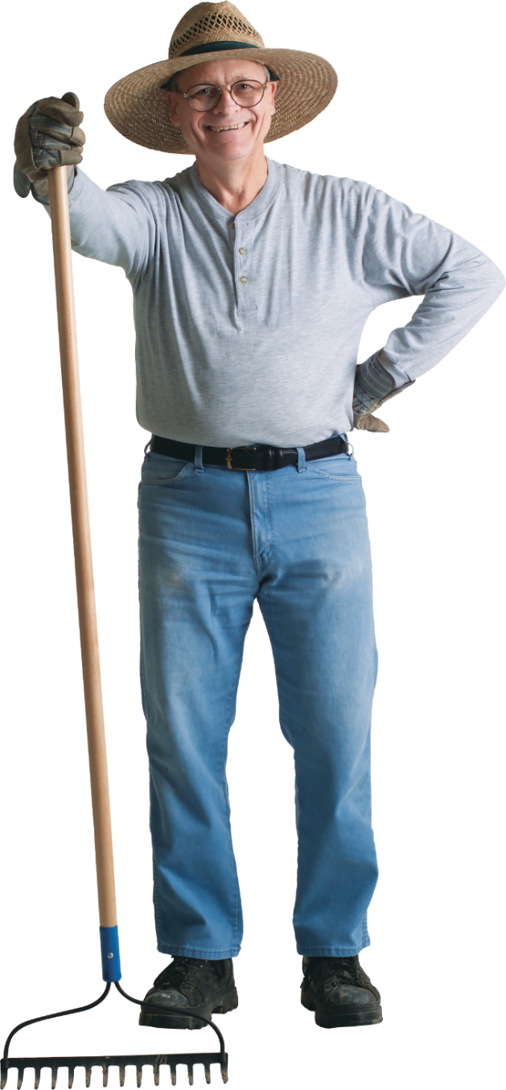
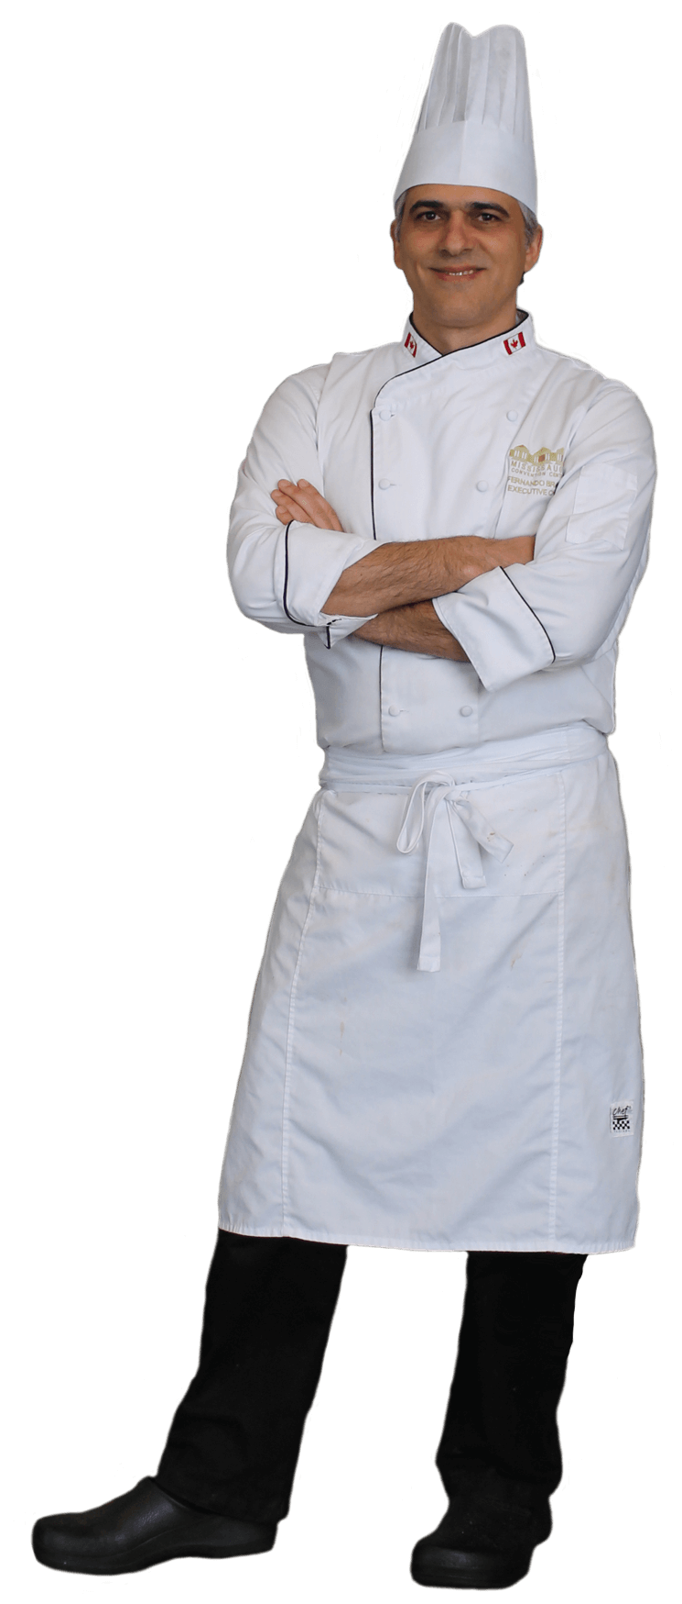
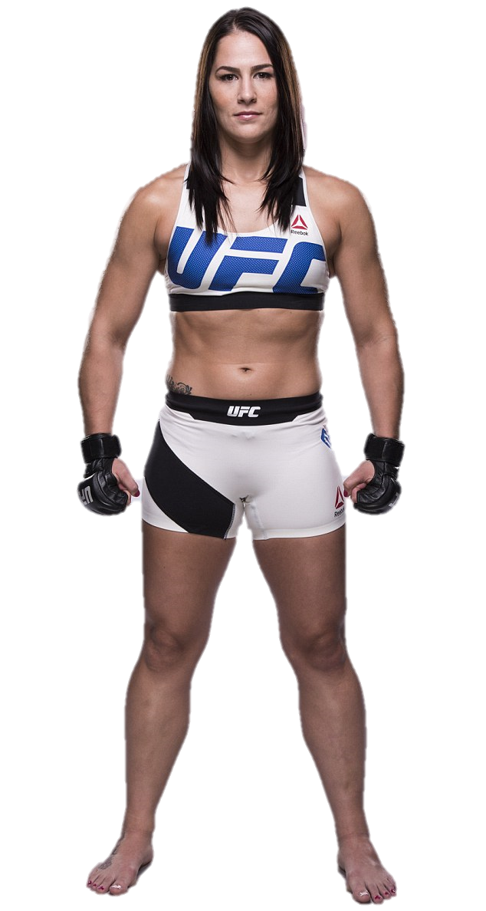
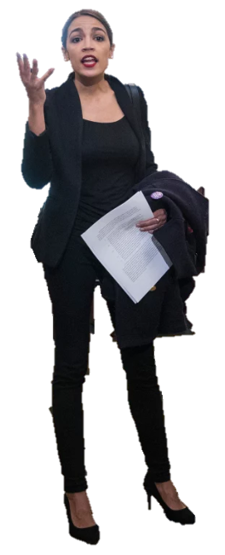
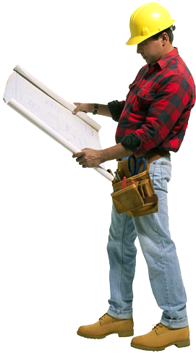
Choose 5 crew members to send to Mars to start a new colony.

Slide 39
Tier List
Choose a topic
Put matching items into levels

Slide 40
Special

Slide 52
https://tiermaker.com/

Slide 53
Does this Color Turn You Off?
https://www.theage.com.au/national/does-this-colour-turn-you-off-20120816-24bf4.html
Emoji Popularity Comparison
https://www.youtube.com/watch?v=W49KAyAKjHM&list=PL9i6nLIBlfKvunIYrc60Hsw0vNQsANk5n&index=58
Tier Lists
https://knowyourmeme.com/memes/tier-lists
Who Should go to Mars?
https://www.theverge.com/2016/9/30/13099134/space-x-elon-musk-mars-mission-colonists-personality-fitness-health-requirements
Michelin Star Chef Ranks Top 5 Fast Food Chains * Top 5 Breakdown
https://www.youtube.com/watch?v=36oRiPAn4Tw&fbclid=IwAR2gb3SKi2_iAa3gdcgB5cH3Rf660wAyWOTkqY8wPuwxfnt3MtecU5vw6lE

