Slide 1
Solve the Problem

Slide 2
The Goalie Problem
Feb. 22, 2020

Slide 3
Goalie
Back-up Goalie

Slide 4
Both goalies were injured.

Slide 6
There are no more goalies, but the game must continue.
What should they do?

Slide 8
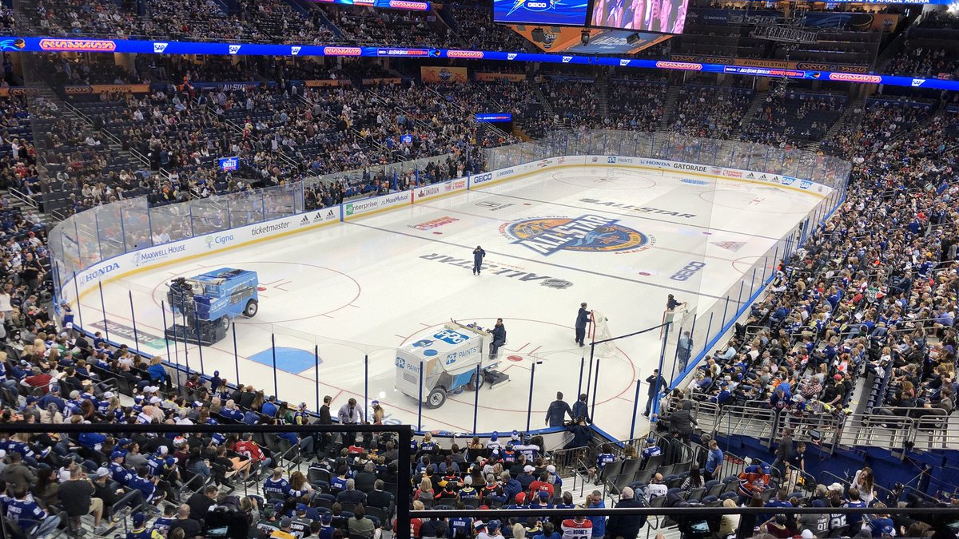
David Ayres
42 Years old
Zamboni driver
How did he do?

Slide 11
Porch Pirates

Slide 12
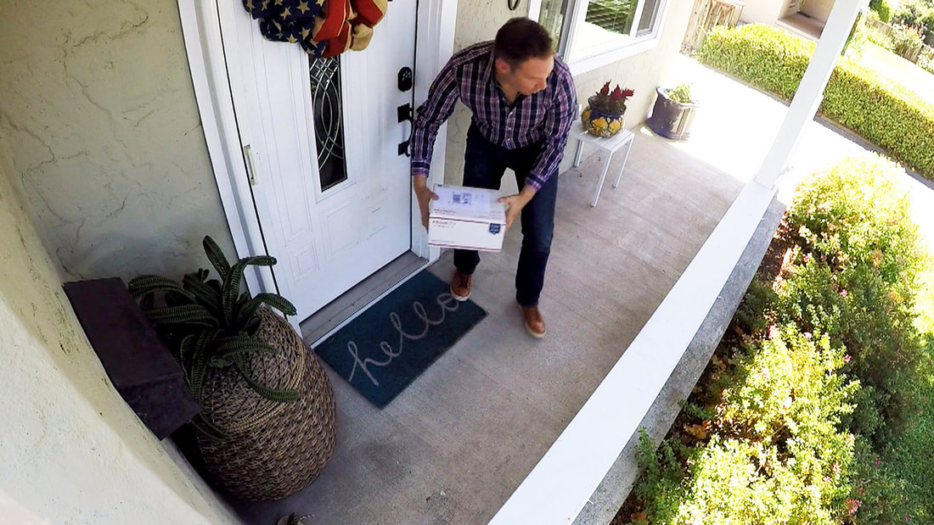
Porch Pirate
Someone who steals from your porch
Amazon packages

Slide 14
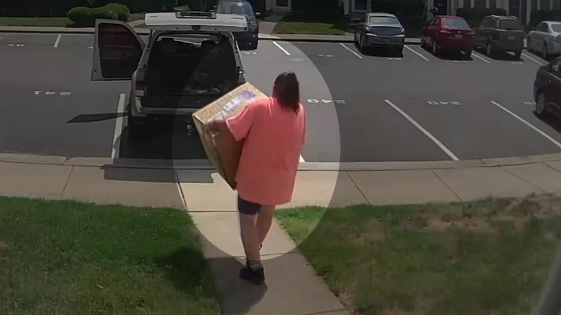
Porch Pirate
1.7 million packages stolen daily in America.
Some porch pirates follow delivery trucks and steal when they go.

Slide 15
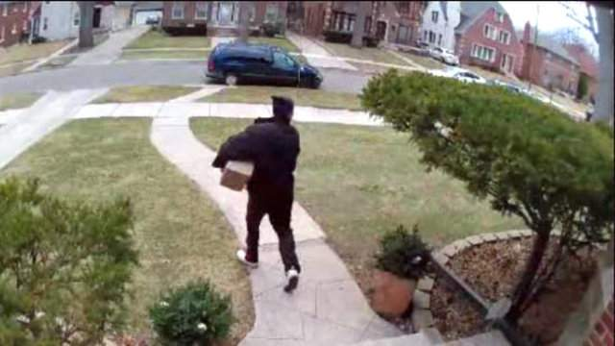
What would you do?
Nothing illegal

Slide 16
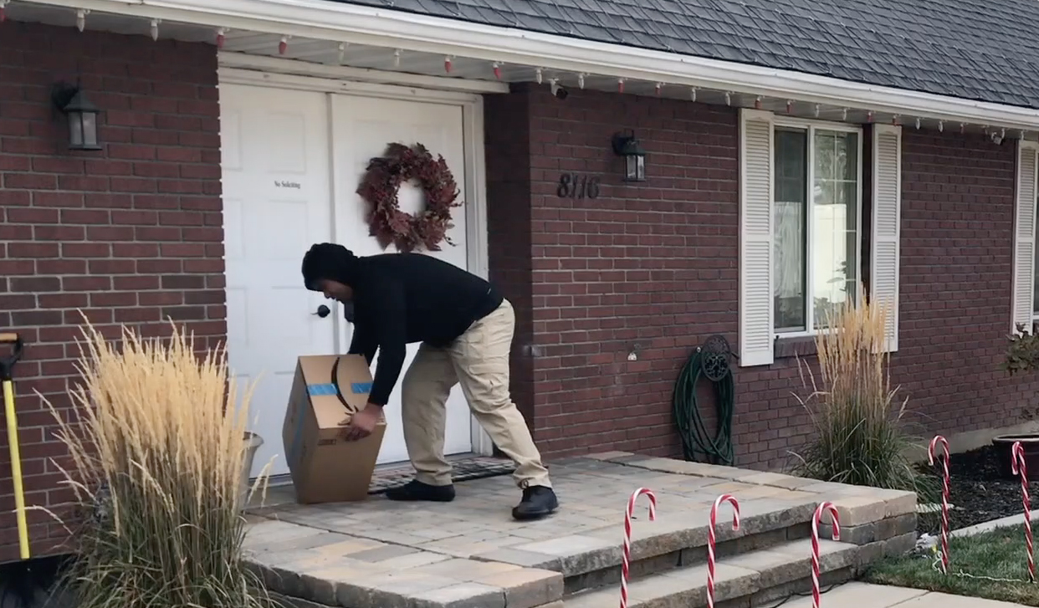

Slide 17
Was it effective?

Slide 19
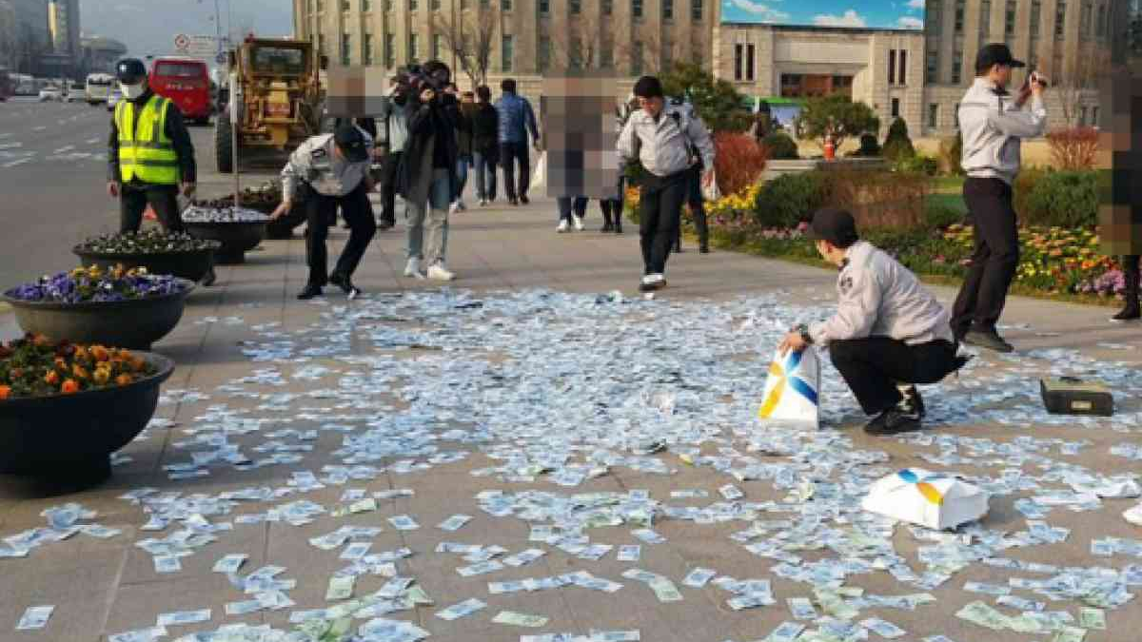
But there was no single citizen who picked up the bills, with many of passersby glancing at the grass covered by banknotes and taking photos of the scene, police said.
A Korean woman threw cash worth 22 million won ($19,030) on the street in downtown Seoul on Monday, but caused no major disruption as passersby did not rush to pick them up, police said Tuesday.
The 56-year-old threw hundreds of 1,000-won, 5,000-won and 10,000 won-banknotes in the Seoul Square at around 5 p.m.

Slide 20
Police said that picking up unattended money can be punished by law on charges of theft. But in this case, the women had intended to give up her rights to the money, so there was no legal basis to punish those who gathered the bills.
During the questioning at a nearby police box, she allegedly said that she was afraid of her ex-husband and son trying to take her money and would rather donate the money to anyone on the street.
The police probe found that she had withdrawn 42 million won in cash from a local bank in Seoul a few days earlier. She arrived in the Seoul Square by taxi and hired a private guard to escort her with a paper bag full of the banknotes.
She was neither under threat from her family nor in need of police protection, according to police.

Slide 21
Penguin Tracker

Slide 22
Adelie Penguins
Numbers are decreasing
“canary in the coal mine” for Antarctica.

Slide 23
They are difficult to track
Hard to see individuals with a plane
Tracking chips cause death
Far from humans.

Slide 24
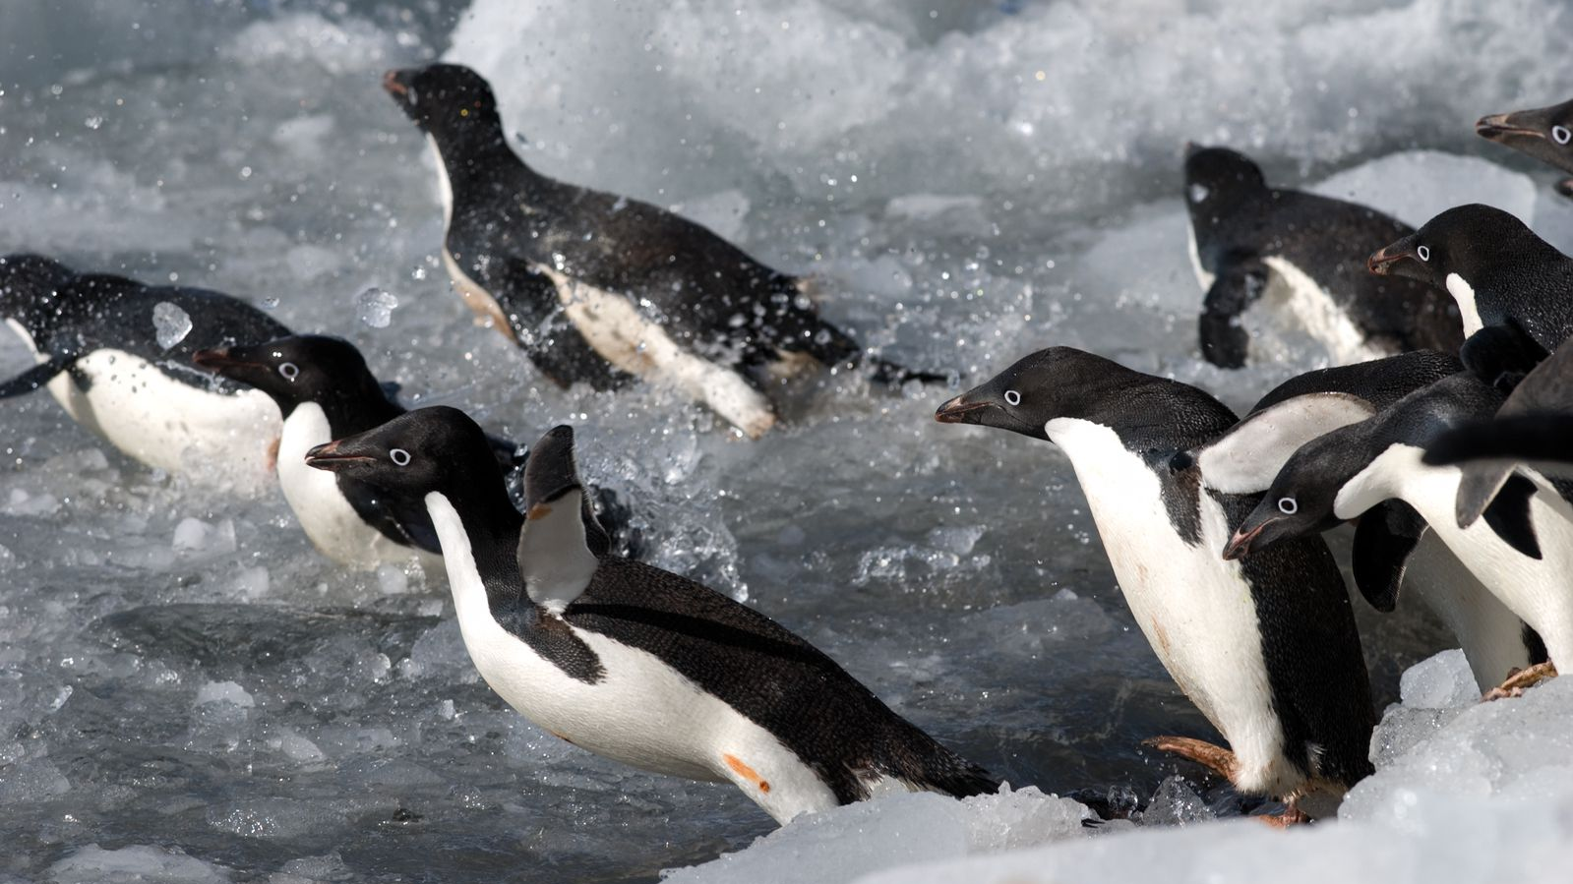
How can you track them?

Slide 26
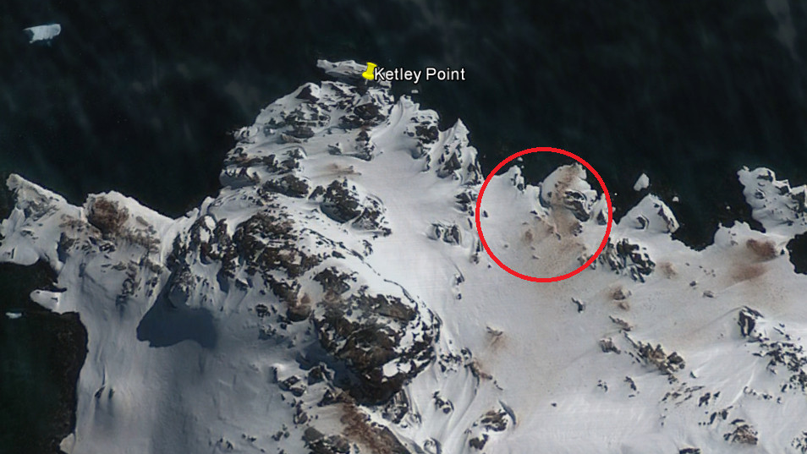
Poop
Look for brown spots on ice
View from space

Slide 27
Waiting in Line

Slide 28
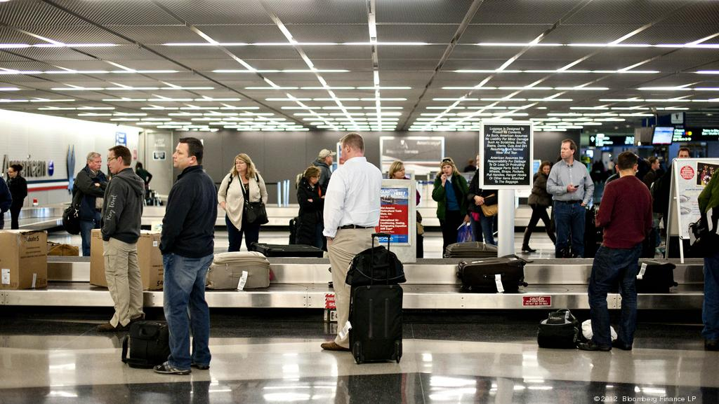
Huston Airport
1990s
Customers complained about waiting for baggage

Slide 29
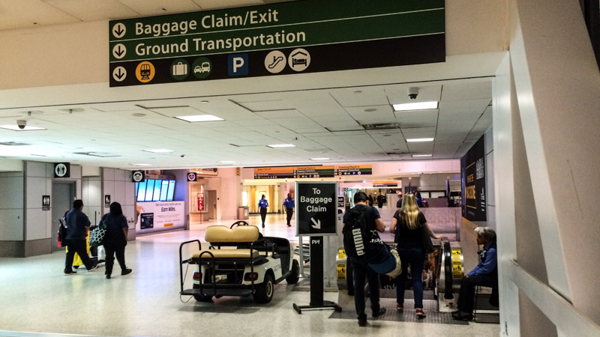
Huston Airport
They tried hiring extra staff.
They were within industry standard (8 minutes)
People continued to complain.

Slide 30
Huston Airport
Your task is to find a solution so customers stop complaining.

Slide 32
Solution
Move baggage claim (6x) farther away
Customers walked longer, but waited less.

Slide 33
Trapped Americans

Slide 34
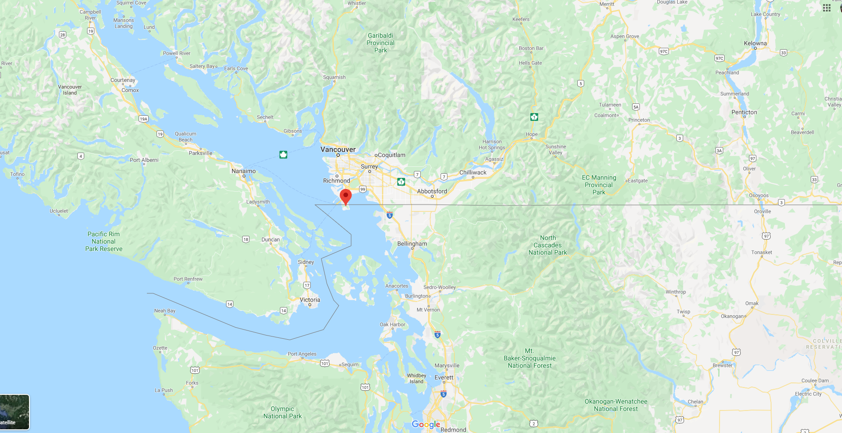
Trapped Americans
Due to the agreement between Britain and America, there is a small American town trapped in Canada.
The town is too small for a high school.

Slide 35
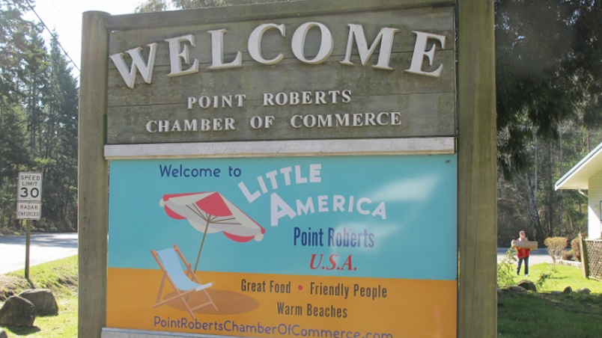
Trapped Americans
How do these high school students receive their education?

Slide 37
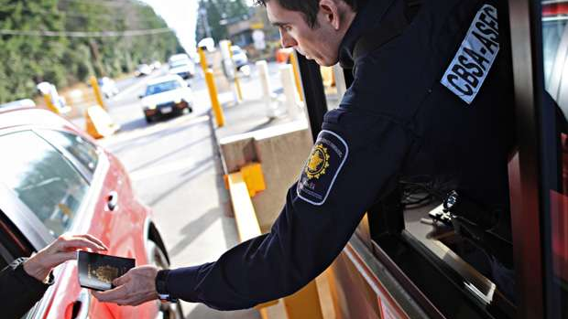
Solution:
Students have to cross the border 4 times every day

Slide 38
LA Reservoir

Slide 39
LA Reservoir
Bromide is safe (natural in saltwater) but when it reacts with ozone, it becomes bromate (carcinogen)
The reservoir was the problem
Bromide + Chlorine + Sunlight = Bromate

Slide 40
LA Reservoir
Your task is to block the sun over LA Reservoir

Slide 42
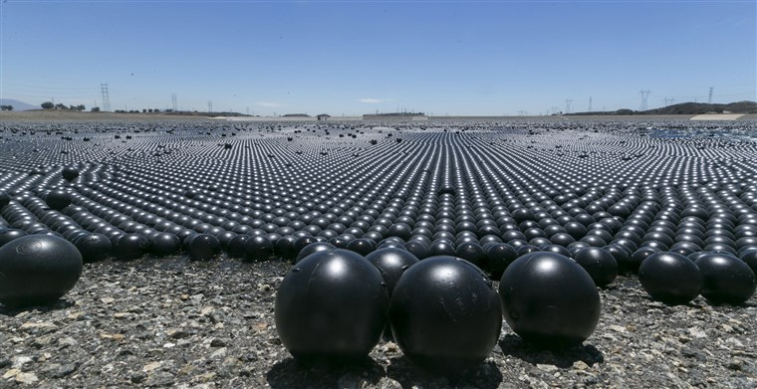
Solution:
96,000,000 shade balls
Bird balls
Added benefits
(algae, evaporation, chlorine, animals, water quality)

Slide 44
A famous Actor

Slide 45
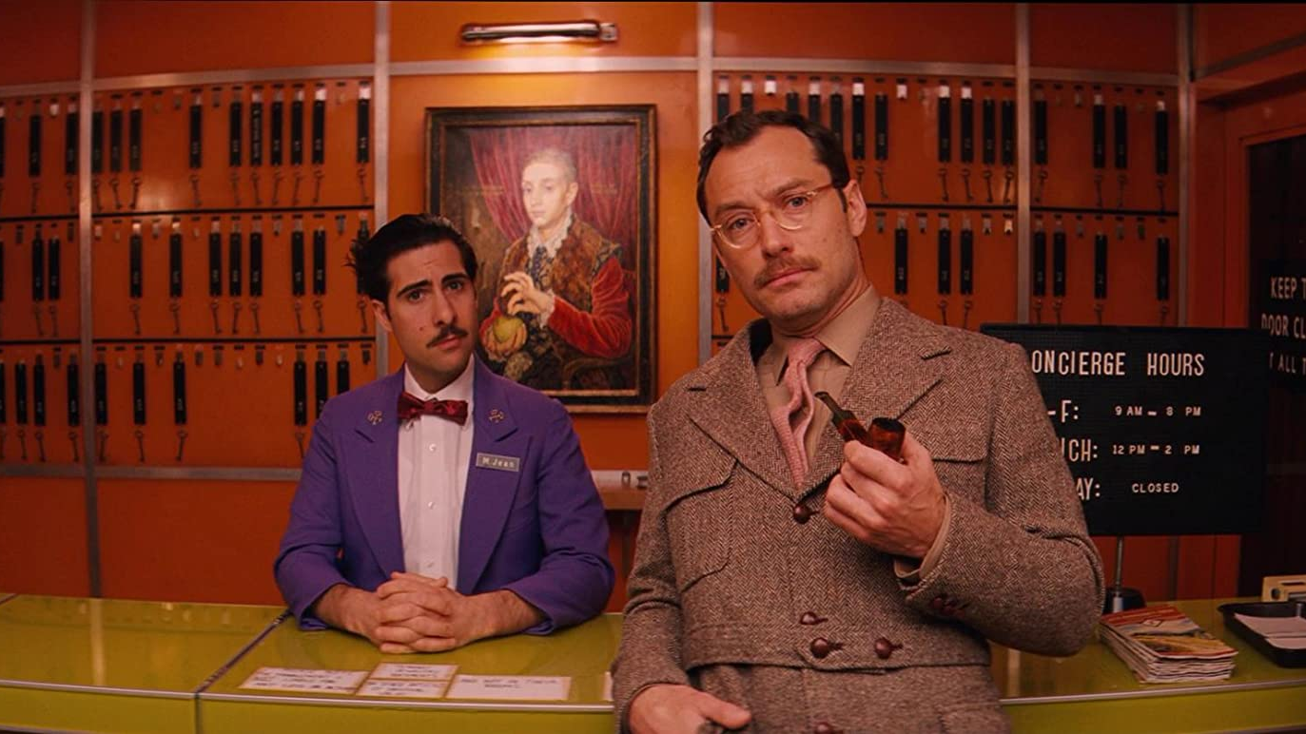
A Famous Actor
Your task is to get a famous actor in your movie.

Slide 47
9 Step Process
Take out a pen
Make the movie
Pick a world famous actor
Use your friend for your connections
Wake up in an alternate universe
An email must be written
Make a personal video
Do your homework
Fly to London
https://www.youtube.com/watch?v=sZpvVggtwyk

Slide 49
Zamboni driver turned NHL goalie David Ayres given his own hockey card
https://www.ctvnews.ca/canada/zamboni-driver-turned-nhl-goalie-david-ayres-given-his-own-hockey-card-1.4832575
Package Thief vs. Glitter Bomb Trap
https://www.youtube.com/watch?v=xoxhDk-hwuo
90,000 Packages Disappear Daily in NYC. Is Help on the Way?
https://www.nytimes.com/2019/12/02/nyregion/online-shopping-package-theft.html
Koreans ignore scattered cash in downtown square
http://m.koreaherald.com/view.php?ud=20160322000995&fbclid=IwAR2ObKXt1pUzdbkcgD0v56ItsLsYk-Ee0SpkZW4oUttpCjD6JEX-N3lTEeE#cb
10 Unusual Ways People Solved Difficult Problems
https://listverse.com/2013/06/07/10-unusual-ways-people-solved-difficult-problems/

Slide 50
Solving a Waiting Problem by Making it Worse
http://www.failurethebook.com/2017/01/22/how-the-houston-airport-solved-a-waiting-problem-by-making-it-worse/
Why Are 96,000,000 Black Balls on This Reservoir
https://www.youtube.com/watch?v=uxPdPpi5W4o
How to Get a World-Famous Actor in your Short Film
https://www.youtube.com/watch?v=sZpvVggtwyk
Point Roberts
https://www.atlasobscura.com/places/point-roberts
Canada & How Borders Define a Country
https://www.youtube.com/watch?v=gr3UVG-Ocyg

