Slide 1
Rhetoric
Modes of Persuasion

Slide 3
ETHOS
ETHICS
The appearance of credibility / authority

Slide 4
Ethos
“Character”

Slide 5
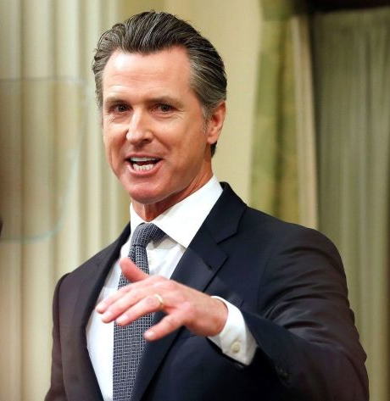
Who is more competent?
A
B

Slide 6
A
B

Slide 7
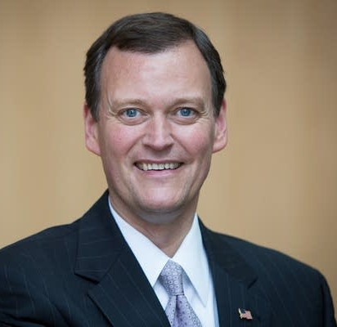
A
B

Slide 8
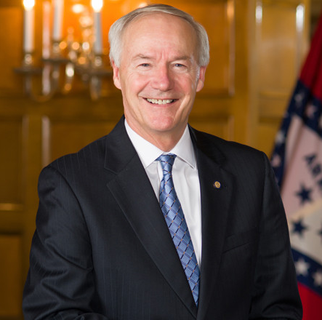
A
B

Slide 9
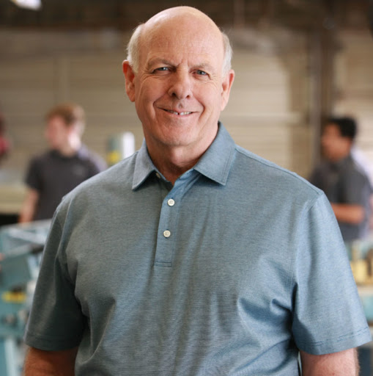
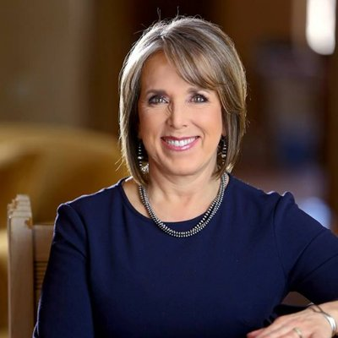
A
B

Slide 10
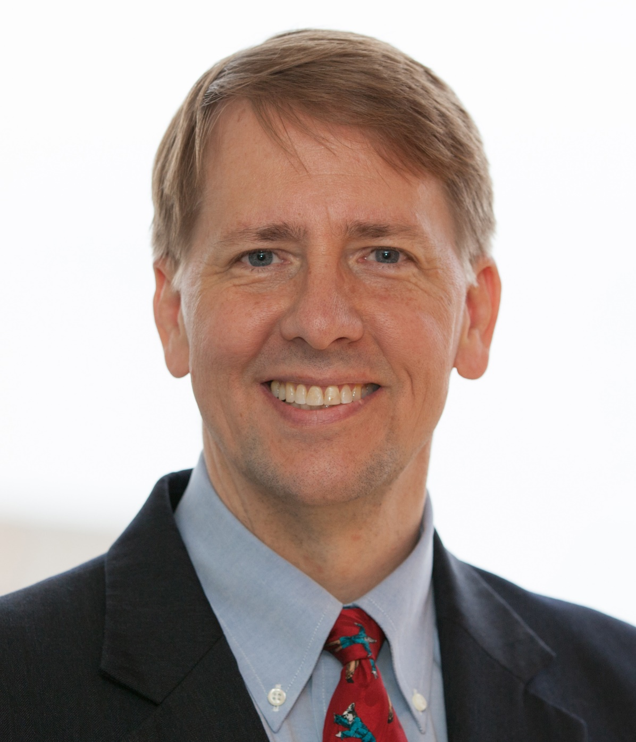
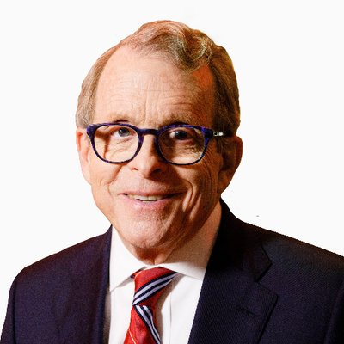
A
B

Slide 11
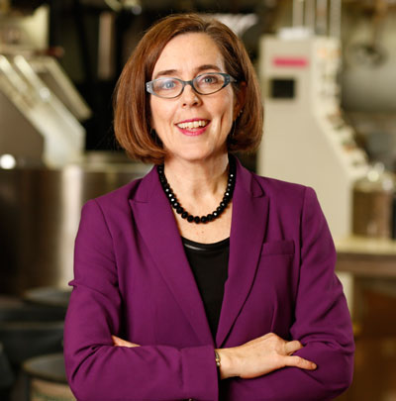
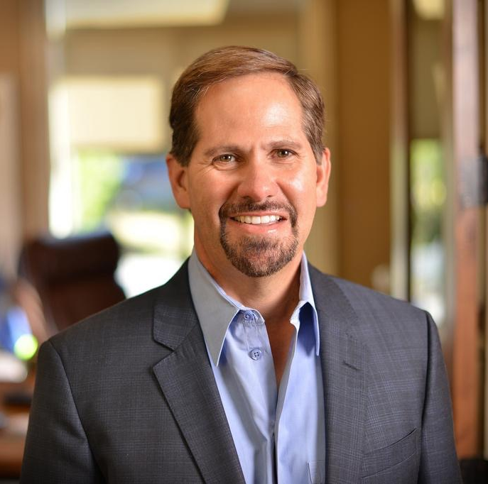
A
B

Slide 12
Competence / Trustworthiness
Facial Appearance (70%)
Height
Weight
Dress
Accent
Pitch (other vocal traits)
Setting (next to flag)

Slide 13
Credentials
As a cyclist…

Slide 14
Credentials
Because I have worked in IT for 10 years…

Slide 16
Credentials
Using:
insider language, technical language, jargon, acronyms, etc.

Slide 17
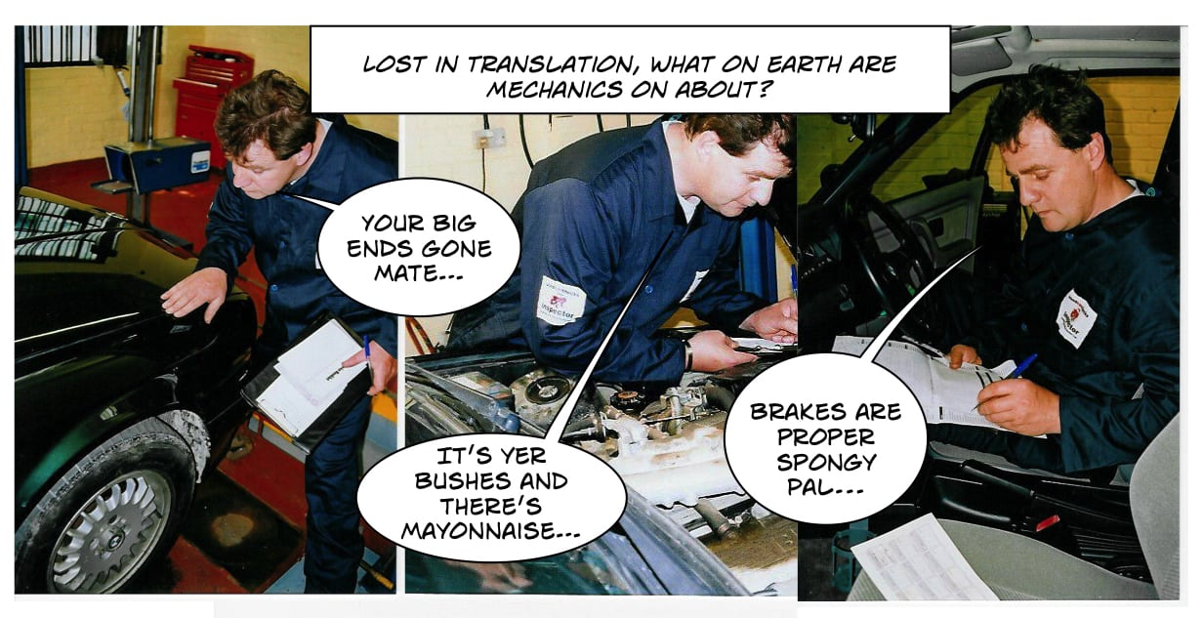

Slide 18
Let others do it
Allow me to introduce to you…
Have someone else say your credentials.

Slide 19
Advertising Hacks
Trusted figure / Celebrity

Slide 21
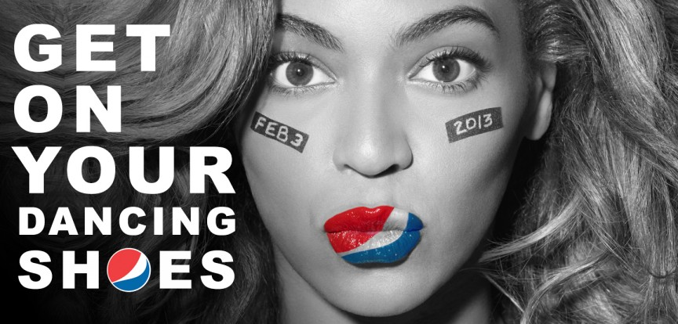

Slide 22
Character
Openness
Share your personal experience

Slide 23
Character
Honesty
Full disclosure
Not hiding anything

Slide 25
Caring
Good will towards audience

Slide 26
Town Hall Meeting

Slide 27
Caring
Treat everyone well (helpers)
Do not condescend

Slide 28
Ad Hominem
Attack someone’s character.
Discredit opponent

Slide 29
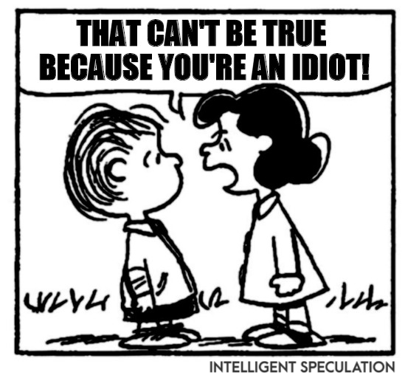

Slide 31
PATHOLOGY
EMPATHY
SYMPATHY
PATHOS
An emotional persuasion.

Slide 32
Pathos
“Suffering”
“Experience”

Slide 34
Hearts over Heads
Emotional Speech
More convincing than Logos or Ethos.

Slide 35
Audience Emotions
Make the audience feel it.
Not always the speaker’s emotion.

Slide 38
Emotionally Charged Words
Words that elicit a response.
Metaphors / Similes

Slide 41
Visually Demonstrate
Use:
pictures / magic tricks / realia / theatrical / descriptive language

Slide 42
Stories
Caught up in the narrative.
The social condition

Slide 44
Vivid Language
Rhetorical Devices
Quotations

Slide 46
Humor
Sense of Identity
Self-Interest
Sentiments

Slide 48
Appeal to
Calms people down
Personality
Common Ground

Slide 50
LOGOS
LOGIC
The appearance of logic / reason.

Slide 51
Logos
“Word”

Slide 52
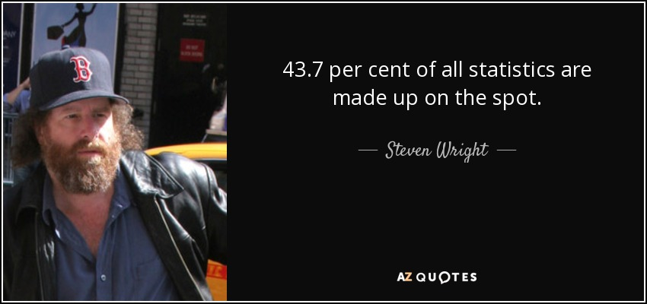

Slide 53
Information
Facts / Figures / Support / Evidence

Slide 54
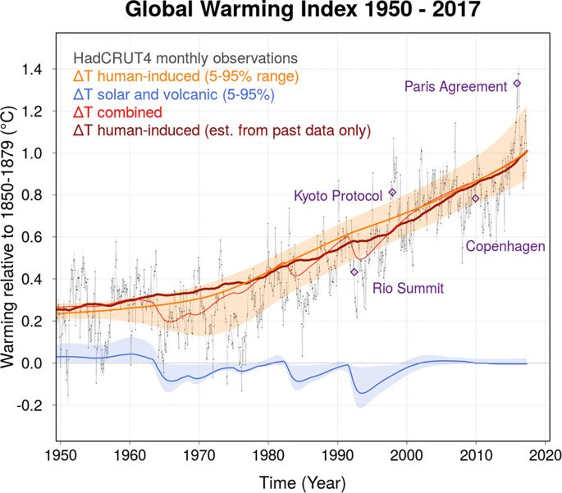
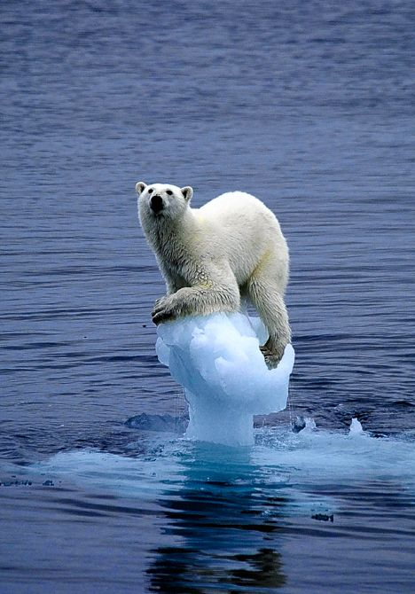

Slide 55
Making an Argument
Know your thesis.

Slide 56
Making an Argument
Start with things that the audience already agrees with before moving the goal posts.

Slide 57
Some people believe…
As you know…

Slide 58
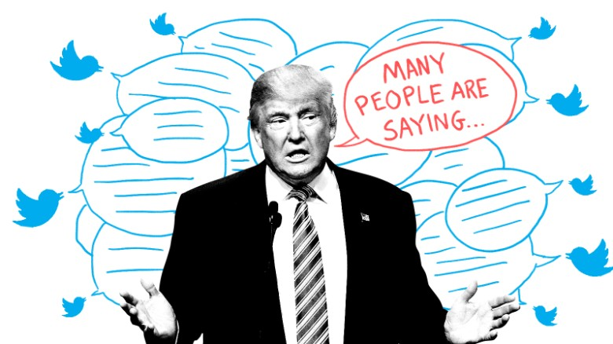
People are saying

Slide 59
Support with evidence
High quality information
Statistics
Tables
Data
Etc.

Slide 60
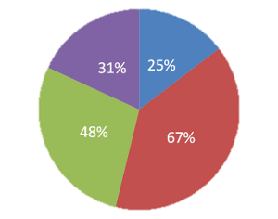
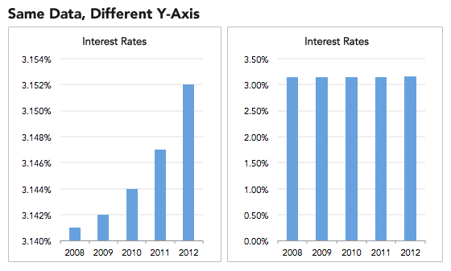

Slide 61
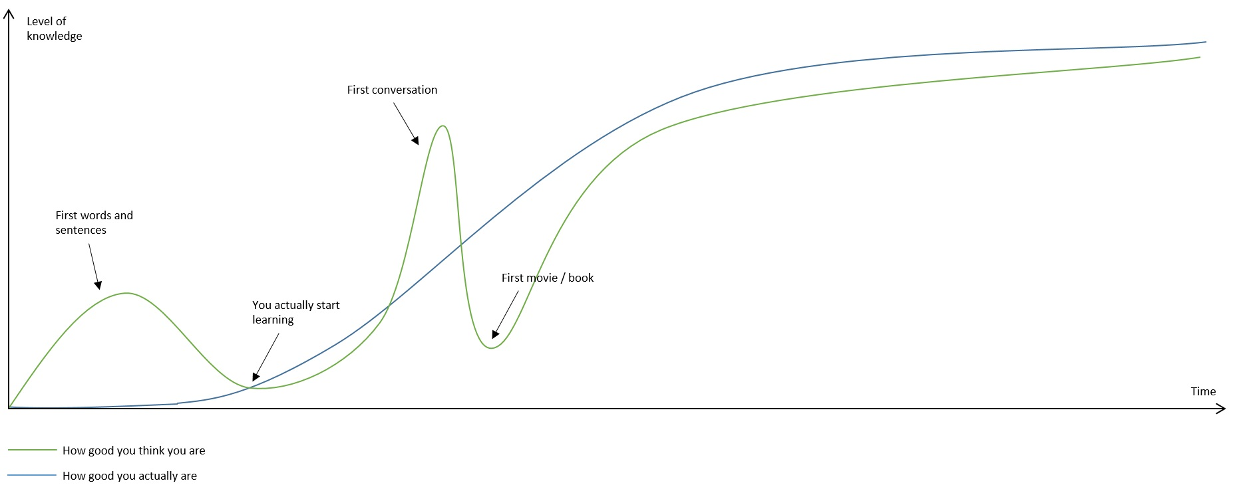

Slide 62
Reasonable connections:
Linking claims to evidence.

Slide 64
Explain the Graph
I will give you a graph.
What will you put in it?
Explain it to another person.

Slide 65
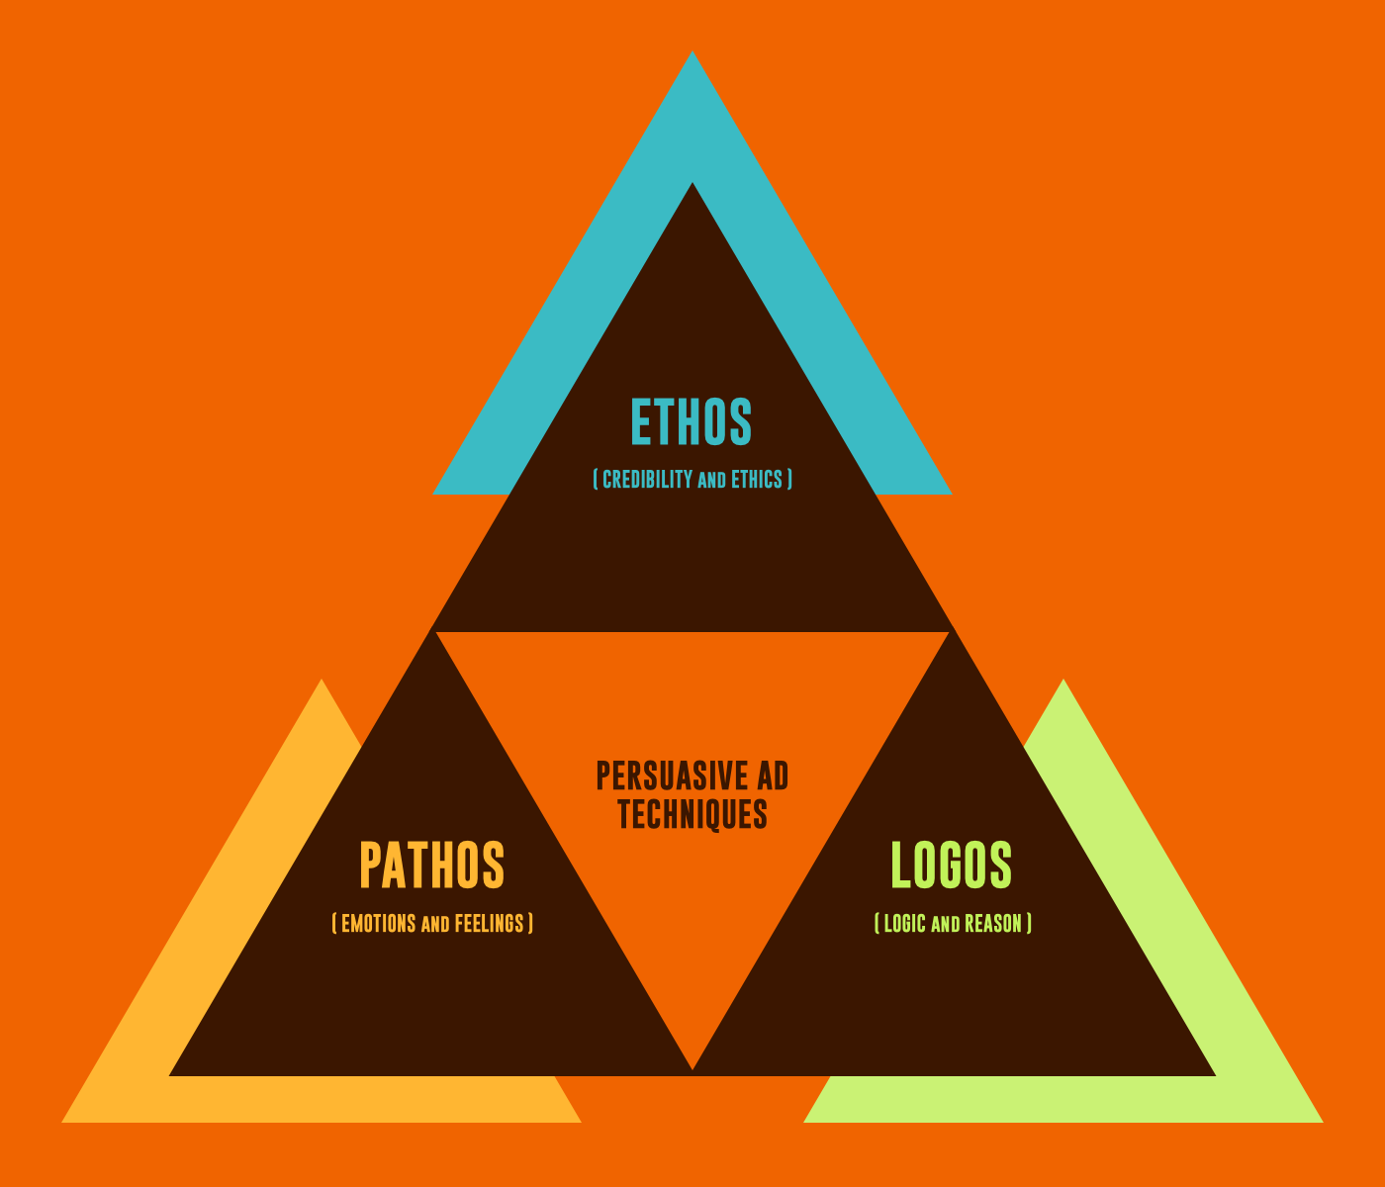

Slide 66
KAIROS
The opportune moment

Slide 67
Kairos
“Time”

Slide 68
Response
Responding in a timely manner.
How long should you wait?

Slide 69
Relevance
Is the information (or person) still useful.

Slide 70
I was outside playing with my fidget spinner and…

Slide 72
In Speech
Dramatic pauses
Cadence

Slide 73
Opportunistic
Responding to events.

Slide 76
Spokesperson
Choose your company.

Slide 77
Awestruck: Surprising facts about why we fall for charismatic leaders | Jochen Menges | TEDxUHasselt
https://www.youtube.com/watch?v=qpCnR7BOS0I
Predicting Elections from Politicians’ Faces
https://www.researchgate.net/publication/24116339_Predicting_Elections_from_Politicians'_Faces
When the Party Decides: The Effects of Facial Competence and Dominance on Internal Nominations of Political Candidates
https://journals.sagepub.com/doi/full/10.1177/1474704917732005
Predicting political elections from rapid and unreflective face judgements
https://www.pnas.org/content/104/46/17948.short
English Speech | Mohammed Qahtani: The Power of Words (English Subtitles)
https://www.youtube.com/watch?v=xwbI8VOsDTo
Ethos, Pathos & Logos: How to Use Persuasive Ad Techniques
https://www.youtube.com/watch?v=lmR58_dqLxY

