Slide 1
A recent virus has made many people afraid of travelling. Let everyone know that your company cares and that it is safe to travel with you.
A customer got sick after eating a hamburger. They got sick because the food was not cooked long enough. Now the public is worried about your quality of food.
Your company made record profits this year. Your boss wants you to announce the company’s success to get more investors. But, some people might see it as bragging.
Your company wants to advertise to some shy communities. The people are afraid of technology and identity theft. Your job is to make a statement for them to join Instagram.
Recently your company has been accused of being dirty. One customer was chased by rats. Your job is to let everyone know that Wallmart is cleaning up and to get more customers.

Slide 2
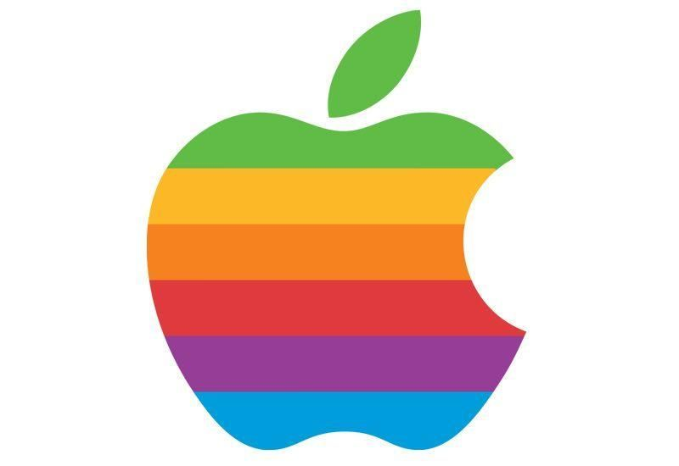
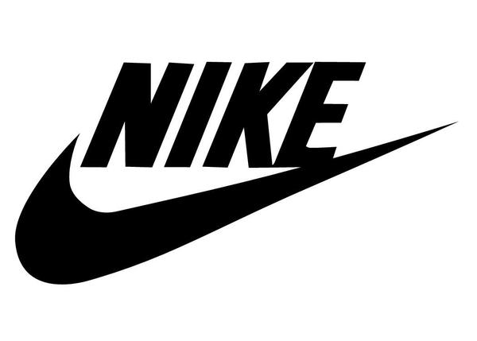
Your company had an accident on one of the offshore oil drill. Millions of liters of oil leaked into the ocean. Surely a lot of wildlife will be affected. You need to let the public know about this and protect the company.
Apple has decided to launch a new phone. The new phone is much faster, has more memory as well as every tech feature available. Because of record sales, the company will be offering it at a large discount. Tell the world.
Not enough people are spending money at your company. Therefore, Costco has decided to get out of Korea. Make a statement to leave Korea without the public getting upset.
Your company is going to launch system later this year. It will be entirely web based and run through a VR device.
Get the public excited about this.
Recently the public learned that your company uses child labor to produce shoes. As a response, Nike will shut down those factories, but the cost of shoes will increase. You need to break the news to the public.

