Slide 1
The Greatest Lesson of All Time!!

Slide 2
Hyperbole
An exaggeration of the truth

Slide 4
Adnaton
Extremely hyperbolic metaphors to suggest something is impossible.

Slide 5
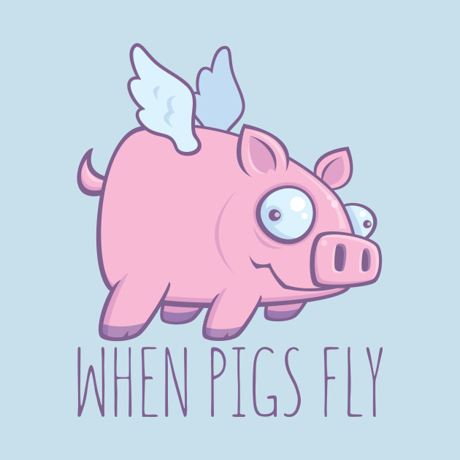

Slide 6
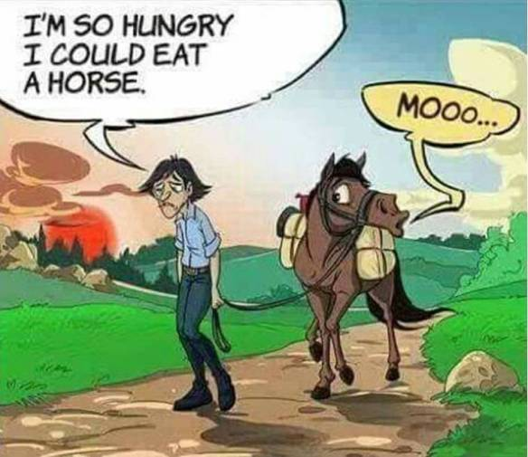

Slide 7
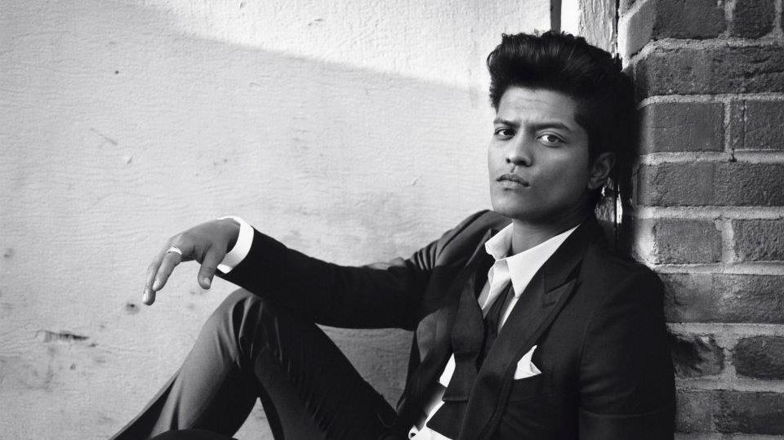
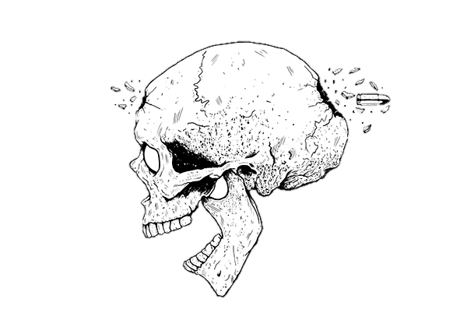
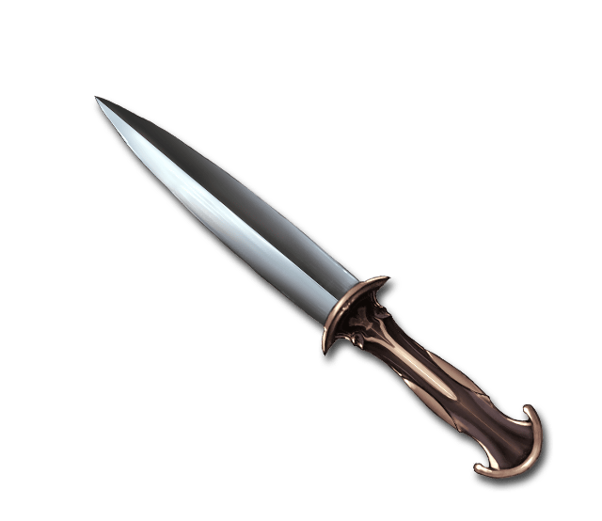
I’d catch a grenade for you.
..throw my hand on a blade for you
I’d jump in front of a train for you
Take a bullet strait through the brain
I would die for you

Slide 8
Asterismos
Starting a phrase with an exclamation.

Slide 9
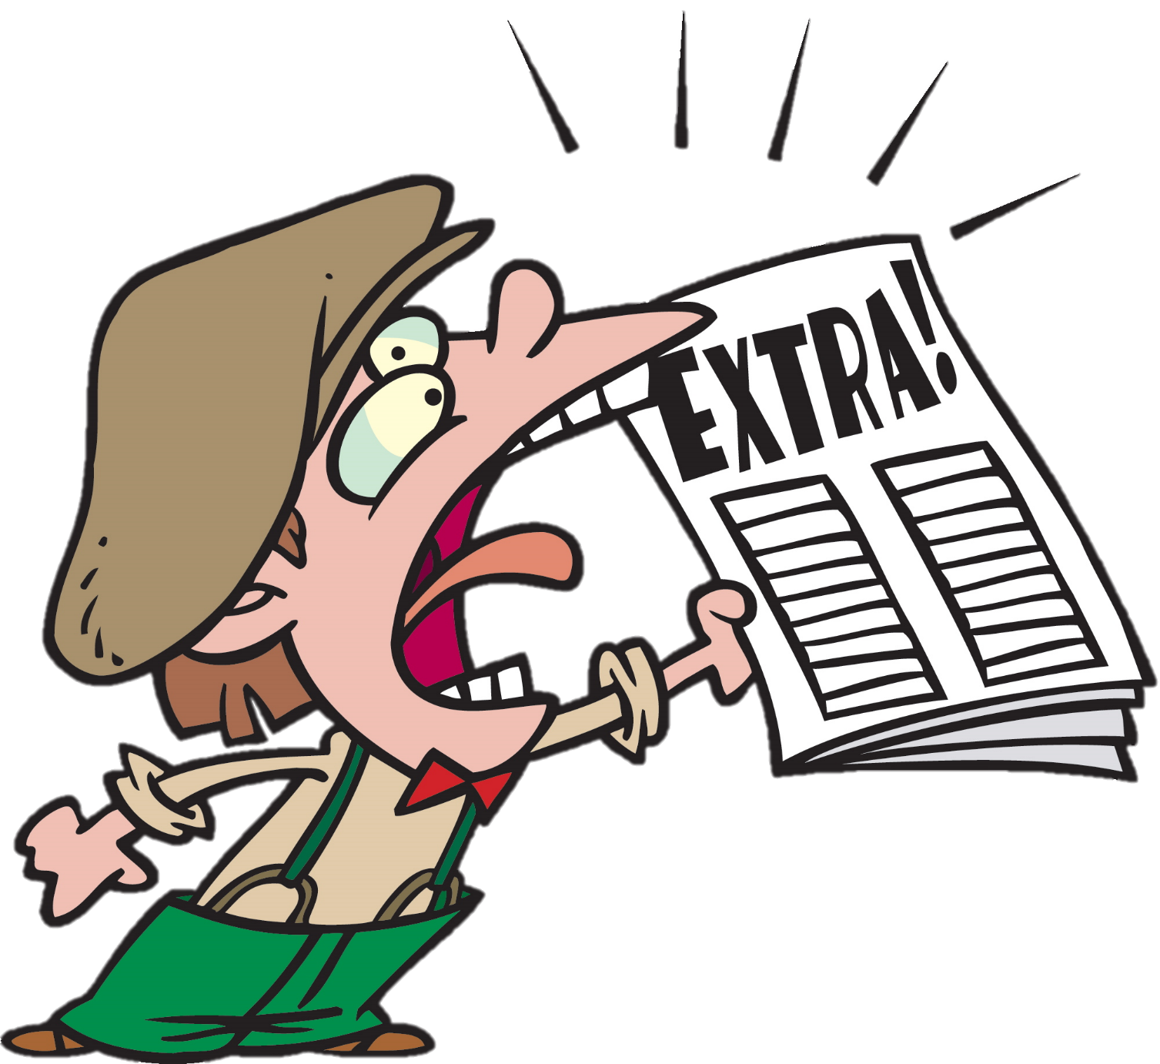

Slide 10
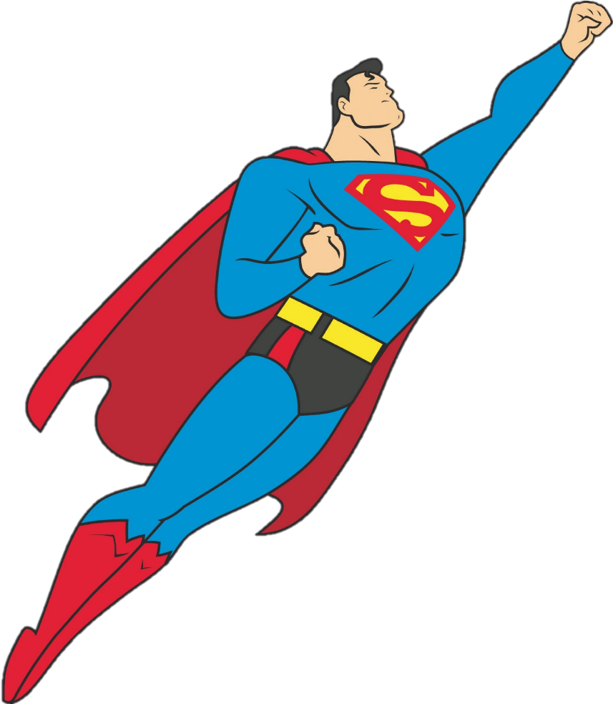
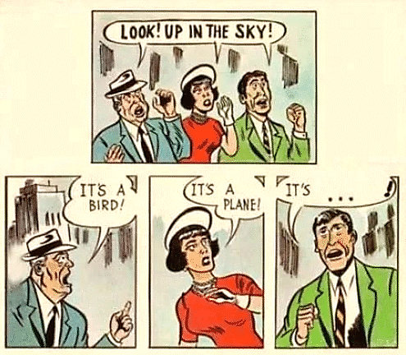

Slide 11
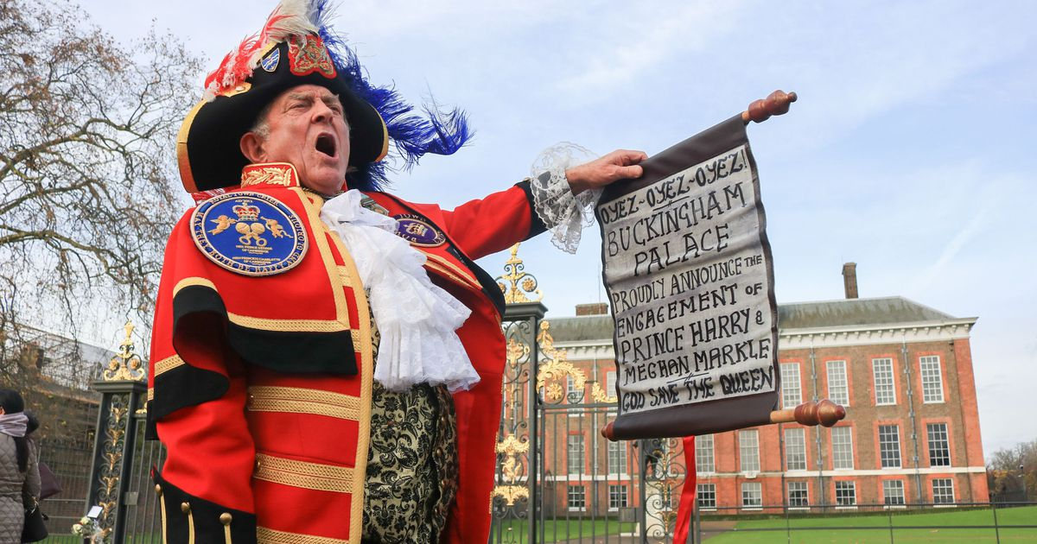

Slide 13
Oh!
I’m sorry.
Did I break your concentration?

Slide 14
Yes!
A nice strong flavor…
Oh, that’s good!
This one going into the empty plate club

Slide 15
Onomatopoeia
Word that sound like the sounds

Slide 16
What sound does it make?
한국어
쿵쾅 쿵쾅
English
Thump

Slide 17
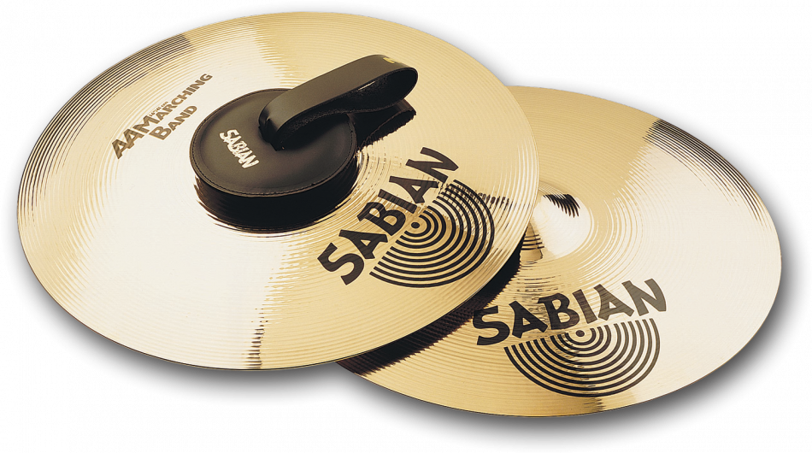
What sound does it make?
한국어
칭 칭 칭
English
Clang clang

Slide 18
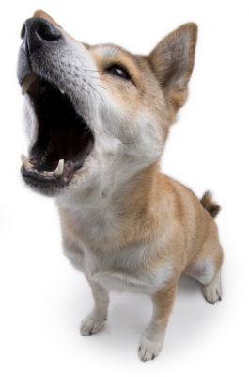
What sound does it make?
Woof
Bow-wow
Bark
한국어
멍멍
English

Slide 19
What sound does it make?
한국어
야옹
English
Meow

Slide 20
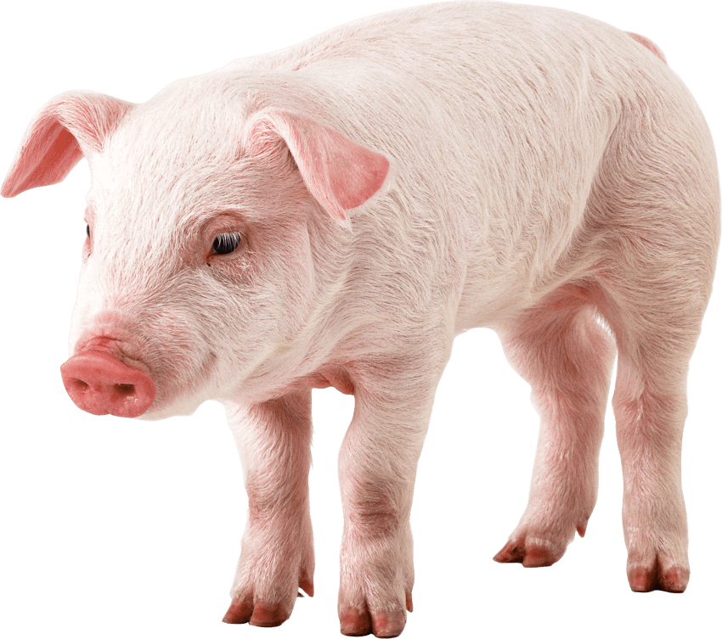
What sound does it make?
한국어
꿀꿀꿀
English
Oink

Slide 21
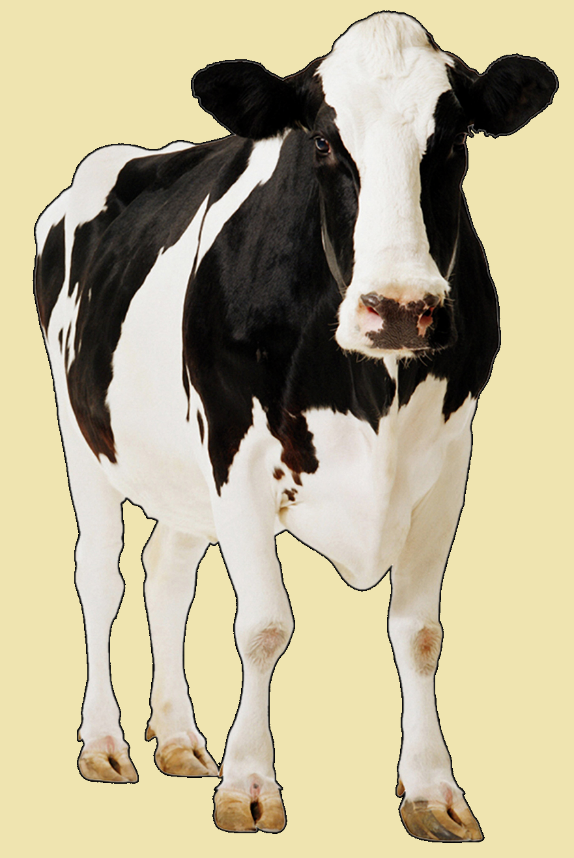
What sound does it make?
한국어
음메
English
Moo

Slide 22
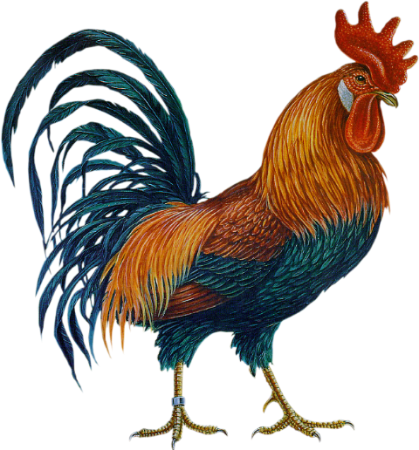
What sound does it make?
한국어
꼬끼오
English
Cock-a-doodle-do

Slide 23
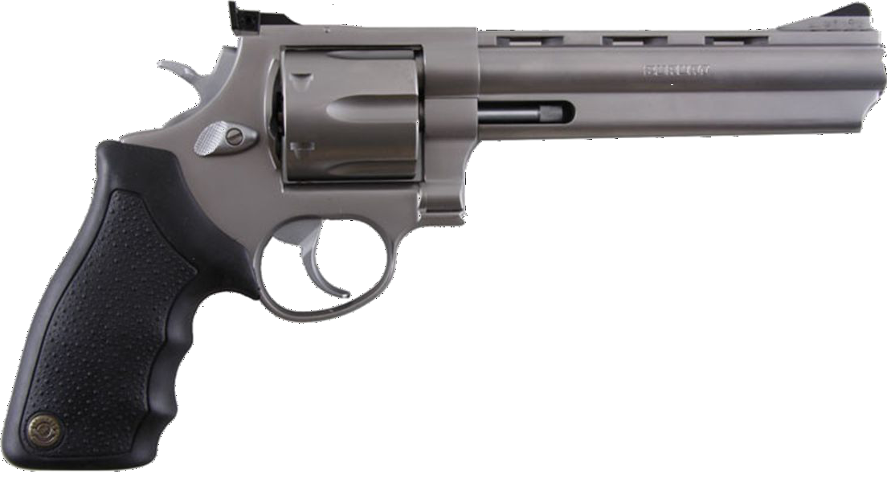
What sound does it make?
한국어
빵
English
Bang

Slide 24
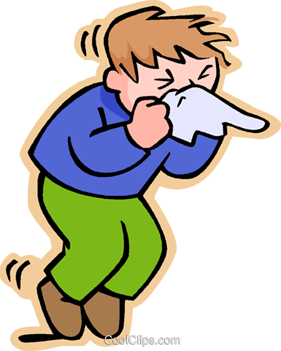
What sound does it make?
한국어
에취
English
Achoo!

Slide 25
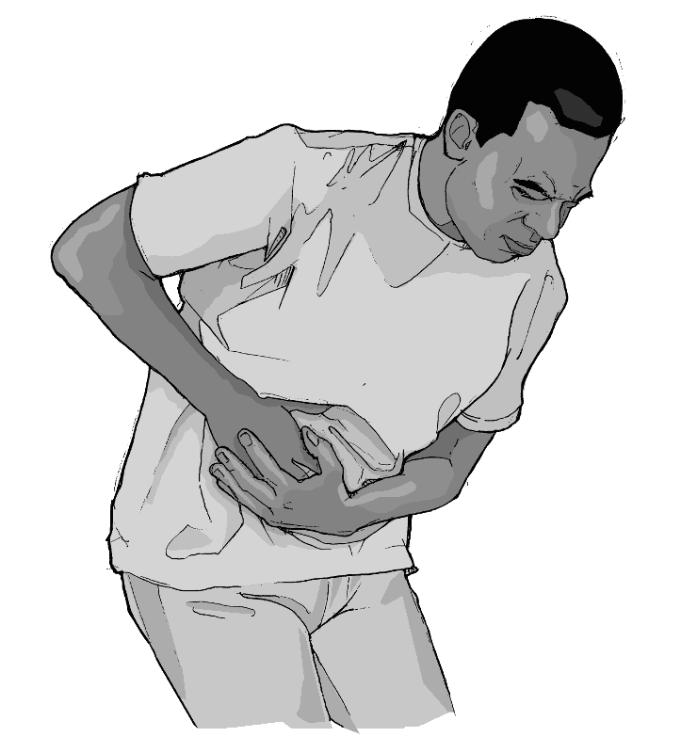
What sound does it make?
한국어
아야
English
Ouch

Slide 26
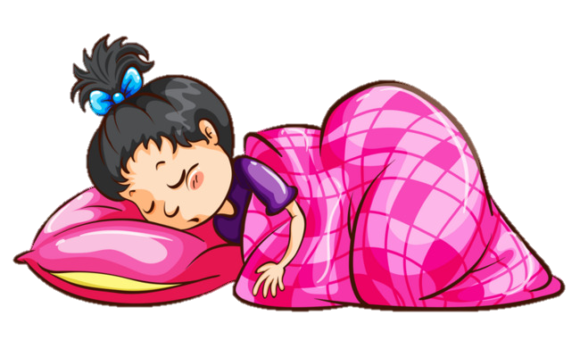
What sound does it make?
한국어
드르렁드르렁
English
zzzzzzzzz

Slide 27
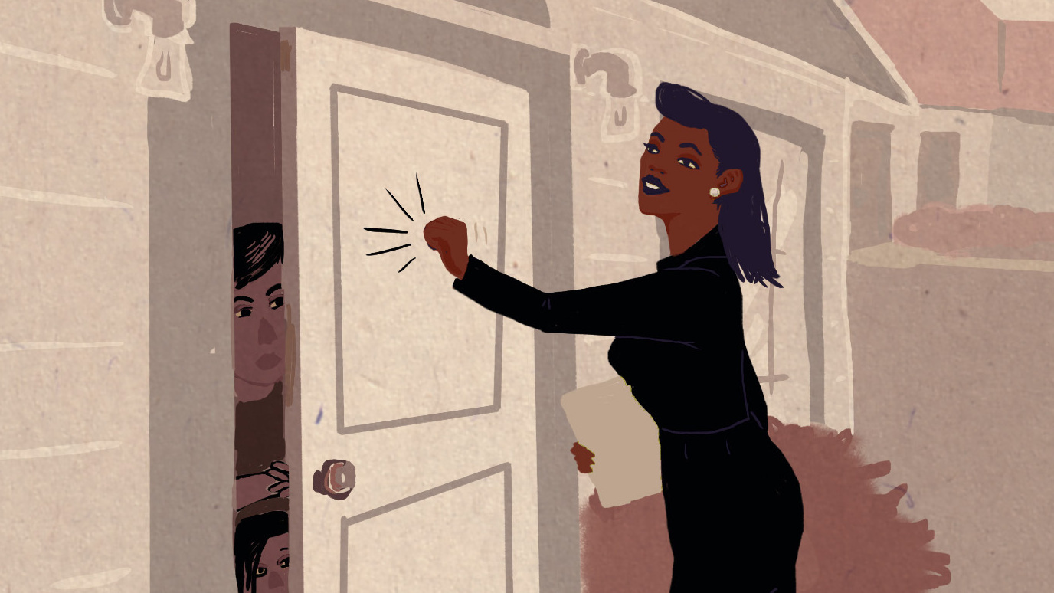
What sound does it make?
한국어
똑똑
English
Knock knock
(blam)

Slide 28
What sound does it make?
한국어
빵빵
English
Honk honk
Beep beep

Slide 29
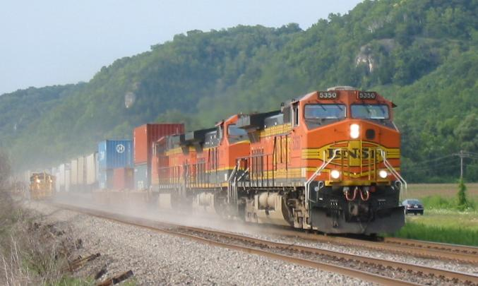
What sound does it make?
한국어
칙칙폭폭
English
Choo-choo

Slide 30
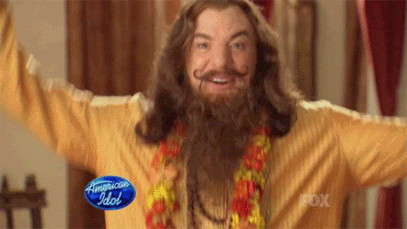
What sound does it make?
한국어
뿅, 펑, 팡
English
Poof

Slide 31
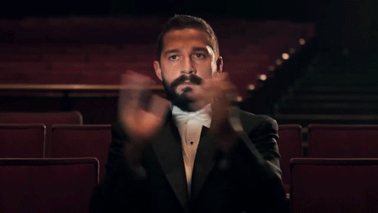
What sound does it make?
한국어
짝짝짝
English
Clap clap clap

Slide 32
Auxesis
Listing things in ascending order

Slide 33
I could have been somebody.
I could have been a contender.
I could have had class.

Slide 34
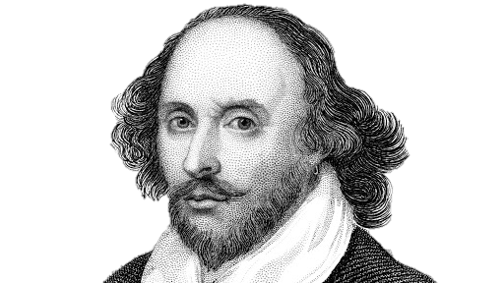
Since brass, nor stone, nor earth, nor boundless sea, But sad mortality o'er-sways their power . . . --Shakespeare, "Sonnet 65" (Vickers 493)

Slide 37
Tmesis
The separation of one word into two parts
– with a word inserted for emphasis.

Slide 38
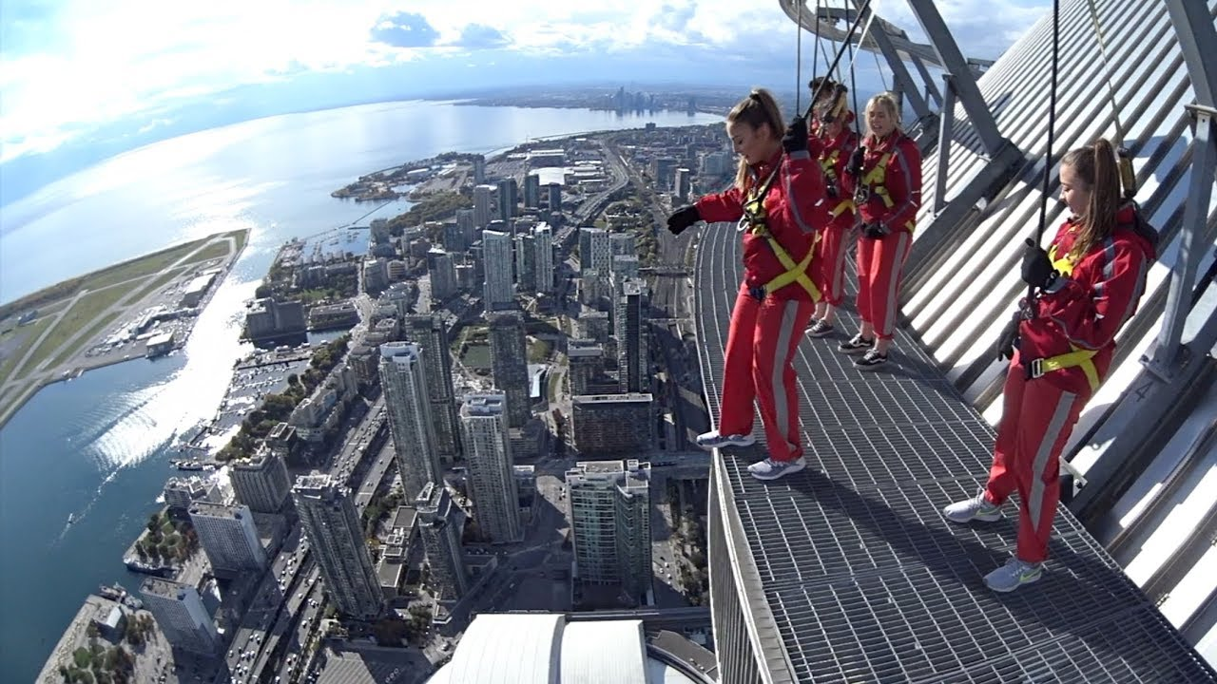
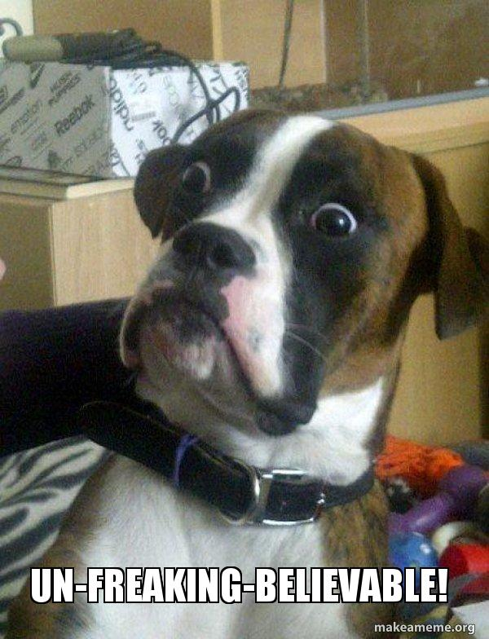

Slide 39
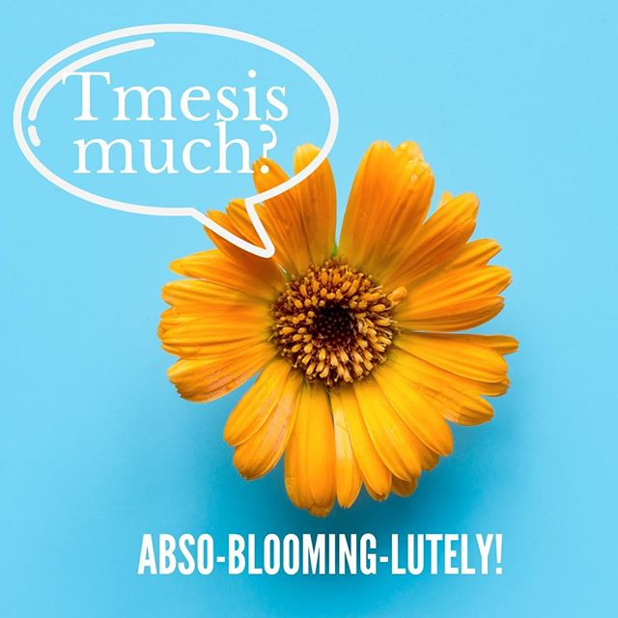

Slide 41
Critic Reviews
Rhetoric in advertising.

Slide 42
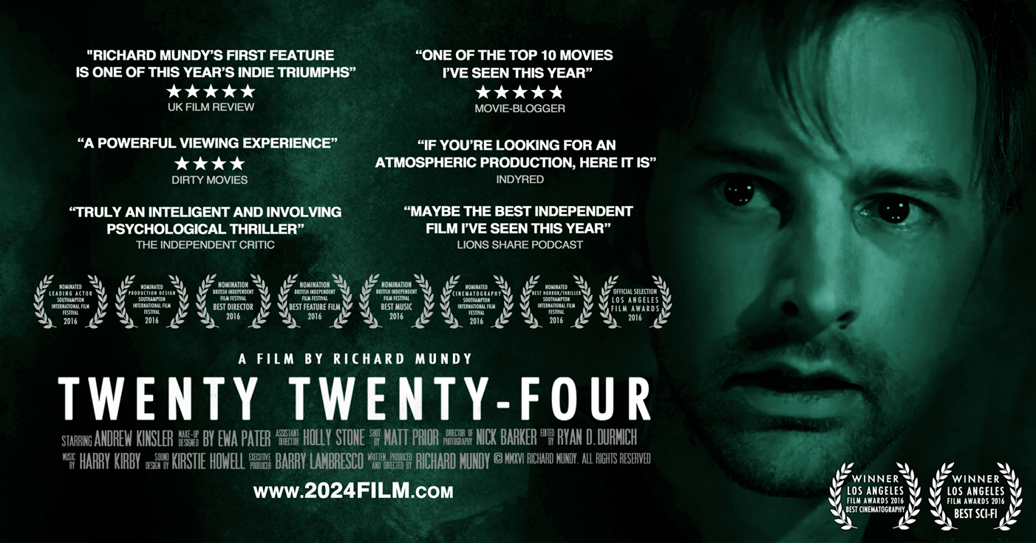

Slide 44
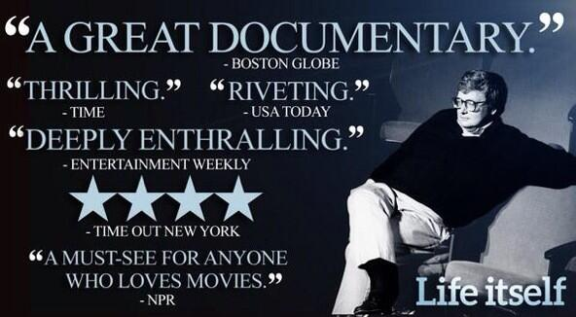

Slide 47
Lame Reviews
Choose something mundane
Everyone must use exaggeration to say something about it.

Slide 48
“This PowerPoint was in-freaking-credable.”
-Tim Schilstra
“Wow. All PPTs should be like this!”
-Tim Schilstra
“Tim deserves a raise!”
-Tim Schilstra

Slide 49
Bdelygmia
A rhetorical insult
– the uglier and more elaborate the better.

Slide 50
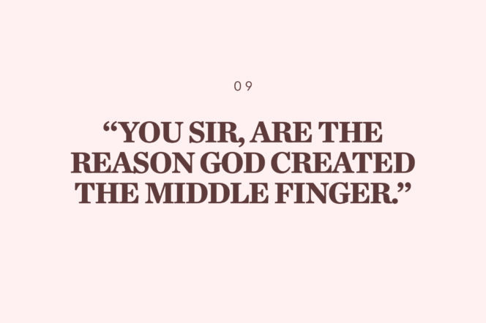

Slide 51
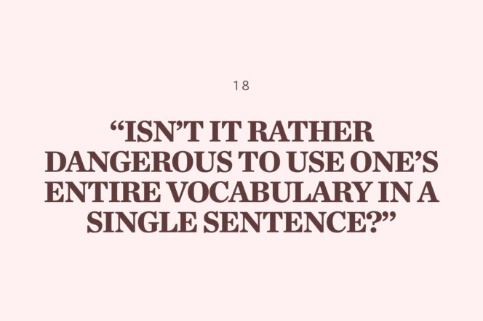

Slide 52
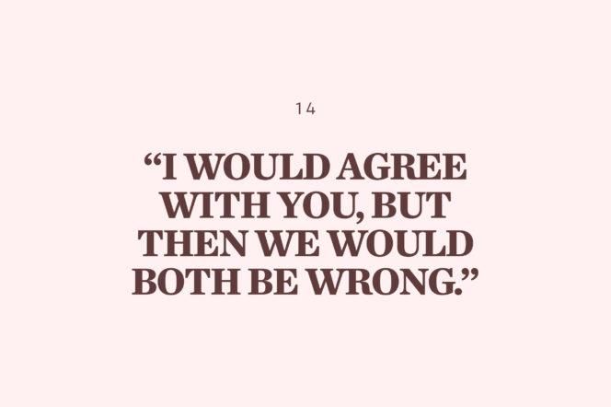

Slide 53
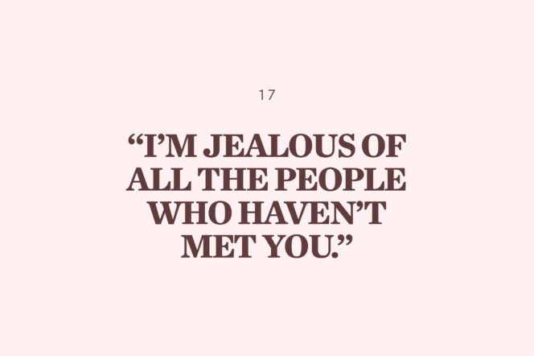

Slide 54
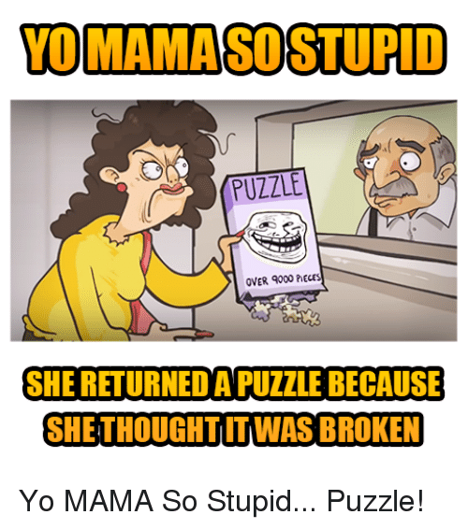
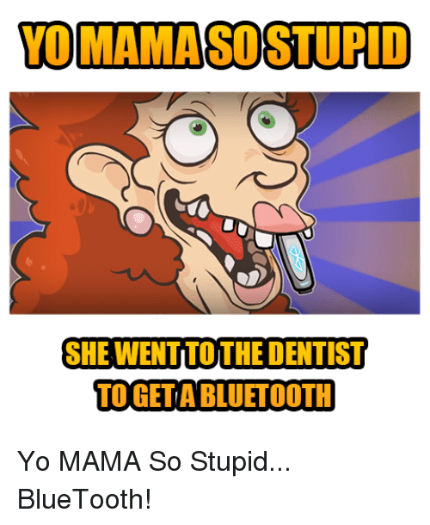

Slide 55
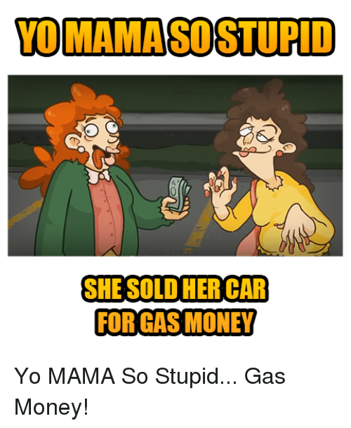
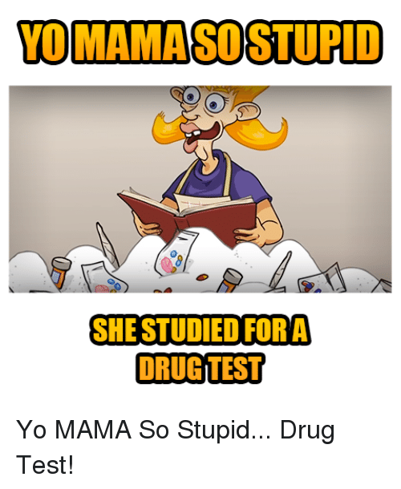

Slide 57
Understatement
The opposite of hyperbole.
Used to make it seem unimportant / not a big deal.
(meosis)

Slide 58
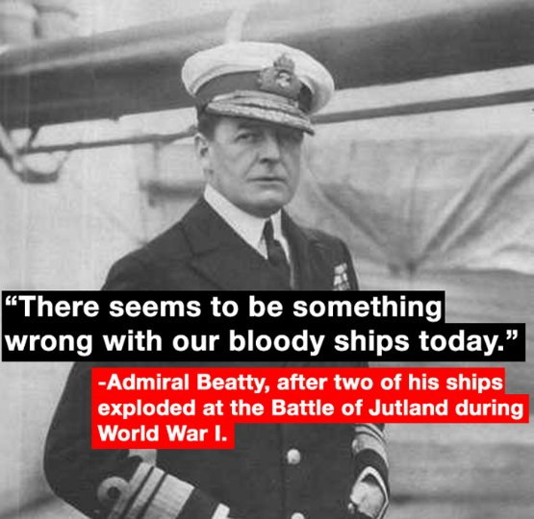

Slide 59
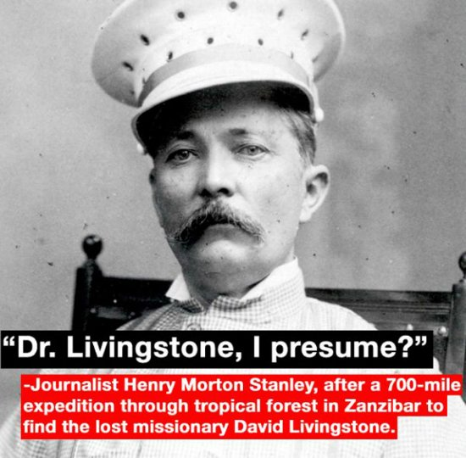

Slide 61
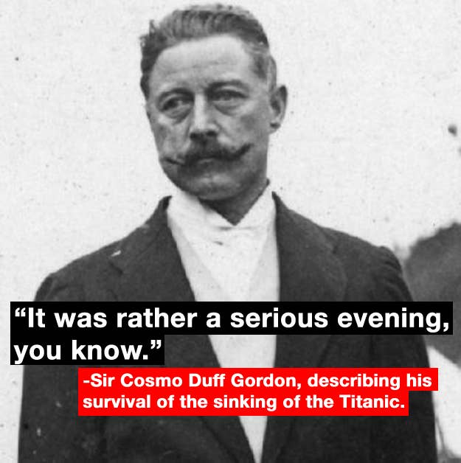

Slide 62
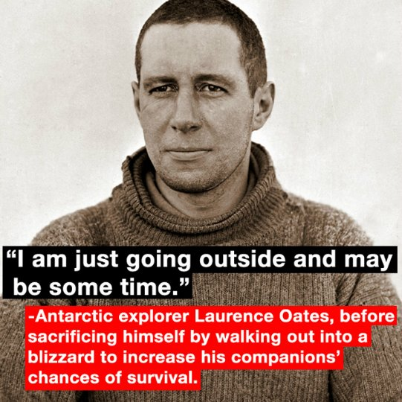

Slide 63
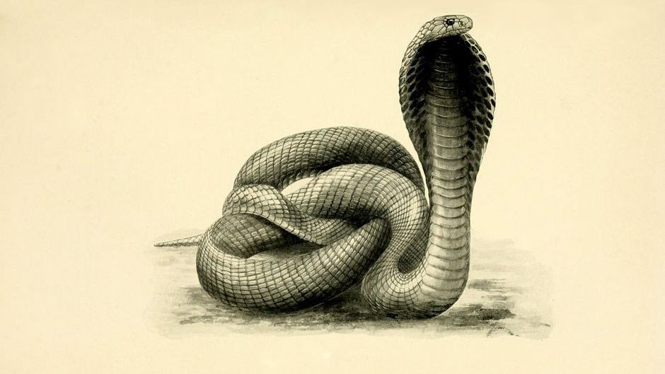
The Indian government’s plan didn’t work out well.
https://ourworld.unu.edu/en/systems-thinking-and-the-cobra-effect

Slide 64
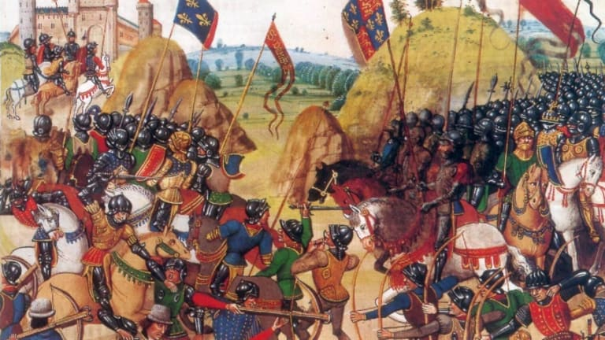
France and England had a disagreement.
https://www.history.com/topics/middle-ages/hundred-years-war

Slide 65
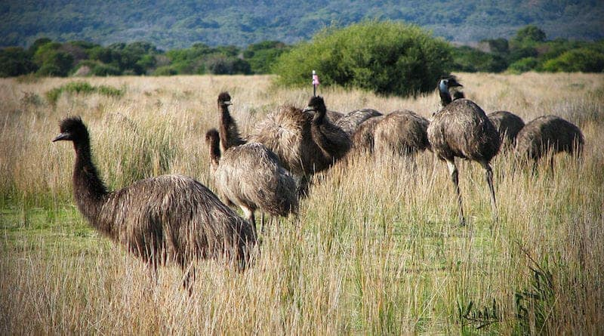
Australia had a bit of an emu problem.
https://nomadsworld.com/great-emu-war/

Slide 66
It’s nothing but a flesh wound.

