Slide 1
Repetition
repetition

Slide 3
The key to real estate is location, location, location.

Slide 4
Let it snow, let it snow, let it snow.

Slide 5
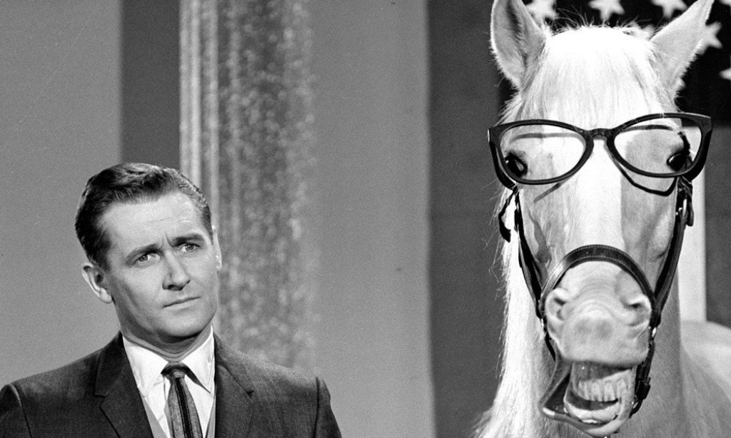
"A horse is a horse, of course, of course,
And no one can talk to a horse of course,
That is, of course, unless the horse is the famous Mr. Ed."
--Theme Song from Mr. Ed, television show

Slide 6
Propaganda / Advertising
Keep saying it until it is true.

Slide 7
Land of the Free

Slide 10
Alliteration
Repeating the same (stressed) sounds.

Slide 11
Consonance
Repeating consonant sounds

Slide 12
Assonance
Repeating the vowel sounds.

Slide 13
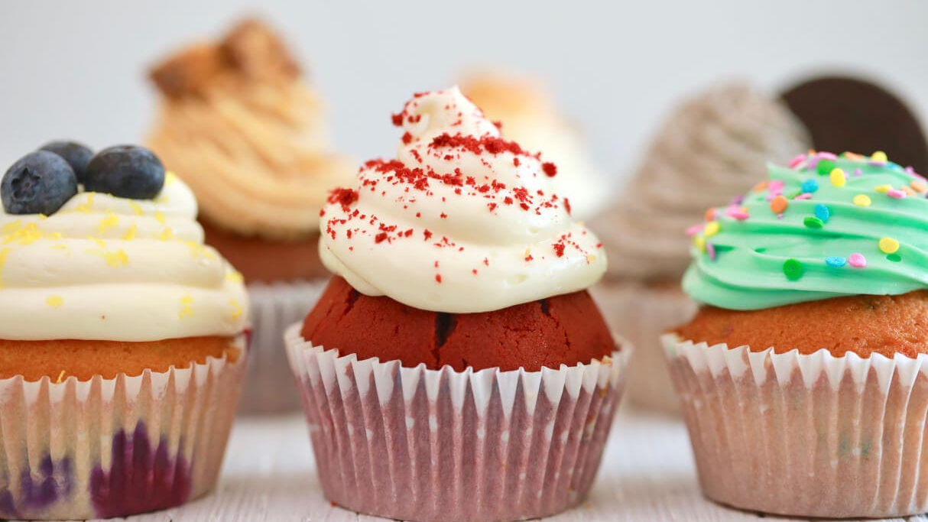
Kyle cooked cupcakes in the kitchen.

Slide 14
Go slow over the road.

Slide 15
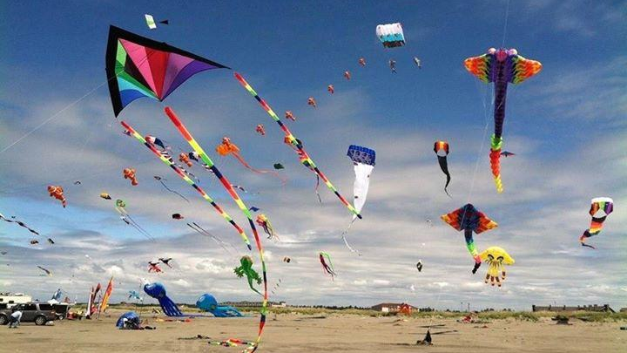
Try as I might, the kite did not fly.

Slide 16
That’s the first photo of France from far away.

Slide 17
That’s the sound of someone sipping soup for supper.

Slide 19
Your Turn!
Choose a letter from the bag.
Use that letter (sound) as much as possible in one sentence.
Share your results.

Slide 20
Adnomination
Word with the same root (or morpheme) in the same sentence.

Slide 21
Someone somewhere says something sometimes.

Slide 22
He is nobody from nowhere and he knows nothing.

Slide 23
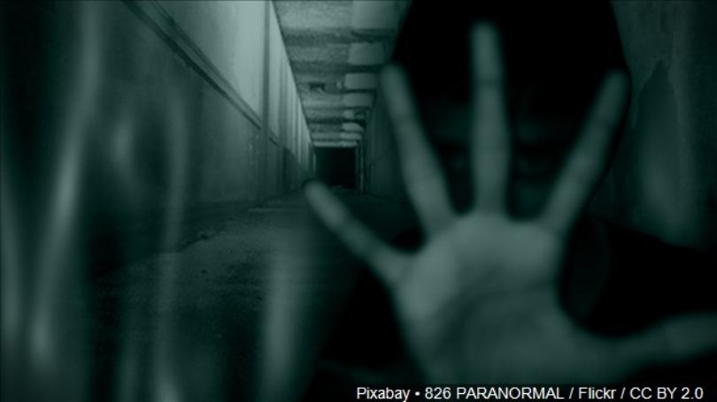
There’s nothing abnormal about the paranormal.

Slide 24
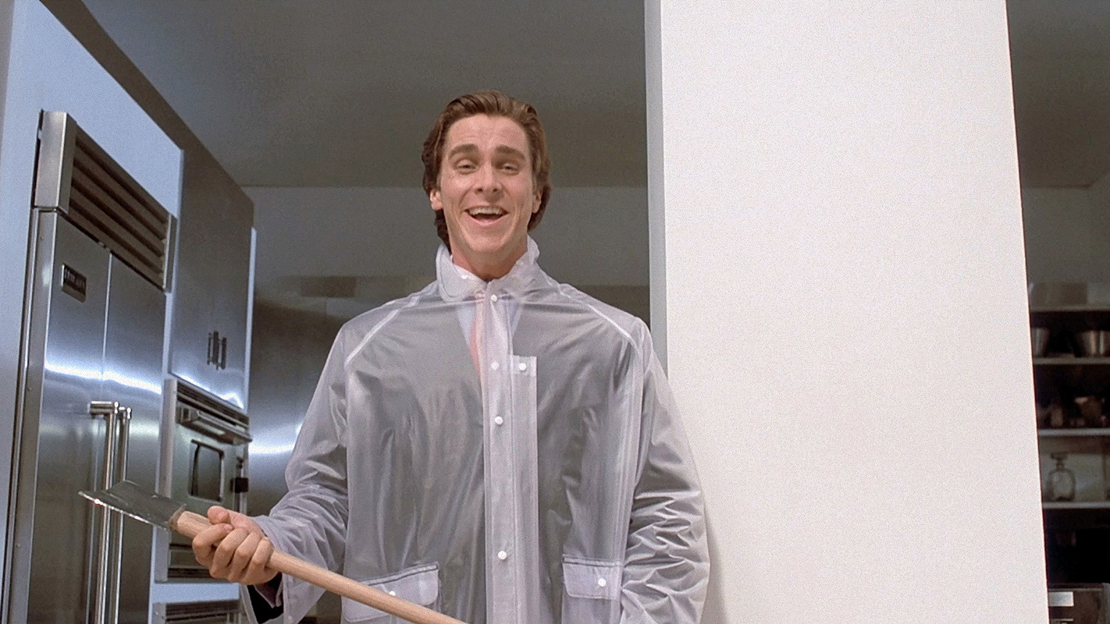
Psychopaths are pathetic and I have no empathy for them.

Slide 25
Anadiplosis
Repetition of the word from the end of one sentence (or phrase) to the beginning of the next.

Slide 26
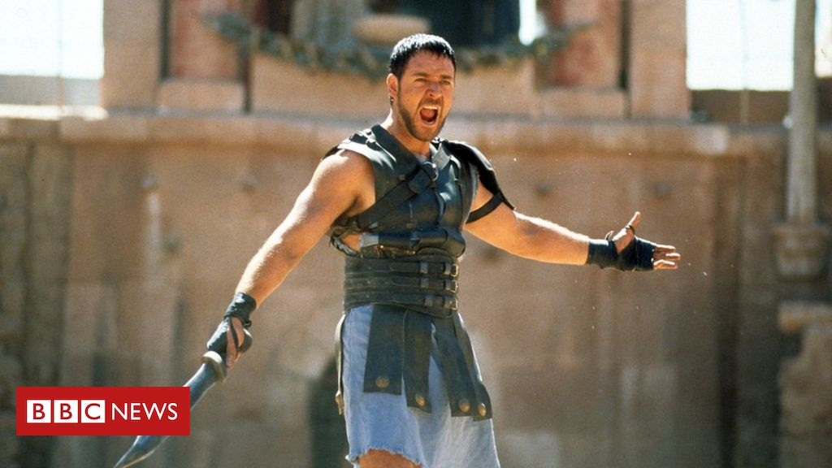
They call for you: The general who became a slave; the slave who became a gladiator; the gladiator who defied an Emperor.

Slide 27
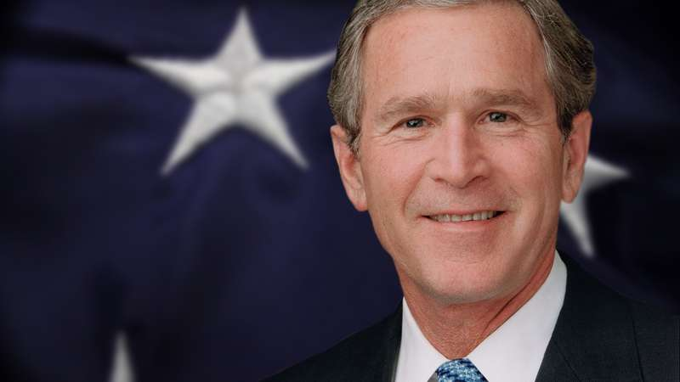
Tonight, we are a country awakened to danger and called to defend freedom. Our grief has turned to anger, and anger to resolution

Slide 29
Fear leads to anger. Anger leads to hatred. Hatred leads to conflict. Conflict leads to suffering.

Slide 30
Anaphora
Repetition of a word at the beginning of subsequent sentences.

Slide 31
Every day, every night, in every way, I am getting better and better.

Slide 32
Tell them to be good, tell them to follow their leaders, tell them to mind their manners.

Slide 33
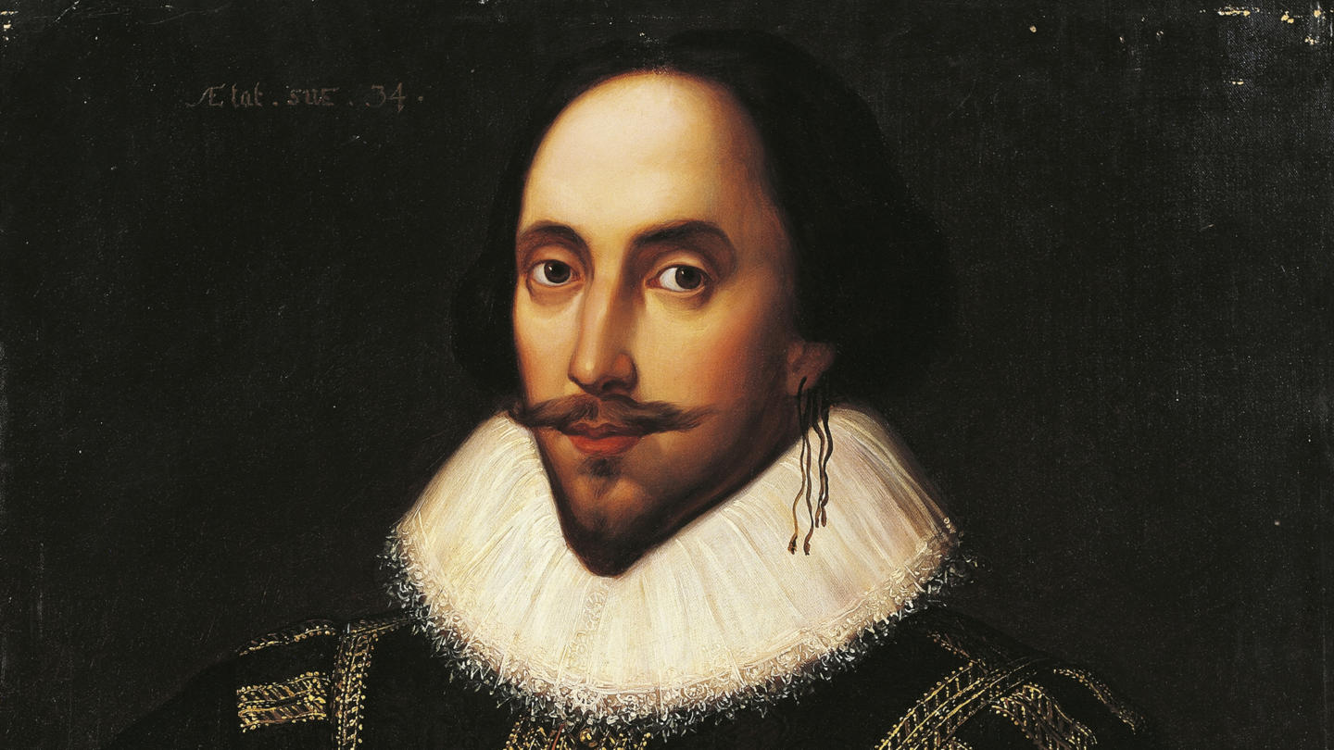
This blessed plot, this earth, this realm, this England,
This nurse, this teeming womb of royal kings […]
This land of such dear souls, this dear dear land.

Slide 34
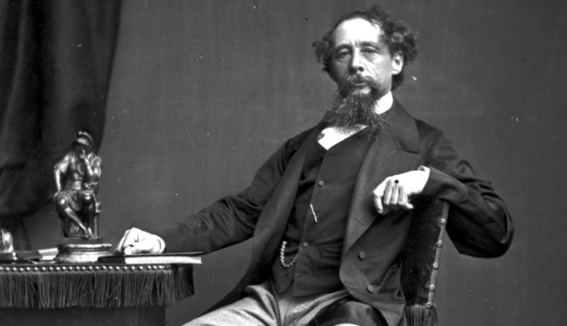
It was the best of times, it was the worst of times,
it was the age of wisdom, it was the age of foolishness,
it was the epoch of belief, it was the epoch of incredulity,
it was the season of Light, it was the season of darkness, it was the spring of hope, it was the winter of despair.

Slide 35
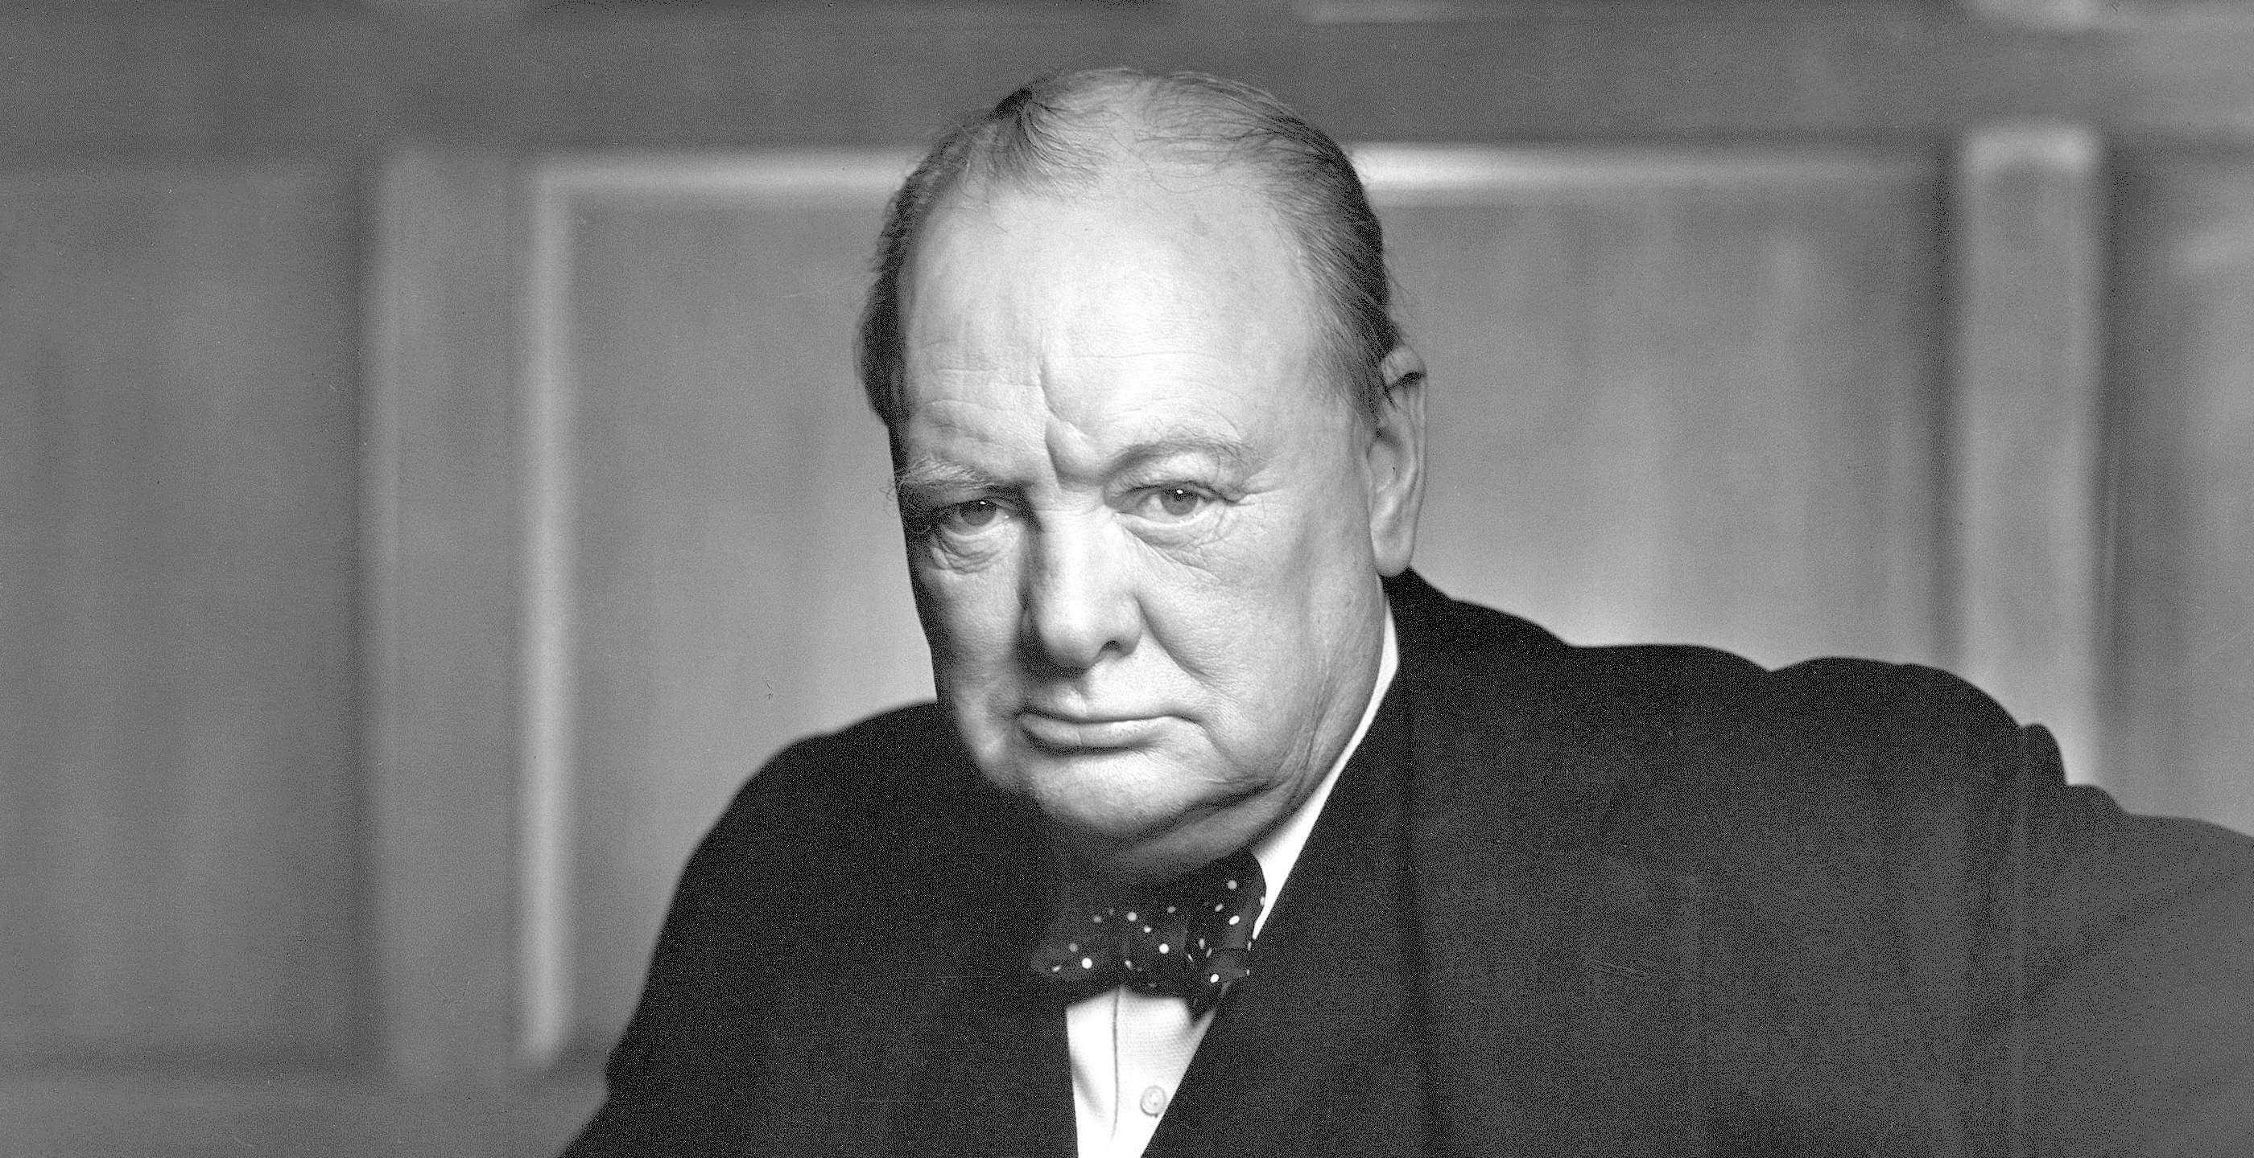
We shall go on to the end.
We shall fight in France,
we shall fight on the seas and oceans,
we shall fight with growing confidence and growing strength in the air,
we shall defend our island, whatever the cost may be.
We shall fight on the beaches, we shall fight on the landing grounds,
we shall fight in the fields and in the streets,
we shall fight in the hills;
we shall never surrender

Slide 36
Your Turn!
In your group, write an anaphora.
Each member reads one line.
(one line for each member )

Slide 37
Epistrophe
Repetition of a word at the end of subsequent sentences
(or phrases).

Slide 38
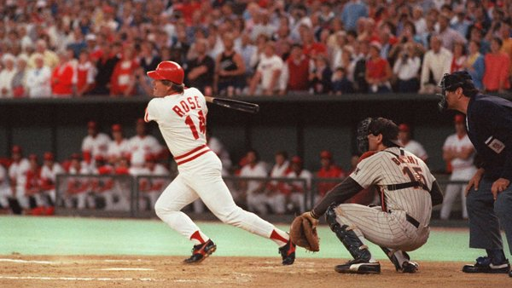
See the ball, hit the ball.

Slide 39
May God bless you. May God keep you.
May he make his face shine up you.

Slide 40
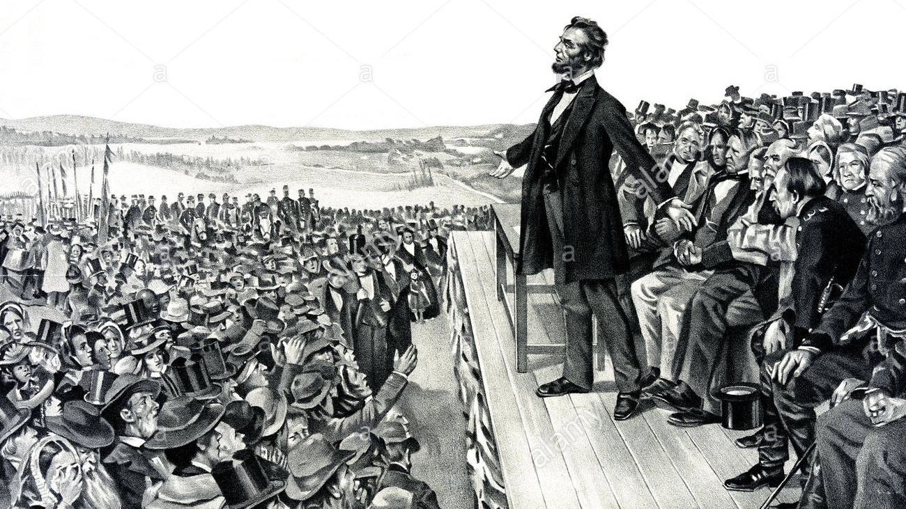
The government of the people, by the people and for the people, shall not perish from the earth.

Slide 41
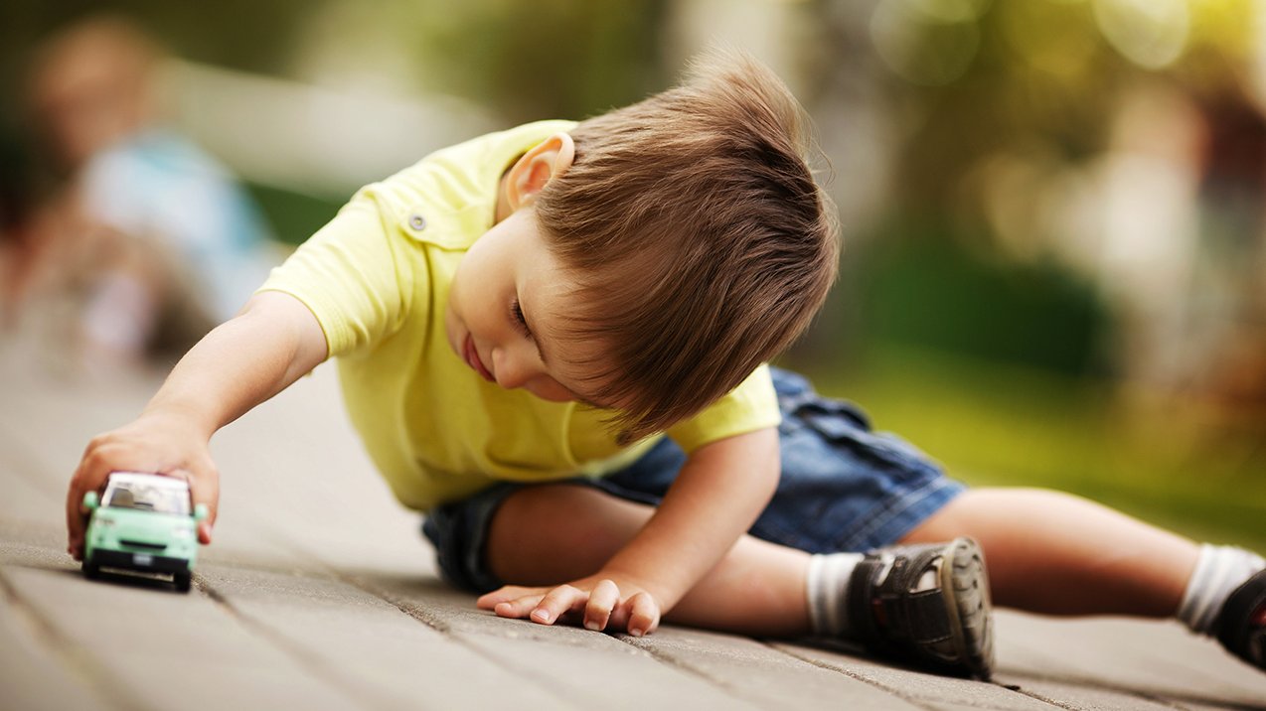
When I was a child, I talked like a child, I thought like a child, and I reasoned like a child.

Slide 42
MONEY
MONEY
MONEY
MONEY
Diamonds on my neck
I like boarding jets, I like morning sex
But there’s nothing in this world that I like more than checks …
All I really wanna see is the…
I don’t really need the D, I need the…
All a bad bitch need is the…

Slide 43
Chaismus
Repetition (or reversal) of words or grammatical structure across two phrases.

Slide 44
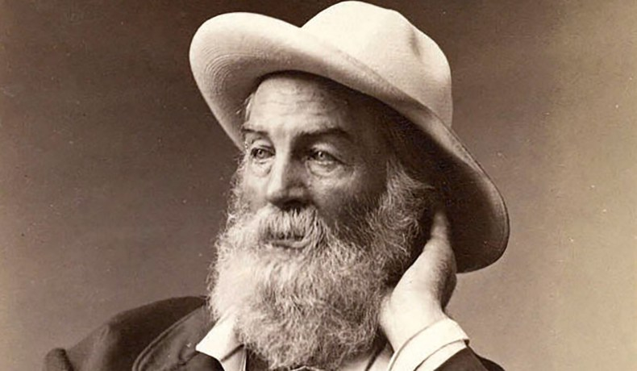
I may be as bad as the worst, but thank God, I am as good as the best.

Slide 45
We walked tiredly; drowsily, we ambled along toward the motel.

Slide 46
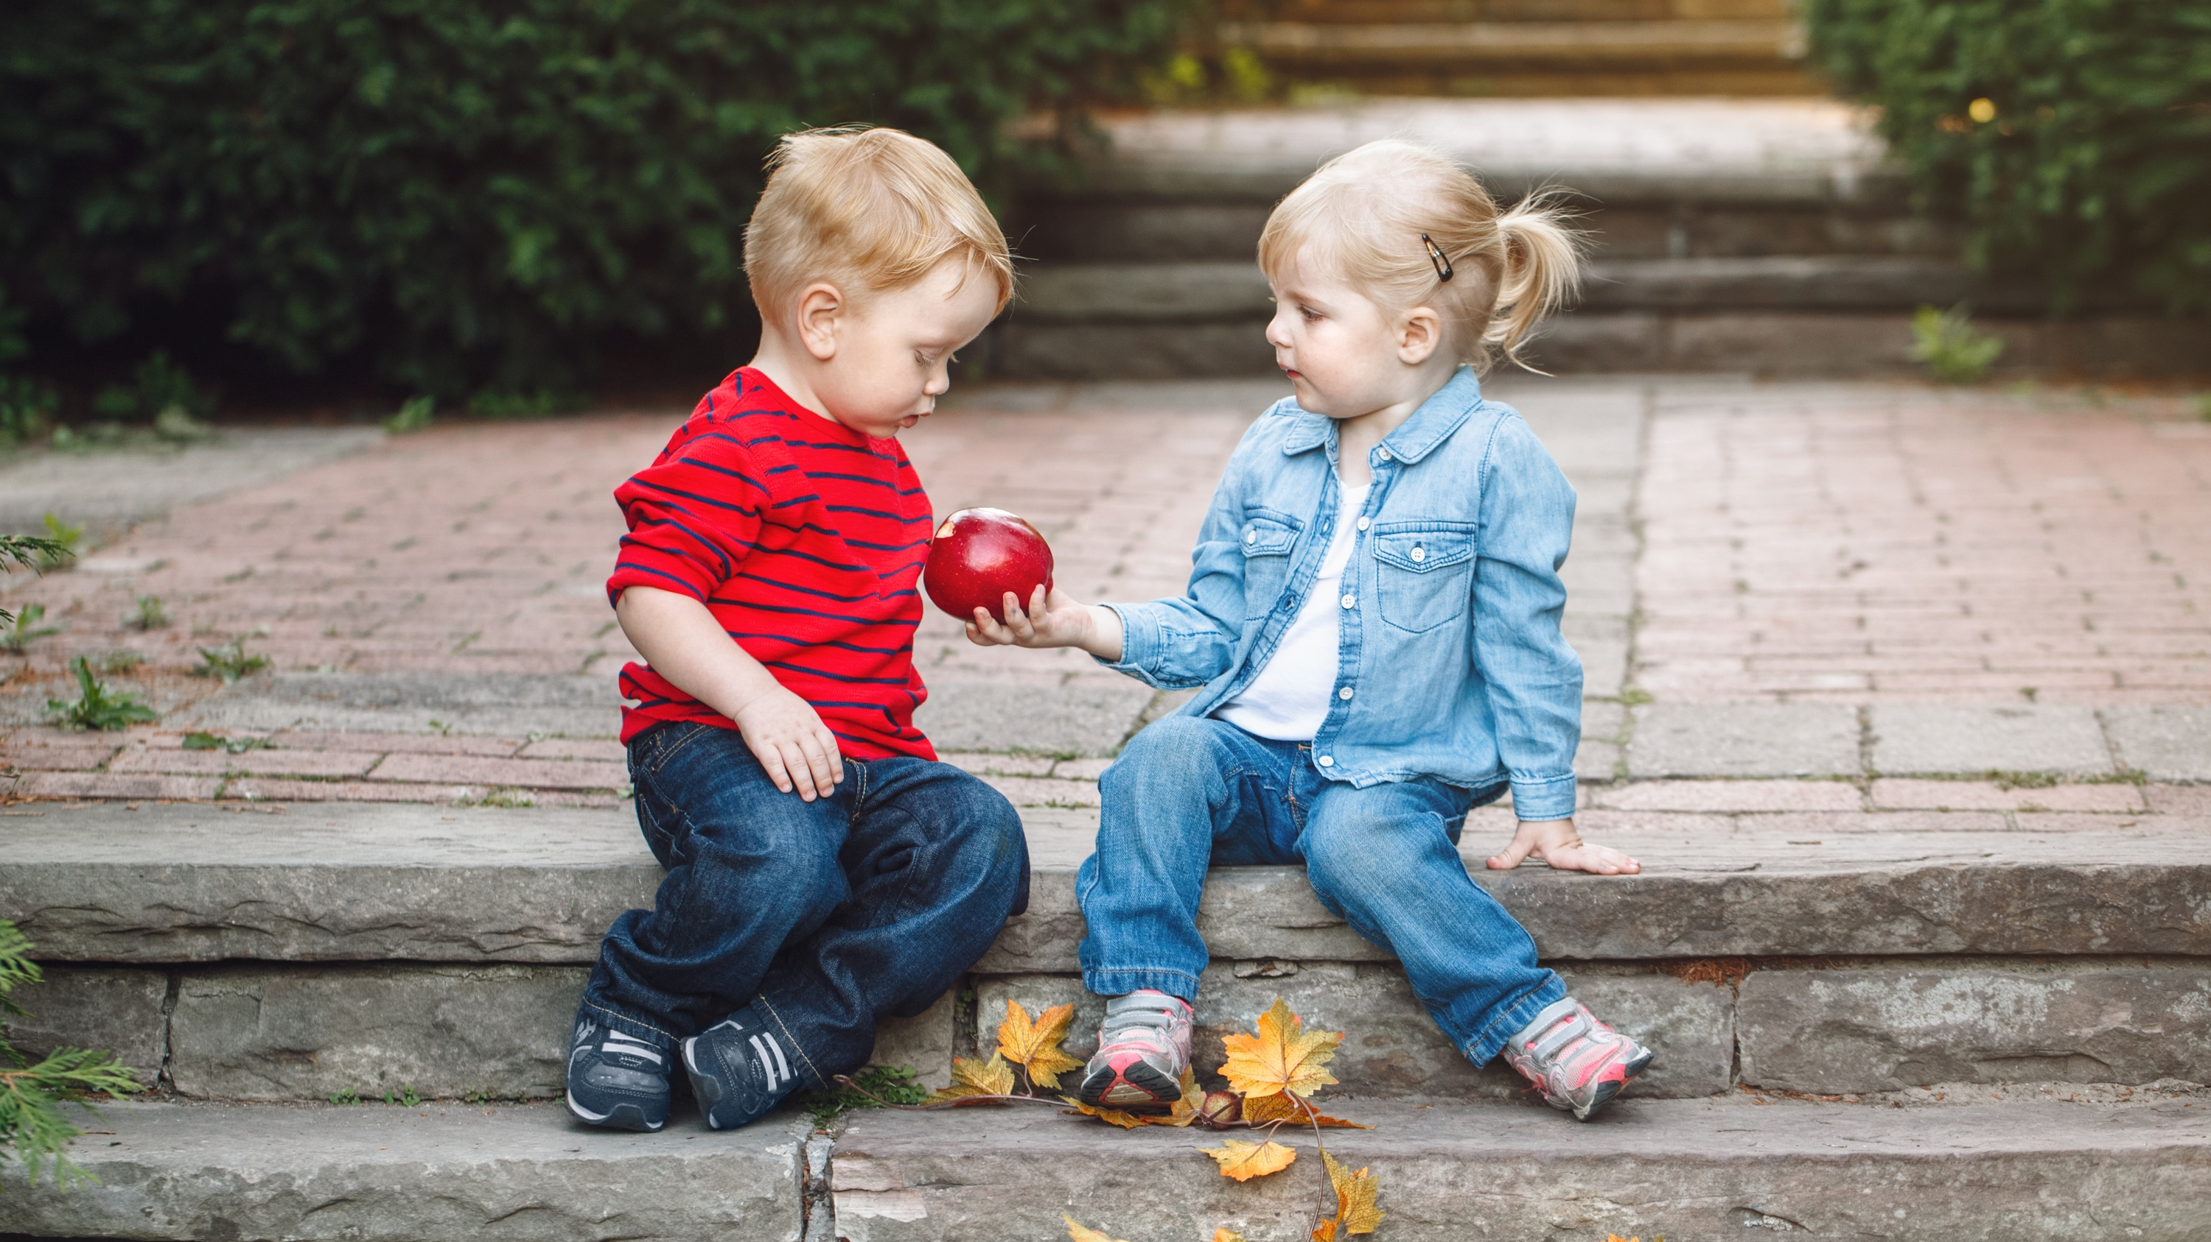
It’s nice to be important but it’s more important to be nice.

Slide 47
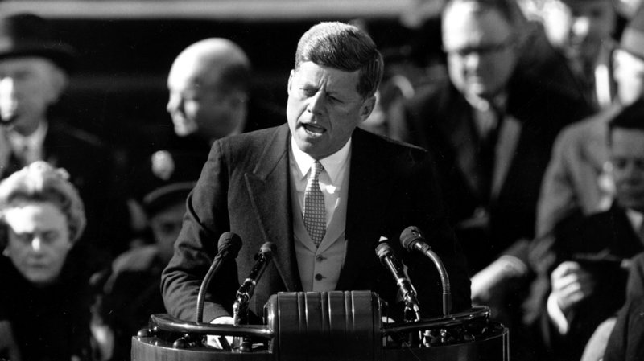
Ask not what your country can do for you, Ask what you can do for your country.

Slide 48
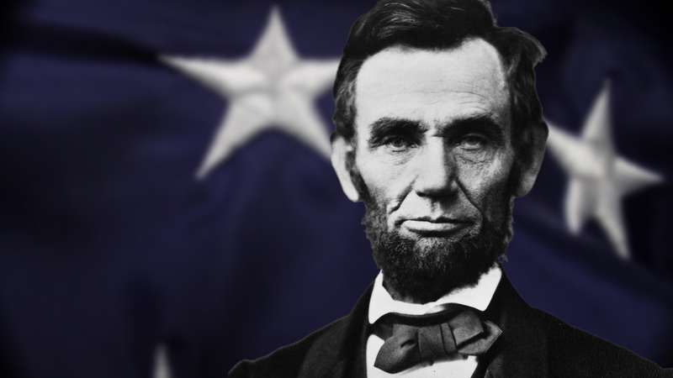
You can fool some of the people all of the time, and all of the people some of the time, but you can not fool all of the people all of the time.

Slide 49
It’s a small step for a man
One giant leap for mankind.

Slide 50
Zeugma
Placing two nouns with different meanings in a similar position in a sentence.
1 verb, 2 nouns

Slide 51
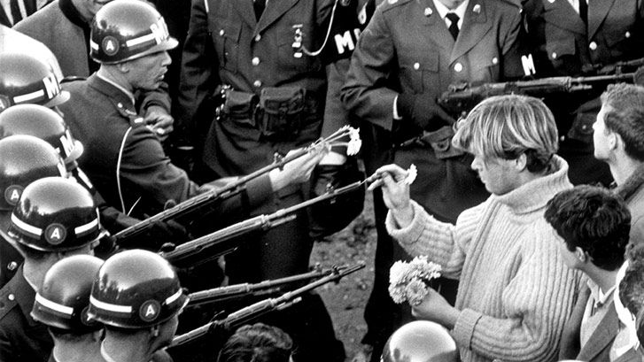
Make love, not war

Slide 52
You are beautiful inside and out.

Slide 53
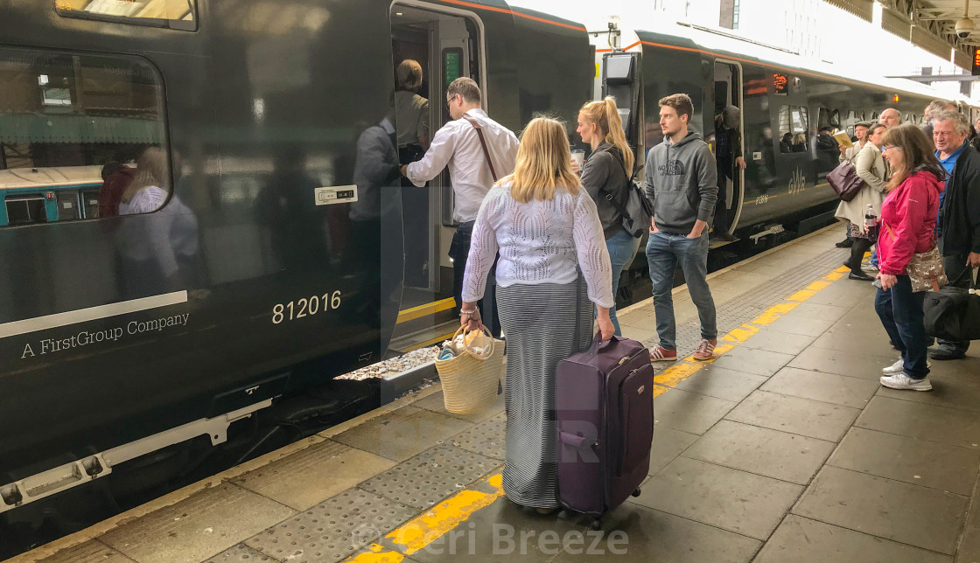
She caught the train and a bad cold.

Slide 54
I have lost my keys and my mind.

Slide 55
Hold your breath and the door.

Slide 56
Your paper and your presentation were delightful.

Slide 57
I am going camping..
I am going camping and I am going to bring a….
(list the previous suggestions + one new)

Slide 58
30 Rhetorical Devices – And How to Use Them
https://blog.reedsy.com/rhetorical-devices/?fbclid=IwAR3rki6C3cWs7QCbwRpVokJuF13oA0alLFYLYBDo40BfPvRiTL0ET4mJKus
25+ Terrific Repetition Examples in Literature
https://blog.reedsy.com/repetition-examples/

