Slide 1
The Power of Three
Tricolon / Triad / Tripartite motto

Slide 2
Three Irishmen on an Island
There are three Irishmen stranded on an island.
Suddenly a fairy appears and offers to grant each one of them one wish.

Slide 3
Three Irishmen on an Island
The first one asks to be intelligent.
Instantly, he is turned into a Scotsman and he swims off the island.

Slide 4
Three Irishmen on an Island
The next one asks to be more intelligent than the previous one.
So, instantly, he is turned into a Welshman.
He builds a boat and sails off the island.

Slide 5
Three Irishmen on an Island
The third Irishman asks to become even more intelligent than the previous two.

Slide 6
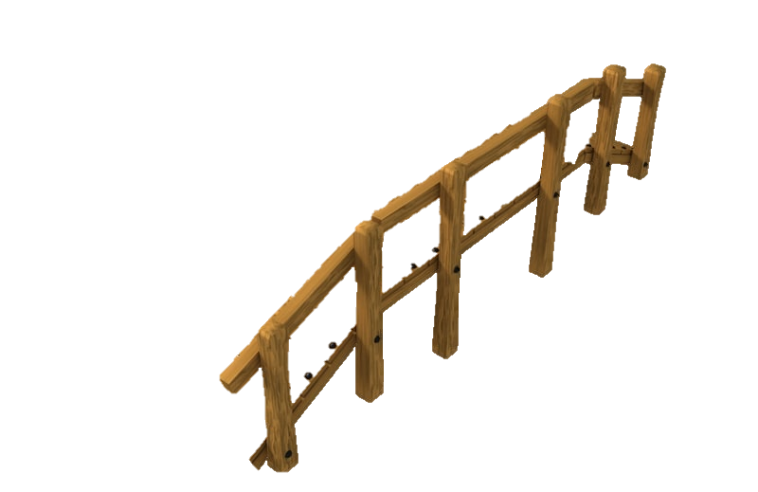
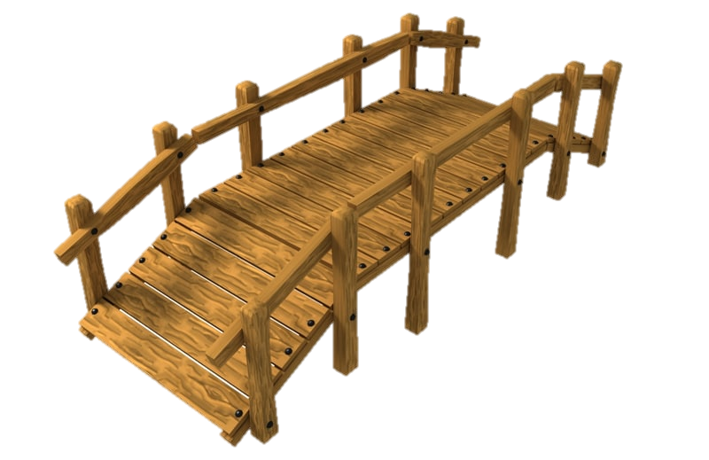
Three Irishmen on an Island
The fairy turns him into a woman, and she walks across the bridge.

Slide 7
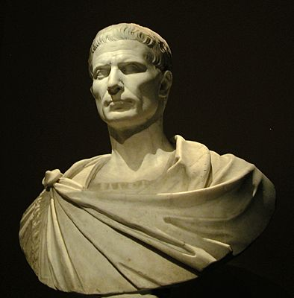
“Veni – Vidi – Vici”
- Julius Caesar

Slide 8
“I came. I saw. I conquered.”
- Julius Caesar

Slide 9
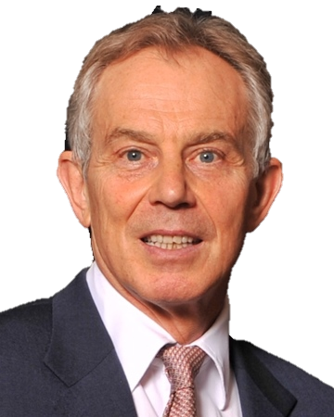
“Ask me my three main priorities for government, and I tell you:
education, education, education.”
- Tony Blair

Slide 10
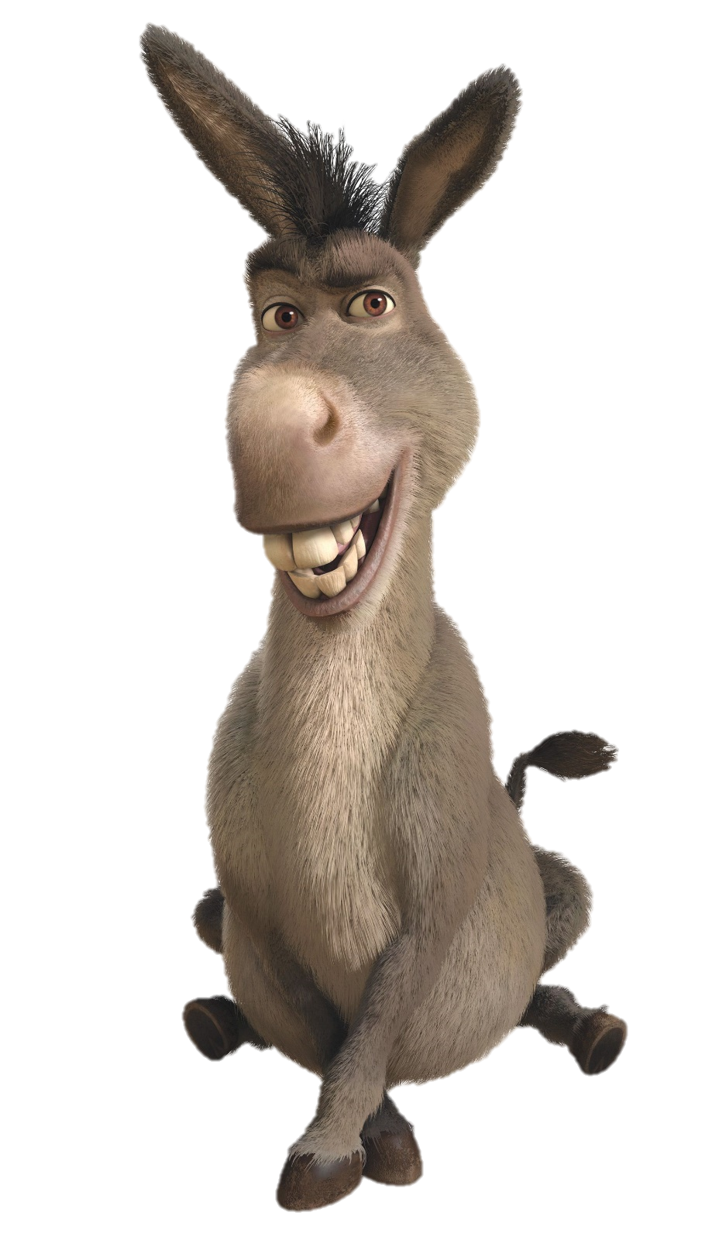
“You might have seen a horsefly, maybe even a superfly, but I bet you ain’t never seen a donkey fly.”
- Eddie Murphy (Donkey in Shrek)

Slide 11
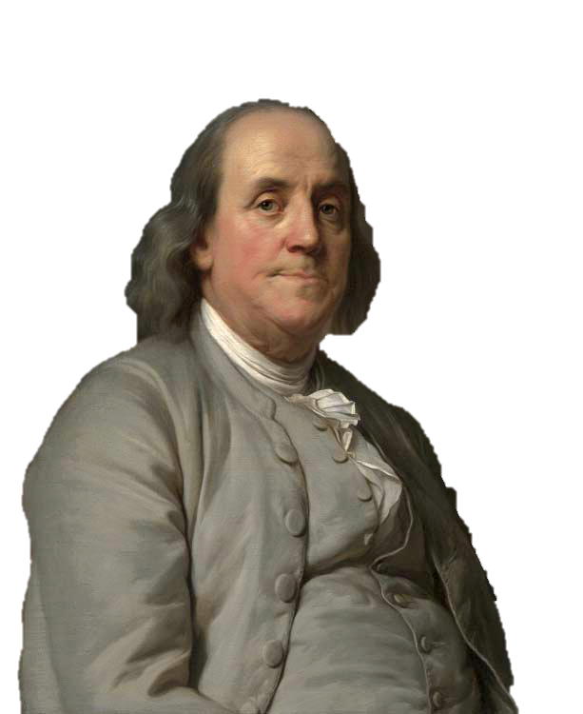
“Tell me and I forget.
Teach me and I remember.
Involve me and I learn.”
- Benjamin Franklin

Slide 12
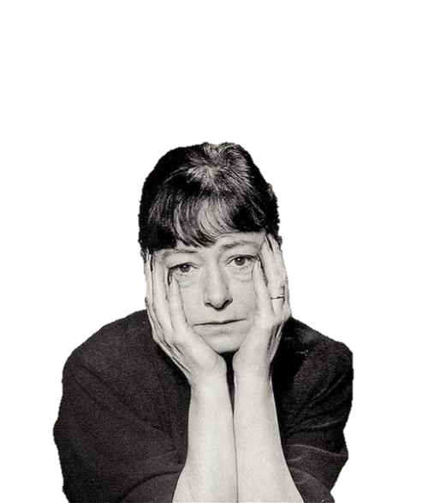
“I require only three things of a man. He must be handsome, ruthless and stupid.”
- Dorothy Parker

Slide 13
“Use one for power.
Two for comparison.
Three for completeness, wholeness, roundness.”
- Roy Peter Clark

Slide 15
A Sense of Completeness
Easy to remember
Sounds good
Rhythm

Slide 16
Famous Examples
Guess the triad

Slide 17
The Olympics
Gold, Silver, Bronze

Slide 18
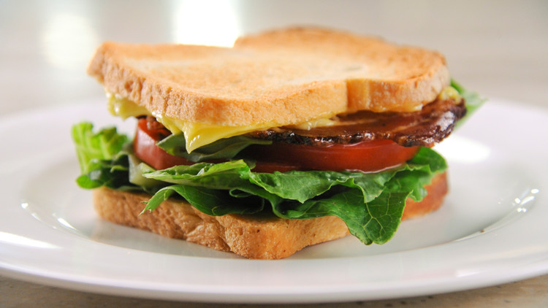
My favorite sandwich (BLT):
Bacon, Lettuce, Tomato

Slide 19
Stages of a Story
Beginning, middle, end

Slide 20
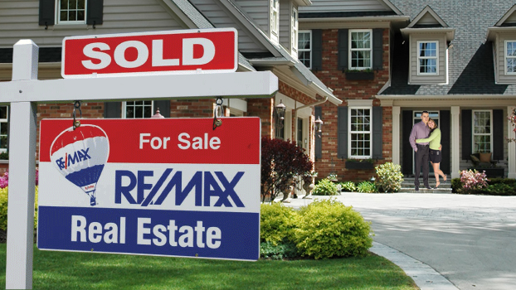
The three most important tings in real estate:
location, location, location

Slide 21
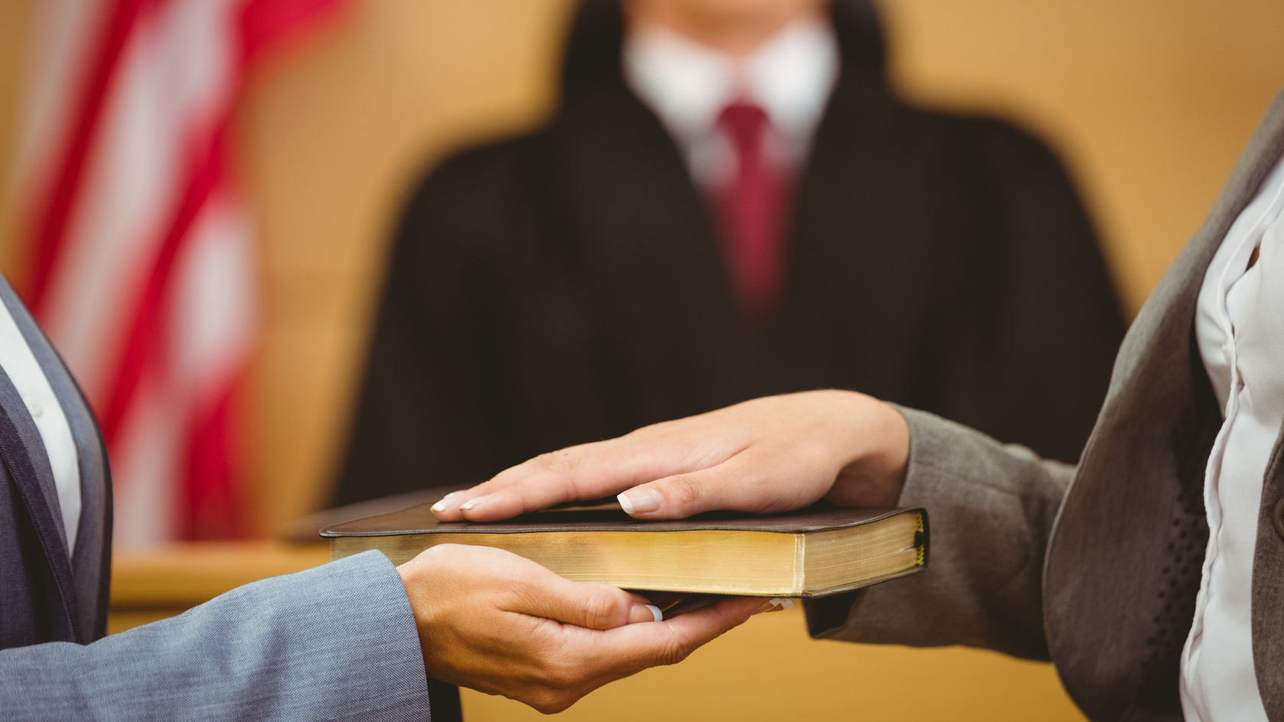
Do you swear to tell
the truth, the whole truth, and nothing but the truth?

Slide 22
You can help the environment
Recycle – Reduce – Reuse

Slide 23
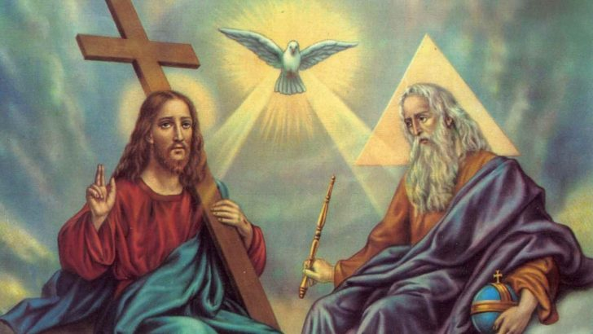
Triune God
The father, the son, the holy spirit

Slide 24
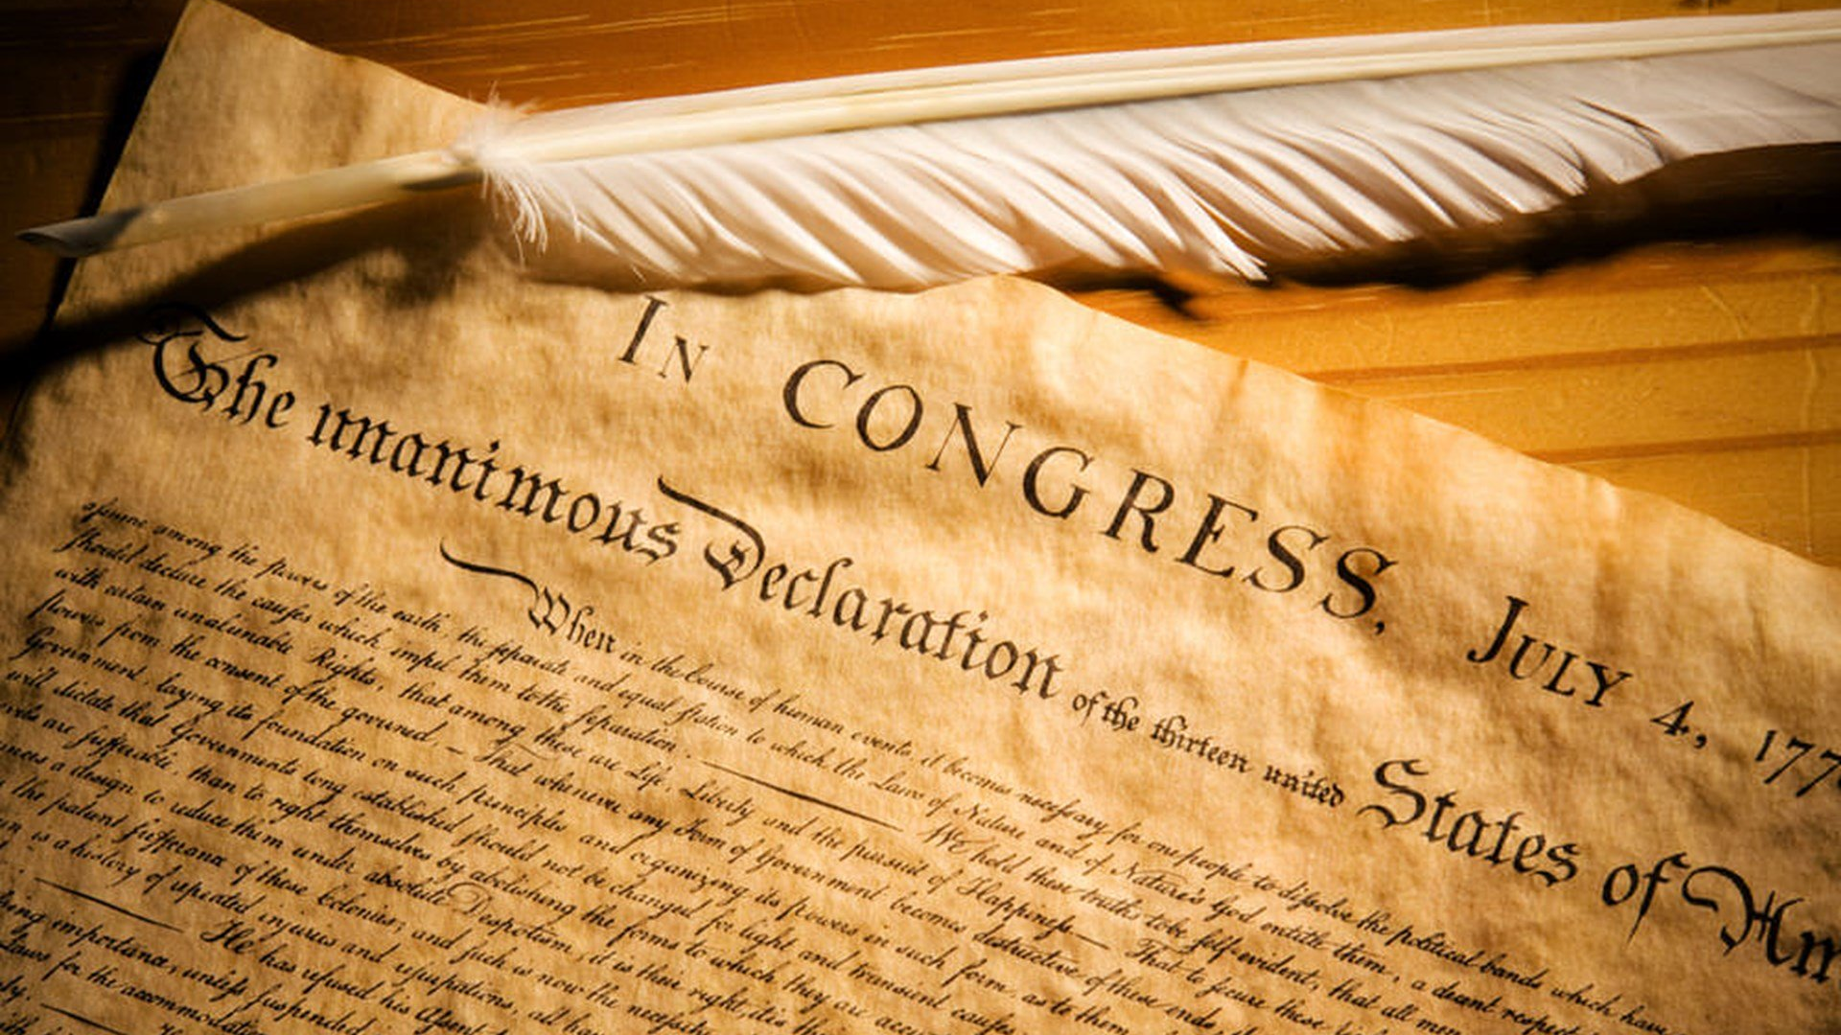
American Declaration of Independence
Life, Liberty and the Pursuit of Happiness

Slide 25
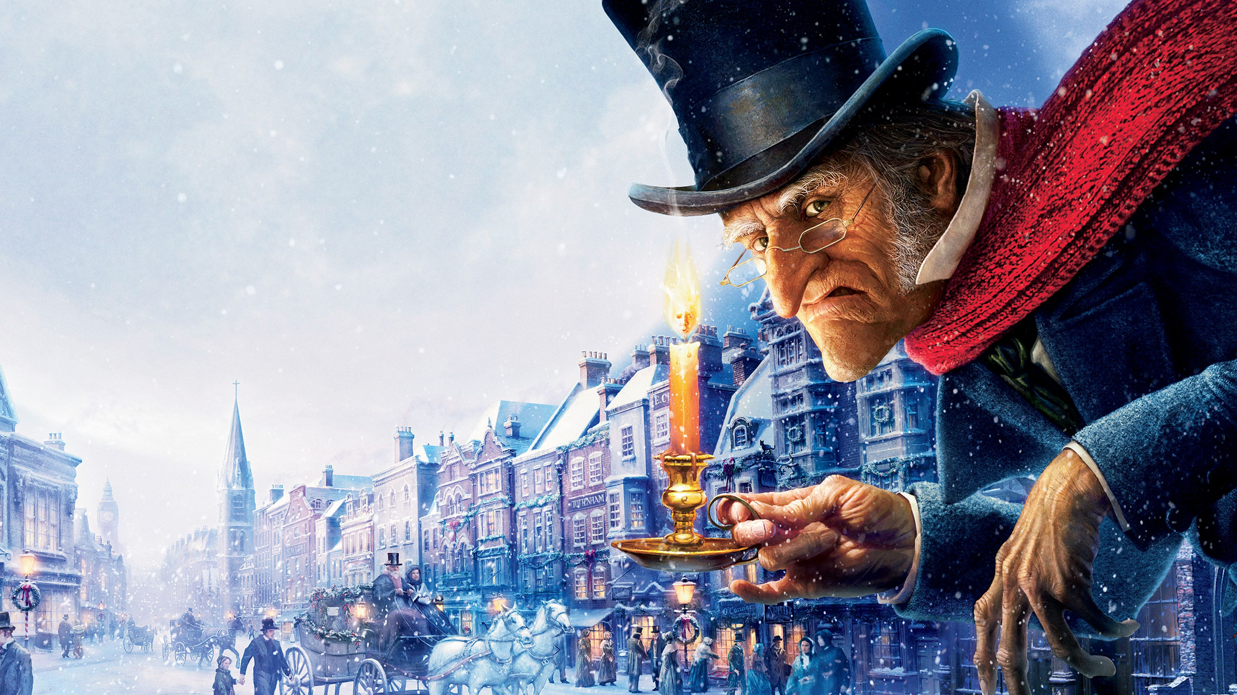
Scrooge’s Sages
The ghost of Christmas past, the ghost of Christmas present, the ghost of Christmases yet to come

Slide 26
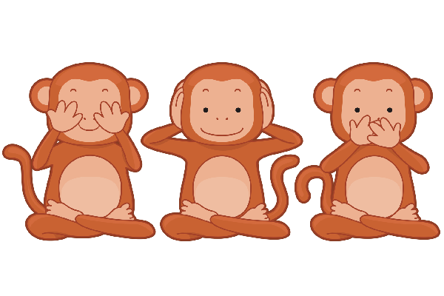
The three monkeys:
See no evil, hear no evil, speak no evil.

Slide 27
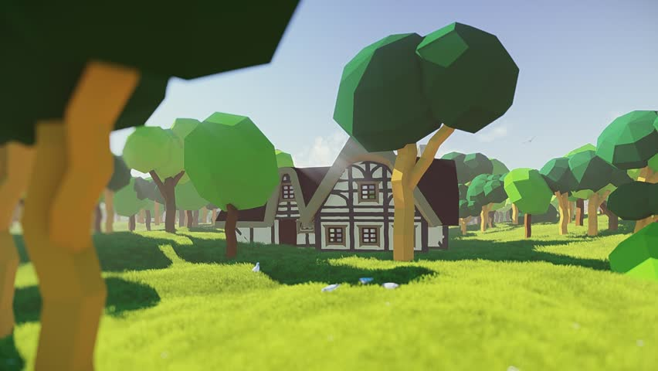
Goldilocks
How many sets of three?

Slide 28
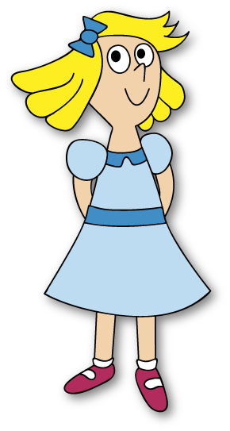
Once upon a time, there was a little girl named Goldilocks. She went for a walk in the forest. Pretty soon, she came upon a house. She knocked and, when no one answered, she walked right in.

Slide 29
At the table in the kitchen, there were three bowls of porridge. Goldilocks was hungry. She tasted the porridge from the first bowl.
"This porridge is too hot!" she exclaimed.
So, she tasted the porridge from the second bowl.
"This porridge is too cold," she said
So, she tasted the last bowl of porridge.
"Ahhh, this porridge is just right," she said happily and she ate it all up.

Slide 30
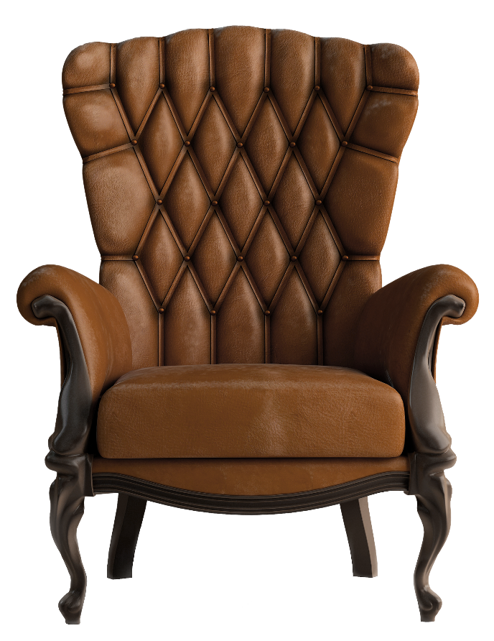
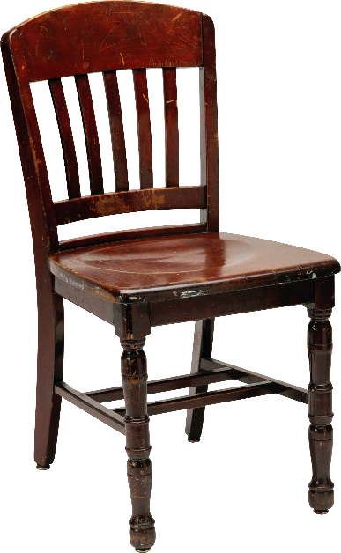
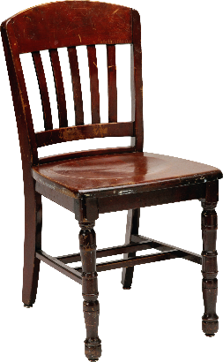
After she'd eaten the three bears' breakfasts she decided she was feeling a little tired. So, she walked into the living room where she saw three chairs. Goldilocks sat in the first chair to rest her feet.
"This chair is too big!" she exclaimed.
So she sat in the second chair.
"This chair is too big, too!" she whined.
So she tried the last and smallest chair.
"Ahhh, this chair is just right," she sighed. But just as she settled down into the chair to rest, it broke into pieces!

Slide 31
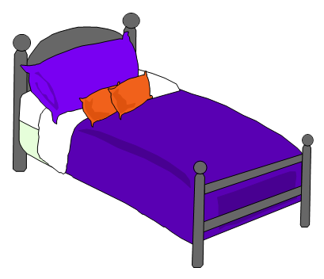
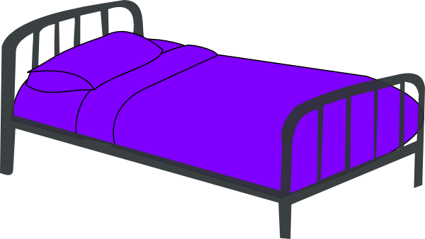
Goldilocks was very tired by this time, so she went upstairs to the bedroom. She lay down in the first bed, but it was too hard. Then she lay in the second bed, but it was too soft. Then she lay down in the third bed and it was just right. Goldilocks fell asleep

Slide 32
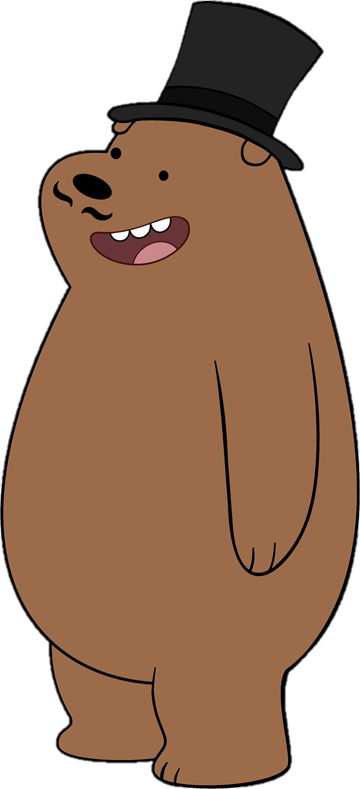
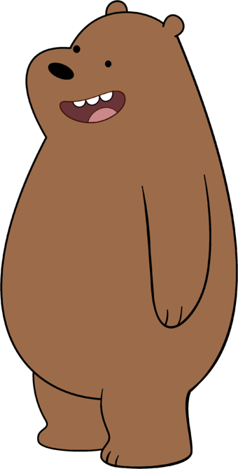
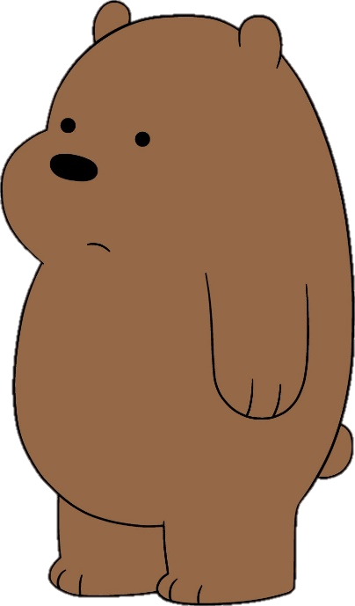
As she was sleeping, the three bears came home.
"Someone's been eating my porridge," growled the Papa bear.
"Someone's been eating my porridge," said the Mama bear.
"Someone's been eating my porridge and they ate it all up!" cried the Baby bear.

Slide 33
"Someone's been sitting in my chair," growled the Papa bear.
"Someone's been sitting in my chair," said the Mama bear.
"Someone's been sitting in my chair and they've broken it all to pieces," cried the Baby bear.

Slide 34
They decided to look around some more and when they got upstairs to the bedroom, Papa bear growled, "Someone's been sleeping in my bed,"
"Someone's been sleeping in my bed, too" said the Mama bear
"Someone's been sleeping in my bed and she's still there!" exclaimed Baby bear.

Slide 35
Just then, Goldilocks woke up and saw the three bears. She screamed, "Help!" And she jumped up and ran out of the room. Goldilocks ran down the stairs, opened the door, and ran away into the forest. And she never returned to the home of the three bears.

Slide 36
Advertising
Examples

Slide 38
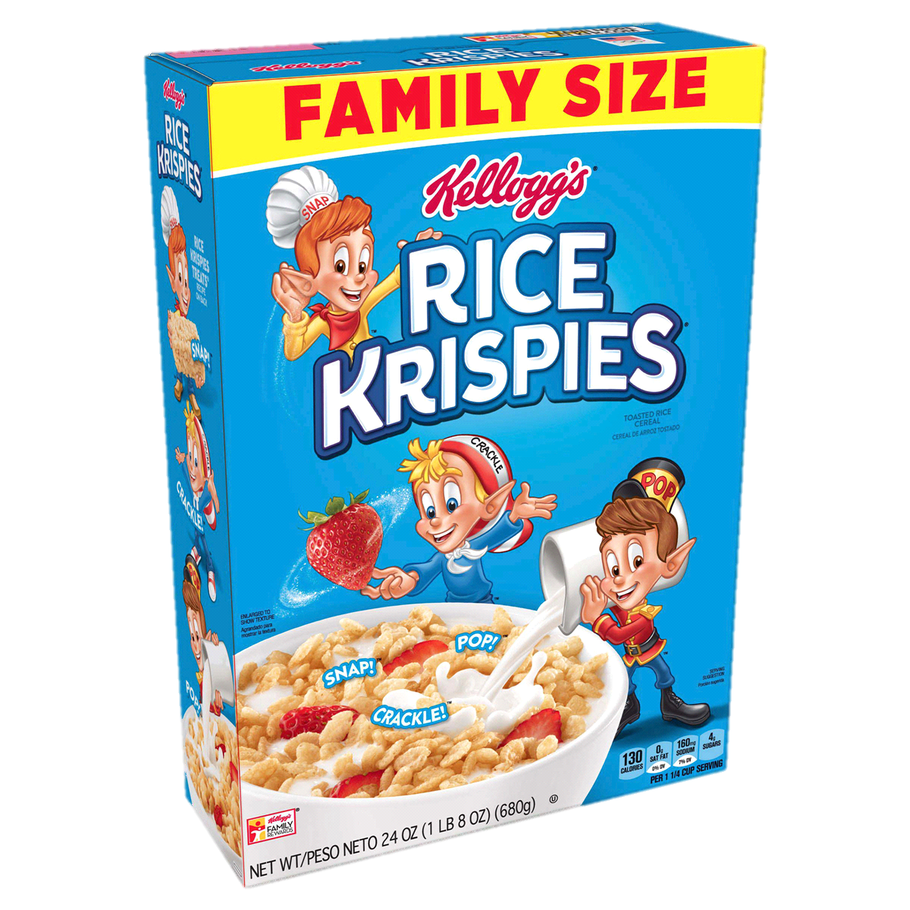

Slide 39
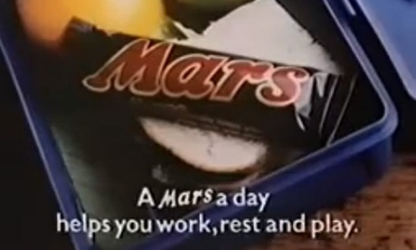

Slide 46
Messages
What are they talking about?

Slide 47
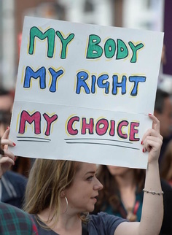
Pro-Choice
(abortion issue)

Slide 48
Clothing on Fire
(fire prevention)

Slide 49
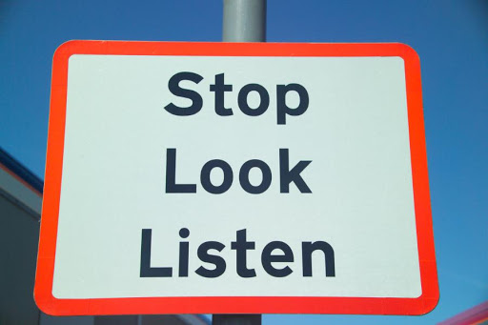
Crossing the Road
(Traffic Safety)

Slide 50
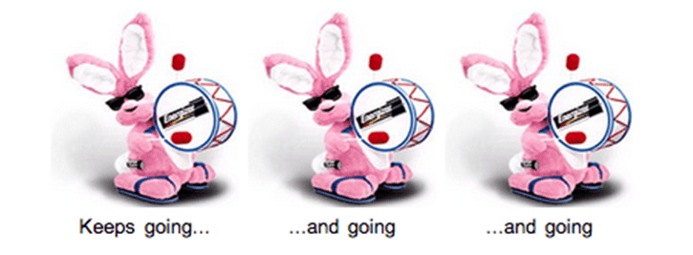
It keeps going and going and going…
Batteries
(Energizer)

Slide 51
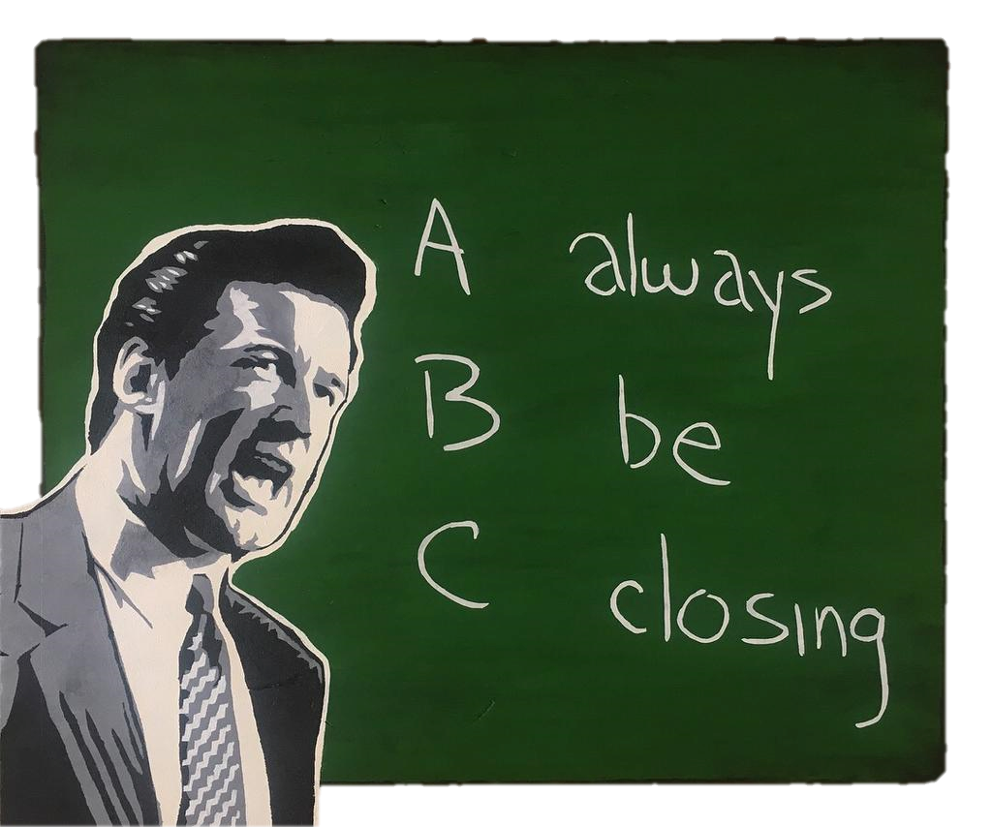
Sales
(always close the deal)

Slide 52
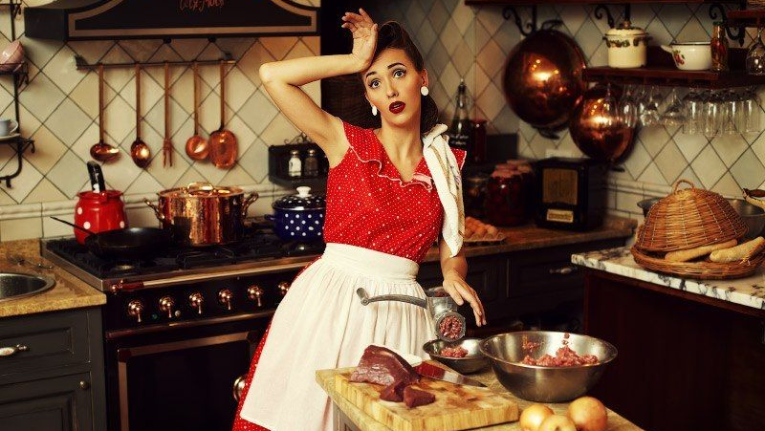
Trying Hard
Blood, sweat and tears

Slide 53
Lascivious
Wearing a bra
You’re driving in your car
Chocolate
Delicious
no top
Salacious
You’re with your friend.
Peanuts
Scrumptious
walking around in broad daylight
Outrageous
Minding your own business.
Nugget
Outstanding

Slide 54
Quick Thinking
Tricolon Examples

Slide 55
Prompts
Trainees choose a topic and create a tricolon on the spot
Create a choose your category (nouns, adjectives, verbs) that trainees can choose from.

Slide 56
Nouns
Adjectives
Verbs
1
2
1
2
1
2
3
4
3
4
3
4
5
5
5
Finish

Slide 57
People You Admire

Slide 58
Places To Go

Slide 59
My Favorite Things

Slide 60
In This Classroom

Slide 61
A Cold Day

Slide 62
What They Say About You

Slide 63
Character

Slide 64
Famous Person

Slide 65
Feelings

Slide 66
The Future

Slide 67
Recommendations

Slide 68
Chores

Slide 69
Leisure Time

Slide 70
A Lazy Day

Slide 71
Every Day

Slide 72
Comedy
Subversion of Expectation

Slide 73
Subversion of Expectation
The first two set up a narrative
The third stands in contrast to them
Can be used for comedic effect or to drive home a point.

Slide 74
Three Irishmen on an Island
There are three Irishmen stranded on an island.
Suddenly a fairy appears and offers to grant each one of them one wish.

Slide 75
Three Irishmen on an Island
The first one asks to be intelligent.
Instantly, he is turned into a Scotsman and he swims off the island.

Slide 76
Three Irishmen on an Island
The next one asks to be more intelligent than the previous one.
So, instantly, he is turned into a Welshman.
He builds a boat and sails off the island.

Slide 77
Three Irishmen on an Island
The third Irishman asks to become even more intelligent than the previous two.

Slide 78
Three Irishmen on an Island
The fairy turns him into a woman, and she walks across the bridge.

Slide 79
Three Irishmen on an Island
3 Irishmen
3 Wishes
3 Strategies

Slide 80
Other Things
Consider..

Slide 81
Length of Elements
The elements of a tricolon need not always be the exact same length. In fact, as Mark Forsyth has noted, tricolons sound especially good when the third element is longer than the preceding two; for example, Life, Liberty and the Pursuit of Happiness.
The smallest list size.

Slide 82
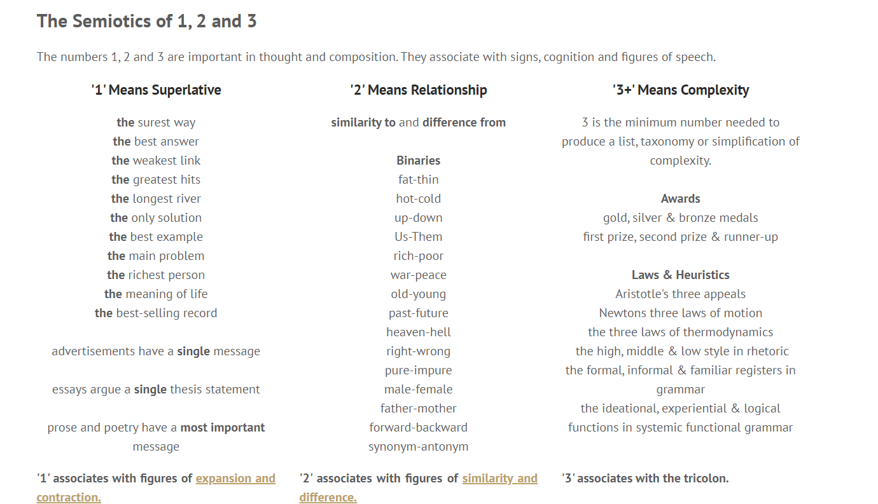

Slide 84
A classic way to give public speakers rhythm
https://www.ft.com/content/a731822a-0373-11e4-817f-00144feab7de
Figures of Music & Repetition
https://www.vernaculardiscourse.com/tricolon.html
How to Use the ‘Rule of Three’ to Create Engaging Content
https://copyblogger.com/rule-of-three/

