Slide 2
Metaphors

Slide 3
Metaphors
We use about 6
per minute

Slide 4
Metaphors
can be or
“frozen”
“novel”

Slide 5
We use 1.80
metaphors per minute
“novel”
“frozen”
and 4.08 metaphors per minute.

Slide 6
5.88 metaphors per minute.

Slide 7
“Frozen” metaphor:
is a metaphor

Slide 8
“Frozen” metaphors:
I was frozen in fear.
Her heart was frozen.
We had to freeze the salaries.
The bank froze his assets until he paid his debt.

Slide 9
Taste Metaphors

Slide 11
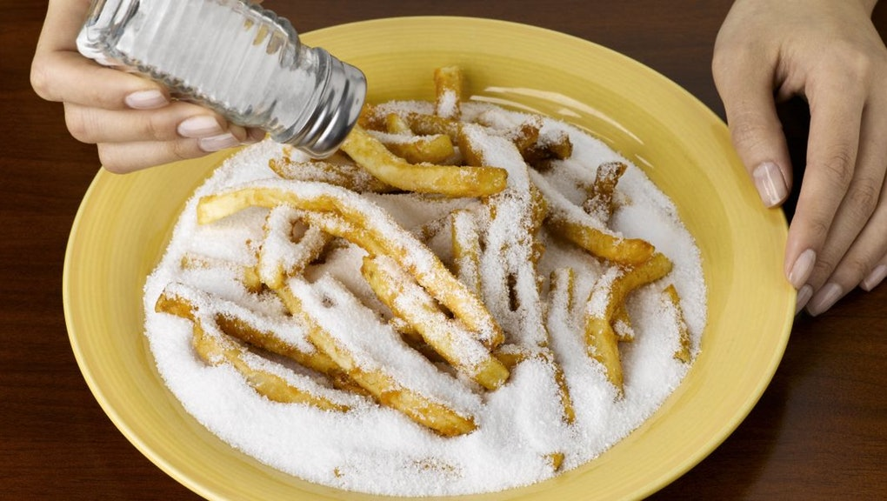

Slide 12
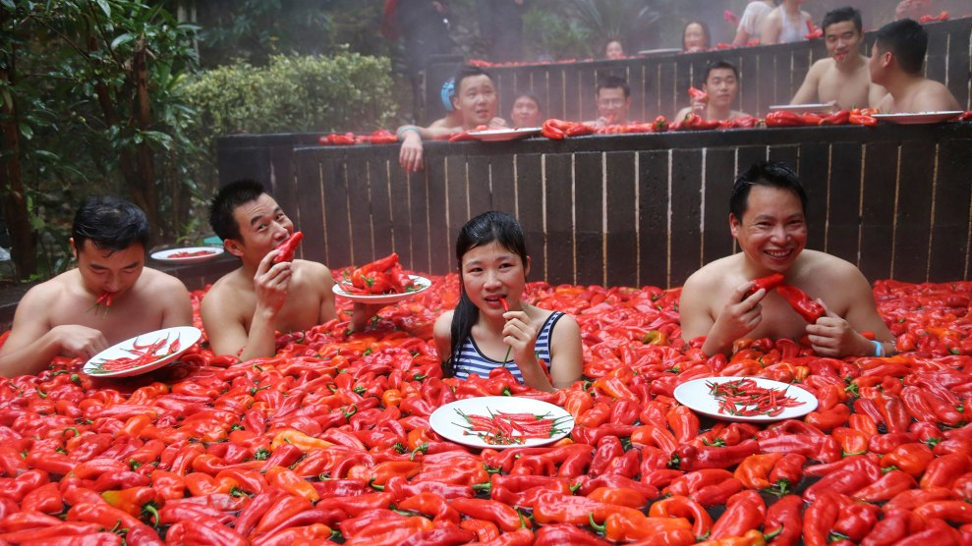

Slide 14
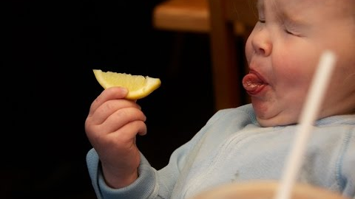

Slide 15
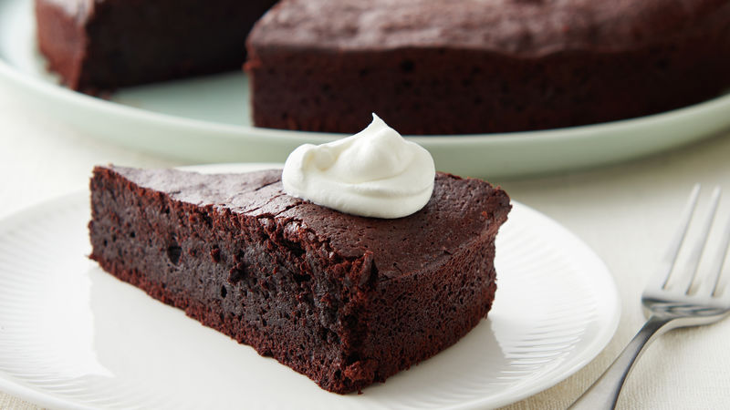

Slide 16
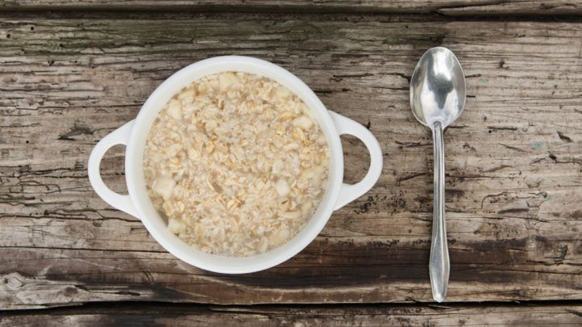

Slide 17
She was always sweet to me.

Slide 18
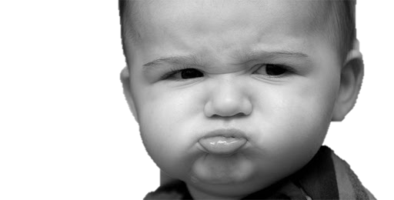
Don’t be bitter.
There’s always next time.

Slide 19
That’s a bland statement.

Slide 20
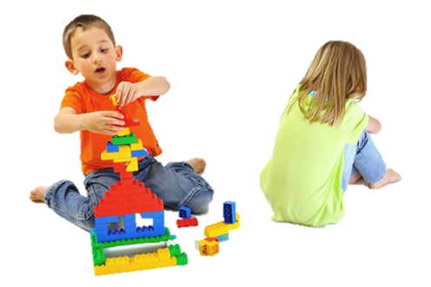
Just because you lost doesn’t mean you should be salty.

Slide 21
She has impeccable taste. She is always so fashionable.

Slide 22
That’s a delicious suit you’re wearing.

Slide 23
I want you to tell me some spicy rumors.

Slide 24
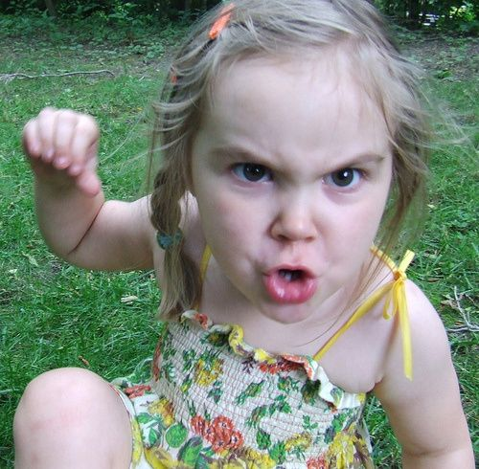
Her punching him was a
tasteless act.

Slide 25
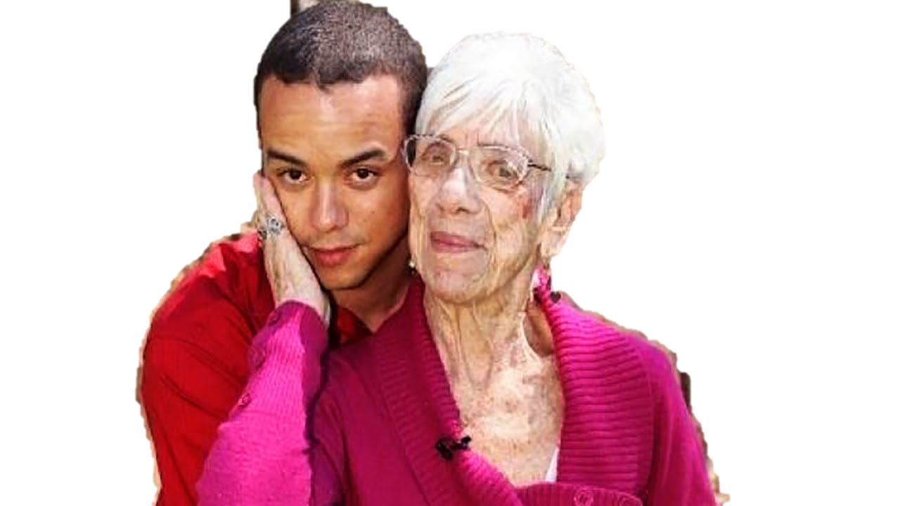
Why is he going out with her?
He has no taste.

Slide 26
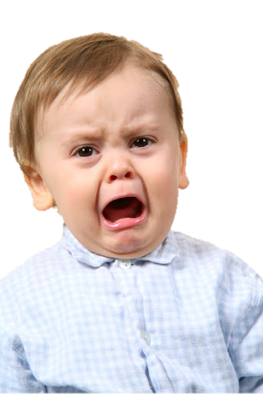
Stop complaining.
Stop being so sour.

Slide 27
Metaphors + Idioms

Slide 28
Eat your words

Slide 29
That kid is a bad apple.

Slide 30
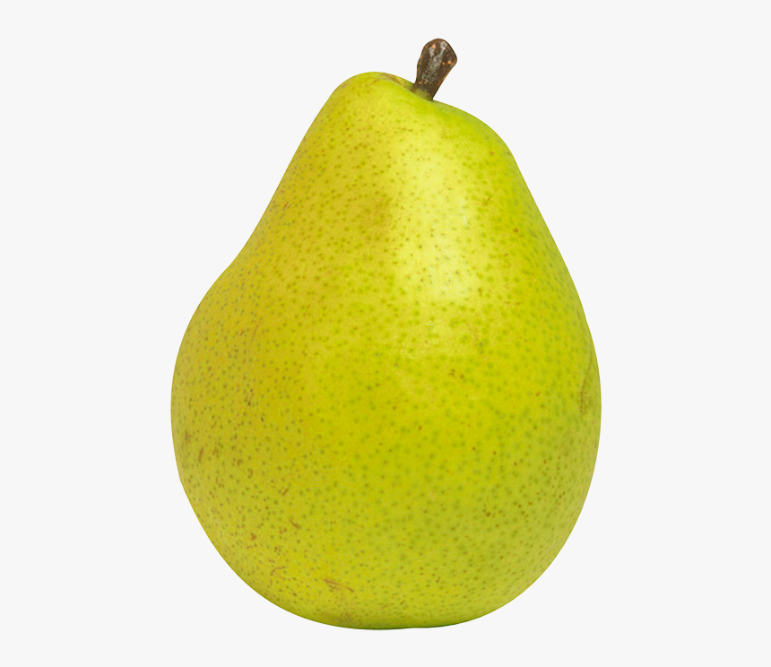
It’s gone pear-shaped.

Slide 31
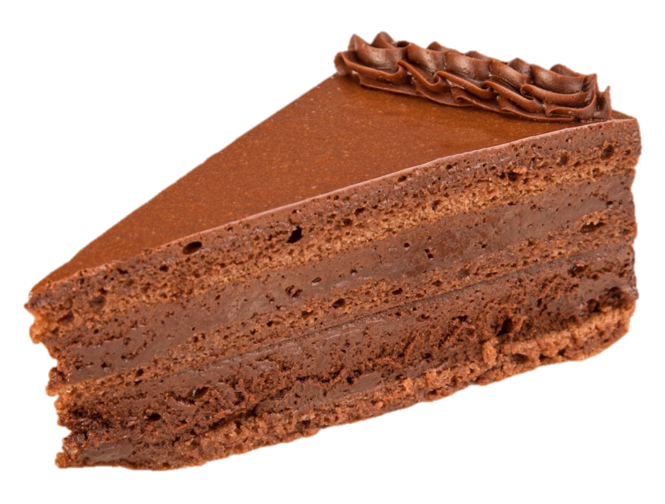
No problem.
It was a piece of cake.

Slide 32
It’s just not my cup of tea.

Slide 33
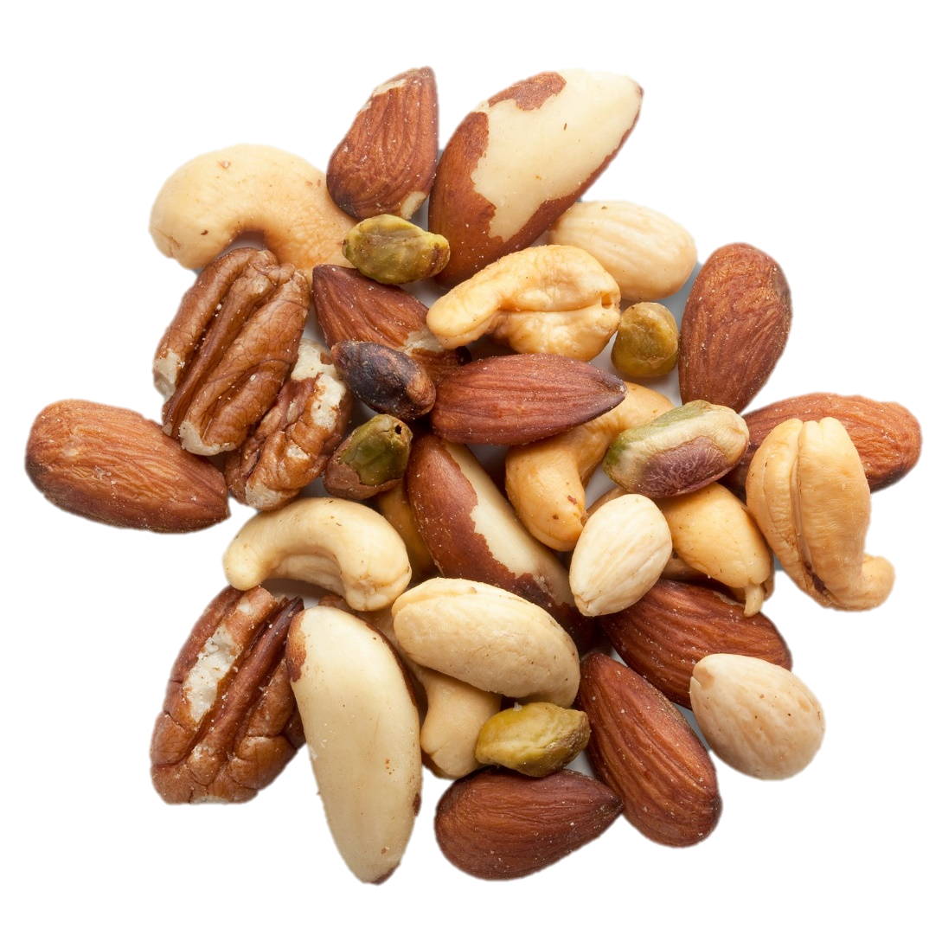
I’m going nuts.

Slide 34
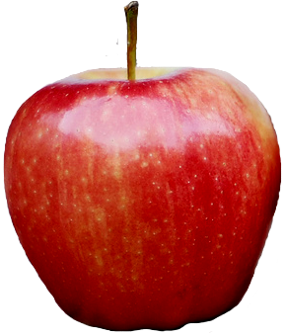
vs
Comparing apples to apples.

Slide 35
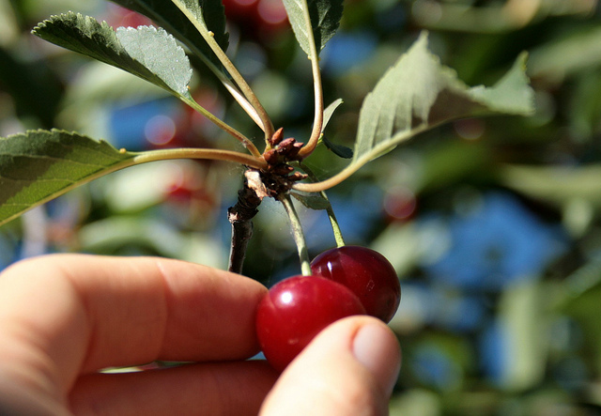
He’s cherry picking information.

Slide 36
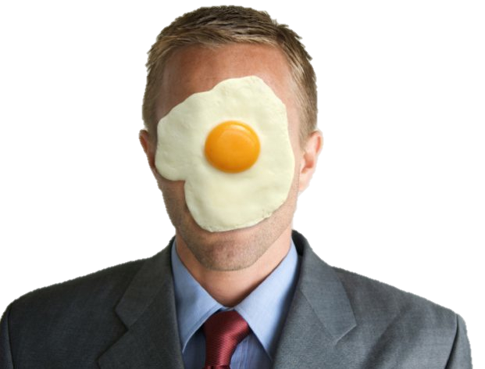
You’ve got egg on your face.

Slide 37
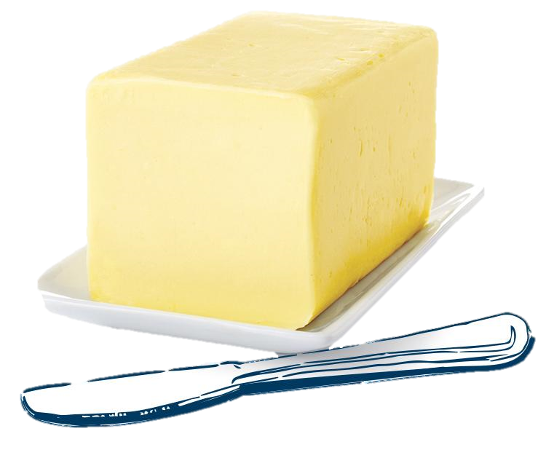
You better butter up to the boss.

Slide 38
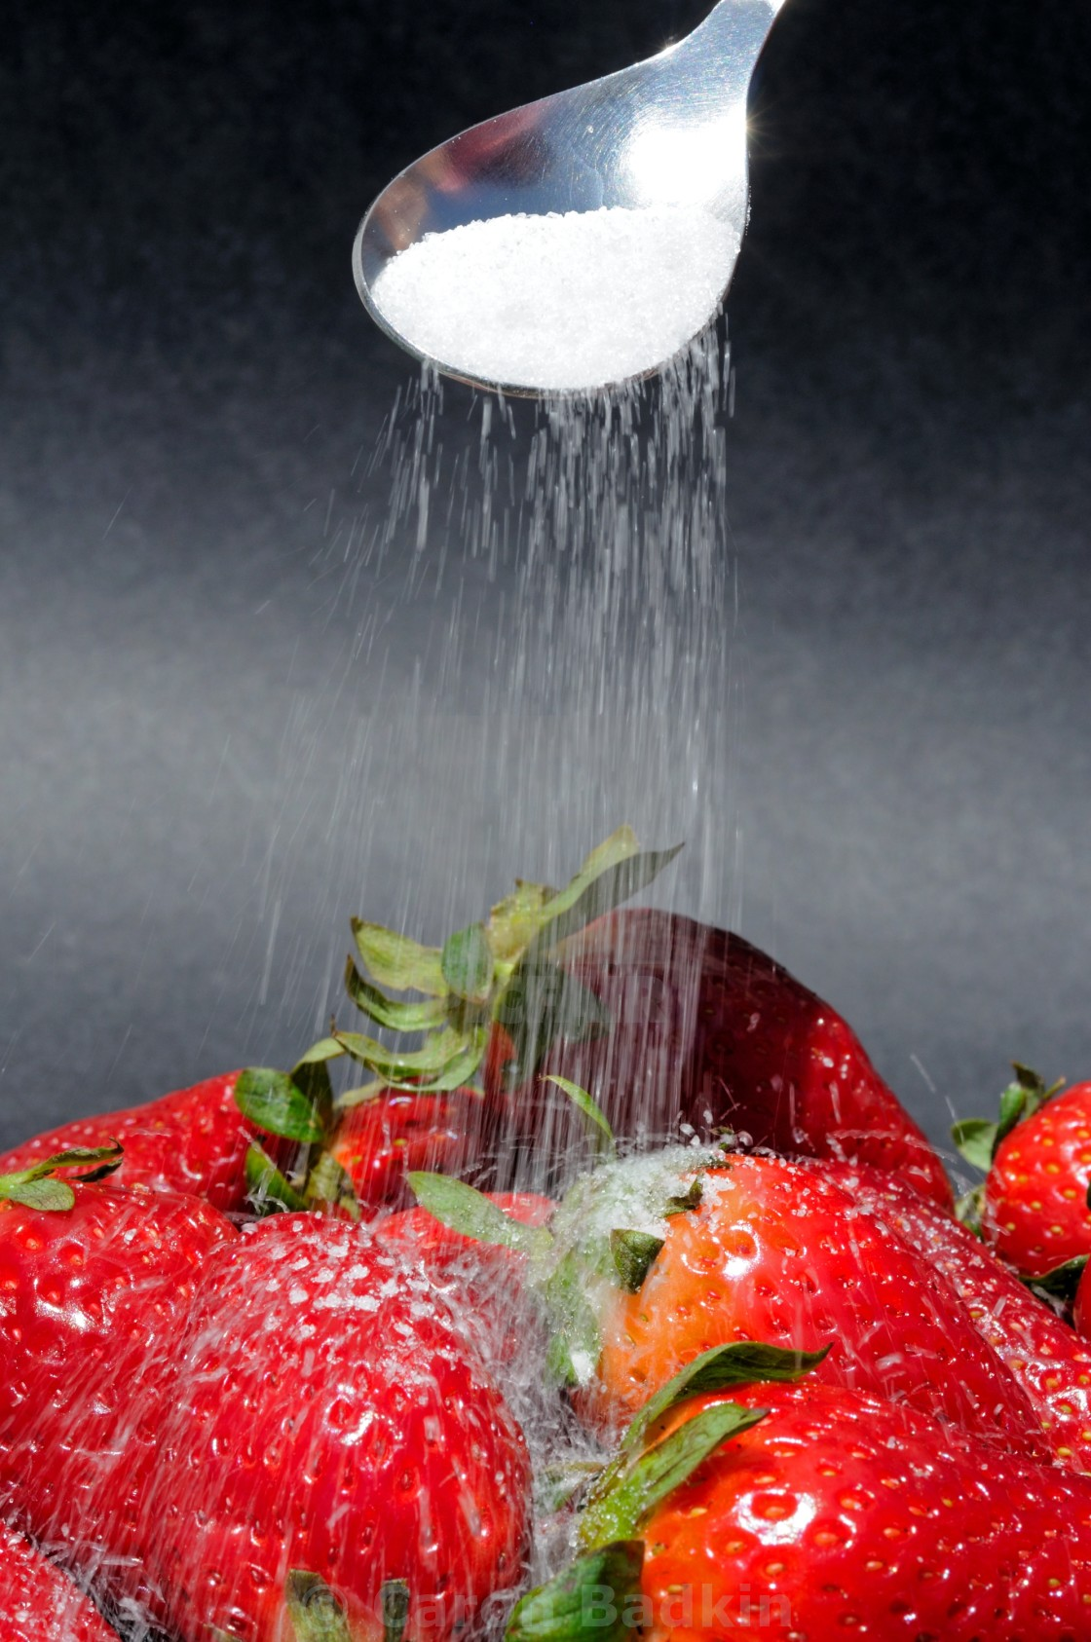
Don’t sugarcoat it.

Slide 39
Something is fishy here.

Slide 40
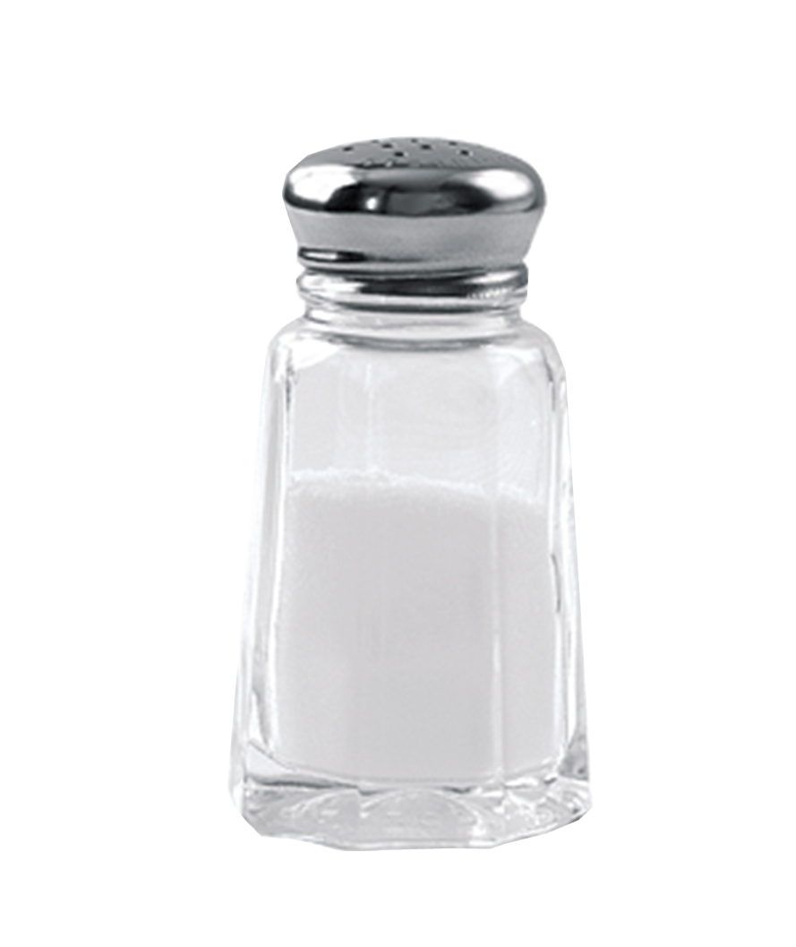
Take what he says with a grain of salt.

Slide 41
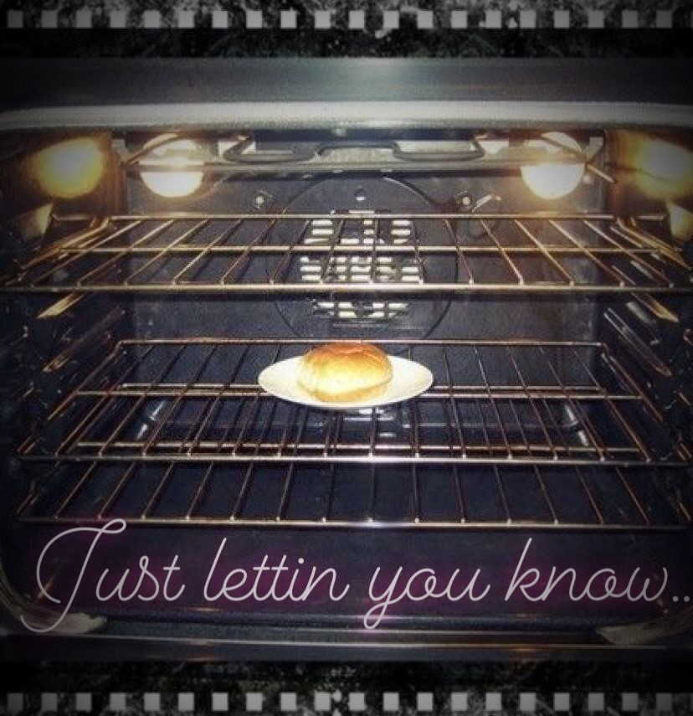
She’s got a bun in the oven.

Slide 42
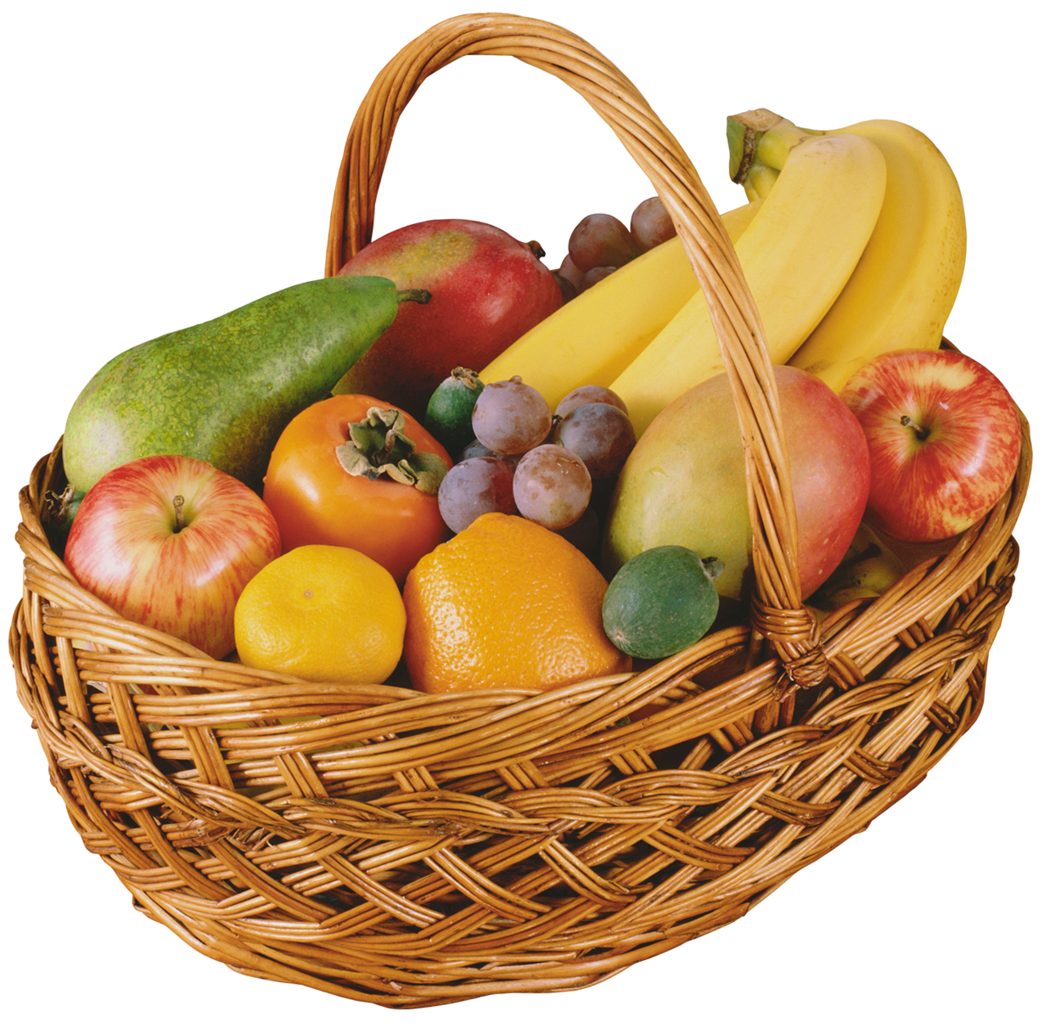
It was a fruitful investment.

Slide 43
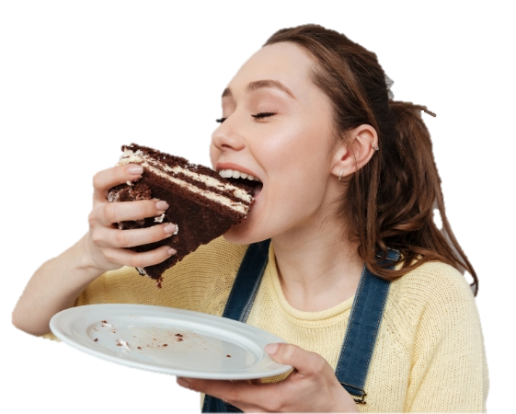
You can’t have your cake and eat it too.

Slide 44
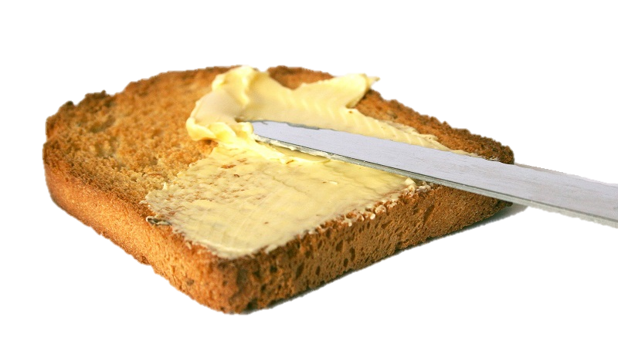
English is my bread and butter.

Slide 45
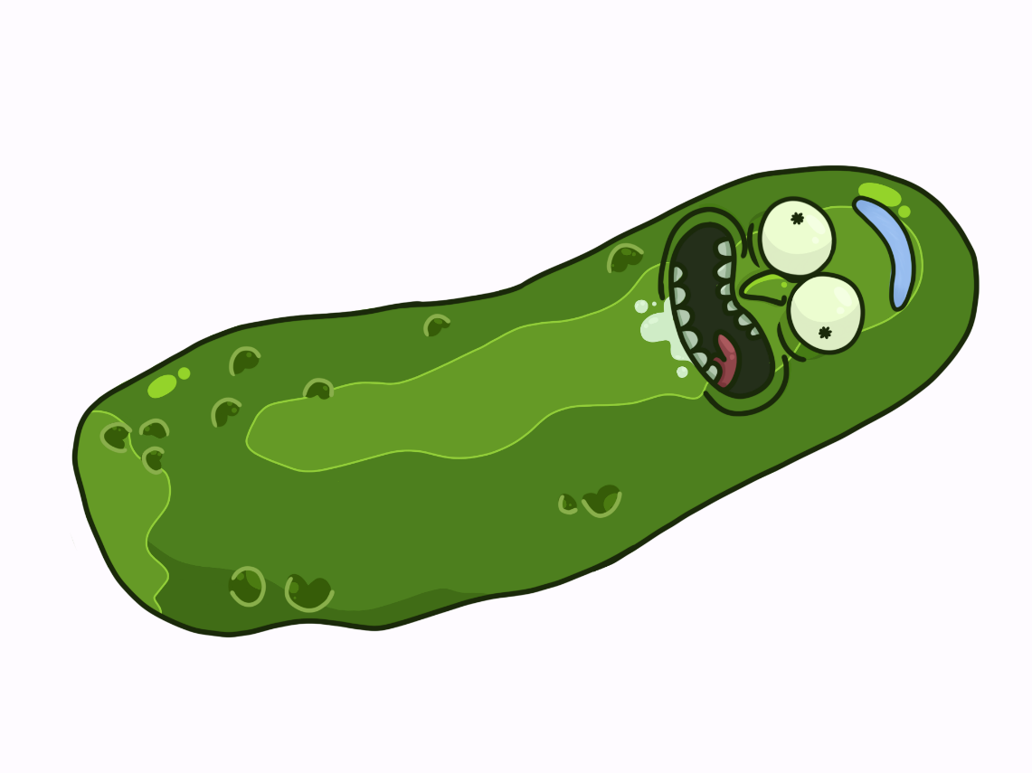
We’re in a pickle now.

Slide 46
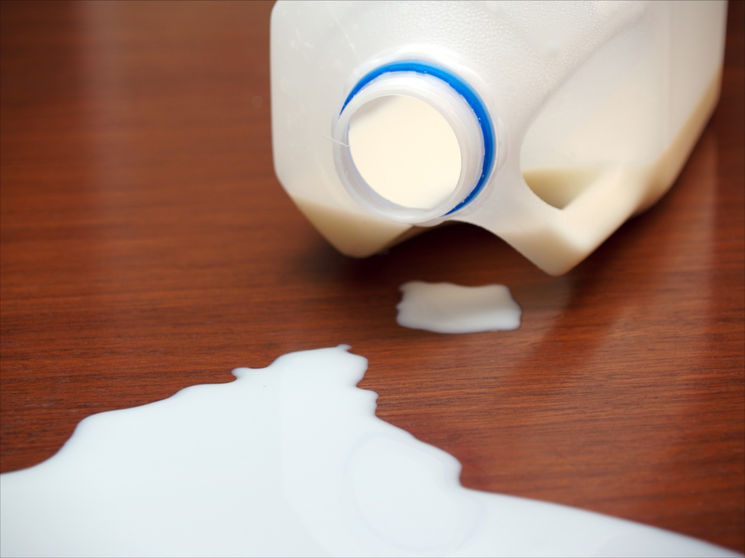
Don’t cry over spilled milk.

Slide 47
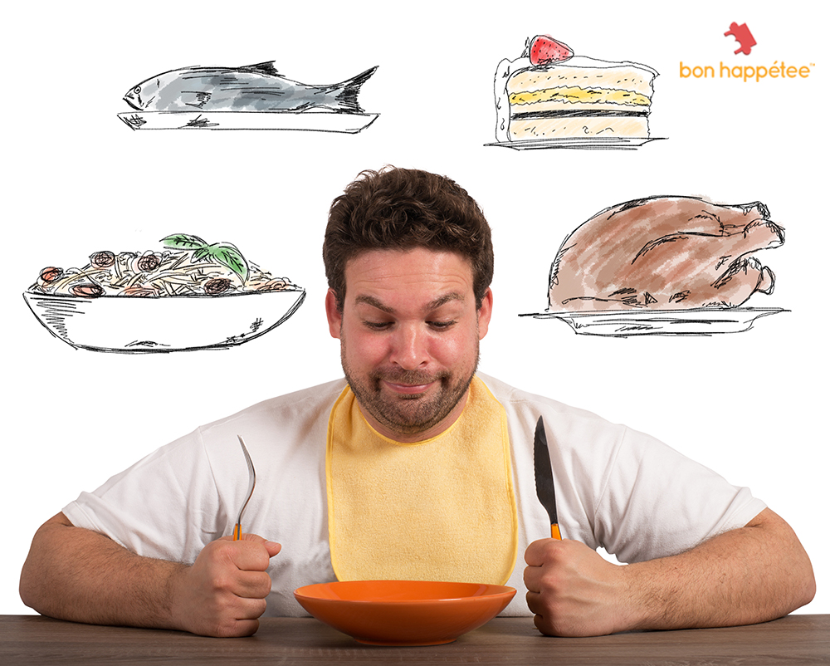
Food for thought

Slide 48
Metaphoric Mad Libs

Slide 49
Object of the story
Body part
Body part
Body part
Body part
Body part
Action
Object
Object

Slide 50
__________ Joyce Kilmer
I think that I shall never see
A poem lovely as a ____________.
A ____________ whose __________________ is prest
Against the earth’s sweet ___________________;
A ______________ that look at God all day,
And lifts her _____________ to pray;
A ____________ that may in summer wear
A ____________ in her ______________;
Upon whose ___________ snow has ___________;
Who intimately lives with _____________.
Poems are made by fools like me,
But only God can make a _____________.

Slide 51
Trees Joyce Kilmer
I think that I shall never see
A poem lovely as a tree.
A tree whose hungry mouth is prest
Against the earth’s sweet flowing breast;
A tree that look at God all day,
And lifts her leafy arms to pray;
A tree that may in summer wear
A nest of robins in her hair;
Upon whose bosom snow has lain;
Who intimately lives with rain.
Poems are made by fools like me,
But only God can make a tree.

Slide 52
Dreams

Slide 53
Dreams Langston Hughes
Hold fast to dreams
For if dreams _________
Life is a ______________
That cannot ___________.
Hold fast to dreams
Life is a ________________
________with ________.

Slide 54
Dreams Langston Hughes
Hold fast to dreams
For if dreams die
Life is a broken-winged bird
That cannot fly.
Hold fast to dreams
Life is a barren field
Frozen with snow.

Slide 55
Lyrics

Slide 57
If you like the way you look that much,
Oh baby, you should go and love yourself

Slide 58
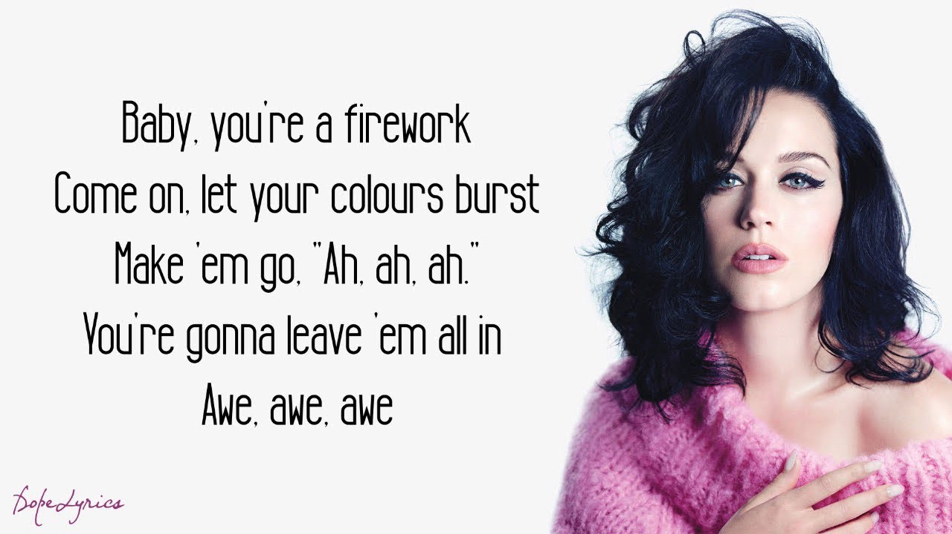

Slide 59
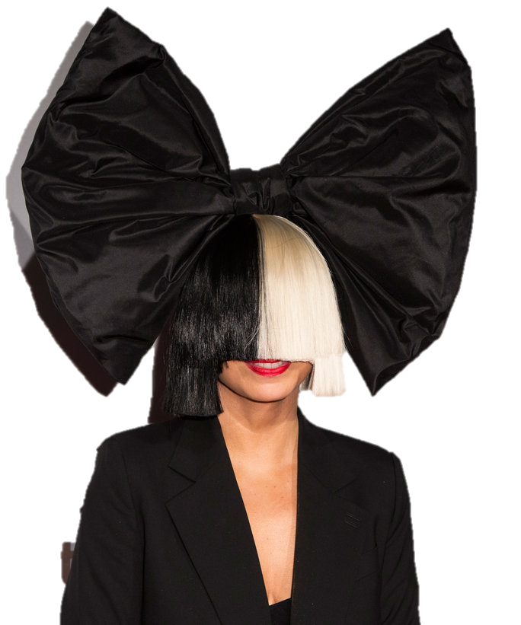
Shoot me down,
but I wont fall
I am titanium.

Slide 60
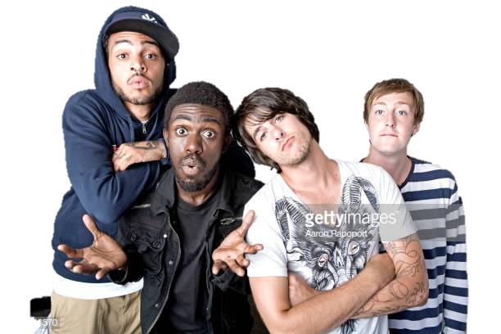
My heart’s a stereo
It beats for you so listen close

Slide 61
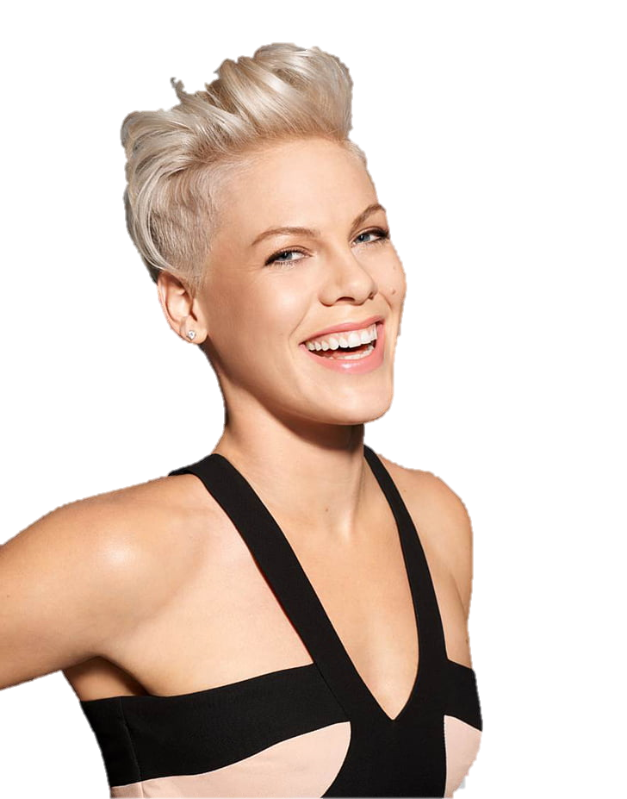
God is a DJ, life is a dancefloor
Love is the rhythm, you are the music

Slide 62
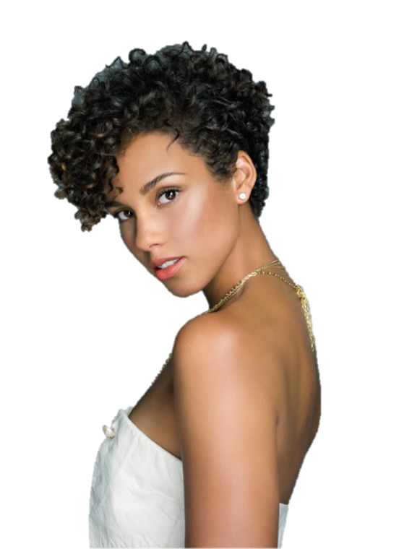
She’s just a girl,
and she’s on fire

Slide 63
You’re a falling star, you’re the getaway car
You’re the line in the sand when I go to far
You’re the swimming pool on an August day
And you’re the perfect thing to see

Slide 64
The Rose

Slide 65
The Rose Bette Midler
Some say love, it is a river, that drowns the tender reed
Some say love, it is a ______, because _______________________

Slide 66
The Rose Bette Midler
Some say love, it is a river, that drowns the tender reed
Some say love, it is a rose, that leaves your soul to bleed
Some say love, it is a hunger, an endless aching need
I say love, it is a flower, and you, its only seed

Slide 67
The Rose Bette Midler
It’s the heart of breaking, that never learns to dance
It’s the dream afraid of waking, that never takes the chance
It’s the one who won’t be taken, who cannot seem to give
And the soul afraid of dying, that never learns to live

Slide 68
The Rose Bette Midler
When the night has been too lonely and the road has been too long
And you think that love is only for the lucky and the strong
Just remember in the winter, far beneath the bitter snows
Likes the seed, that with the sun’s love in the spring becomes the rose.

Slide 69
Daily Life Metaphors

Slide 70
That’s music to my ears.

Slide 71
Love is a battlefield.

Slide 72
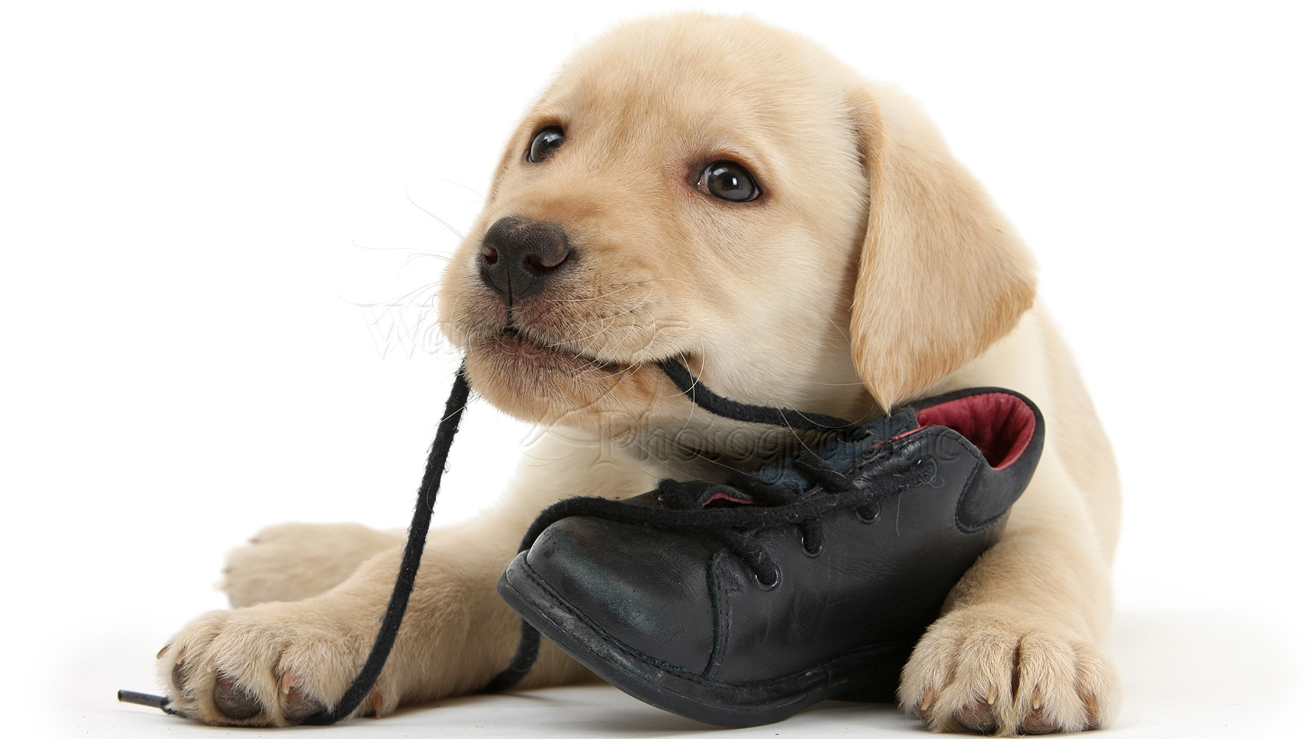
You’ve given me something to chew on.

Slide 73
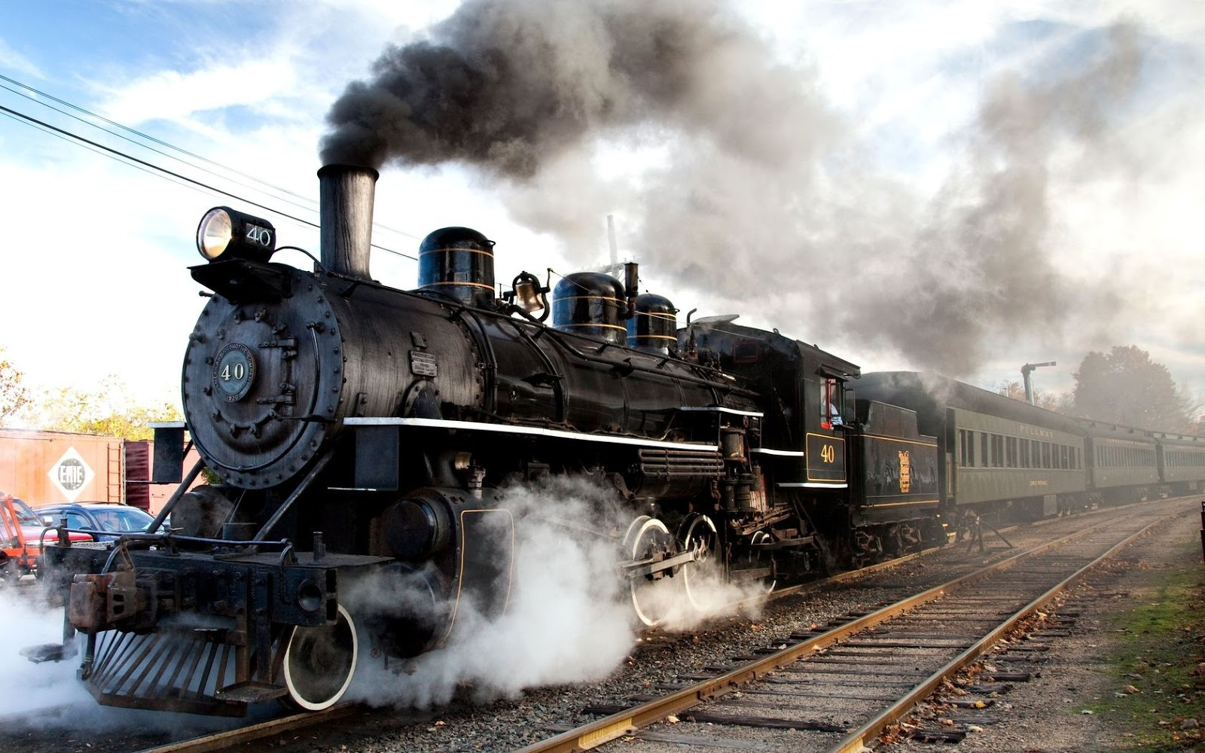
He’s just blowing off steam.

Slide 74
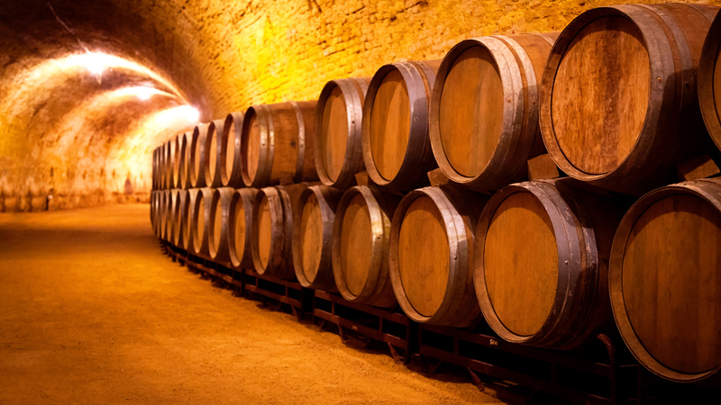
Love is a fine wine.

Slide 75
She’s a thorn in my side.

Slide 76
You are the light of my life.

Slide 77
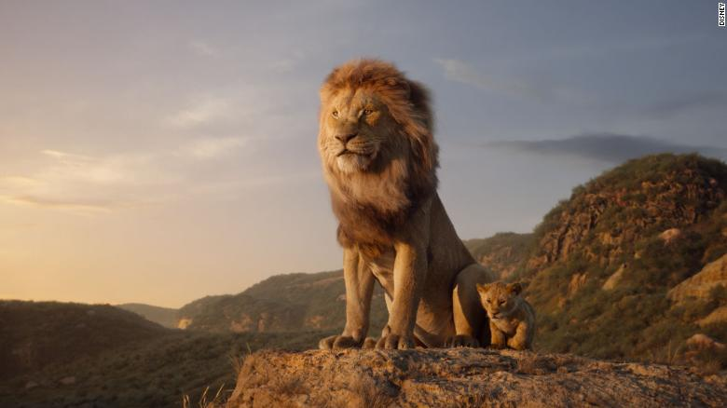
He has the heart of a lion.

Slide 78
Am I talking to a brick wall?

Slide 79
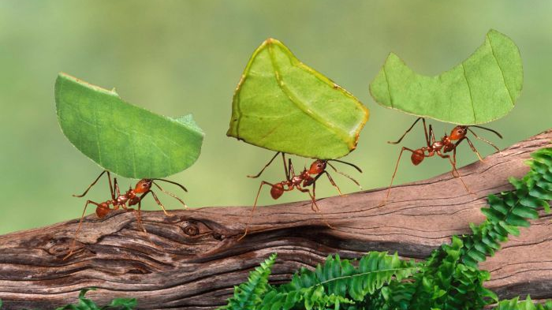
He has ants in his pants.

Slide 80
Beauty is a fading flower.

Slide 81
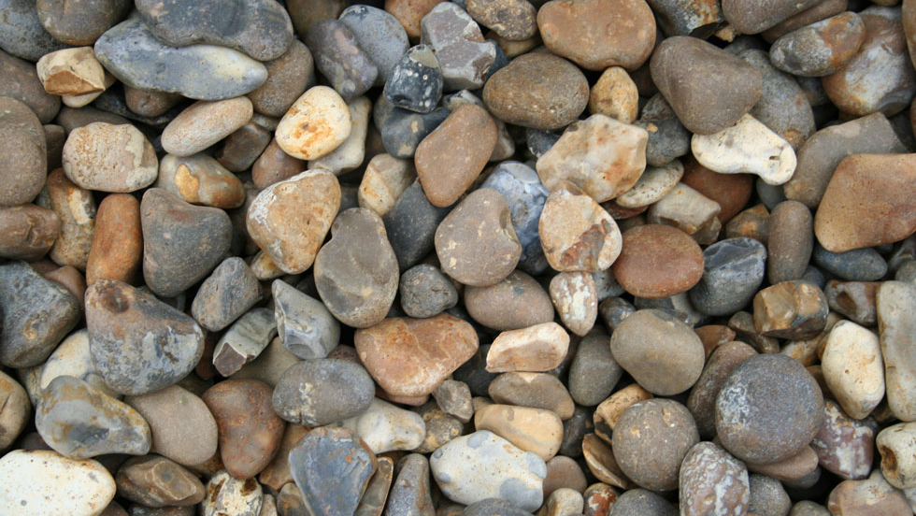
She has a heart of stone.

Slide 82
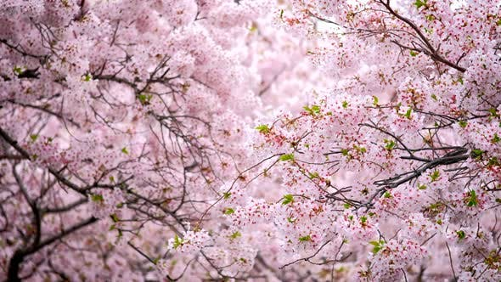
He’s a late bloomer.

Slide 83
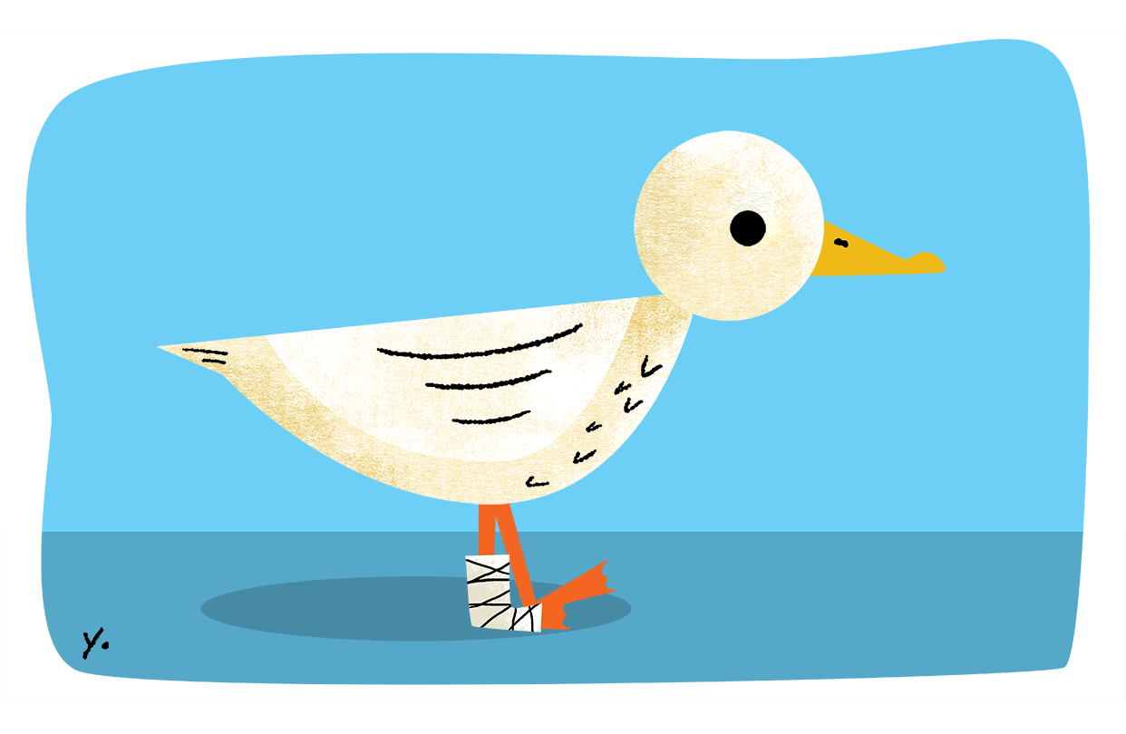
He’s a lame duck now.

Slide 84
Clean Sources: Six Metaphors a Minute?
http://www.cleanchange.co.uk/cleanlanguage/wp-content/uploads/2014/02/Six-metaphors-a-minute-final.pdf
The Rose – Bette Midler
https://www.youtube.com/watch?v=zxSTzSEiZ2c
The Essential List of 90+ Metaphor Examples in Literature and Pop Culture
https://blog.reedsy.com/metaphor-examples/?fbclid=IwAR1rkgCQ0j-p3ePC5k0estc6uqz-xXRZ4FYXkXOFkoB8ZGztkcqcZ1fCZQ4

Slide 85
Stopping by a Woods on a Snowy Day Robert Frost
Whose woods these are I think I know.
His house is in the village though.
He will not see me stopping here.
To watch his woods fill up with snow.

Slide 86
Stopping by a Woods on a Snowy Day Robert Frost
My little horse must think it queer
To stop without a farmhouse near
Between the woods and frozen lake
The darkest evening of the year.

Slide 87
Stopping by a Woods on a Snowy Day Robert Frost
He gives his harness bells a shake
To ask if there is some mistake.
The only other sound’s the sweep
Of easy wind and downy falke.

Slide 88
Stopping by a Woods on a Snowy Day Robert Frost
The woods are lovely, dark and deep,
But I have promises to keep,
And miles to go before I sleep,
And miles to go before I sleep.

Slide 89
Stopping by a Woods on a Snowy Day Robert Frost
Whose woods these are I think I know.
His house is in the village though.
He will not see me stopping here.
To watch his woods fill up with snow.

