Slide 1
Rhetorical Questions
A question without expecting an answer

Slide 5
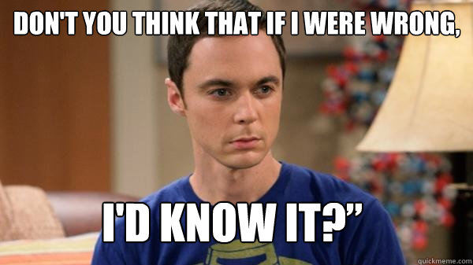

Slide 6
?

Slide 9
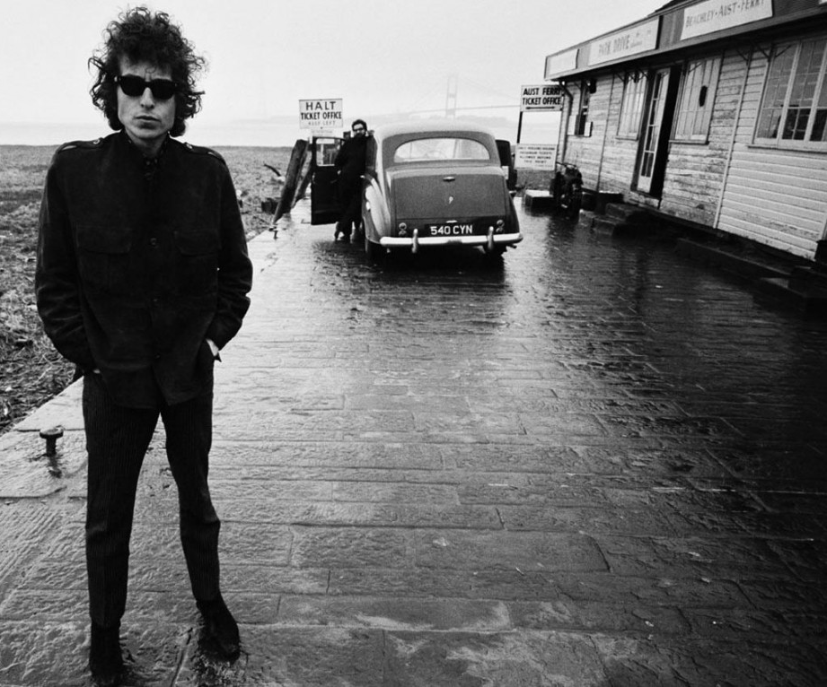
How many roads must a man walk down before you call him a man?
How many seas must a white dove sail before she sleeps in the sand?
How many times must the cannon balls fly before they’re forever banned?

Slide 10
Why Questions?

Slide 11
Our brains want to resolve questions.
Asking questions makes us curious, but we’re too lazy to research
Use this to get attention (raised inflection)

Slide 12
It can also help raise questions that the audience might have
then lead them through the answers, or how to find the answers.
Questions are more powerful than statements.

Slide 13
Questions Only
(Whose Line is it Anyways?

Slide 14
Answering your own Questions

Slide 15
Hypophora
Gives closure.
Our brains give us a pleasure response to solving mysteries.
Add a little silence to create a larger effect.

Slide 16
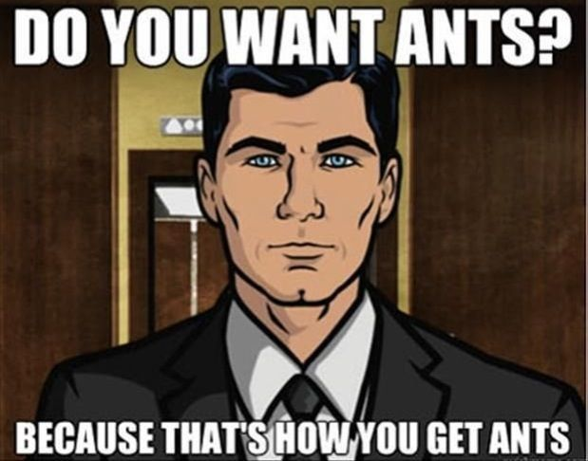

Slide 18
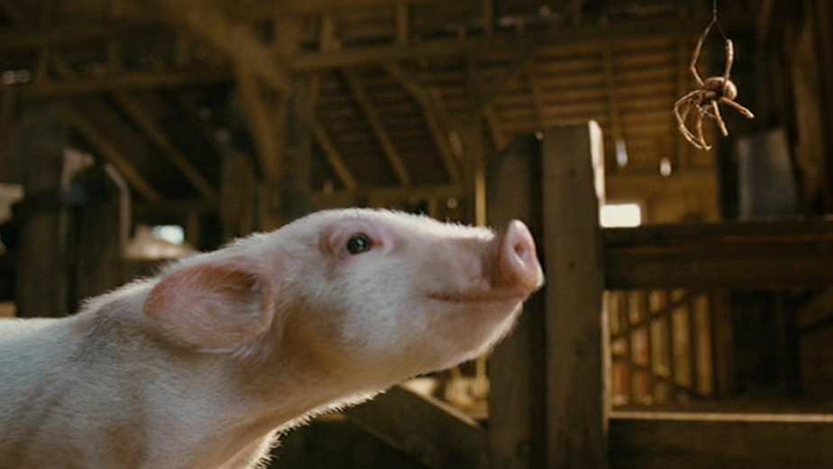
After all, what's a life, anyway?
We're born, we live a little while, we die.

Slide 19
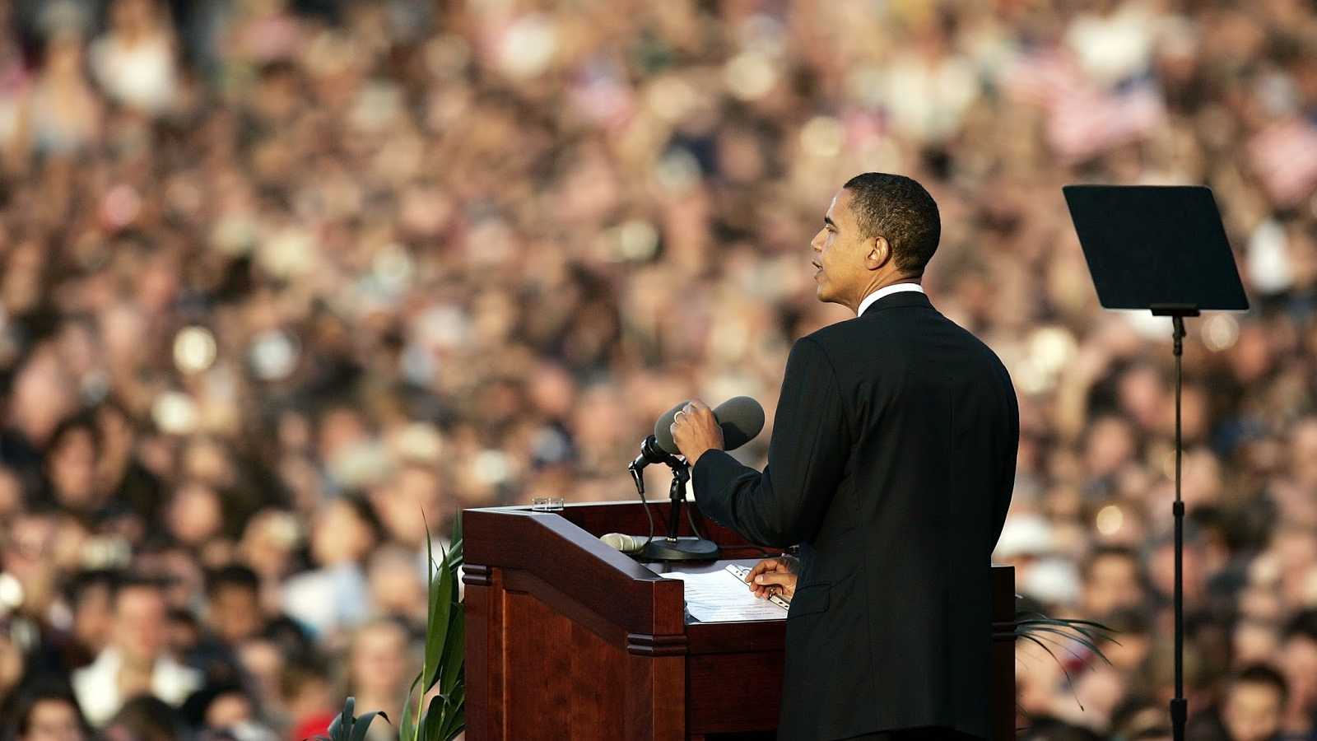
Why should you vote for me?
I’ll give you 5 good reasons…

Slide 20
"Do you know the difference between education and experience? Education is when you read the fine print; experience is what you get when you don't." (Pete Seeger in Loose Talk, ed. by Linda Botts, 1980)

Slide 21
Why chose this as our goal?
Why climb the highest mountain?
Why, 35 years ago, fly the Atlantic?
Not because they are easy,
But because they are hard.
Why does Rice play Texas?

Slide 22
Advertising

Slide 26
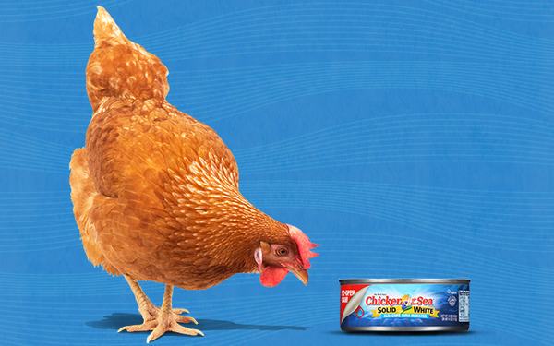
What’s the best tuna?
Chicken of the Sea

Slide 29
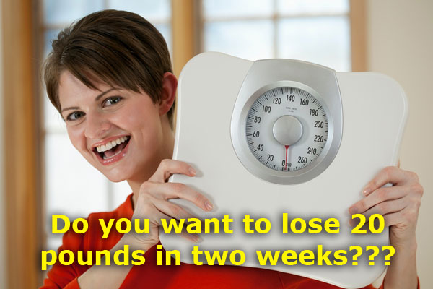

Slide 30
Snake Oil

Slide 31
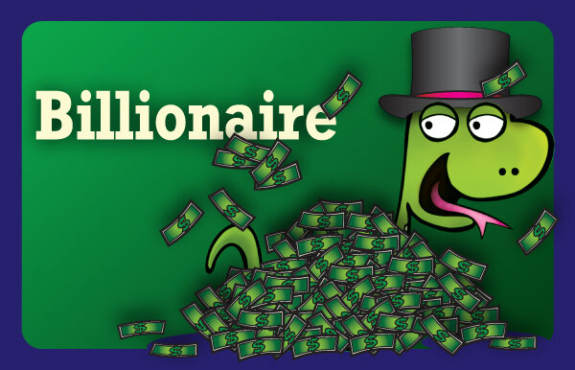
First player draws a card to select a customer ...

Slide 32
The other players create a 2-word product for that customer from their 7-card hands ...

Slide 33
Try selling the product.
It’s so hard for a billionaire to get away. Everybody wants your money.
Don’t you wish you could press a button and get away?
Now with the AMAZING Freedom Button, you have that power.
OMG! This is what you NEED!

Slide 34
Should You Ask Rhetorical Questions? Yes, You Should.
https://www.persuasivelitigator.com/2016/08/should-you-ask-rhetorical-questions-yes-you-should.html
Hypophora
https://literarydevices.net/hypophora/

