Slide 1
Role Play

Slide 2
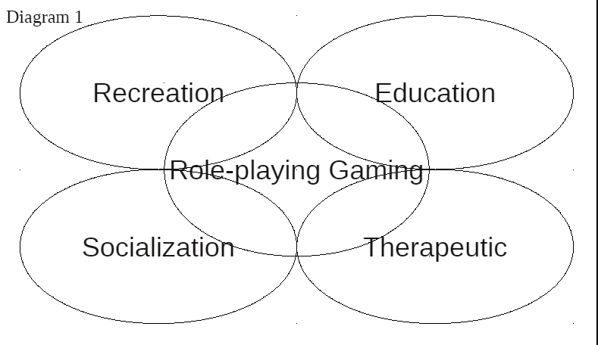

Slide 3
Grab Bag Skits
Getting out of the comfort zone

Slide 4
Take a bag

Slide 5
Create a Skit
Use the props anyway you want

Slide 6
Game of Possibilities
Aug 10, 2017 - Game of Possibilities Give an object to one person in each group. One at a time, someone has to go up in front of the group and demonstrate a use for that object. The rest of the team must guess what the player is demonstrating. The demonstrator cannot speak, and demonstrations must be original, possibly wacky, ideas.

Slide 7
Restaurant
Add a task and choice

Slide 8
The waiter / waitress
chooses the menu

Slide 9
Everyone else can order food from the menu.

Slide 10
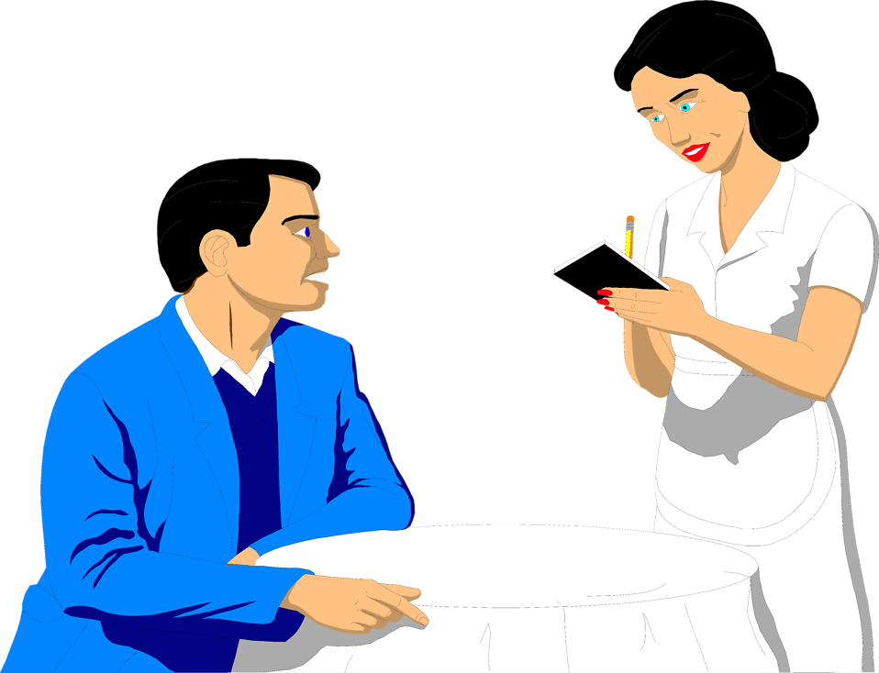
Write down the orders

Slide 11
Secret Awards

Slide 12
Awards
Most expensive
Least expensive
Most delicious meal
Healthiest

Slide 13
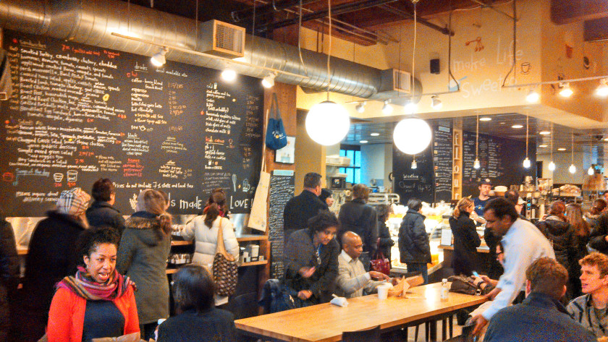
Set up a real restaurant:
Subway / Starbucks
Students must order using key phrases
Students are responsible for set up, etc.

Slide 14
DnD
Dungeons and Dragons

Slide 15
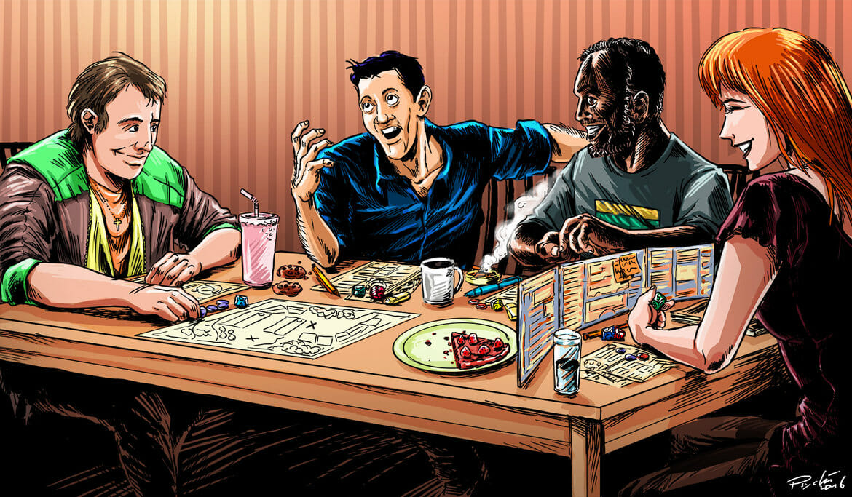
DM / GM (Game Master)
PCs (Player Characters

Slide 16
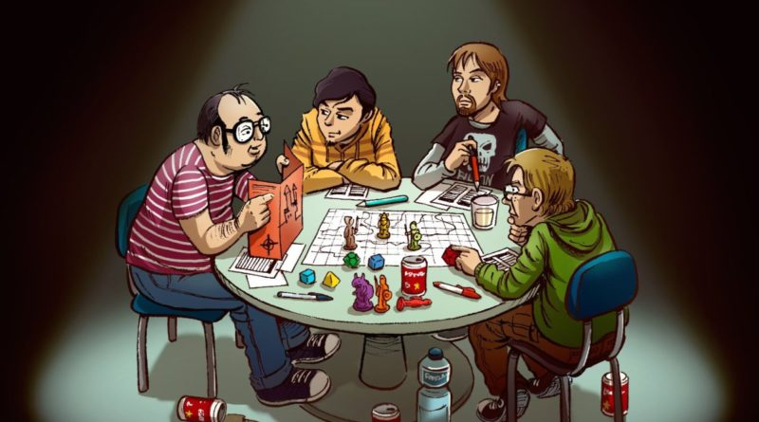
Create a story together:
PCs = main characters
GM = knows what is happening in the world

Slide 17
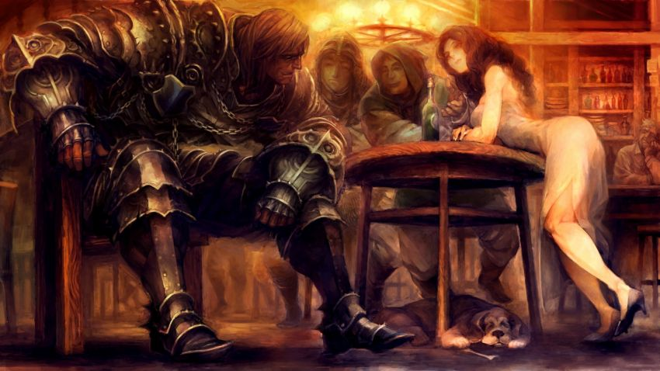
PCs have stats
Better at some things

Slide 18
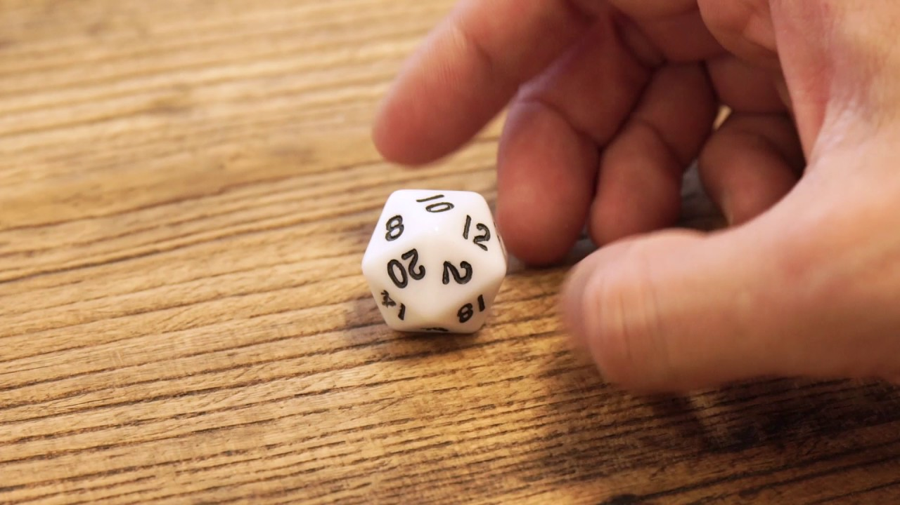
Roll to resolve issues

Slide 19
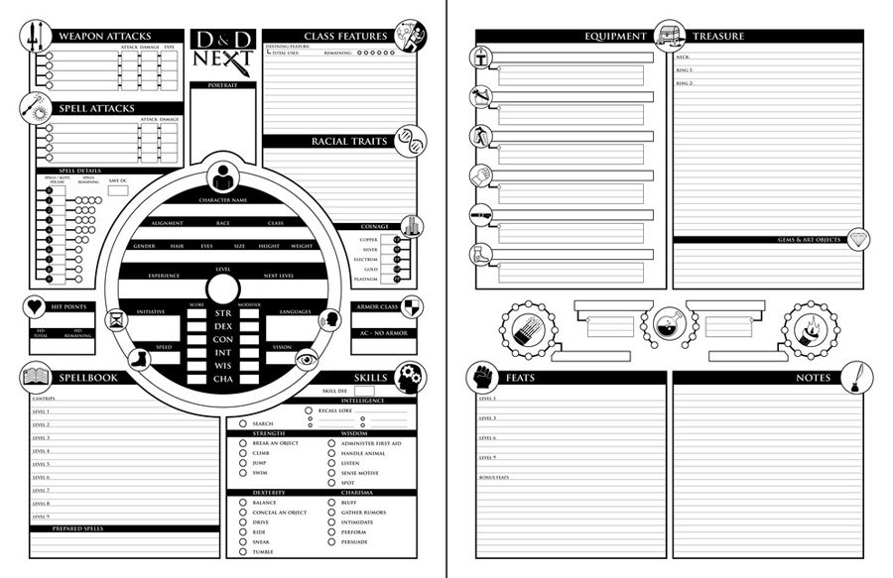

Slide 20
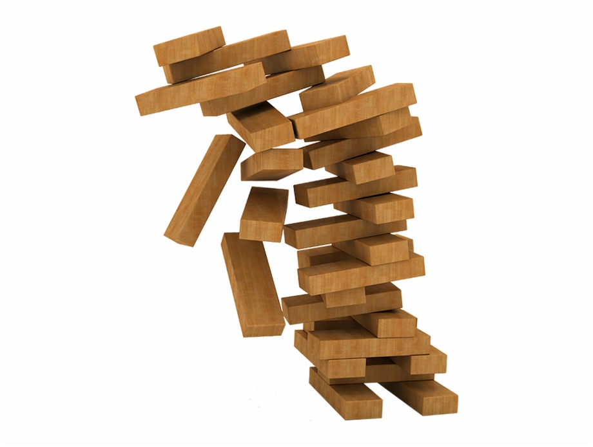
Dread
Role play with Jenga

Slide 21
During the story, students make decisions

Slide 22
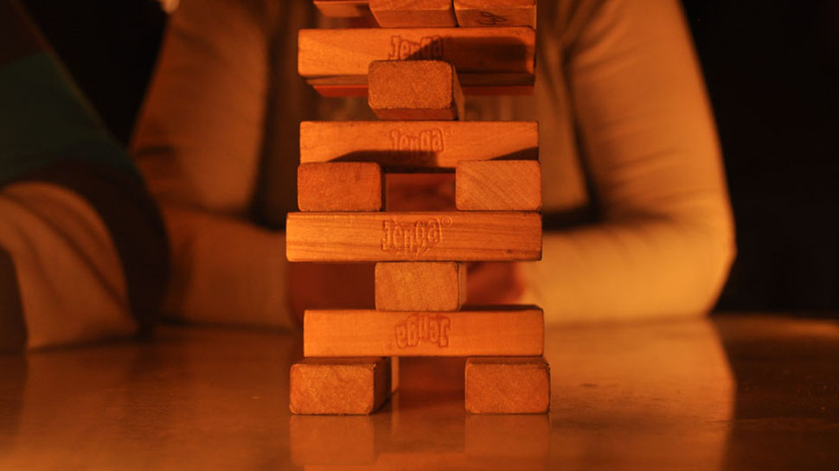
If it is risky, or out of character (take a block)
Falls – something bad happens
Survive – successful

Slide 23
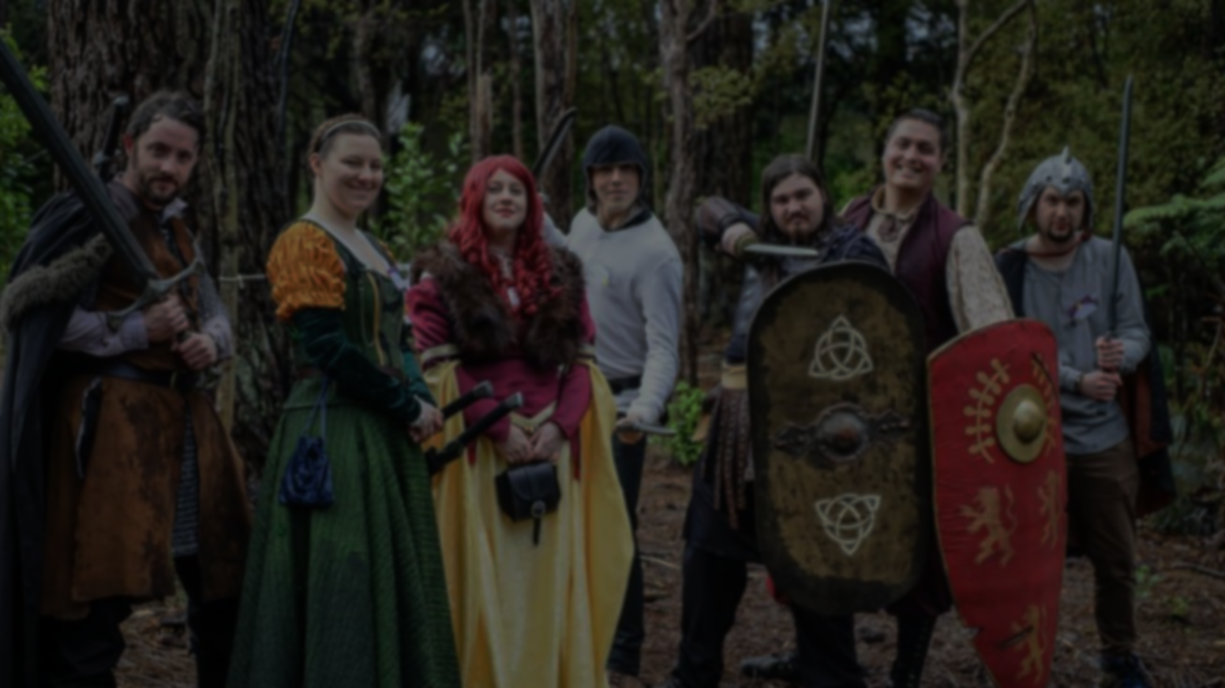
LARP
Live Action Role Play

Slide 24
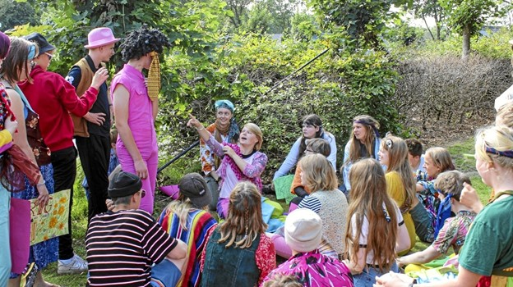
Edularp (Education Larp) is a style of teaching using larp.
Denmark (Østerskov Efterskole)
https://goodjobstudios.com/animation-edu-larp/

Slide 25
Autonomy is designed to deal with social expectations for each gender.
https://payhip.com/b/KvbG

Slide 26
PanoptiCorp explores corporations (ad agency)
Moral issues (identity)
Whole weekend
https://www.youtube.com/watch?v=mifzvxepjOA

Slide 27
Mad About the Boy is a future where there are no men.
http://mad-about-the-boy-larp.blogspot.com/p/the-larp.html
https://www.theverge.com/2012/11/27/3609806/my-so-called-larp-living-world-without-men

Slide 28
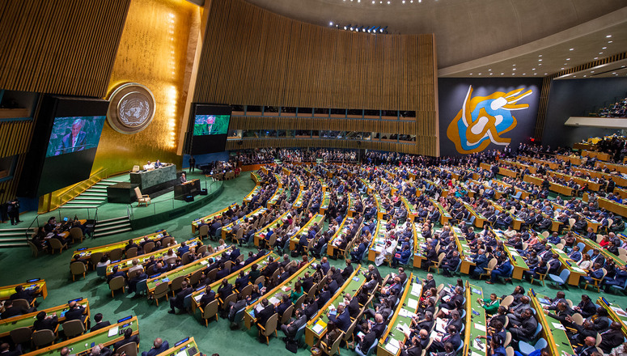
Mini-UN
Discuss current political issues

Slide 29
Murder Mysteries are also good examples of LARP

Slide 30
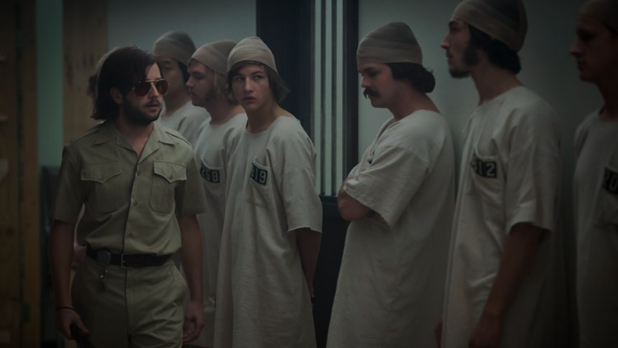
The Stanford Prison Experiment was controversial
Abuse of power

Slide 31
More @ the Larp Library
https://library.interactiveliterature.org/
More @ the Drive Thru RPG
https://www.drivethrurpg.com/

Slide 32
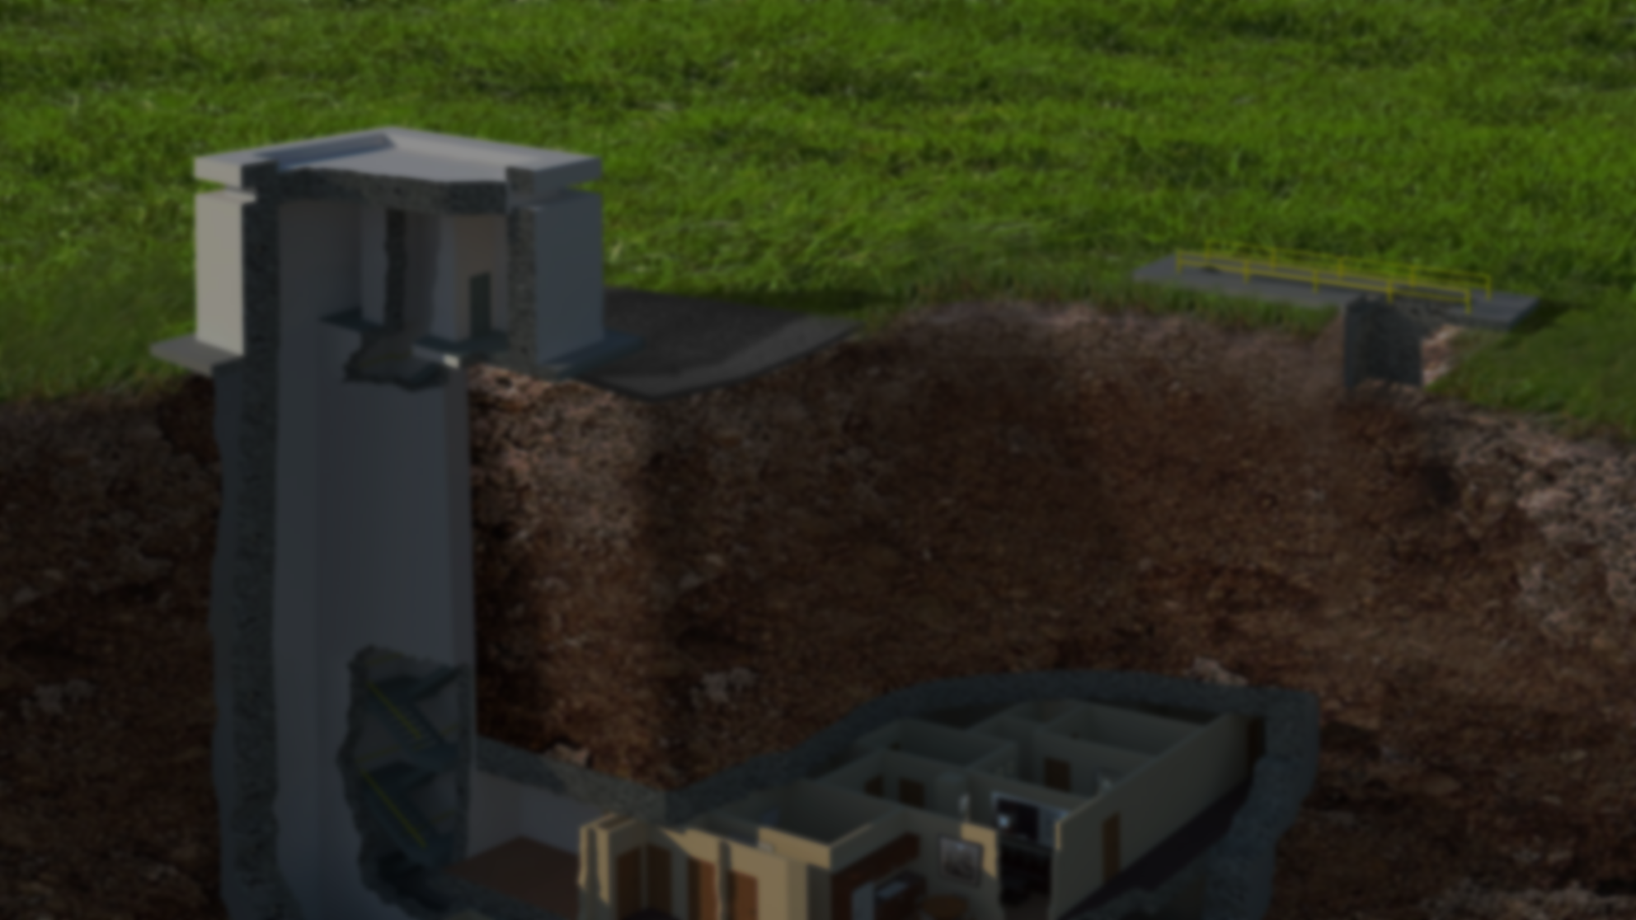
Bunker Interviews
A fun way to do interviews

Slide 33
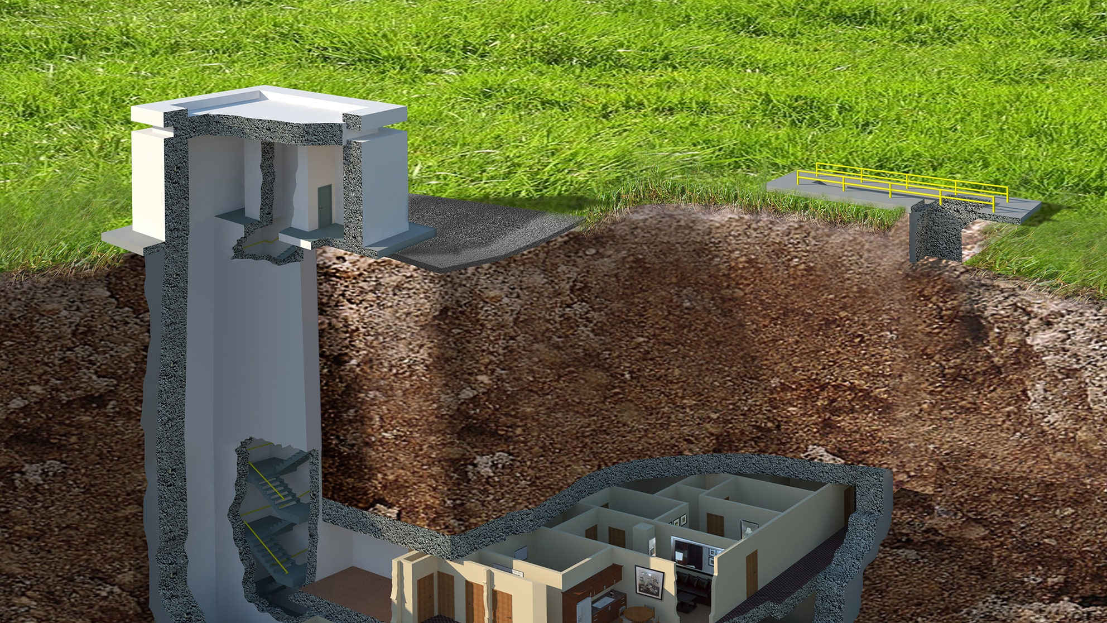
Bunker Interviews
A fun way to do interviews

Slide 35
Gamification in the Classroom:
Rewards students with xp
Punishes students with hp
Real life consequences / power ups
Arranged into teams
Classcraft
https://www.classcraft.com/
https://www.youtube.com/watch?v=30oNjYEO4wk

Slide 36
Gamification in the Classroom:
Public schools
Uses game systems
Game designers / Teachers
Problem-Based Learning
Need to know
21st Century skills
Quest to Learn
https://www.q2l.org/
https://www.youtube.com/watch?v=kHtj6PCpyLQ

Slide 37
No Thank You, EVIL!
For elementary role plays kids

Slide 38
Role –Playing Games Used as Educational and Therapeutic Tools for Youth and Adults
https://www.researchgate.net/publication/237074784_Role-playing_Games_Used_as_Educational_and_Therapeutic_Tools_for_Youth_and_Adults
Role –Playing Games for Common Well-Being in High School – Notes from a Study Developed in Southern Brazil
https://www.researchgate.net/publication/333755286_Role-Playing_Games_for_Common_Well-Being_in_High_School_-_Notes_from_a_Study_Developed_in_Southern_Brazil

