Slide 1
Bias

Slide 2
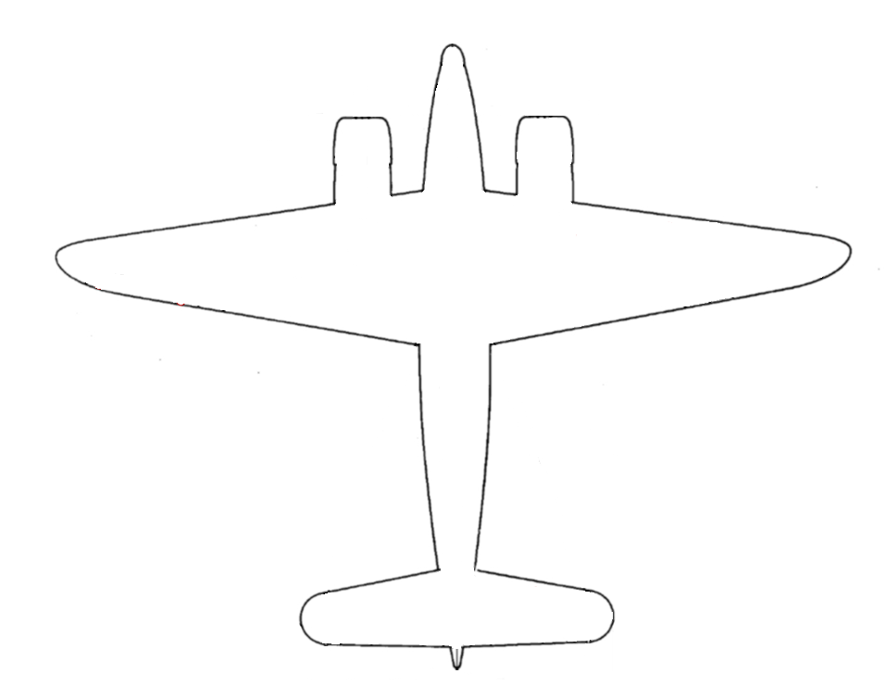

Slide 3
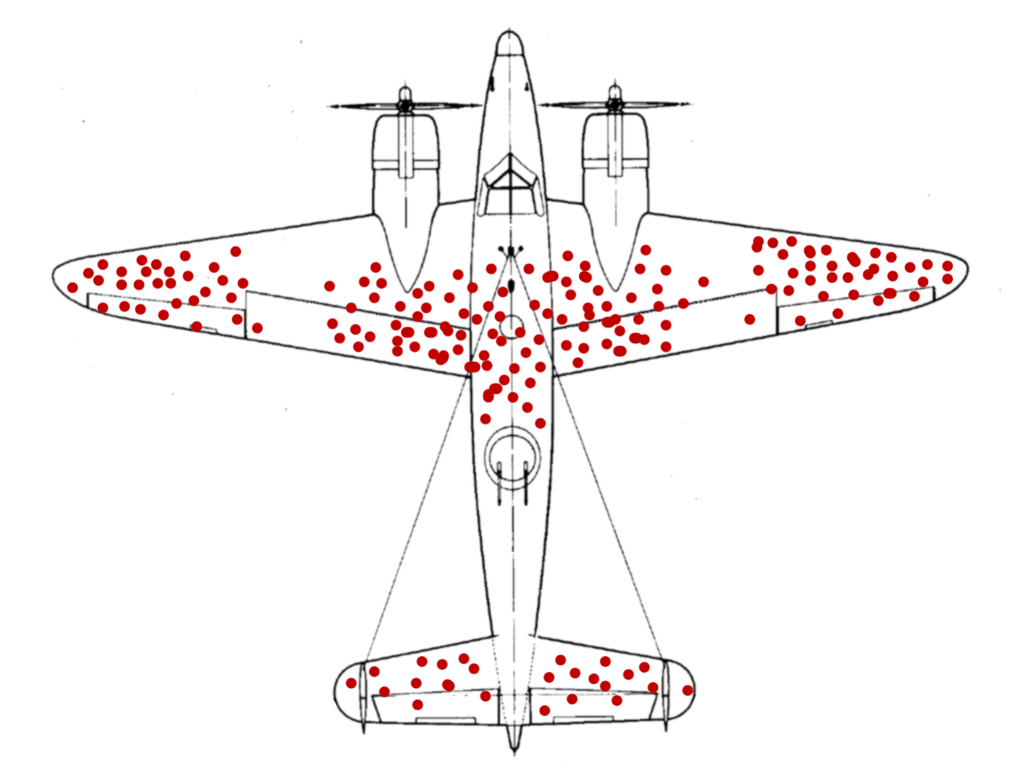
Where should we add armor?

Slide 4
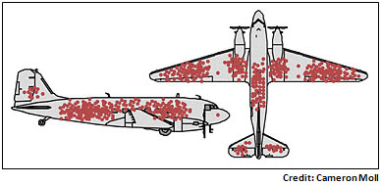
Survivor Bias
We don’t have all of the information.
Only results from the planes that came back.

Slide 5
What does a traditional Korean house look like?

Slide 6
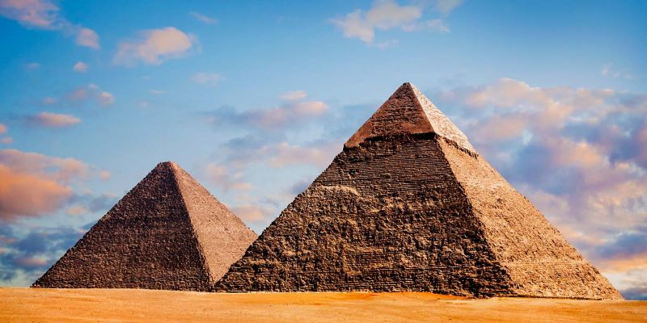
The Egyptians had advanced technology.

Slide 7
If you work hard, you will succeed.

Slide 8
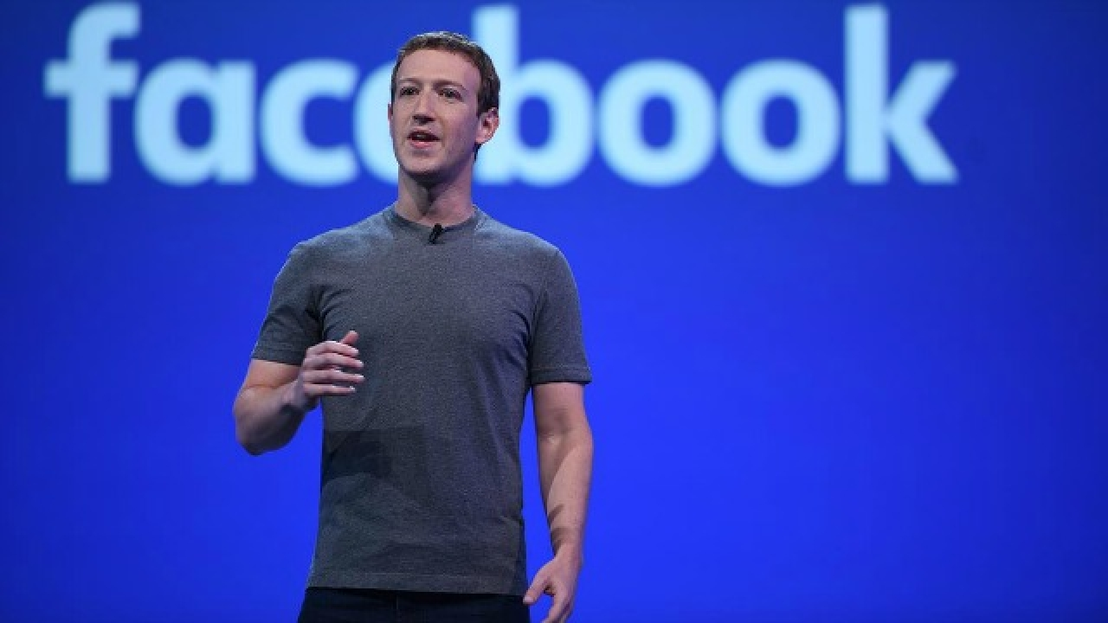
Many of the richest people dropped out of college. (Bill Gates, Mark Zuckerberg, Larry Ellison, etc)

Slide 9
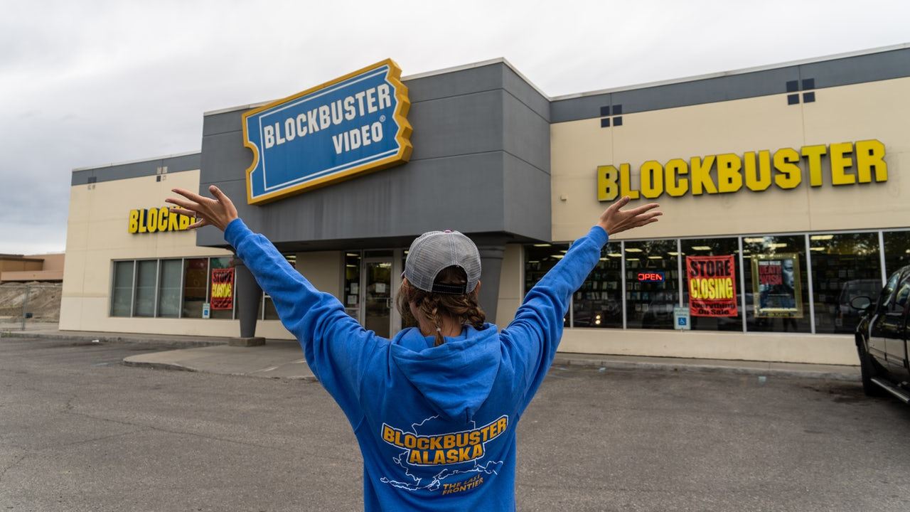
Just because something was successful in the past, does not mean it will be successful in the future.

Slide 11
Survey Question
Create a question to ask everyone here.

Slide 12
Survey Question
What do our results show?

Slide 13
Volunteer Bias
Only information from when people fill out the form
Restaurant reviews – only people hate or love it.
Research surveys
Political Polling
Who are taking the surveys?
Someone with time
Usually socio-economically advantaged
University students
Who the researcher has access to

Slide 14
What is my rule?
2,4,6
You can only ask for three numbers at a time.

Slide 15
Confirmation Bias
We only seek information that agrees with our beliefs
Numbers that prove ‘our rule’
It is more useful to find information that disagrees with us.

Slide 16
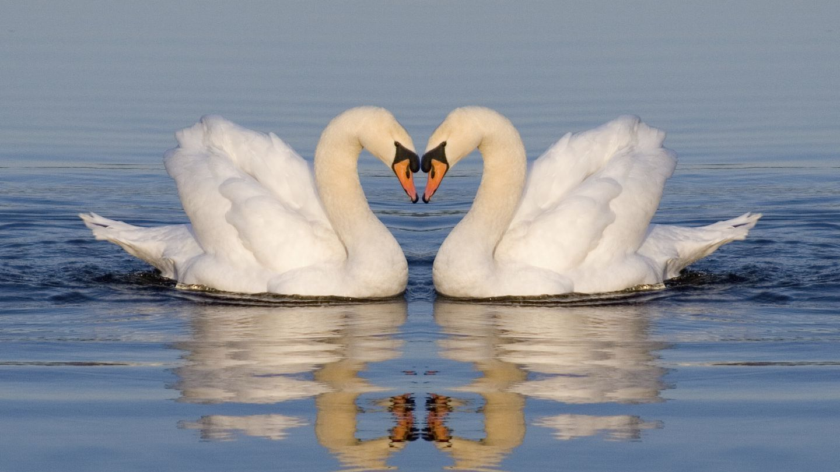
In Europe there are only white swans.
Every time a European saw a swan, they confirmed their belief that all swans are white.
However…

Slide 17
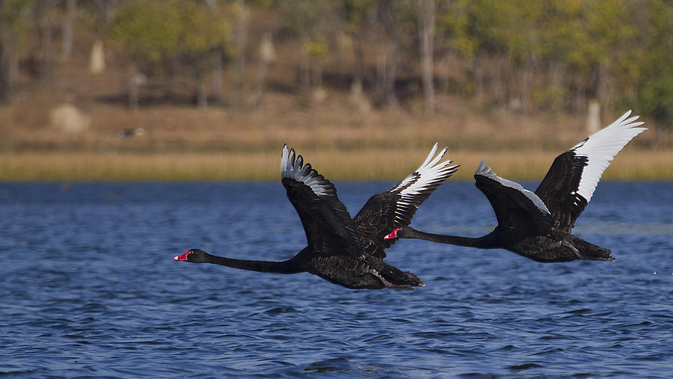
In Australia, there are black swans.

Slide 18
The Facebook algorithm looks for groups and stories that you will enjoy.
However…

Slide 19
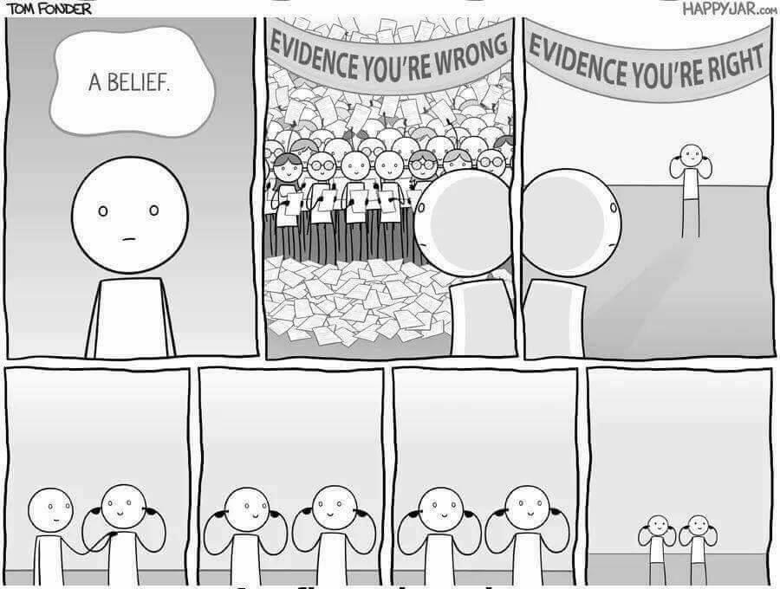
You won’t see issues from another perspective.

Slide 20
Foreigners can’t eat spicy food.

Slide 21
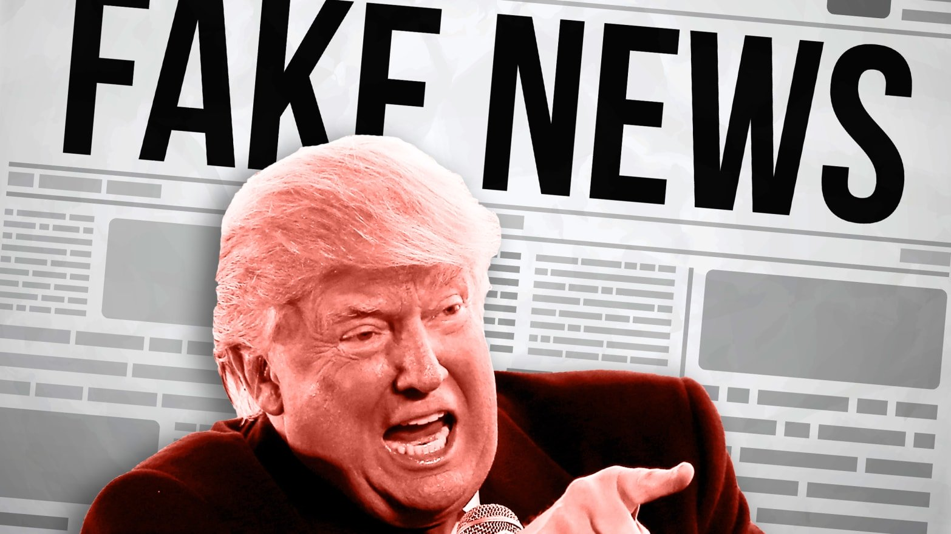
Fake News

Slide 22
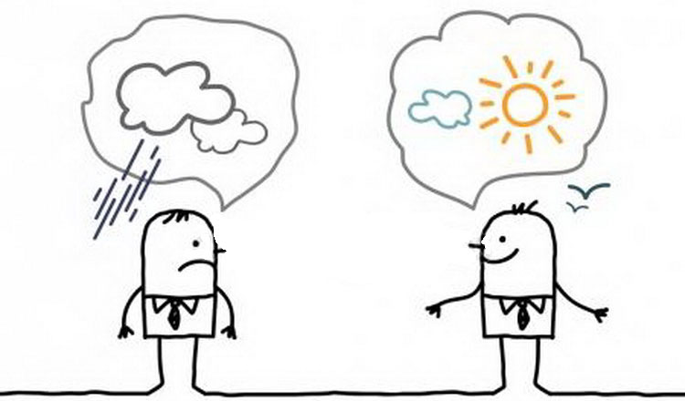
Pessimist vs Optimist

Slide 23
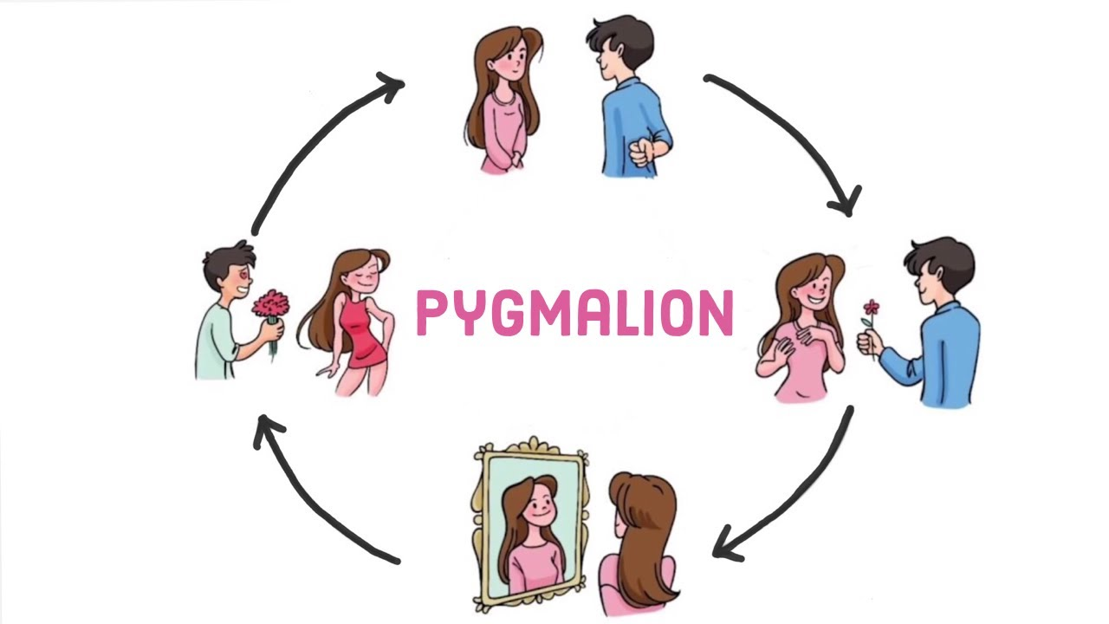
Pygmalion Effect

Slide 24
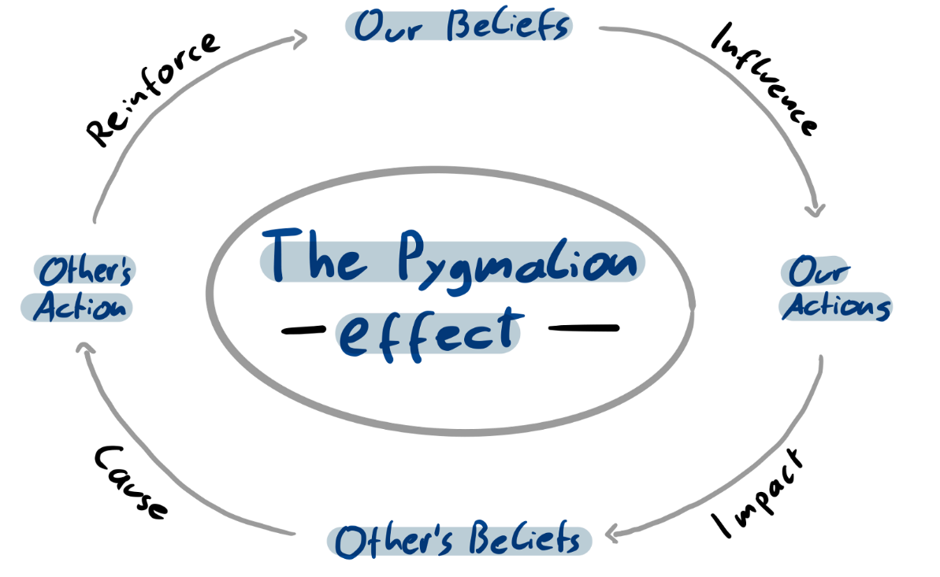
Pygmalion Effect
Self-fulfilling prophecy
Two students with the same intelligence:
Treat one student better, they have a better experience, they try harder, and they do better
Treat one student worse, they have a bad experience, they don’t want to try, their lack of studying leads to failure.

Slide 25
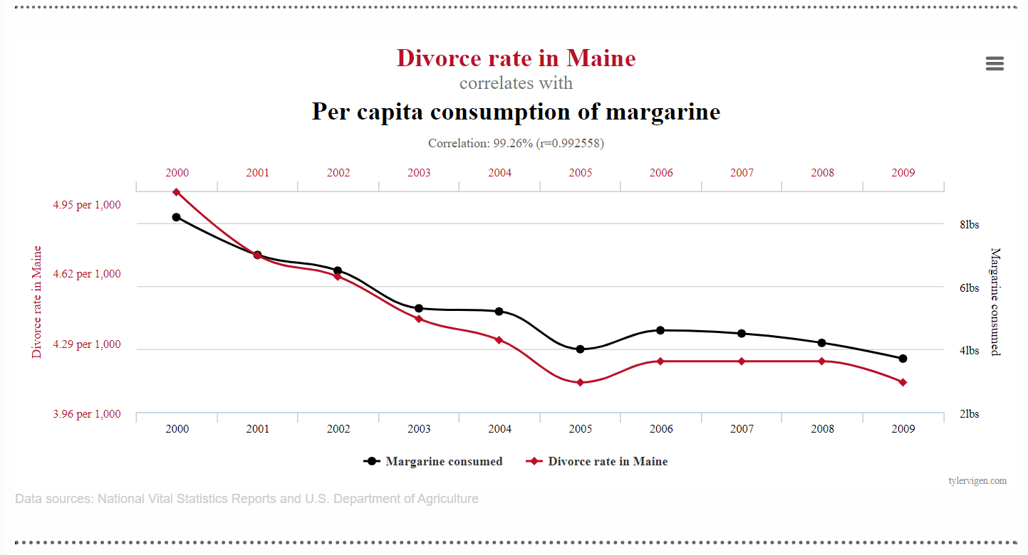

Slide 28
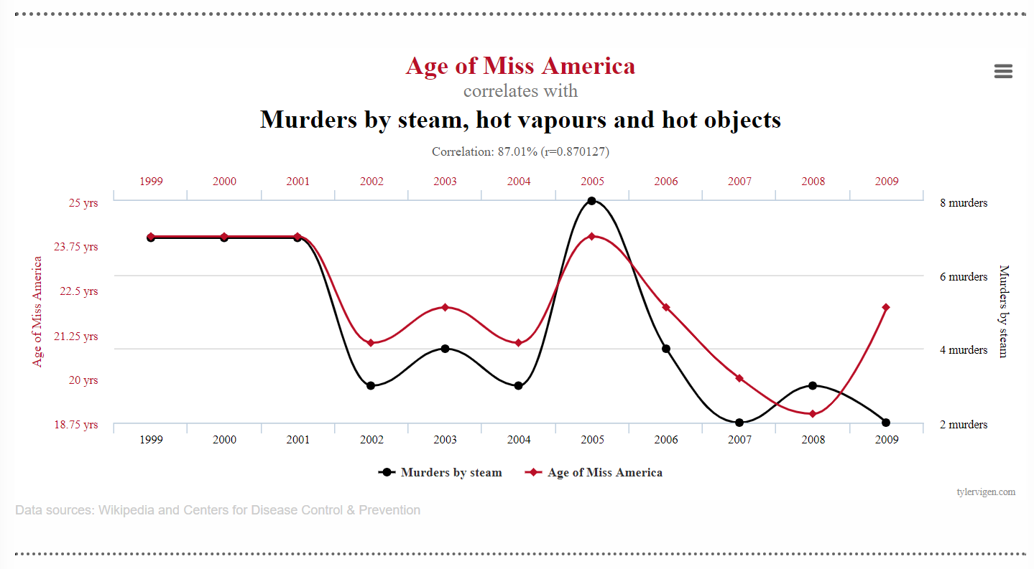

Slide 29
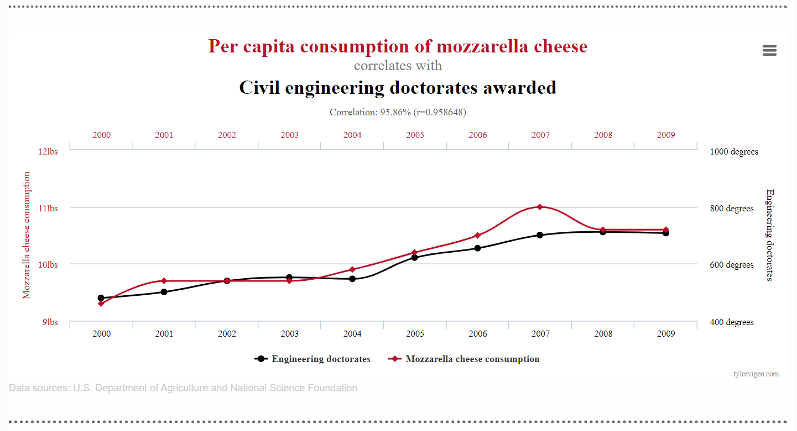

Slide 30
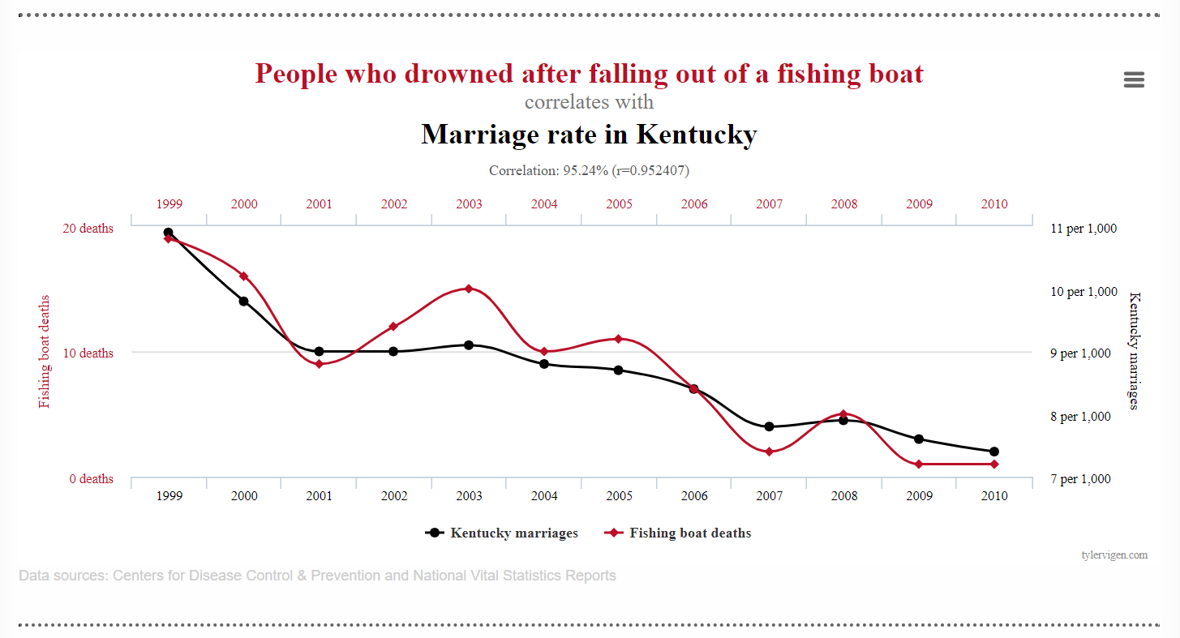

Slide 32
Heuristics
Cognitive shortcuts (rules of thumb)
Don’t have time or energy to examine ALL of the information
See relationships that are not actually there.
Coincidence

Slide 33
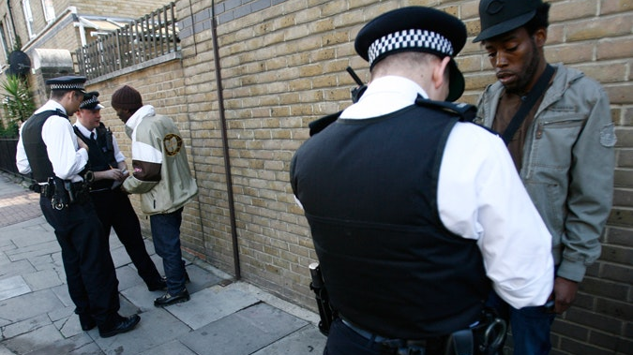
Police profiling

Slide 34
Stereotypes

Slide 35
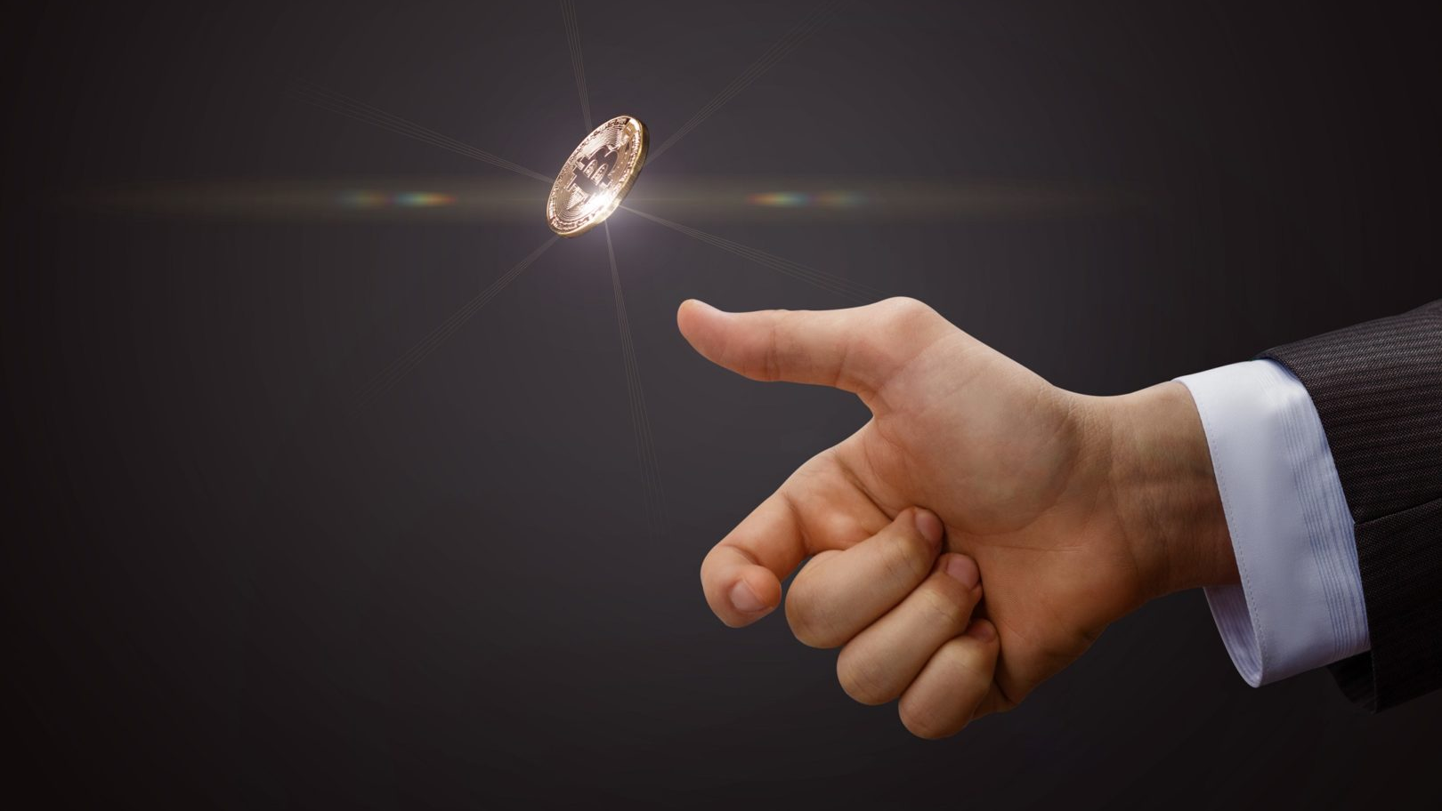

Slide 36
Coin Flip
You win, you get $5
You lose, you give me $10

Slide 37
Coin Flip
You win, you get $10
You lose, you give me $10

Slide 38
Coin Flip
You win, you get $15
You lose, you give me $10

Slide 39
Coin Flip
You win, you get $___
You lose, you give me $10

Slide 40
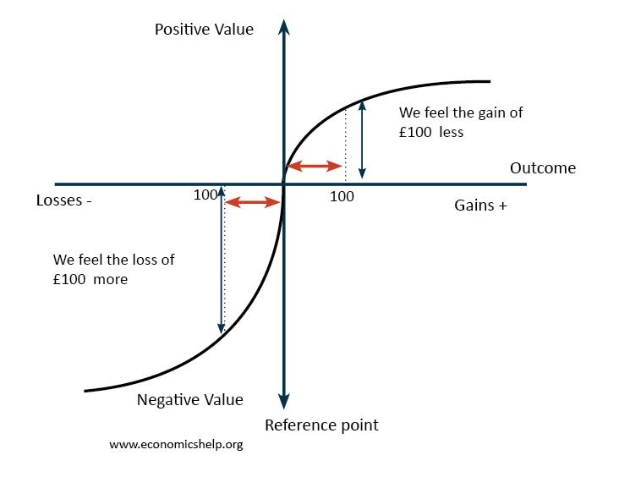
Loss Aversion
Losses are felt more strongly than gains

Slide 41
Free Trial Period

Slide 42
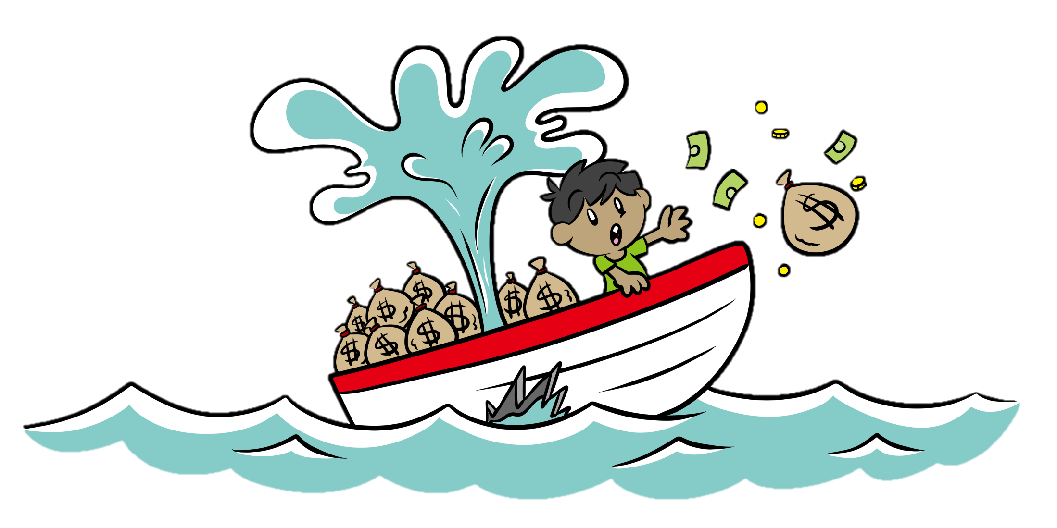
Sunk Cost Fallacy

Slide 43
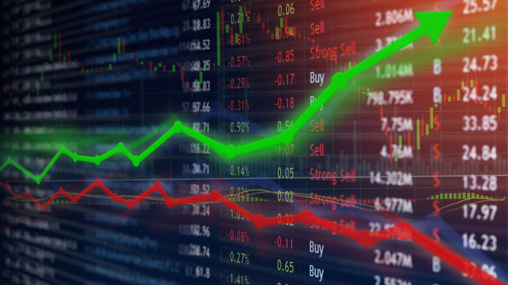
Stock Market

Slide 44
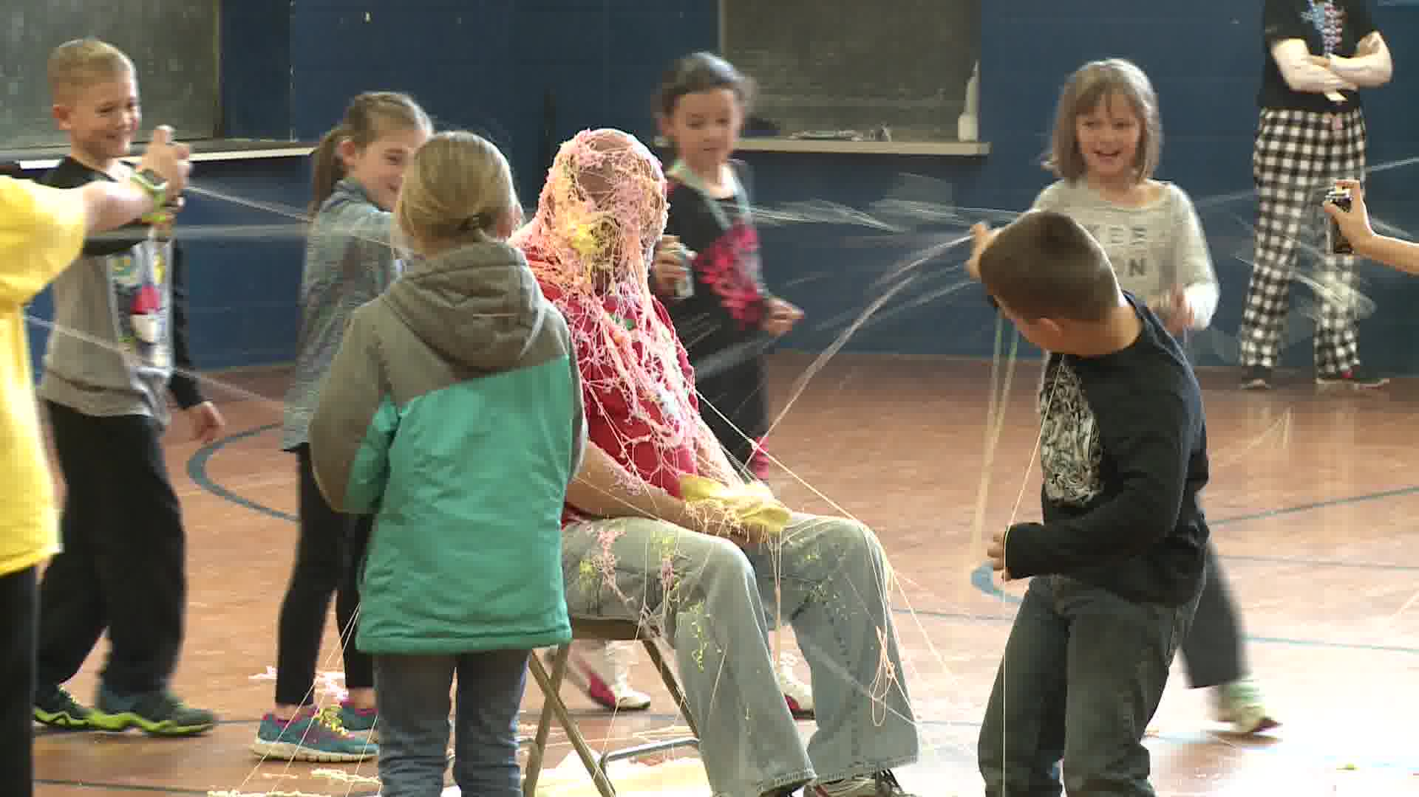
Afraid to take chances (lessons)

Slide 45
Classroom
Progress charts
Focus on successes (effort)

Slide 48
Bias Blind Spot
661 Americans were asked if they thought they were more or less biased than average:
85% of Americans think they are less biased than average.
Not possible
Only one participant believed that he or she was more biased than the average American

Slide 49
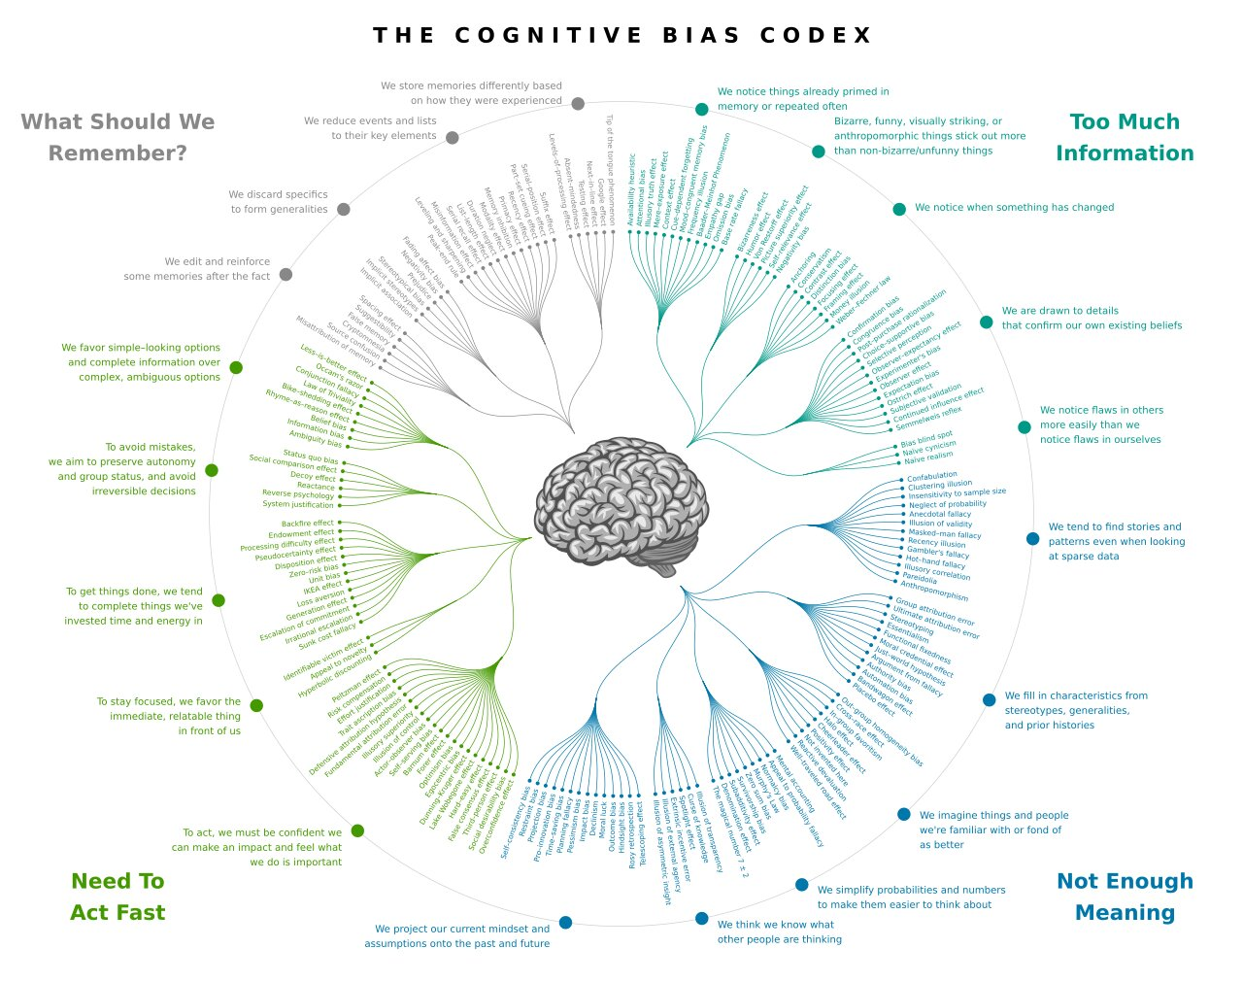

Slide 50
Can You Solve This?
https://www.youtube.com/watch?v=vKA4w2O61Xo
Survivorship Bias
https://www.youtube.com/watch?v=P9WFpVsRtQg
7 Lessons on Survivorship Bias that Will Help You Make Better Decisions
http://blog.idonethis.com/7-lessons-survivorship-bias-will-help-make-better-decisions/
Spurious Correlations
https://www.tylervigen.com/spurious-correlations
Researchers Find Everyone Has a Bias Blind Spot
https://www.cmu.edu/news/stories/archives/2015/june/bias-blind-spot.html

Slide 51
Overcoming Aversion to Loss
https://www.nytimes.com/2013/12/09/your-money/overcoming-an-aversion-to-loss.html
Ironic Effect of Dietary Supplementation Illusory Invulnerability Created by Taking Dietary Supplements Licenses Health-Risk Behaviors
https://web.archive.org/web/20160529122129/https://www.researchgate.net/profile/Wen-Bin_Chiou/publication/51498271_Ironic_Effects_of_Dietary_Supplementation_Illusory_Invulnerability_Created_by_Taking_Dietary_Supplements_Licenses_Health-Risk_Behaviors/links/02bfe5109d79451154000000.pdf

Slide 52
Dunning Cruger
Decoy Effect
Anchoring
Time Discounting
FOMO
Halo Effect
Licencing
Optimism Bias
Overjustification Effect
https://web.archive.org/web/20160529122129/https://www.researchgate.net/profile/Wen-Bin_Chiou/publication/51498271_Ironic_Effects_of_Dietary_Supplementation_Illusory_Invulnerability_Created_by_Taking_Dietary_Supplements_Licenses_Health-Risk_Behaviors/links/02bfe5109d79451154000000.pdf

