Slide 1
5
THE
Canons
of
Rhetoric
D
E
L
I
V
E
R
Y

Slide 2
Delivery
How it is said
Volume
Tone
Intonation
Clarity
Body Language
Hand gestures
PPT
Realia
Props
Think about your audience

Slide 3
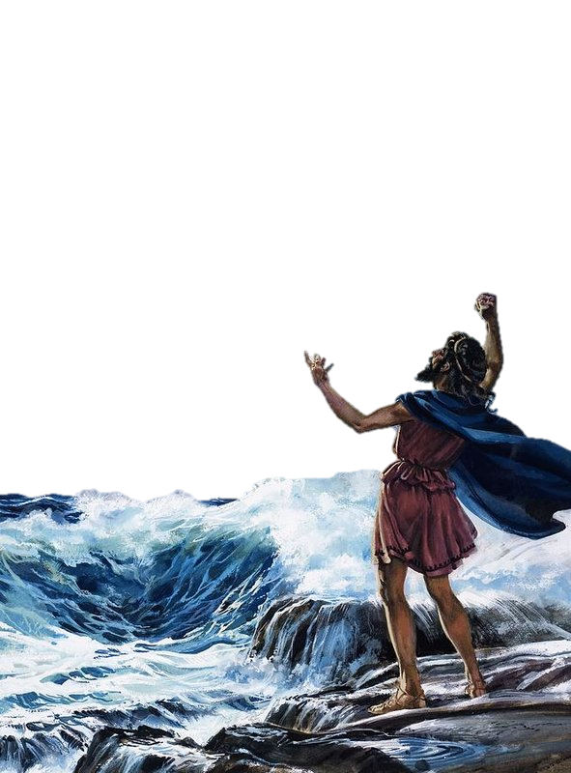
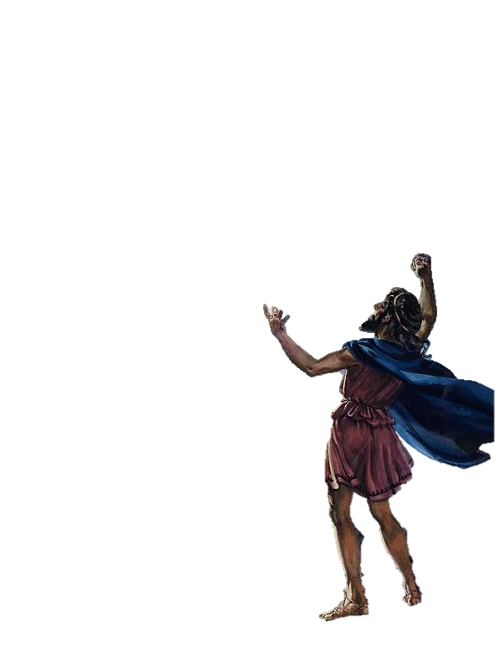
Demosthenes
Practiced his speeches with pebbles in his mouth
Ran while practicing
Shouted it over the seashore and the roaring waves

Slide 4
Nowadays
Natural speech
Authenticity
“someone to drink a beer with”
Distrust of the well spoken
Silver-tongued deceiver

Slide 5
You are already the oldest president in history…
I will not make age and issue of this campaign
I am not going to exploit, for political purposes, my opponents youth and inexperience

Slide 6
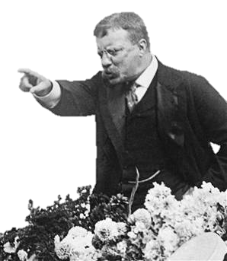
Techniques to Consider
Master the … pause
Pacing
Body language
Shows emotion, audience reflects feelings
Adds information
Confidence
Tone
Vary your voice
Don’t be a robot
Inflections
Hand Gestures

Slide 7
Techniques to Consider
Match your speed with your emotion
Rapid: haste, alarm, confusion, anger, fear, revenge, terror
Quick: joy, hope, playfulness, humor
Moderate: Good for narration, descriptions, and teaching
Slow: gloom, sorrow, melancholy, grief, pity, admiration, reverence, dignity, authority, awe, power, majesty
Very slow: used to express the strongest and deepest emotions.

Slide 8
Techniques to Consider
Voice intensity
Vary from soft to loud
Enunciate
Can the audience understand you?
Tongue twisters
Eye Contract
A few seconds with everyone

Slide 9
Delivery
https://www.artofmanliness.com/articles/canon-of-delivery/

