Slide 1
5
THE
Canons
of
Rhetoric
M
E
M
O
R
Y

Slide 2
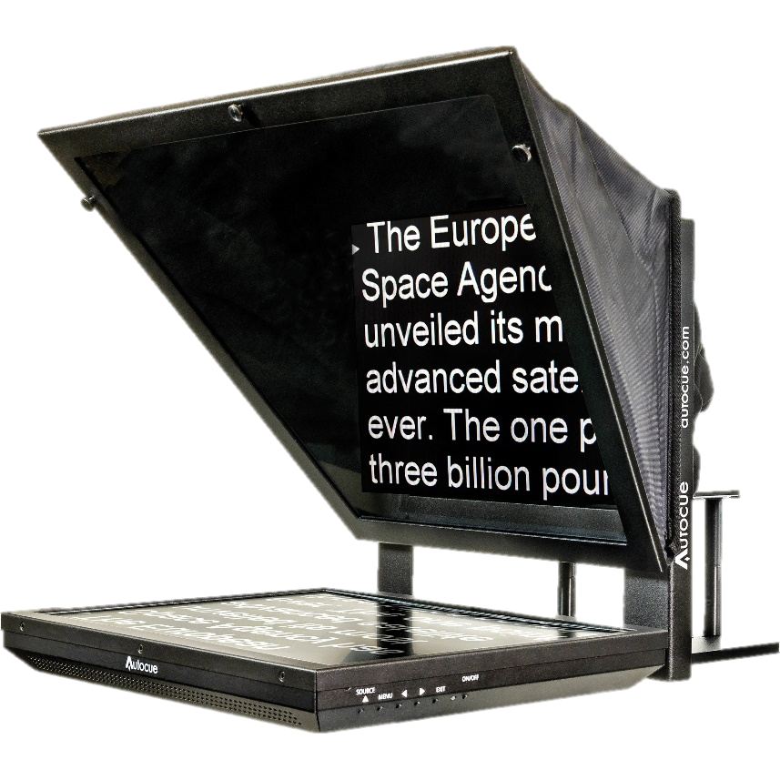
Memory
Not as important nowadays
Socrates believed writing weakened the memory
Ethos (at least in ancient times)
Experts don’t need to rely on notes

Slide 3
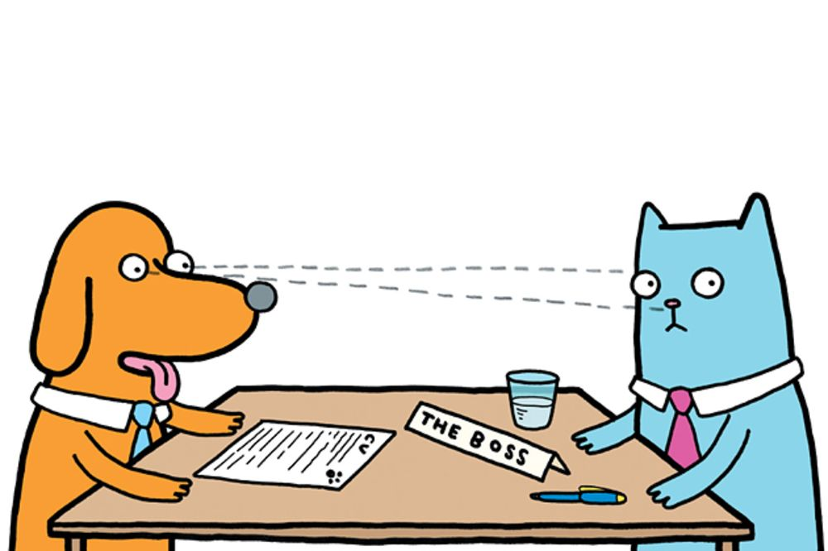
Memory
Memorization allows:
Eye contact
Personality
Natural story telling

Slide 4
Memory Strategies
Mnemonic devices
Have a clear plan
Break the plan into smaller bits
Break those into the facts, etc.
Localize it
Pretend it is happening in front of you

Slide 5
Memorable
Its also about having the audience remember.
Have a list of back ups:
Quotations
Facts
Antidotes

Slide 6
Memorable
Solid introduction
Clearly laid plan for your speech
Blueprint
Rhetorical devices
Analogies
Power of Three
Call to Action

Slide 7
Memory
https://www.artofmanliness.com/articles/classical-rhetoric-101-the-five-canons-of-rhetoric-memory/

