Slide 1
5
THE
Canons
of
Rhetoric
S
T
Y
L
E

Slide 2
Style
How you present your ideas.
Why people want to listen to you

Slide 3
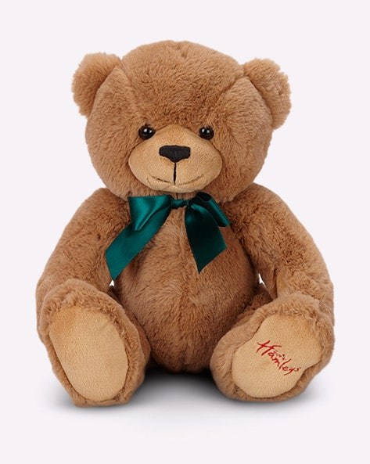
Style
Which gift would you rather open?

Slide 4
5 Virtues of Style
Correctness
Clarity
Evidence
Propriety
Ornateness

Slide 5
Correctness
Clear and precise communication
Word choice and usage
Syntax
Grammar
Ethos
Must be well-educated
Cares about the details
They made a mistake? Can I trust them?

Slide 6
Clarity
Volume
Clear and simple language
Smart writing is simple writing
8th grade textbook
Strong verbs (avoid to be)
“Diane was killed by Jim” vs “Jim killed Diane”
Shorter, clearer, punchier
Average sentence is about 20 words
It’s relatable

Slide 7
Evidence
Evidence has a slightly different meaning
emotional response through physical senses
Pathos
Vivid descriptions
Detailed stories

Slide 8
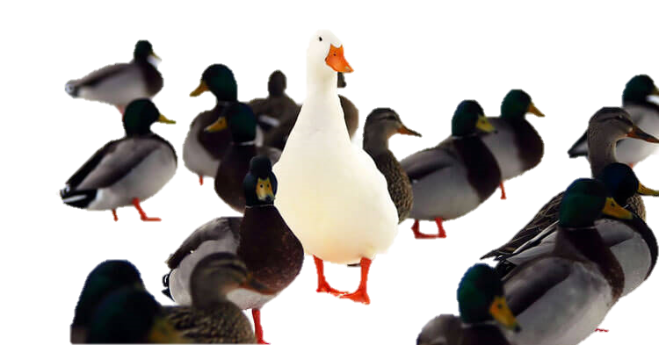
Propriety
Selecting words that are appropriate for:
Your subject mater
Audience
Occasion

Slide 9
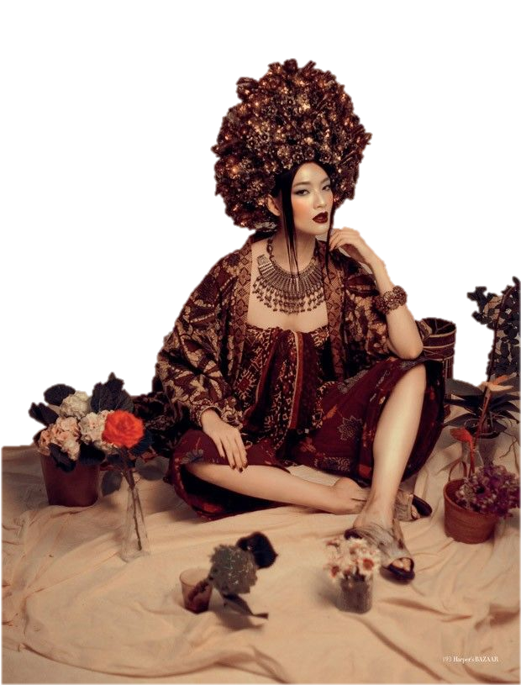
Ornateness
Making your speech interesting to listen to
Rhetorical devices
Figures of speech
Sound / Rhythm of words

Slide 10
Onomatopoeia

Slide 11
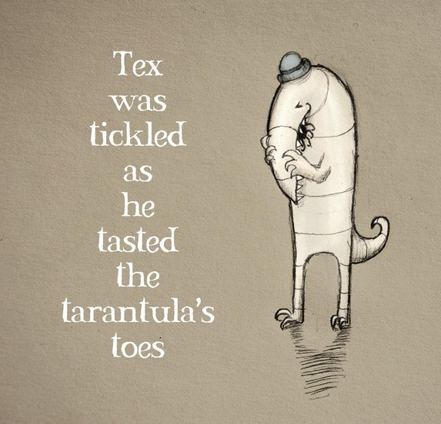
Alliteration
(consonance)

Slide 12
Metaphor

Slide 13
Hyperbole

Slide 14
Repetition

Slide 15
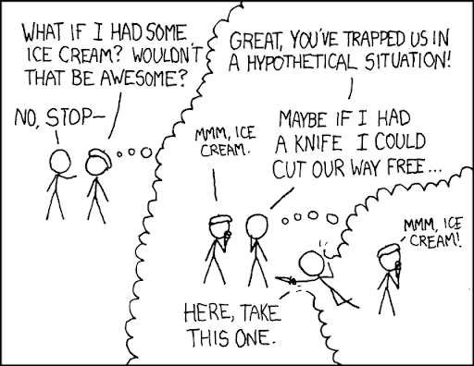
Hypothetical

Slide 16
Rhetorical
Question

Slide 17
Style
https://www.artofmanliness.com/articles/classical-rhetoric-101-the-five-canons-of-rhetoric-style/

