Slide 1
5
THE
Canons
of
Rhetoric

Slide 2
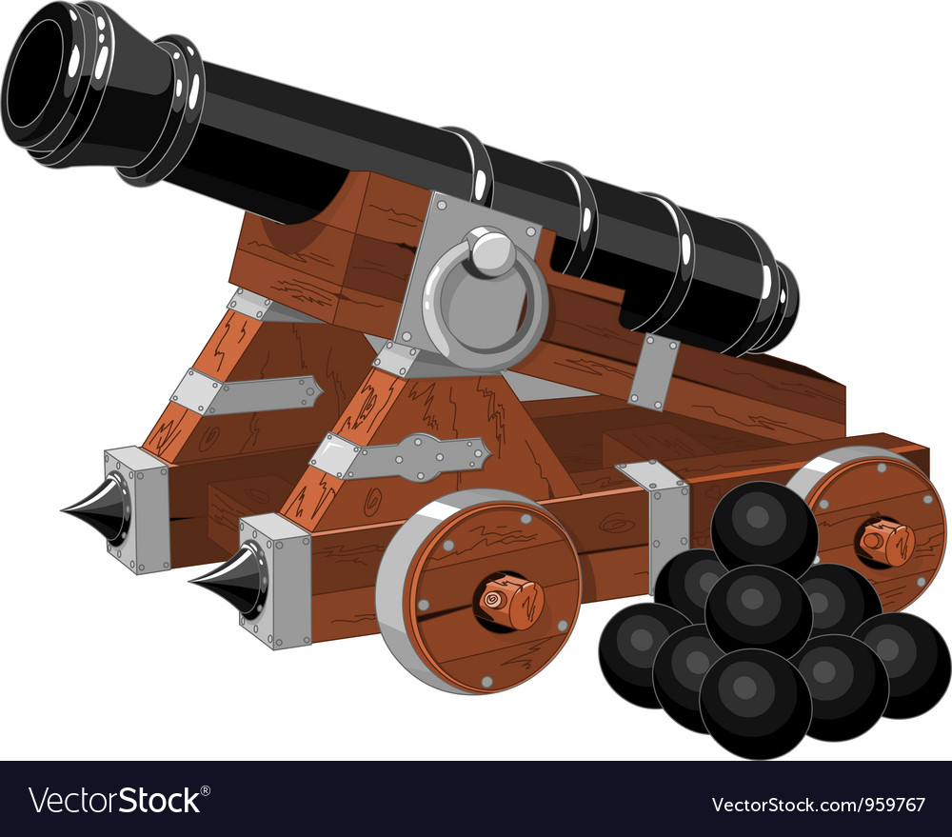
Cannon
vs
Canon

Slide 3
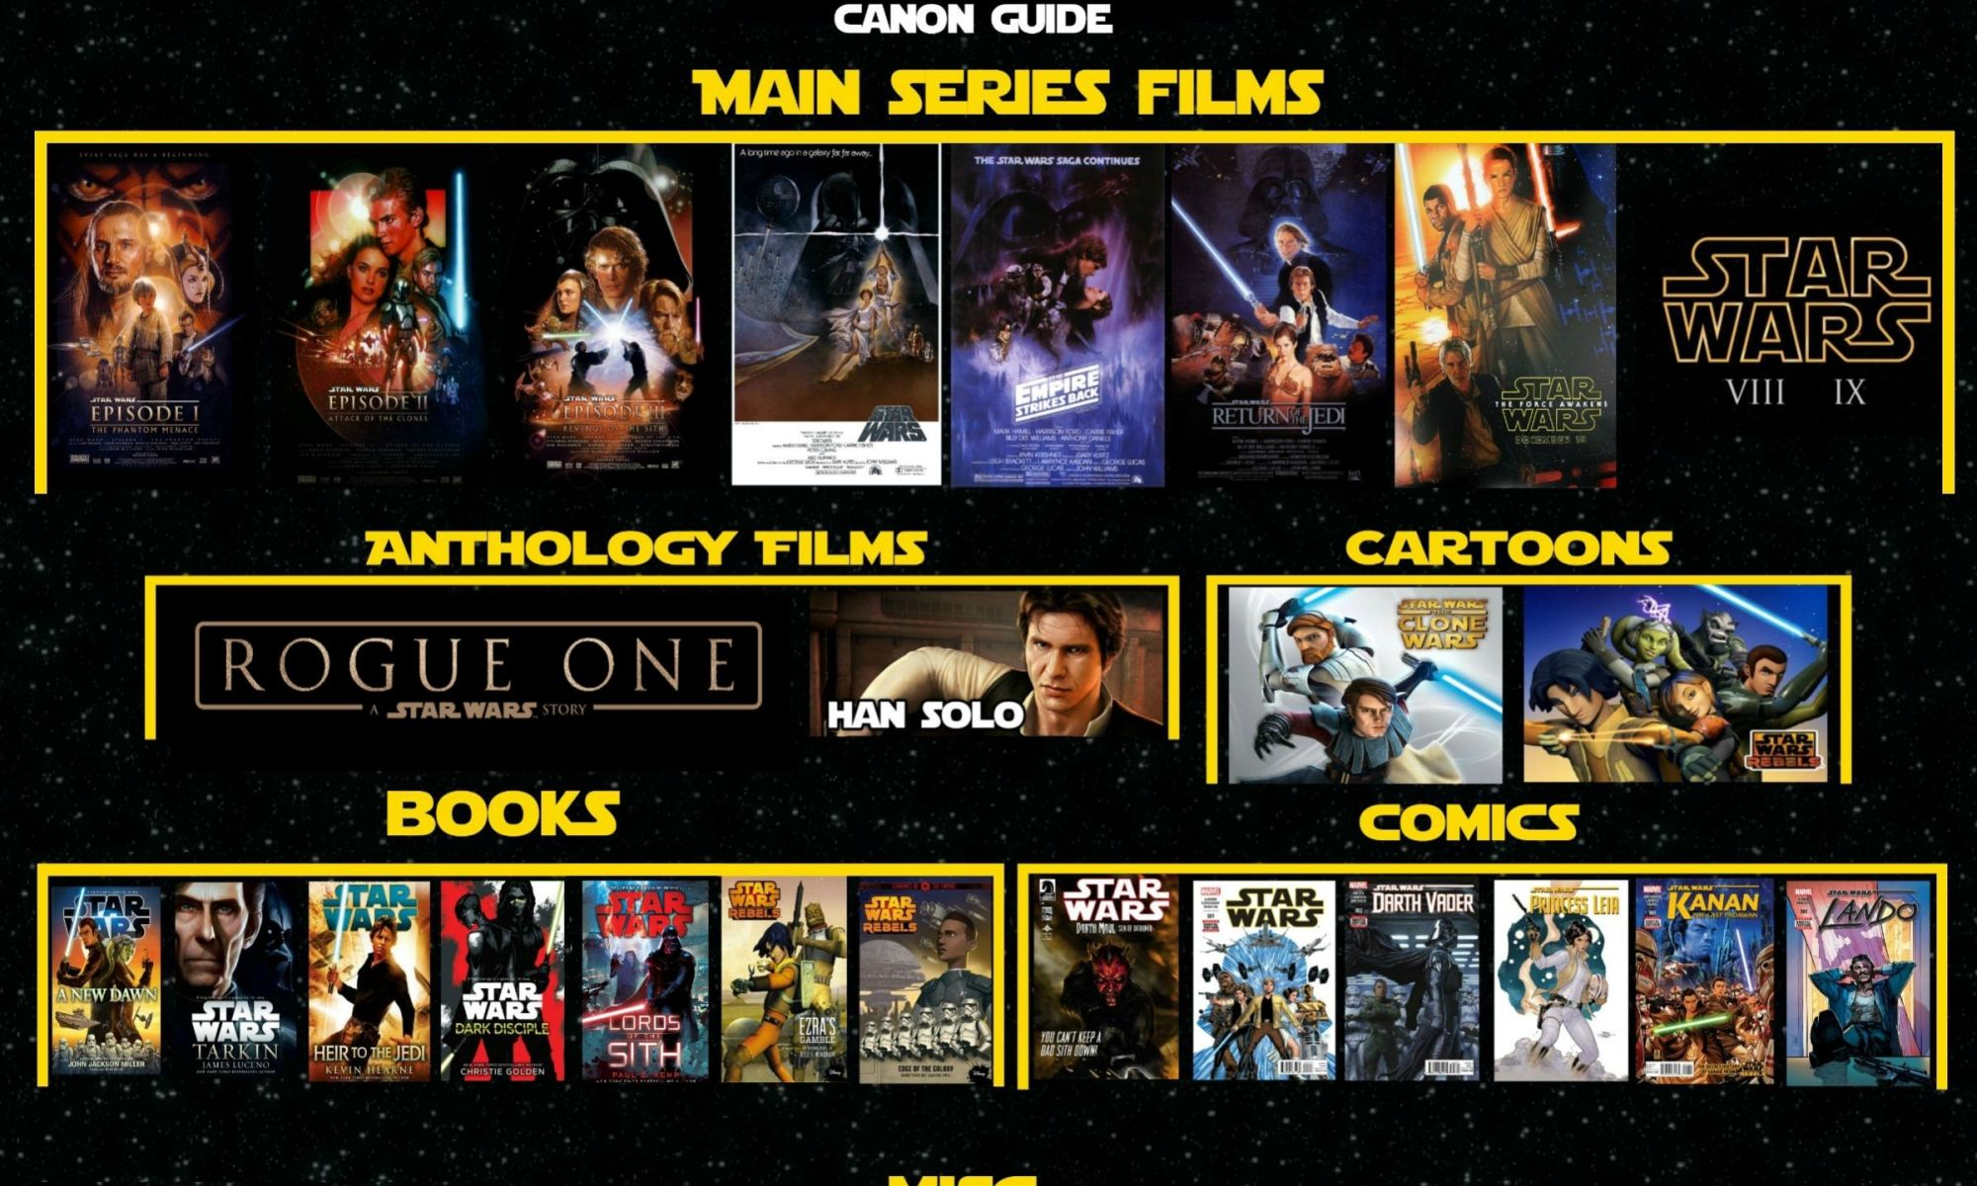

Slide 4
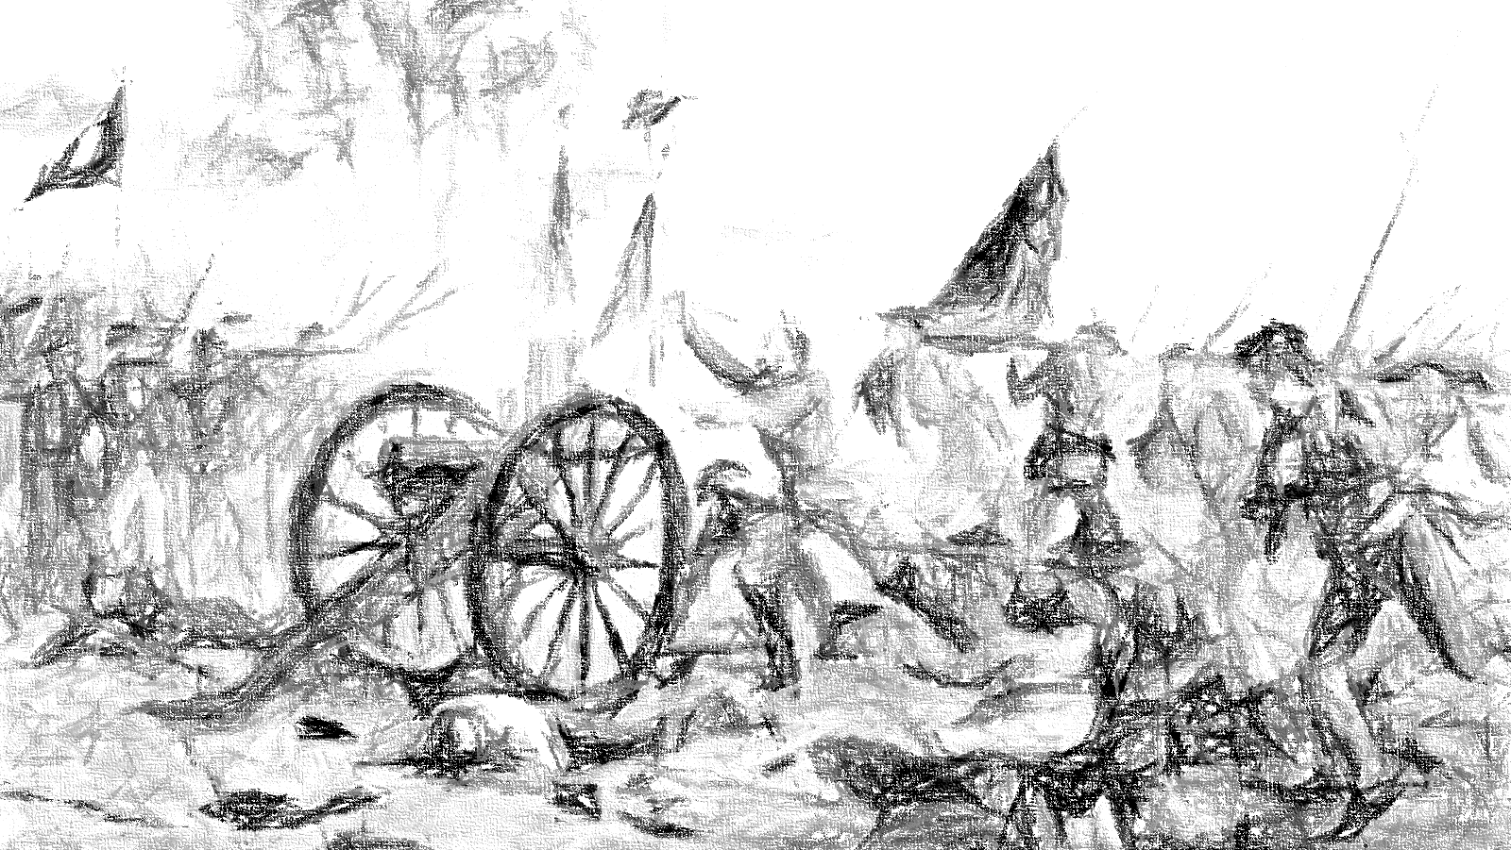
5 Canons of Rhetoric
Inventio
Dispositio
Elecutio
Memoria
Actio

Slide 5
Invention
Inventio

Slide 6
Invention (Research)
“To discover or find”
Logos
I can’t think of anything to say
Question
Speaking prompts
Assignment
Research
Learn more about the subject

Slide 7
Disposition
Dispositio

Slide 8
Disposition (Arrangement)
Story structure
5 Paragraph Essay
Poetry
Formulas
Have a purpose

Slide 9
Elocution
Elecutio

Slide 10
Elocution (Style)
The way in which something is said.
Vocabulary
Sentence Structure
Expressions
Rhetorical Devices
Pathos

Slide 11
Elocution (Style)
“Rubrics or checklists can stretch students to use words in ways they might not naturally use them, and by the requirement to include such things as an adjective clause, a participle opener, or a simile, students will be challenged to use words, expressions, and devices beyond their everyday habits.”

Slide 12
Memory
Memoria

Slide 13
Memory
More important in ancient times
Ethos
Eye contact
“furnishing the mind”

Slide 14
Action
Actio

Slide 15
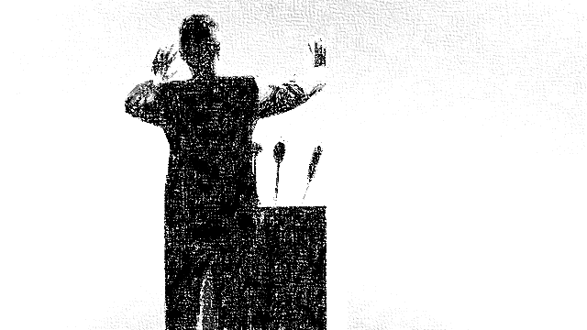
Action (Delivery)
Practice
Confidence
Vocal modulation
Projection
Eye contact
Gestures
Pathos

Slide 16
1. Invention
2. Arrangement
3. Style
4. Memory
5. Delivery

Slide 17
5 Canons of Rhetoric
https://www.memoriapress.com/articles/5-canons-of-rhetoric/
The canons of rhetoric
http://rhetoric.byu.edu/Canons/Canons.htm
Classical Rhetoric 101: The Five Canons of Rhetoric – Invention
https://www.artofmanliness.com/articles/classical-rhetoric-101-the-five-canons-of-rhetoric-invention/

