Slide 1
Smartphones
Listening with apps

Slide 2






Improve English:
Word Games
Duolingo
Busuu
LingQ
Memrise
Babbel

Slide 3






Rosetta
Stone
LearnEnglish
Grammar
LingoDeer
Beelinguapp
ELSA Speak
Speak English
Conversation

Slide 4

Spaceteam ESL
http://spaceteamesl.ca/

Slide 5


Slide 6
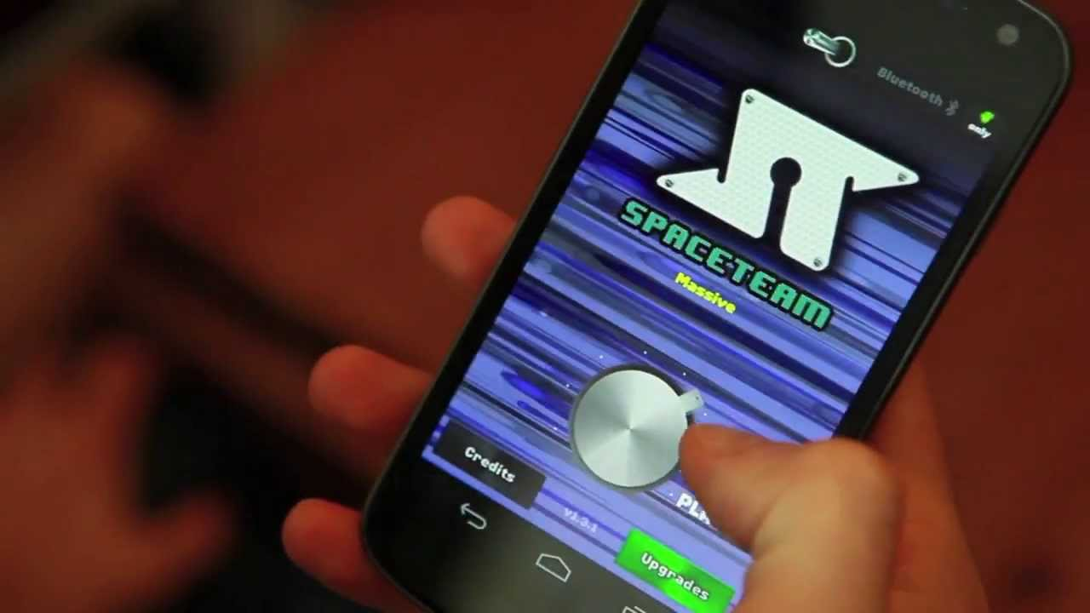

Slide 7


Slide 8
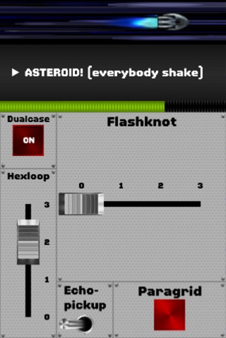

Slide 9
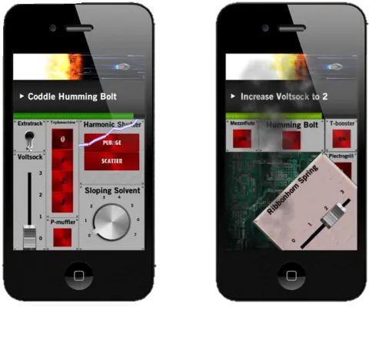

Slide 10


Slide 11

Spyfall

Slide 12


Slide 13
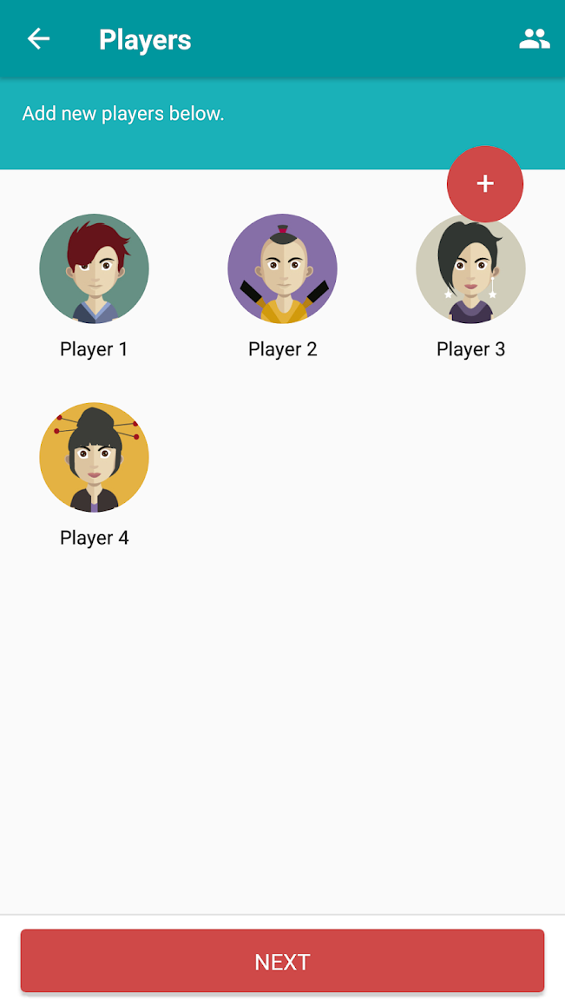

Slide 14
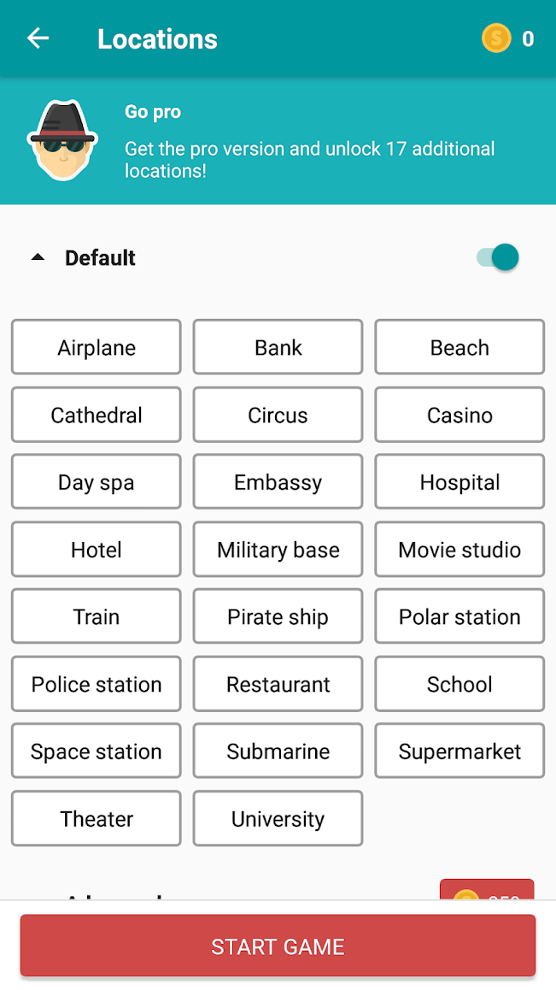

Slide 15

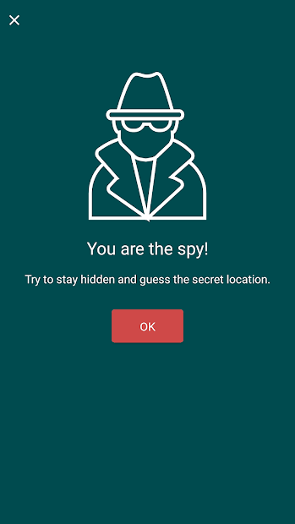

Slide 16
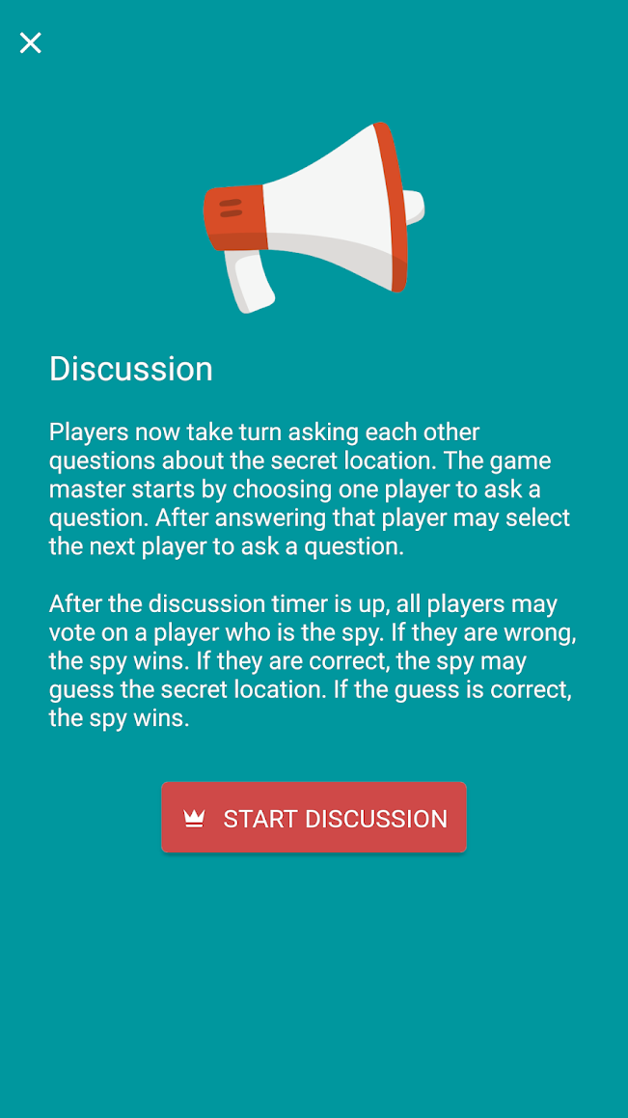

Slide 17
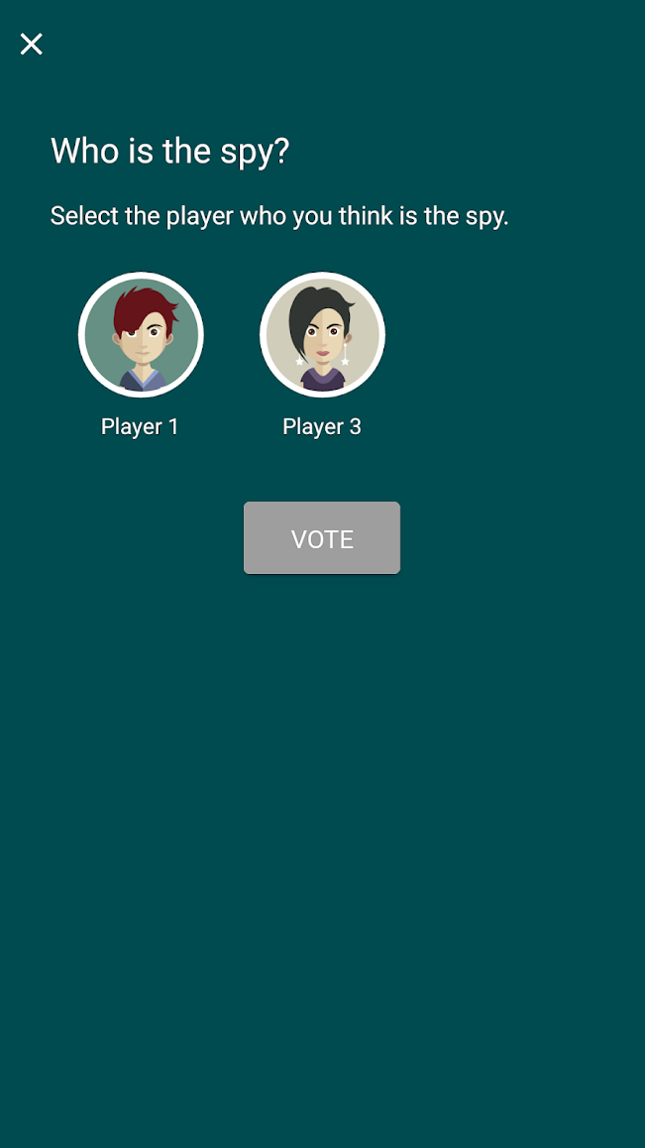

Slide 18

Mafia Online

Slide 19
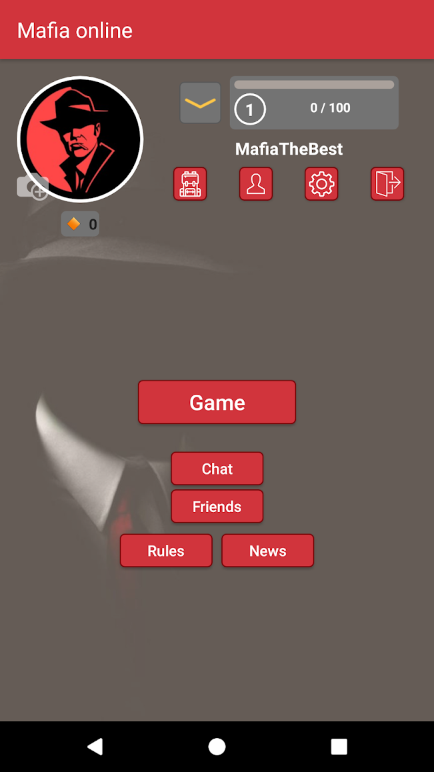

Slide 20
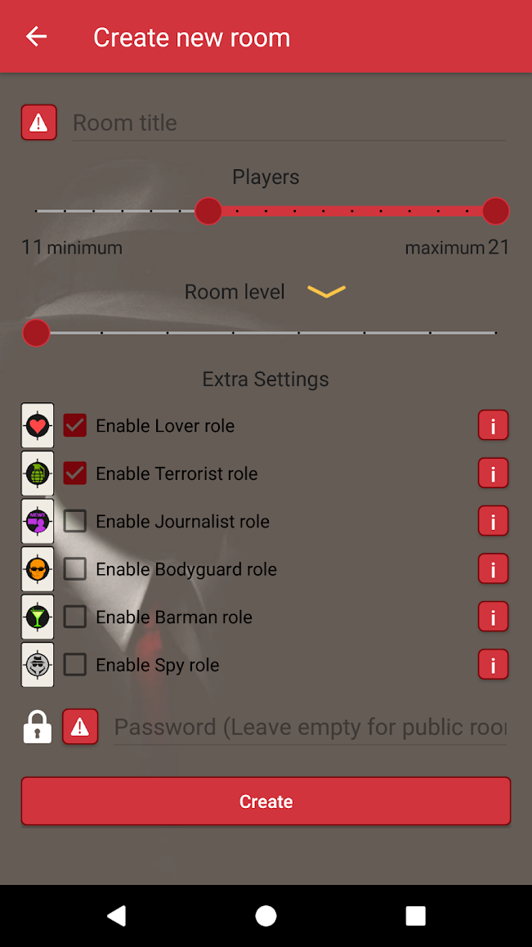

Slide 21
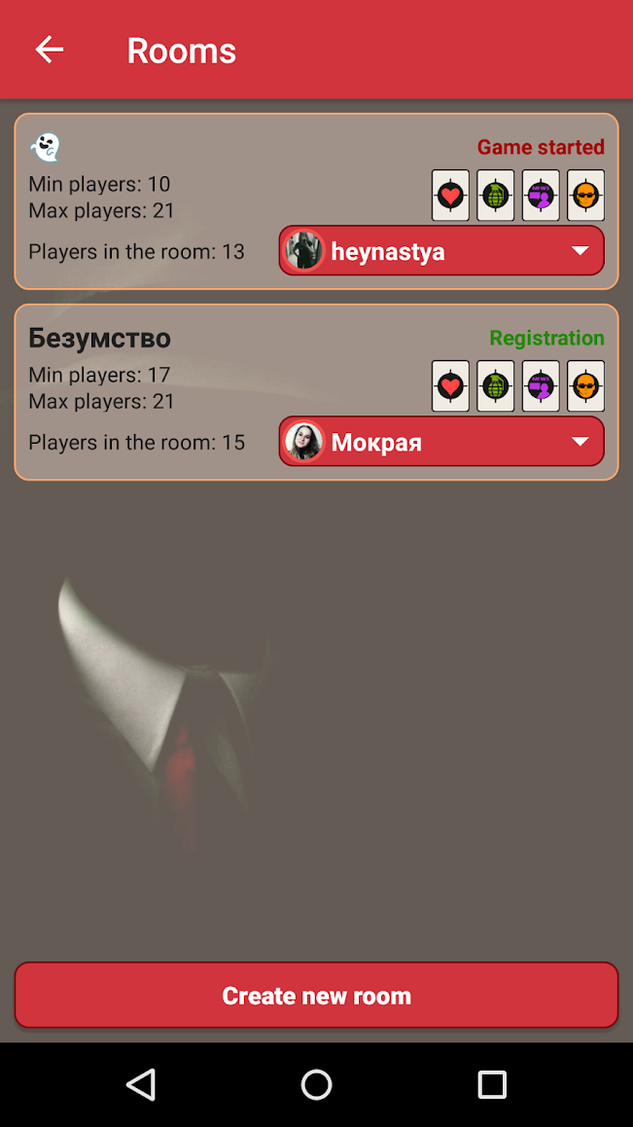

Slide 22
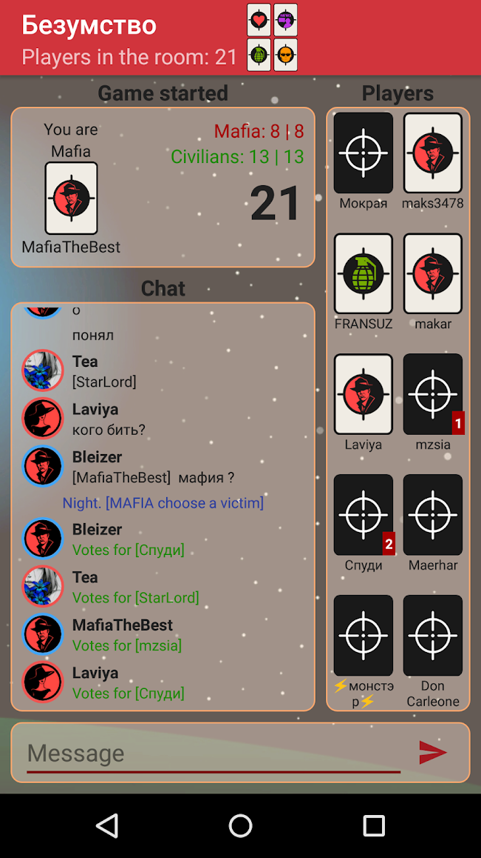

Slide 23
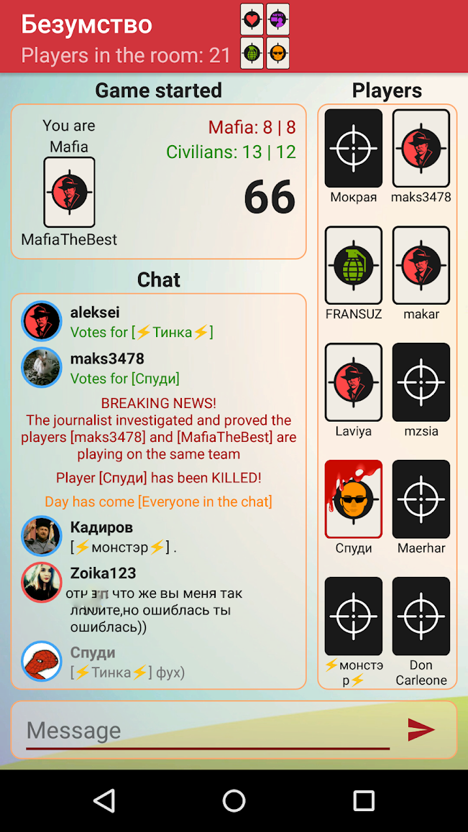

Slide 24

Heads Up!

Slide 25

Draw It

Slide 26

Coup

Slide 27

Battle Text

Slide 28

Guess Up

Slide 29

Scattegories

Slide 30

Taboo

Slide 31

Would You Rather?

Slide 32

Hangman Free

Slide 33

Scrabble

Slide 34

Boggle with Friends

Slide 35

2 Pictures 1 Word

Slide 36

Charades

Slide 37

Word Search Online

Slide 38

Just Riddles

Slide 39

Match-UP Learn English

Slide 40

Wheel of Fortune

Slide 41

Epic!

Slide 42

Draw a Stickman EPIC

Slide 43

FarFaria

Slide 44

Curious World*

Slide 45
…and many
hidden objects apps

