Slide 1
Two Rooms and a BOOM
http://www.tuesdayknightgames.com/tworoomsandaboom/

Slide 3
Room 1
Players divide into two rooms.
Room 2

Slide 4
Room 1
It says: Blue Team
Or
Red Team
Players receive a role card secretly.
Room 2

Slide 5
The blue team wants to protect the president.
The red team wants to blow up the president.
The president is on the blue team
(avoid the bomber)
The bomber is on the red team.
(Be with the president)

Slide 6
You can change the leader at any time (vote / leader chooses)
Choose a Leader
(each room)

Slide 7
Hostage Exchange:
After the round, the leader sends hostages to the other room

Slide 8
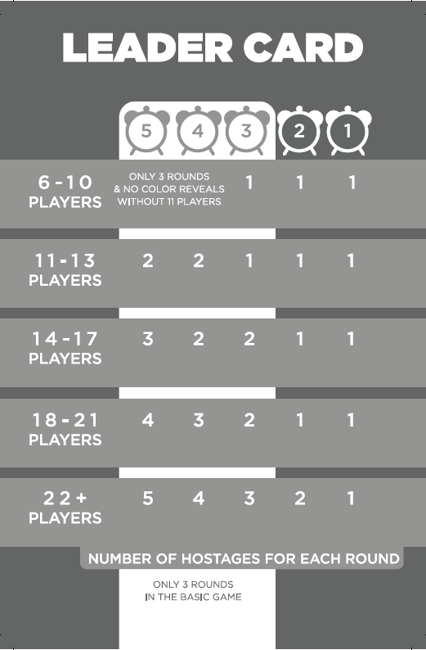
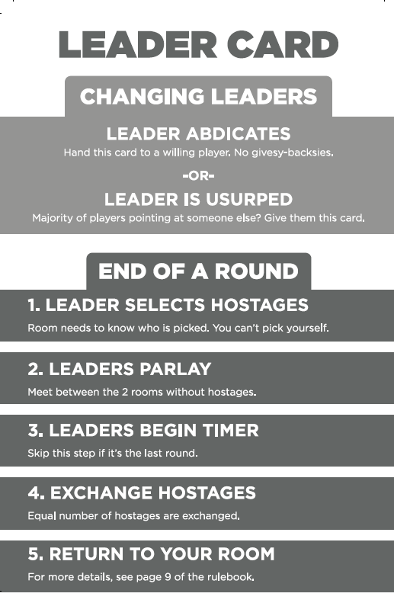

Slide 9
Game End:
The bomber explodes!
Everyone in the room with the bomber dies
If the President dies, the red team wins.
If the President is in the other room, the blue team wins

Slide 10
Sharing Information:
You can ask/tell information
You can choose to show your color and/or role
You can’t talk to the other room

Slide 12
Additional Roles:
Angel
You must tell the truth

Slide 13
Additional Roles:
Demon
You must lie.

Slide 14
Additional Roles:
Spy
Blue card, but Red team
Red Card, but Blue Team

Slide 15
Additional Roles:
Agent
Each round, you can force a player to show their card to you.

Slide 16
Additional Roles:
Zombie
Whoever looks at your card becomes a zombie.
(All survivors must be a zombie)

