Slide 1
“It’s always fun listening to someone’s lie when you already know the truth.”
- Anonymous

Slide 2
Would I Lie to You?

Slide 3
As a child, I was afraid of the sun.
https://www.youtube.com/watch?v=mKc32jQIY0w

Slide 4
I accidently bought a horse.
https://www.youtube.com/watch?v=B94q7gUu75k

Slide 5
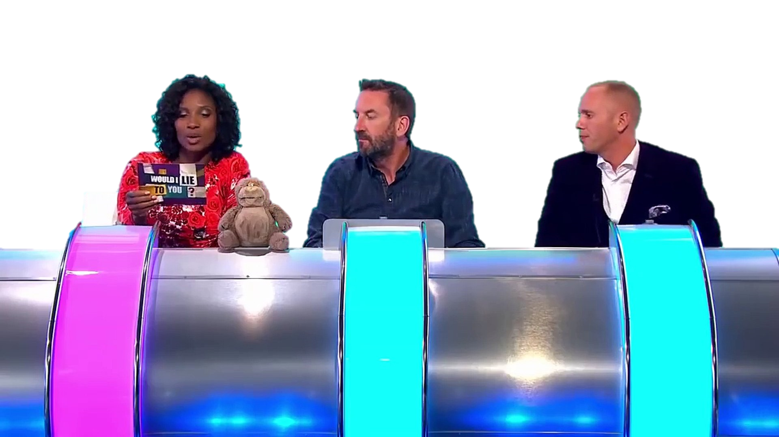
One person says a statement.

Slide 6
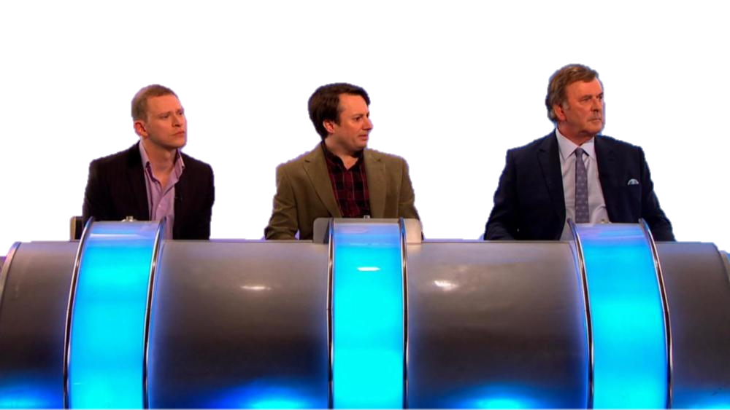
The other team can ask questions.

Slide 7
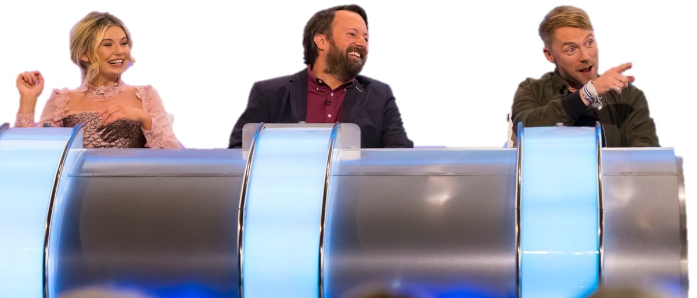
Guess if it is a lie or the truth.

Slide 8
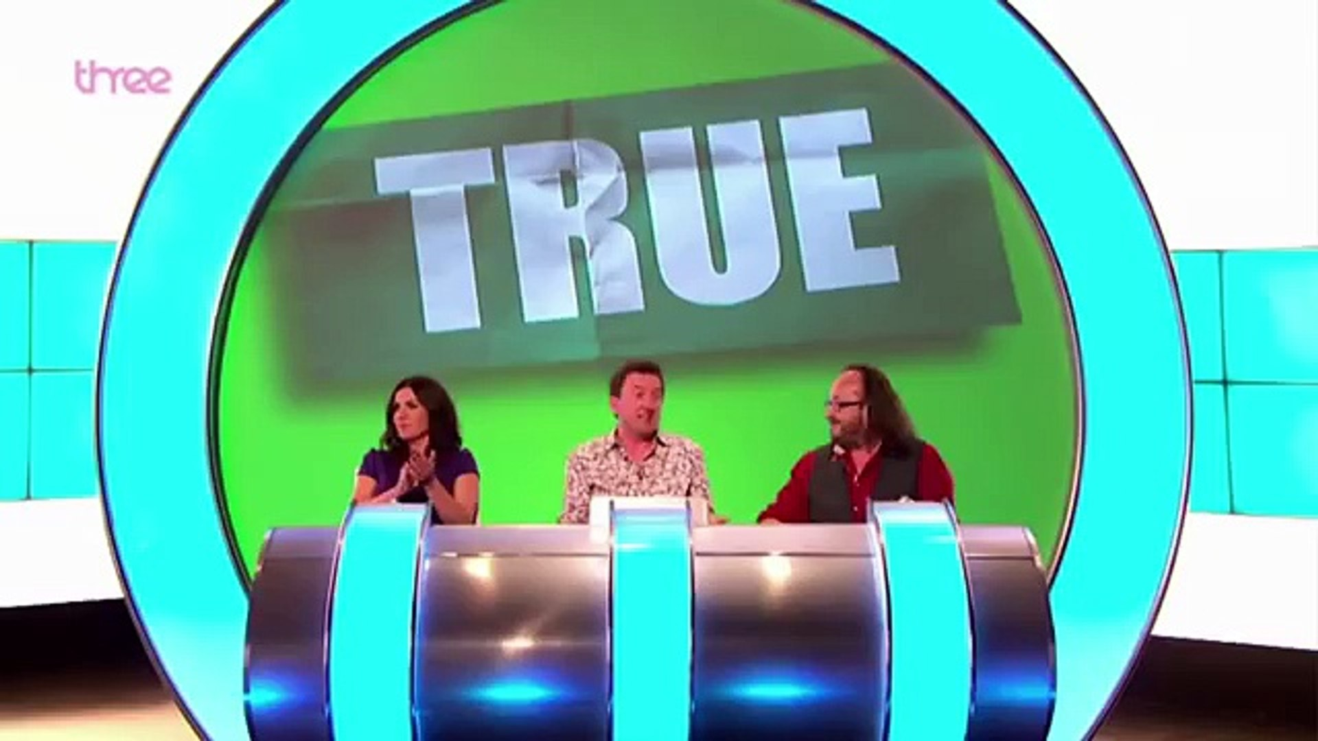
Reveal the answer.

Slide 9
One team:
In the hall, decide who will lie or tell the truth.
At least 2 truths and 2 lies
Come back in, other teams can ask questions.

Slide 10
Would I Lie to You?

