Slide 1
Interest Theory
Application to the classroom

Slide 3
Interest is influenced by:
Content, objects, or events
Interaction with the environment
Cognitive (paying attention) and Affective (feelings) components
Unaware of their interests
Physiological / Neurological
Looks like reward in MRI

Slide 4
Types of Interest
Situational
Temporary
Environmental influence
Individual
Long lasting
Affective

Slide 5
Phases of Interest (Hidi & Renninger)
Situational
1. Triggered situational interest
2. Maintained situational interest
Individual
3. Emerging individual interest
4. Well-developed individual interest

Slide 6
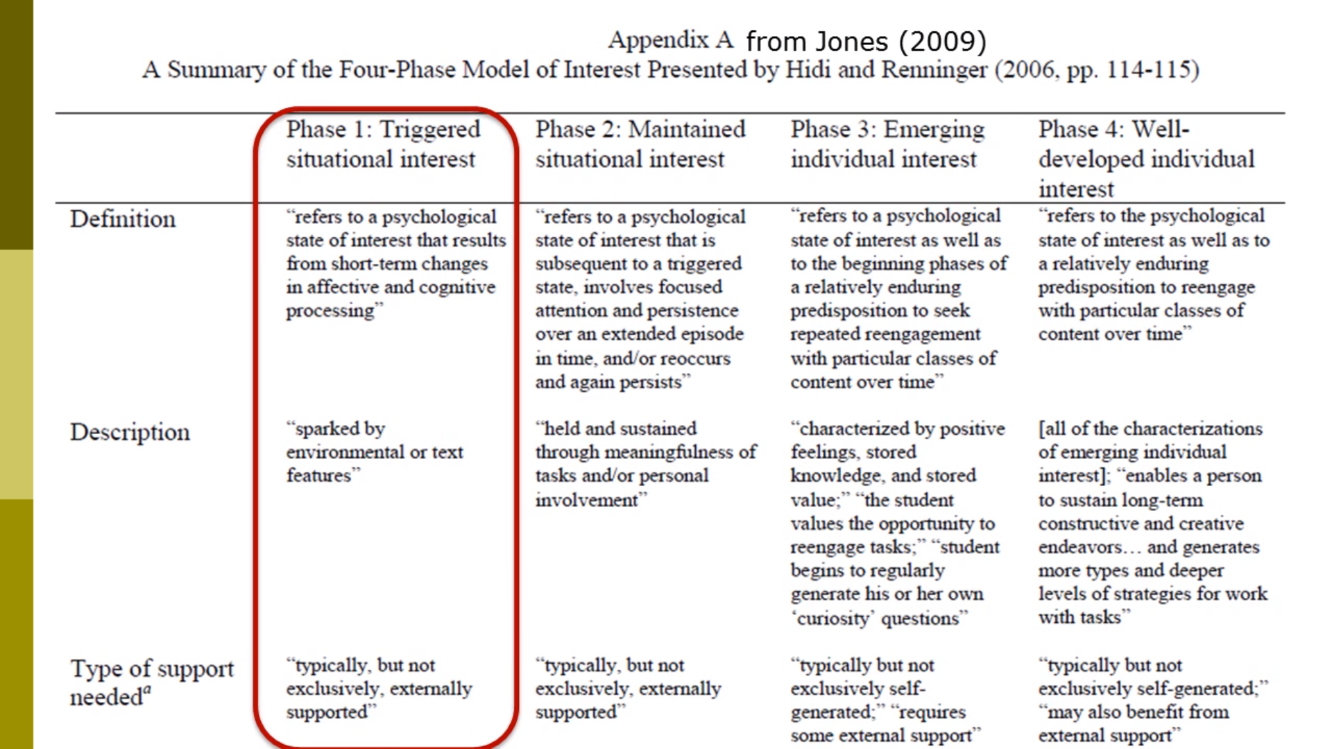
Summary of Phases (Jones, 2009)
https://www.youtube.com/watch?v=mTWo1nlPz1M

Slide 7
Triggered Situational Interest
Externally supported
Temporary

Slide 8
Maintained Situational Interest
Focused attention
Extended period of time
Persists or reoccurs
Meaningful
External influence

Slide 9
Emerging Individual Interest
Enduring
Repeated engagement
Positive feelings
Knowledge and value
Curiosity questions
Transition to self-motivated

Slide 10
Well-Developed Individual Interest
Reengage over time
Deeper strategies
Creative endeavors
Self-motivated

Slide 11
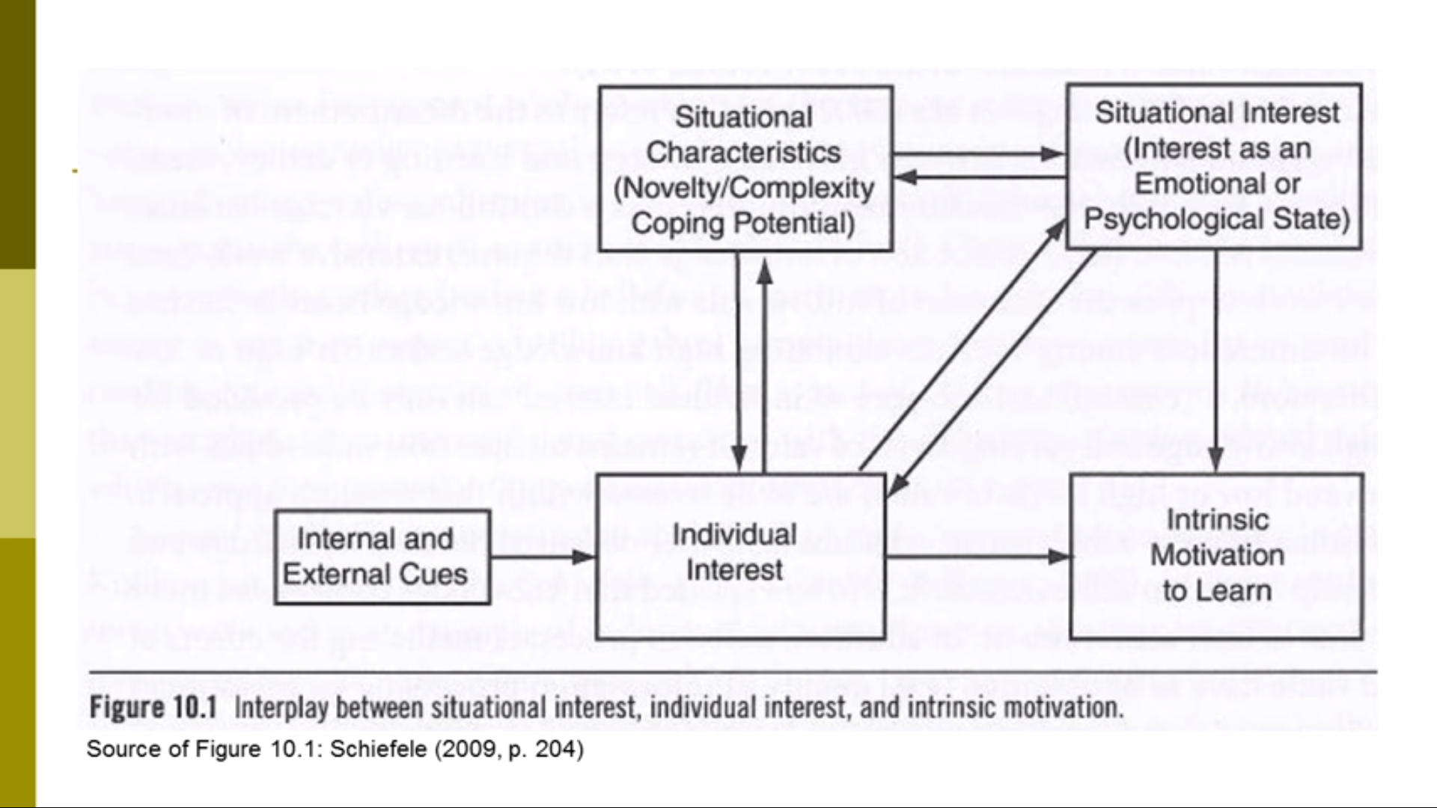
https://www.youtube.com/watch?v=mTWo1nlPz1M

Slide 12
Stimulating Interest

Slide 13
Uninterested Students
Design environment to motivate to learn
What are some ways to get students interested?

Slide 14
Include (Bergin, 1999):
Novelty
Food
Humor
Social interaction
Games
Puzzles
Fantasy
Narrative
Physical activities
Content related to injury, sex, or scandal

Slide 15
Include:
Content related to students’ background knowledge and interests
Activities that include an emotional component
Vary your presentation style
Information that is surprising

