Slide 1
“It’s the show with hot wings and even hotter questions”

Slide 2
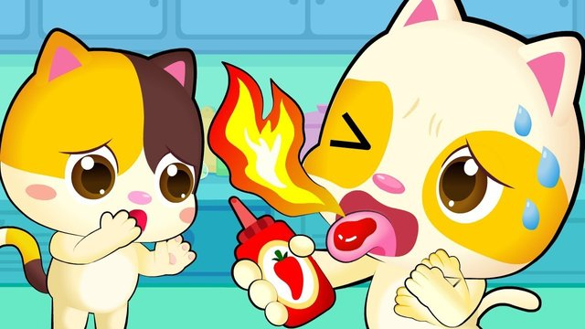

Slide 4
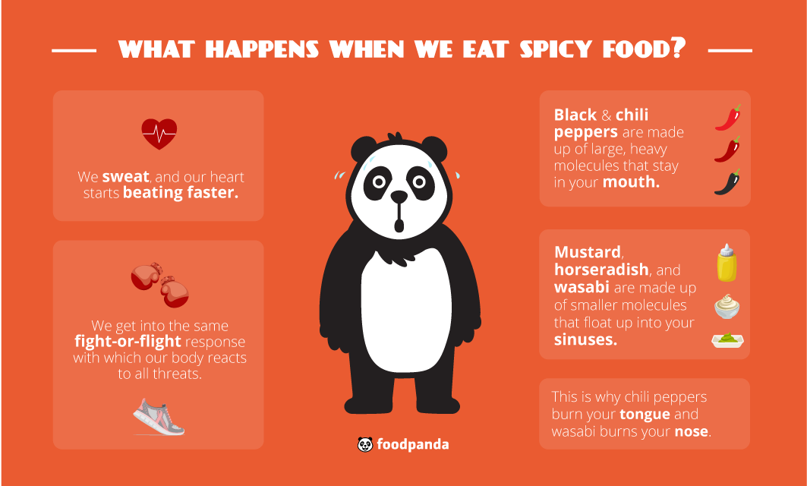

Slide 5
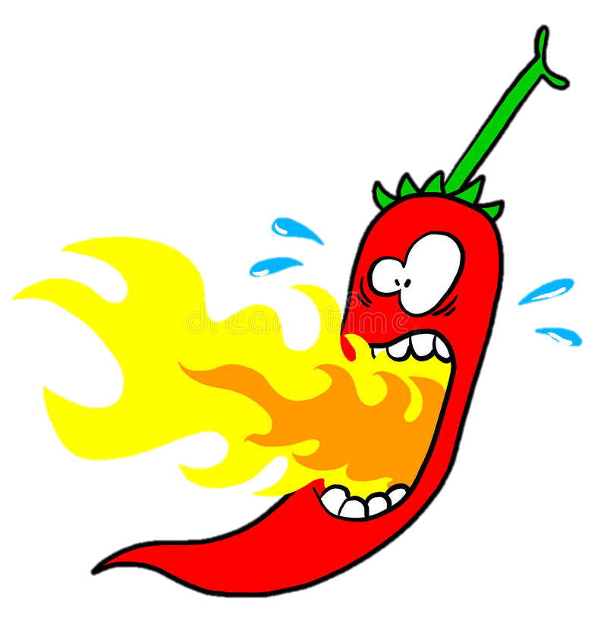
Warning
Don’t touch your eyes
Keep your mouth closed

Slide 6
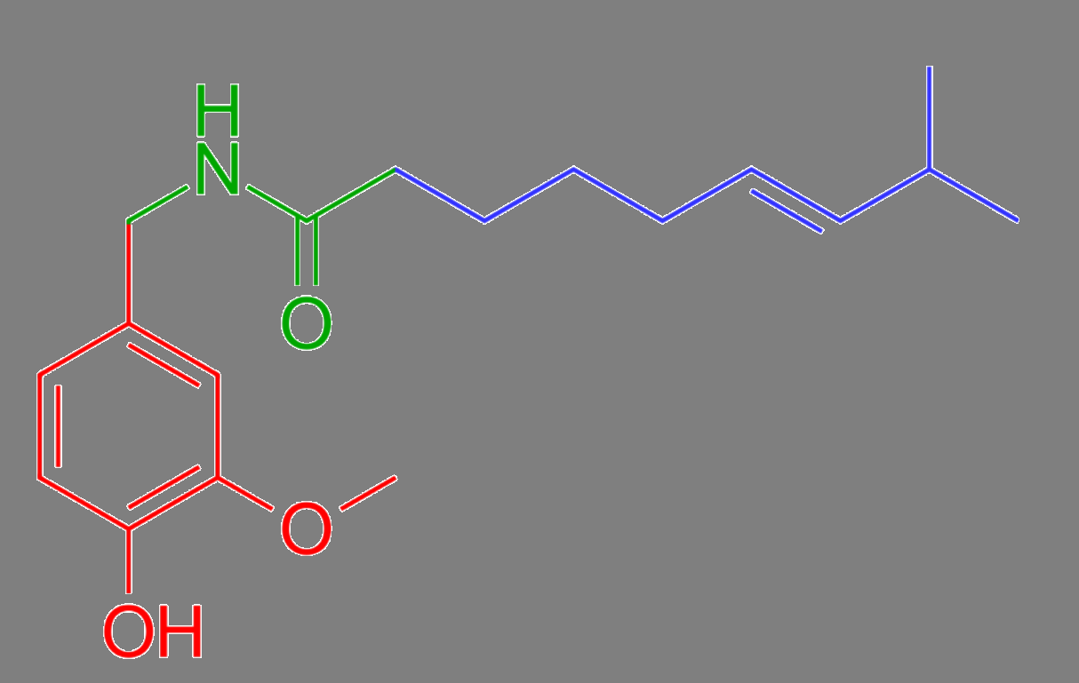
Capsaicin
Makes it spicy
Usually it doesn’t hurt us…
Makes us feel like burning
Alkaline Oil

Slide 7
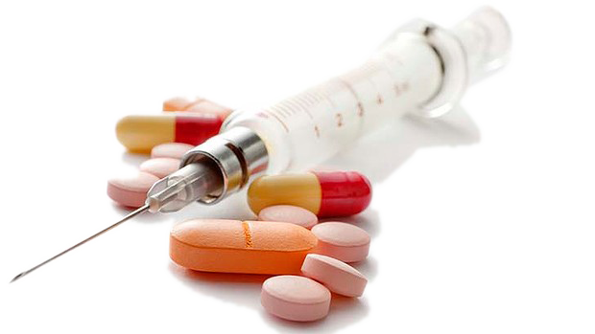
The Cure?
Milk
Bread
Lime juice
Honey
Peanut butter
Banana / Avocado

Slide 9
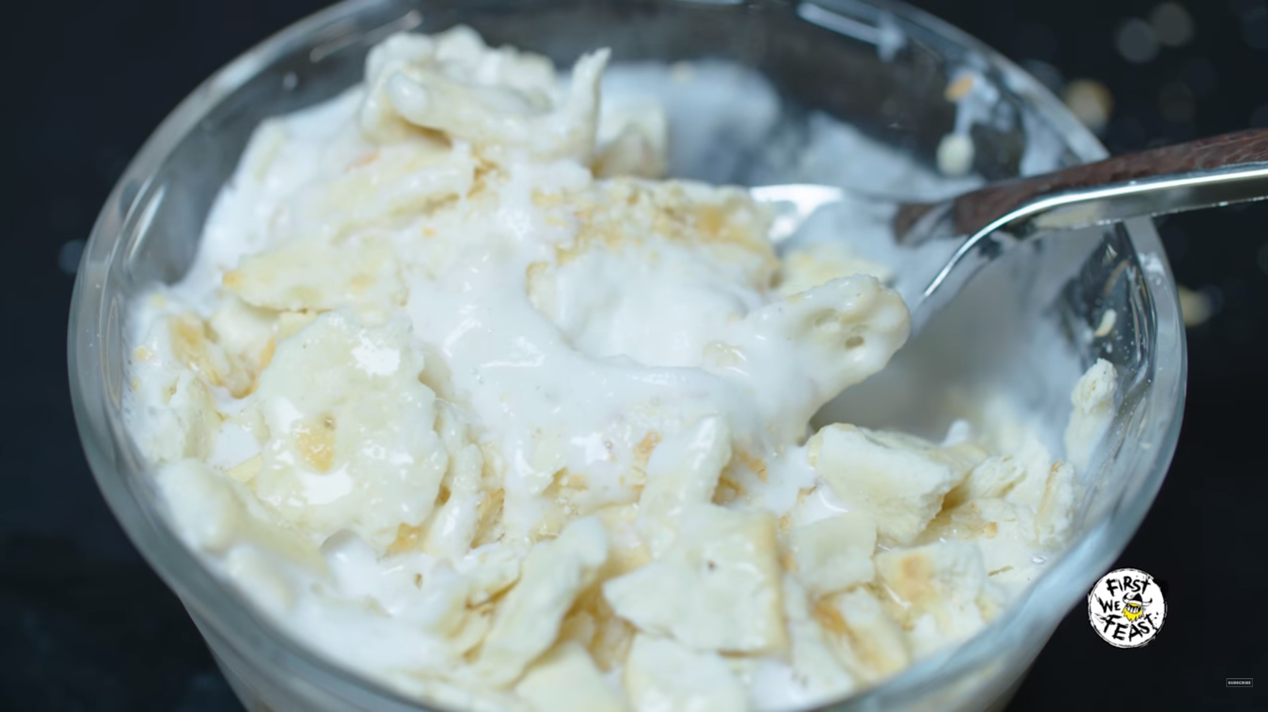
The Cure?
VSauce Solution
Gelato
Honey
Saltine crackers
Baby Shampoo

Slide 11
10 Questions
Something you really want to know
Perhaps afraid to ask before
Not accusatory

Slide 12
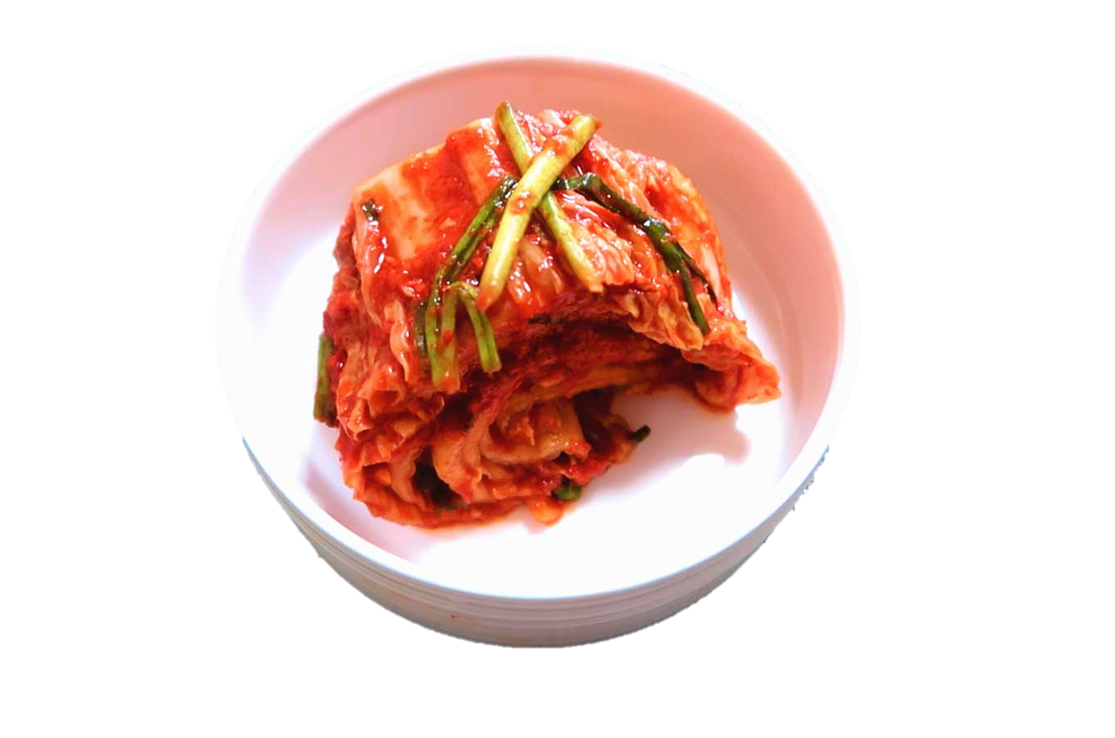

Slide 13
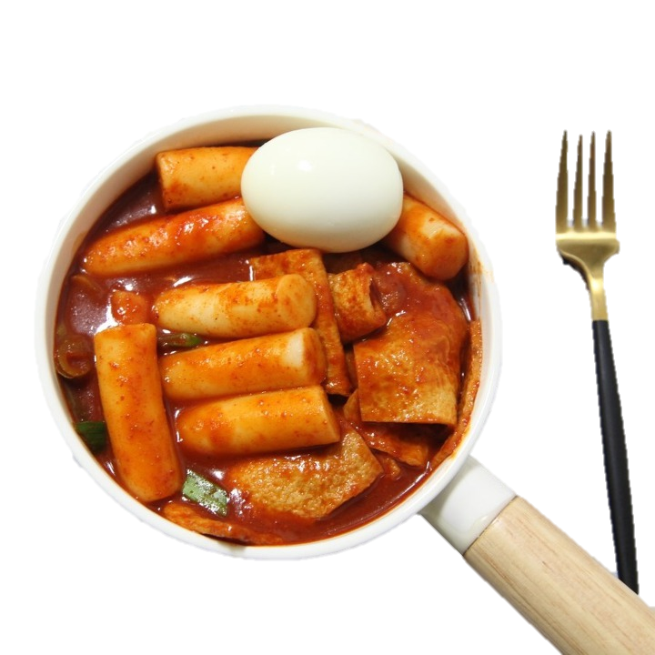

Slide 14
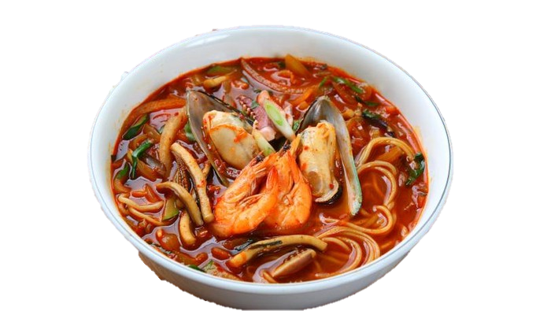

Slide 15
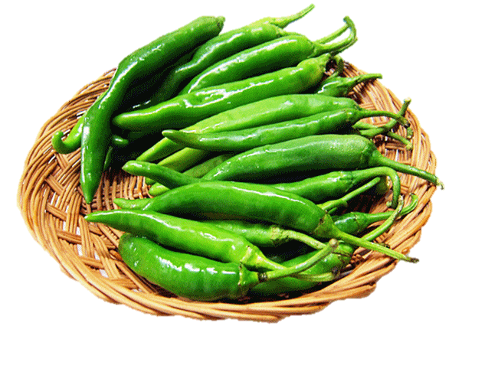

Slide 16
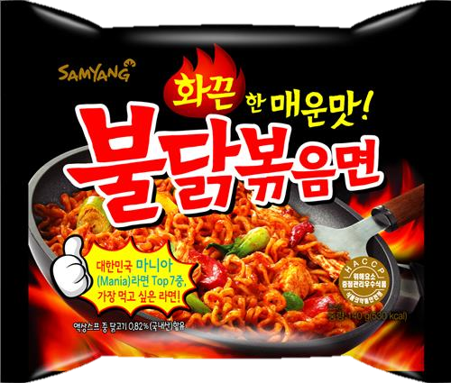

Slide 17
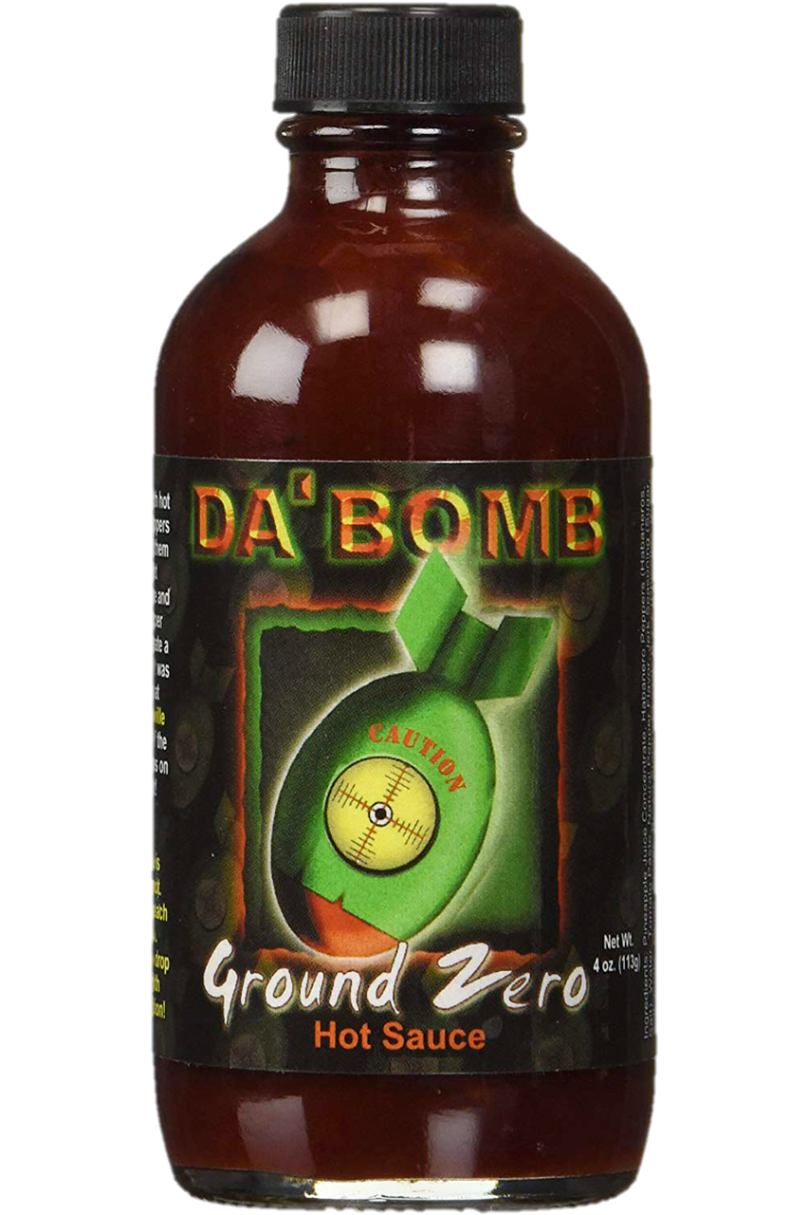
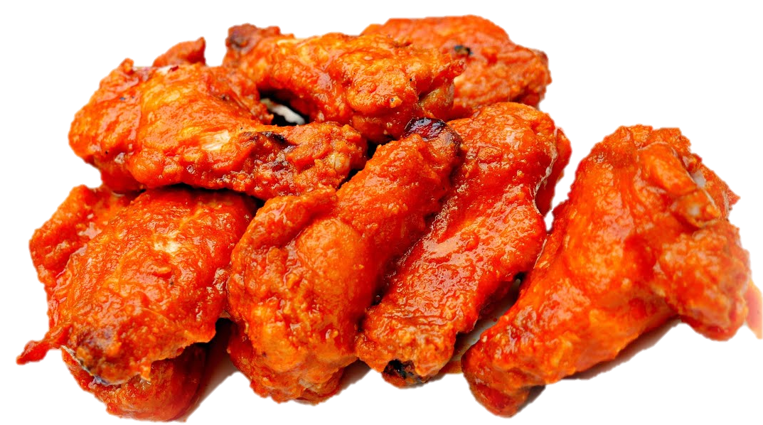

Slide 18
Vsauce and Sean Evans Test Spicy Food Remedies | Sean in the Wild
https://www.youtube.com/watch?v=GDEVOCTW4qk
Vsauce and Sean Evans Test Spicy Food Remedies | Sean in the Wild
https://www.youtube.com/watch?v=BvogZ88qRTk

