Slide 1
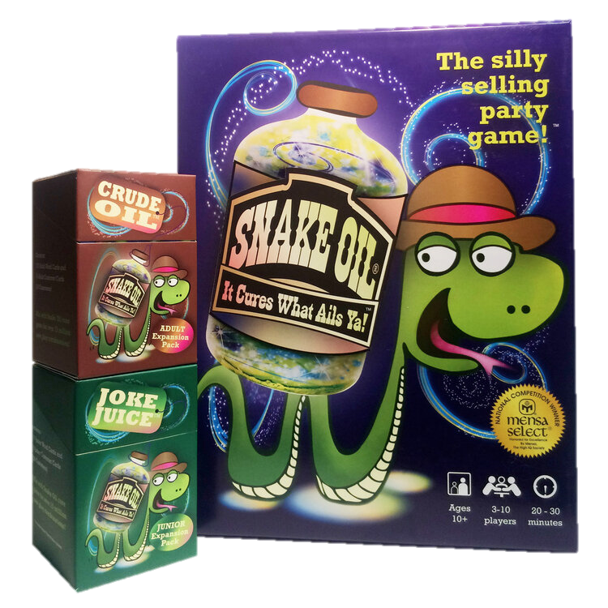
Snake Oil

Slide 2
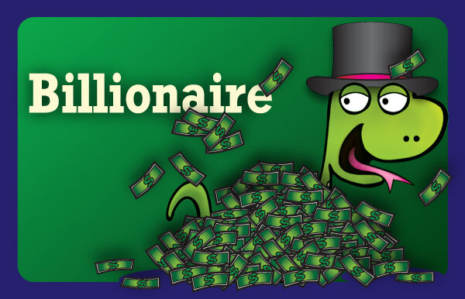
First player draws a card to select a customer ...

Slide 3
The other players create a 2-word product for that customer from their 7-card hands ...

Slide 4
Try selling the product.
It’s so hard for a billionaire to get away. Everybody wants your money.
Don’t you wish you could press a button and get away?
Now with the AMAZING Freedom Button, you have that power.
OMG! This is what you NEED!

Slide 5
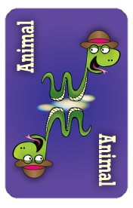
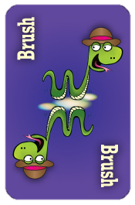
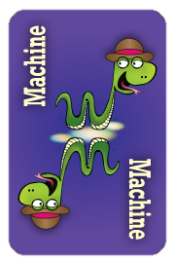
The customer chooses their favorite product.

