Slide 1
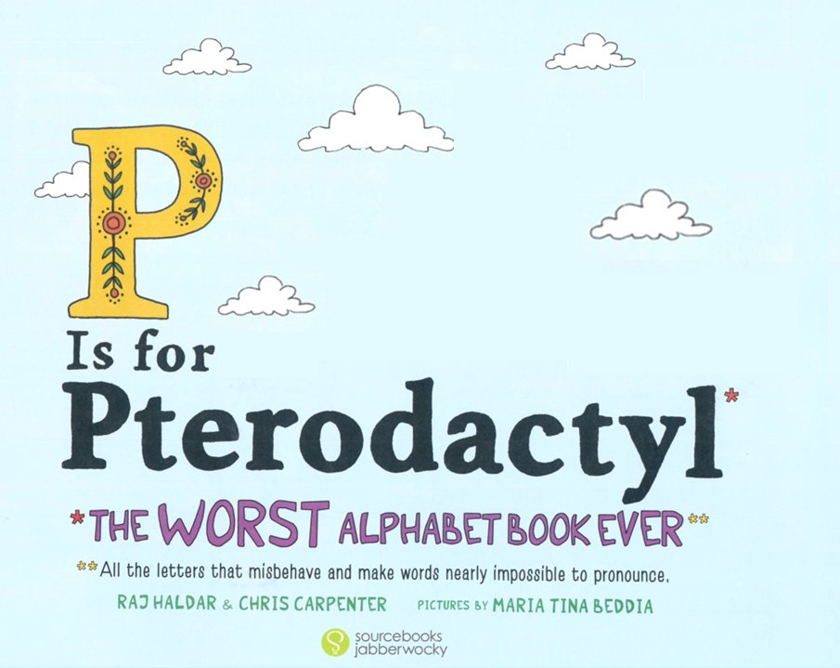

Slide 3
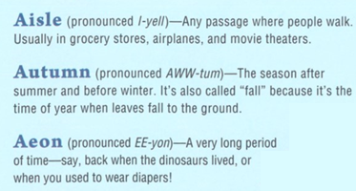
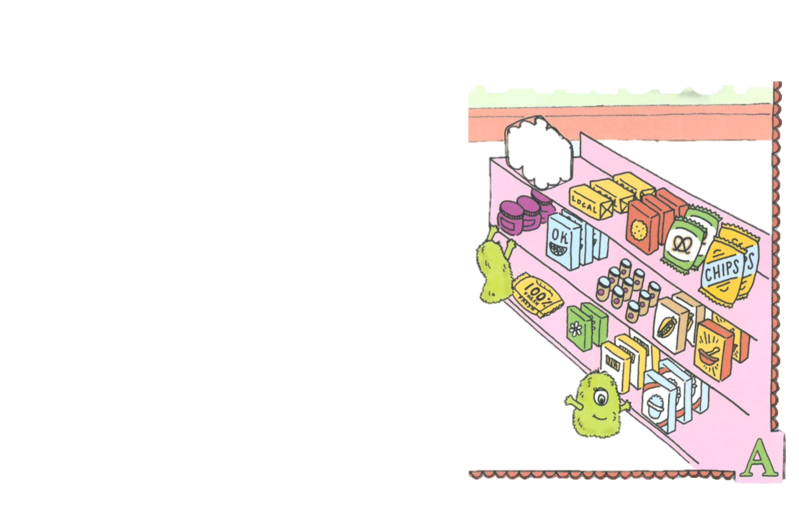
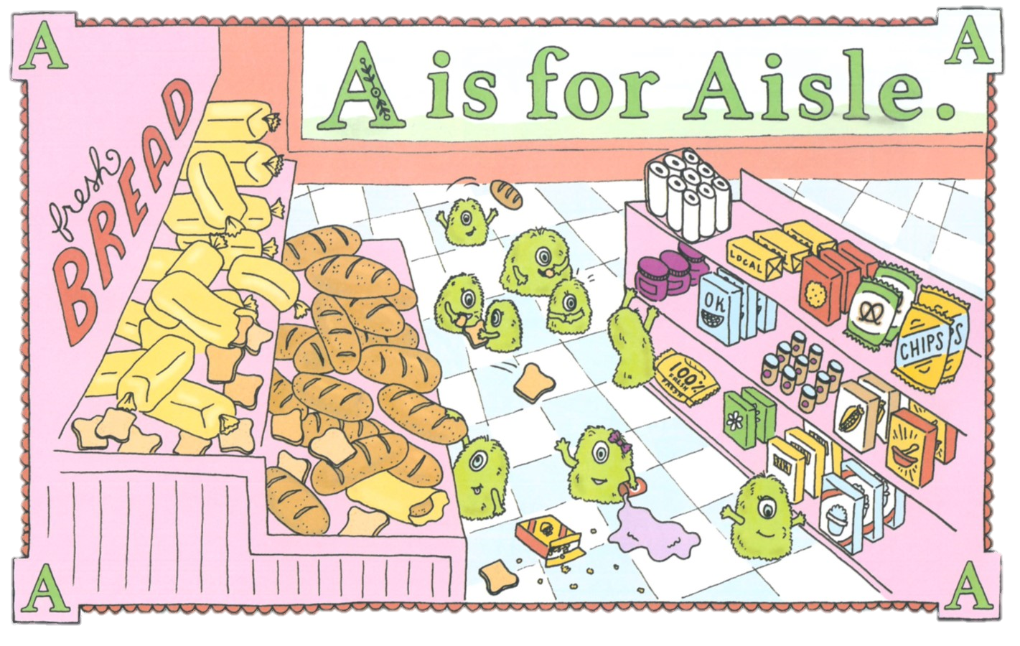
The bread aisle has not been cleaned in aeons, and nine tiny beasts meet to have a feast.

Slide 4
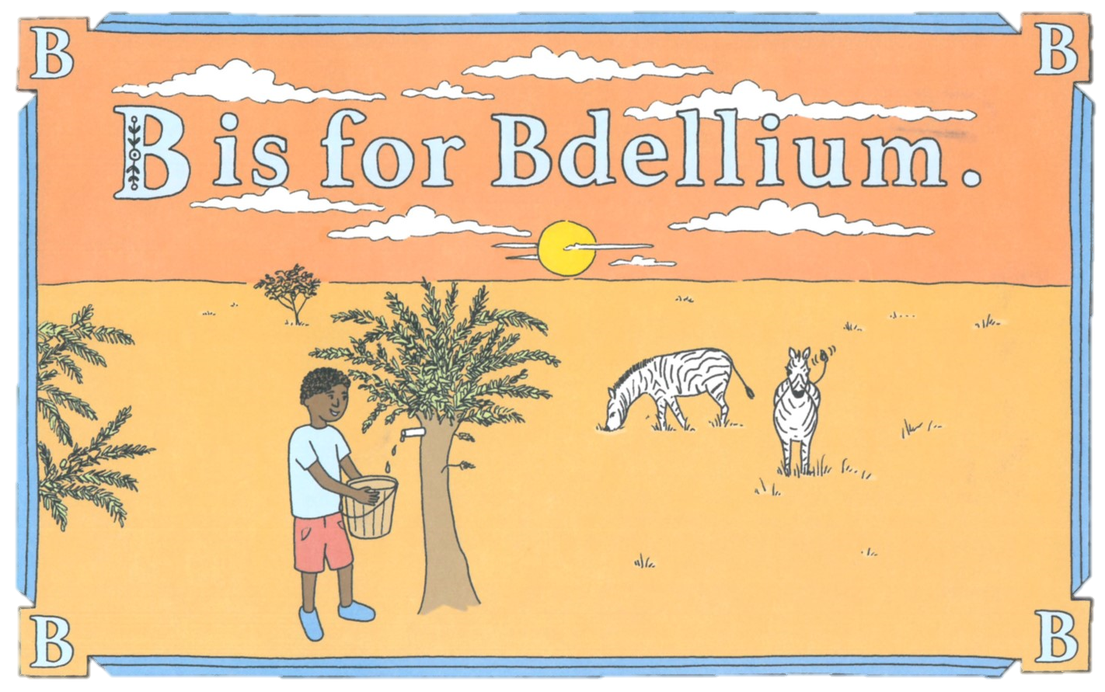
We doubt anyone knows what bdellium is, but it’s the only word dumb enough to begin with a silent B.

Slide 5
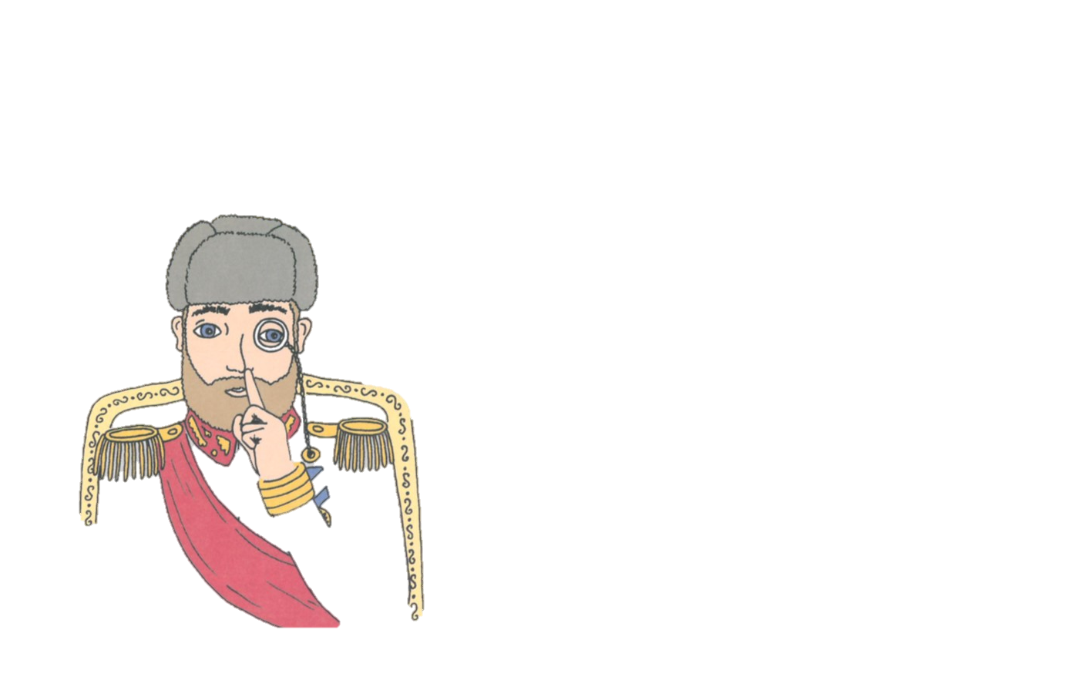
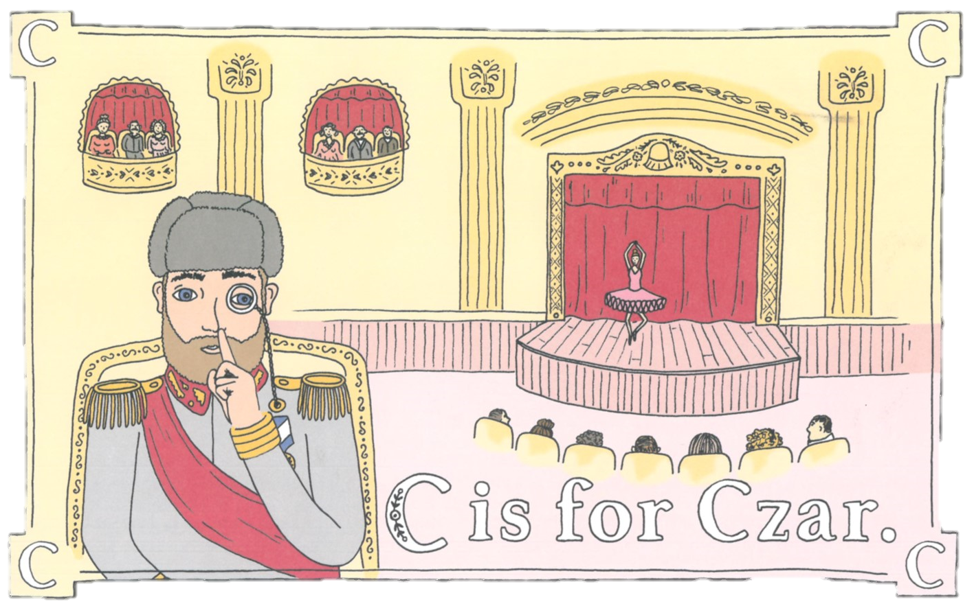
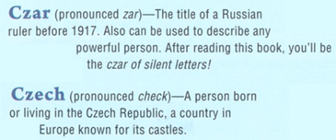
Shhh! The fascinating czar is secretly part Czech.

Slide 6
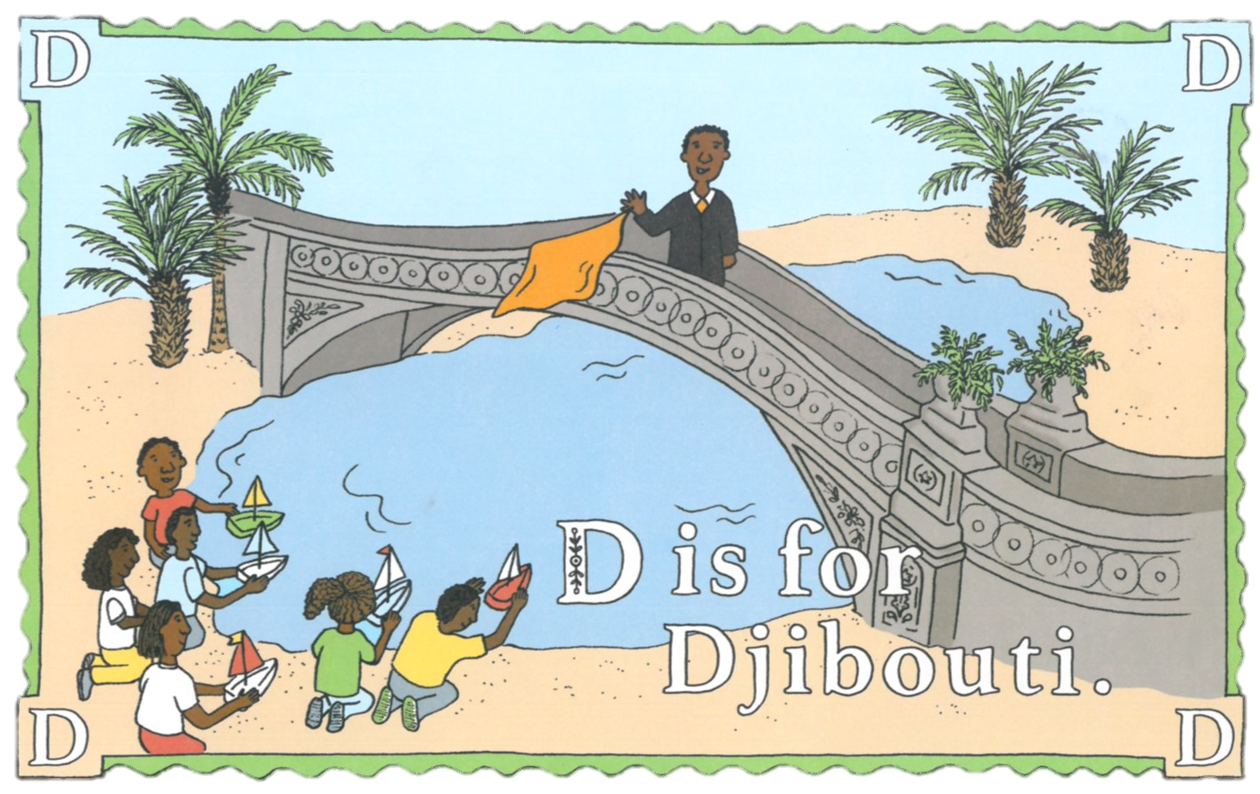
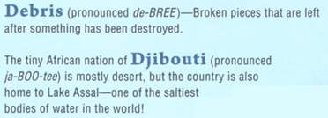
The boat race beings when the handsome judge from Djibouti drops his handkerchief from the bridge.

Slide 7
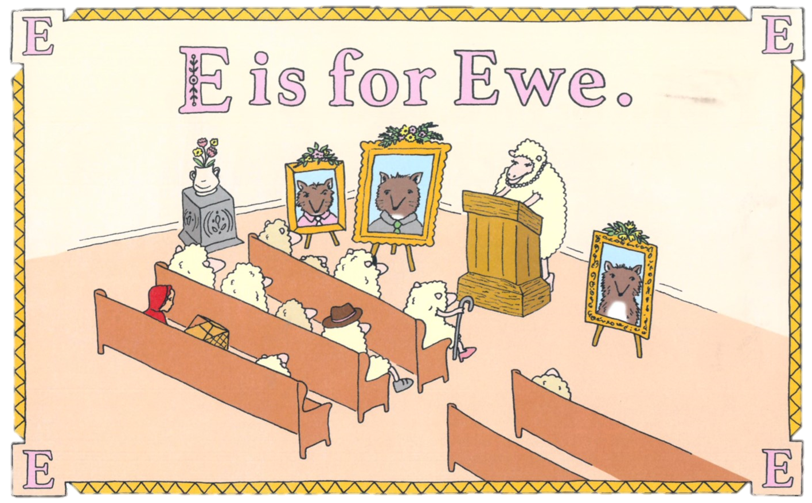
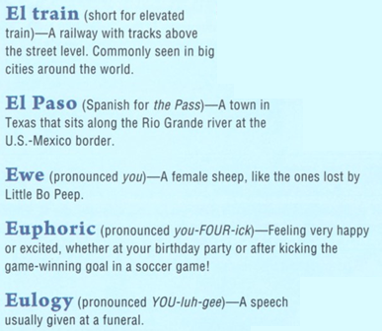
Eileen the ewe was so euphoric the wolves were eaten, she even gave the eulogy.

Slide 8
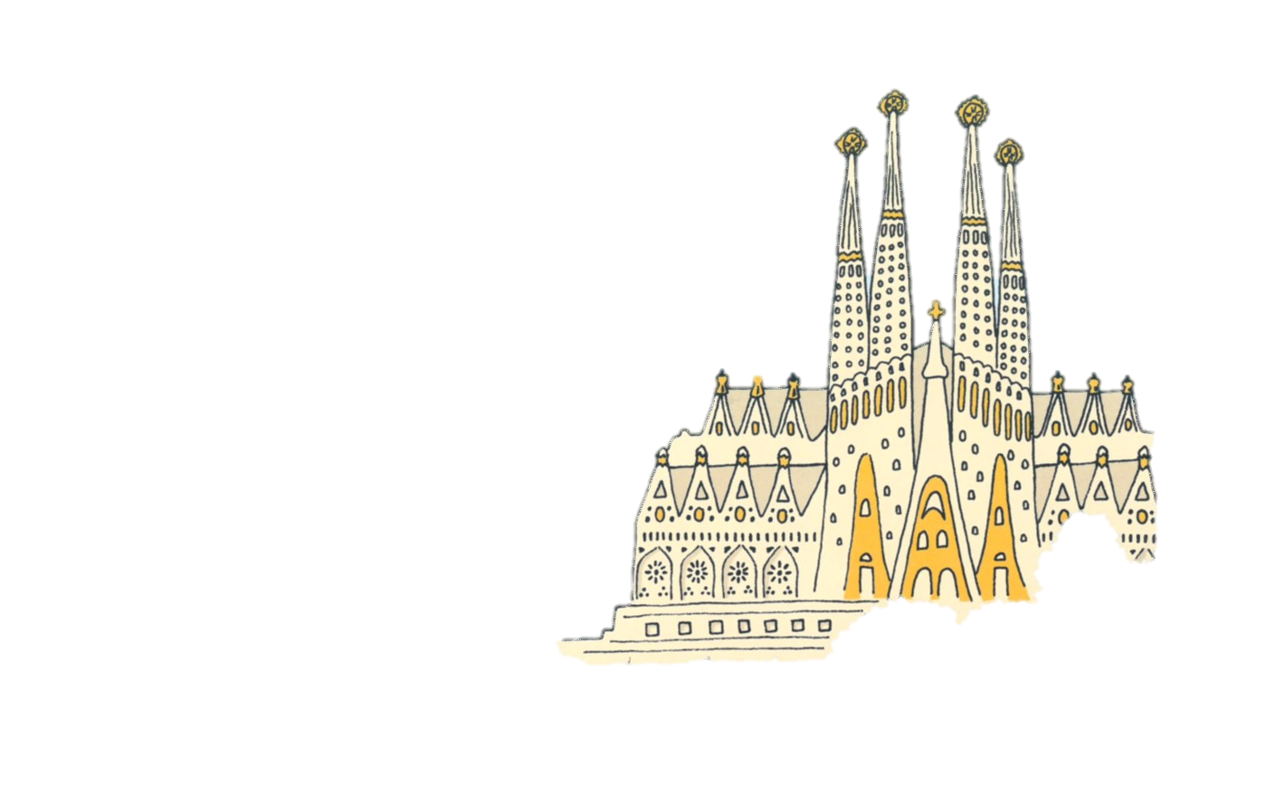
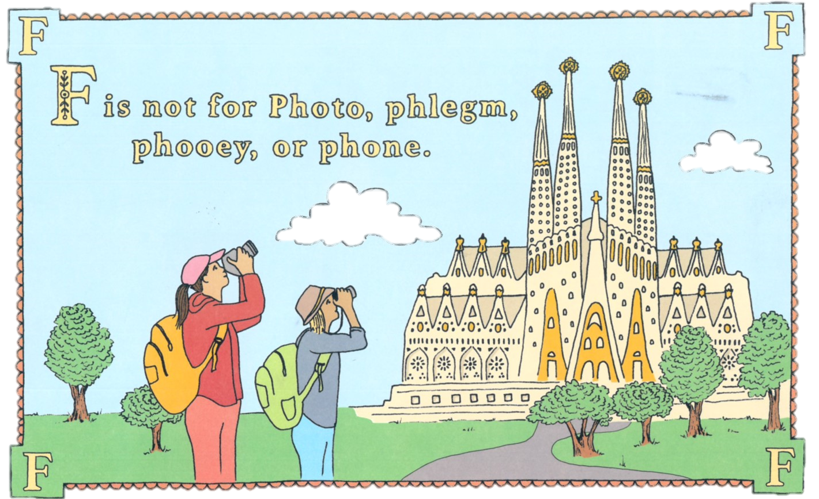
F is only for “foto” when you speak fluent Spanish at home!

Slide 9
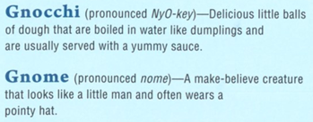
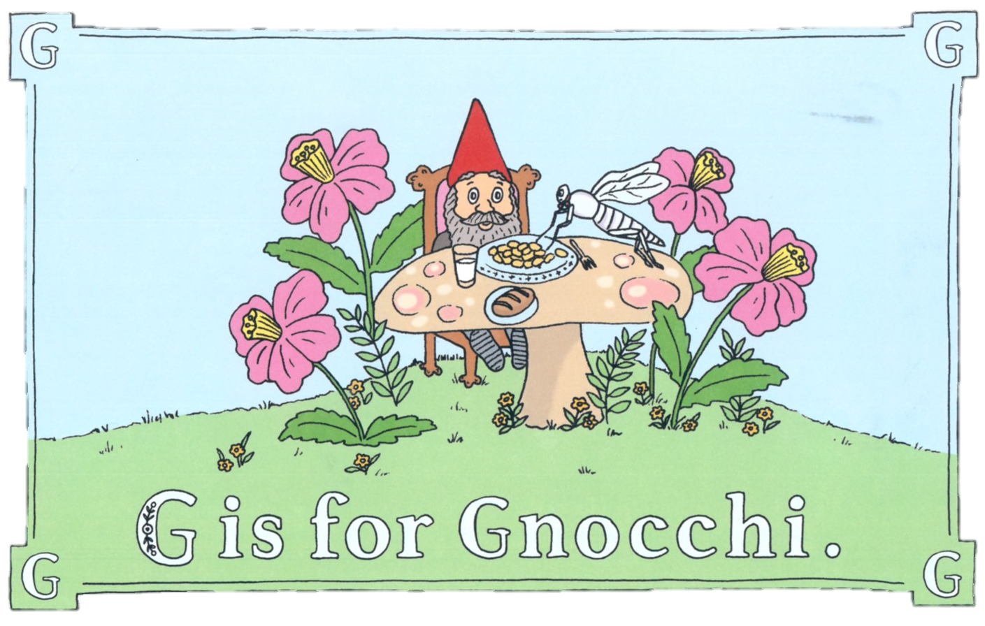
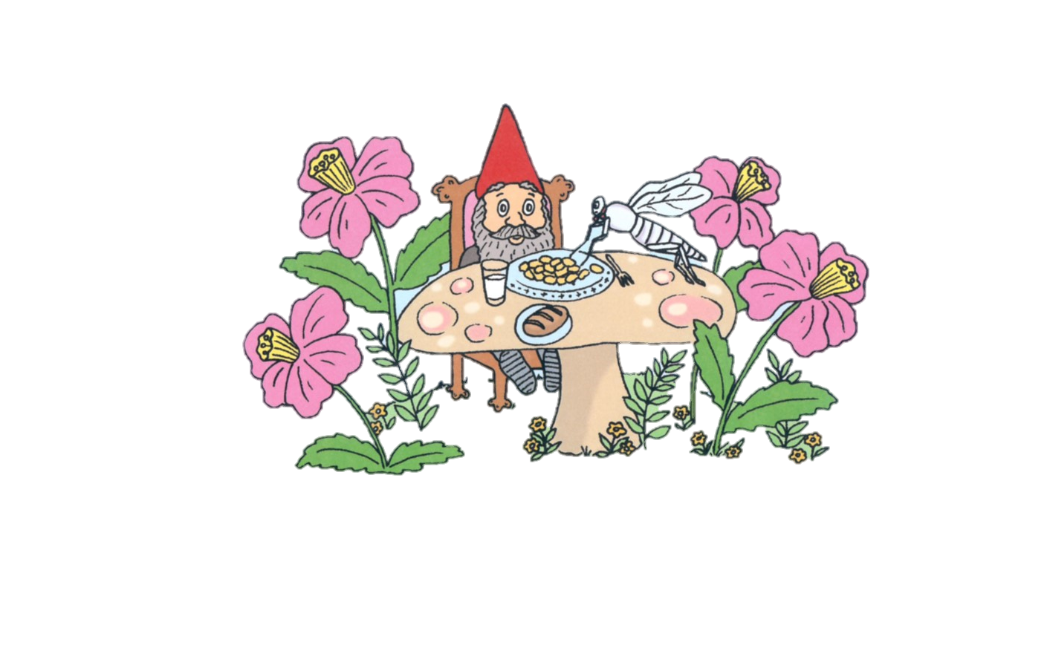
The gnome yells, “Waiter! There’s a bright white gnat nibbling on my gnocchi!”

Slide 10
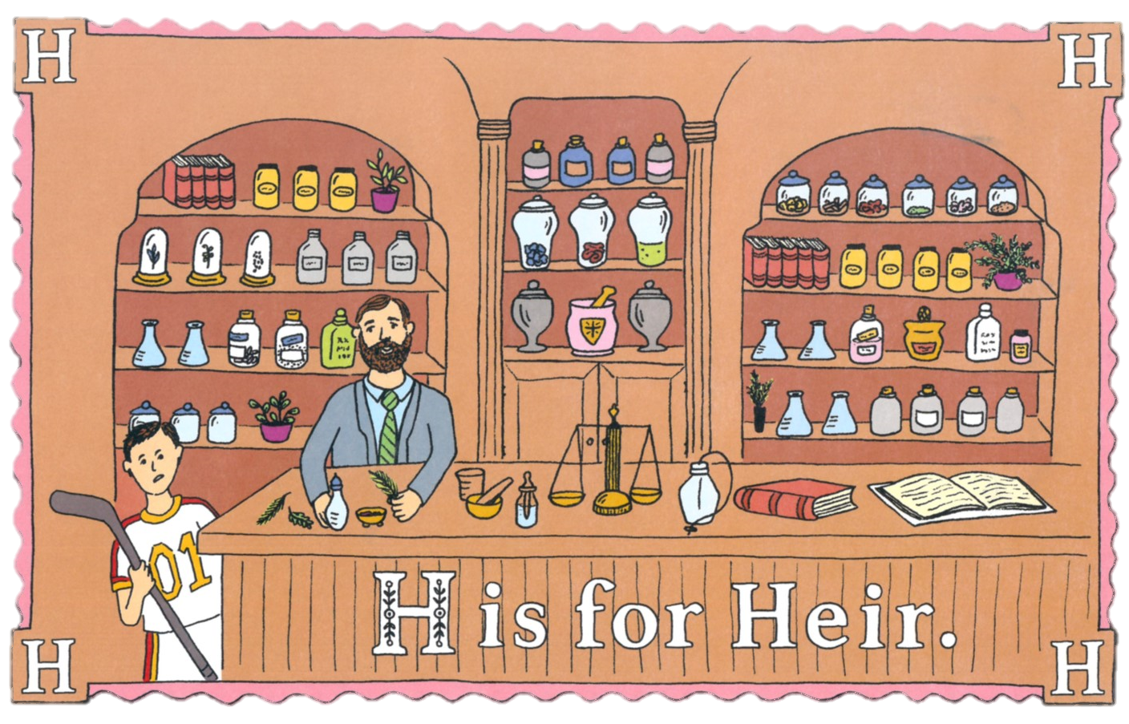
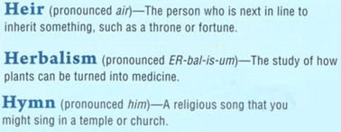
The honest heir admits that herbalism isn’t his cup of tea.

Slide 11
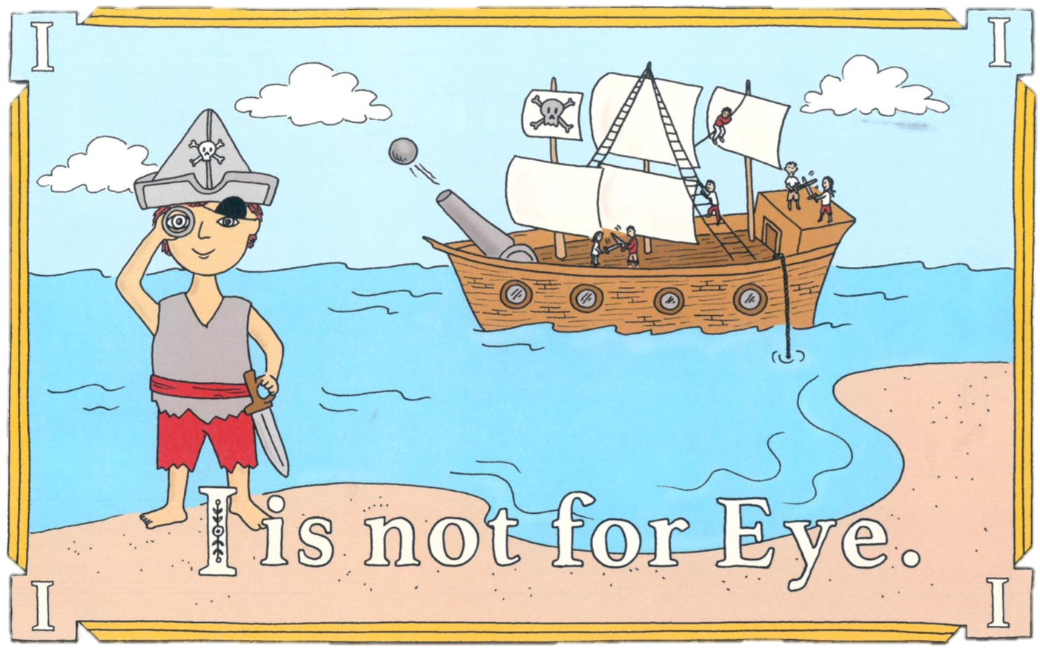
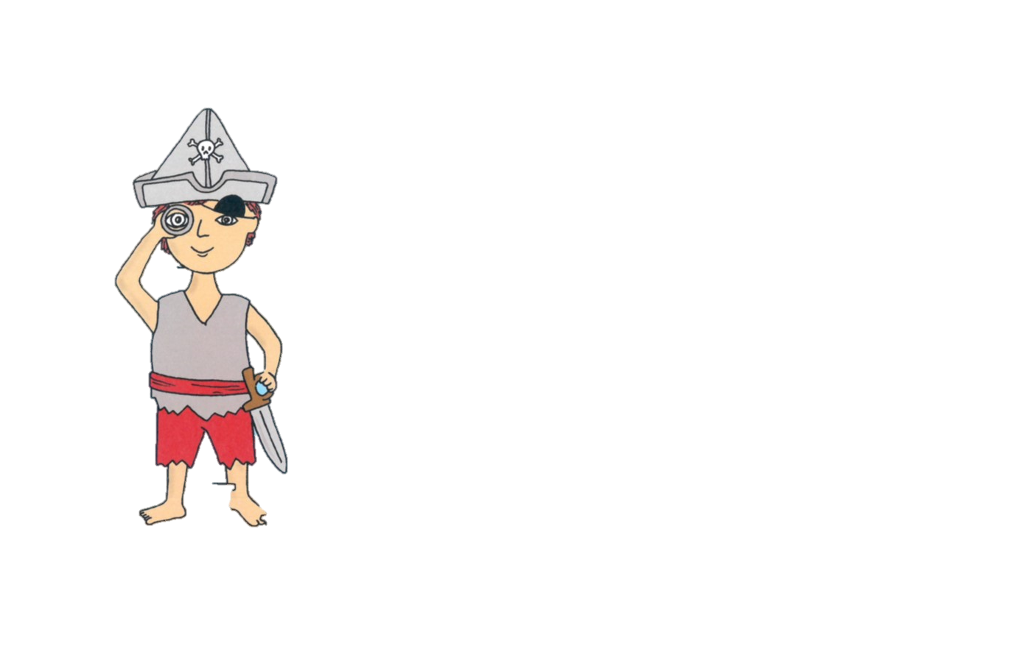
We asked the pirate if he has two eyes, and he said, “Aye, aye!”

Slide 12
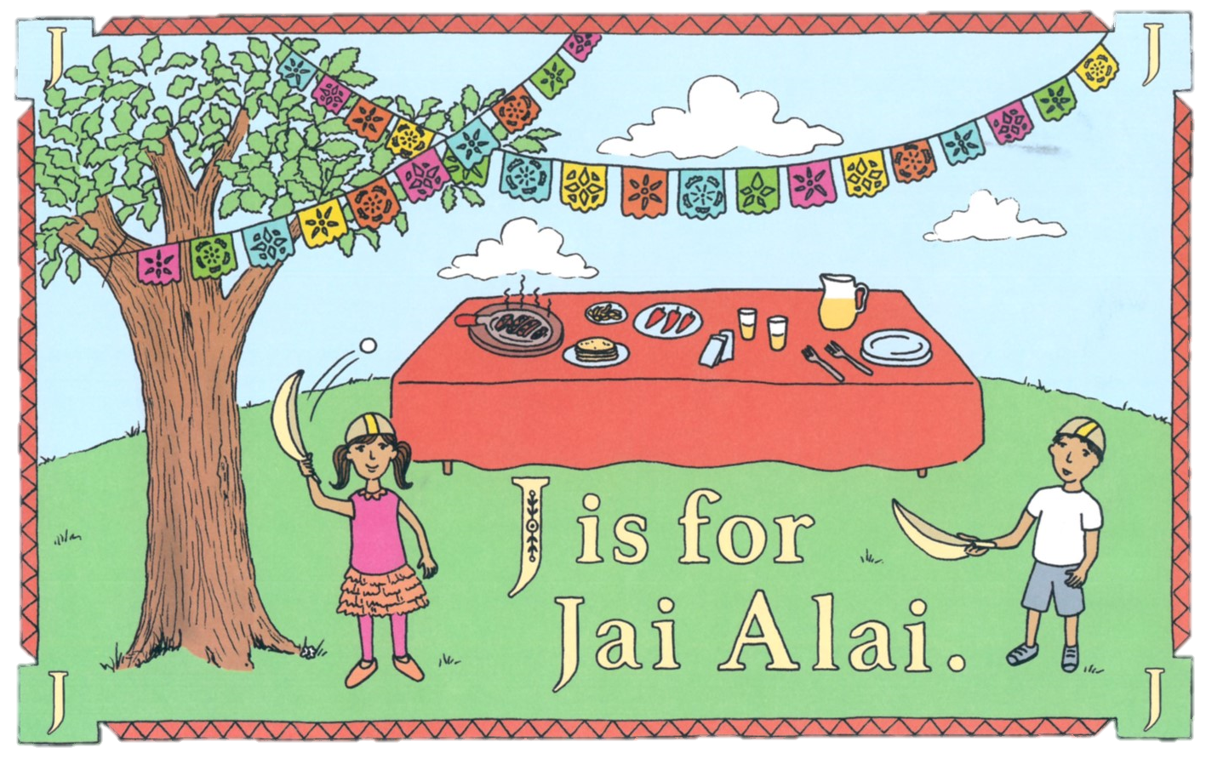
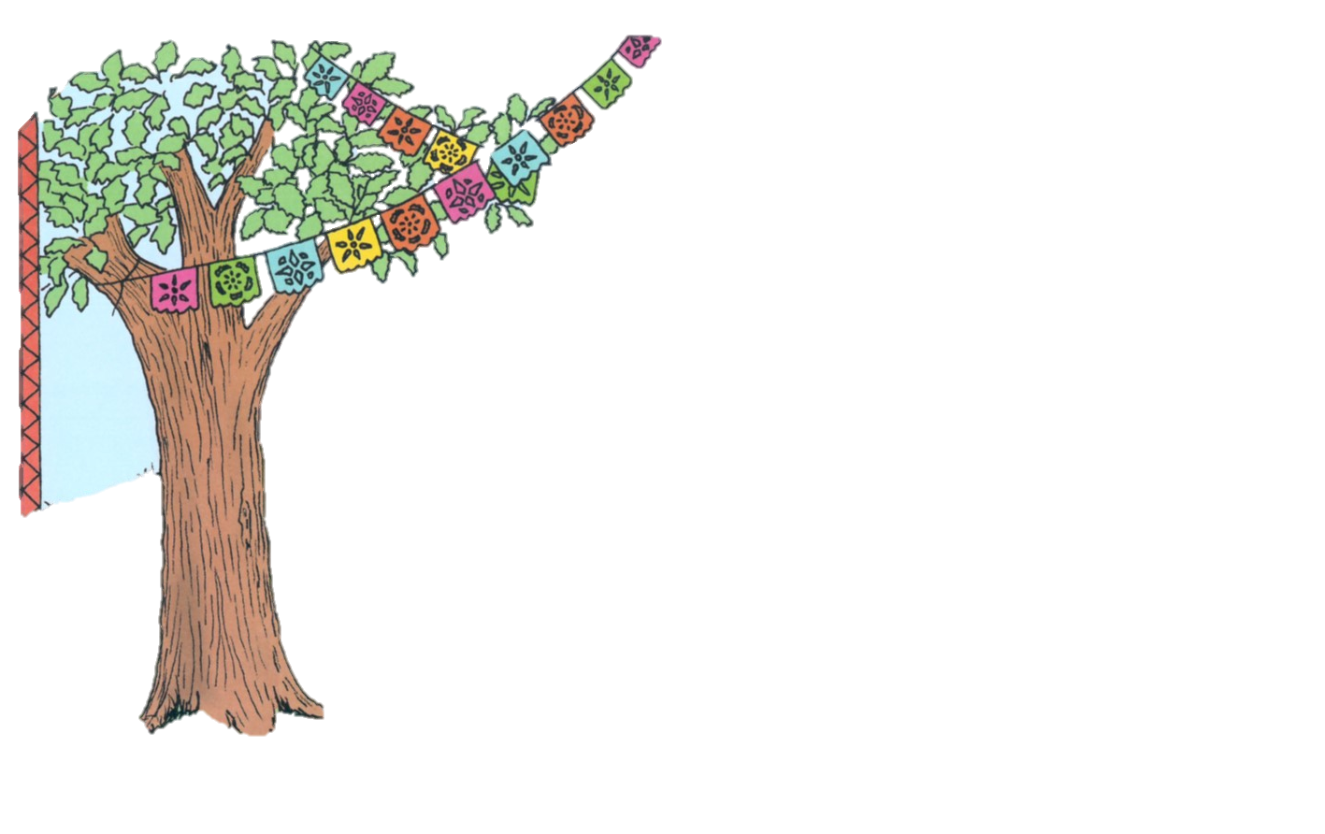
Juanita and Bjorn happily played jai alai before eating fajitas in Juarez.

Slide 13
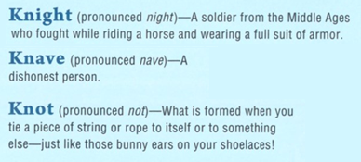
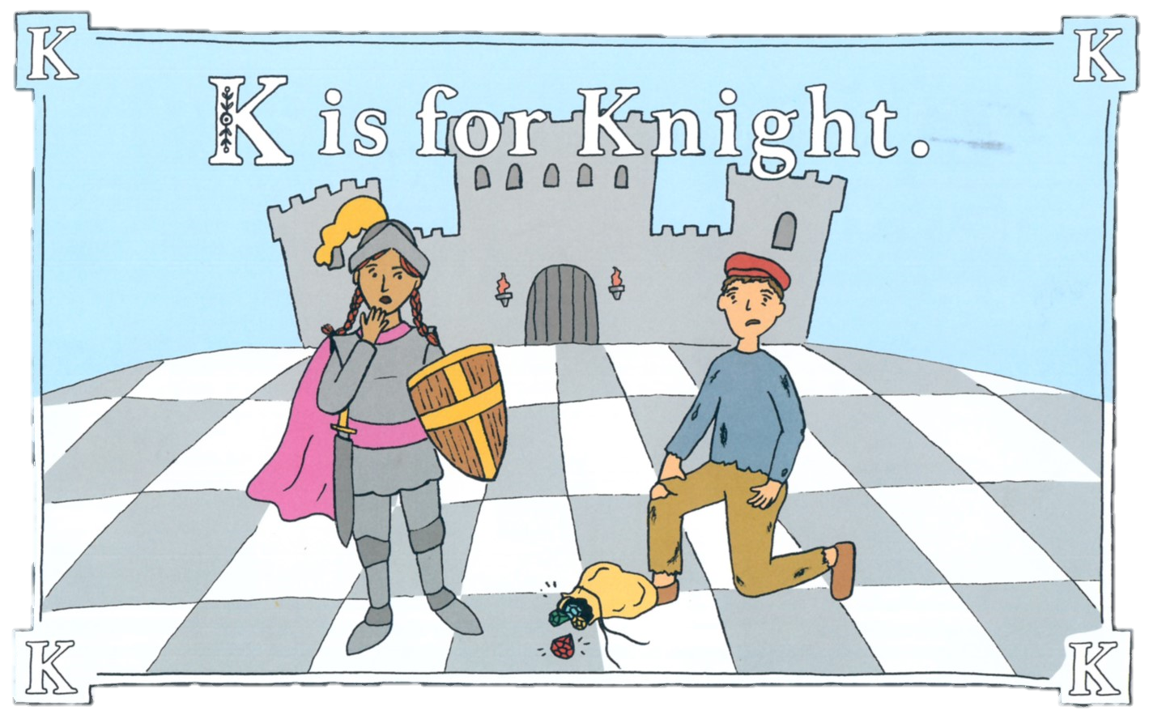
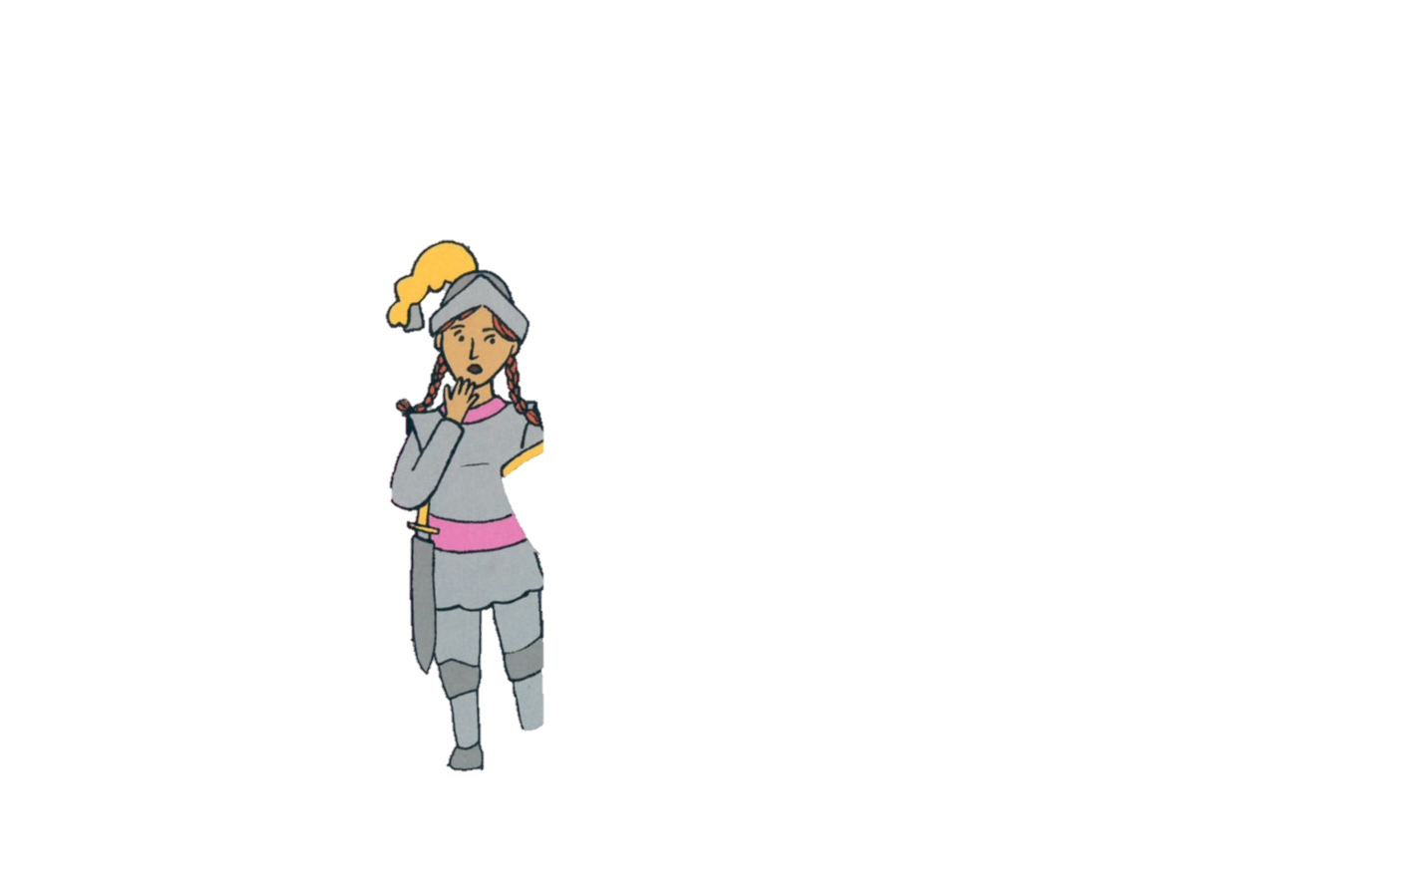
The noble knight’s knife nicked the knave’s knees.

Slide 14
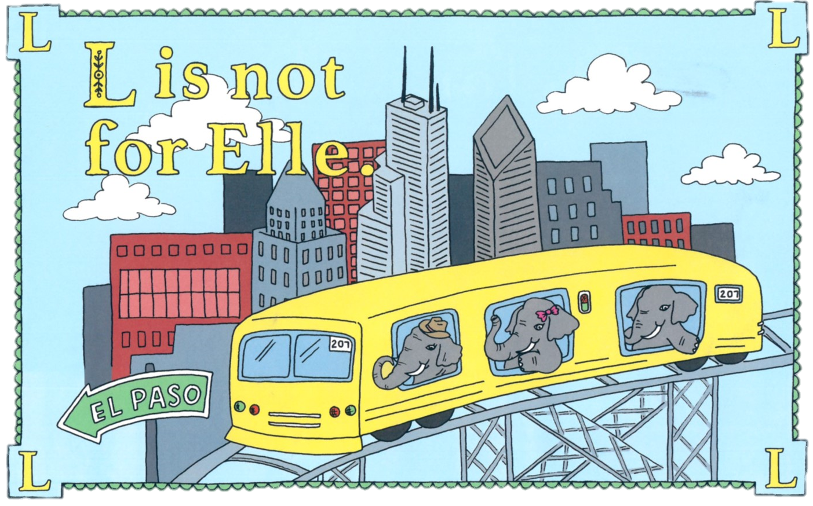
An elephant named Elle rode the el train halfway to El Paso and dined on hearts of palm with her folks.

Slide 15
But now Mr. M can’t remember why.

Slide 16
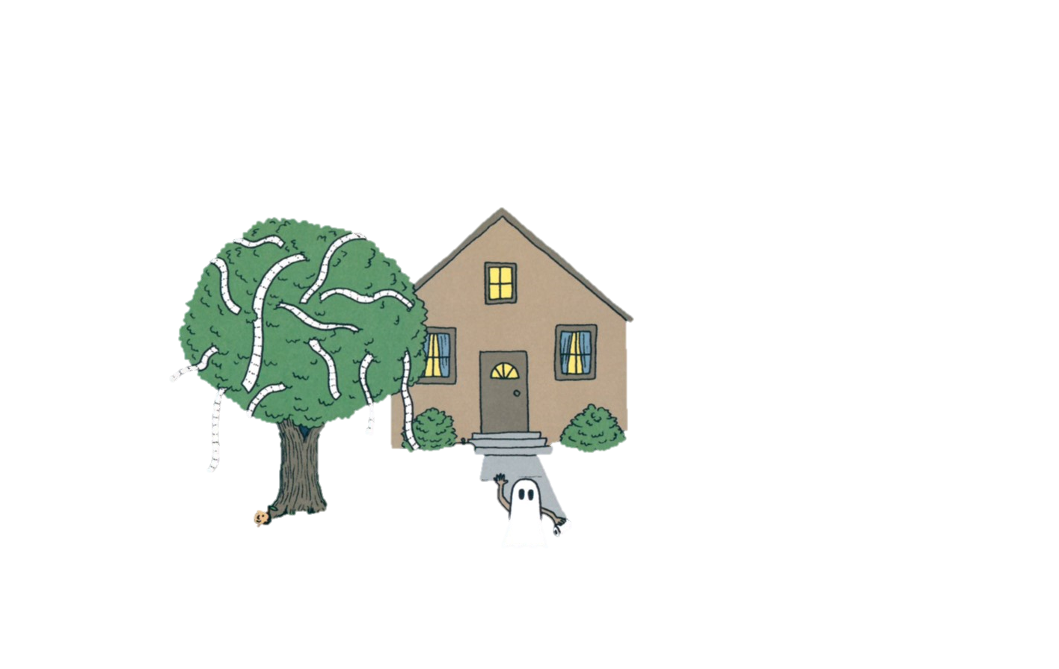
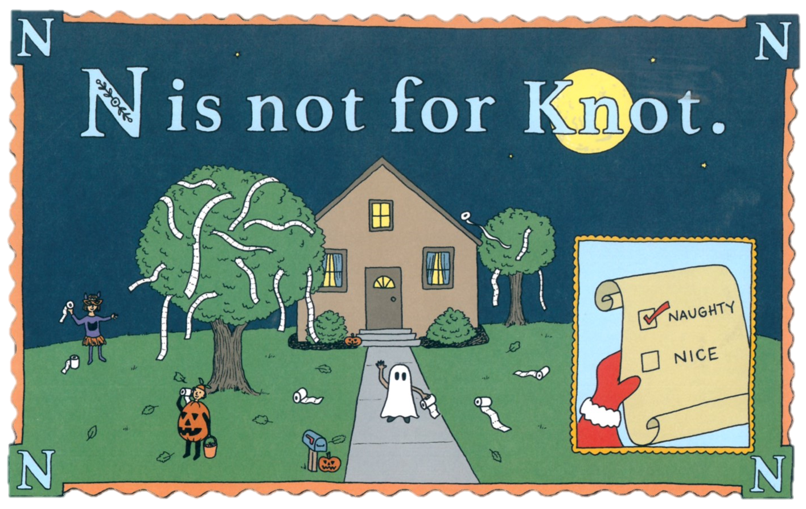
N is for naughty children who will sing a solemn hymn when autumn comes to an end.

Slide 17
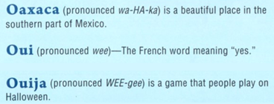
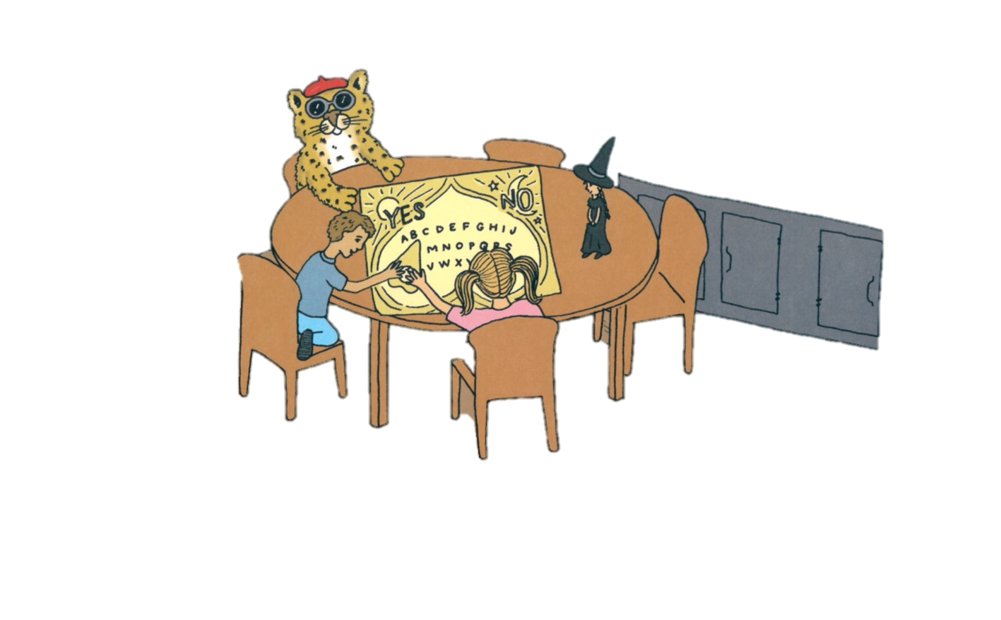
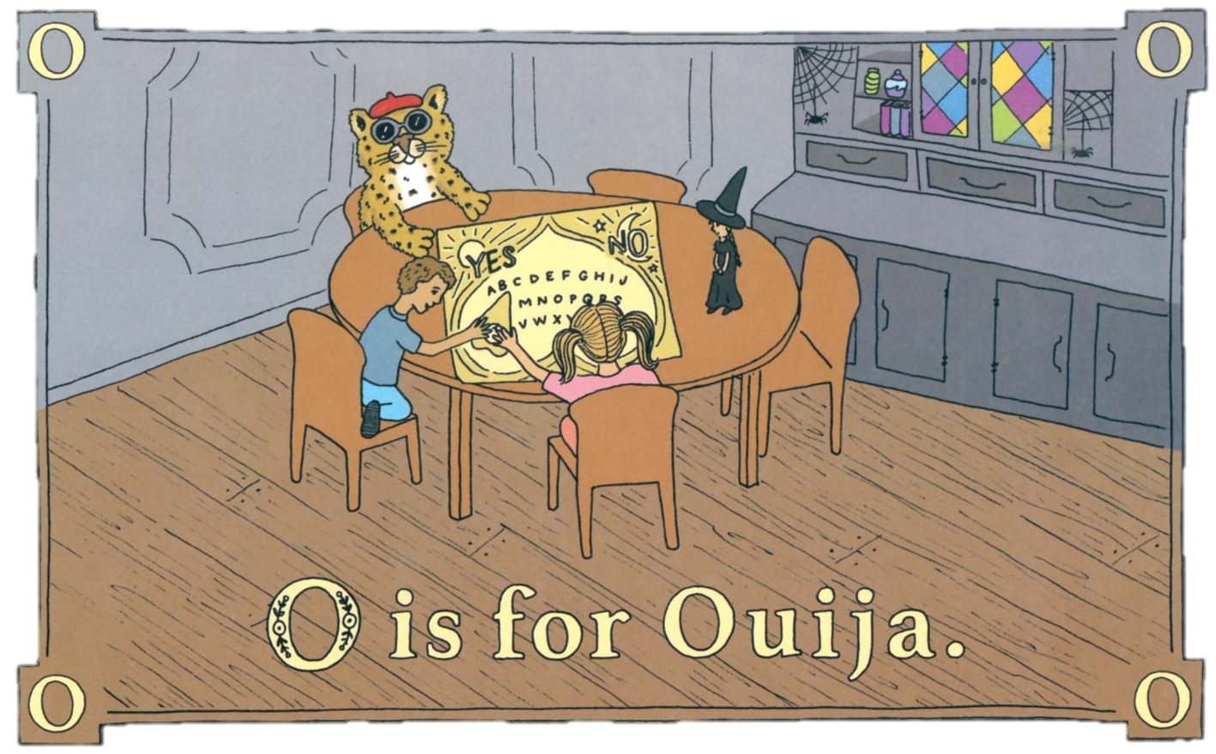
The French leopard says, “Oui! We’d love to play Ouiji with the wee witch from Oaxaca.”

Slide 18
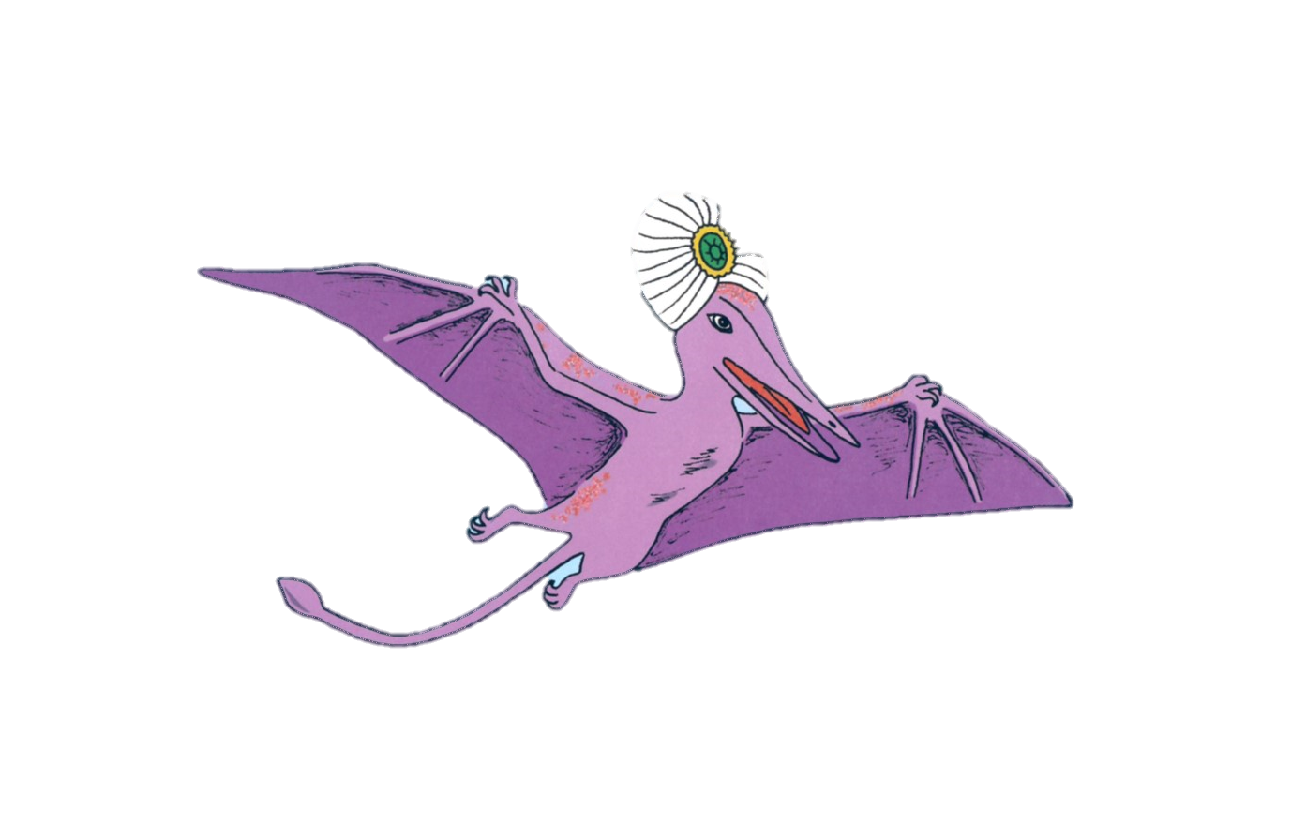
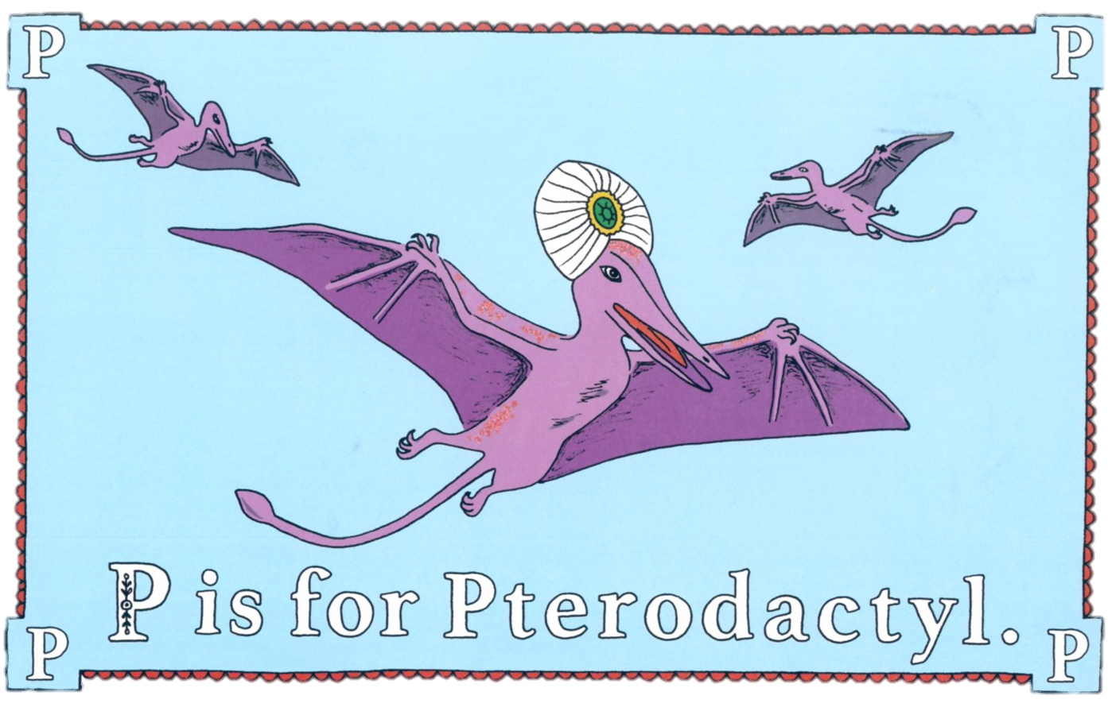
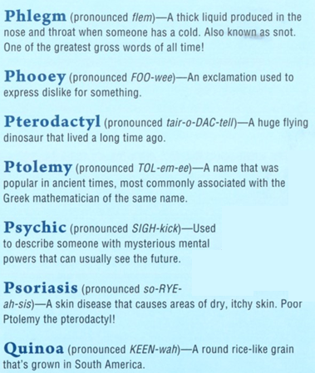
Ptolemy the psychic pterodactyl struggles with psoriasis.

Slide 19
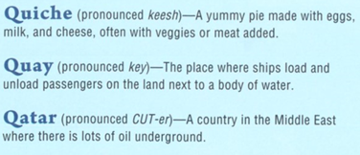
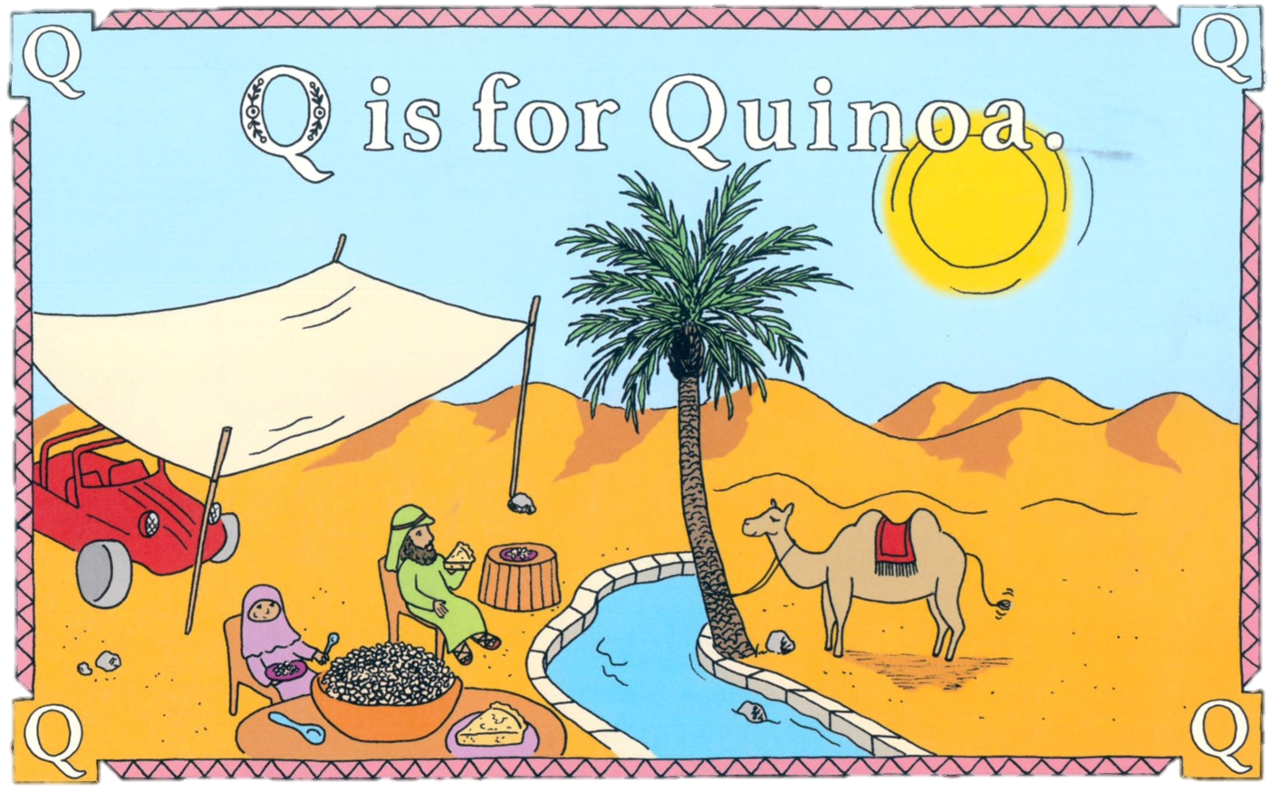
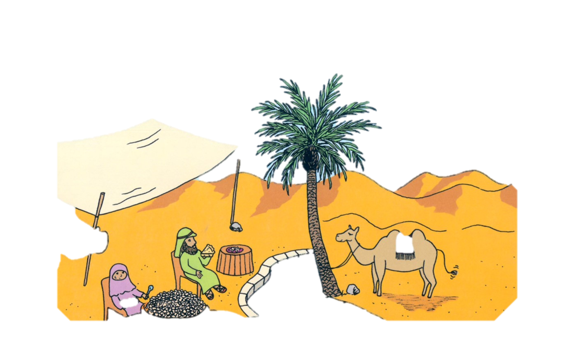
We can enjoy quinoa and quiche by the quays of Qatar.

Slide 20
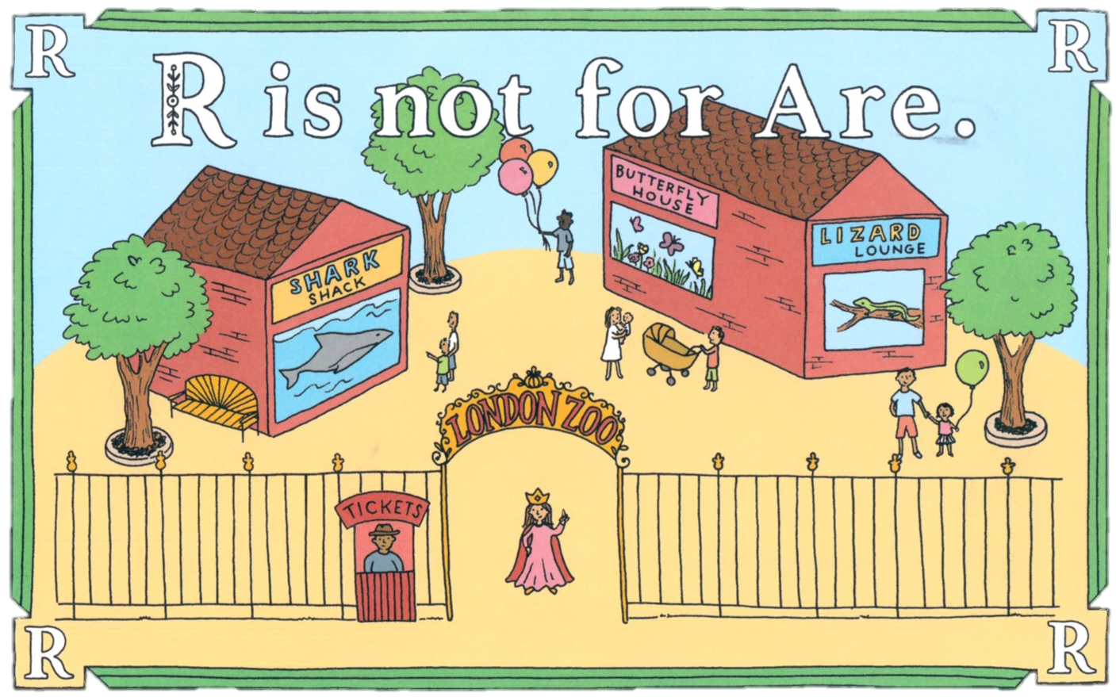
In England, the Queen proclaims, “We aren’t saying the r’s in butterfly, shark or lizard!”

Slide 21
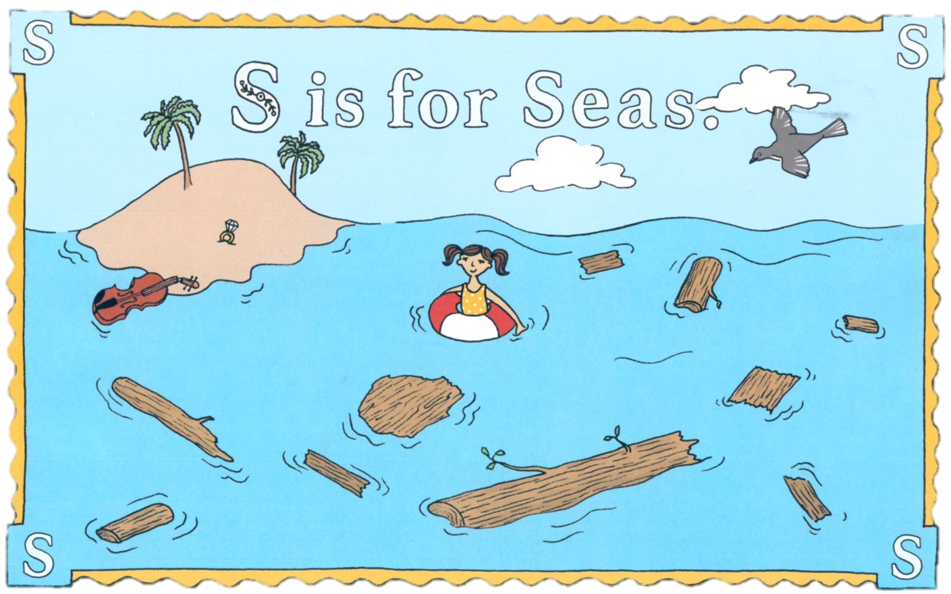
Cee Cee swam through the debris in the seas to see the imaginary isle of New Arkansas.

Slide 22
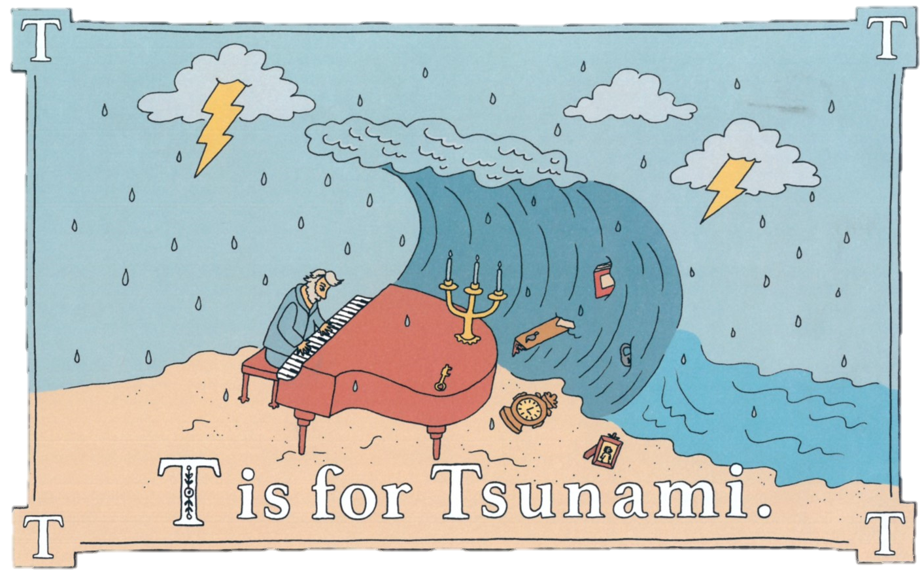
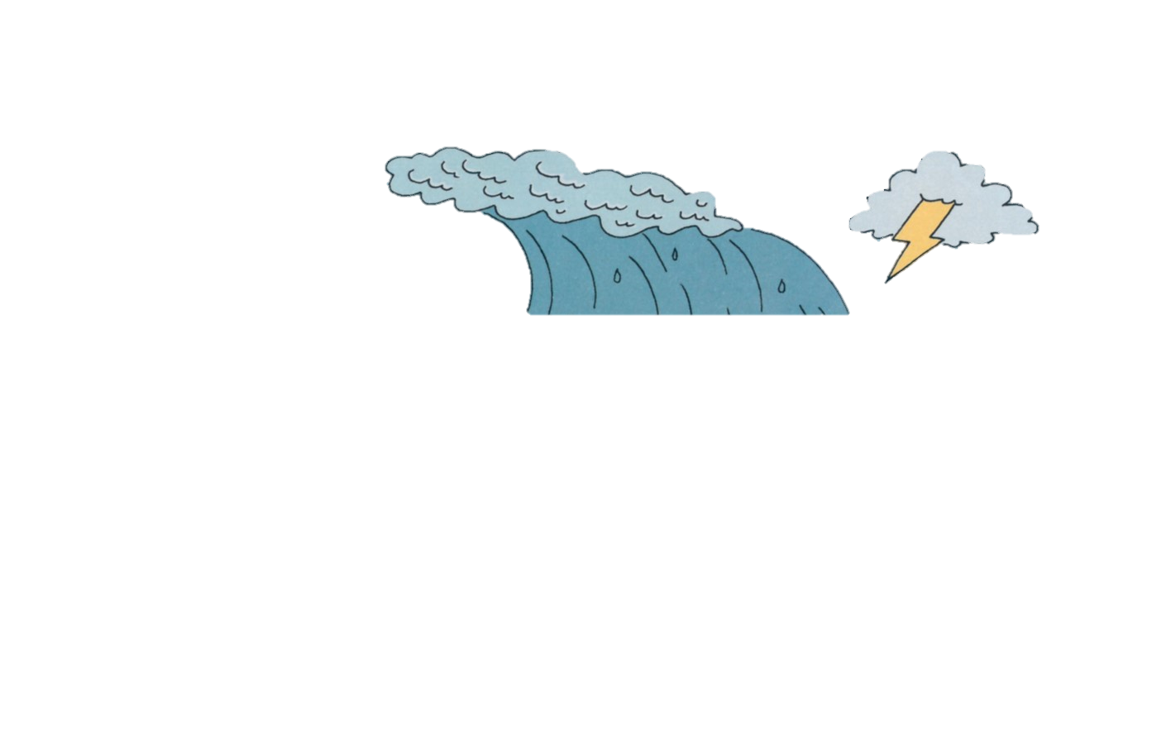
The charging tsunami washed away all of Tchiakovsky’s tchotchkes.

Slide 23
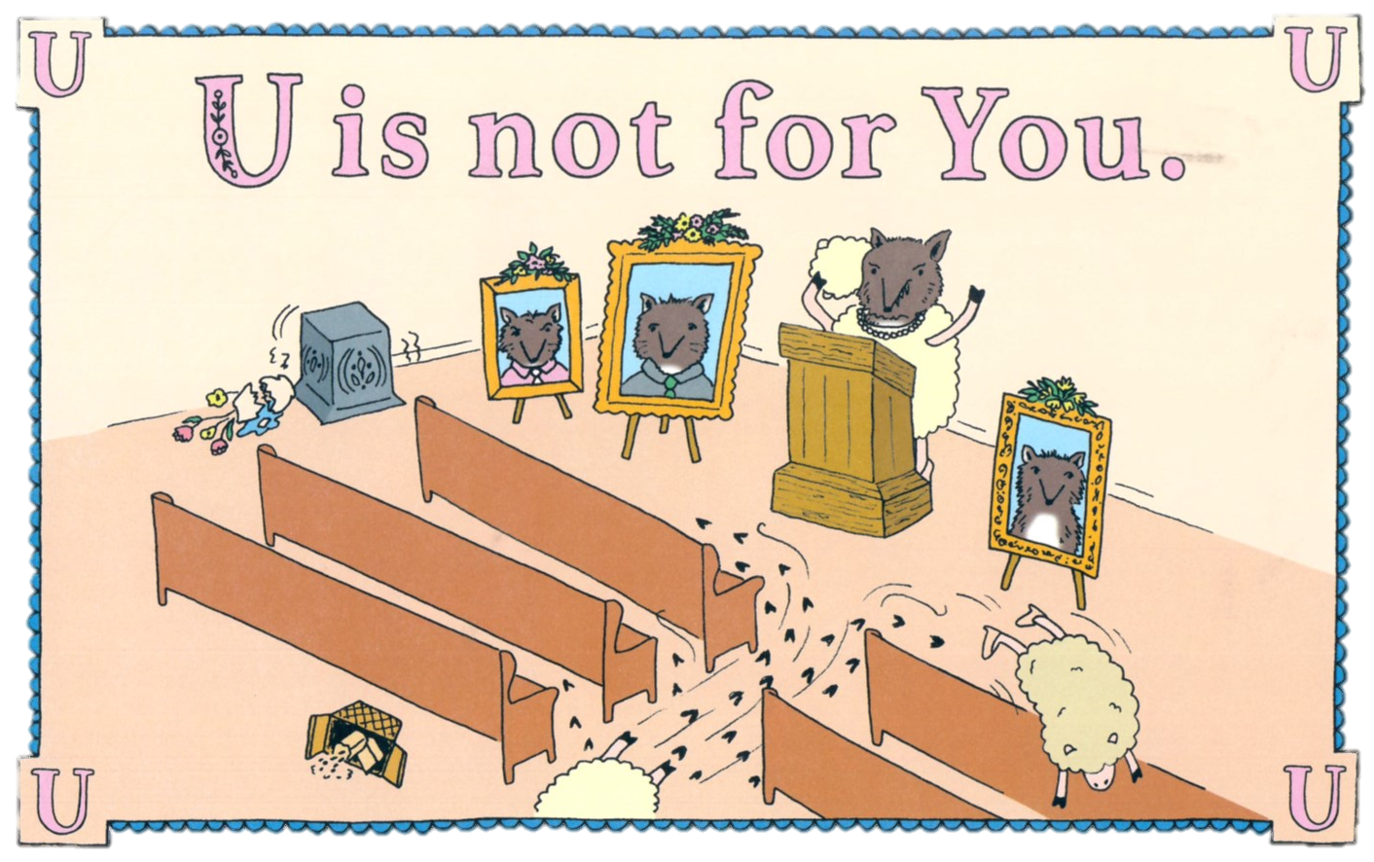
You never could have guessed that the wolf was disguised as the ewe!

Slide 24
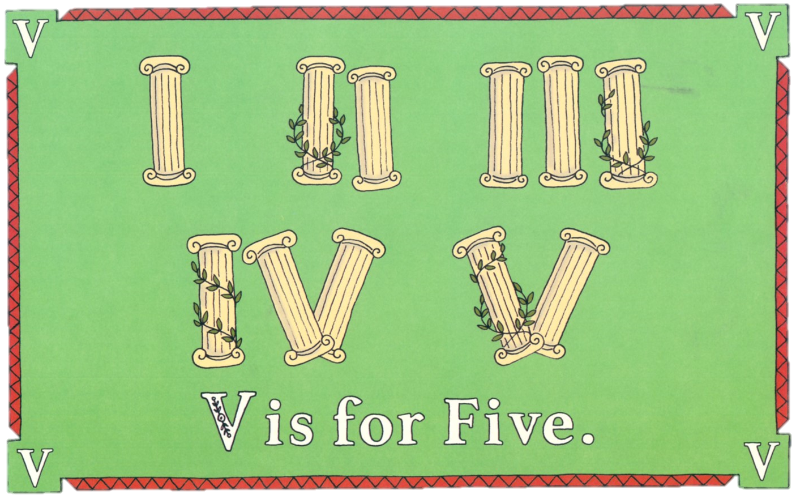
How roman-tic!

Slide 25
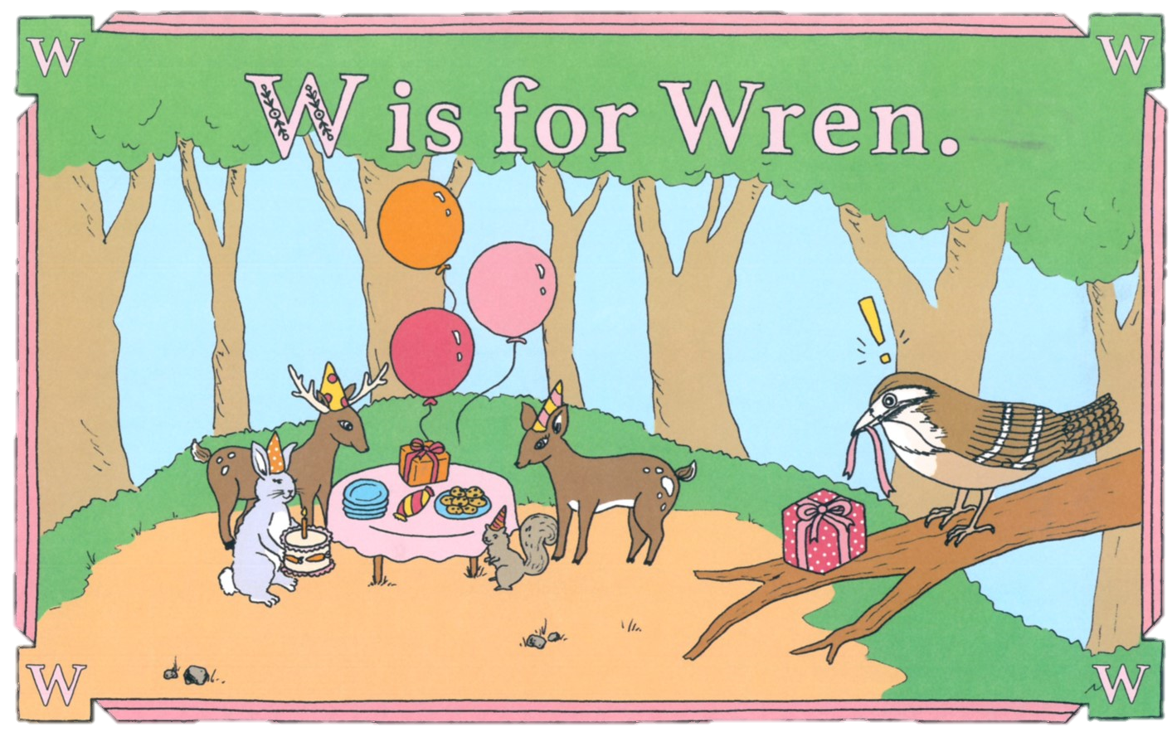
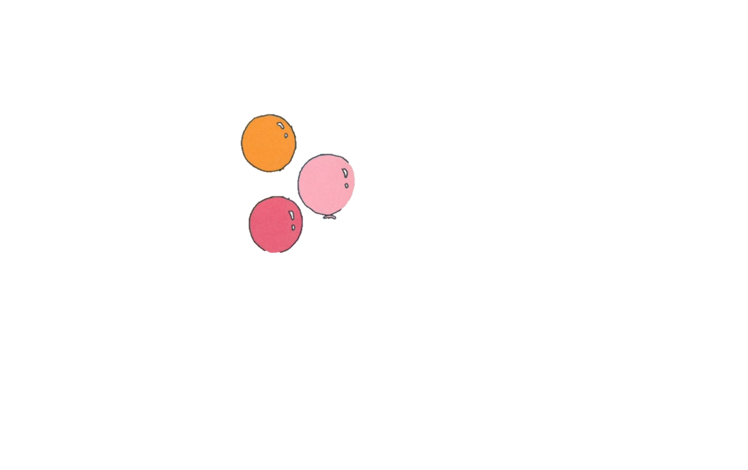
The wren wrapped the rabbit’s gift in red, but forgot to write a note.

Slide 26
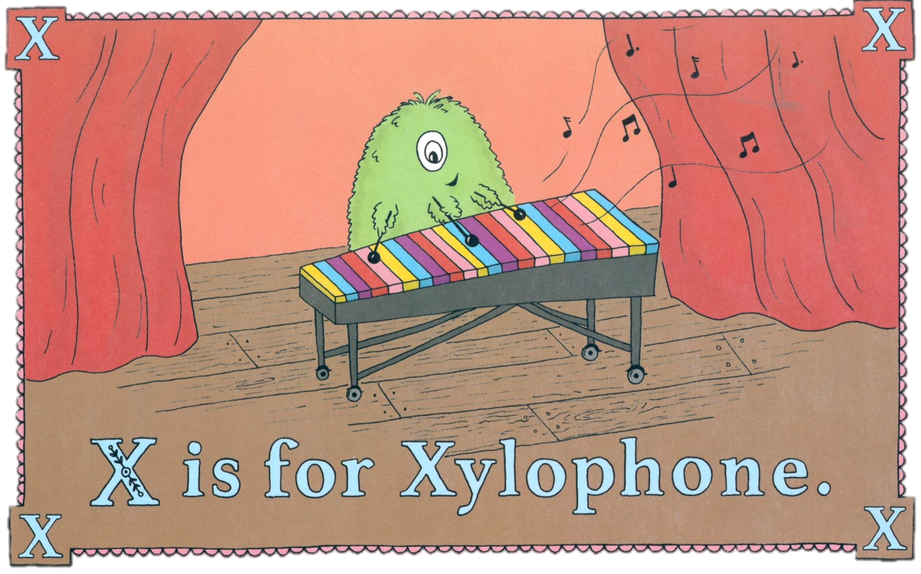
Xavier’s extra arm made him an exceptional xylophone player.

Slide 27
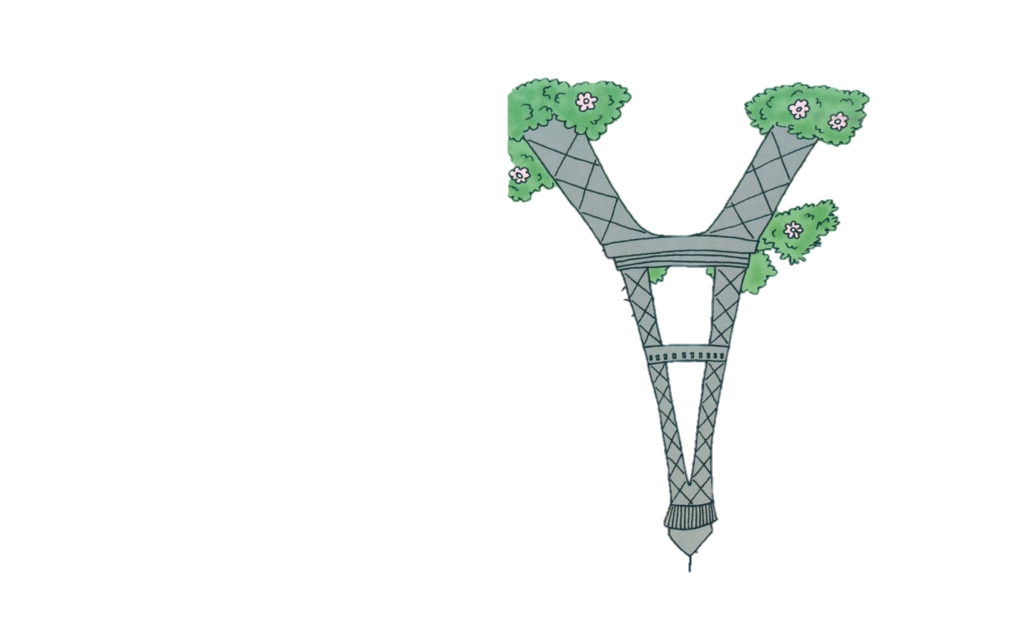
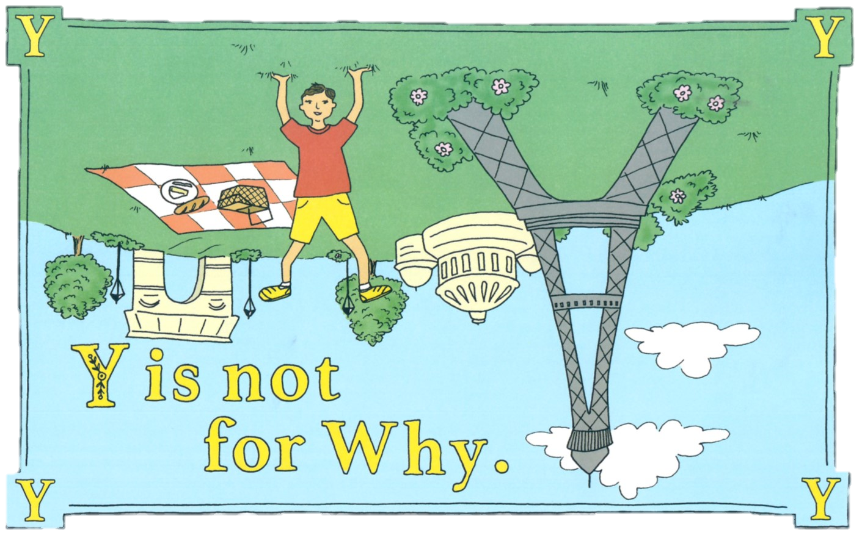
But Yves, who is wearing yellow shorts, yells, “Why is the Eiffel Tower upside down?”

Slide 28
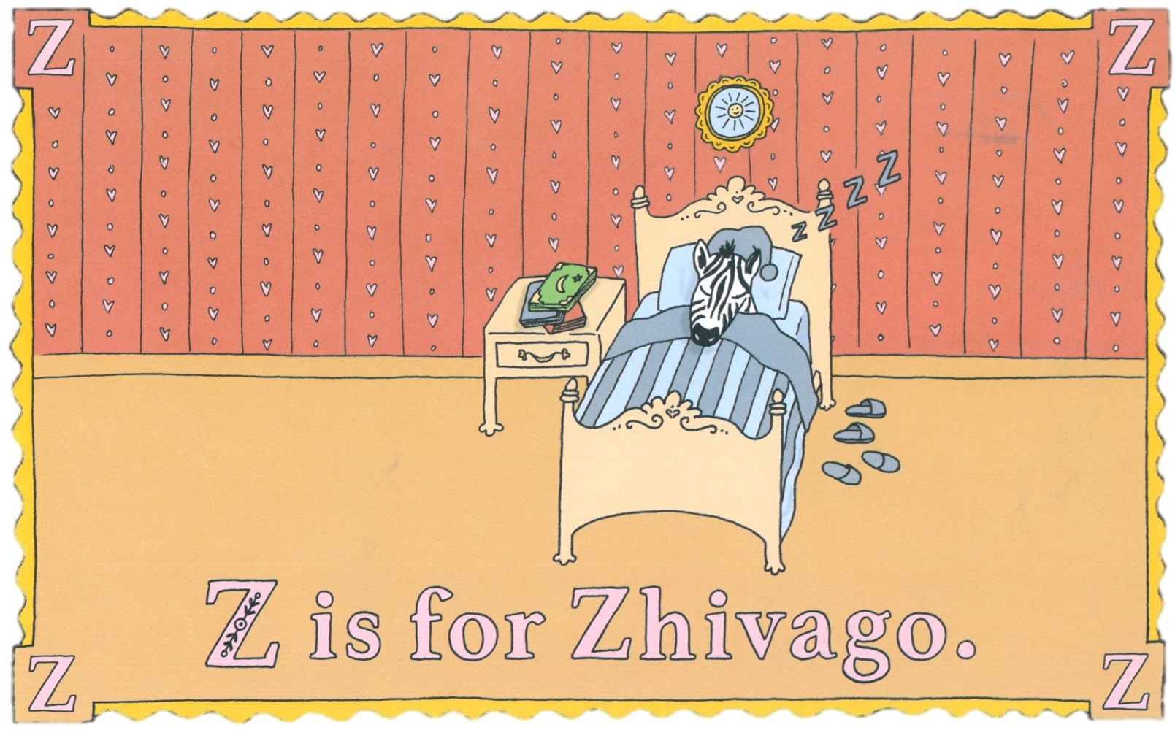
Goodnight, Zhivago the zebra! I’ve enjoyed our rendezvous. Zzzz

