Slide 2
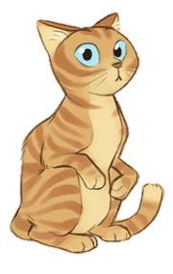
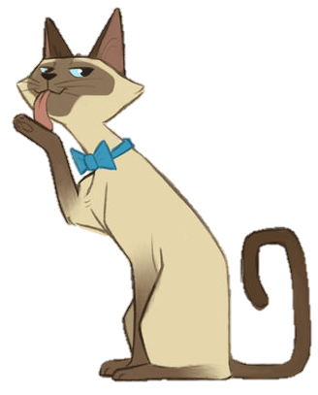
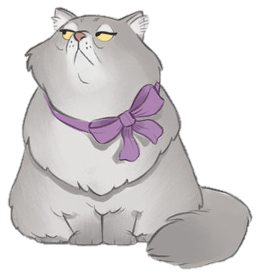
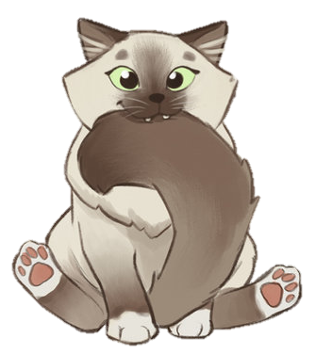

Slide 3
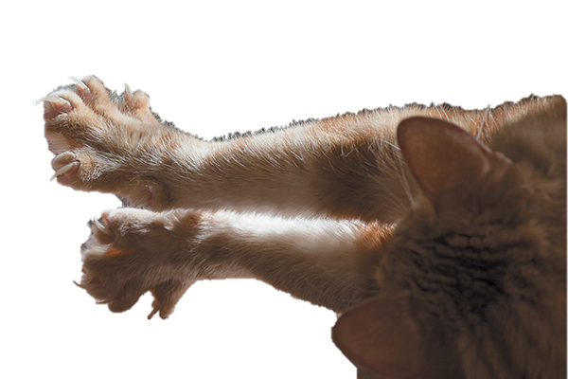
Claw Marks
Bell Ball
What is it?
Flower Pot
Paw Print
Mouse
Sock
Catnip
Coffee Cup
Shoes
Ball of Yarn
Fish Bowl
Bird Cage

Slide 4
Practice:
Pip Squeak is sitting in front of the coffee cup.
Practice:
Duchess was sitting in front of a bell ball.

Slide 5
Practice:
Mr. Mittens is near a sock.
Practice:
Tom Cat is sitting near the catnip.

Slide 6
Practice:
Sassy is sitting next to Pip Squeak.
Practice:
Ginger is sitting next to Mr. Mittens.

Slide 7
Practice:
Ginger is sitting to the left of Mr. Mittens.
Practice:
Sassy is sitting to the right of Tom Cat.

Slide 8
Practice:
Pip Squeak is sitting between Sassy and Mr. Mittens
Practice:
Ginger is sitting two seats away from Duchess.

Slide 9
Practice:
Pip Squeak is sitting across from Tom Cat.
Practice:
Ginger is sitting across from Mr. Mittens.
Practice:
Sassy is sitting across from Duchess.

Slide 10
Clues:
Sassy was sitting next to Ginger.
Clues:
Tom Cat was sitting across from Mr. Mittens.
Clues:
Ginger was not sitting across from Duchess.
Clues:
Duchess was sitting next to Pip Squeak.
Clues:
Pip Squeak was sitting in front of a mouse.
Crime:
Who Spilled the Coffee?
Clues:
Mr. Mittens was sitting “in front of” the bird cage.
Crime:
Who spilled the coffee?

Slide 11
&

Slide 12
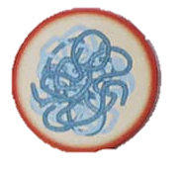
Cat Crimes
Easy
Medium
Hard

Slide 13
Who ruined the shoes?
Mr. Mittens and Pip Squeak were upstairs sleeping.
Tom Cat was sitting in front of catnip & a sock
Ginger was sitting next to the fish bowl.
Sassy was sitting across from Tom Cat.
Duchess was sitting to the left of Sassy

Slide 14
Duchess

Slide 16
Who broke the flower pot?
Mr. Mittens was sitting in front of the fish bowl.
Sassy was sitting to the left of Mr. Mittens.
Tom Cat was sitting near claw marks.
Ginger was sitting 2 seats from Sassy.
Ginger was sitting to the right of Duchess.
Pip Squeak was sitting across from Duchess.

Slide 17
Pip Squeak

Slide 19
Who spilled the coffee?
Tom Cat was sitting between Pip Squeak and Mr. Mittens.
Sassy was sitting across from Tom Cat.
Mr. Mittens was sitting 3 seats from Duchess
Ginger was sitting across from Pip Squeak.
Mr. Mittens was not sitting in front of the fish bowl.
Ginger was sitting to the right of Duchess.

Slide 20
Sassy

Slide 22
Who ate the fish?
No cats were sitting in front of the bell ball & paw print nor the catnip & claw marks.
Tom Cat was sitting in front of a mouse.
Duchess was sitting in front of a sock.
Ginger was sitting next to Sassy.
Sassy was sitting next to the fish bowl.

Slide 23
Duchess

Slide 25
Who ate the bird?
Three cats were upstairs sleeping.
Ginger was sitting next to another cat, but not next to the fish bowl.
Mr. Mittens was sitting in front of the fish bowl.
Pip Squeak was sitting in front of a bell ball & paw print.

Slide 26
Ginger

Slide 29
Who ruined the shoes?
One cat was upstairs sleeping.
No cat was sitting across from Pip Squeak.
Ginger was sitting across from Tom Cat.
Duchess was sitting near claw marks.
Sassy was the only cat sitting near paw print.
Tom Cat was sitting in front of a sock.

Slide 30
Duchess

Slide 32
Who broke the flower pot?
Three cats were in the living room, but none were sitting next to each other.
A cat wearing a bell was sitting near a paw print.
Tom Cat was sitting in front of a bell ball.
Ginger was sitting across from a cat with white paws.

Slide 33
Ginger

Slide 35
Who spilled the coffee?
No cat was sitting in front of the mouse & paw print.
Only one cat was sitting next to Sassy.
Ginger was sitting 2 seats from a cat wearing a bow.
Pip Squeak was sitting to the left of a cat with blue eyes.
Mr. Mittens was sitting to Sassy’s left.
Ginger was not sitting next to a cat with white paws.

Slide 36
Tom Cat

Slide 38
Who ate the fish?
Sassy was sitting in front of catnip & a sock.
Ginger was not sitting next to a cat wearing a bell nor a cat with white paws
Pip Squeak was sitting 3 seats from Tom Cat.
Ginger was not sitting across from Sassy.
Pip Squeak was not sitting in front of a mouse.
Duchess was sitting next to Pip Squeak.

Slide 39
Ginger

Slide 41
Who ate the bird?
Tom Cat and Mr. Mittens were upstairs sleeping.
No cat was sitting in front of the fish bowl.
Ginger was not sitting next to any cats.
Sassy was sitting between two cats.
Duchess was sitting near claw marks.
Pip Squeak was sitting in front of either the bell ball & paw print or the catnip & claw marks.

Slide 42
Duchess

Slide 44
Who unraveled the yarn?
Ginger was sitting across from Pip Squeak.
Duchess was either sitting in front of a mouse & claw marks or catnip & a sock.
Sassy was sitting in front of the fish bowl.
Tom Cat was sitting next to a cat wearing a bell.
Pip Squeak was not sitting next to the fish bowl.
Mr. Mittens was either sitting in front of the bell ball & paw print or the catnip & claw marks .

Slide 45
Tom Cat

Slide 48
Who ruined the shoes?
Sassy was sitting between a cat wearing a bell and a cat wearing a bow.
Tom Cat was sitting in front of catnip
Ginger was sitting to Tom Cat’s right.
Mr. Mittens was not sitting near claw marks.
Duchess was sitting across from Mr. Mittens.
Ginger was not sitting across from a sock.

Slide 49
Pip Squeak

Slide 51
Who broke the flower pot?
Ginger was sitting next to a long-haired cat.
Tom Cat was sitting across from Sassy.
Ginger was sitting across from Pip Squeak.
Pip Squeak was not sitting next to the fish bowl.
Ginger was sitting to Tom Cat’s right.
Sassy was sitting between Mr. Mittens and Duchess.

Slide 52
Ginger

Slide 54
Who swallowed the fish?
Ginger was sitting to Tom Cat’s left.
Duchess was sitting 3 seats from Pip Squeak.
Ginger was sitting 2 seats from Pip Squeak
Sassy was sitting to Mr. Mittens’ right.
Mr. Mittens was sitting across from Duchess.
Ginger was not sitting next to the birdcage.

Slide 55
Tom Cat

Slide 57
Who ate the bird?
Tom Cat was sitting to Sassy’s right.
Ginger was not sitting across from Mr. Mittens.
Duchess was sitting in front of the fish bowl.
Tom Cat was not sitting next to Pip Squeak.
Pip Squeak was sitting 3 seats from Mr. Mittens.

Slide 58
Tom Cat

Slide 60
Who unraveled the yarn?
Sassy was sitting in front of a bell ball & paw print.
Duchess was sitting in front of a sock.
Ginger was sitting across from Mr. Mittens.
Pip Squeak was sitting 2 seats from Tom Cat.
Ginger was sitting to the right of a cat wearing a bow.

Slide 61
Tom Cat

