Slide 1
Euphemisms
Let’s talk about the birds and the bees.

Slide 2
Foreplay
Seduction and getting ready for sex.

Slide 3
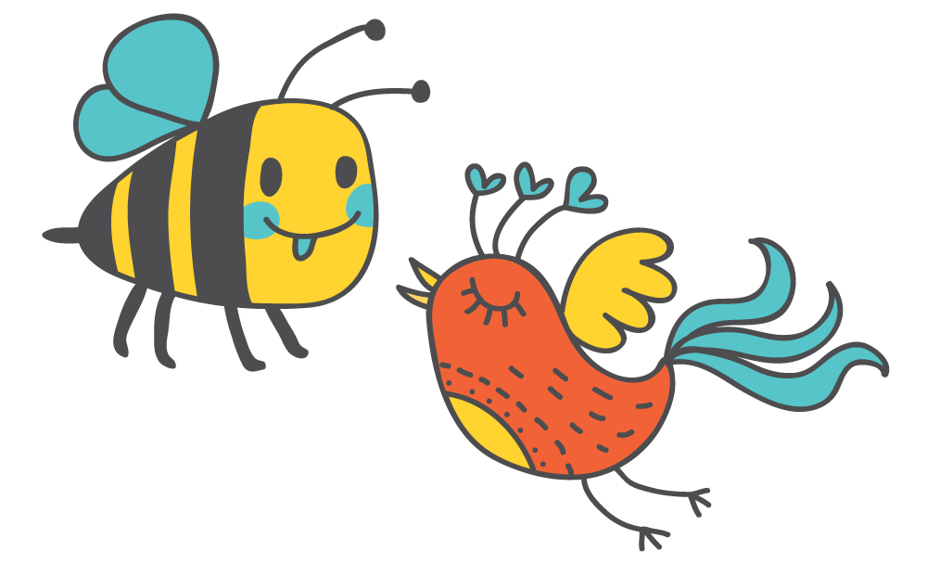
Let’s talk about the birds and the bees.
sex

Slide 4
In English it can be taboo to talk about sex. So, we often use euphemisms to soften our language.
“can’t talk about it”

Slide 5
Even the word “sex” is a bit taboo. Jim Goad lists 400 euphemisms for “sex”
https://thoughtcatalog.com/jim-goad/2014/12/400-euphemisms-for-sexual-intercourse/

Slide 6
Positive euphemisms for “sex”
Knocking boots
Afternoon delight
Roll in the hay
Nooky
Horizontal tango
Riding it
Scoring
Humping
Whoopee
Sleeping with
Copulate
Mating
Take to bed
Going all the way
Making Love
Sleeping together
Getting laid
Getting some
Getting Lucky
Getting it on
Getting busy
Doing it
A quickie
Hooking up
Having relations with
Hanky Panky
One night stand
Knowing someone in the biblical sense

Slide 7
Negative euphemisms for “sex”
Porking
Sleeping around
Getting ass
Having an affair
Ravish
To bone someone
Fucking
Screwing
Banging
Shagging
Nailing someone
Doing the nasty
Pounding it
Bumping uglies
Tap that ass
Smack that ass
Fornication
Getting boned
Plowing
Making the beast with two backs

Slide 8
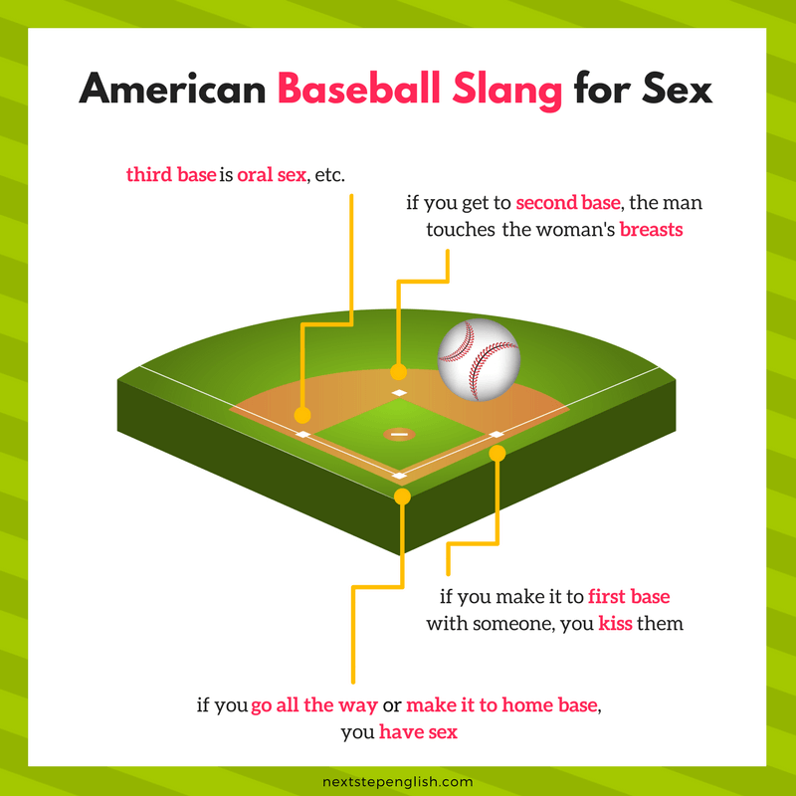
Baseball Metaphor
https://nextstepenglish.com/love-words-english-funny-euphemisms-sex/

Slide 9
Get Busy
Time to do it (sex)

Slide 10
Let’s start by looking at body parts
Name the body part.

Slide 11
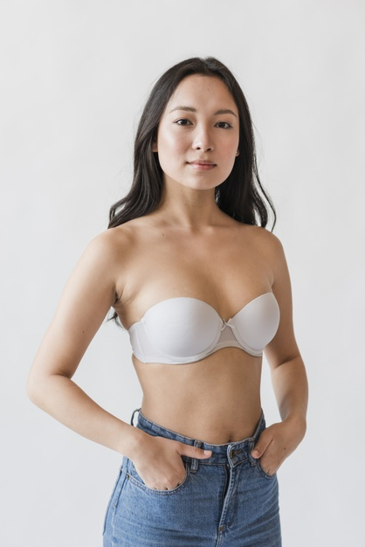
Tatas
Breasts

Slide 12
Box
Vagina

Slide 13
Rear
Butt

Slide 14
Large personality
Large Breasts

Slide 15
Schlong
Penis

Slide 16
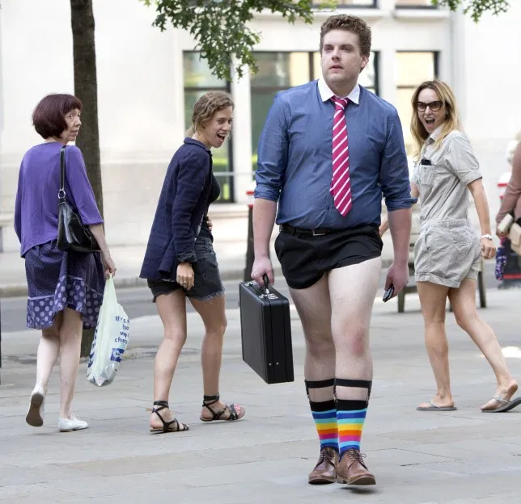
Trouser Stick
Penis

Slide 17
Poontang
Vagina

Slide 18
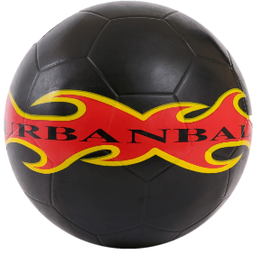
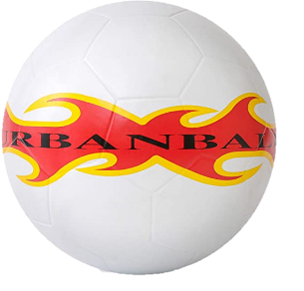
Balls
Testicles

Slide 19
Balloons
Fun bags / Fun balloons
Breasts

Slide 20
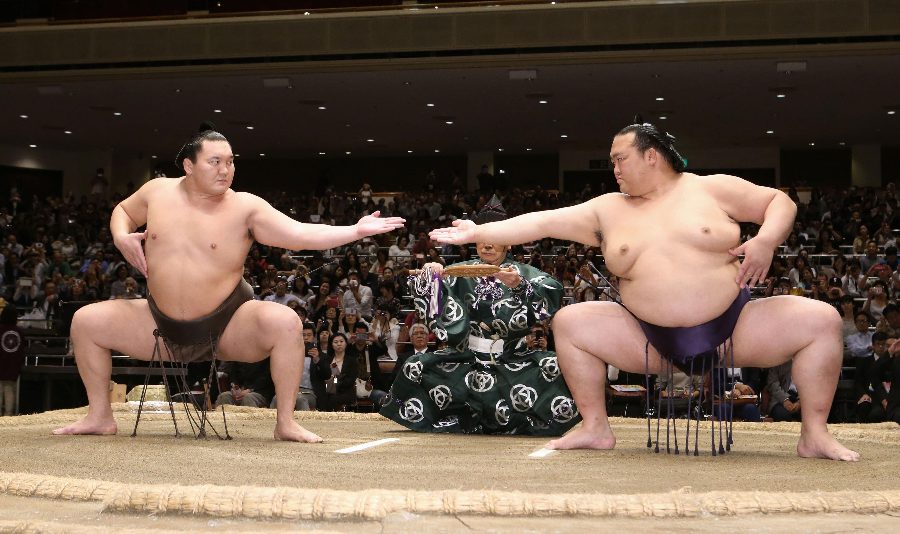
Bollocks
Testicles

Slide 21
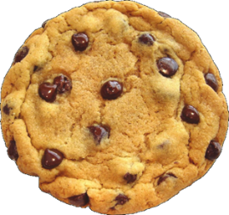
Cookie
Vagina

Slide 22
Package
Testicles (sometimes penis)

Slide 23
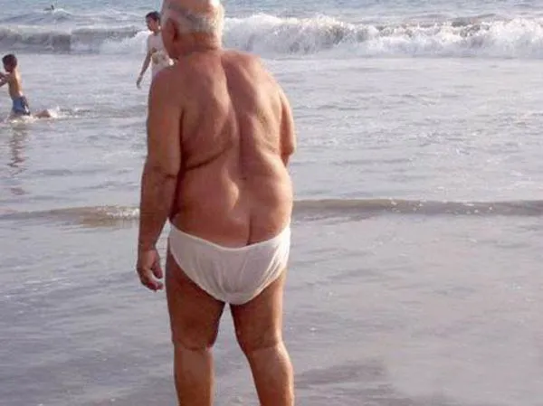
Derriere
Butt

Slide 24
Badunkadonk
Butt

Slide 25
Muff
Vagina (public hair)

Slide 26
Love tunnel
Vagina

Slide 27
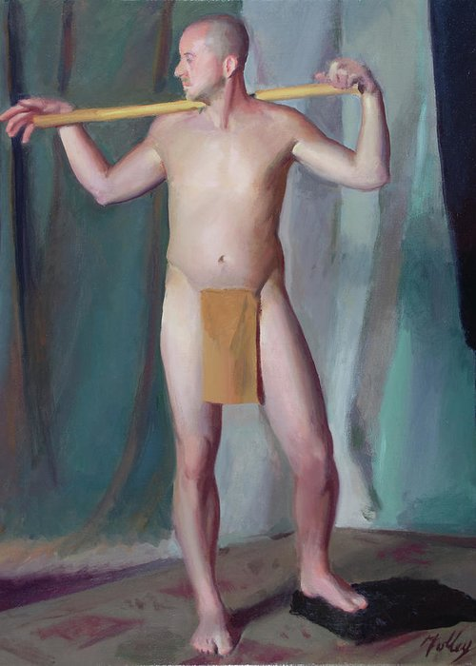
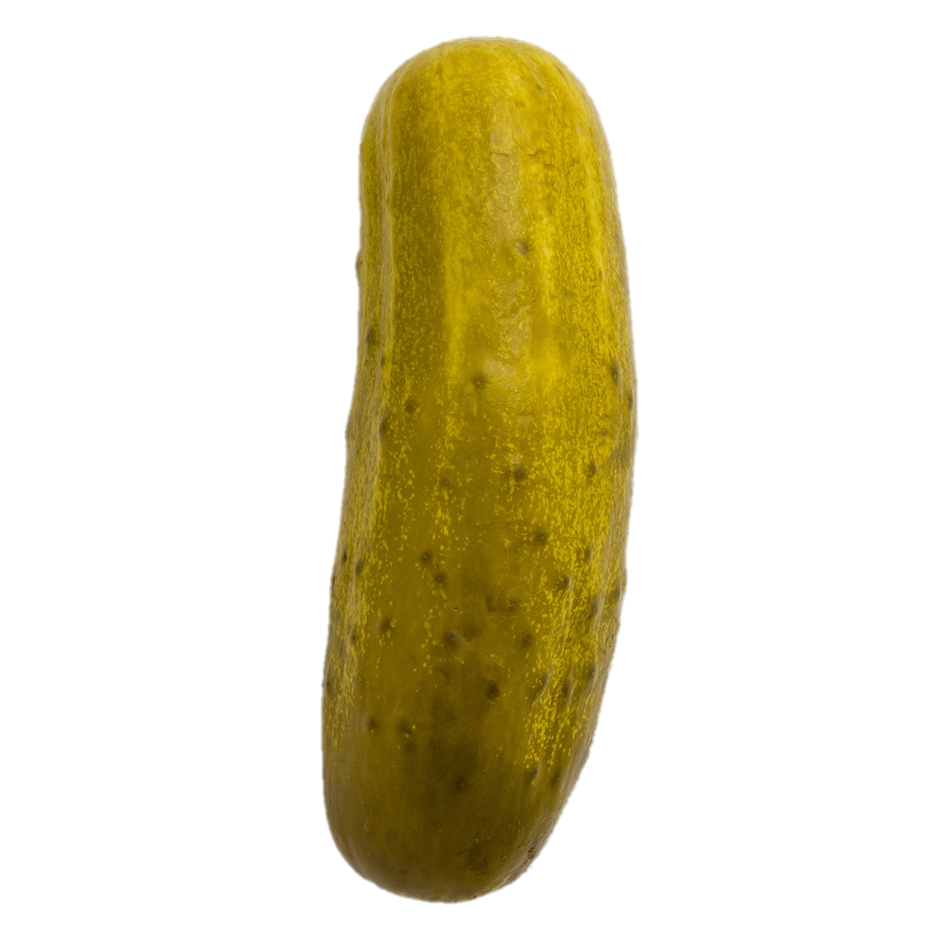
Pickle
Penis

Slide 28
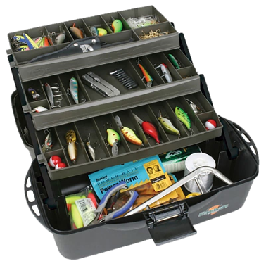
Wedding tackle
Testicles

Slide 29
Tukhus
Butt

Slide 30
Coochie
Vagina

Slide 31
Scrotum
Testicles

Slide 32
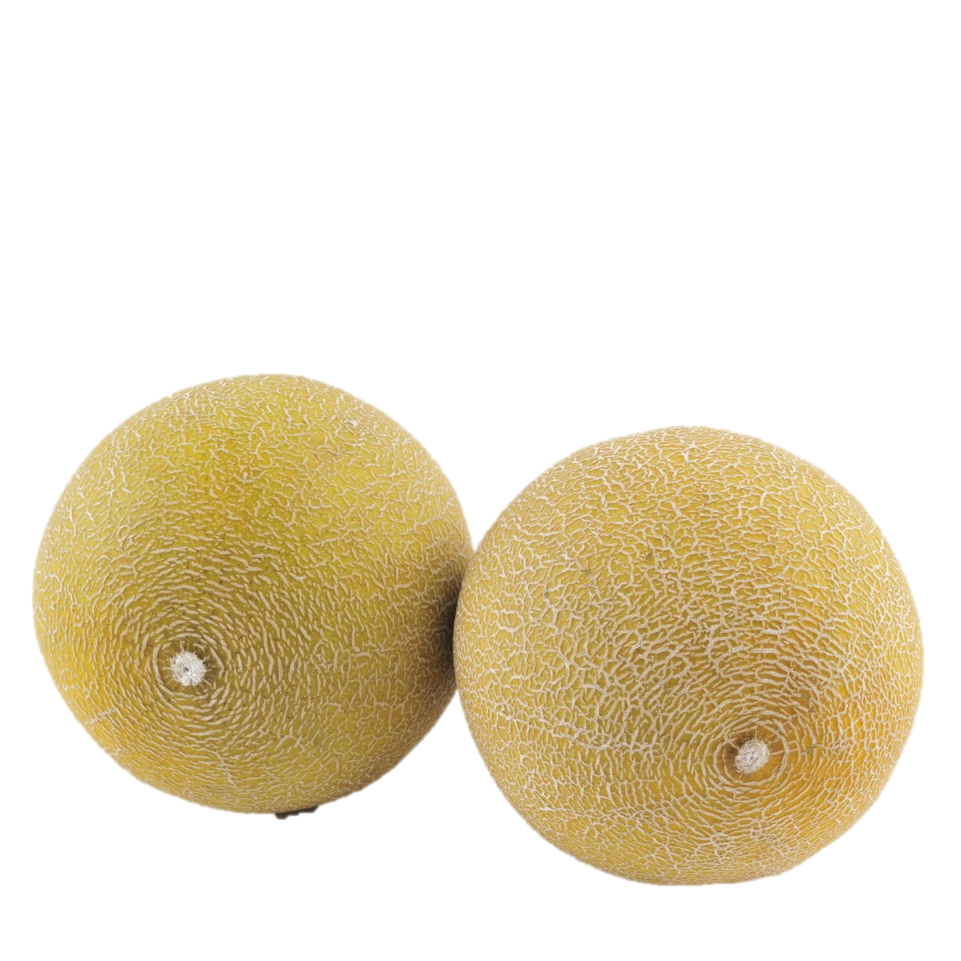
Melons
Watermelons if large
Breasts

Slide 33
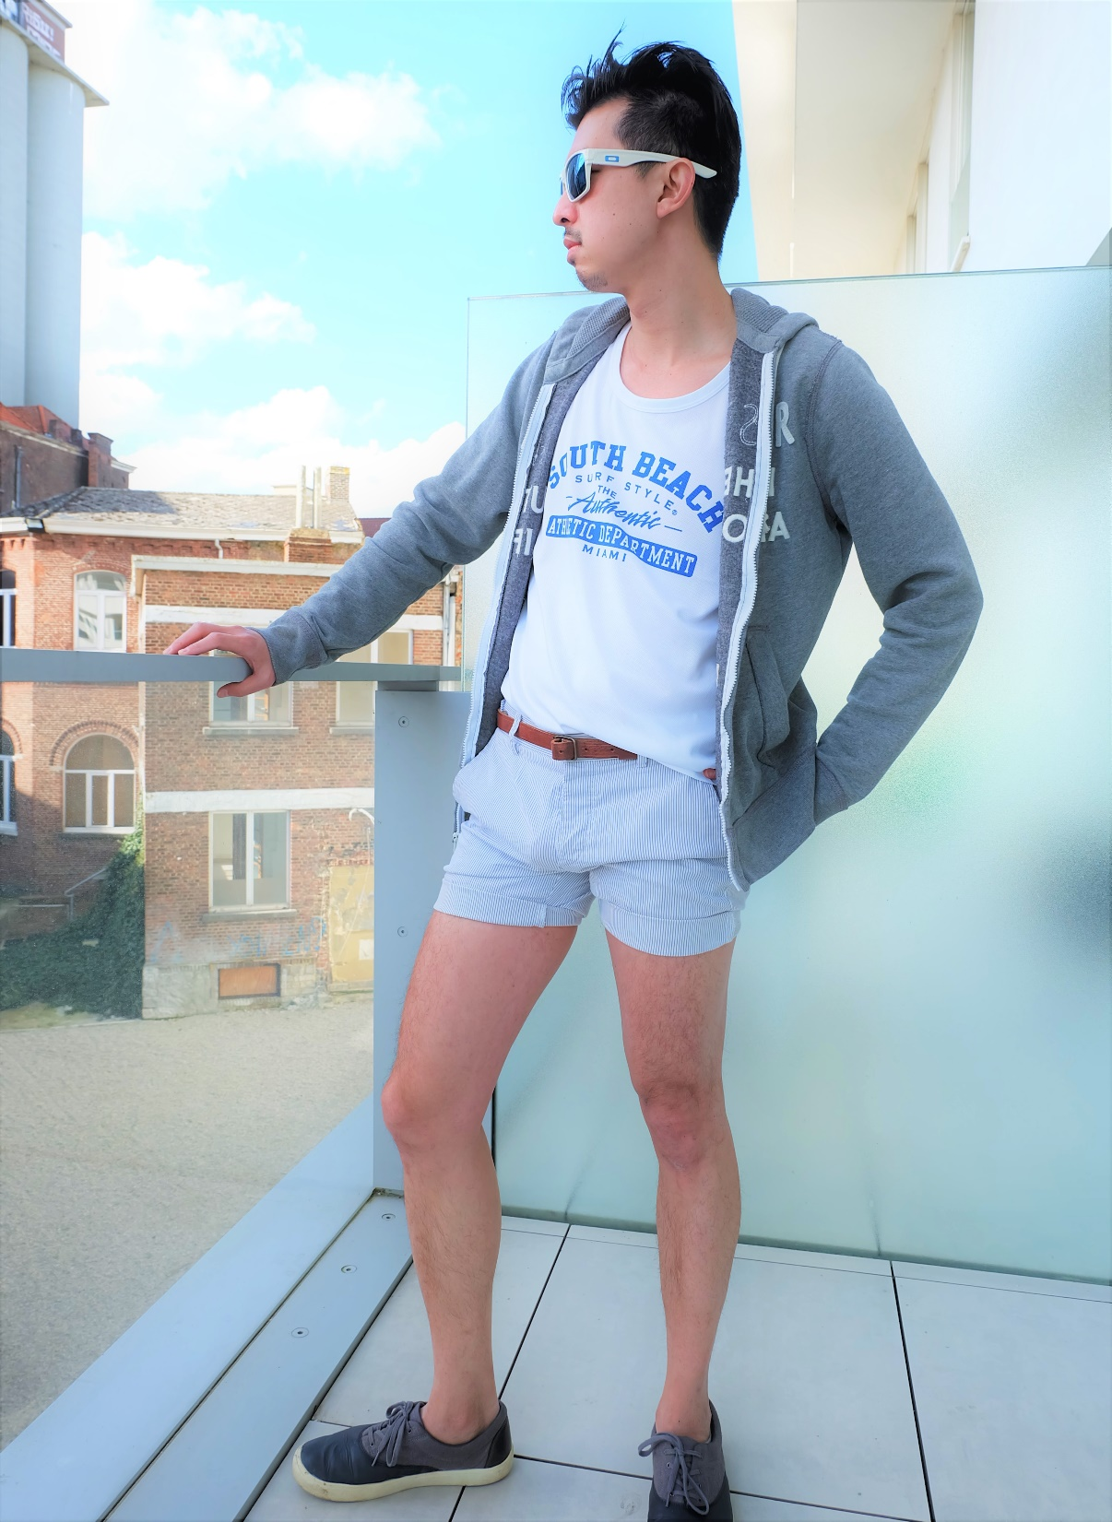
The boys
Testicles

Slide 34
Rump
Butt

Slide 35
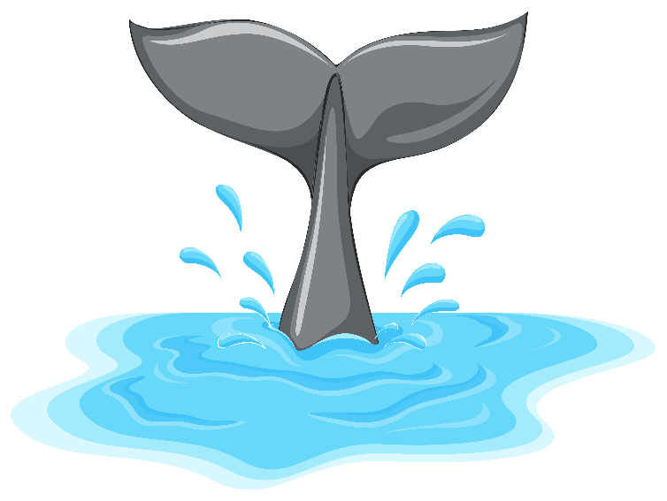
Tail
Butt

Slide 36
Twat
Vagina

Slide 37
Buttocks
Butt

Slide 38
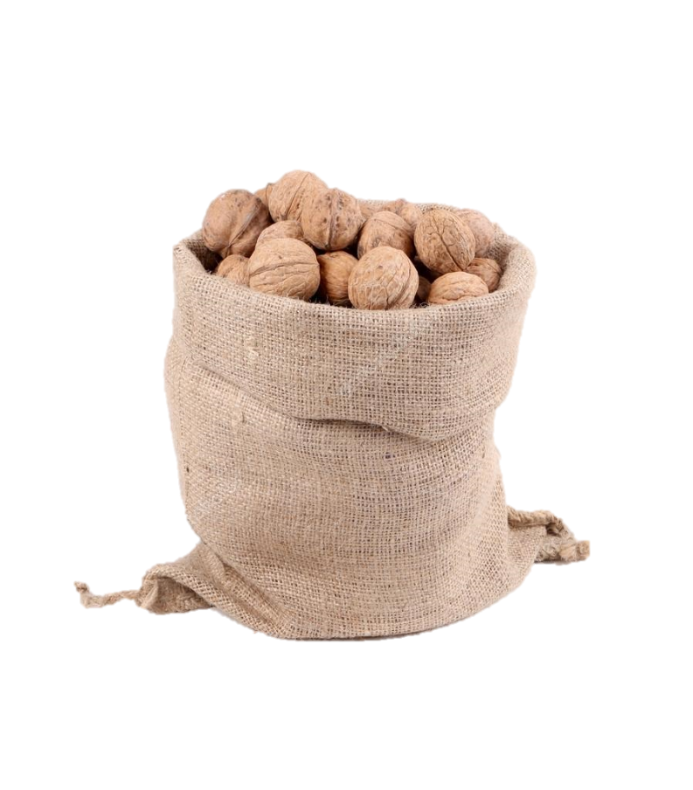
Nutsack
Testicles

Slide 39
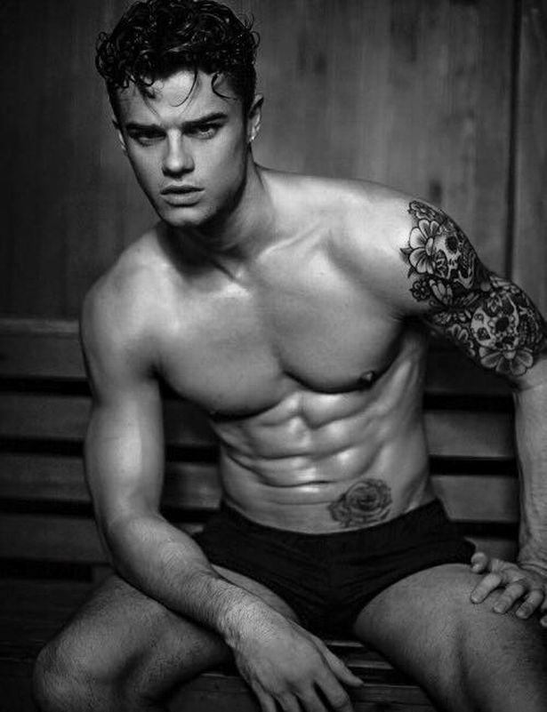
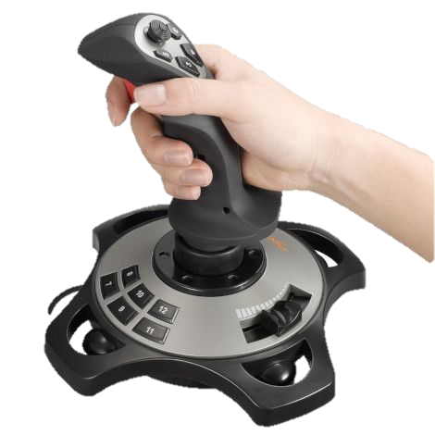
Joystick
Penis

Slide 40
Headlights
Breasts

Slide 41
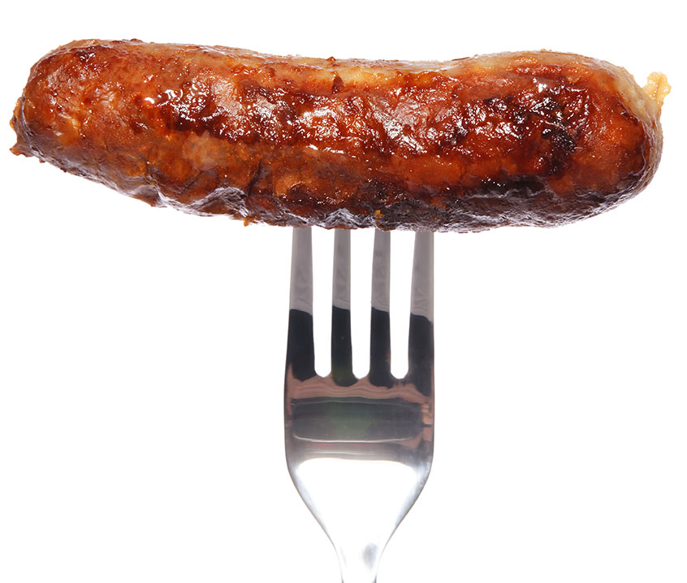
Sausage
Penis

Slide 42
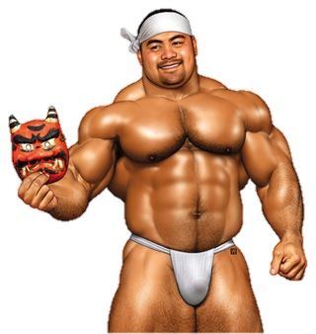
The D
Penis (short for dick)

Slide 43
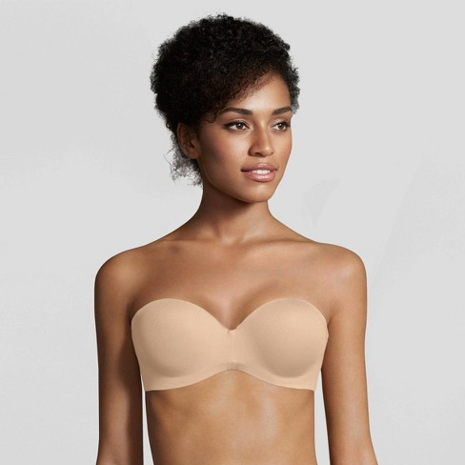
Bosom
Breasts

Slide 44
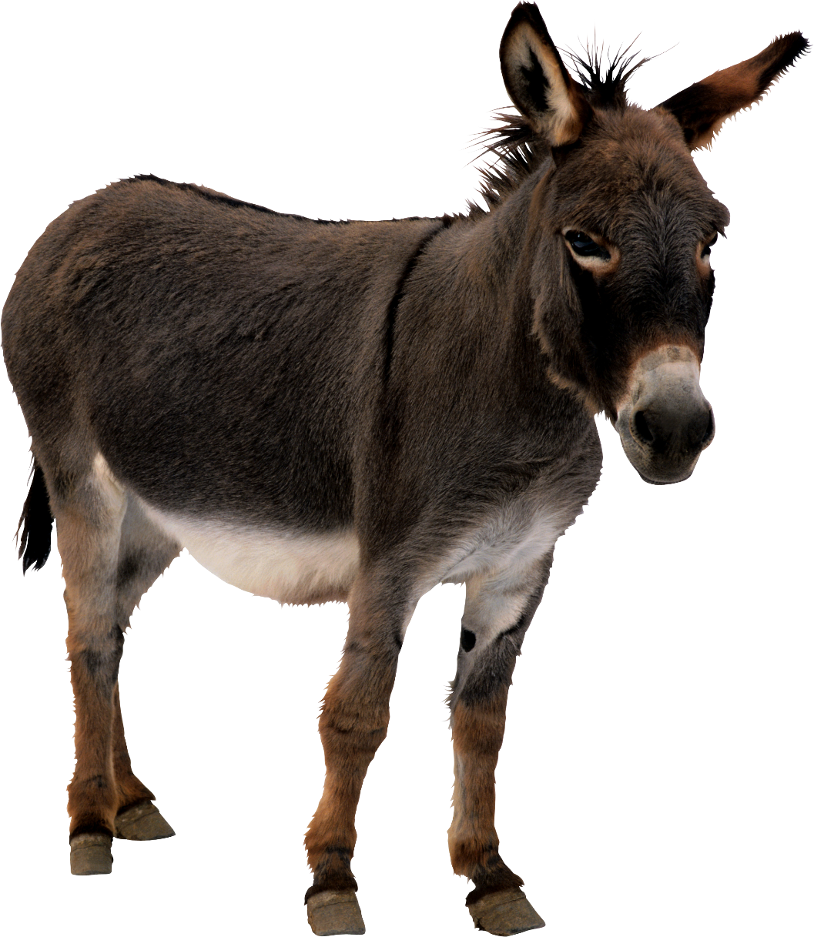
Ass
Butt

Slide 45
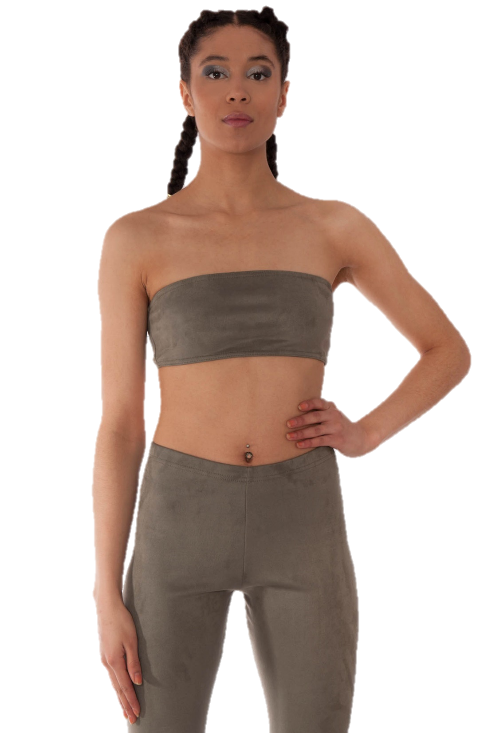
The girls
(the twins)
Breasts

Slide 46
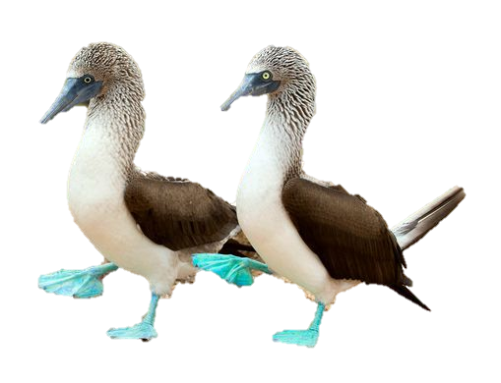
Boobies
Breasts

Slide 47
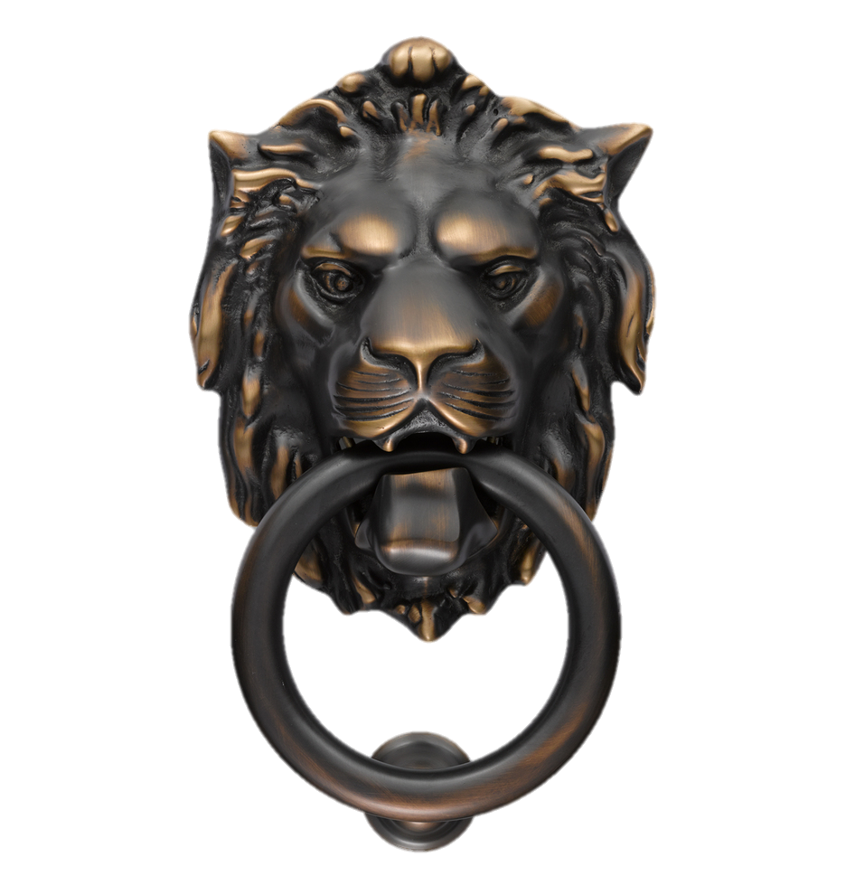
Knockers
Breasts

Slide 48
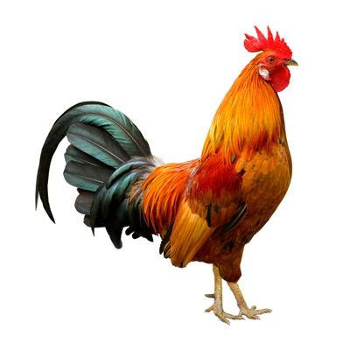
Cock
Penis

Slide 49
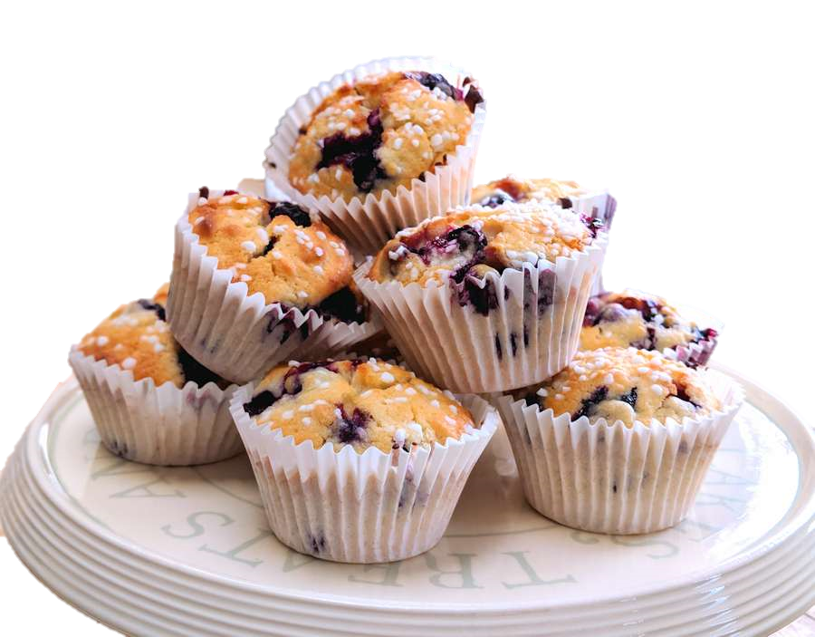
Love muffins
Breasts

Slide 50
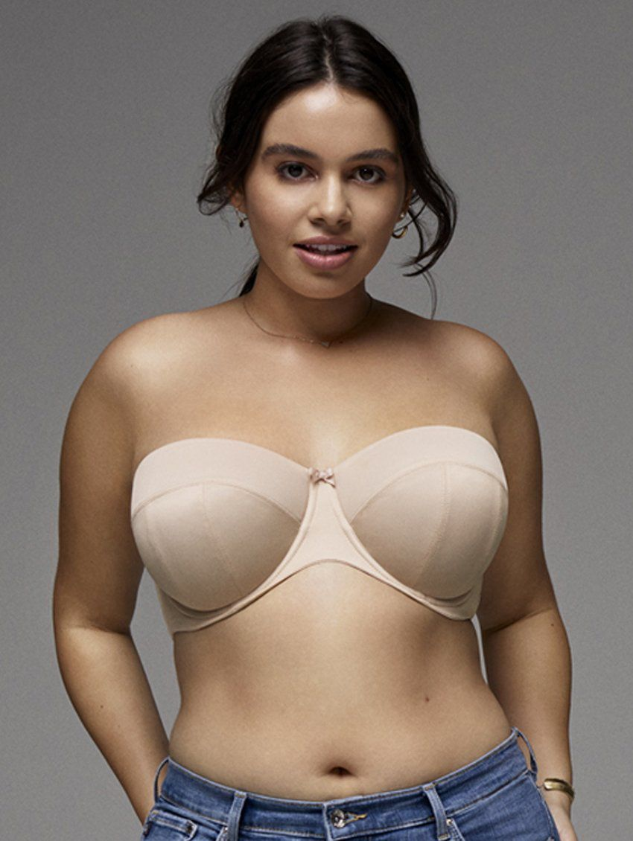
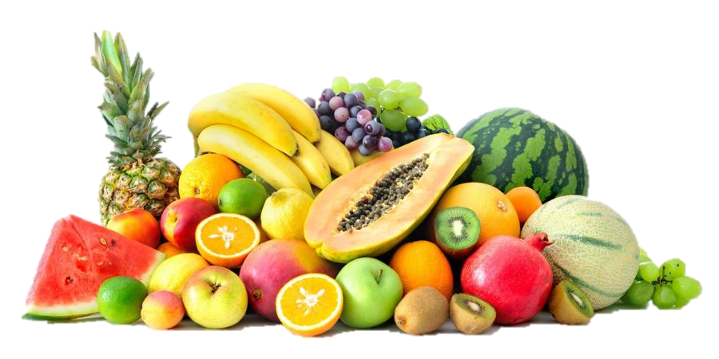
Peaches, Tomatoes, Avocados
Depends on size
Breasts

Slide 51
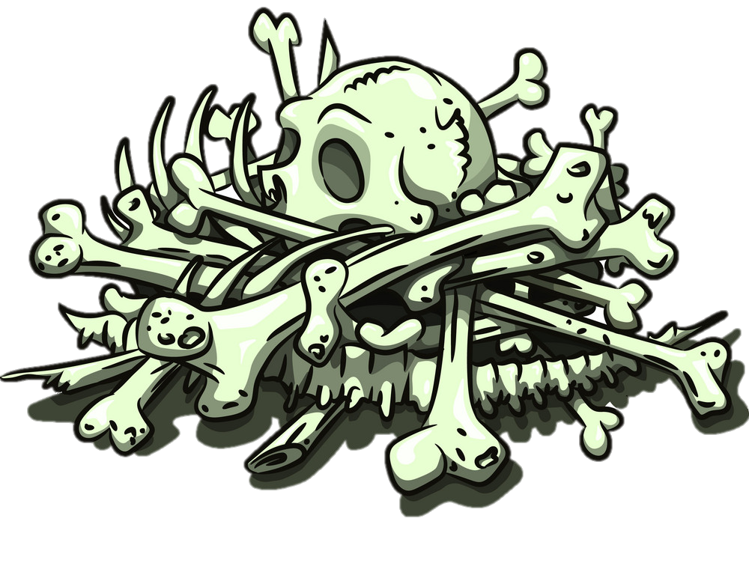
Boner
Erect Penis

Slide 52
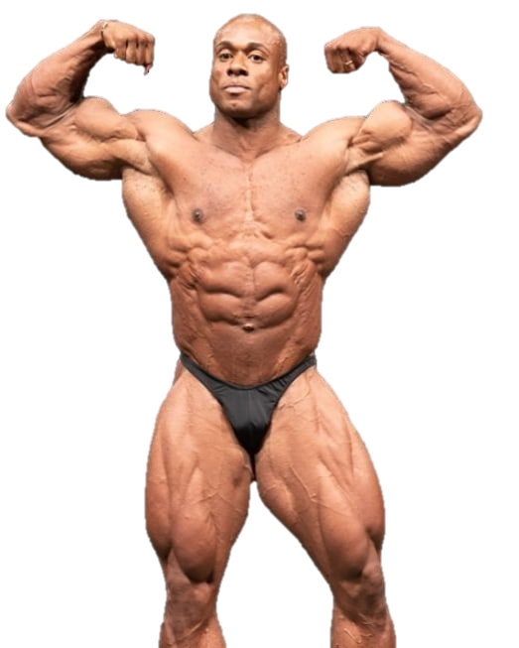
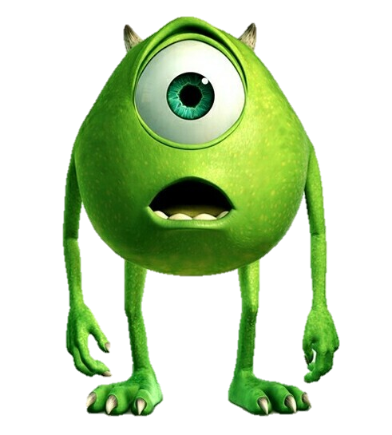
One eyed Monster
Penis

Slide 53
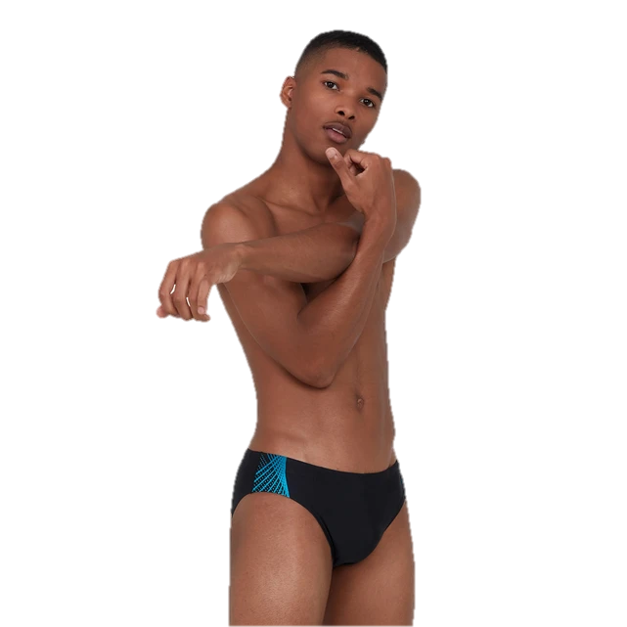
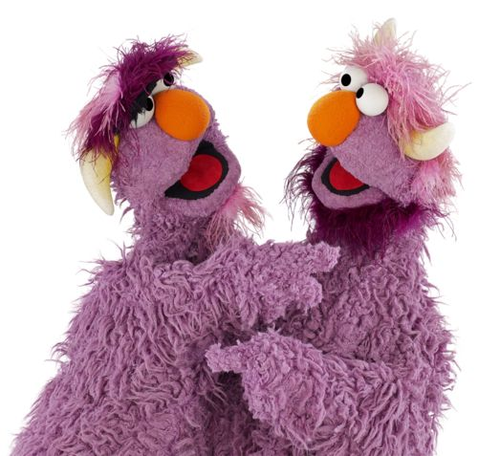
Purple headed monster
Penis

Slide 54
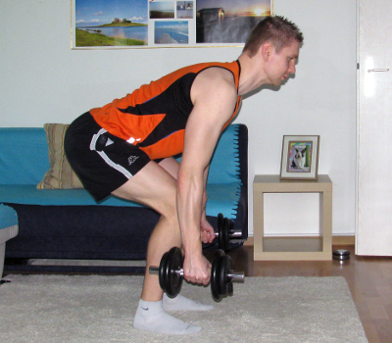
Tush / tushie
Butt

Slide 55
Cooter
Vagina

Slide 56
Honkers
Breasts

Slide 57
Nads
Testicles

Slide 58
Junk in the Trunk
Large butt

Slide 59
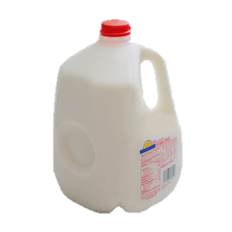
Jugs
Breasts

Slide 60
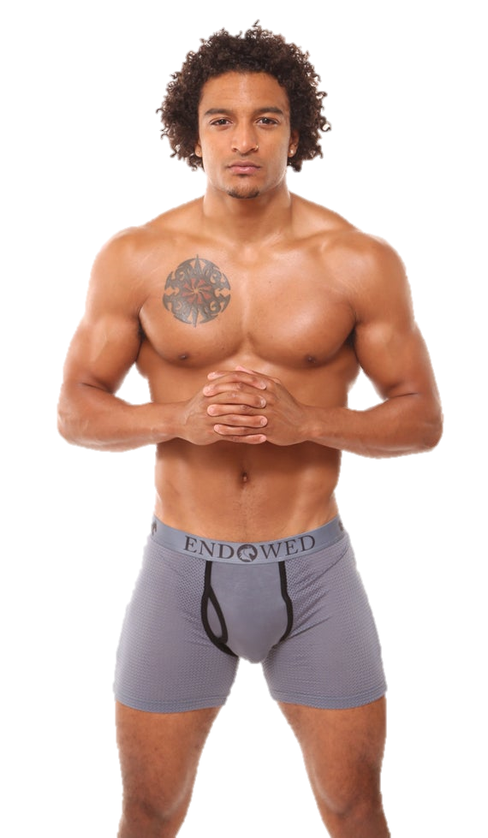
Dick
Penis

Slide 61
Vajayjay
Vagina

Slide 62
Backside
Butt

Slide 63
Backdoor
Butt

Slide 64
Cunt
Vagina

Slide 65
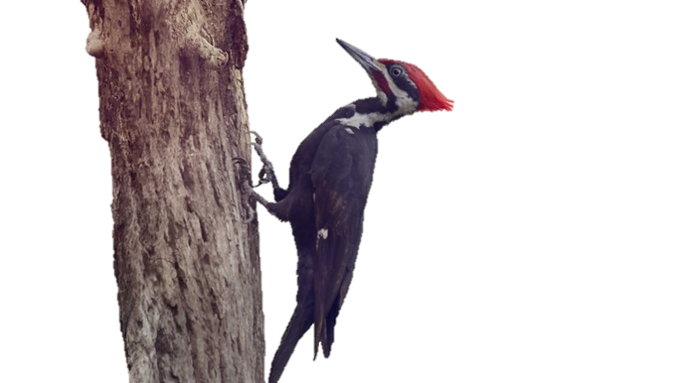
Pecker
Penis

Slide 66
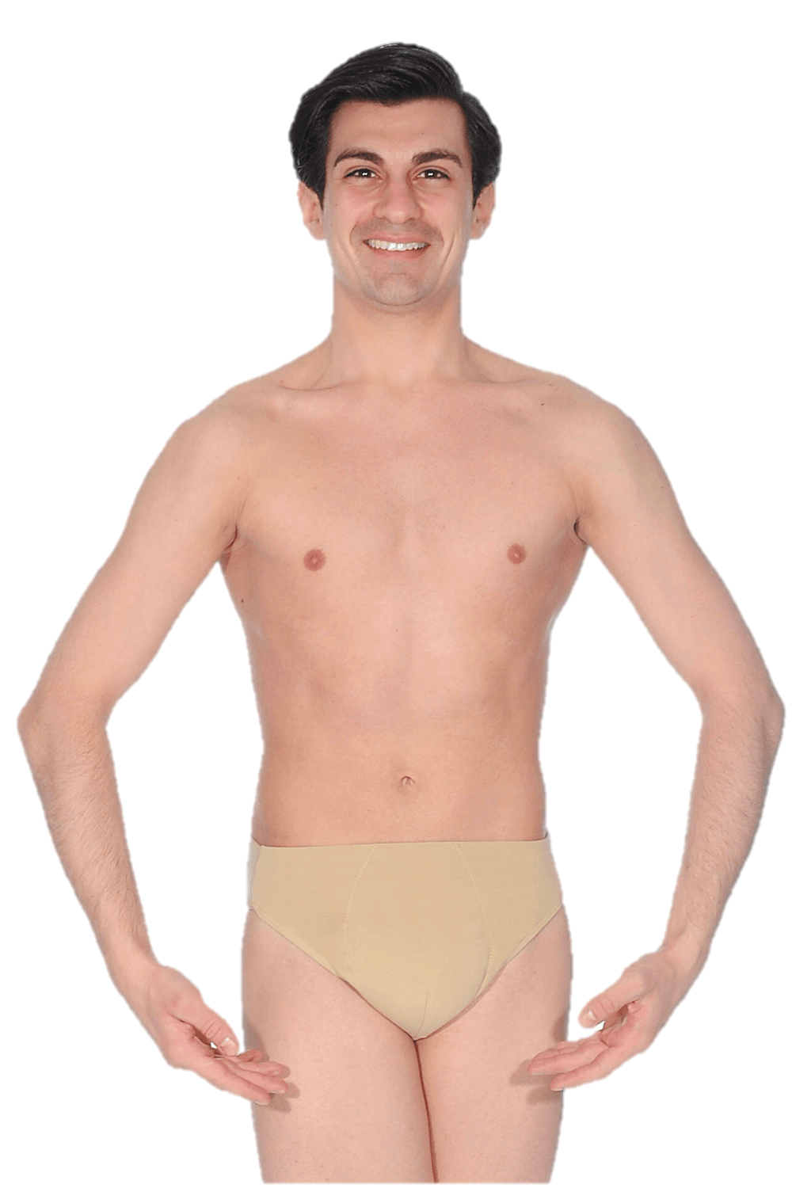
Shaft
Penis

Slide 67
Wang
Penis

Slide 68
Snake
Penis

Slide 69
Pussy
Vagina

Slide 70
Pink taco
Vagina

Slide 71
Moon
Butt

Slide 72
Weiner
Penis

Slide 73
Lady parts (girly bits)
Vagina

Slide 74
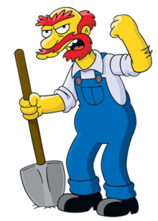
Willie
Penis

Slide 75
Sack
Testicles

Slide 76
Buns
Butt

Slide 77
Booty
Butt

Slide 78
Anaconda
Penis

Slide 79
Hooters
Breasts

Slide 80
Clam
Vagina

Slide 81
Slit
Vagina

Slide 82
Tits
Breasts

Slide 83
Family jewels
Breasts

Slide 84
Nuts
Testicles

Slide 85
Arse
Butt

Slide 86
Money maker
Butt

Slide 87
Assets
Breasts (or butt)

Slide 88
Johnson
Penis

Slide 89
Disco stick
Penis

Slide 90
Snatch
Vagina

Slide 91
Beaver
Vagina (pubic hair)

Slide 92
Muffin
Vagina

Slide 93
Dangly bits
Testicles

