Slide 1
Explain the map

Slide 2
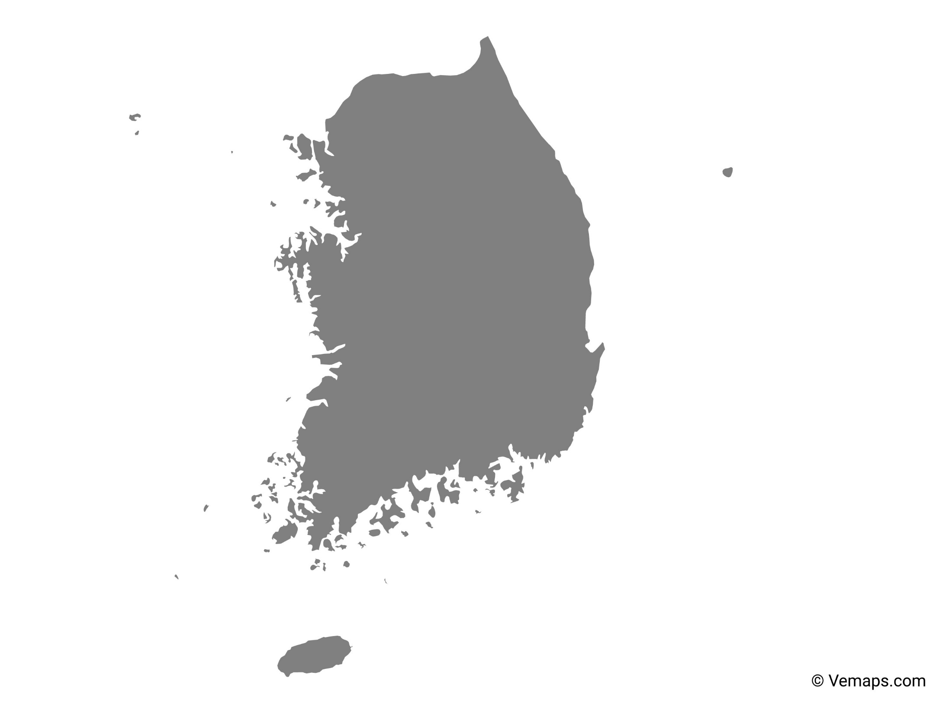
Find the Country
Use the shapes to find the country names
Korea

Slide 3
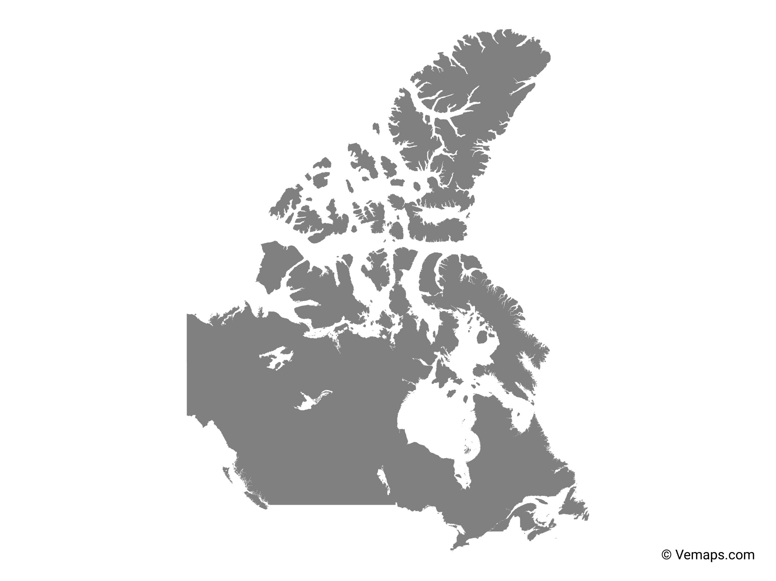
Canada

Slide 4
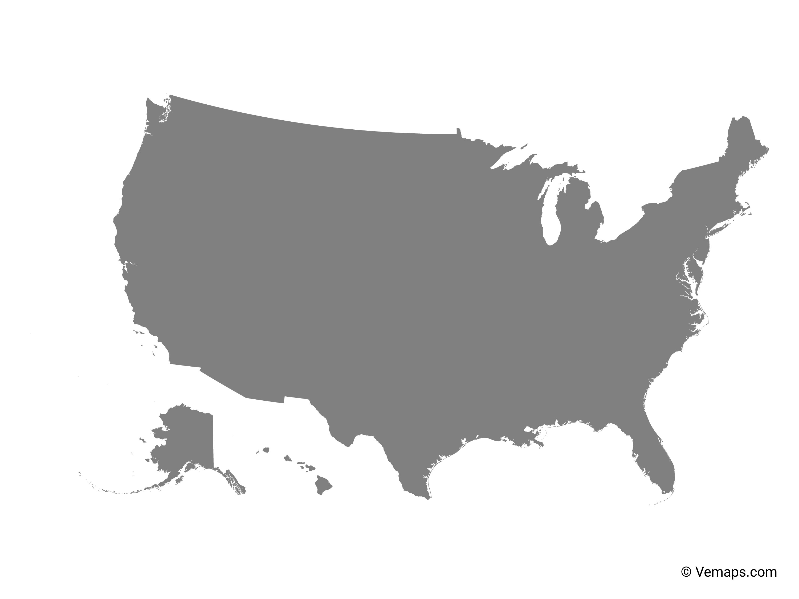
USA

Slide 5
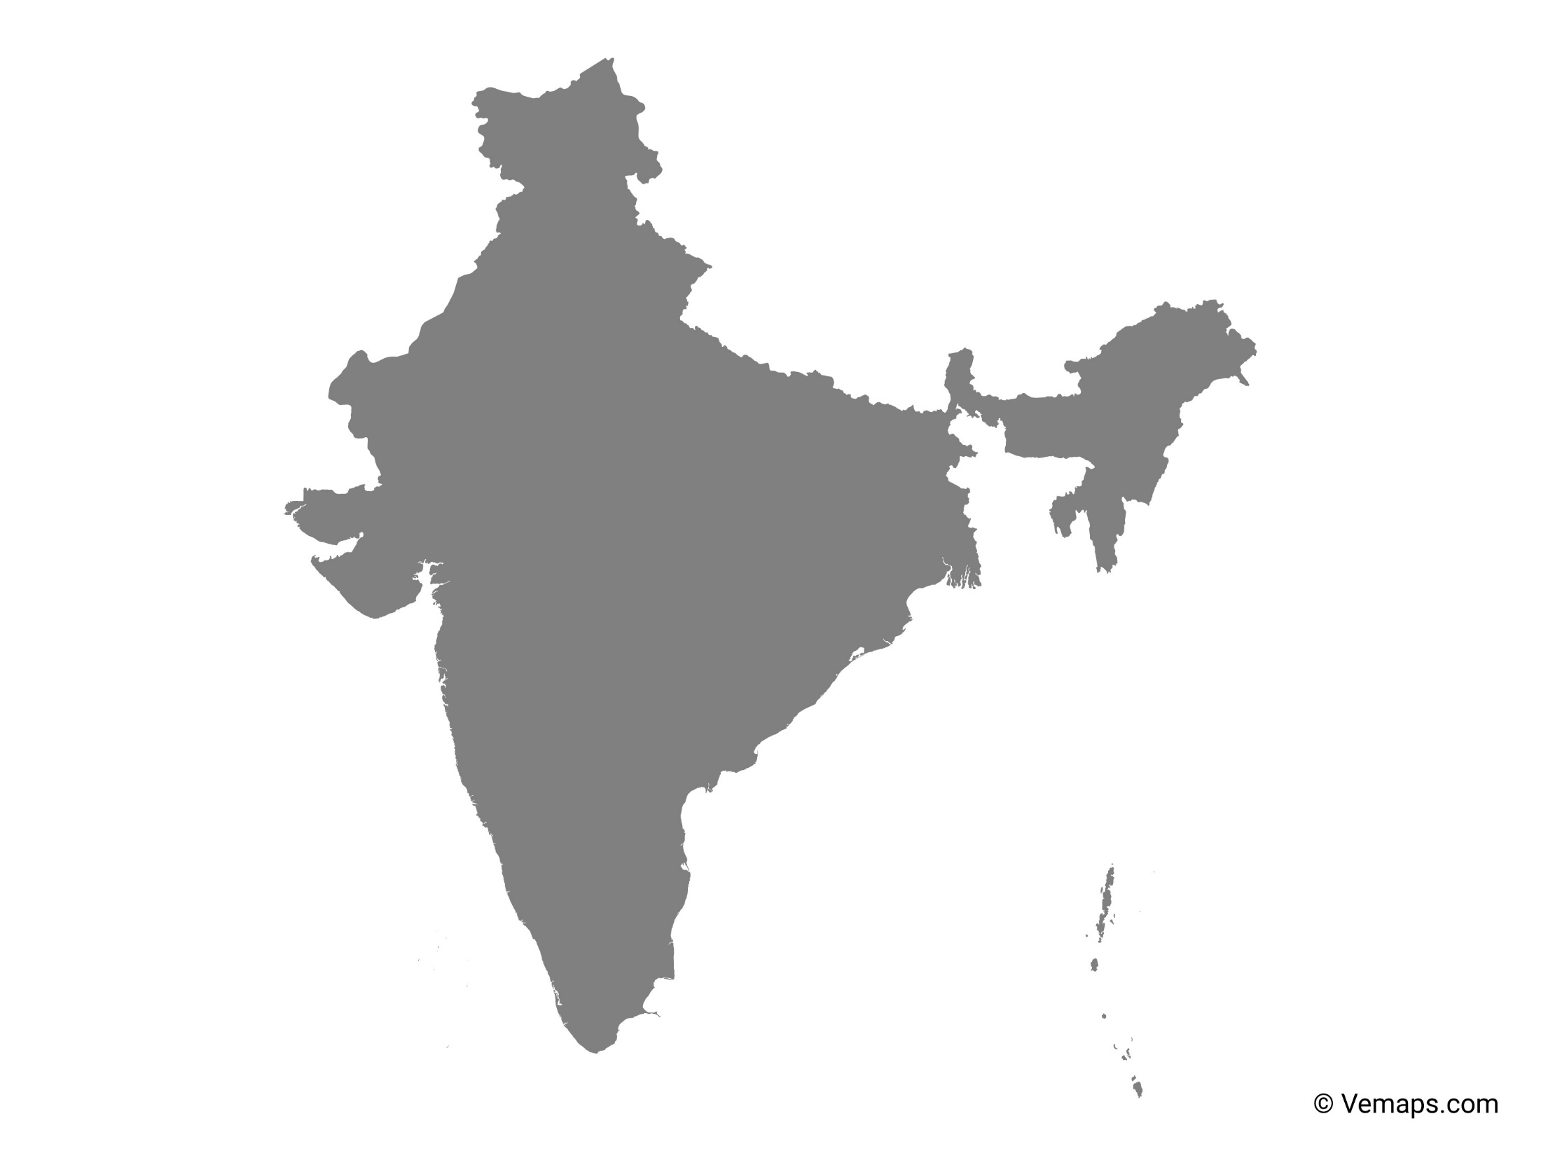
India

Slide 6
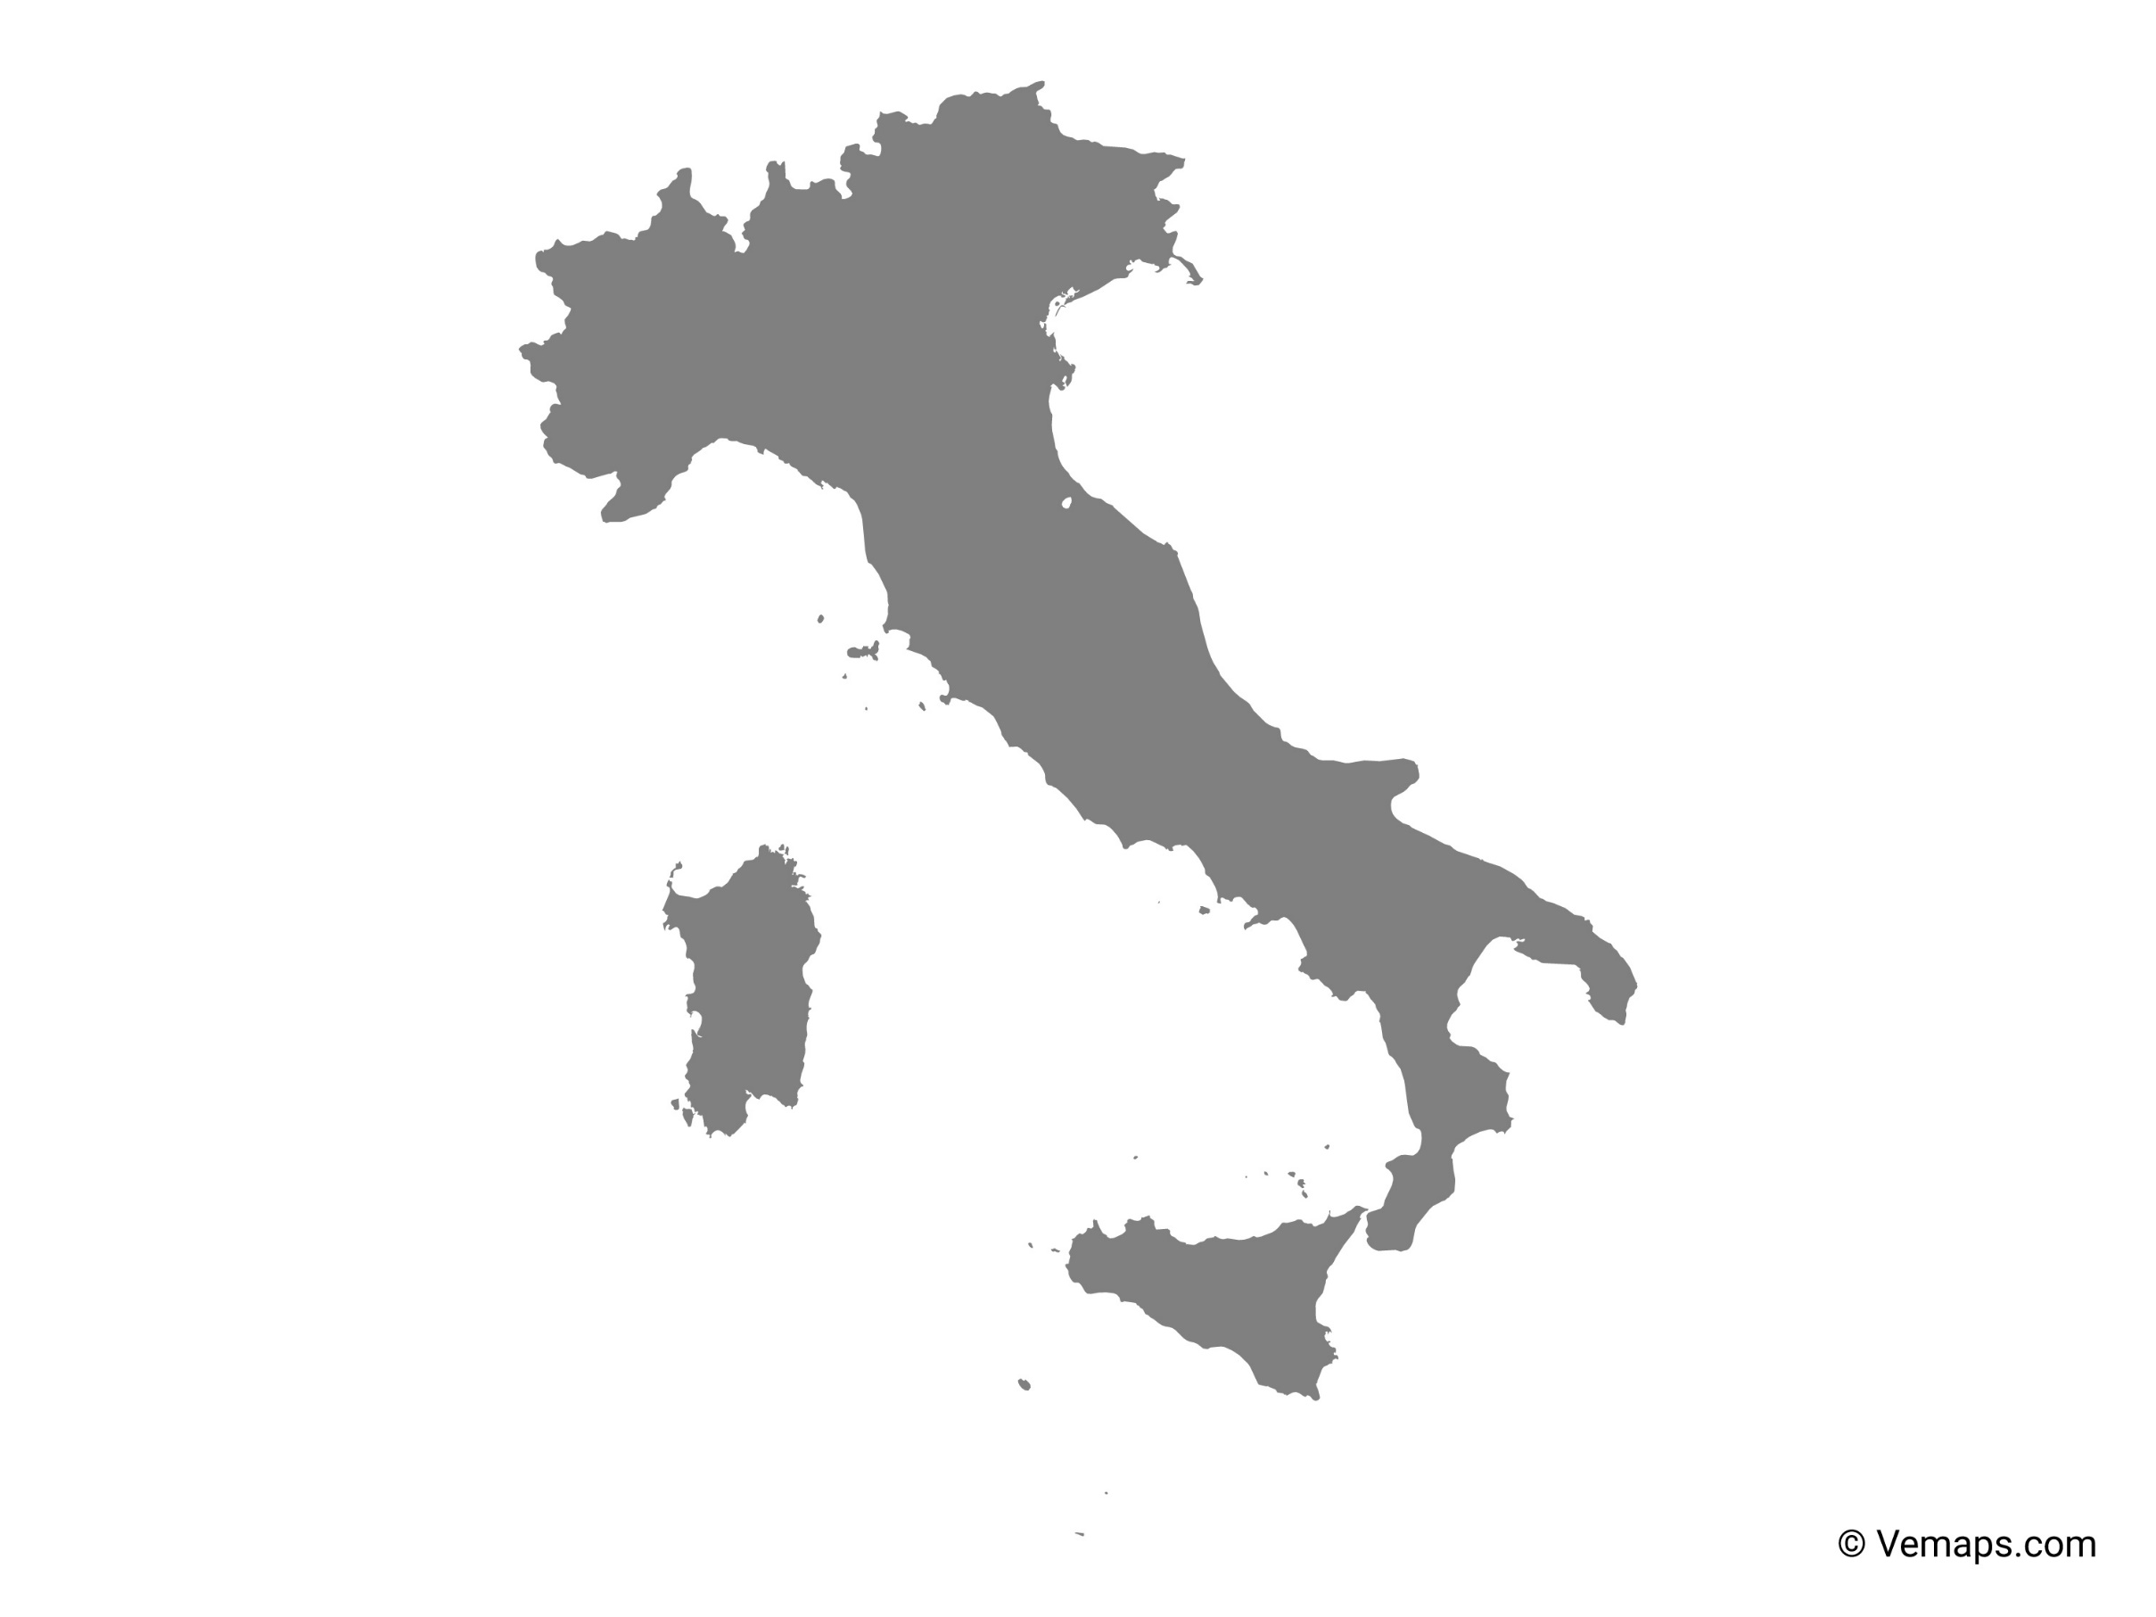
Italy

Slide 7
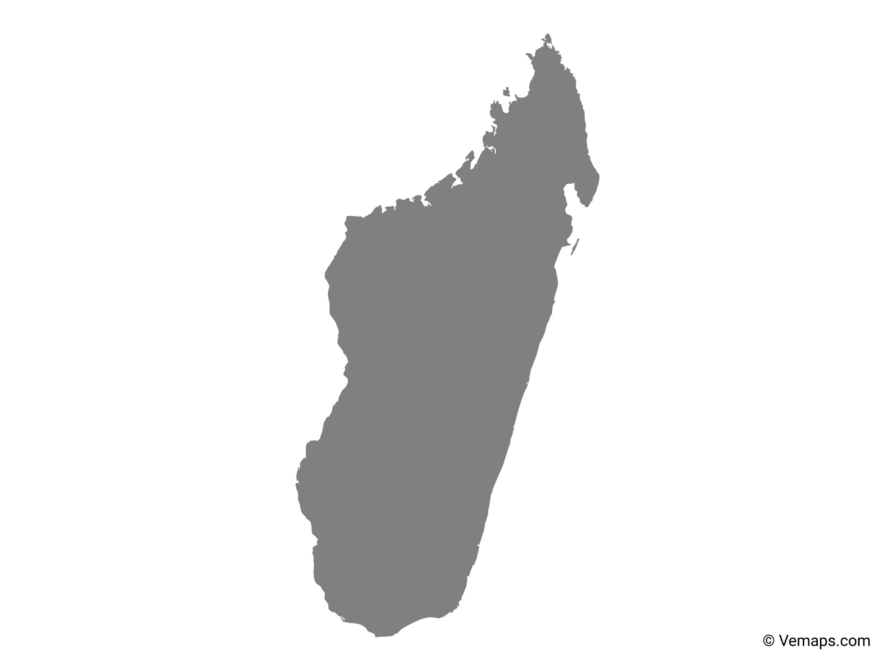
Madagascar

Slide 8
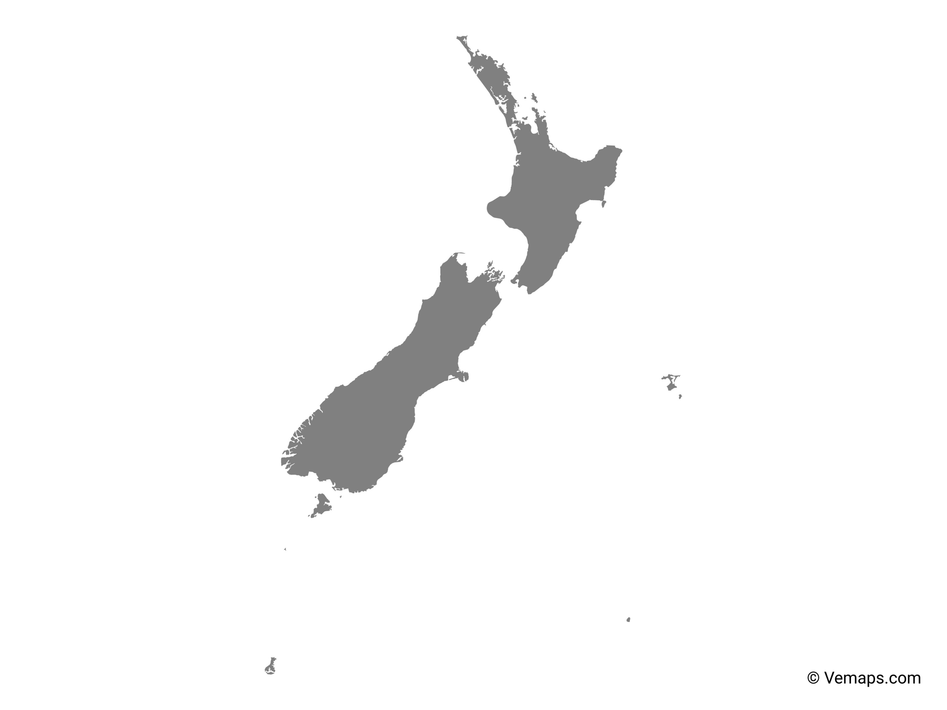
New Zealand

Slide 9
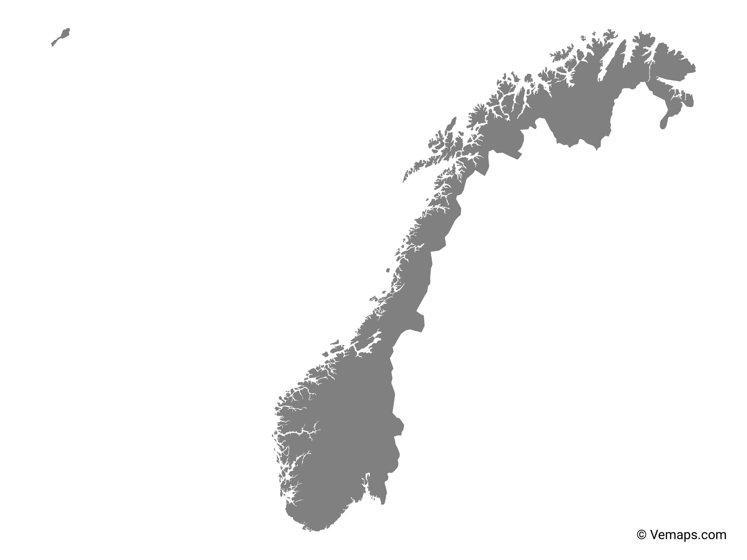
Norway

Slide 10
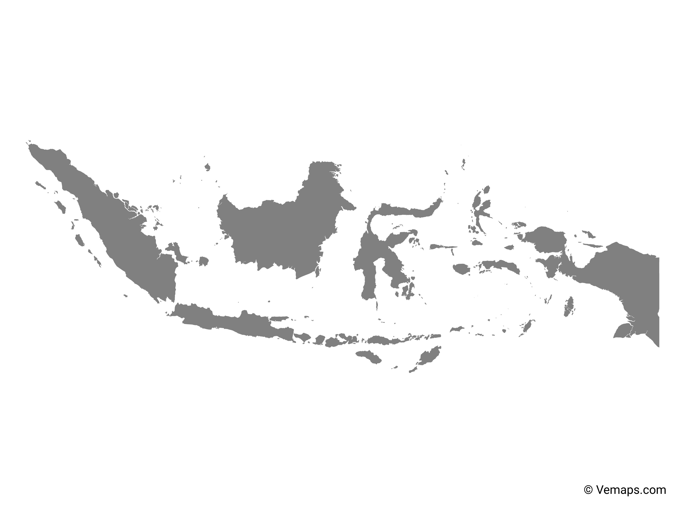
Indonesia

Slide 11
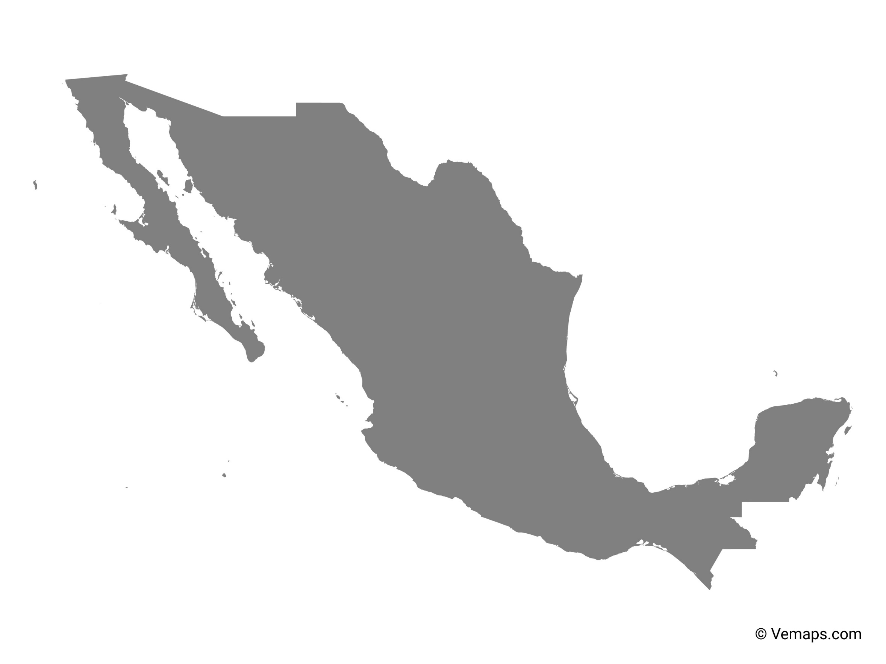
Mexico

Slide 12
Turkey

Slide 13
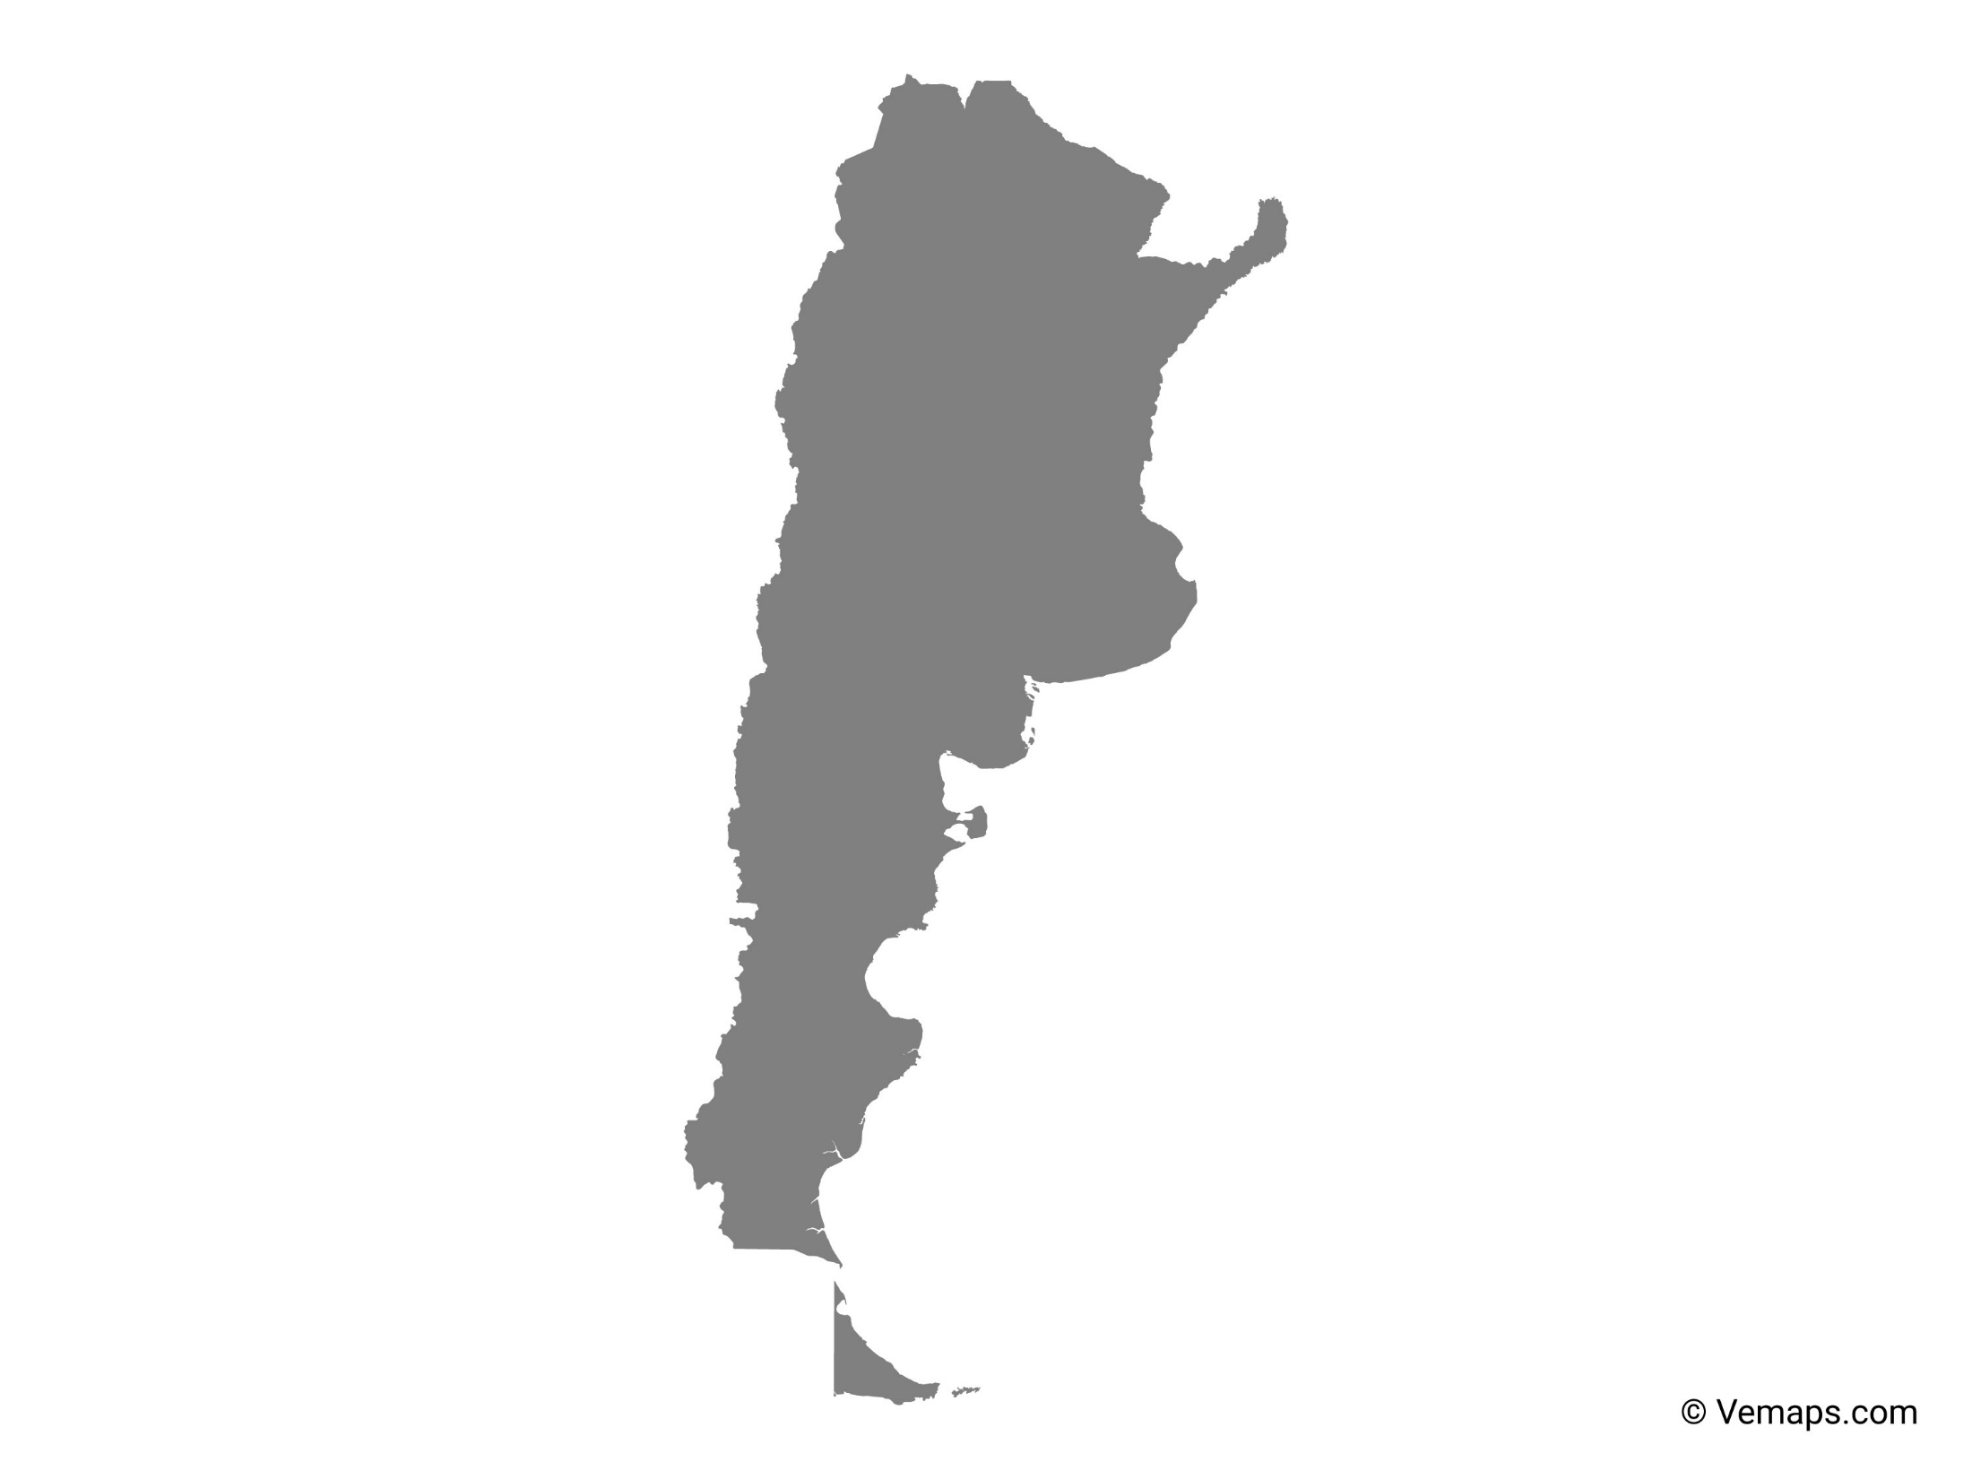
Argentina

Slide 14
Spain

Slide 15
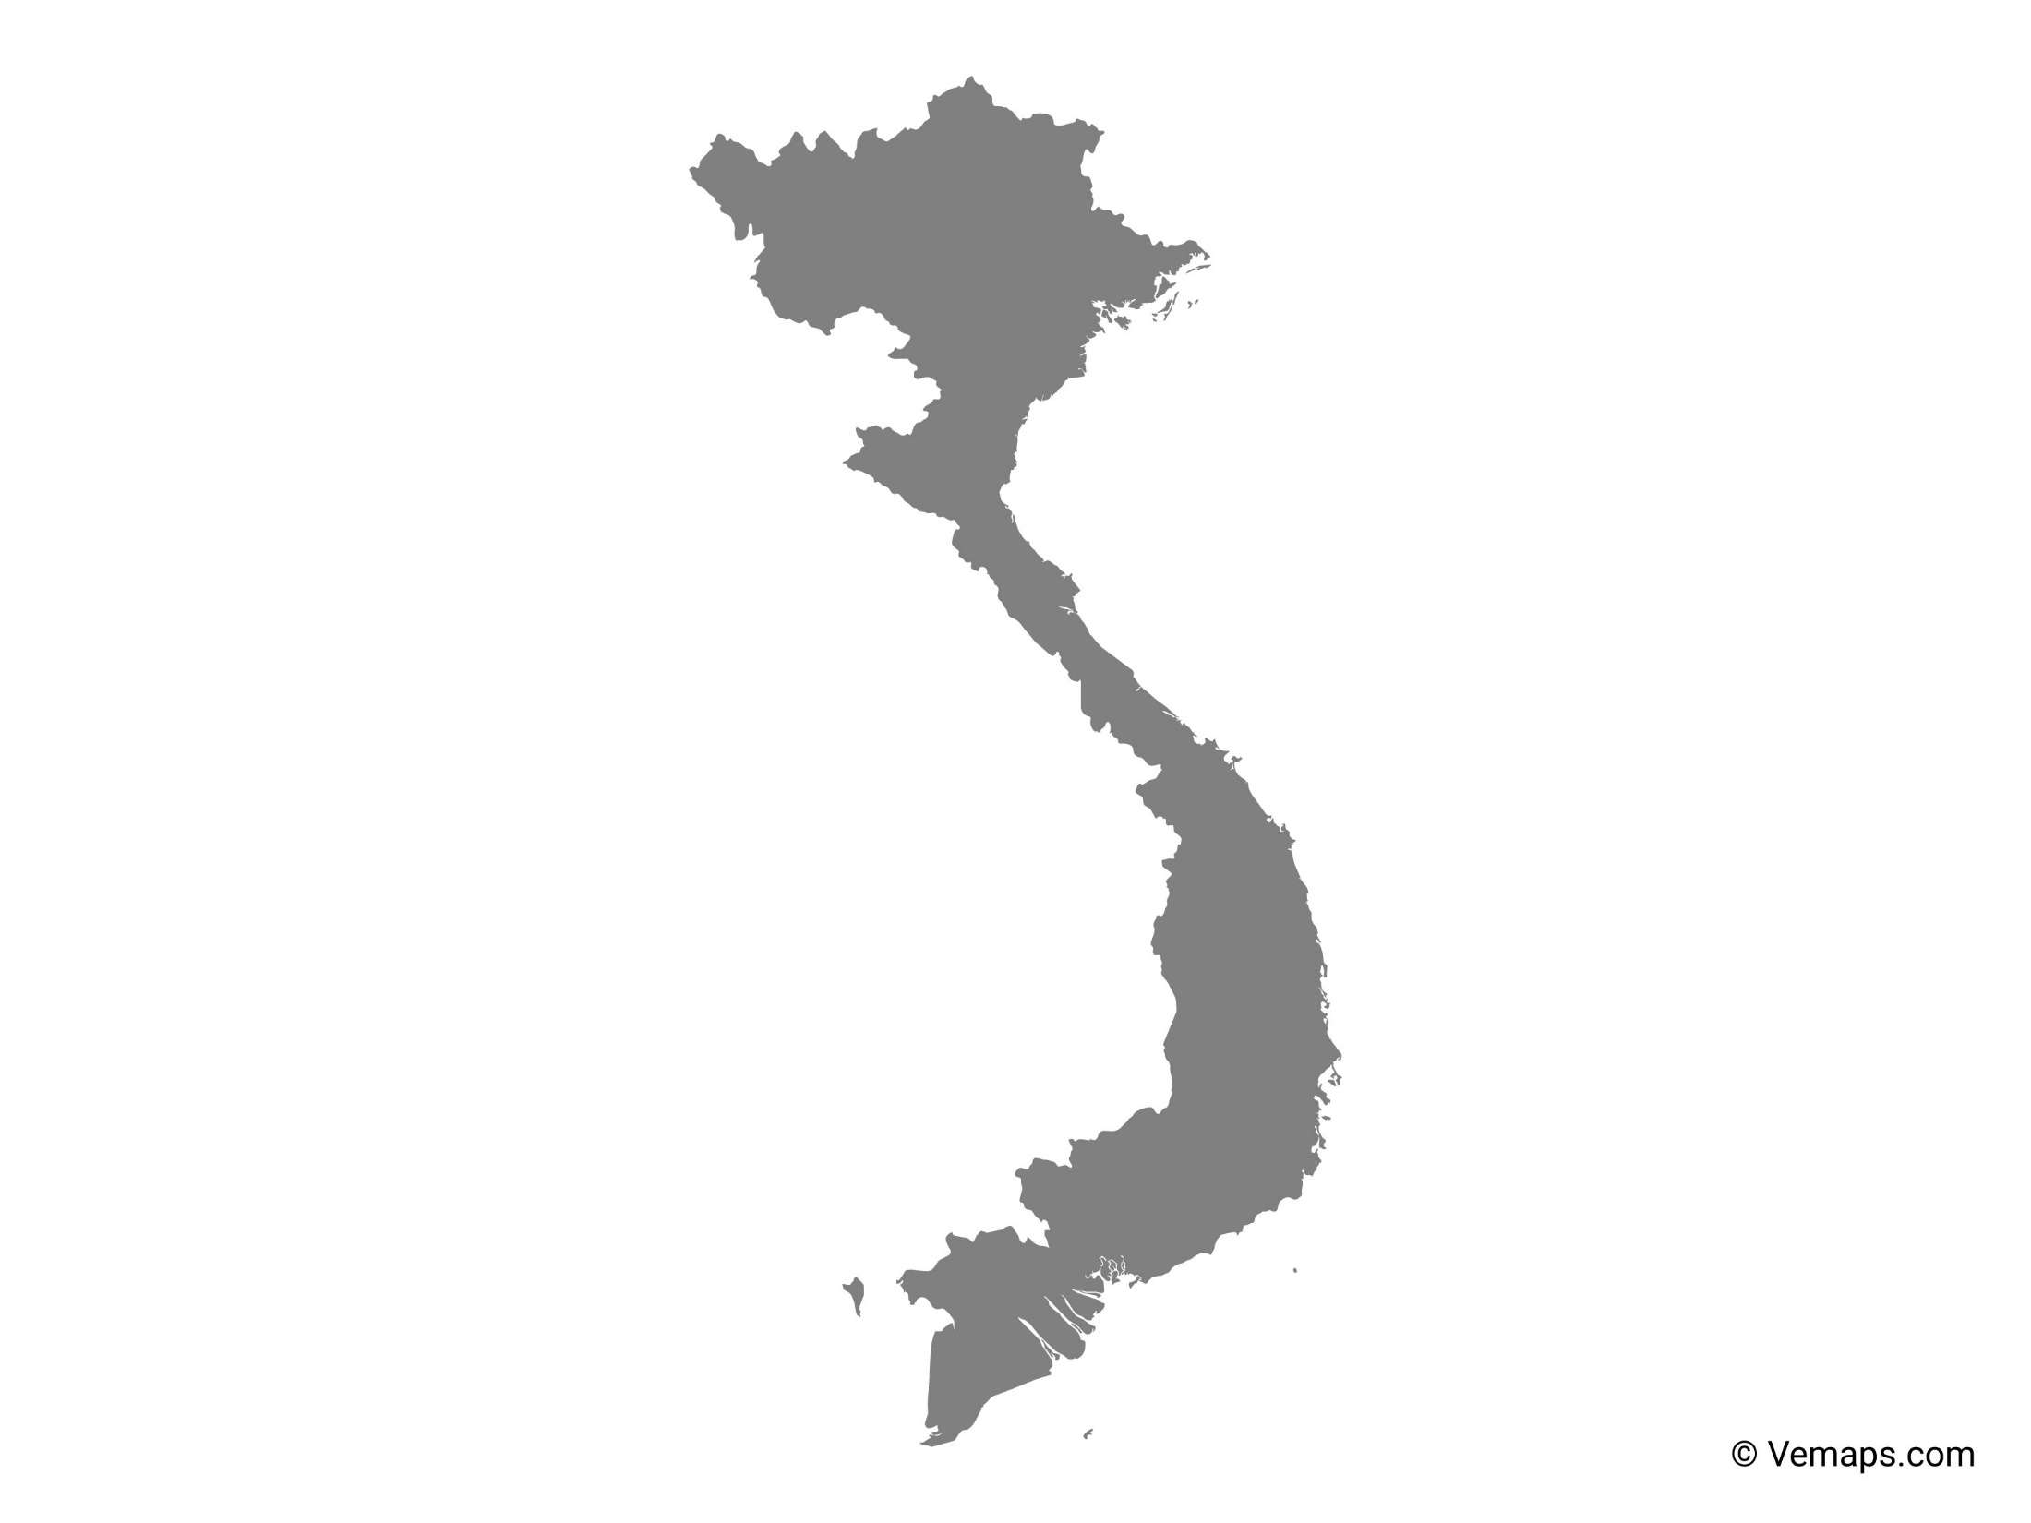
Vietnam

Slide 16
Mongolia

Slide 17
Cuba

Slide 18
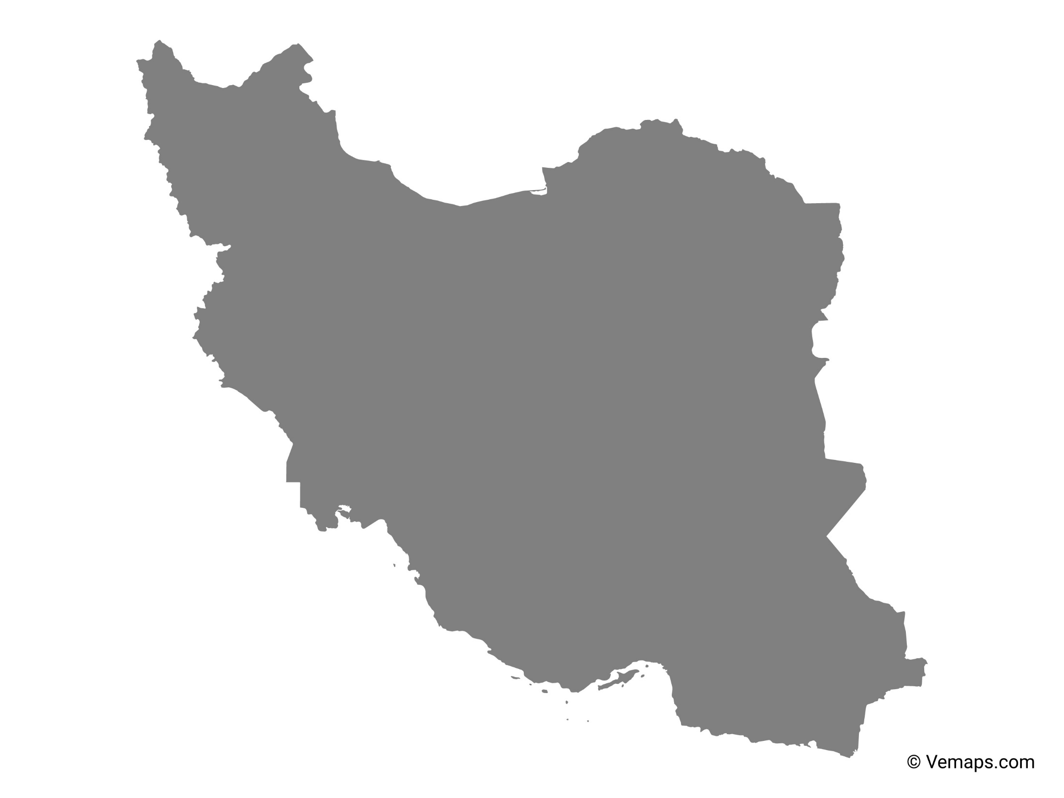
Iran

Slide 19
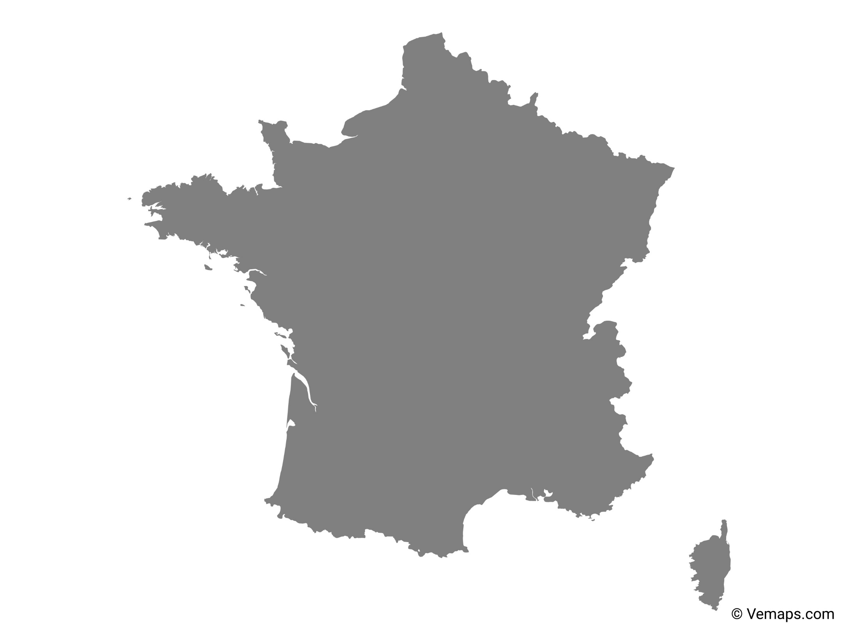
France

Slide 20
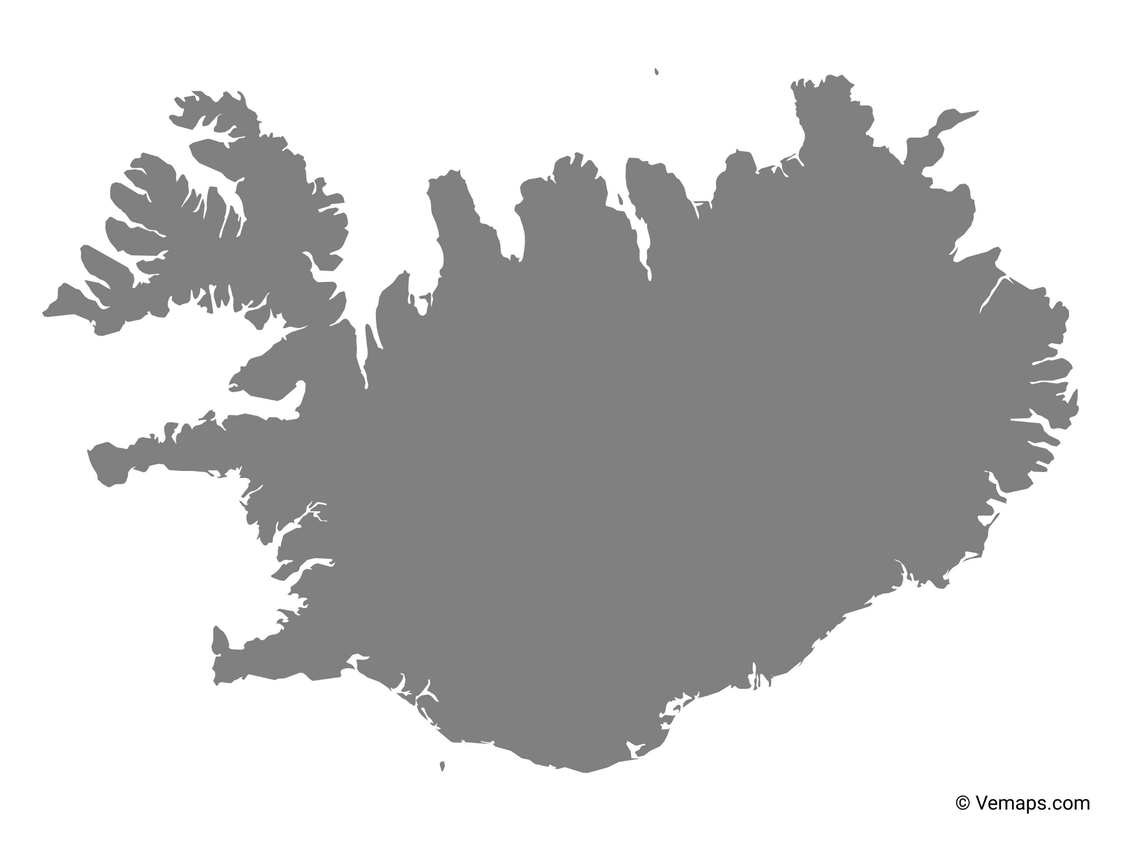
Iceland

Slide 21
South Africa

Slide 22
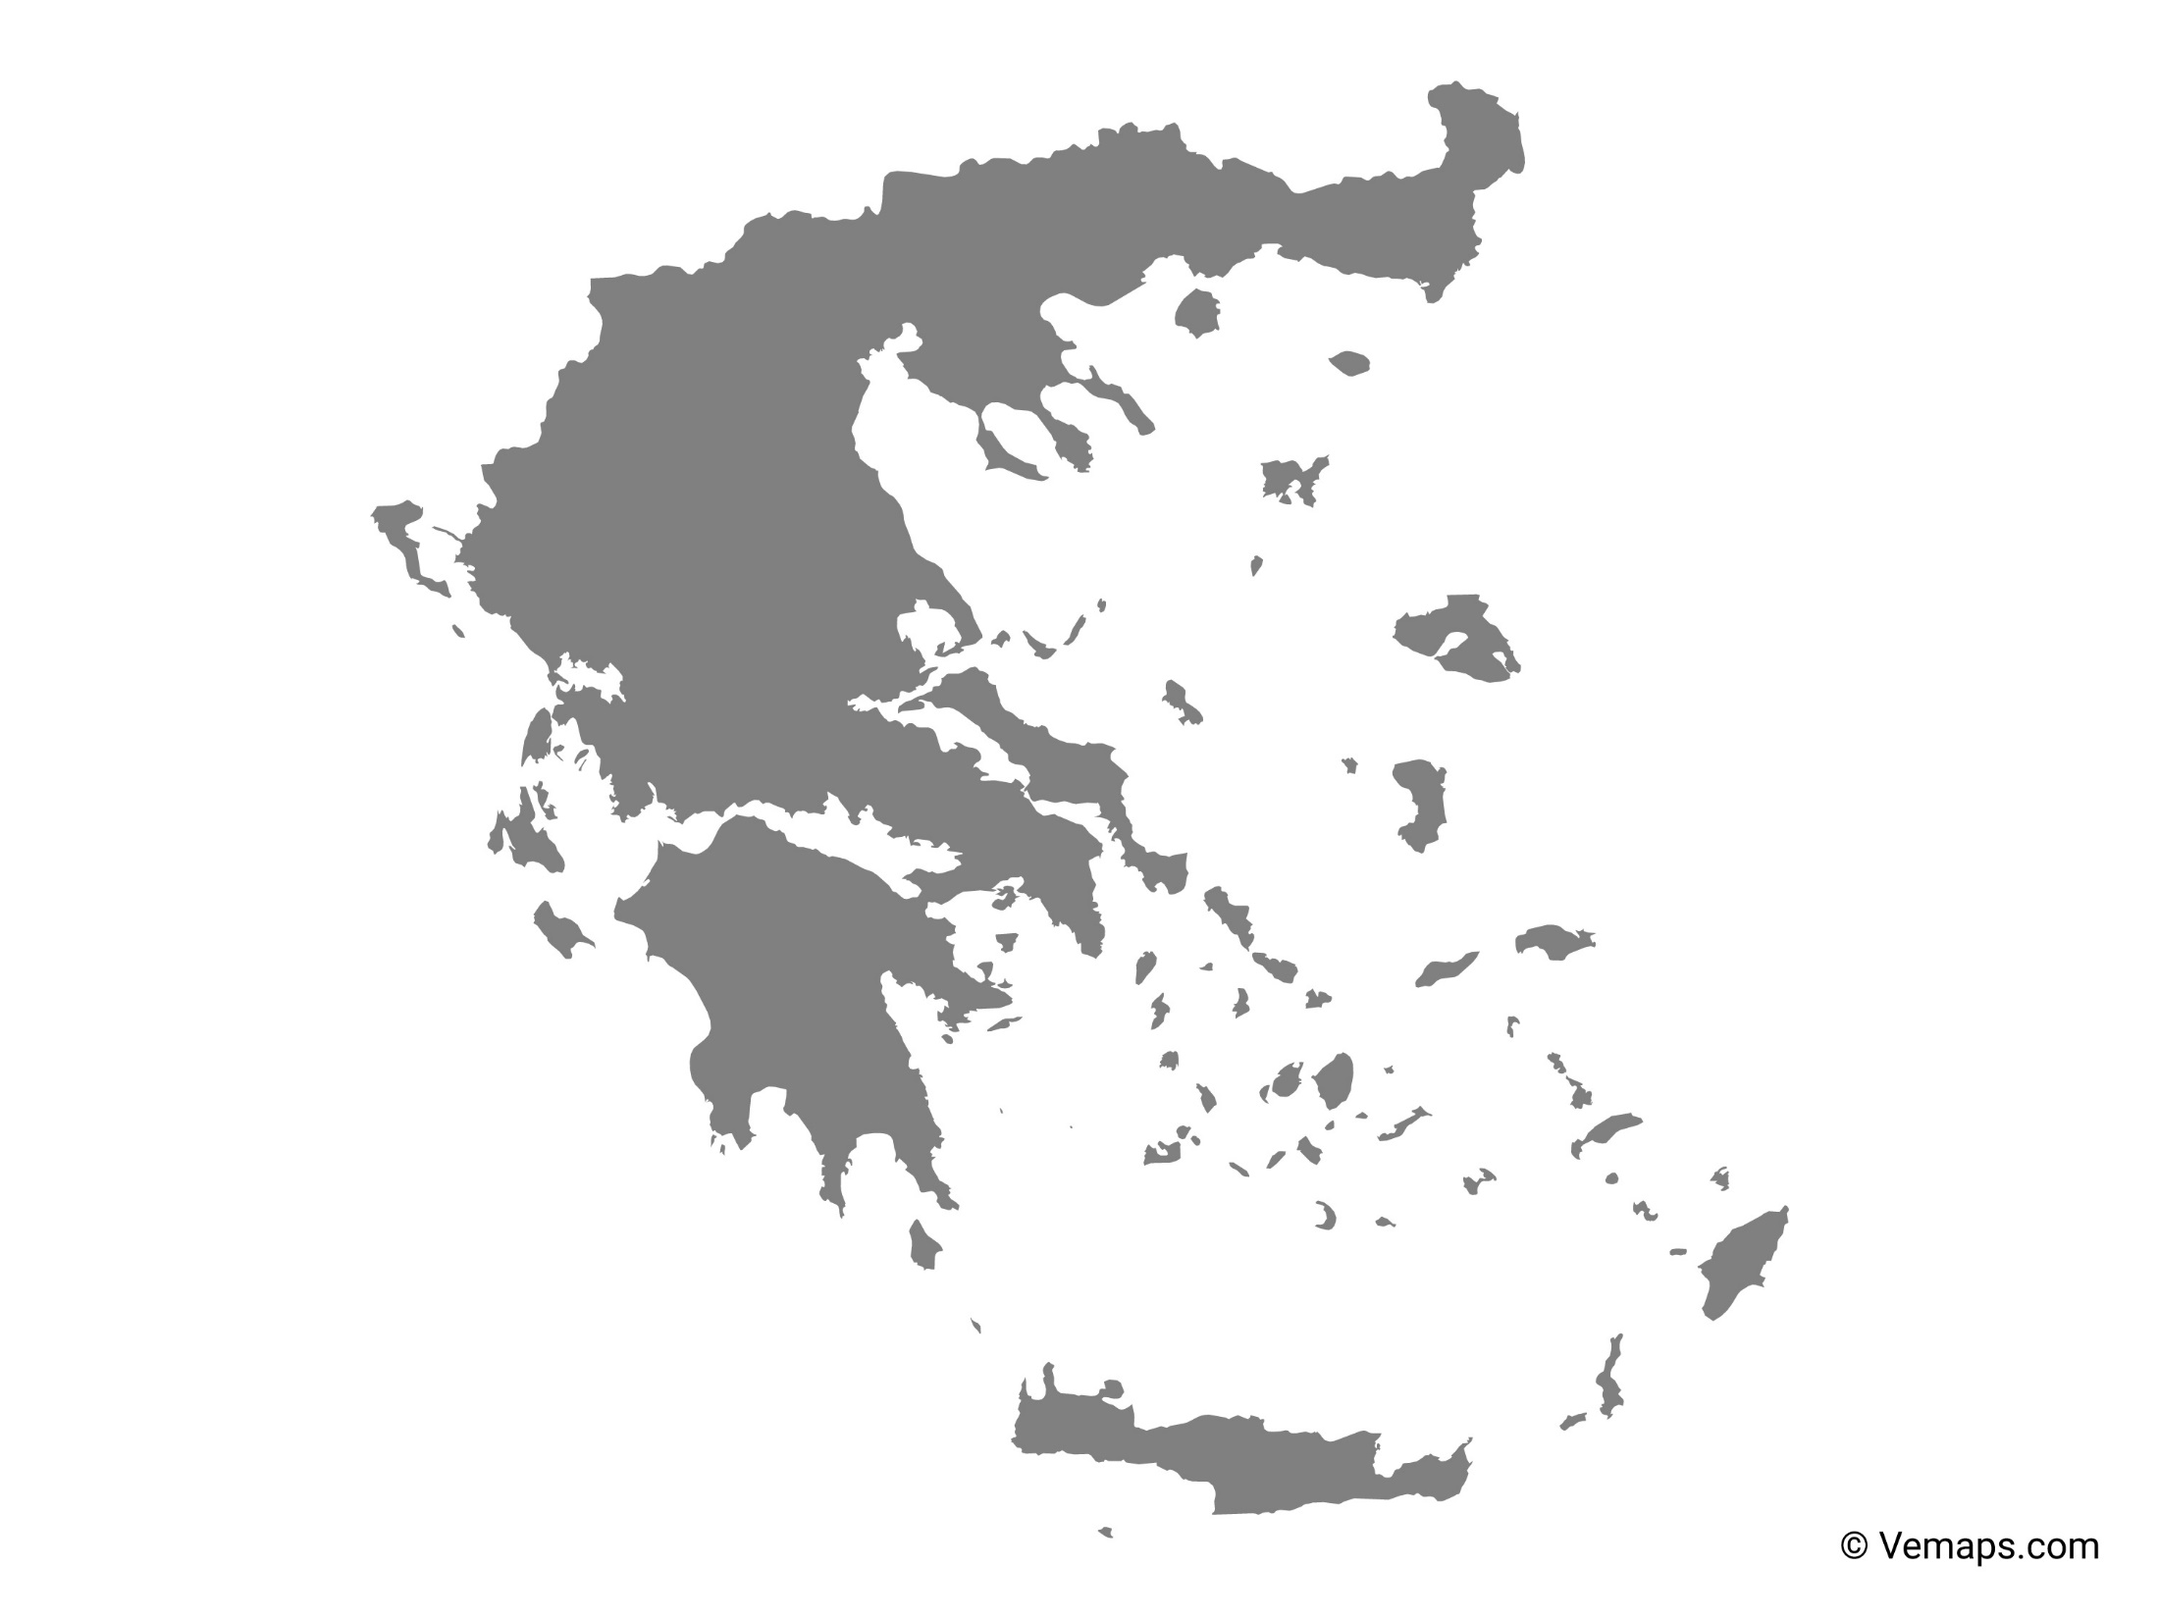
Greece

Slide 23
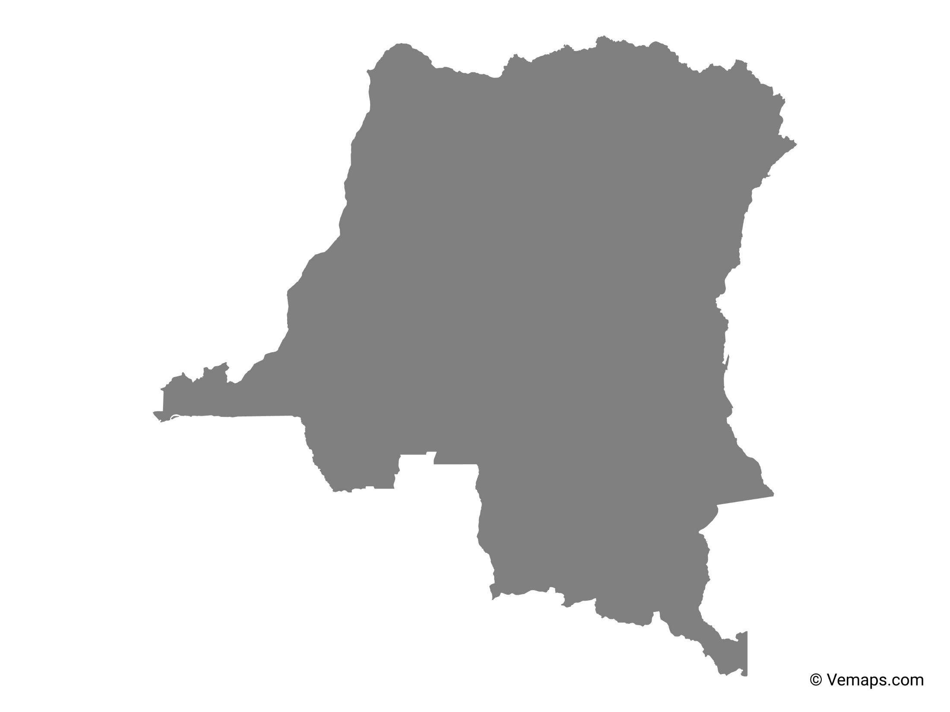
Congo

Slide 24
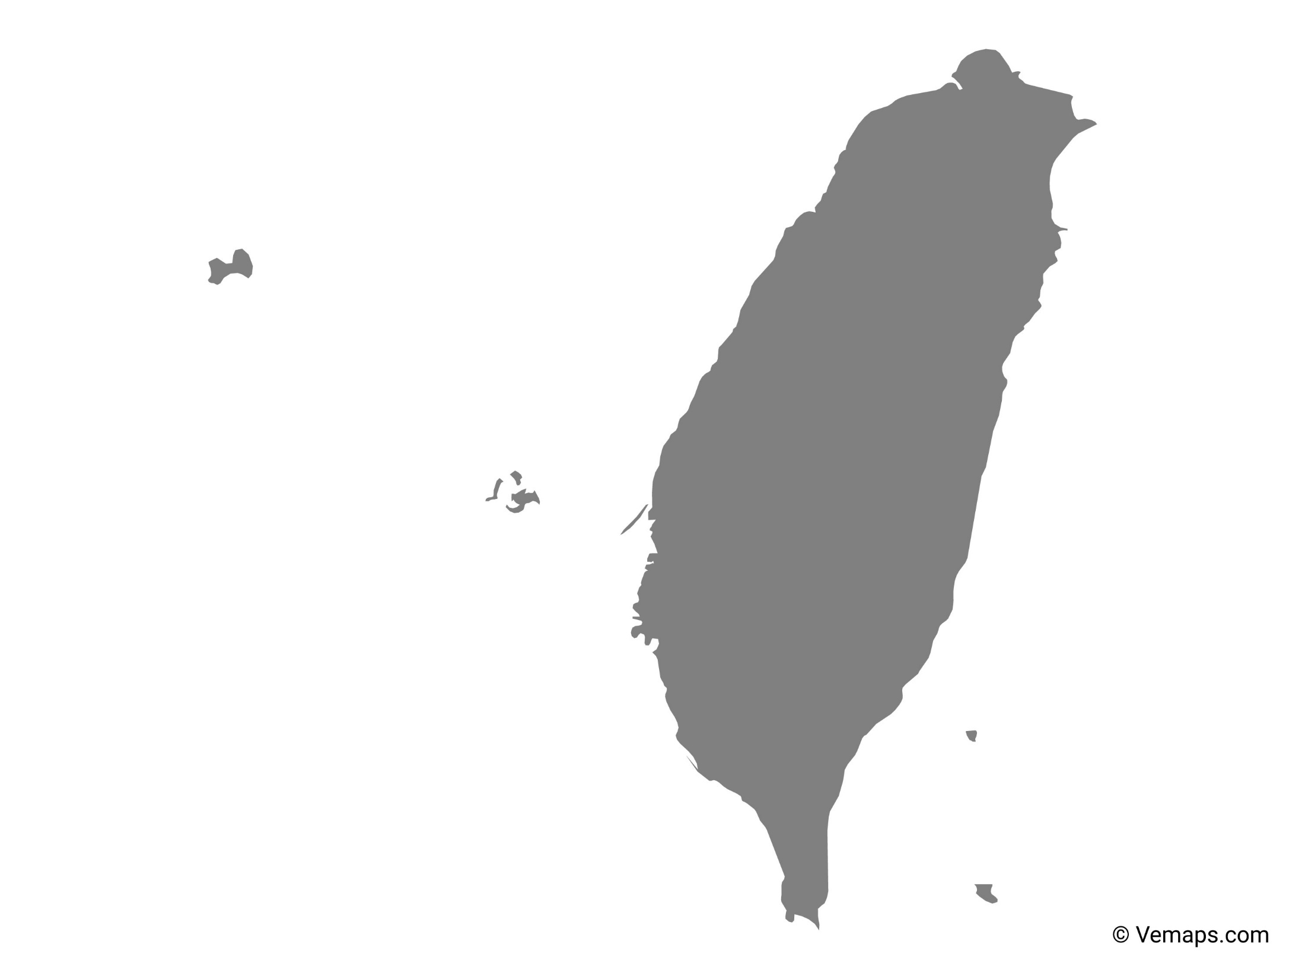
Taiwan

Slide 25
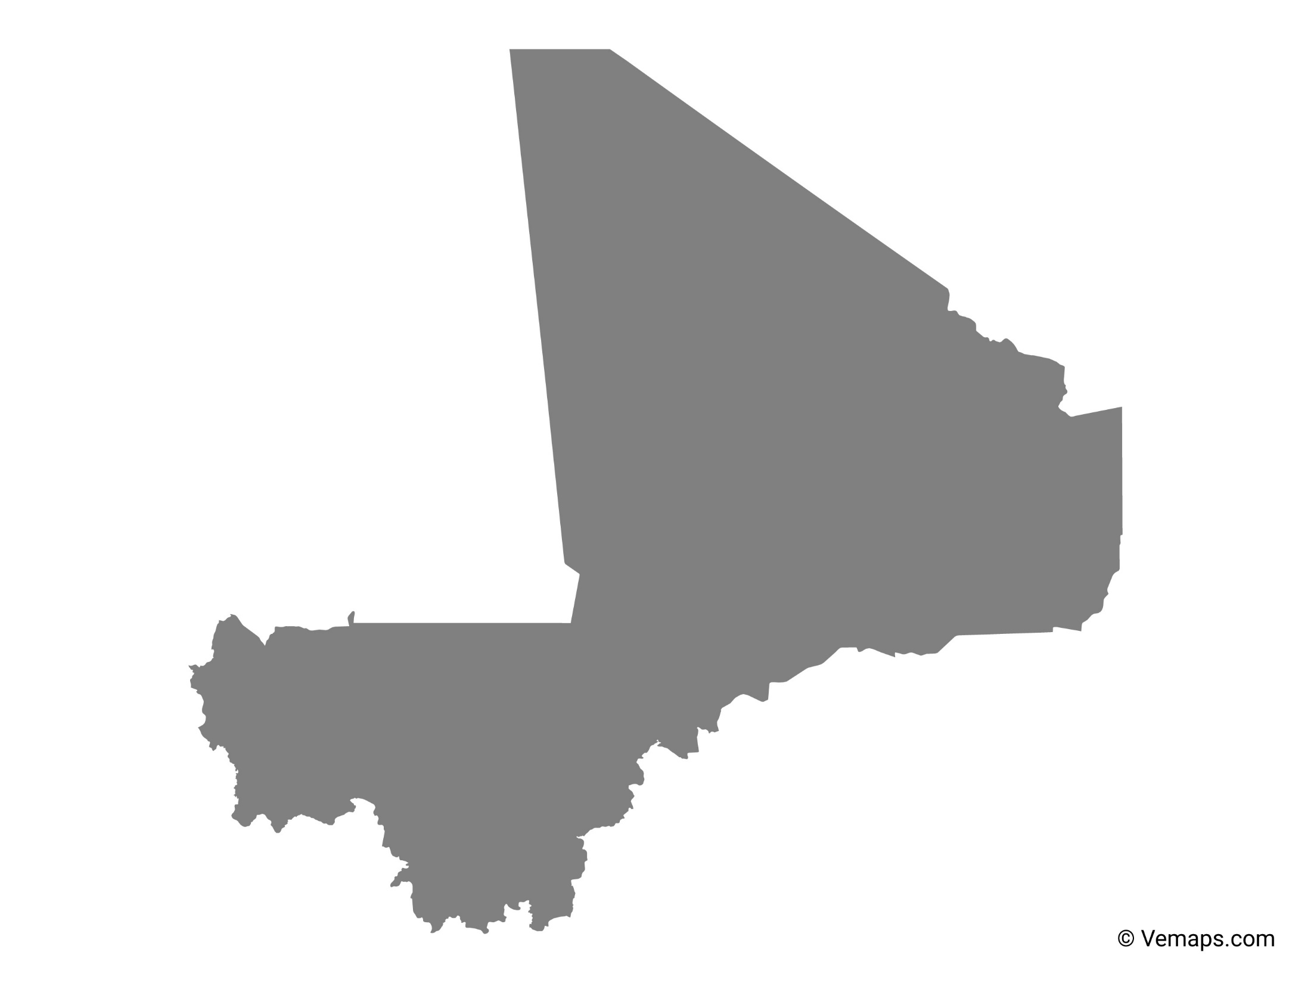
Mali

Slide 26
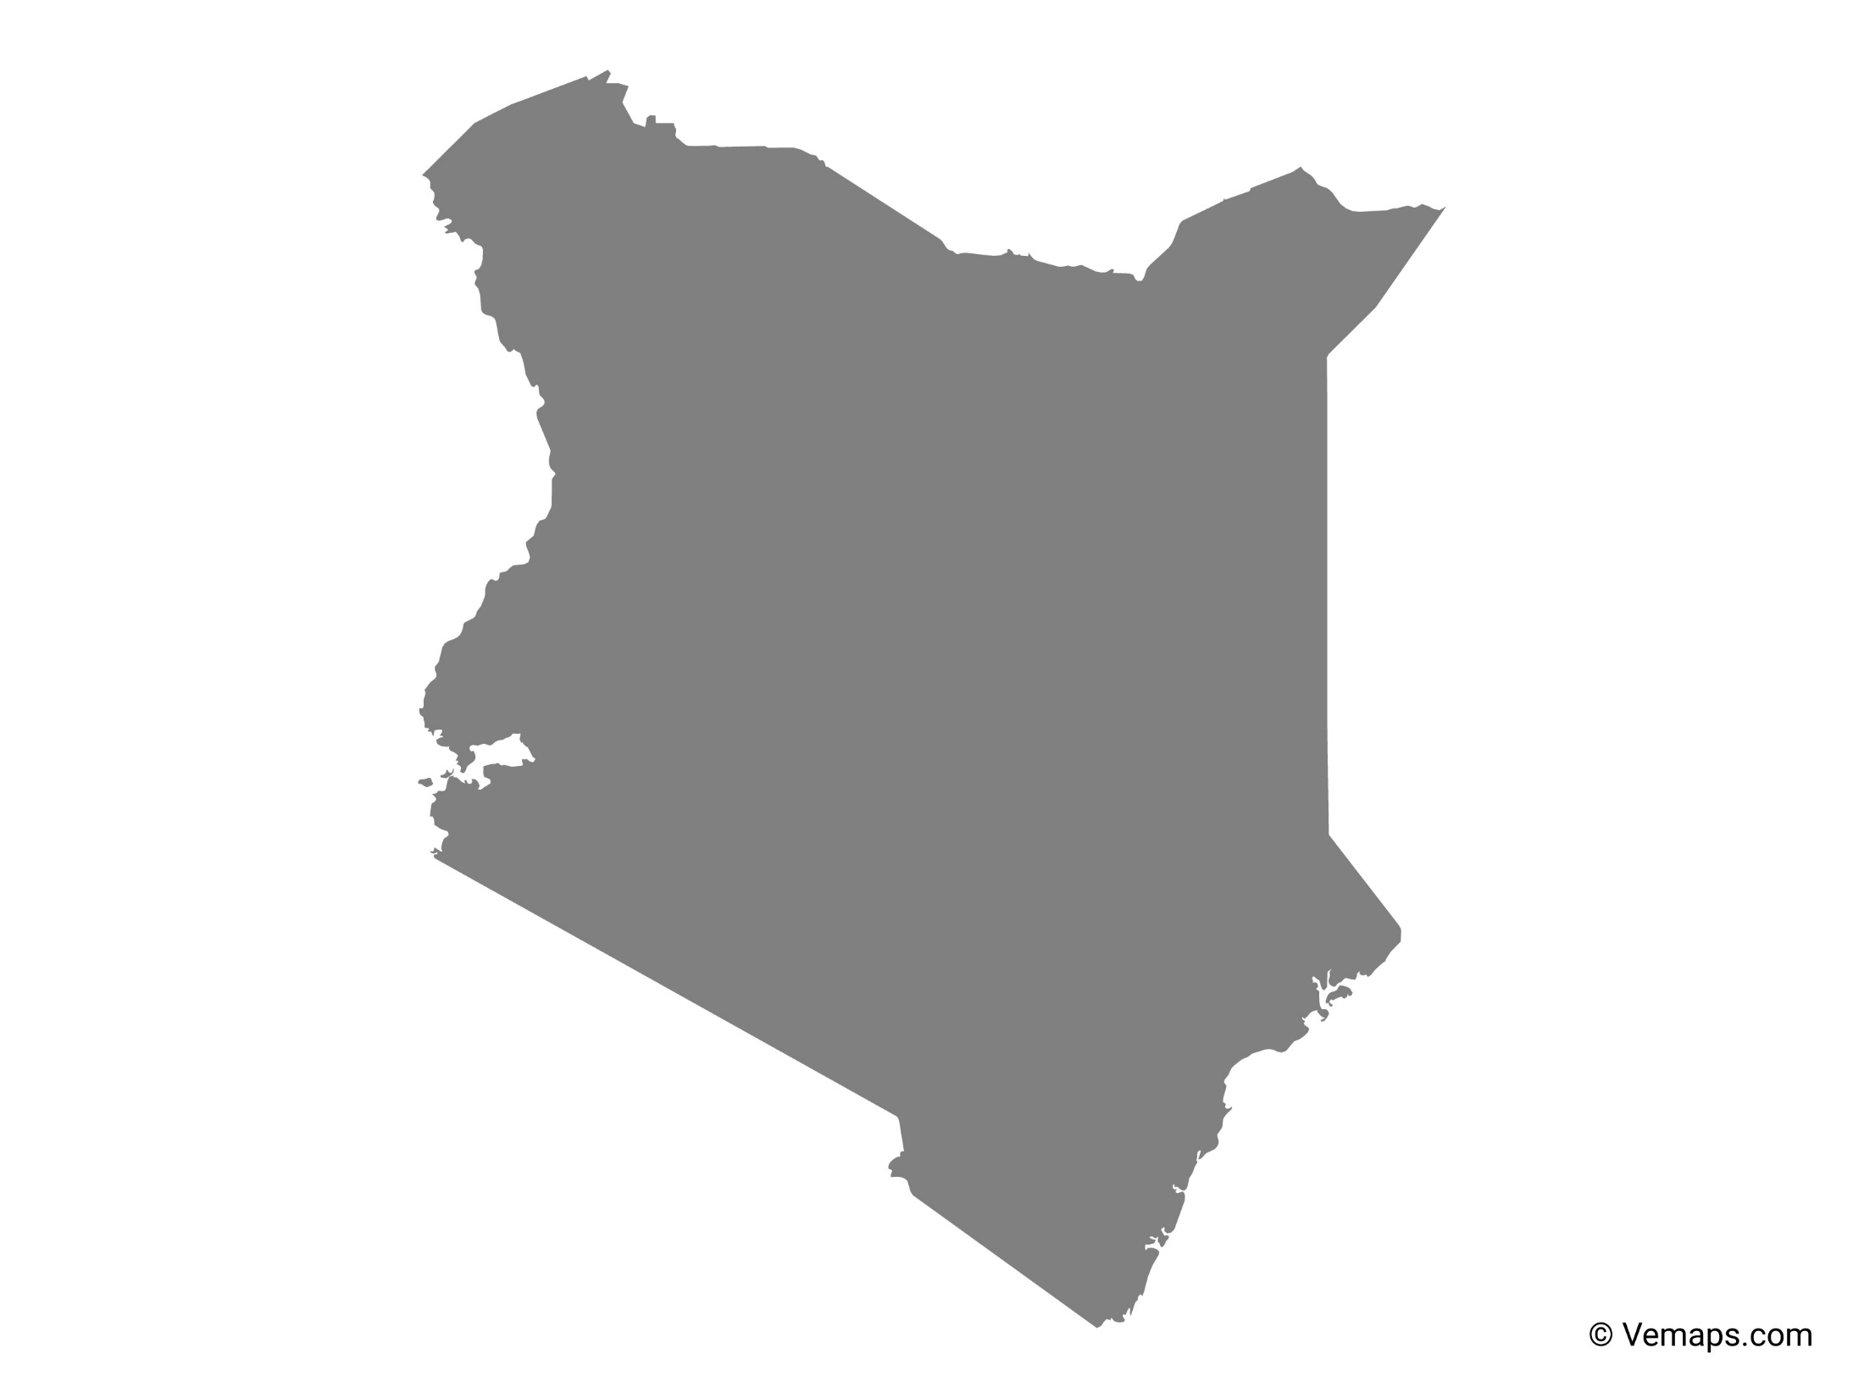
Kenya

Slide 27
Paraguay

Slide 28
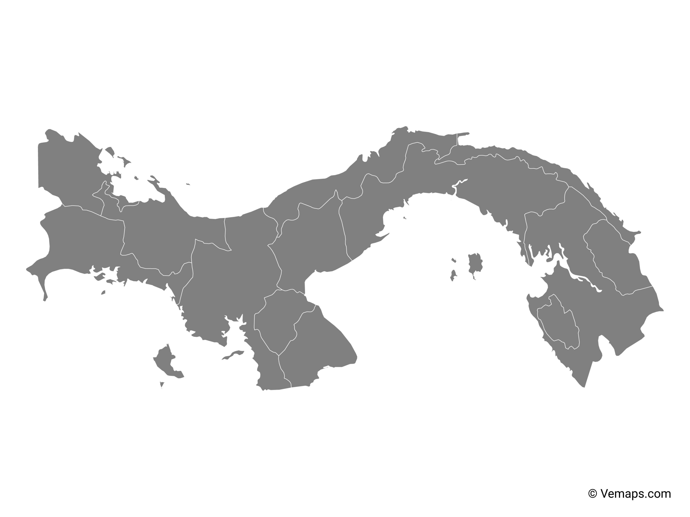
Panama

Slide 29
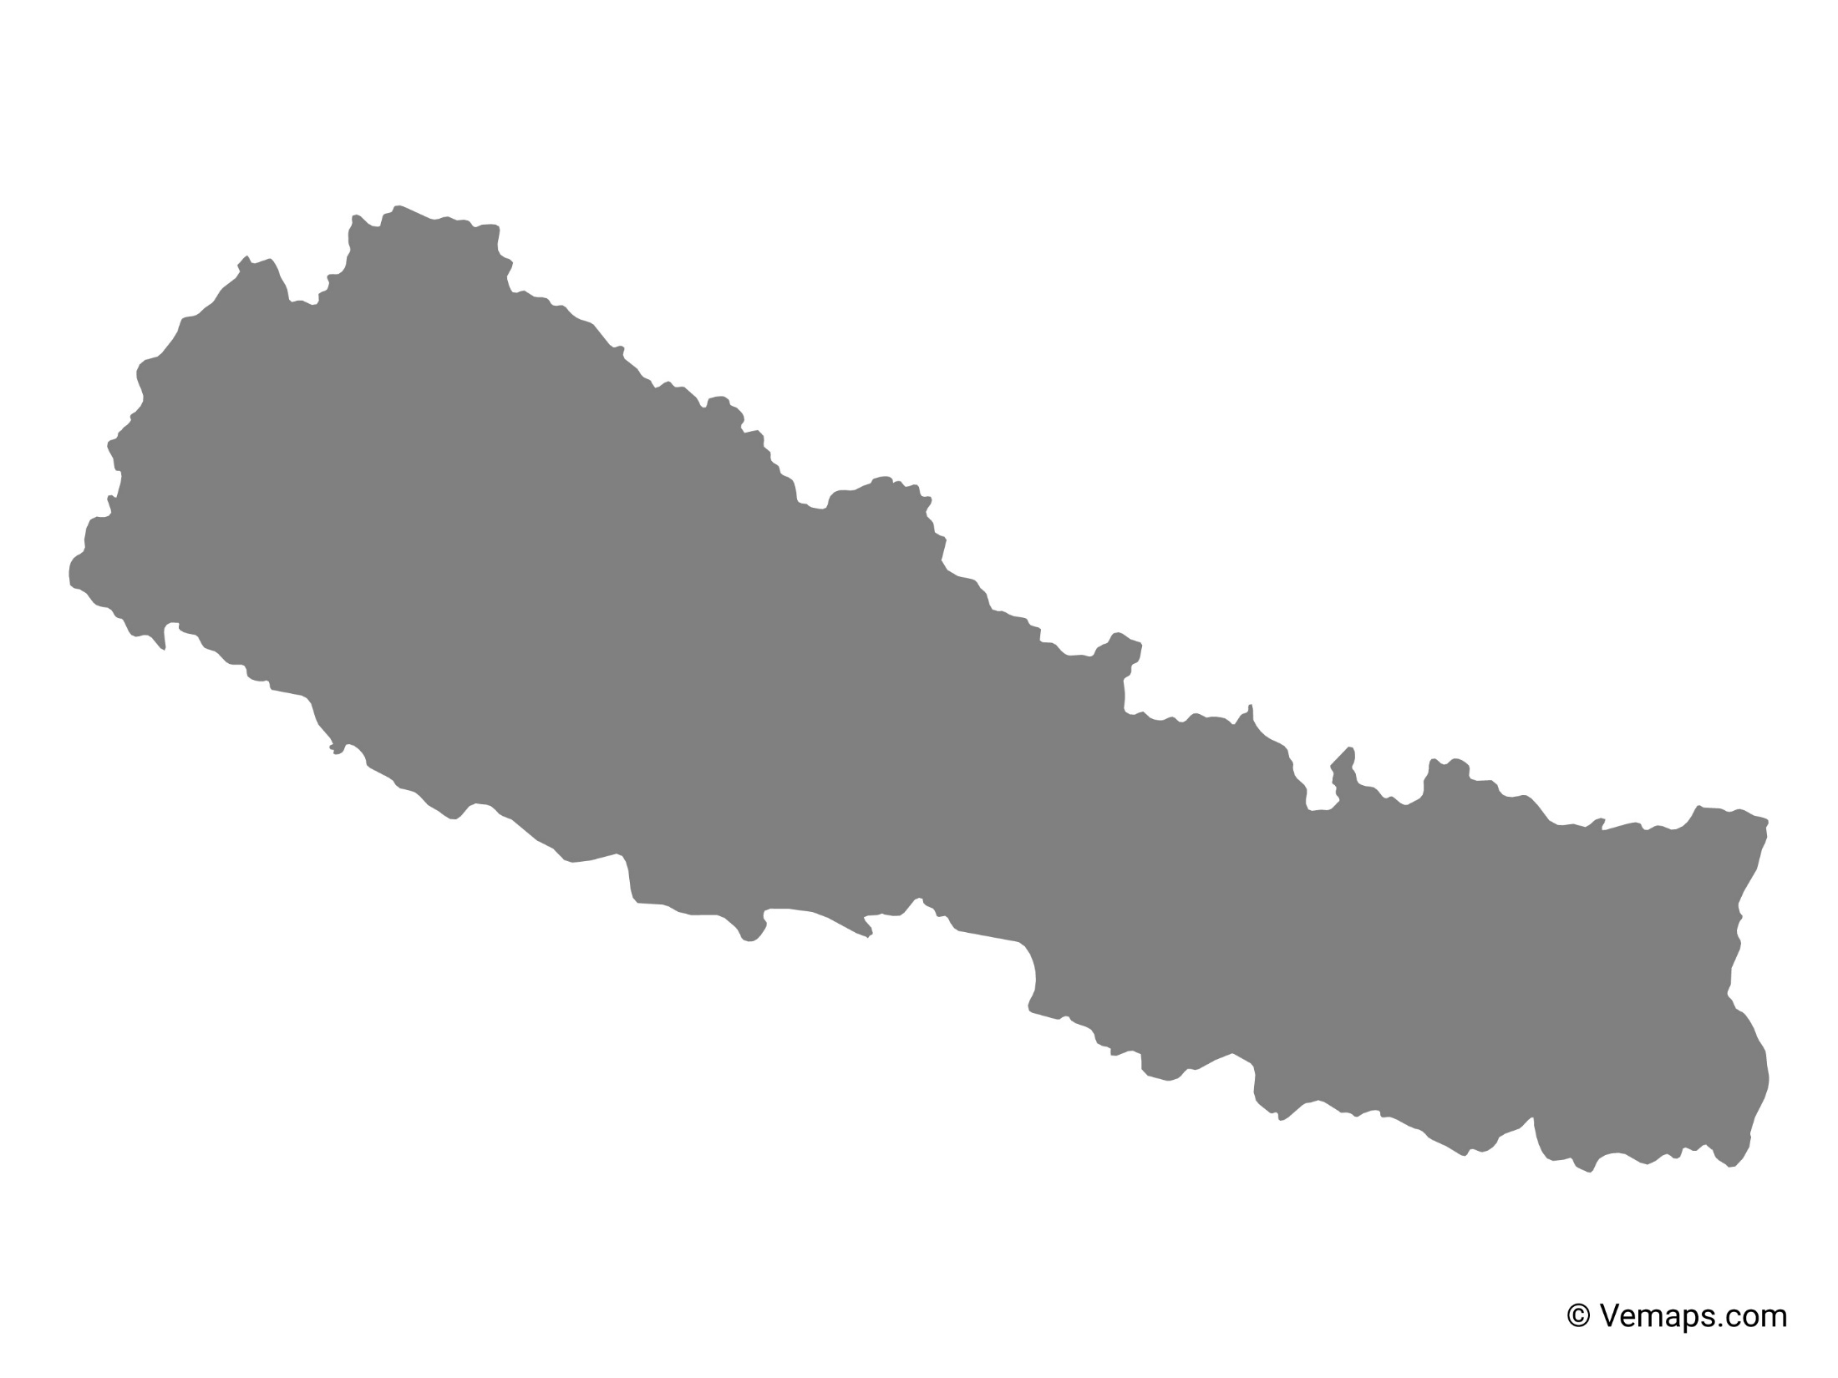
Nepal

Slide 30
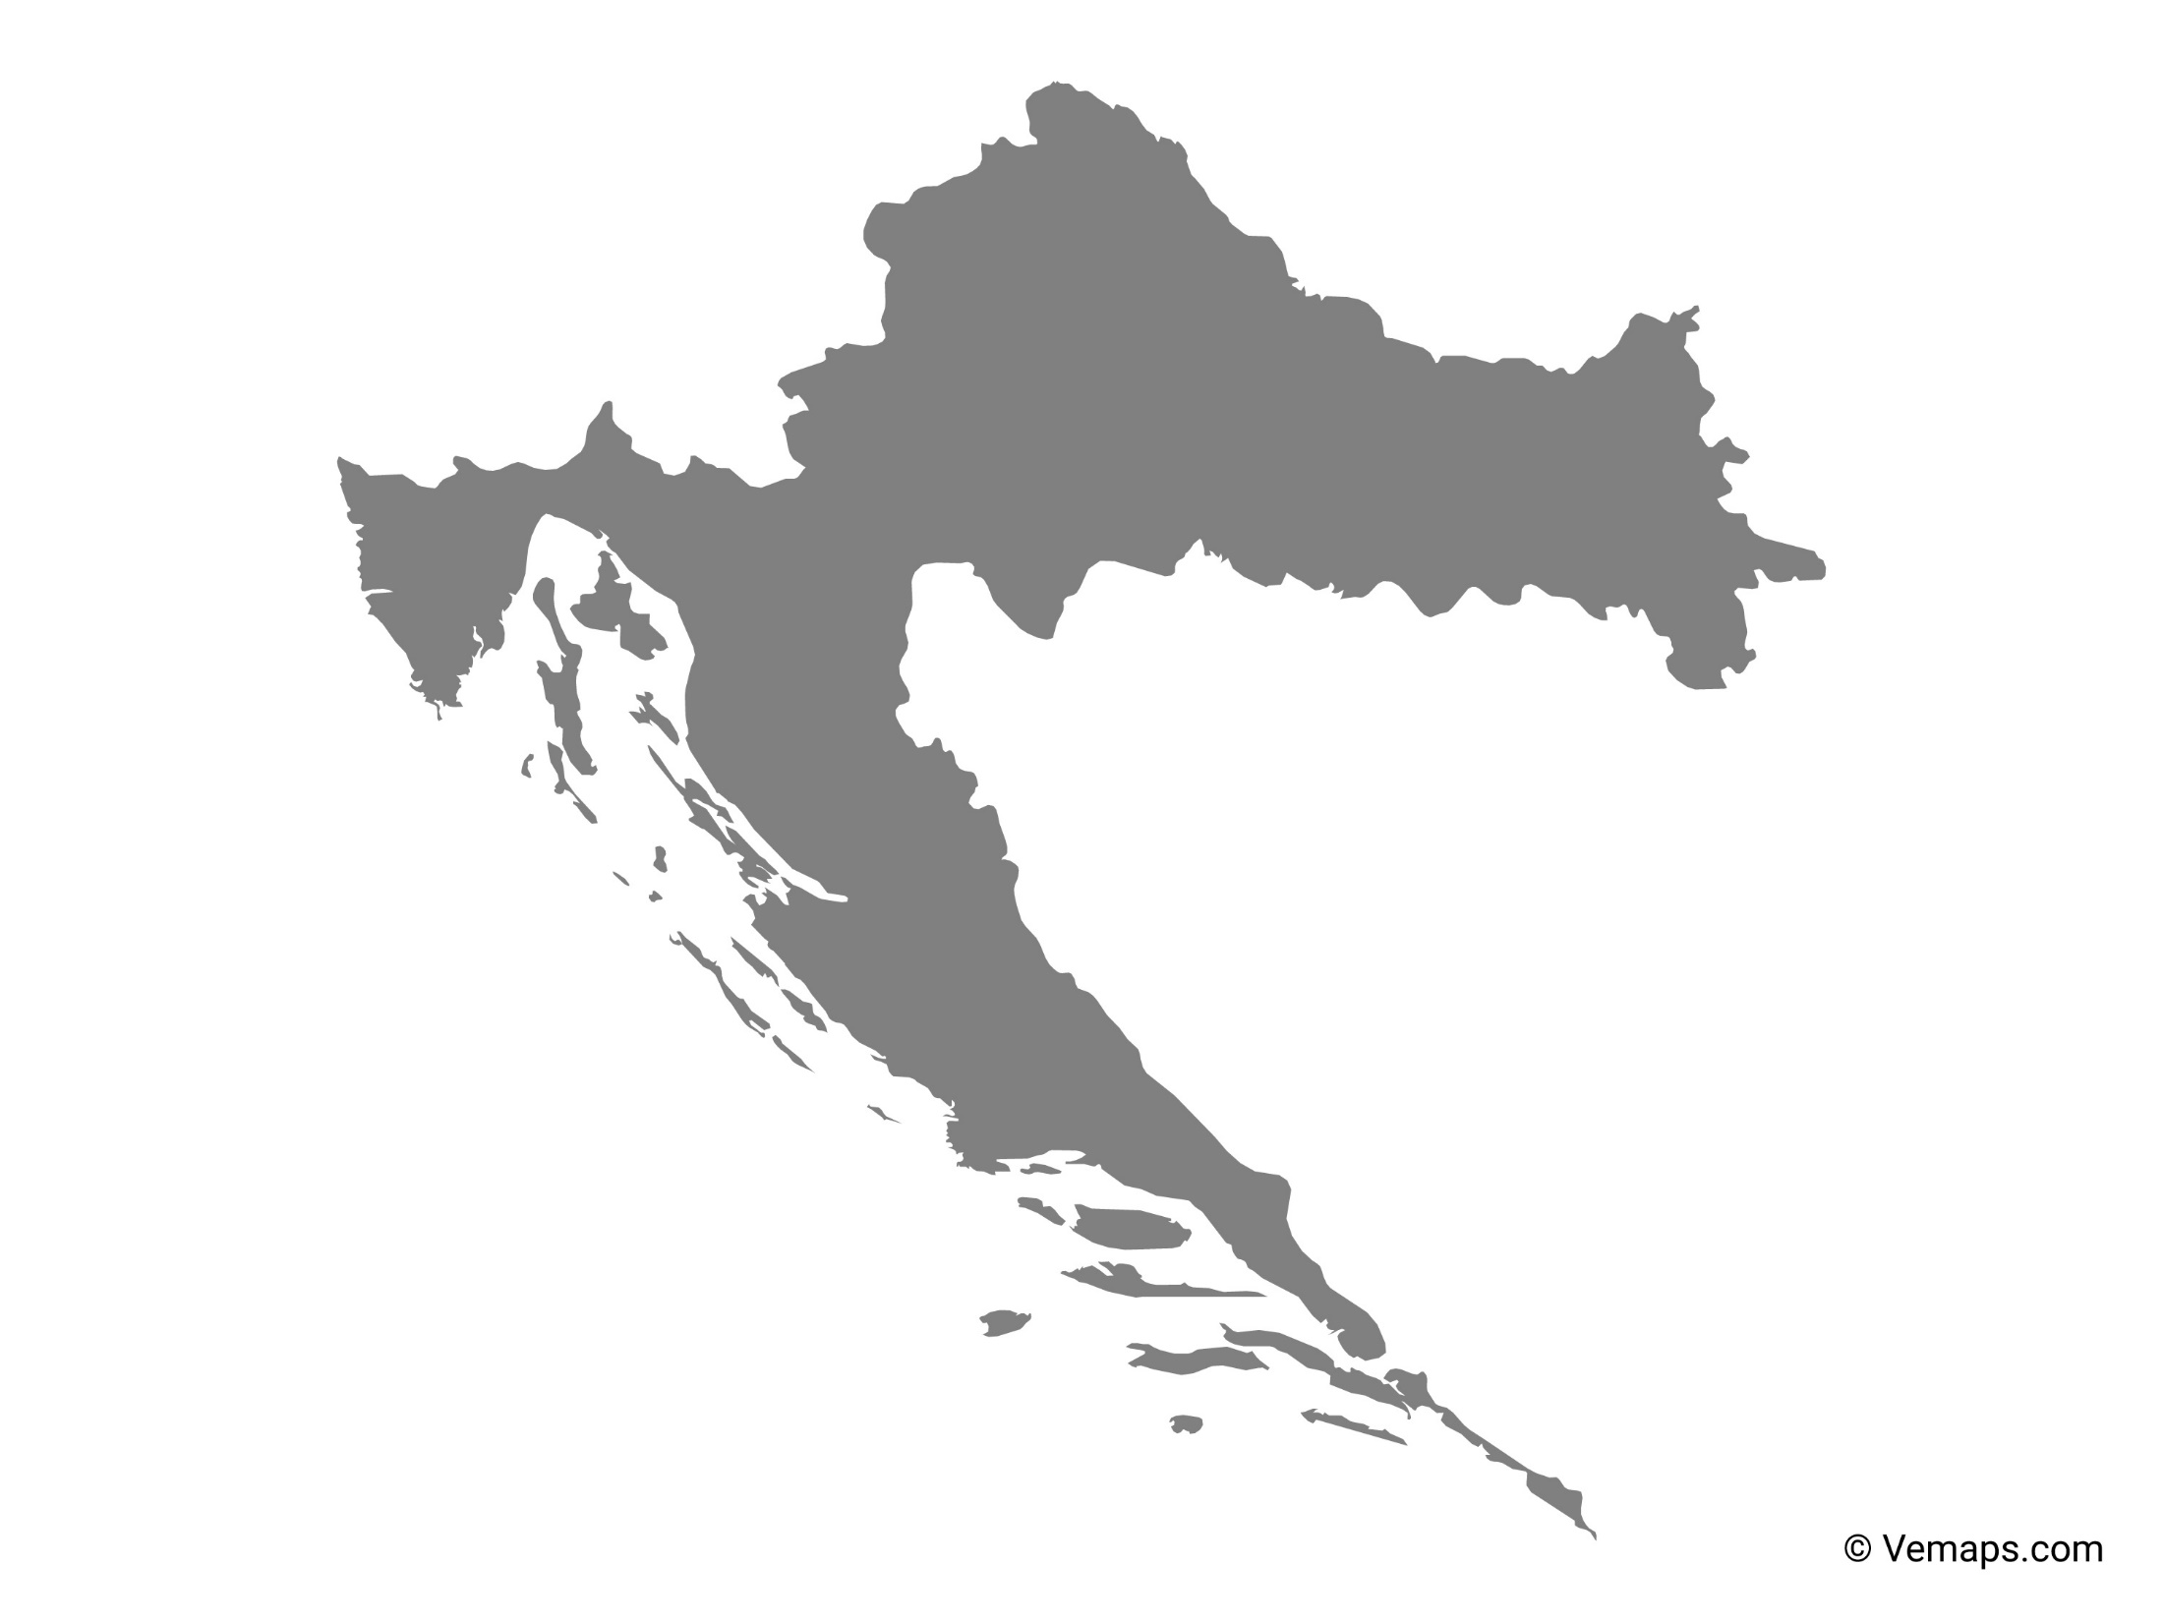
Croatia

Slide 31
Azerbaijan

Slide 32
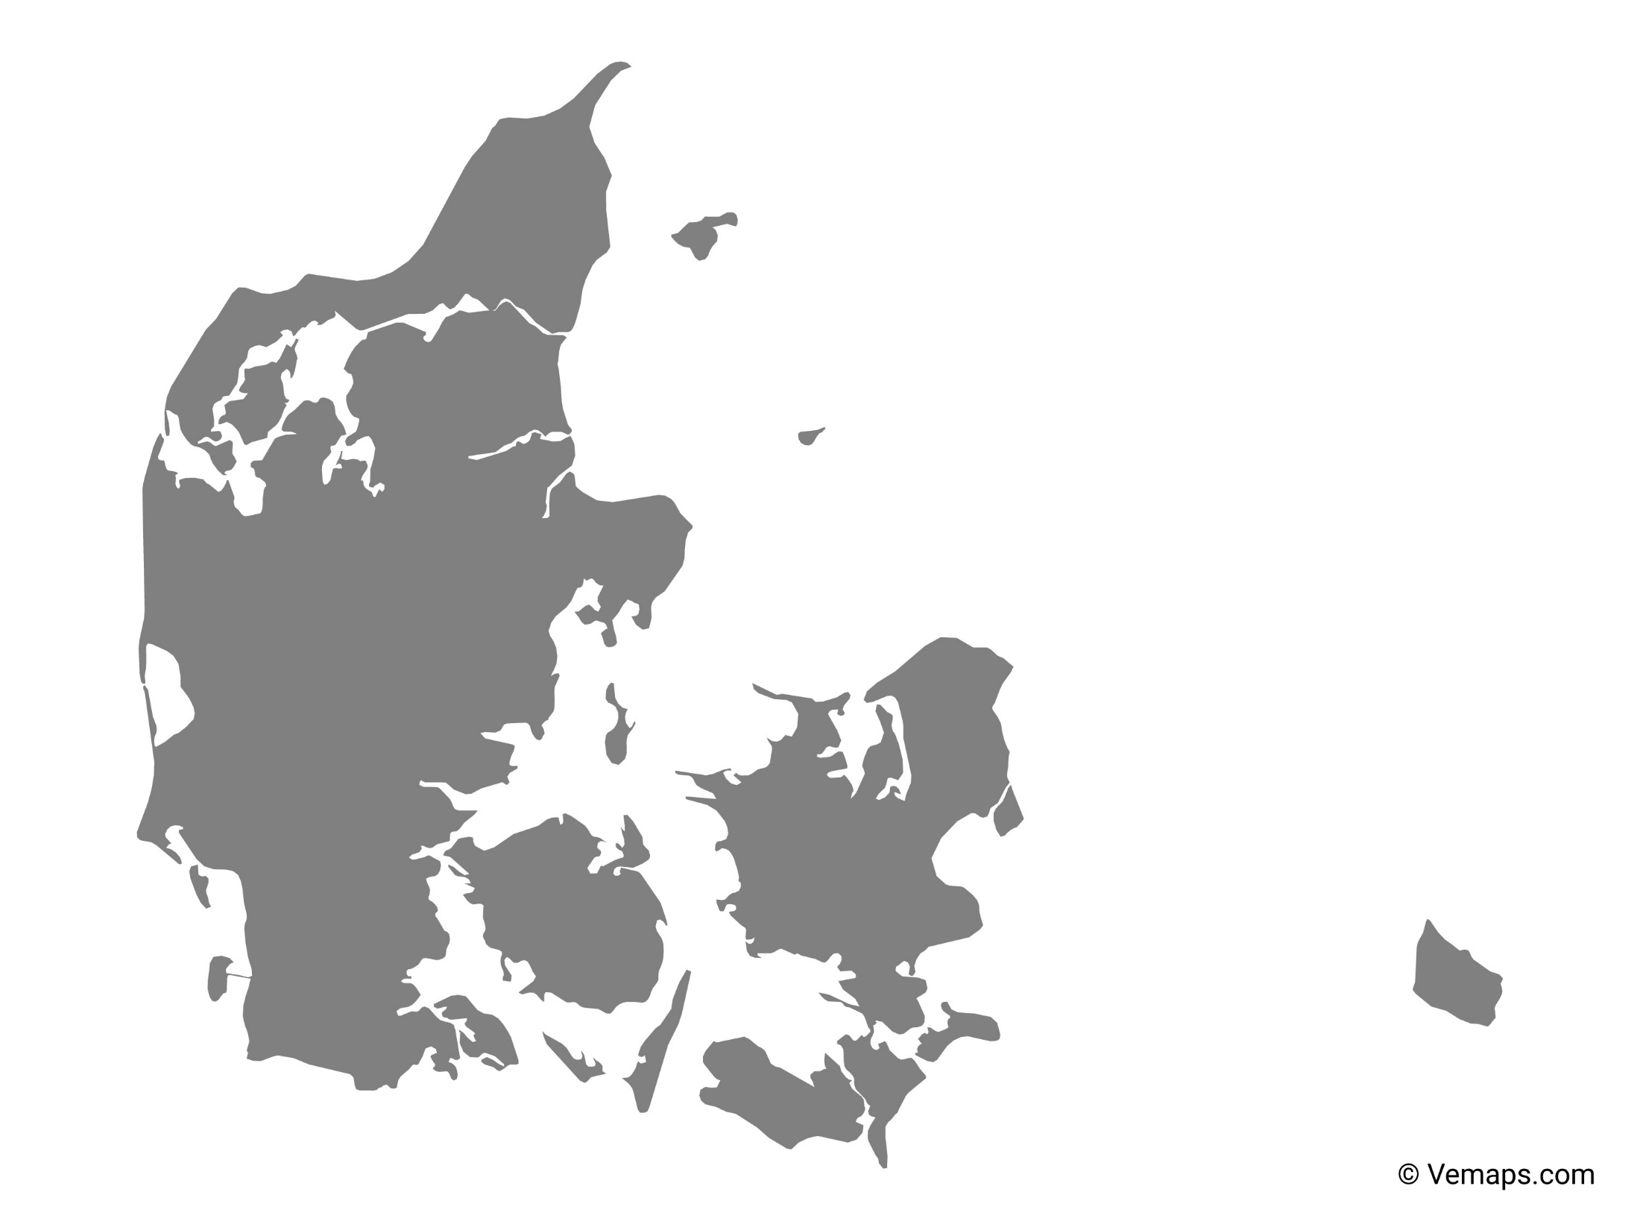
Denmark

Slide 33
Jamaica

Slide 34
Ecuador

Slide 35
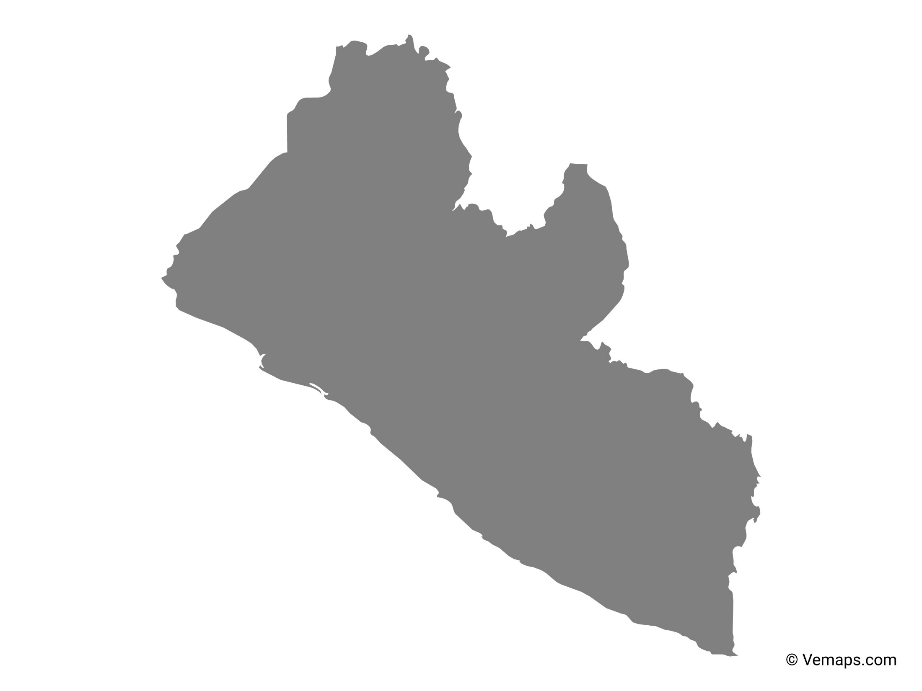
Liberia

Slide 36
Every Map is Wrong

Slide 37
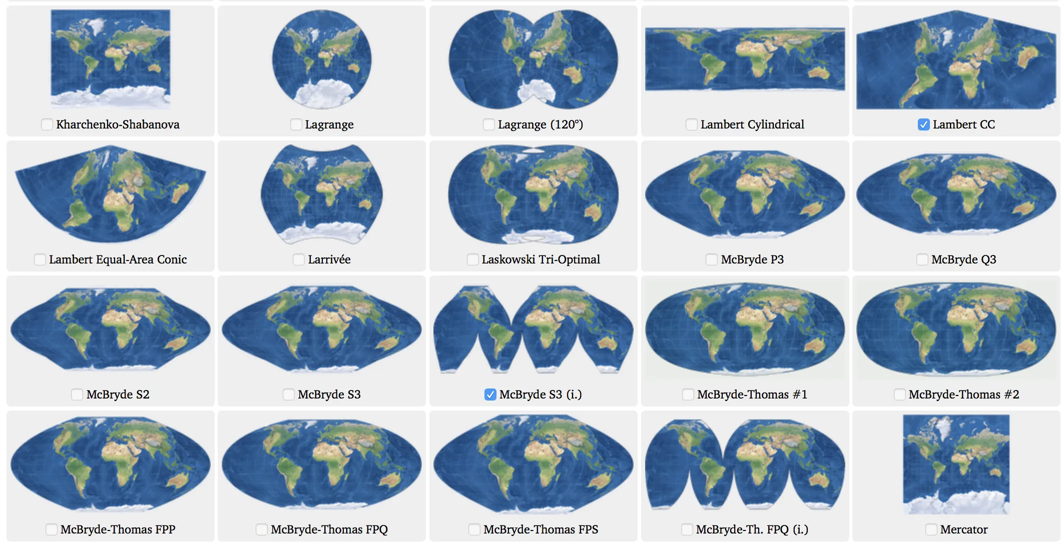

Slide 38
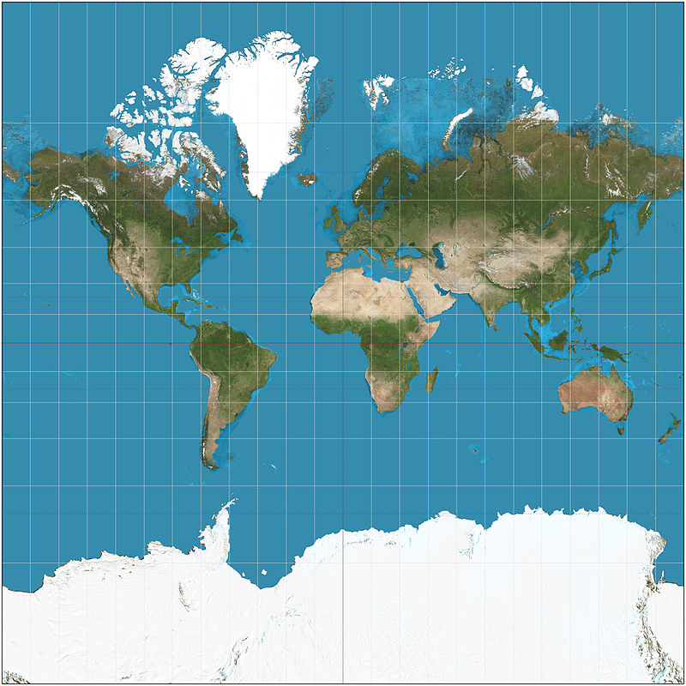
Mercator Projection
Notes:
By Strebe - Own work, CC BY-SA 3.0, https://commons.wikimedia.org/w/index.php?curid=17700069

Slide 39
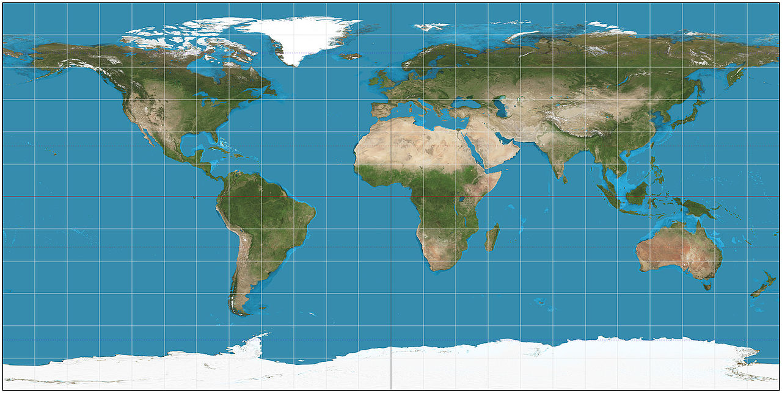
Plate Carrée Projection
Notes:
By Strebe - Own work, CC BY-SA 3.0, https://commons.wikimedia.org/w/index.php?curid=16115228

Slide 40
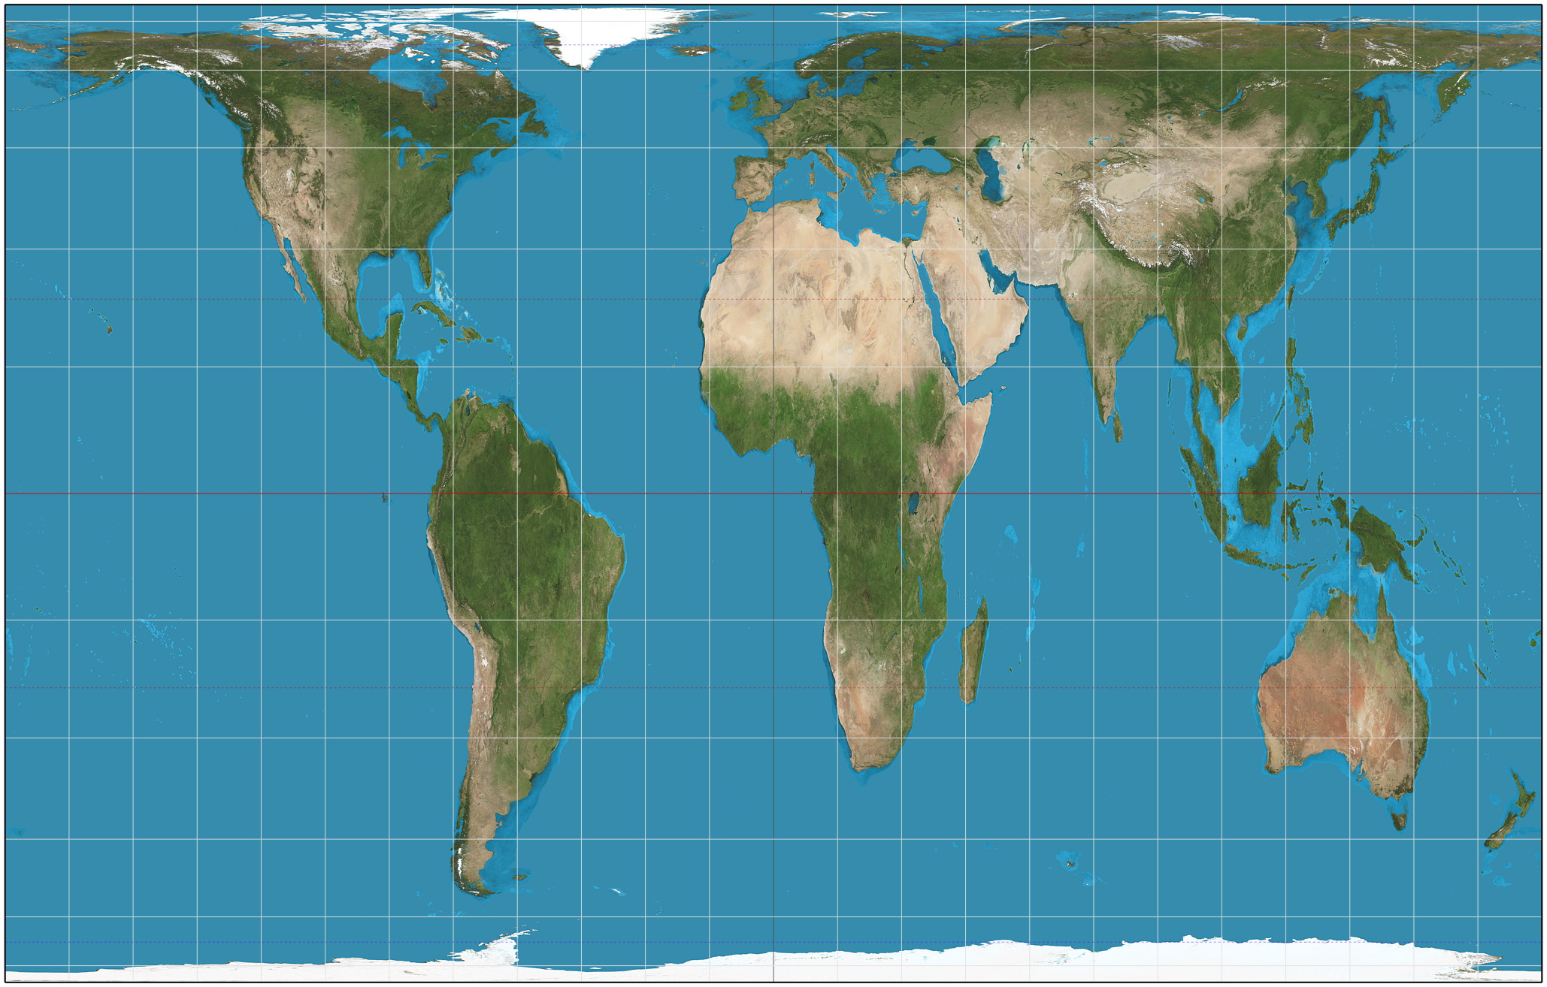
Gall-Peters Projection
Notes:
By Strebe - Own work, CC BY-SA 3.0, https://commons.wikimedia.org/w/index.php?curid=16115242

Slide 41
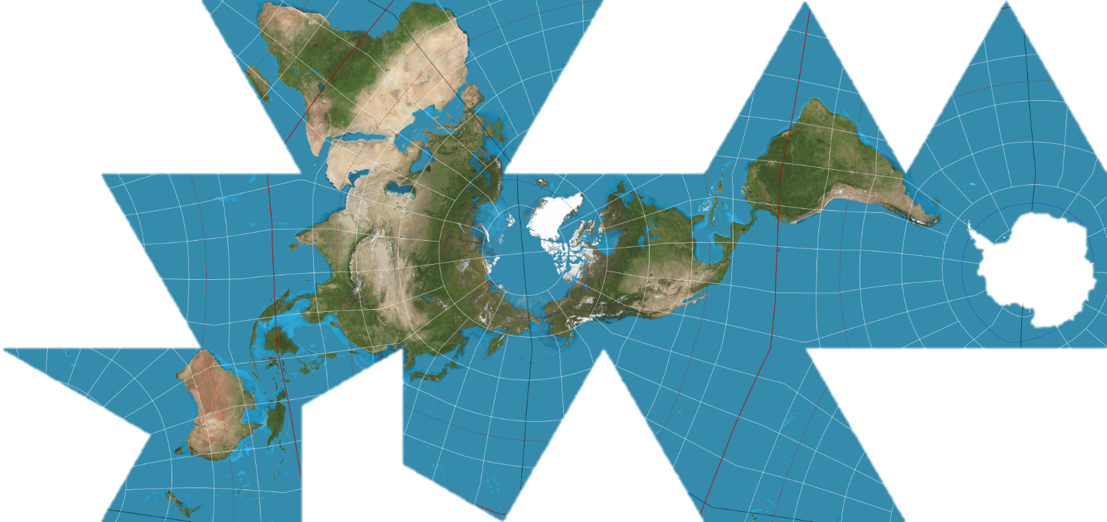
Dymaxion Map (Fuller Projection)
Notes:
By Justin Kunimune - Own work, CC BY-SA 4.0, https://commons.wikimedia.org/w/index.php?curid=65694588

Slide 42
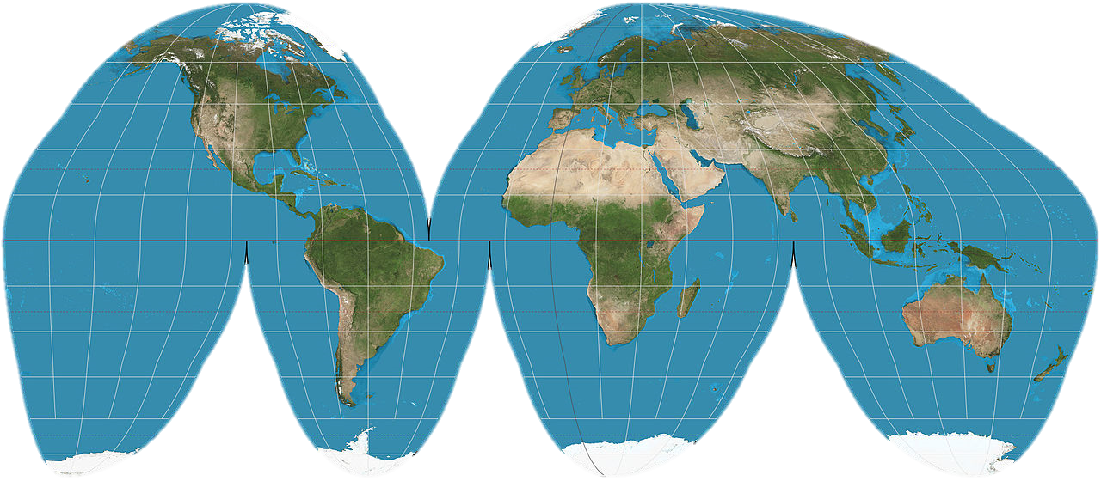
Goode Homolosine
Notes:
By Strebe - Own work, CC BY-SA 3.0, https://commons.wikimedia.org/w/index.php?curid=16115269

Slide 43
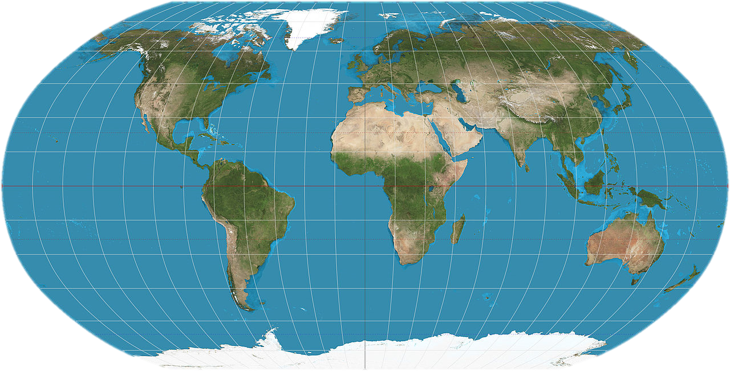
Robinson Projection
Notes:
By Strebe - Own work, CC BY-SA 3.0, https://commons.wikimedia.org/w/index.php?curid=16115337

Slide 44
The Problem with Projections

Slide 45
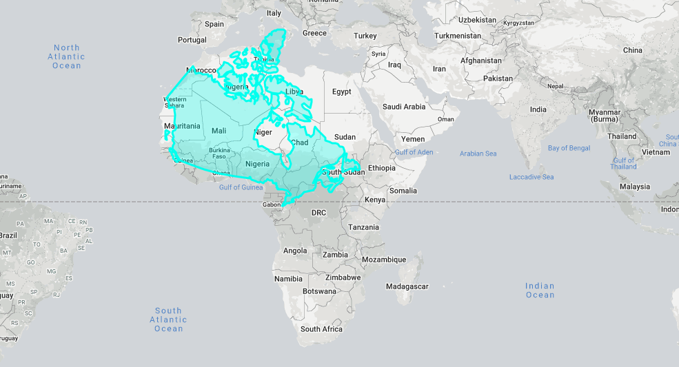

Slide 46
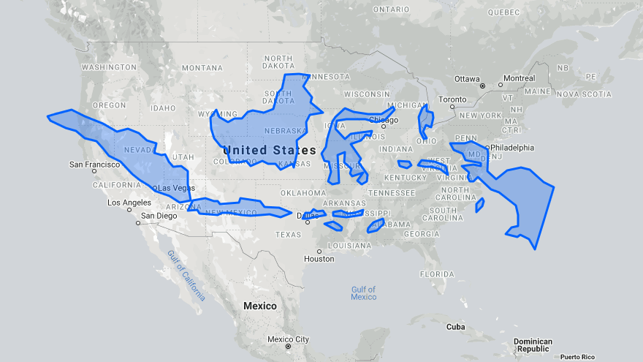

Slide 47
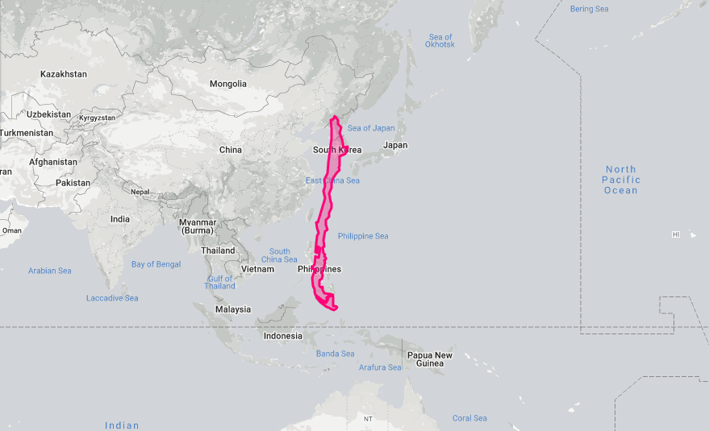

Slide 48
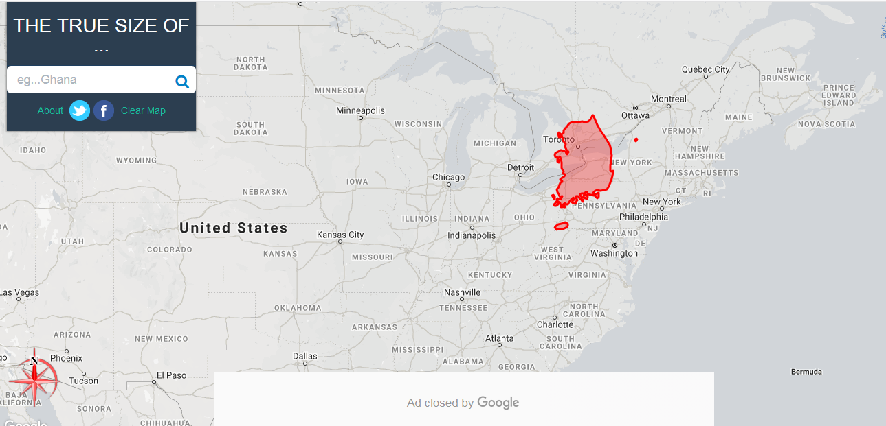
The true size of countries
https://thetruesize.com/#?borders=1~!MTU4MDg0MTA.NzMyMjMxNQ*NjcwMzUzNQ(MTg5OTA2NDU~!KR*MA.MTgwMDAwMDA)NQ

Slide 49
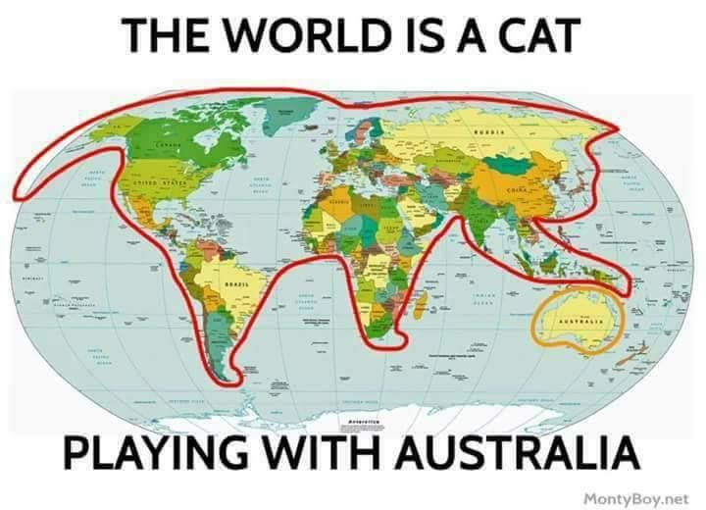
Korea
Italy
Pakistan (dog)

Slide 50
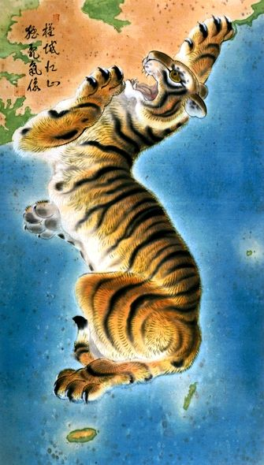
It looks like a tiger.

Slide 51
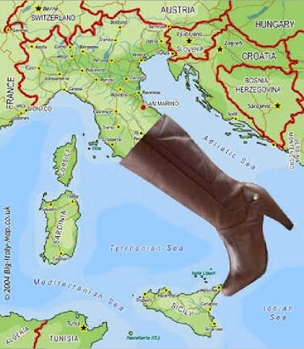
It looks like a boot.

Slide 52
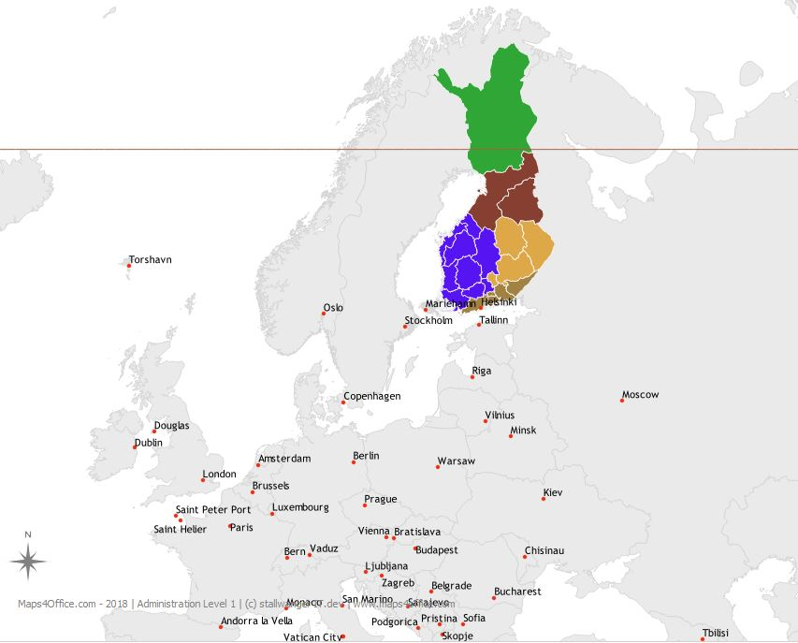
It looks like a rabbit.

Slide 53
It looks like a dog.

Slide 54
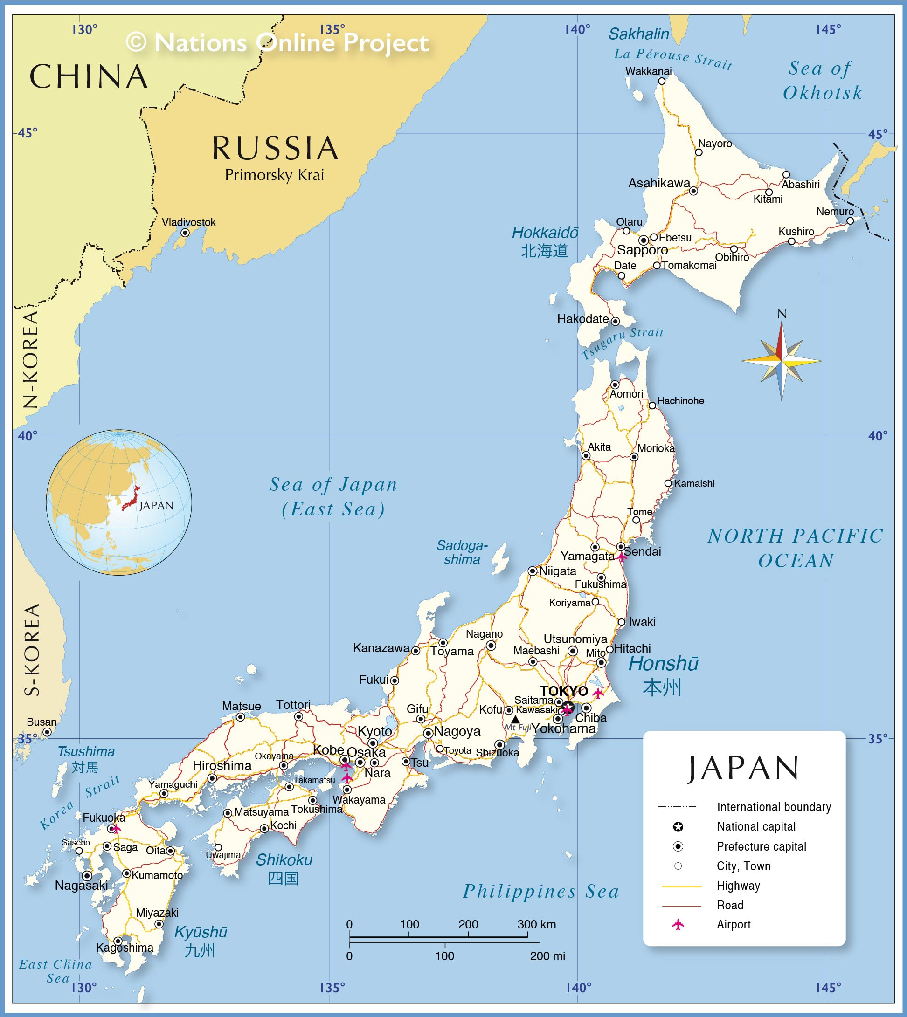
It looks like a seahorse.

Slide 55
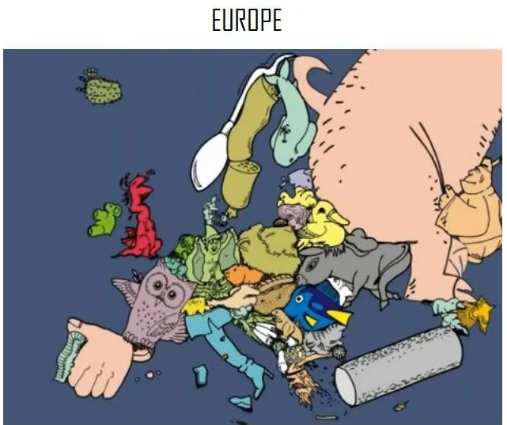

Slide 56
Explain the map

Slide 57
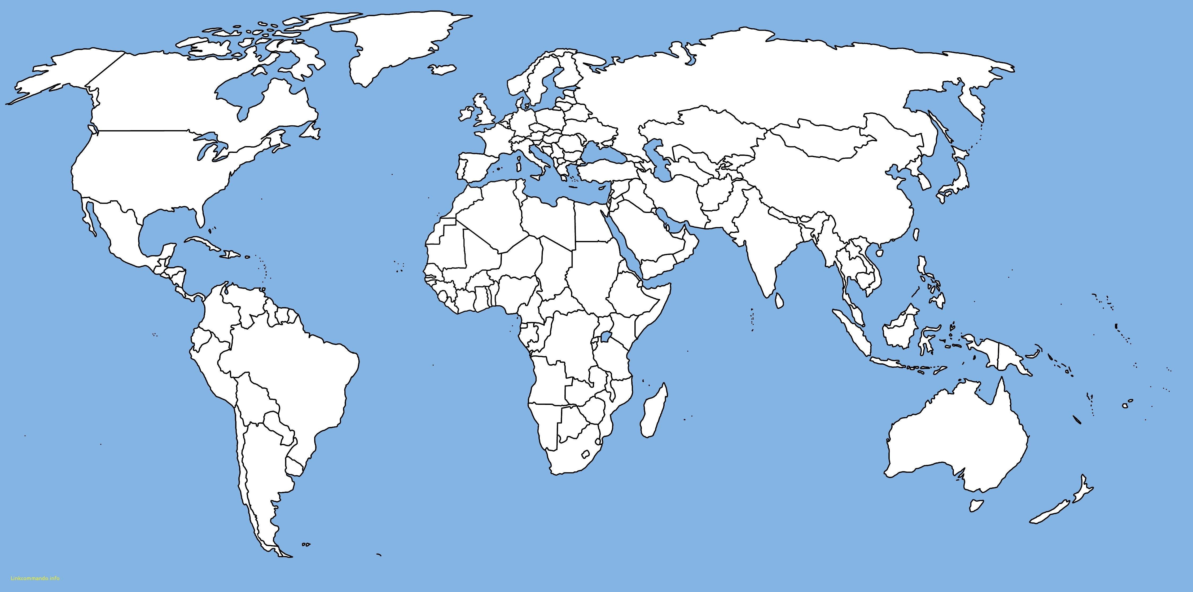
1
2
3
4
5
6
7
8
9
10
11
12
13
14
15
16
17
18
19
20
21
22
23
24
25
26
27
28
29
30
31
32
33
34
35
36
37
38
39
40
41
42
43
44
45
46
47
48
49
50
51
52
53
54
55
56
57
58
59
60

Slide 58
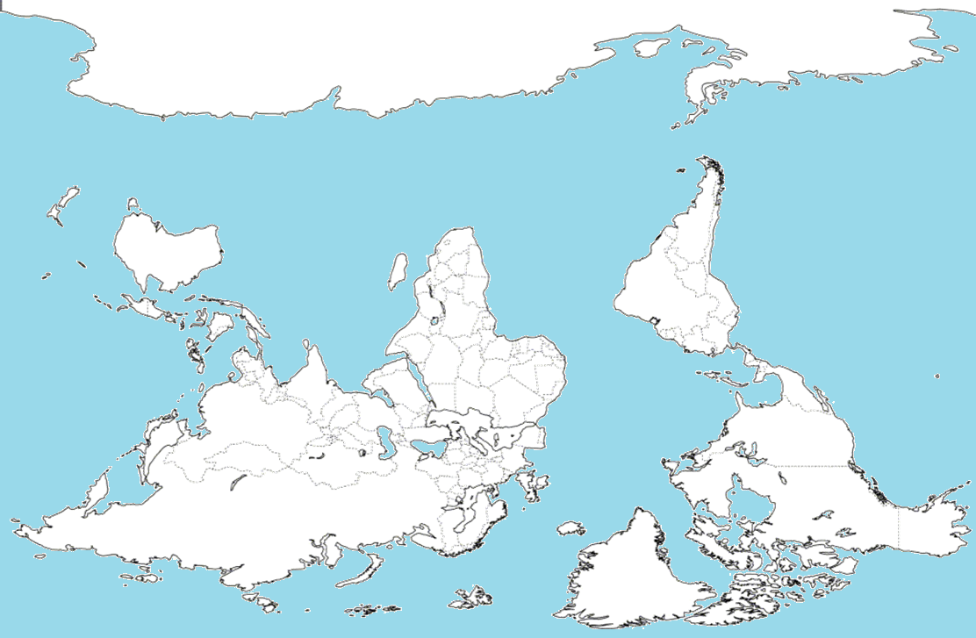
Root Menu
Upside-down map

Slide 59
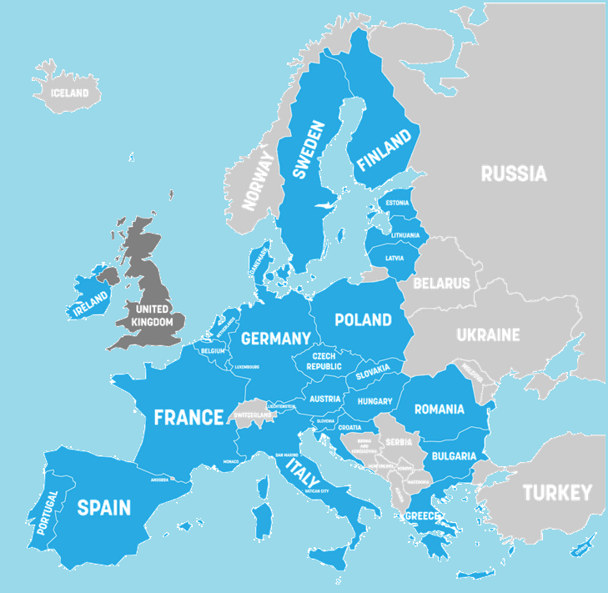
Root Menu
Members of the European Union

Slide 60
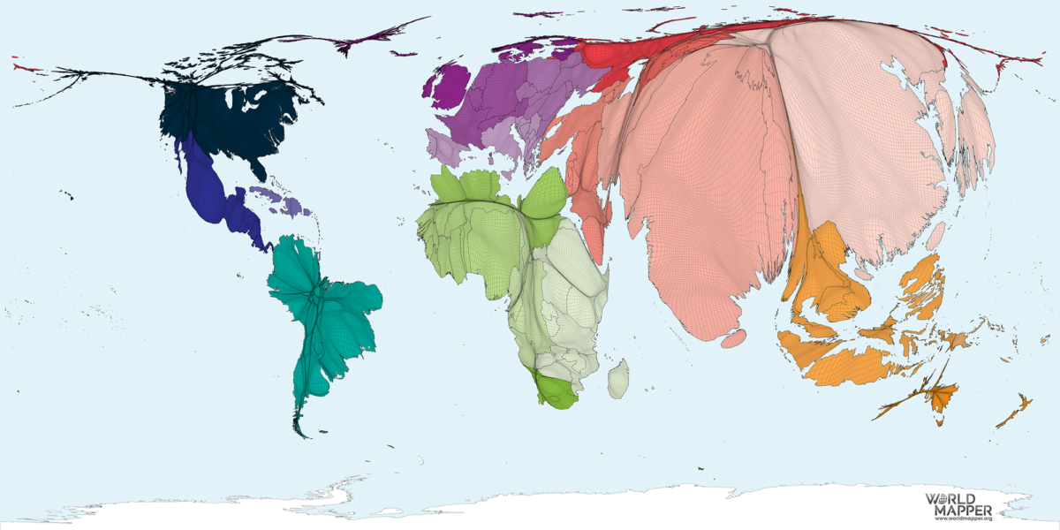
Root Menu
Area = Population

Slide 61
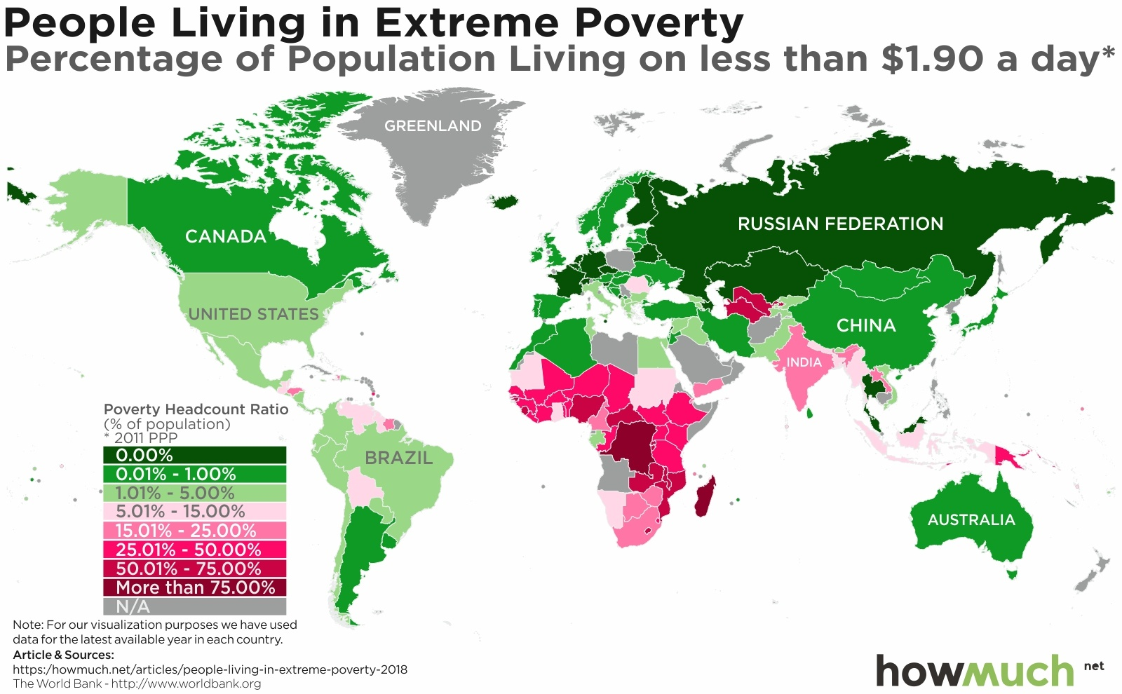
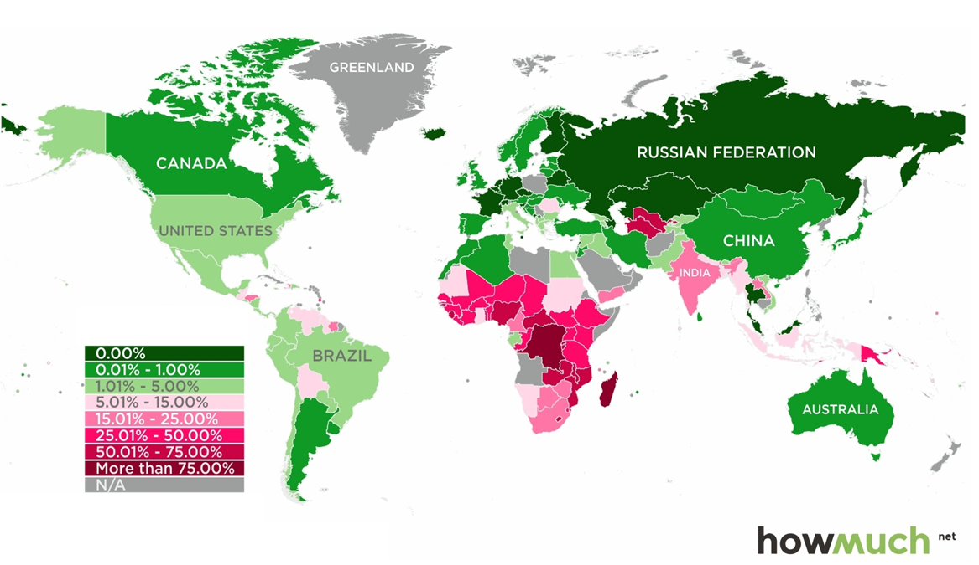
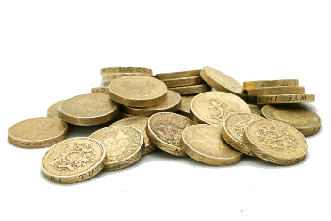
Root Menu
Percentage Living in Extreme Poverty

Slide 62
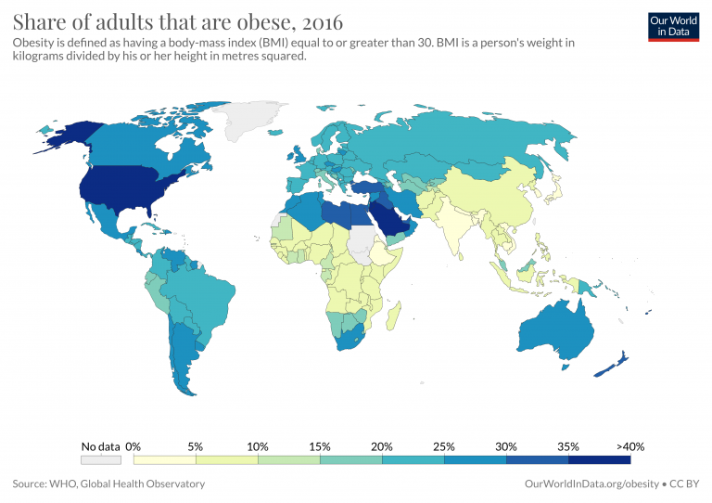
Root Menu
Adult Obesity %

Slide 63
Root Menu
Education Index

Slide 64
Root Menu

Slide 65
Root Menu
Language Groups

Slide 66
Root Menu
Wars Through History

Slide 67
Root Menu
Half of the World’s Population Lives in the Circle

Slide 68
Root Menu
Tectonic Plates

Slide 69
Root Menu
Similar GDP to each State

Slide 70
Root Menu
Alcohol Consumption

Slide 71
Root Menu

Slide 72
Root Menu
Capital Punishment

Slide 73
Root Menu

Slide 74
Root Menu

Slide 75
Root Menu

Slide 76
Across the Ocean

Slide 77
Root Menu

Slide 79
Root Menu

Slide 80
Root Menu
YouTube Access

Slide 81
Root Menu

Slide 82
Root Menu

Slide 84
Root Menu

Slide 85
Root Menu
Moons vs Flags

Slide 86
Root Menu
Mongol Empire

Slide 87
Root Menu
The Scramble for Africa
France
Britain
Netherlands
Italy
Portugal
Belgium
Spain

Slide 88
28Most visited countries
Root Menu

Slide 89
Root Menu
Driving Side

Slide 90
Root Menu
Cities with over 1 Million People

Slide 91
Root Menu
Railroads

Slide 92
Root Menu
Type of Electrical Outlet

Slide 93
33Coutnries that hosted the olympcs
Root Menu
Countries that Hosted the Olympics

Slide 94
34National IQ score
Root Menu
IQ Average

Slide 95
35Map of mars with water
Root Menu
Mars With Water

Slide 96
36Immigrants as a percentage of population
Root Menu

Slide 97
37English speakers
Root Menu
English Speaker (% of Population)

Slide 98
38Second languages
Root Menu
Language Being Studied

Slide 99
39Nuclear weapons
Root Menu
Countries with Nuclear Weapons

Slide 100
Root Menu
Elephant Range

Slide 101
41Gay marriage is legal
Root Menu
Legalized Same-Sex Marriage

Slide 102
42Profitable export
Root Menu
Top Exports

Slide 103
43Blonde hair distribution
Root Menu
Blonde Hair

Slide 104
44Number of internet users
Root Menu
Number of Internet Users

Slide 105
45 1570 - Old maps first of north America(ortelius)
Root Menu
Ortelius Map (1570)

Slide 106
46Viking conquest
Root Menu
Viking Settlements

Slide 107
47Most popular website
Root Menu
Tiger Range

Slide 108
48Emerging mega regions
Common Last Names

Slide 111
Root Menu

Slide 112
49Total precipitation
Root Menu
Total Annual Rainfall

Slide 113
50Eye color
Major Mountain of the Earth
Root Menu

Slide 114
51Countries colonized by Europe
Root Menu

Slide 115
52Pangea today
Root Menu
Pangaea with Modern Countries

Slide 116
53Friendliness towards visitor s
Friendliness to Foreigners
Root Menu

Slide 117
54Global peace index
Root Menu
Airplanes

Slide 118
55Korea from space?
Root Menu
Korea From Space (Night)

Slide 119
56French territories
Root Menu
French Territories

Slide 120
57Google street coverage
Root Menu
Google Street View

Slide 121
58what the world would look like if all of the ice melted
Root Menu
If the Poles Melted

Slide 122
59Time Zones
Root Menu

Slide 123
60Median Age
Root Menu
Average Age

Slide 124
Distorted Maps:
https://worldmapper.org/maps/
Terrible (funny) Maps:
https://www.boredpanda.com/funny-terrible-maps/?utm_source=google&utm_medium=organic&utm_campaign=organic
1 Hour of Maps
https://www.youtube.com/watch?v=8xM7afTG2Jk
Our World in Data (Informative maps)
https://ourworldindata.org/
Vermaps
Make Your Own Maps:
https://vemaps.com/
https://mapchart.net/

