Slide 1
Anagrams

Slide 2
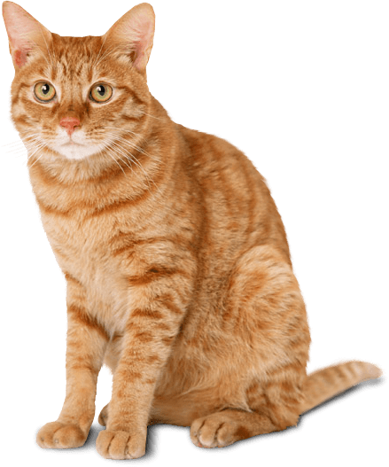
CAT
ACT

Slide 3
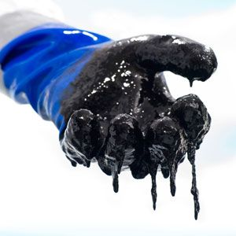
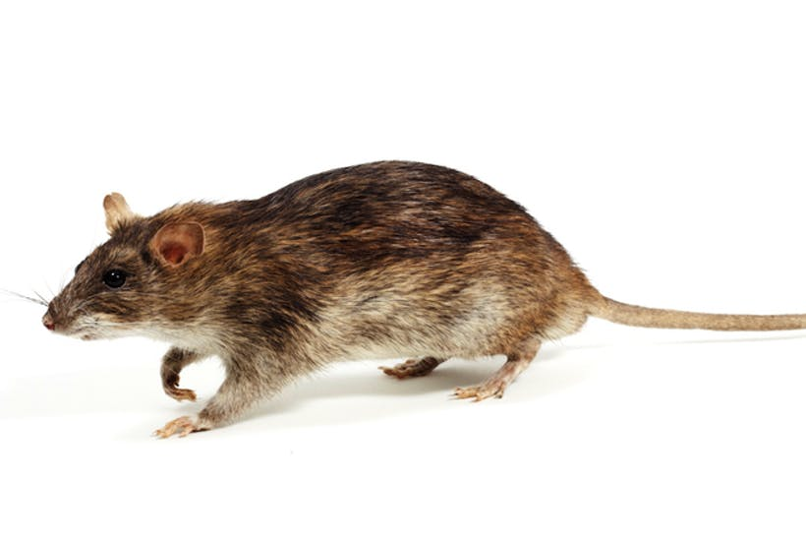
TAR
RAT

Slide 4
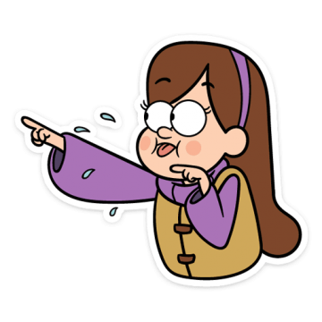
THERE
THREE

Slide 5
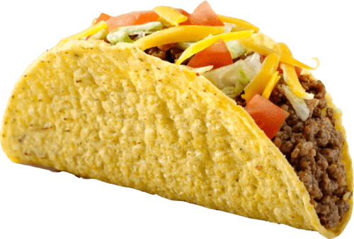
TACO
COAT

Slide 6
LISTEN
SILENT

Slide 7
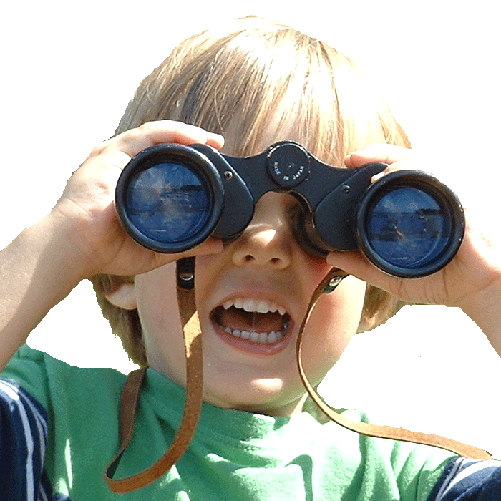
THE EYES
THEY SEE

Slide 8
VIOLET
I LOVE IT

Slide 9
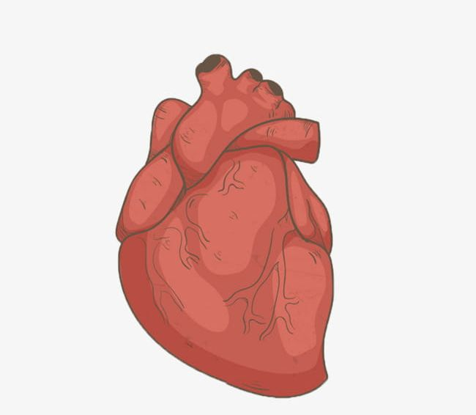
EARTH
HEART

Slide 10
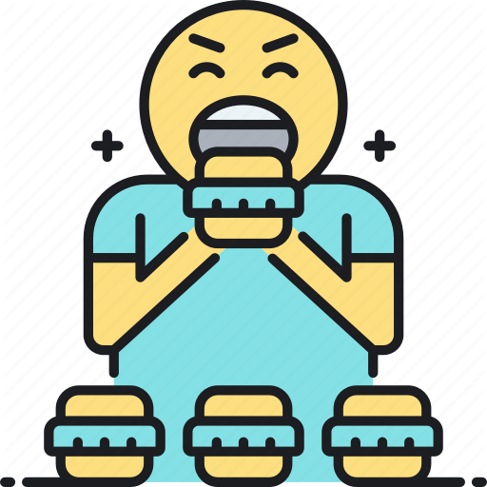
BINGE
BEGIN

Slide 11
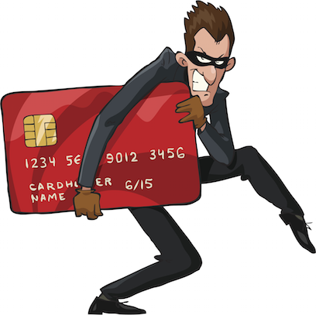
CHEATER
TEACHER

Slide 12
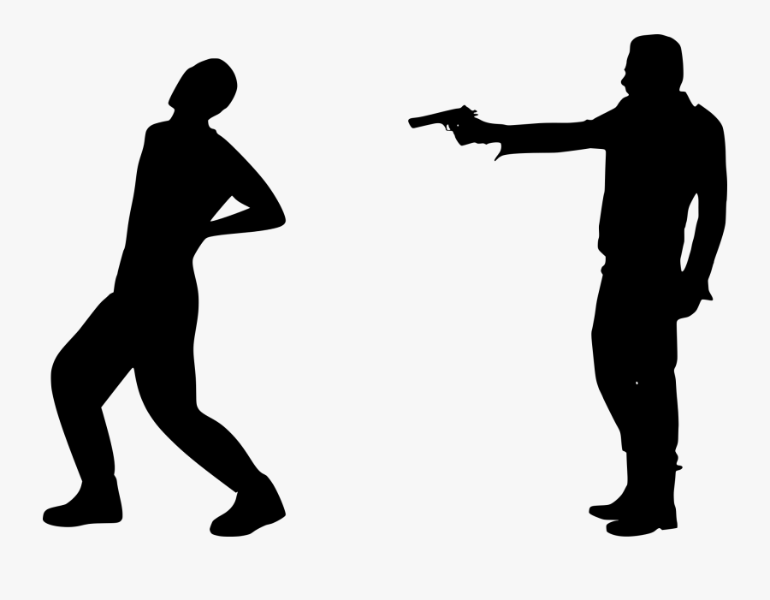
REDRUM
MURDER

Slide 13
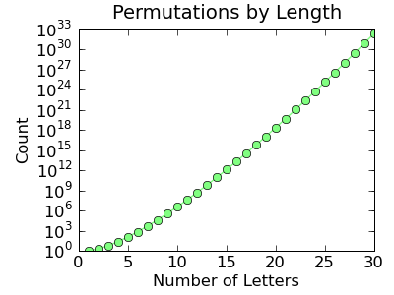

Slide 14
https://examples.yourdictionary.com/anagram-examples.html

