Slide 1
The Right Words

Slide 2
Adjectives
Help to explain
Add feeling
Adds emphasis

Slide 3
Oxymoron vs Tautology
Words that are contradictory
Words that are redundant

Slide 4
Oxymoron vs Tautology
Repeat that again.
It’s a bitter sweet moment.
He is the only honest thief.
Shout it loudly.
Remember when 4G was a new innovation?
A small crowd appeared.
There’s a lot of frozen ice on the road.
Now is a good time to act naturally.
In my opinion, I think he is wrong.

Slide 5
Tautology
Adds emphasis
Helps to explain (especially new info)…
Adds more information

Slide 6
A tautology, or repetition, is used to help students understand what is being said.

Slide 7
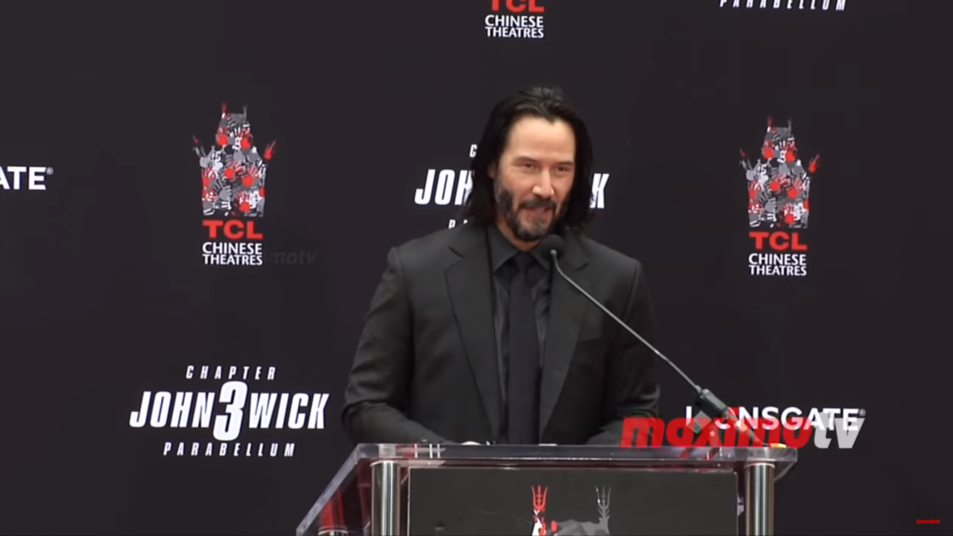
Keanu
Reeves

Slide 8
Remarkable
Historical
Magical

Slide 9
Kind
Gracious
Over-the-top

Slide 10
Friendship
Mentorship
Spirit
Soul
Wisdom

Slide 11
Forecourt
Front

Slide 12
Los Angeles, California
Hollywood

Slide 13
Memorialized
Celebrated

Slide 14
Belief
Support
What you did for me

Slide 15
Tautology
Second meaning
A statement that is true by virtue or its form.
“There are two types of people. People who like spicy food, and people who don’t.”
“You are either with me or against me.”

Slide 16
Thesaurus
Why?
Sounds nicer, smarter, better
Educated, well-informed, intellectual
Politically correct

Slide 17
Previously Owned
Transportation
Guest Room
Dining
Automobile
Accidents
Occasional
Irregularity
Directory
Assistance
House Trailers
Room Service
Partly Cloudy
Constipation
Toilet Paper
Car crashes
False Teeth
Information
Used Cars
Sneakers
Medicine
Motels
Dump
Dental Appliances
Bathroom Tissue
Running Shoes
Mobile Homes
Motor Lodges
Partly Sunny
Medication
Landfill

Slide 18
Toilet Paper
Bathroom Tissue

Slide 19
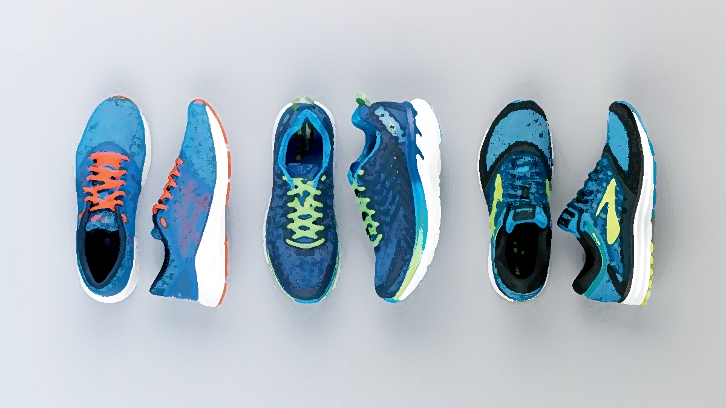
Sneakers
Running Shoes

Slide 20
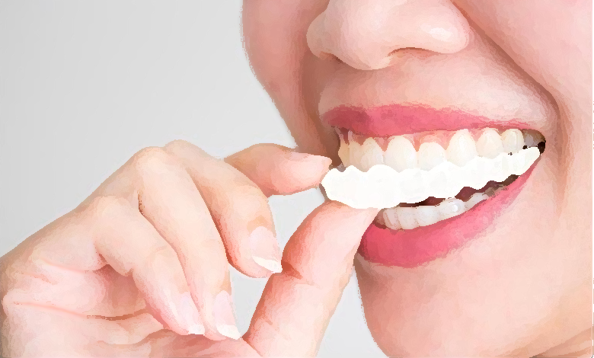
False Teeth
Dental Appliances

Slide 21
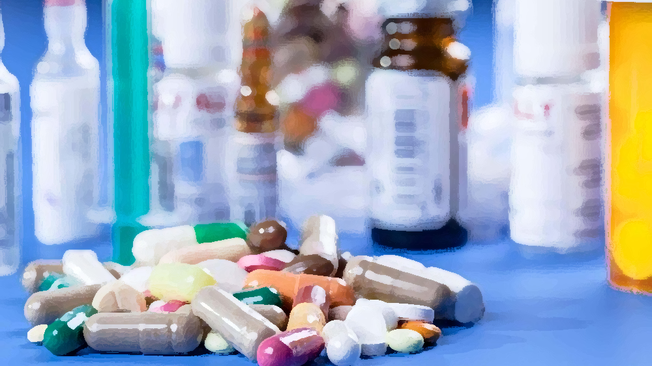
Medicine
Medication

Slide 22
Directory
Assistance
Information

Slide 23
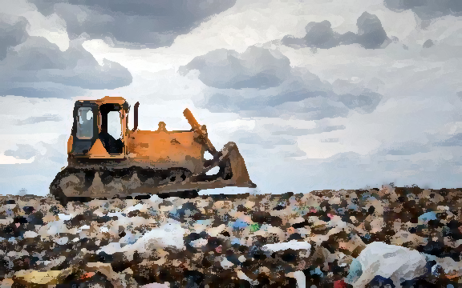
Dump
Landfill

Slide 24
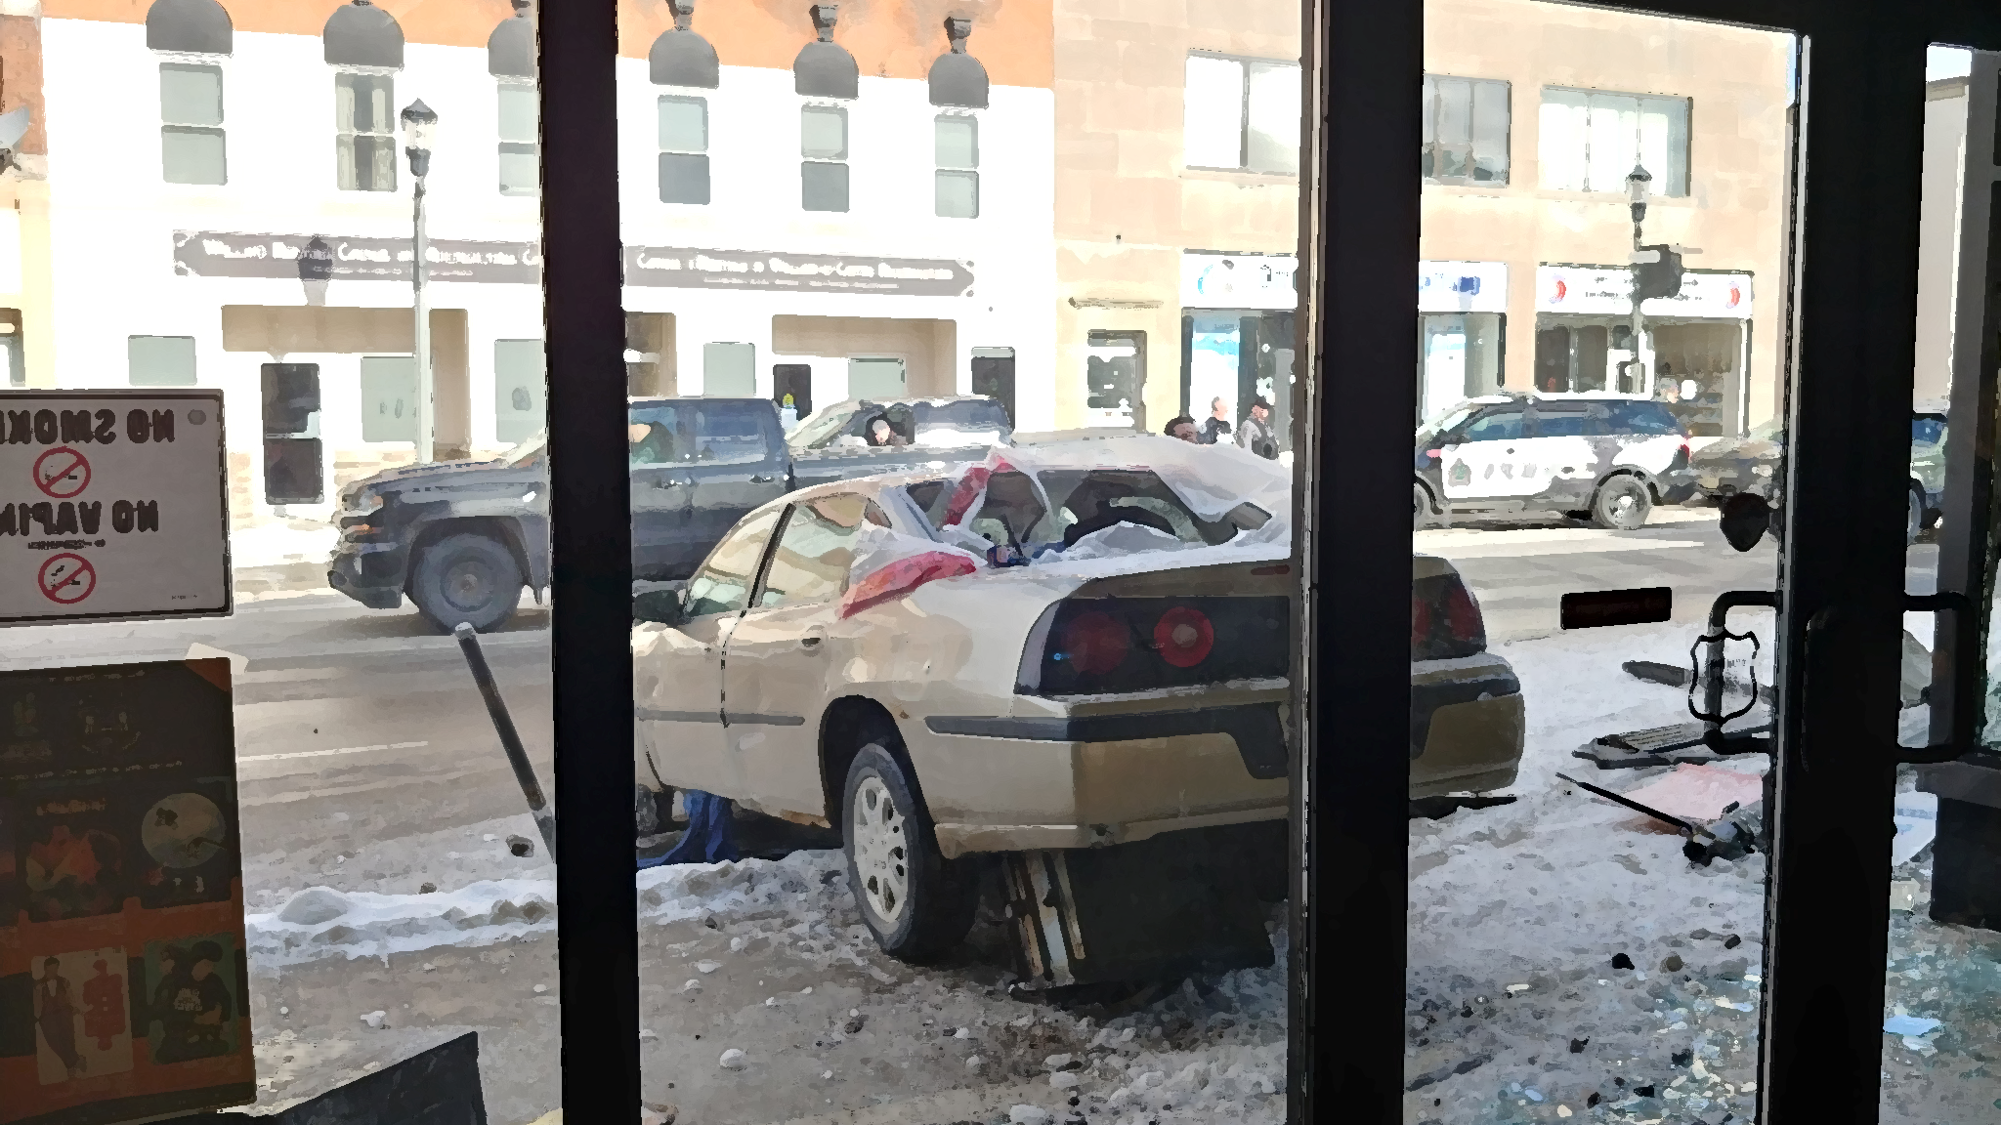
Automobile
Accidents
Car Crashes

Slide 25
Partly Cloudy
Partly Sunny

Slide 26
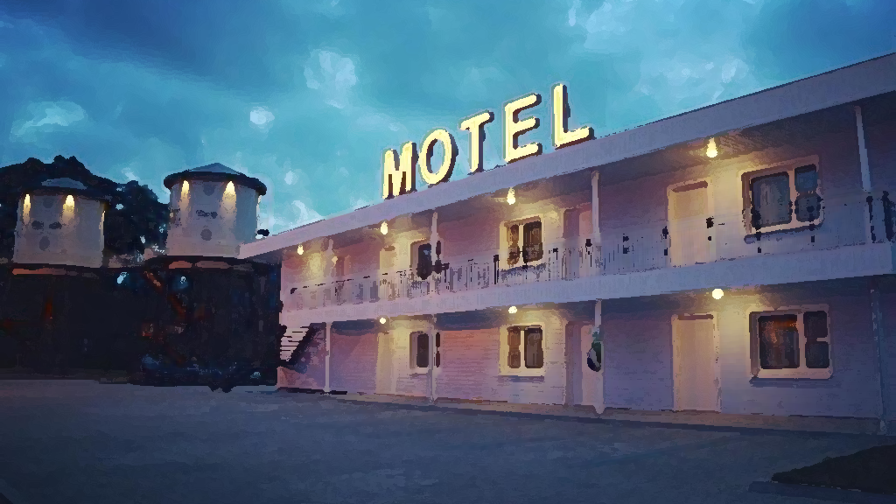
Motels
Motor Lodges

Slide 27
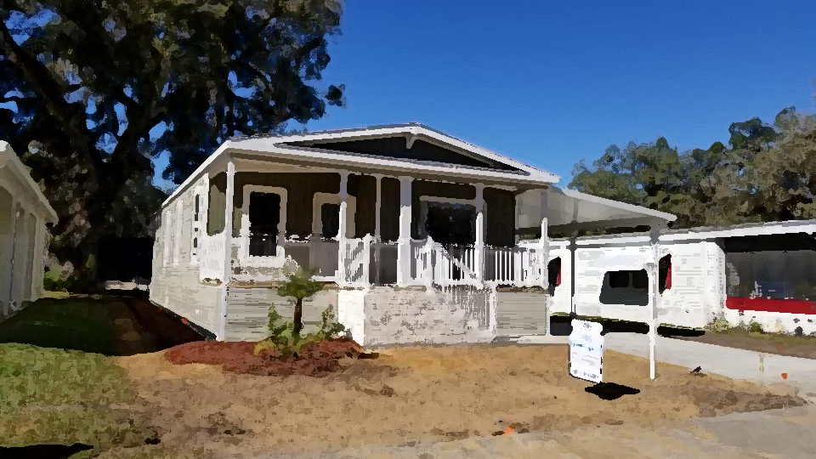
House Trailers
Mobile Homes

Slide 28
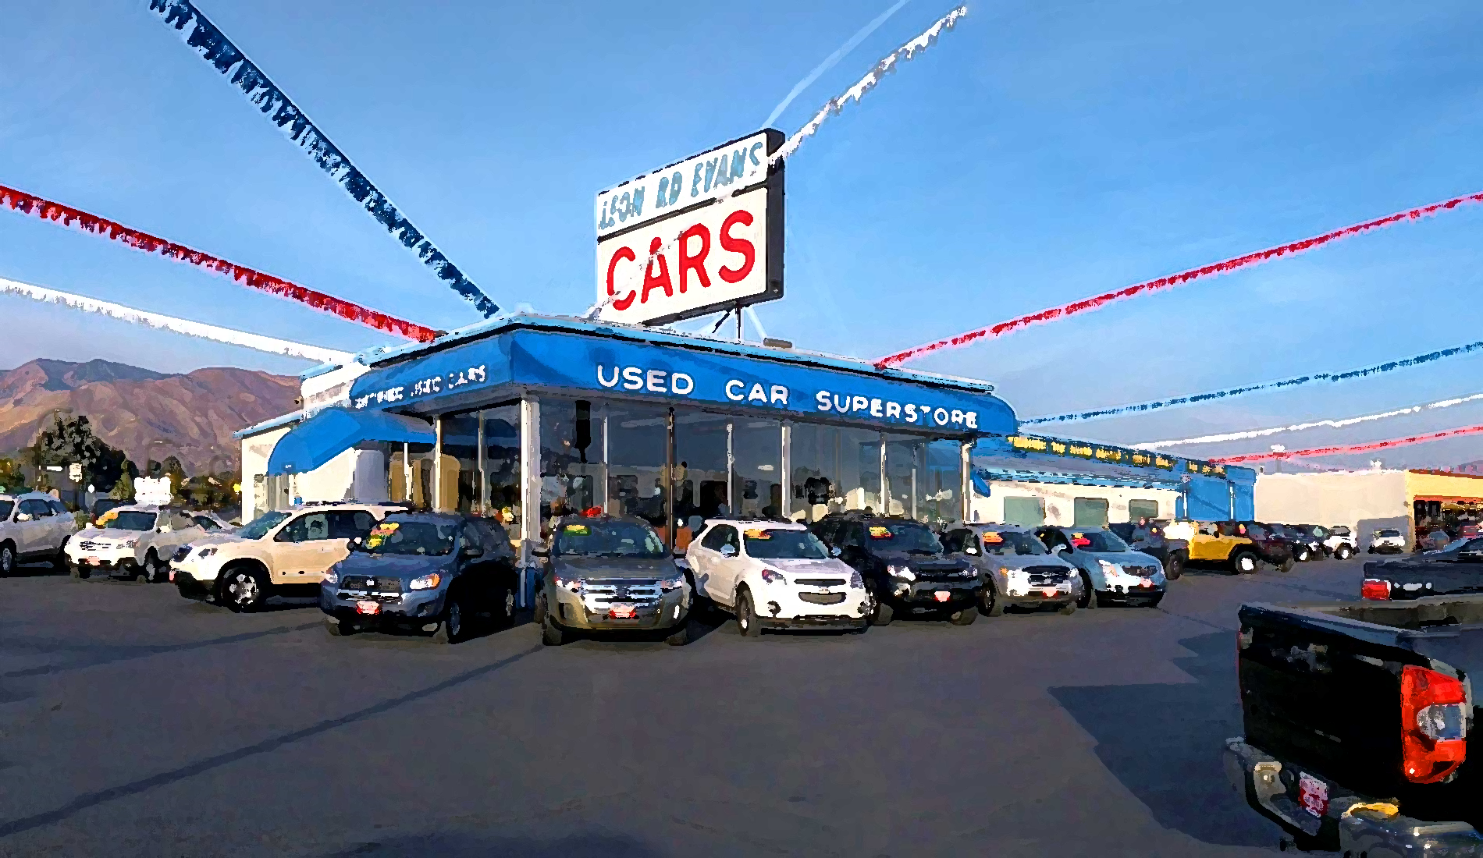
Previously Owned
Transportation
Used Cars

Slide 29
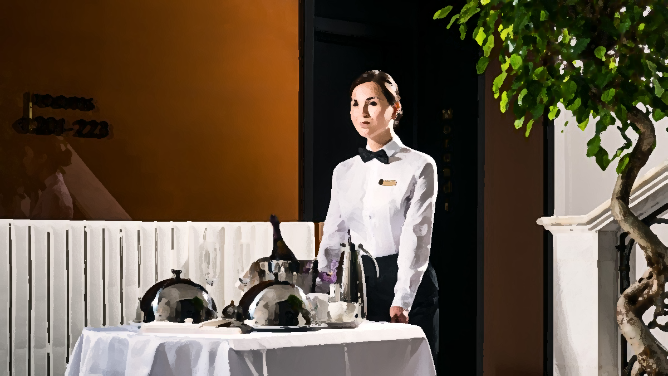
Guest Room
Dining
Room Service

Slide 30
Occasional
Irregularity
Constipation

Slide 31
War
Conflict

Slide 32
Pandemic
Epidemic

Slide 33
Word Association

Slide 34
What do people lie about?
I’m on my way
Age
Job / Profession
Relationship status
Fake merchandise
Lying about liking your friends’ outfit
Finances
Sexual partners
“I’m not drunk.”
“This is my real hair”
https://www.vibe.com/2014/03/20-most-common-lies-people-tell

Slide 35
What do people lie about?
11. “I’m fine.”
“I’m going to call you back.”
Ethnic background
Calling in sick
“I love you.”
“I’m not hungry.”
“I love my job.”
“You don’t have to get me a gift.”
“I’ll be right back.”
“I promise”
https://www.vibe.com/2014/03/20-most-common-lies-people-tell

Slide 36
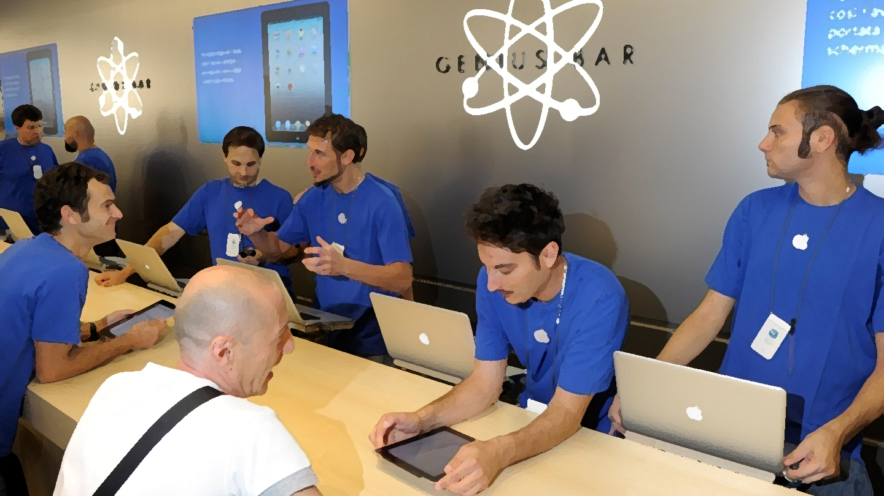
Apple Employee
Apple Genius

Slide 37
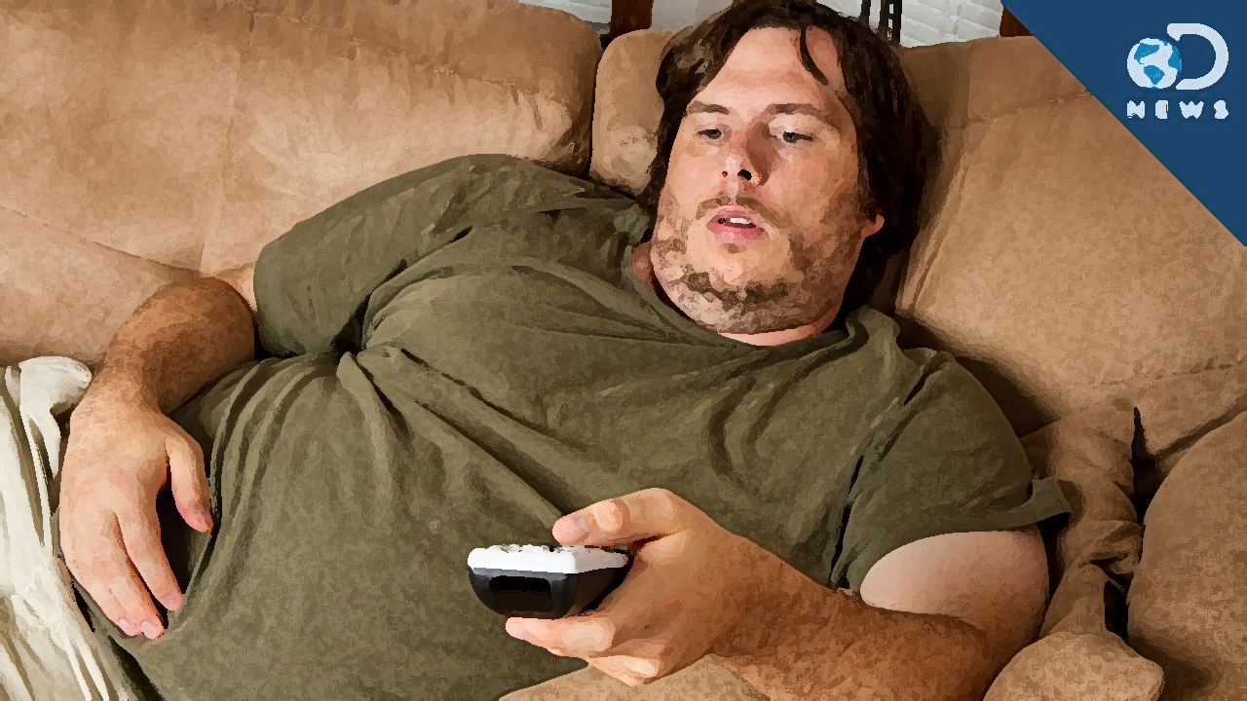
Unemployed
Between jobs

Slide 38
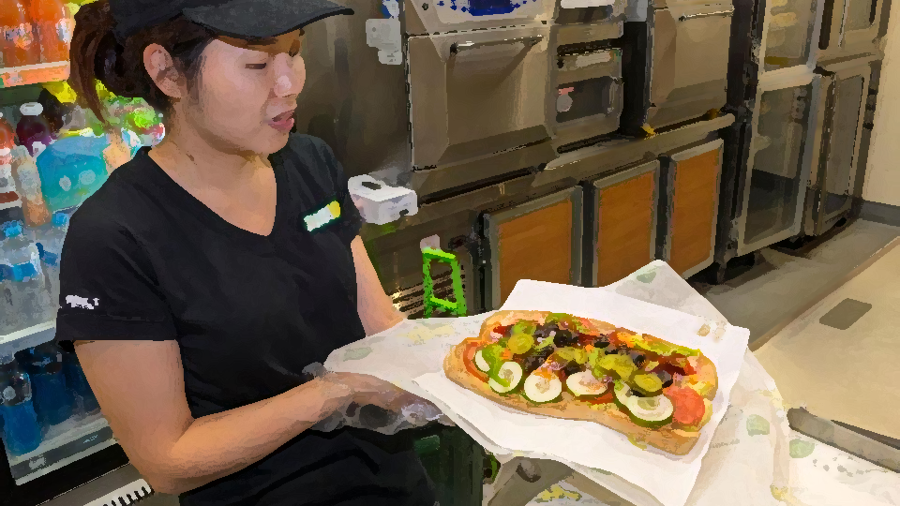
Subway Employee
Sandwich Artist

Slide 39
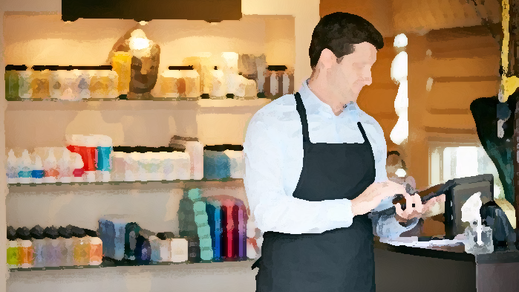
Salesperson
Retail Associate

Slide 40
News writer
News reporter
Spin Doctor

Slide 41
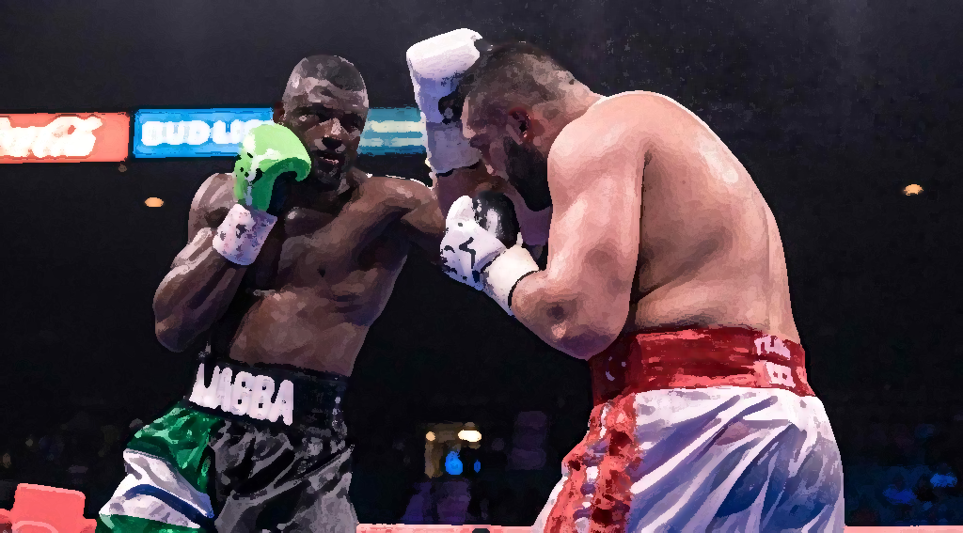
Boxer
Pugilist

Slide 42
YouTuber
Instagram model,
Etc.
Influencer

Slide 43
Administrative
Assistant
Secretary

Slide 44
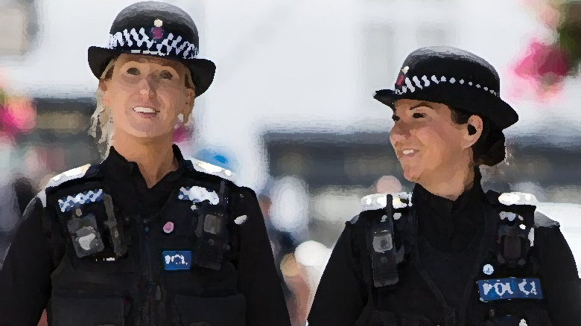
Law
Enforcement
Officer
Police Officer

Slide 45
Patient Care
Provider
Nurse

Slide 46
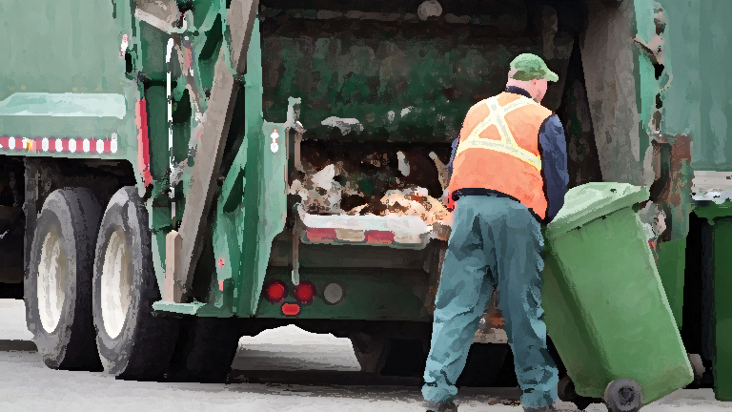
Garbage
Collector
Waste Removal
Engineer

Slide 47
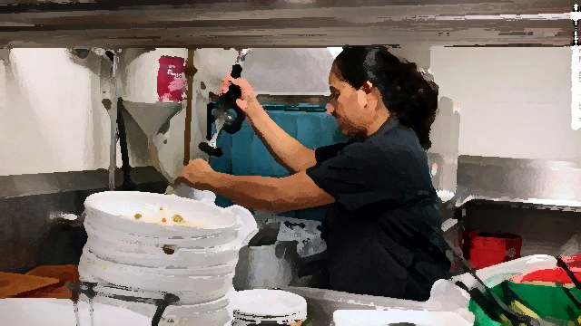
Underwater Ceramic Technician
Dishwasher

Slide 48
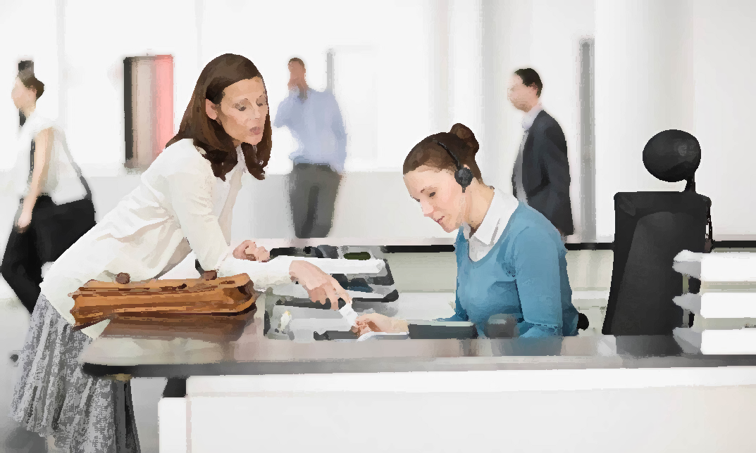
Director of
First Impressions
Receptionist

Slide 49
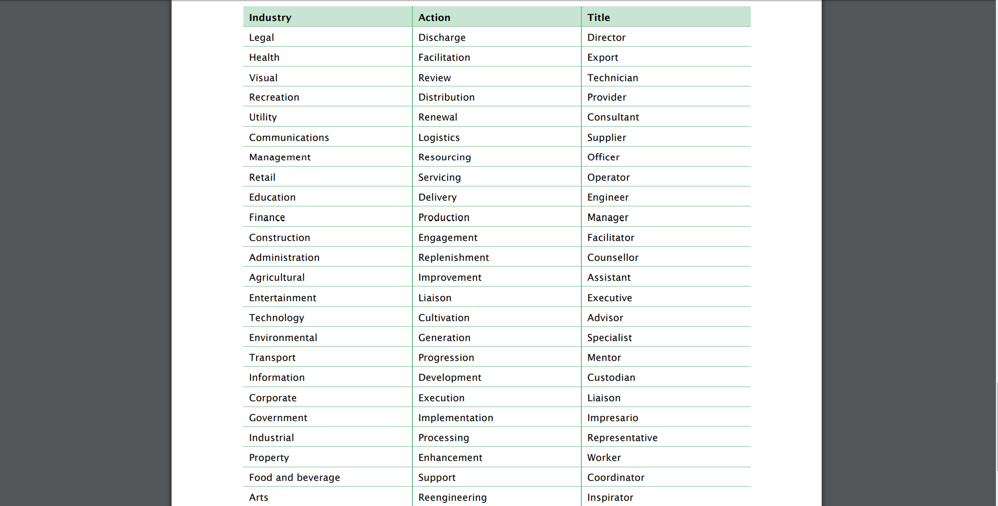

Slide 50
Thesaurus Rex
Use a thesaurus to make a triad.

Slide 51
Word Association

Slide 52
How do these words make you feel?
Blue
Cry
Useless
Stupid
Heartbroken
Pain
Stress
Down
Funeral
Sick
Suicidal
Break-up
Forgotten
Broken
Work
Alone
Dead
Depressed
Hungry

Slide 53
How do these words make you feel?
Kittens
Bright
Puppies
Family
Play
Dancing
Snowflakes
Winning
Compliment
Perfect
Hugs
Singing
Friends
Nature
Spring
Sunshine
Vacation
Mom’s cooking
Kisses

Slide 54
How do these words make you feel?
Award
Trust
Accomplish
Future
Promotion
Conquer
Lead
Create
Climb
Control
Task
Succeed
Overcome
Endeavor
Gold
Special
Win
Achieve
Growth

Slide 55
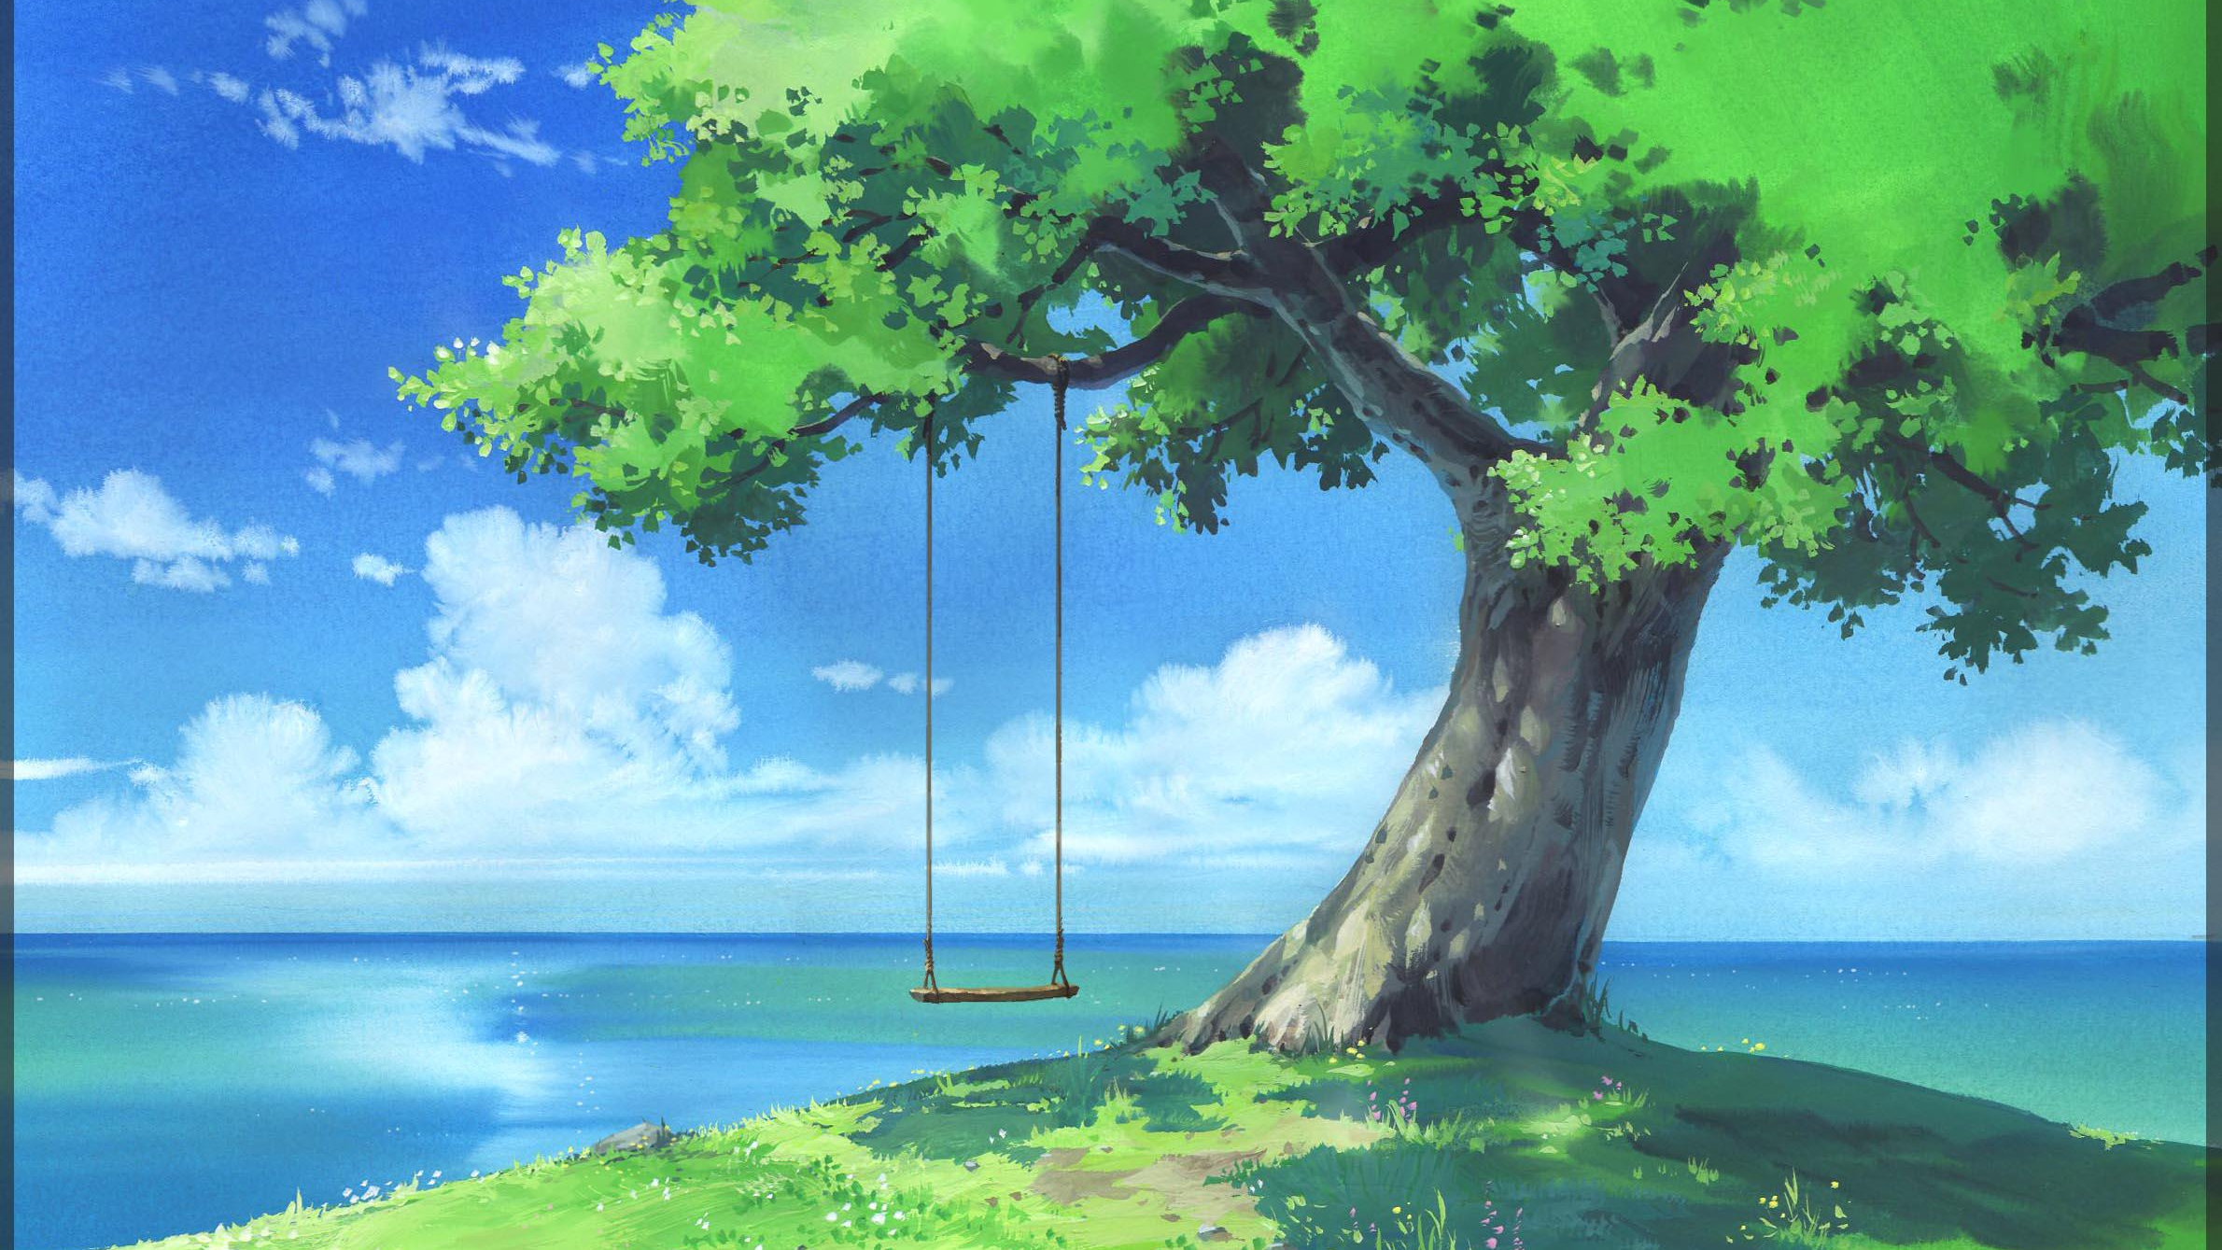
I Love…
Tom T. Hall

Slide 56
I love little baby ducks, old pickup trucks Slow-movin' trains and rain I love little country streams, sleep without dreams Sunday school in May and hay And I love you, too

Slide 57
I love leaves in the wind, pictures of my friends Birds of the world and squirrels I love coffee in a cup, little fuzzy pups Bourbon in a glass and grass And I love you, too

Slide 58
I love honest, open smiles, kisses from a child Tomatoes on the vine and onions I love winners when they cry, losers when they cry Music when it's good and life And I love you, too.

Slide 59
Word Choice Activity

Slide 60
Write words associated with the prompt

Slide 61
Write a speech with the word list

Slide 62
Present the speech

Slide 63
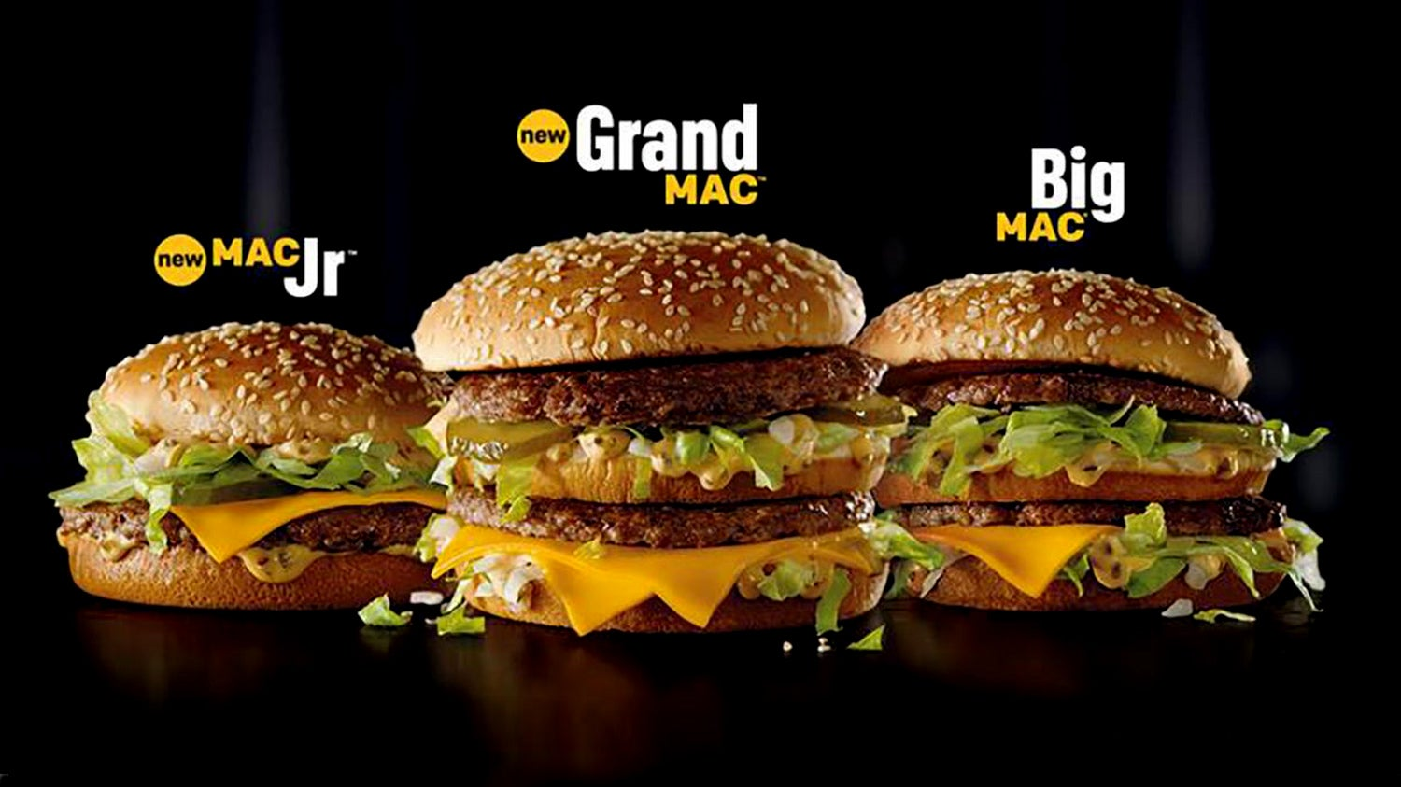

Slide 67
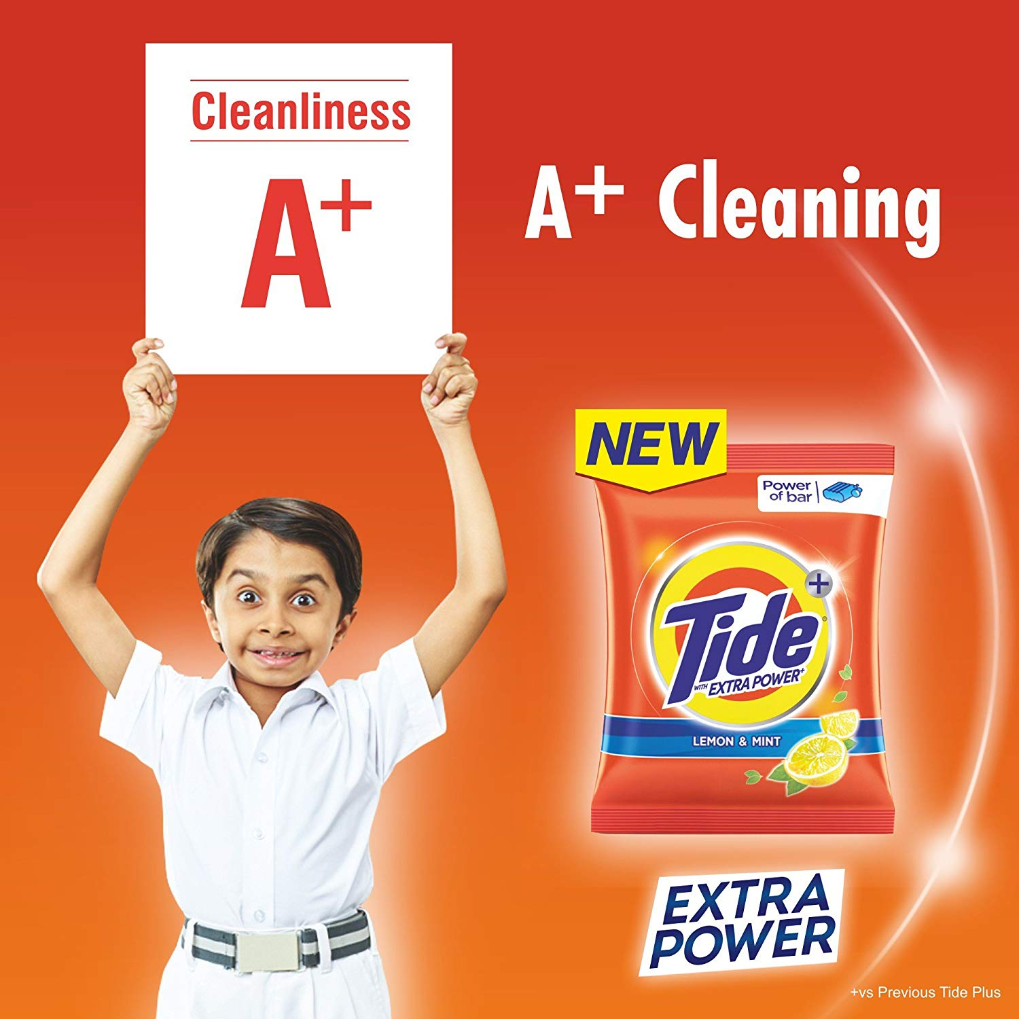

Slide 69
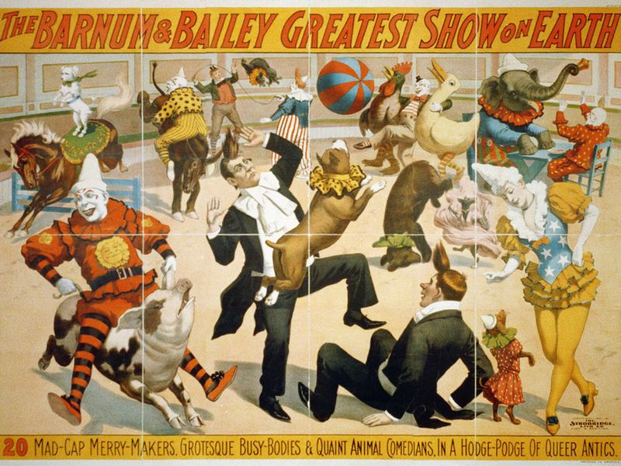

Slide 77
Adjective in Advertising
#1
Good
#2
Beautiful
#3
Real
#4
Better
#5
Best
#6
Great
#7
Perfect
#8
Pure

Slide 78
Fancy Pants Job Titles
https://www.plainenglishfoundation.com/documents/10179/73292/Fancy-pants_job_titles.pdf
Tom T. Hall – I Love
https://www.youtube.com/watch?v=jk64JluO4CI
George Carlin – Euphemisms
https://www.youtube.com/watch?v=vuEQixrBKCc
Keanu Reeves
https://www.youtube.com/watch?v=C0Tq4YttVTQ
Guess what these PC job titles REALLY mean
https://www.thesun.co.uk/archives/news/48628/guess-what-these-pc-job-titles-really-mean/
The Adjective Frequency in Advertising English Slogans
http://www.academypublication.com/issues/past/tpls/vol03/02/09.pdf

Slide 79
word choice… words with positive association, words with negative association 1. give each group a task. They must make a list of words about a subject a. You are a lawyer and you are trying to prove that alcohol is a drug. b. You work for a lottery company and you are going to make an advertisement c. You are head supervisor for education office. Due to budget cuts, you need to fire a lot of teacher. You need to make a press conference d. You are a police captain. After searching for a lost girl for 6 days, you are going to call off the search. 2. pass the list of words to another group. a. create a speech using as many of these words as possible 3. Pass the list of words a. you will give the speech as written by the previous group. Cause guess what, were going to have to eat someone

