Slide 1
Web Based Activities
For use in the English classroom

Slide 4
Kahoot!

Slide 8
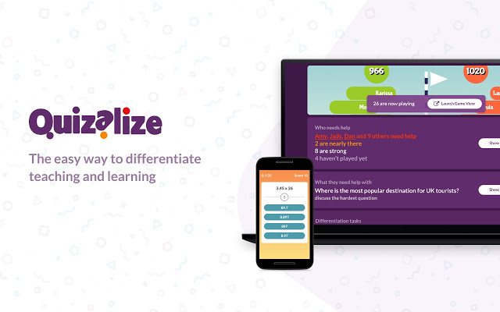

Slide 12
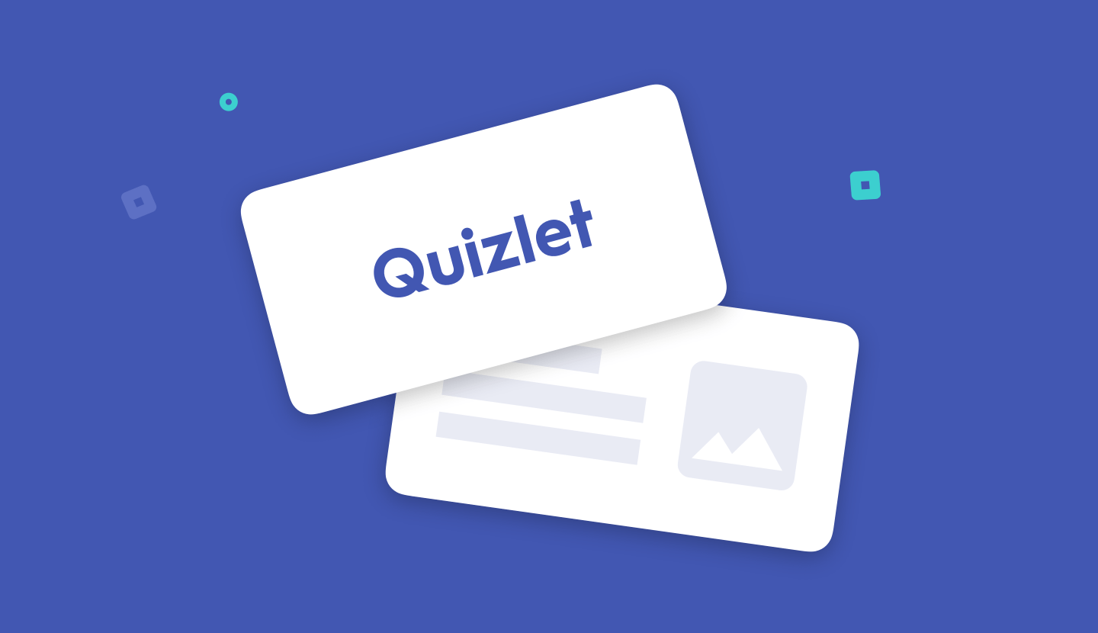
Quizelet

Slide 13
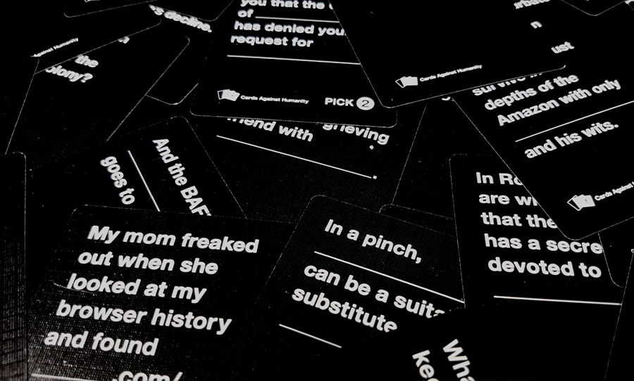
Cards Against Humanity

Slide 15
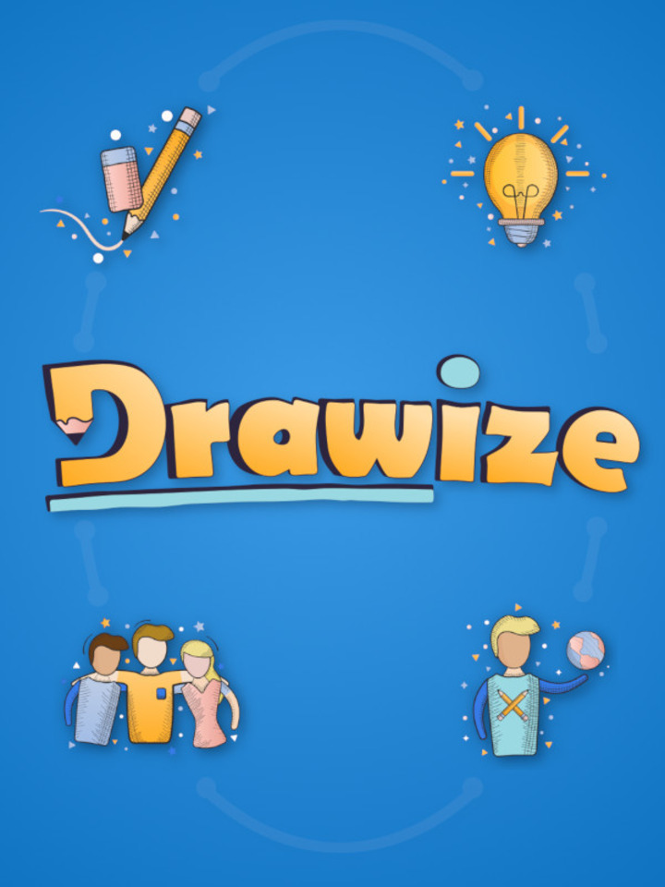

Slide 17
Steam
store.steampowered.com

Slide 18
Scribblenauts

Slide 19
Use Your Words

Slide 21
Jackbox
jackboxgames.com

Slide 22
Drawful

Slide 23
Lie Swatter

Slide 24
Word Spud

Slide 25
You Don’t Know Jack

Slide 26
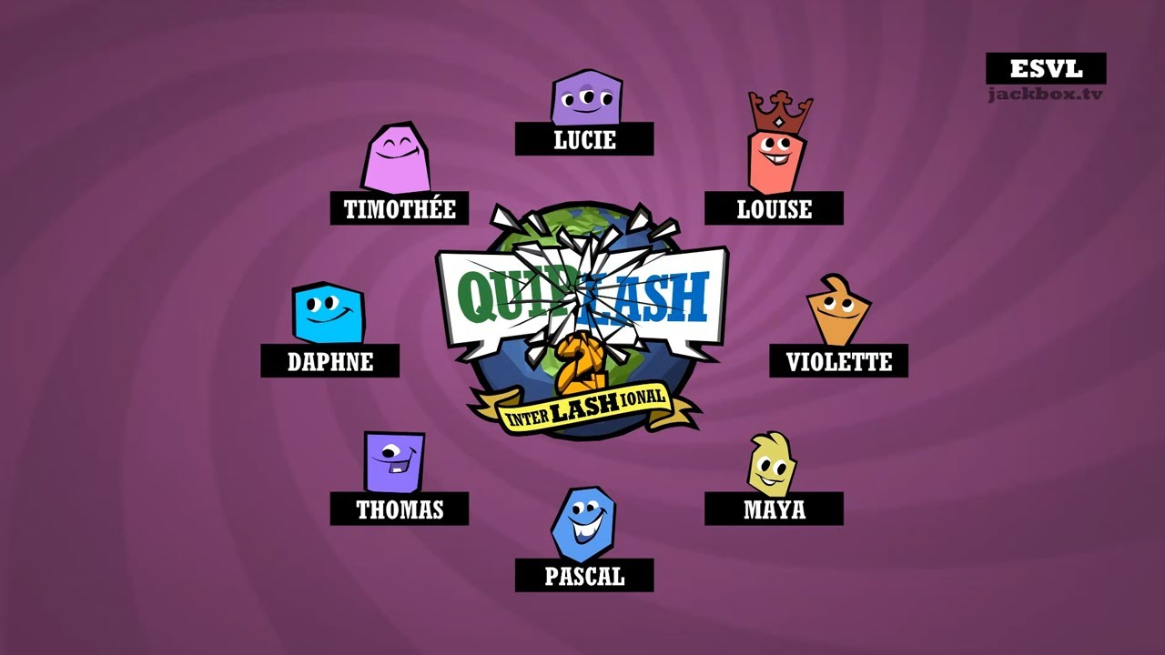

Slide 27
Earwax

Slide 28
https://ditchthattextbook.com/game-show-classroom-comparing-kahoot-quizizz-quizlet-live-and-quizalize/
https://technologypursuit.edublogs.org/2019/05/27/kahoot-quizizz-gimkit-what-should-i-use/

