Slide 1
Smartphones
Listening with apps

Slide 2
Improve English:
Word Games
Duolingo
Busuu
LingQ
Memrise
Babbel

Slide 3
Rosetta Stone
LearnEnglish
Grammar
LingoDeer
Beelinguapp
ELSA Speak
Speak English
Conversation

Slide 4
Spaceteam ESL
http://spaceteamesl.ca/

Slide 6
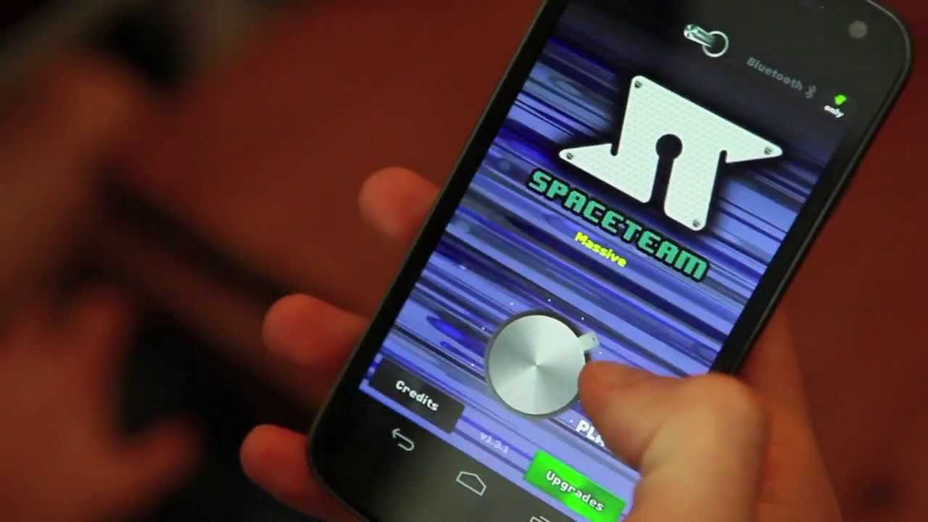

Slide 8
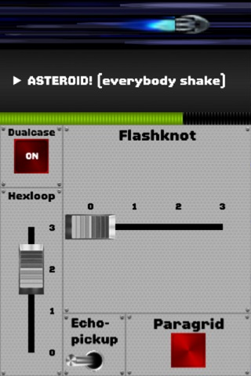

Slide 9
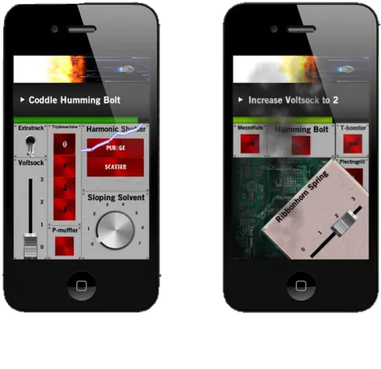

Slide 11
Spyfall

Slide 12
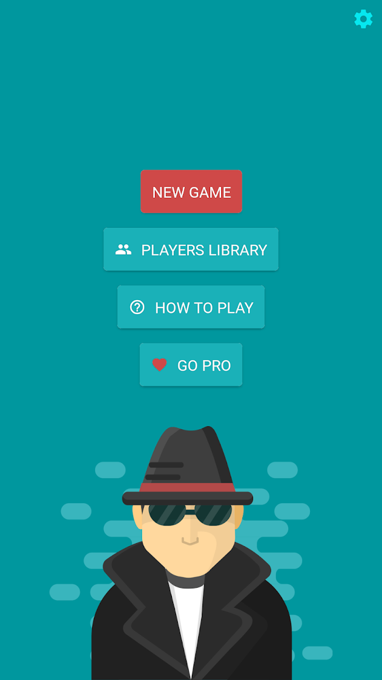

Slide 13
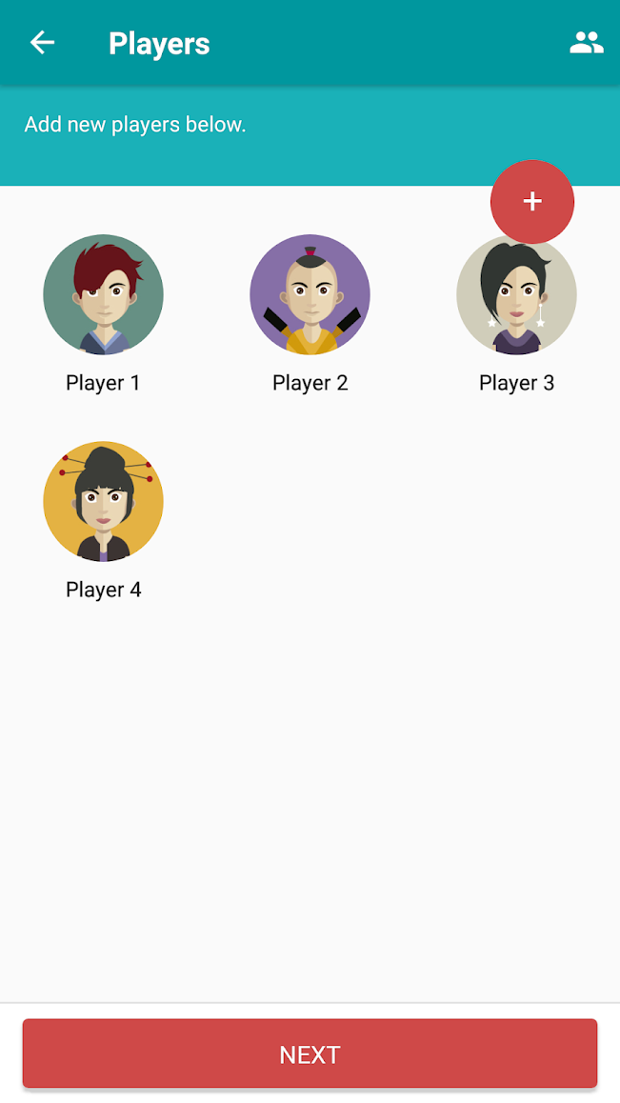

Slide 14
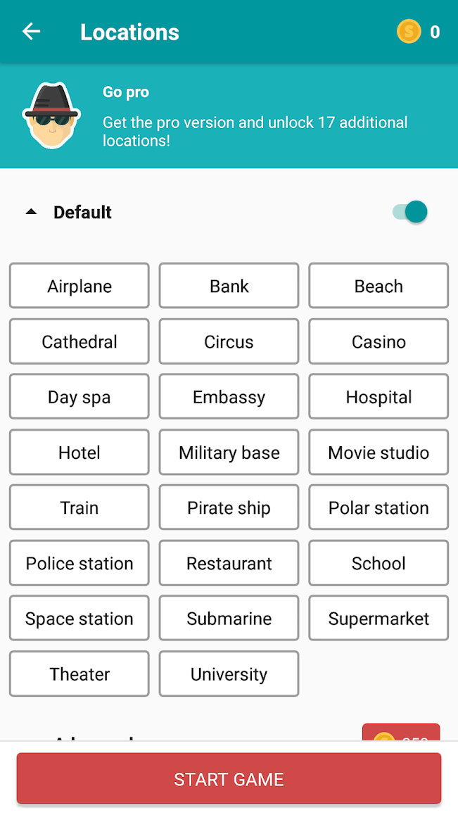

Slide 15
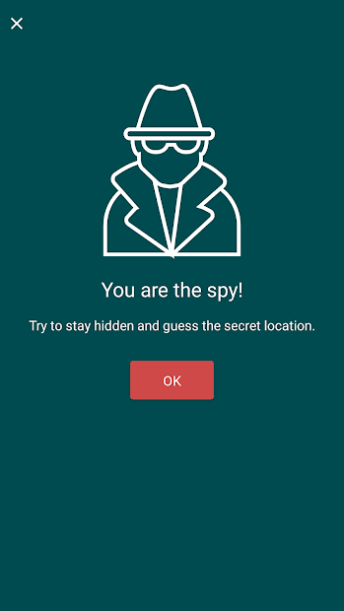

Slide 16
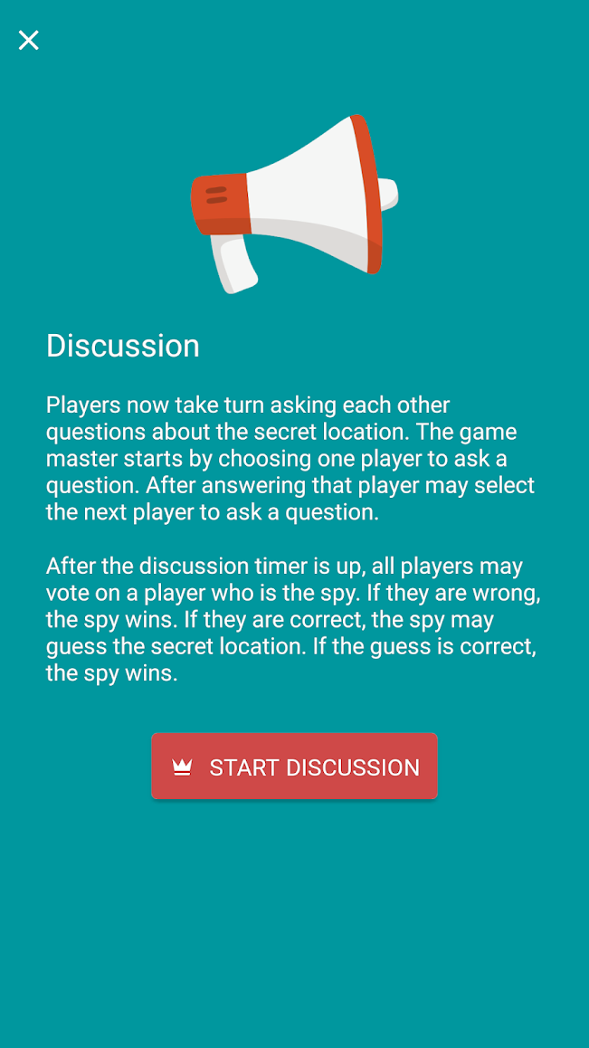

Slide 17
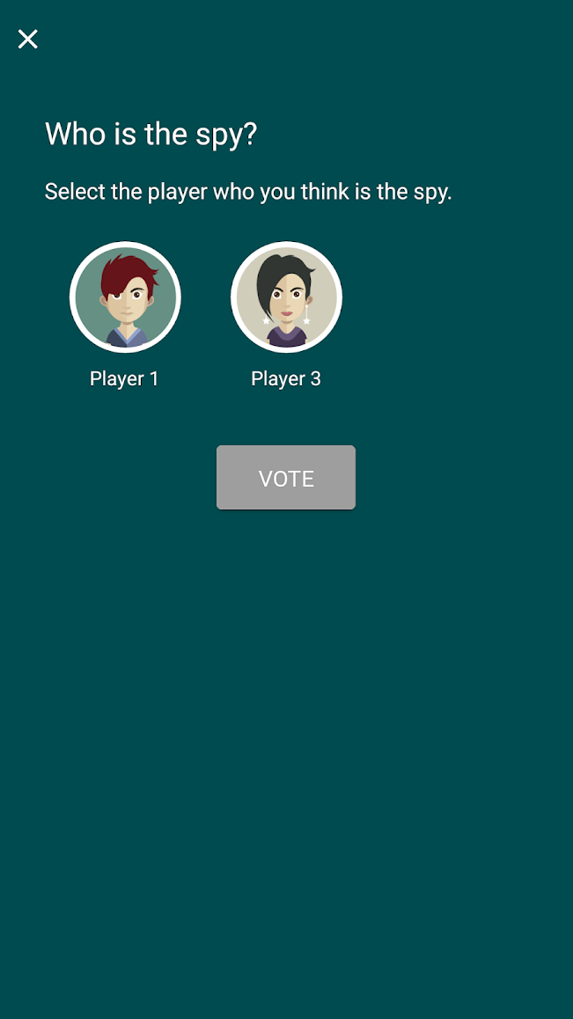

Slide 18
Mafia Online

Slide 19
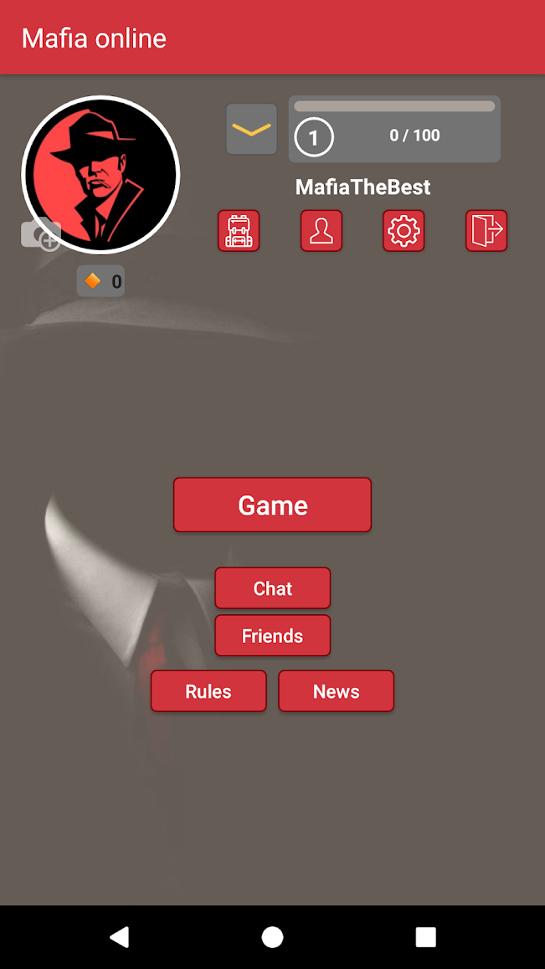

Slide 20
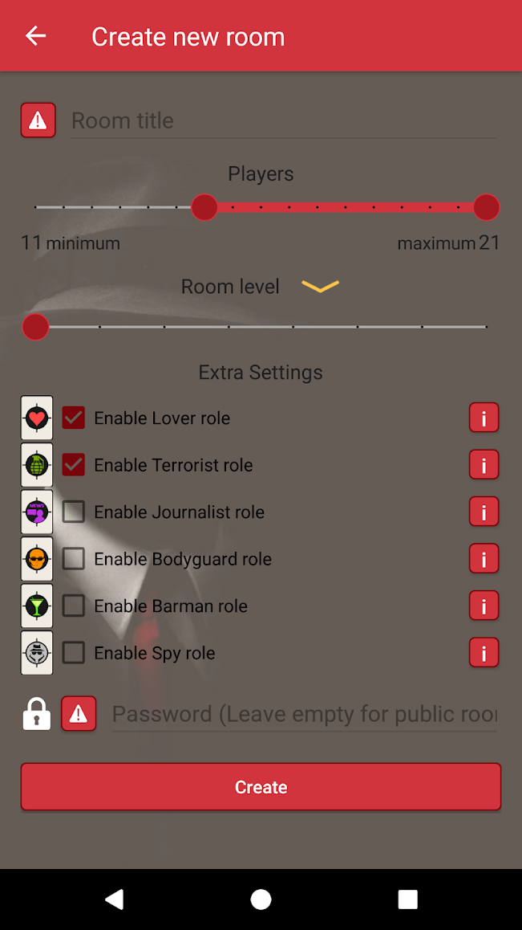

Slide 21
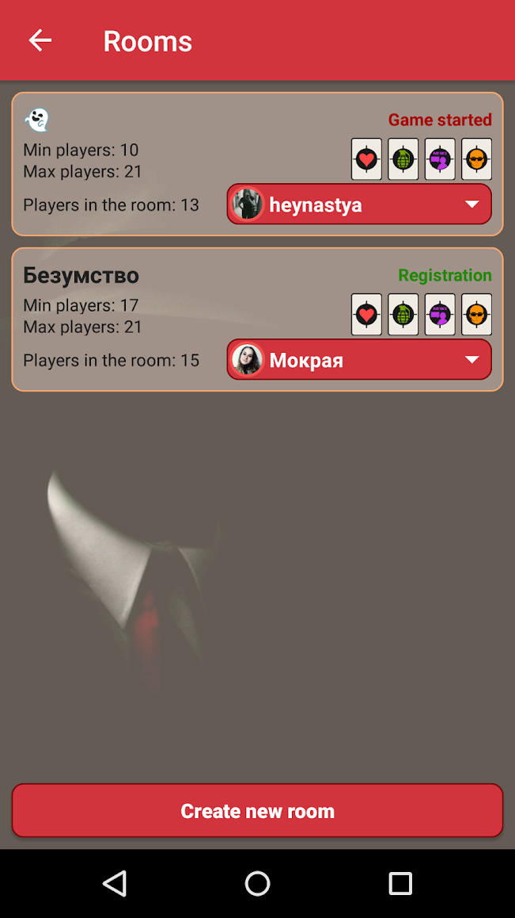

Slide 22
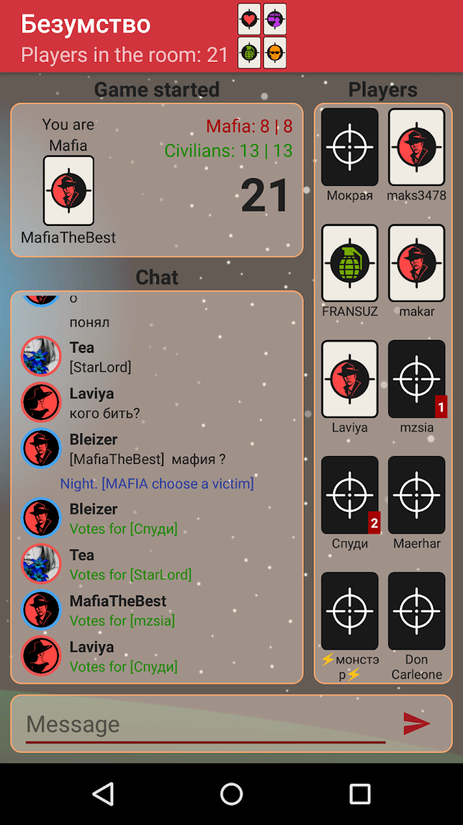

Slide 23
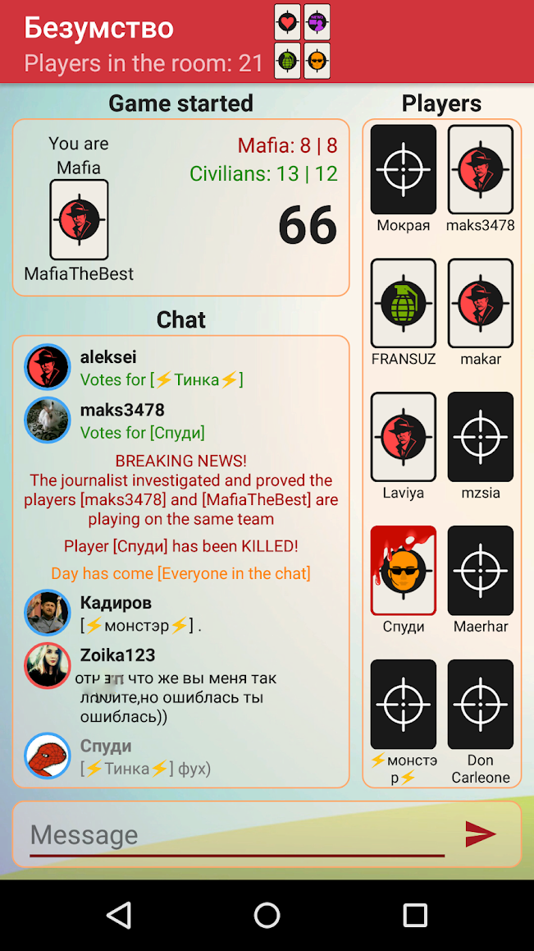

Slide 24
Heads Up!

Slide 25
Guess Up

Slide 26
Charades

Slide 27
Psych! Outwit Your Friends

Slide 28
Words with Friends 2

Slide 29
Draw It

Slide 30
Coup

Slide 31
Battle Text

Slide 32
Scattegories

Slide 33
Taboo

Slide 34
Would You Rather?

Slide 35
Hangman Free

Slide 36
Scrabble

Slide 37
Boggle with Friends

Slide 38
2 Pictures 1 Word

Slide 39
Word Search Online

Slide 40
Just Riddles

Slide 41
Match-UP Learn English

Slide 42
Wheel of Fortune

Slide 43
Epic!

Slide 44
Draw a Stickman EPIC

Slide 45
Selfie Games: Group TV Party
Game (draw and guess)

Slide 46
FarFaria

Slide 47
Curious World*

Slide 48
Triple Agent

Slide 49
Escape Team

Slide 50
…and many
hidden objects apps

