Slide 1
Escape Room
ONLINE

Slide 2
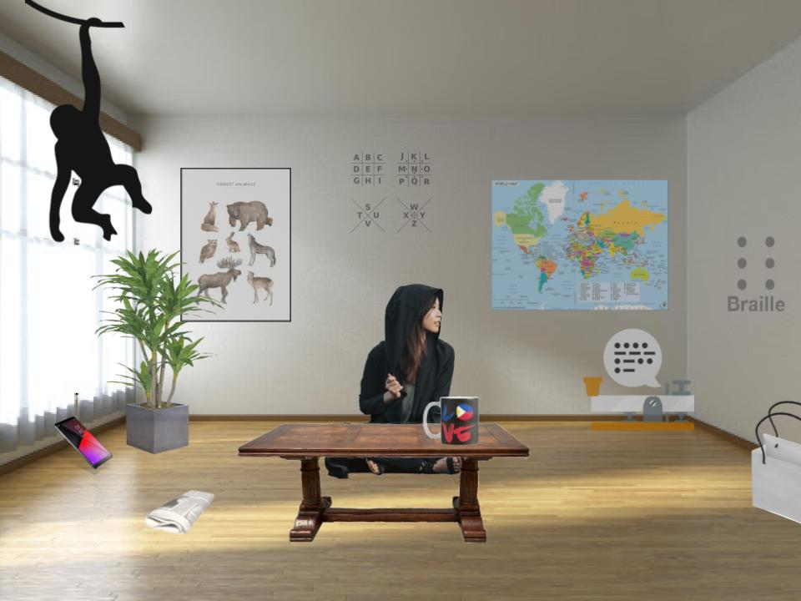
Example:
https://sites.google.com/coeili.or.kr/escape-room-example/home

Slide 3
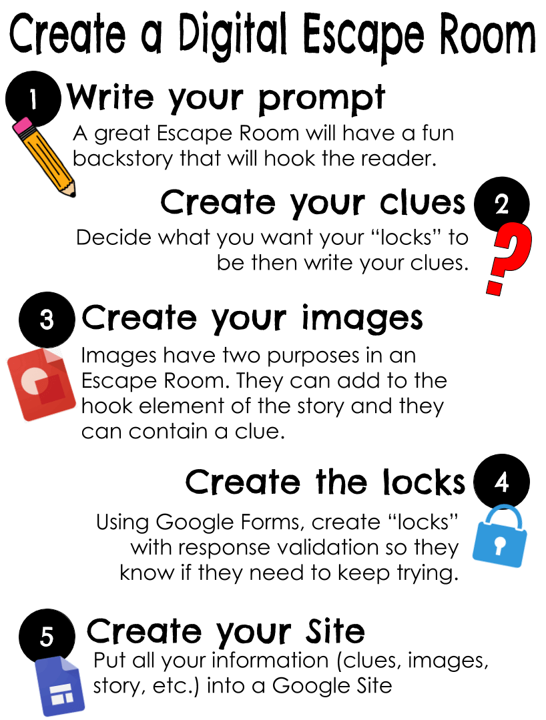

Slide 4
Writing a prompt

Slide 5
Prompts:
Engaging
Hooked into the story

Slide 6
Prompts:
You wake up in a dark room. There is only the soft blue light coming from the corner. It is a computer. The computer is attached to door. You need to use your knowledge to open the door and escape…

Slide 7
Types of clues

Slide 8
Blanks:
Missing letters
Missing words

Slide 9
embark

Slide 10
RAINBOW

Slide 11
Cryptogram:
A1Z26
Substitutions
Pig Pen
Morse Code / Braille
https://www.kidzone.ws/puzzles/cryptogram/
https://www.brailletranslator.org/
https://www.dafont.com/pigpencodefont.font

Slide 12
W h a t
s h a p e
A1Z26:
i s
i t
rectangle

Slide 13
T
T
R
A
N
G
N
R
A
N
F a r t
A
N
G
G
A
G
A

Slide 14
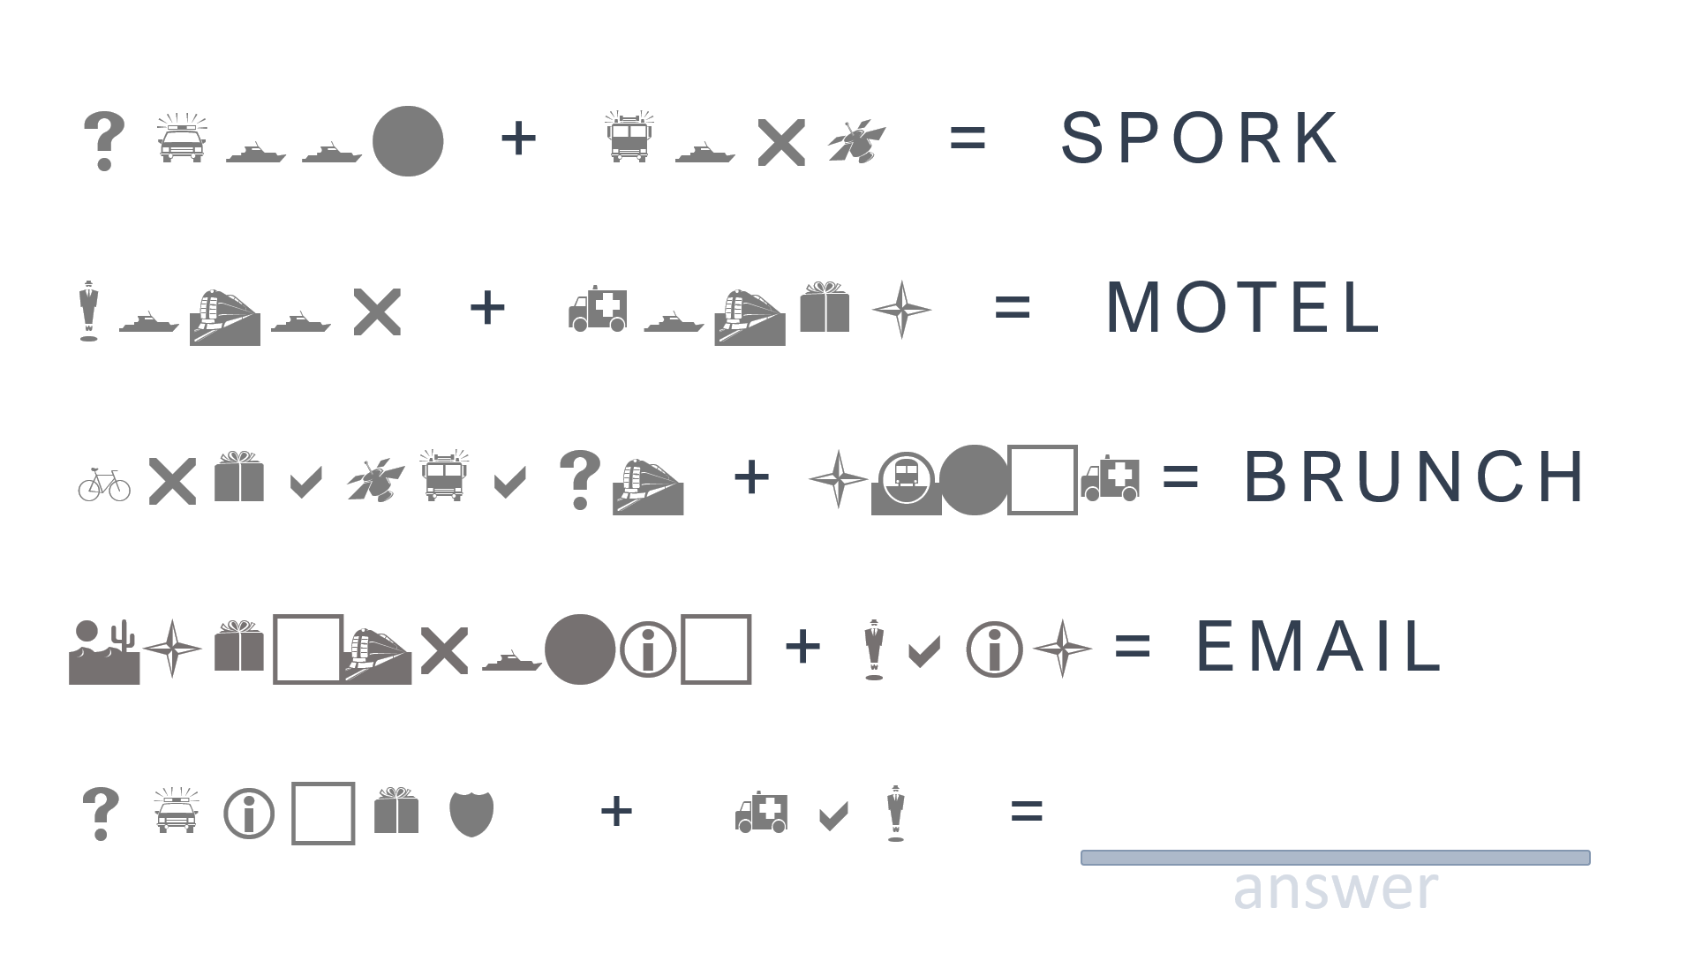
Substitution:
SPOON
FORK
MOTOR
HOTEL
BREAKFAST
LUNCH
ELECTRONIC
MAIL
spam
SPICED
HAM

Slide 15
https://fontmeme.com/fonts/pigpen-cipher-font/
Pig pen:
WHAT IS AMELIA
STINGER’S JOB?
p i l o t

Slide 16
https://www.dafont.com/braille.font
Morse Code:
WHAT IS LISA ANGLE’S JOB?
e n g i n e e r

Slide 17
https://www.dafont.com/morse.font
Braille:
WHAT IS
FRANK
RIVER’S
JOB
f a r m e r

Slide 18
T I M

Slide 19
Phone Number:
Letters are numbers (easy)
Numbers are letters (hard)

Slide 20
5 2 2 5

Slide 21
N e r i

Slide 22
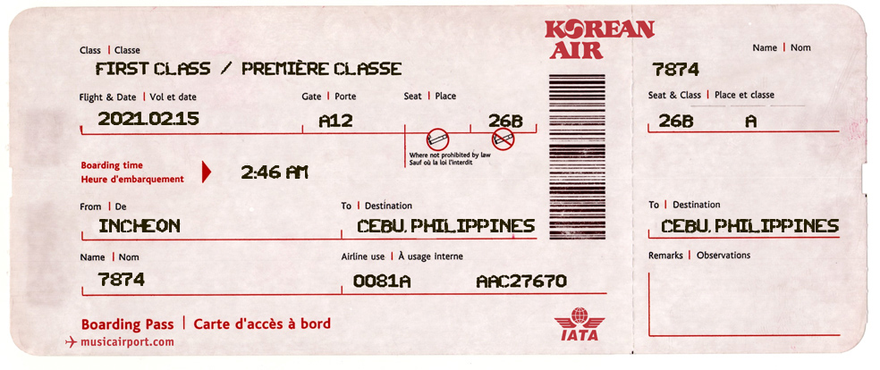

Slide 23
Hidden Word:
Find words in a picture

Slide 24
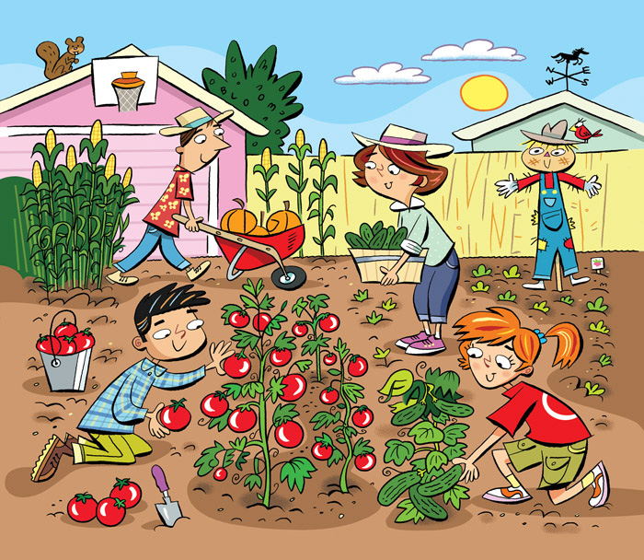
Vine
Garden
Farm
Seed
Dig
Bloom
https://www.boredpanda.com/find-words-challenge/?utm_source=google&utm_medium=organic&utm_campaign=organic

Slide 25
r e d

Slide 26
K o r e a

Slide 27
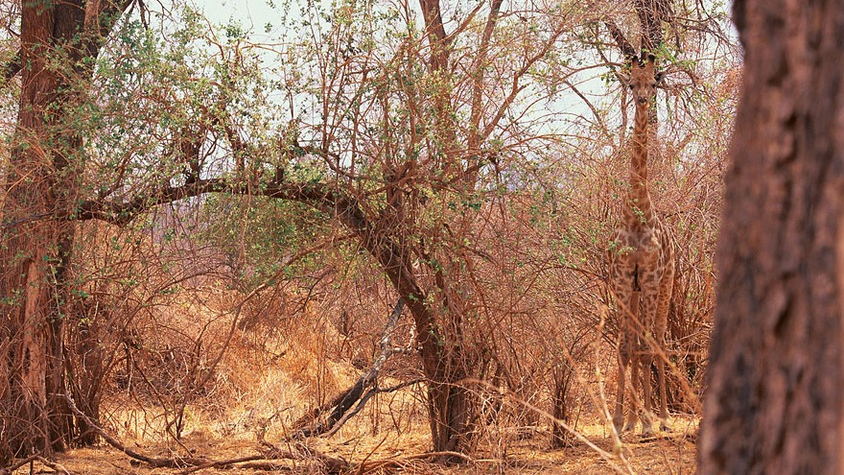
What animal
is here?
giraffe
answer

Slide 28
Riddles:
Clever wording
Parallel thinking
http://www.esltoybox.com/advanced/ (Brain Exercise)

Slide 29
h i g h w a y

Slide 30
m a p

Slide 31
d i c e

Slide 32
Classic Puzzles:
Cross-word
Word search
Maze
http://puzzlemaker.discoveryeducation.com/

Slide 33
Rebus Puzzle:
Shape = meaning

Slide 34
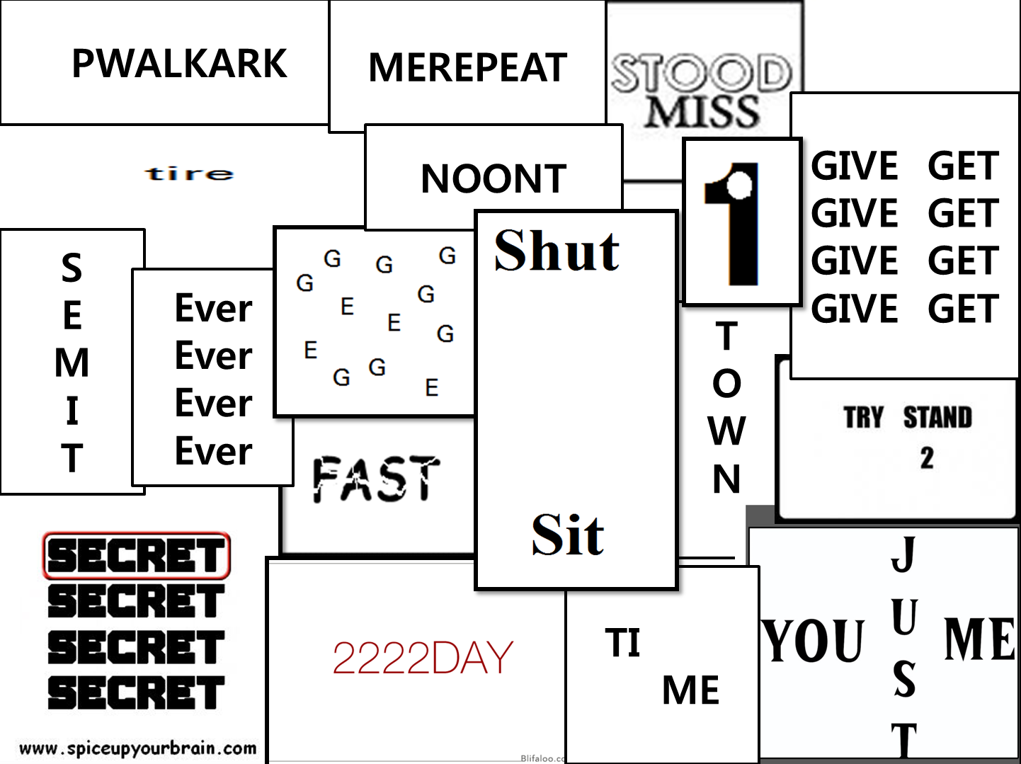

Slide 35
Secret Message:
Reveal the answer
https://www.indigoimage.com/secretmsg/

Slide 36
Text Orientation:
dılɟ
ɿoɿɿim
esrever
Flip
Mirror
Reverse
http://www.upsidedowntext.com/
http://www.en.fliptext.net/

Slide 37
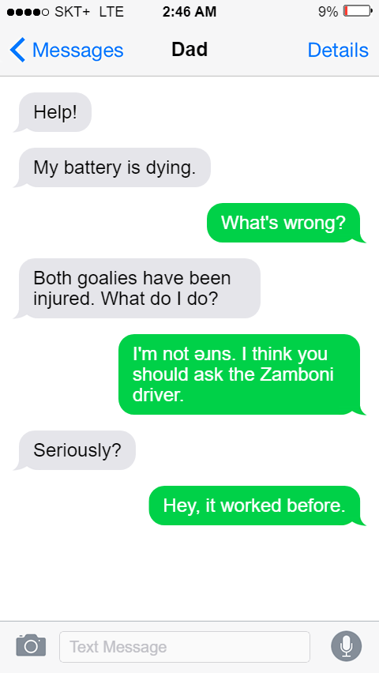
S U R E

Slide 38
linked MEDIA

Slide 39
Image Hosting:
https://imgur.com/

Slide 41
Jigsaw Puzzle:
puzzle
https://www.jigsawplanet.com/

Slide 42
Text message
Newspaper
Breaking news
Plane ticket
Ticket
Images
https://ifaketextmessage.com/
https://www.fodey.com/generators/newspaper/snippet.asp
Fake Things:
https://www.breakyourownnews.com/
http://omatic.musicairport.com/
https://tickets.kadsoftwareusa.com/
http://www.imagechef.com/

Slide 43
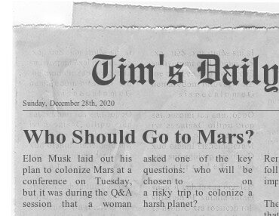
E M B A R K

Slide 44
Infographics:
Words
Images
https://www.genial.ly/

Slide 45
Social Media:
Many platforms
Templates
https://www.canva.com/

Slide 46
Slides:
Templates
https://slidesmania.com/

Slide 47
Digital LOcks

Slide 51
Google site

Slide 53
How to make an Online Escape Room
https://ditchthattextbook.com/30-digital-escape-rooms-plus-tips-and-tools-for-creating-your-own/
Google Drawing: Beginner’s Guide
https://www.youtube.com/watch?v=m_SRYwmj41Y
How to Use Google Sites
https://www.youtube.com/watch?v=5BhCVvFWEtE
Google Forms for Breakout
https://youtu.be/r8V_qnmedxY

