Slide 1
I hired a speech coach to fix my boring voice

Slide 3
What is wrong with his voice ?
Boring
Monotone
Pauses & Gaps
Upwards inflection
Kane Diep

Slide 4
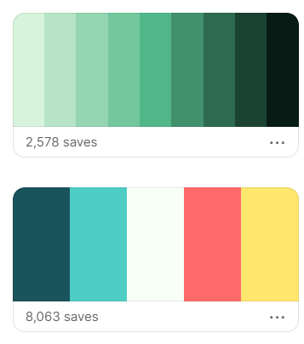
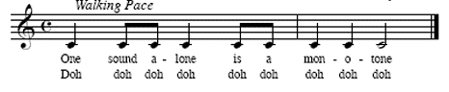
Monotone
Mono pacing
Mono volume
Mono rhythm
Mono style

Slide 5
Monotone
When are you monotone?
In what situation?

Slide 6
stern
Tone adds
color
To
language
Serious
Bored

Slide 7
Monotone
Gives the impression that you don’t care.
Intonation is 38% of impression.
Our voice has a ~30 note range.
Most people only use 1 or 2 notes.

Slide 8
Pace
Pitch
Power
Pauses
4 Ps

Slide 9
Pace
Pitch
Power
Pauses
Slow at key moments

Slide 10
Pace
Pitch
Power
Pauses
Variety of emotion
Excited = high
Power = low

Slide 11
Pace
Pitch
Power
Pauses
“Speak softly and carry a big stick.”
- Theodore Roosevelt

Slide 12
Pace
Pitch
Power
Pauses
Awkwardness is 0.07 seconds.

Slide 13
Meeting the speech therapist
Amy Chapman

Slide 15
“If you stop... And you think exactly what you want to say, your point can come across much more poignantly.”
emotional or moving

Slide 16
Pace
Pitch
Power
Pauses
Pace
Pitch
Power
Pauses
Which P?

Slide 18
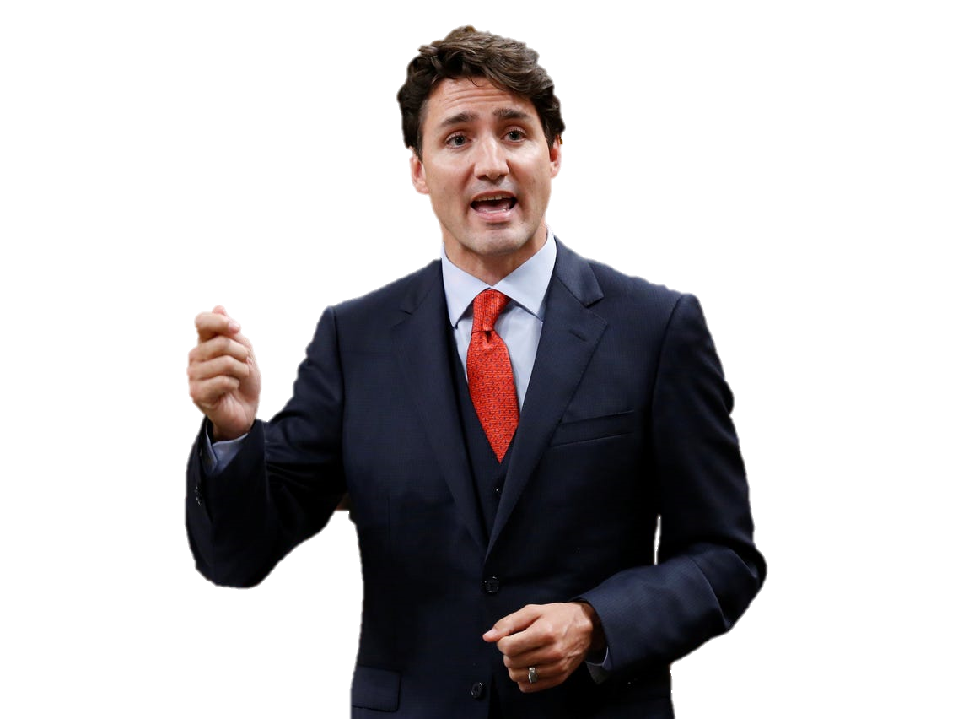
The Power box

Slide 19
What are his hands saying?

Slide 23
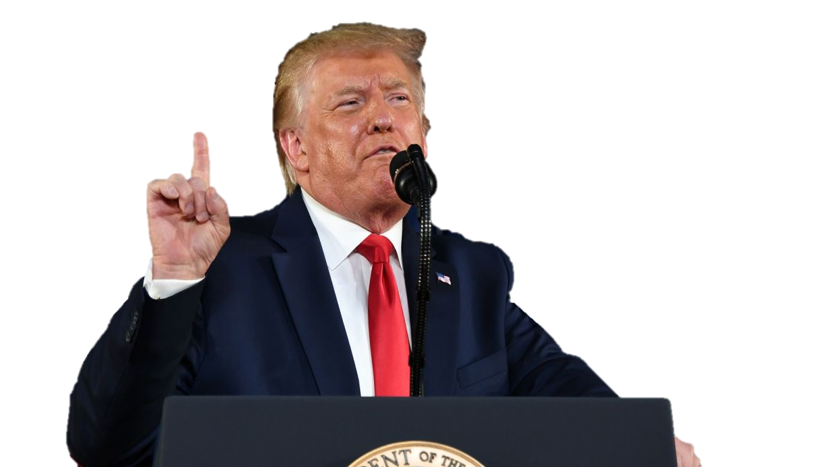

Slide 31
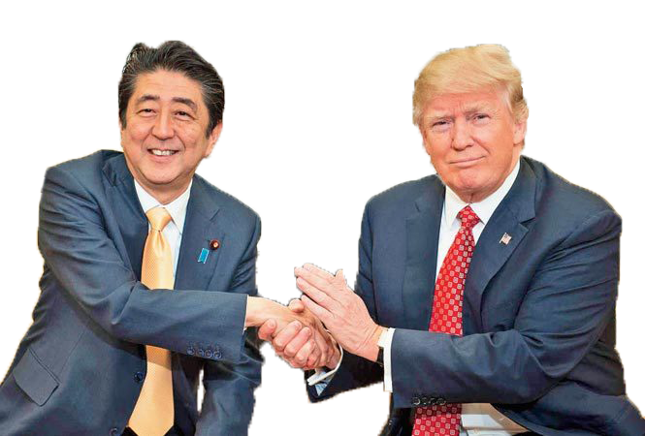

Slide 32
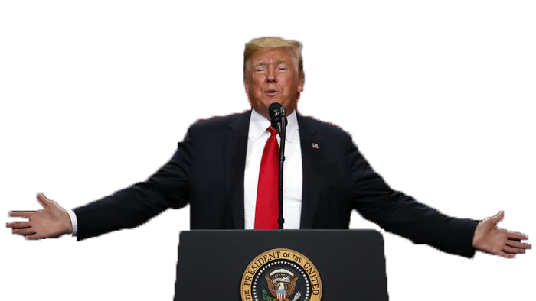

Slide 36
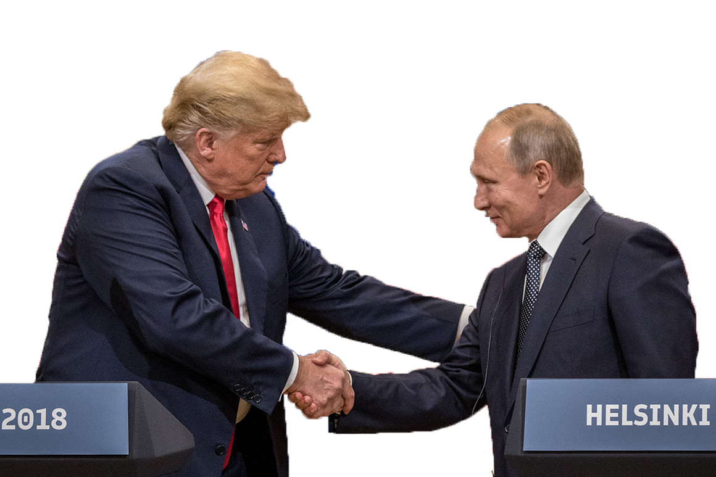

Slide 37
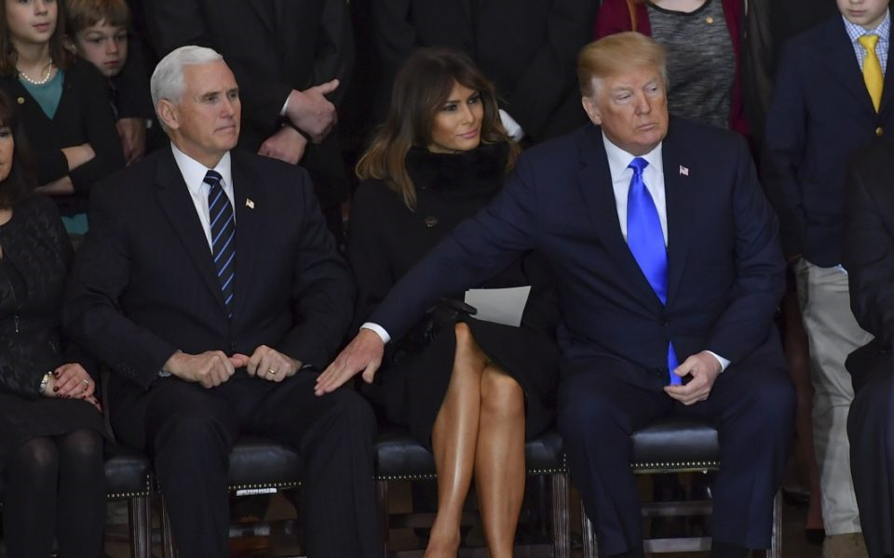

Slide 39
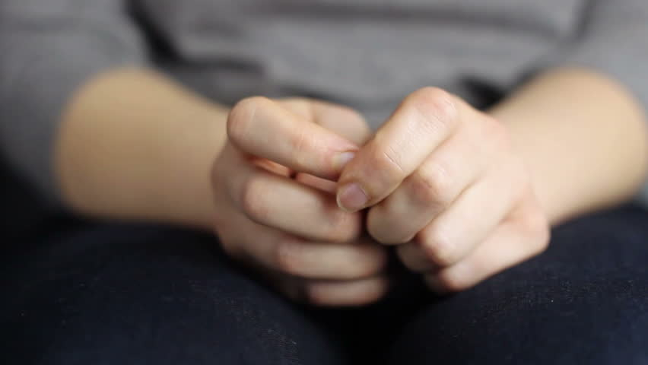

Slide 40
Talking with our hands
Mimic our story
Hand acting
Gestures = Popularity
mimic = to be like the original
https://www.huffpost.com/entry/talking-with-hands-gestures_n_56afcfaae4b0b8d7c230414e#:~:text=Hand%20gestures%20help%20us%20take,make%20it%20intelligible%20to%20others.&text=%E2%80%9CGesture%20is%20really%20linked%20to,and%20use%20more%20declarative%20language.%E2%80%9D

Slide 41
Talking with our hands
Gestures help you understand other people.
https://www.huffpost.com/entry/talking-with-hands-gestures_n_56afcfaae4b0b8d7c230414e#:~:text=Hand%20gestures%20help%20us%20take,make%20it%20intelligible%20to%20others.&text=%E2%80%9CGesture%20is%20really%20linked%20to,and%20use%20more%20declarative%20language.%E2%80%9D

Slide 42
Emotion
Body Response
Verbal Response

Slide 43
Shows true underlying emotion

Slide 44
Talking with our hands
Gestures are a second language.
https://www.huffpost.com/entry/talking-with-hands-gestures_n_56afcfaae4b0b8d7c230414e#:~:text=Hand%20gestures%20help%20us%20take,make%20it%20intelligible%20to%20others.&text=%E2%80%9CGesture%20is%20really%20linked%20to,and%20use%20more%20declarative%20language.%E2%80%9D

Slide 45
Embodied Cognition
Our bodies understand
https://www.businessinsider.com/hand-gestures-reveal-complex-thoughts-2013-6

Slide 46
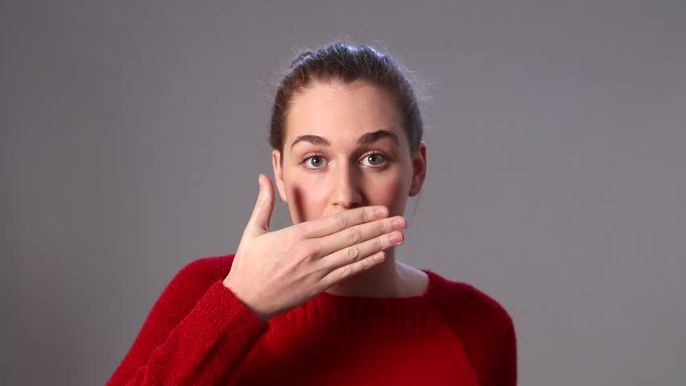
Reveals things missing in our speech.

Slide 47
“This is more important.”
“I am still thinking about this.”
“You must believe me.”
“I am unsure.”

Slide 48
Talking with our hands
Gestures and speech don’t always match.
https://www.huffpost.com/entry/talking-with-hands-gestures_n_56afcfaae4b0b8d7c230414e#:~:text=Hand%20gestures%20help%20us%20take,make%20it%20intelligible%20to%20others.&text=%E2%80%9CGesture%20is%20really%20linked%20to,and%20use%20more%20declarative%20language.%E2%80%9D

Slide 49
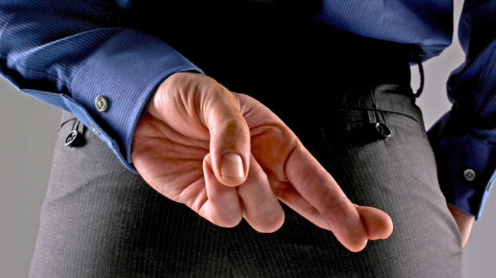
Congruence
Do our hands match our words?

Slide 50
Information at your fingertips

Slide 51
We don’t know what we know.

Slide 52
Teaching with our hands
In the classroom
https://www.huffpost.com/entry/talking-with-hands-gestures_n_56afcfaae4b0b8d7c230414e#:~:text=Hand%20gestures%20help%20us%20take,make%20it%20intelligible%20to%20others.&text=%E2%80%9CGesture%20is%20really%20linked%20to,and%20use%20more%20declarative%20language.%E2%80%9D

Slide 53
Gesturing accelerates learning

Slide 54
Total Physical Response (TPR)

Slide 55
Students follow teachers

Slide 57
“What other things do you think I could improve upon, potentially…”

Slide 58
End your sentence:
Statement
Question

Slide 60
“Vulnerability is what makes for
good content,
good conversation,
good dialogue.”
exposed to harm

Slide 61
Speaking with
your hands

Slide 62
Tell Us a Story
Use your hands.

Slide 63
Toastmasters Speech 6: Vocal Variety
http://sixminutes.dlugan.com/toastmasters-speech-6-vocal-variety/
The Interactional ‘Nudge’ – Talking About Talk
https://youtu.be/e-QbxjXDwXU
How to sound interesting in English | varied pitch vs monotone | intonation
https://www.youtube.com/watch?v=m35l59tMwk8
Why Your First Impression is So Powerful
https://theundercoverrecruiter.com/power-first-impressions/#:~:text=Takeaways%3A,you%20walk%20through%20the%20door.
Science of talk reveals how pauses and single words can change a conversation
https://www.smh.com.au/lifestyle/science-of-talk-reveals-how-pauses-and-single-words-can-change-a-conversation-20150820-gj3s6c.html

Slide 64
The Fascinating Science Behind ‘Talking’ With Your Hands
https://www.huffpost.com/entry/talking-with-hands-gestures_n_56afcfaae4b0b8d7c230414e#:~:text=Hand%20gestures%20help%20us%20take,make%20it%20intelligible%20to%20others.&text=%E2%80%9CGesture%20is%20really%20linked%20to,and%20use%20more%20declarative%20language.%E2%80%9D
Hand Gestures Say A Lot About Your Intelligence
https://www.businessinsider.com/hand-gestures-reveal-complex-thoughts-2013-6

